Slide 1
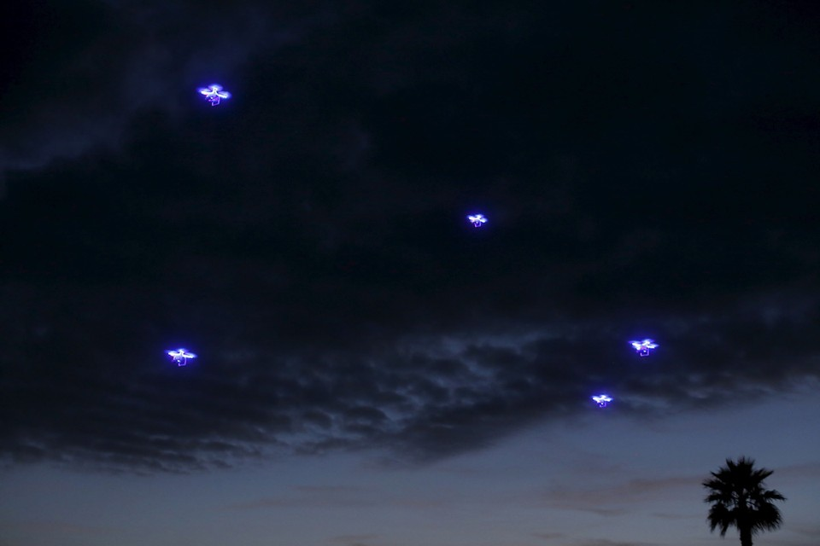
Drone Surveillance
Hugh Whelan, Derek McMaster,
Ryan Orlando, & Matt Suarez
http://www.theatlantic.com/politics/archive/2016/03/the-rapid-rise-of-federal-surveillance-drones-over-america/473136/

Slide 2
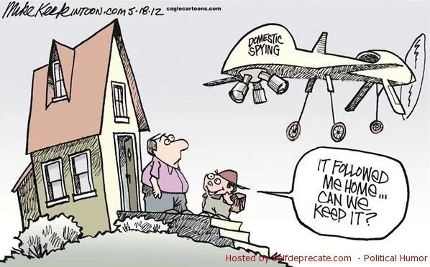
Presentation Agenda
Set the Scene
  What are drones?
  Timeline
Topics under Debate
  Privacy
  Safety
Laws and regulations
  What laws exist?
  What laws must be implemented?
Conclusion
https://rosecoveredglasses.files.wordpress.com/2016/03/drones.jpg?w=652
Notes:
Presenter : Hugh
Median time:
Outline the presentation. Talk about setting the scene and opening up areas of questions that will lead to our conclusion at the end.

Slide 3
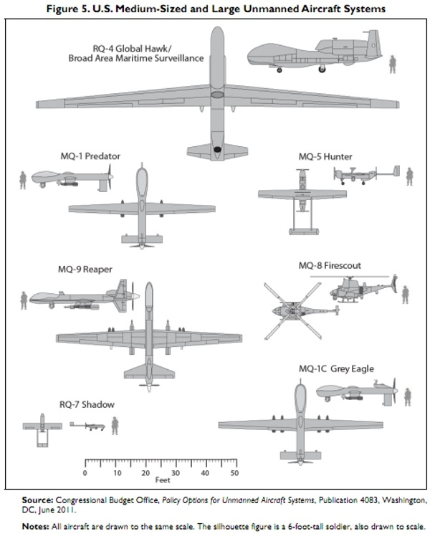
Drones: Definition
Drones are aircraft that are:
  Unmanned
  Controlled remotely or with onboard computers
  Four main classifications: Military, Government,
  Commercial, Hobbyist [9]
They are often equipped with
  Sensors (Hi-def cameras, microphones)
  Communication technology (Radio, satellite)
[20]
Notes:
Presenter : Hugh
Image: various drones used by government. Biggest similar in size to actual plane.
https://lanternhollowpress.com/tag/drone/
Unmanned
Remote controlled or onboard computers
Remotely
Predator drones, most hobby drones
On Board computers
Amazon and Alphabet are developing automated delivery drones
Some people consider on board computers what differentiates drone from an aircraft [20]
However remotely flown drones have on board computers to assist the flight, and have an automated hover mode
4 classes
Military: Such as predator drones used overseas, often used for drone strikes as well
Government: police, searching for marijuana. Will talk more about later
Commercial: Delivery drones such as amazon
Hobbyist: Camera drones, drone racing

Slide 4
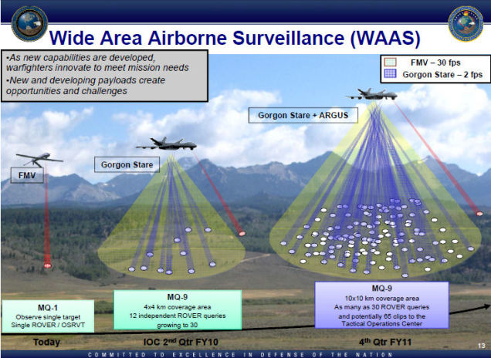
Drones and the Government
Drones are becoming more prevalent as they become more cost effective
Being used or tested by many government agencies including...
  Federal Bureau of Investigations (FBI)
  Drug Enforcement Agency (DEA)
  Bureau of Alcohol, Tobacco, and Firearms (ATF)
  United States Border Control (USBC)
[13], [28], [41]
Notes:
Presenter : Hugh
Image: https://i.kinja-img.com/gawker-media/image/upload/s--Pci7B1qD--/c_fit,fl_progressive,q_80,w_636/pe8uwreaqccdvr2f5sc2.jpg
Other government uses :
Drones are becoming more and more capable of being cost effective government tools [13]
Prices are going down, and capabilities are going up
Drones can cost police departments as little as $25 / hour to use [28]
As a result, domestic use of government drones has increased
Many agencies are testing drones, while others are implementing them
Border patrol
Predator drones are used to patrol border between USA and Mexico
Arrests
SWAT has used predator drones to find suspected criminals on their own property
Drug Enforcement
Used to search for marijuana plants
Crowd surveillance
Used by governments like India for monitoring crowds
Drones with crowd control devices like pepper spray have been tested and sold
North Dakota passed a law last year that allows drones to be weaponized with non-lethal arms
NYC Mayor Bloomberg expects that drones will be used for surveillance as a replacement or supplement to security cameras
“You're gonna have face-recognition software. People are working on that. ... You can't keep the tides from coming in. We're gonna have more visibility and less privacy. I don't see how you stop” [40]
[Notes ref]: http://www.cnn.com/2015/04/09/asia/india-police-drones/

Slide 5
Government Use of Drone
Total Drones : estimated around 7,000
  Department of Homeland Security - 9
  CIA - 30
  Military - 1471
  “Unreported Drones” - around 5,500
Flight logs show other agencies fly missions “on behalf of” other agencies
Cost to Government
  Each drone requires an hour of maintenance for every hour it spends in the air
  The Pentagon plans to spend $40 Billion over the next decade
[25], [27]
Notes:
Presenter: Hugh
The rest of the 7000 are Department of Defense (Military)
Can be difficult to determine how many drones are in use domestically because of lack of transparency
1471 Department of Defence
30 CIA
9 Dept. of Homeland Security
Other 5,500 are missing
The drones are shared, agency will let other use their drones for missions
Costs of Drones
Border Patrol loans drones because of their legality zone to fly in
“Each drone requires an hour of maintenance for every hour it spends in the air”
Border patrol drones: predator B
Border monitoring drone $2,500-$3,000 per flight hour
[7]
In the next decade pentagon will spend $40 Billions over next deck
Research and manufacturing and upkeep

Slide 6
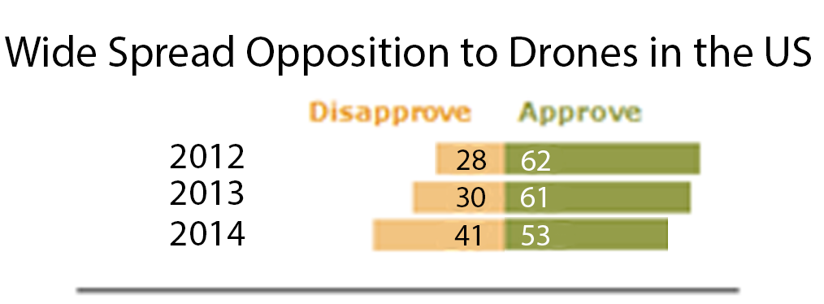
The Need to Address Drones
44% support the idea of police departments using unmanned drones for surveillance
33% are significantly concerned that their privacy will be damaged
  The same percentage are not too concerned or not concerned at all
[30]
Notes:
Presenter : Derek
In a survey conducted by the Associated press, these results were shown [30]
talk about public opion as a general
In 2014, Hockey fans in LA knocked a drone out of the air above them
Thought it was a police drone
Police denied that it was theirs
"I will not sacrifice public support for a piece of police equipment,"
LAPD Chief of police [14]

Slide 7

In 2013, FBI director Robert Mueller admits that the United States employs drones as part of the domestic surveillance program. Speaking before a Senate Judiciary Committee, Mueller agrees that still-uncommon drone usage sparks concerns about personal privacy and is “worthy of debate and perhaps legislation down the road."
http://www.judiciaryreport.com/images/robert-mueller-2-9-10.jpg
Notes:
Presenter: Derek
If your not sold yet, in 2013
As a consequence of the Edward Snowden leaks this fact was found out. This came up as part of the hearing after the leaks. [36]
The director of the FBI Roboert Muller admits drones were used for domestic survalance programs.

Slide 8
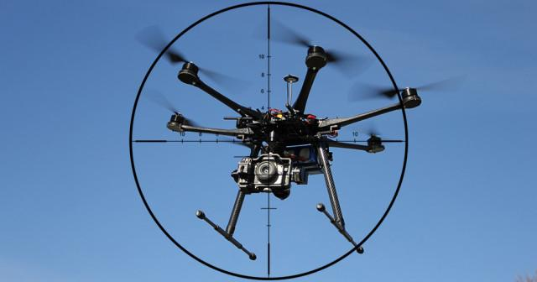
Privacy
Privacy law & rapid pace of drone technology [1]
  Facial recognition software
  Infrared technology
  Microphones capable of monitoring personal conversations [26]
Can you protect yourself?
  Illegal to shoot down a drone
  Anti-drone drone patents [9]
[1], [26], [9]
Notes:
Presenter : Matt
Image: http://1y7vgdz53a11xyb91s53s6d6.wpengine.netdna-cdn.com/wp-content/uploads/2015/07/asij1a-640x336.jpg
Rapid pace of technology outpaces laws
Drones had sparse use in 2013, now we have over 5,500
Newest Regulation (part 107) says it does not deal with privacy and hopes in the future regulations will
Examples
many states can legally spy on citizens without authorization
Citizens can expect to be monitored aerially [2]
Here are technologies that can be used on drones
Can you protect yourself?
Illegal to shoot down drone
People have been arrested [1]
One in particular, a man shot down a drone that was watching his daughter sunbathe, but he got in trouble anyways and the other guy walked away without charges
You can contact law enforcement and have them talk to the person flying the drone (there isn’t necessarily anything law enforcement can do) [3]
Because the air above all properties is considered an highway
At the time, aerial surveillance was at least constrained in practice by the significant cost of flying a helicopter. But today, at the dawn of the cheap-drone era, precedents like the one set in 1989 pose a novel threat to privacy rights. [2]
https://epic.org/privacy/drones/
http://www.theatlantic.com/politics/archive/2014/08/california-lawmakers-back-a-restraining-order-on-police-drones/379267/
https://www.yahoo.com/tech/theres-a-drone-flying-over-my-house-can-i-shoot-125546065994.html

Slide 9
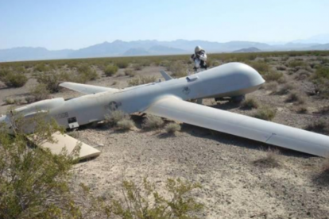
Public Safety Hazard
Drones can put people on the ground
at risk.
  400 large military drone crashes since 2001
  Army officials in 2013 stated that their drones
  crash at a rate 10 times the rate of manned aircraft
[32], [31]
Notes:
Presenter: Matt
A drone malfunction or crash (with an object like a tree or another drone) can put people on the ground at risk [32]
Especially when the drone is over a crowd of people.
Over 400 large drone crashes since 2001
Malfunction, human error, weather related incidents
In 2008, Air Force drone operator crashed a drone into a U.S. base in Afghanistan
No one was killed
But this isn’t just in harsh war conditions
In 2014, an Army drone crashed next to an elementary school playground in Pennsylvania
In 2006, a border patrol drone between us and mexico crashed 1,000 ft away from a residential area [31]
Army drones crash at a rate ten times the rate of manned aircraft
Apparently this is understating the problem, as some issues arent reported

Slide 10
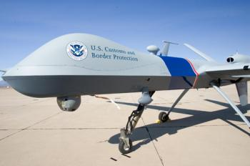
Laws in Place
Florida vs. Riley (1989)
  Drones above private homes
US Airspace restriction
  FAA has exclusive sovereignty of all airspace above U.S.
  United States v. Causby (1946)
Notes:
Presenter : Matt
image:https://www.freedomsphoenix.com/Uploads/Graphics/410-0607150019-drone_canadaus.jpg
Florida v. Riley - Florida circuit court found that it was a violation of 4th amendment but was overturned by the supreme court.
Police don’t need a warrant to veiw things above
You may wonder where these Drones can fly,
Can a Drones fly over my house?
Drones are currently limited to Class G Airspace, not even allowed in barely regulated class E airspace
Drones can be over your house as long as they are not taking away from your enjoyment of your property.
But the problem with these restrictions is that they would keep a manned aircraft from seeing anything. But Drones eye sight is much better than people.
With no obstruction in the air Drones can see far, all the way into your homes.

Slide 11
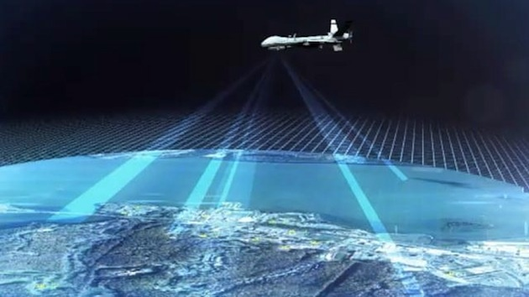
Gaps in the Laws
Issues with United States v. Causby (1946)
  Airspace defined vaguely as “airspace through which unwelcome aerial invasions would ‘subtract from the owner’s full enjoyment of the property.’ “ and “immediate reaches”
Issues with Florida v. Riley (1989)
  Idling vs. observing
  increased drone usage vs. helicopters
Circumventing Democracy
  Private citizens with war
  Government with surveillance and war
[24]
Notes:
Presenter : Derek
Image: http://assets.vice.com/content-images/contentimage/no-slug/d43f0fff1c025368ba4dc9e064bbb804.jpg
Aim to poke holes in the laws Ryan just talked about to promote second-thoughts for conclusion
US v. Causby - Decided by the supreme court. Talk about the contradiction with the FAA saying stay at high altitudes but those are only regulations and not laws. Also note that new technologies like ARGUS drone being able to fly at very reasonable altitudes as considered by the law but having cameras strong enough to take footage as if they were flying right over your property.
Previously before the decision, decision US owned everything not on the ground, later decision you owned infinitely above your property.
Florida v. Riley - Talk about idling a drone and watching vs something you could see in a yard in passing. Someone could have flown over and seen a greenhouse but greenhouses aren’t illegal only monitoring could have revealed what was in the greenhouse. Also talk about the cost of drones allows law enforcement to deploy drones wherever so whereas a helicopter may have seen the greenhouse, they probably wouldn’t have used helicopter amount of resources to watch small greenhouse
Researchers and government groups continually bring up this interesting concept of drones subverting democracy because of their general low cost and ease to deploy.
From the government, where there used to be more checks-and-balances since the missions would include humans, now more people are ambivalent to many missions because drones mitigate these problems
People could take things into their own hands instead of trying to deal with bureaucracy

Slide 12
Laws are Needed to Protect Privacy
Government Accountability Office (GAO) found that agencies are not addressing how data collected from drones will be used
  Privacy leak vector
On the extent of government drone use
  FBI says they are operated the same as manned aircraft
  Privacy advocates argue that low costs may lead to extensive surveillance
[35]
Notes:
Presenter: Derek
GOA found that government agencies are not addressing what happens to data collected by UAO [35]
Laws dont govern what can be done with the data or how it is protected
Why do we need these laws?
Of course to protect privacy of citizens
Also to help to advance drone technology
GOA stated that by not addressing the issue, risk of drones not being adapted as much as they wouldve been
To protect privacy, we must also implement rules that control the extent that drones are used by govt
Due to how cheap drones are to operate, privacy advocates are concerned the government could take advantage for wider spread and routine surveillance

Slide 13
Laws are Needed to Protect Safety
Government's safety standards for drones are not enough
  Warzone vs. domestic territory
  A need for strict safety laws and accountability
Notes:
Presenter: Hugh
It is very difficult to determine what laws and regulations the government abides by, especially with drones over sees used in war
But we have seen so many crashes, losses of drones, that it is clear that govt drones are not as safe as they could be
In order to use government drones as surveillance domestically, and even anywhere else (Safety standards should be the same)
Need to increase accountability, safety regulations, perhaps training for pilots

Slide 14
Future Outlook
1 year
  Increase in proposed regulations and laws
    Presidential Policy Guidance - “The Playbook” [37]
    Presidential Election
5 years
  With increased regulations, the drone industry is booming
  Government using drones in to impact more areas of society. [38]
10 years
  Drone industry estimated around $123 Billion [39]
  Drones integrated into most facets of society
Notes:
Presenter: Derek
1 year
The PPG or “the playbook” brought to light a lot of the policies and programs the government had in regards to drones both domestically and overseas.
Presidential elections usually kick-off with pushes to pass new legislation and grow public confidence in new leadership
From NY Times:
Clinton: Stay with Obama drone policy
Trump: Increase in drones
http://dronecenter.bard.edu/presidential-candidates-on-drones/
5 years
Like amazon testing drone delivery, US exploring integration in USPS
Tightening regulations will allow more business to be started and more research and innovation
http://www.nytimes.com/2016/08/11/technology/think-amazons-drone-delivery-idea-is-a-gimmick-think-again.html?_r=0
10 years
$30 billion from military, 2.5X Zuckerberg’s net worth, 2X Buffet
Reports think two greatest areas of innovation are aerial imaging and data analysis
http://www.investors.com/news/technology/drone-sales-forecast-2015-to-2025-from-tractica/

Slide 15
Conclusion
Drones must me moved to the top of the legislative agenda and more comprehensive laws and regulations must be put in place to limit the capabilities of government's use of drones for surveillance.
Notes:
Presenter : Matt Suarez
Current laws for commercial drones only provide privacy best practices
FAA’s drone advisory has no privacy or consumer advocates [10]
Heavy traffic in the air will increase the risk of drones crashing (collisions or malfunctions)
Safety inspections laws for drones are not strict [11]
I.e. like we saw in the self-search paper, basic information on a person is fairly common and easy to find. Therefore while things like cybersecurity are of extreme importance, Drones at government’s disposal TODAY have capabilities of causing harm and affect a person’s life say using this basic information to find them and track them, etc.

Slide 16
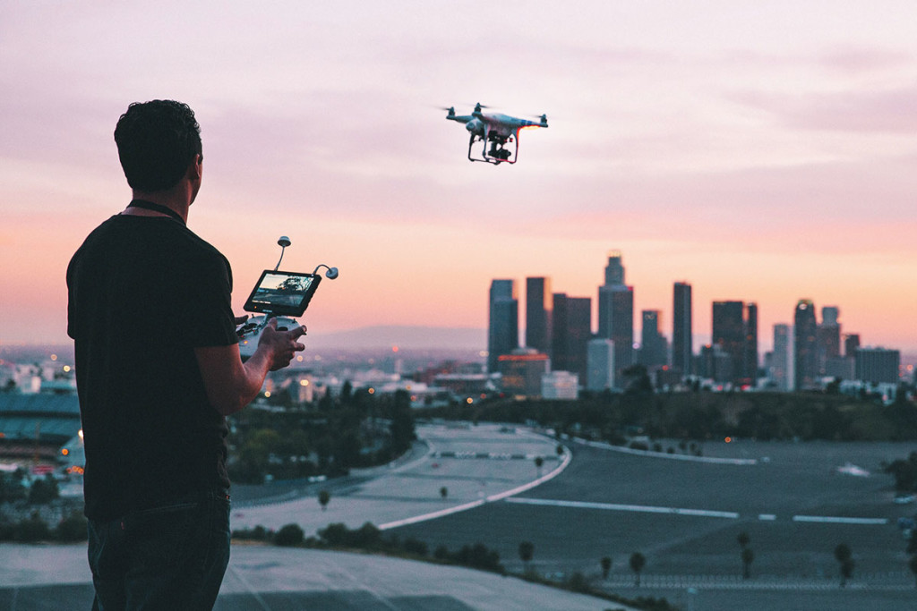
Questions or Comments?
[37]
Notes:
Presenter : Matt Suarez
Image: http://fromwhereidrone.com/wp-content/uploads/2015/03/Drone-about-IMG_915c-1024x683.jpghttp://fromwhereidrone.com/wp-content/uploads/2015/03/Drone-about-IMG_915c-1024x683.jpg

Slide 17
References
“Heverly, Robert A.” The State of Drones: State Authority to Regulate Drones. http://www.albanygovernmentlawreview.org/Articles/Vol08_1/8.1.0029-Heverly.pdf. 28 Sep. 2016.
“Chandran Nyshka”. FAA's new drone laws go into effect Monday, allowing US companies to innovate. http://www.cnbc.com/2016/08/29/faas-new-drone-laws-go-into-effect-monday-allowing-us-companies-to-innovate.html. 28 Sep. 2016.
“Marsh, Alton K.” Lawyer Gets FAA to Approve Paper Airplane. https://www.aopa.org/news-and-media/all-news/2015/september/02/lawyer-gets-faa-to-approve-paper-airplane. 21 Sep. 2016.
“Steinberg, Joseph.” Drones in America Must Now Be Registered. Here’s What You Need to Know. http://www.inc.com/joseph-steinberg/drones-in-america-must-now-be-registered-here-is-what-you-need-to-know.html. 1 Oct. 2016.
Unmanned Aircraft Systems (UAS) Frequently Asked Questions. https://www.faa.gov/uas/faqs/. 18 Sep. 2016.
Booth, William. "More Predator Drones Fly U.S.-Mexico Border." Washington Post. The Washington Post, 21 Dec. 2011. Web. 28 Sept. 2016.
Koebler, Jason. "North Dakota Man Sentenced to Jail In Controversial Drone-Arrest Case." U.S. News and World Report. N.p., 15 Jan. 2014. Web. 28 Sept. 2016.
“Blackwell, Victor. Pearson, Michael.” FBI: Bombs found in Alabama Kidnapper’s Bunker. http://www.cnn.com/2013/02/05/us/alabama-child-hostage/. 2 Oct. 2016.
“Abid, M. Ehtisham. Austin, Travis. Fox, Daniel. Hussain, Syed Shehroz.” Drones, UAV’s, and RPA’s: An Analysis of Modern Technology. https://web.wpi.edu/Pubs/E-project/Available/E-project-050114-120740/unrestricted/Drones_UAVs_and_RPAs.pdf , 30 Sep. 2016.

Slide 18
References
Krzanich, Brain “Drone advisory Committee Membership” Intel 13 Aug. 2016. Web. 29 Sept. 2016. http://www.rtca.org/Files/Miscellaneous%20Files/DAC%20Membership%20Roster.pdf
Voss, Paul “We Need a National Conversation About Sensible Drone Laws” Government Technology, Smith College 7 April 2016. Web. 23 Sept. 2016. http://www.govtech.com/opinion/We-Need-a-National-Conversation-About-Sensible-Drone-Laws.html
Fiber, Hillary B. “Eyes in the Sky: Constitutional and Regulatory Approaches to Domestic Drone Deployment” University of Massachusetts School of Law at Dartmouth, 3 Feb 2014. Web. 11 Sept. 2016.
Vivens, Ruben “LAPD’s Beck says he’ll seek input before considering using drones” Los Angeles Times 5 June 2014. Web. 24 Sept. 2016.” http://www.latimes.com/local/la-me-lapd-drone-20140606-story.html
Rule, Troy “Airspace in the Age of Drones” Web. 27 Sept. 2016 http://www.bu.edu/bulawreview/files/2015/02/RULE.pdf
Frank, Michael “Drone Privacy: Is Anyone in Charge?” Consumer Report, February 10, 2016. Web. Sept. 23 2016
Cavoukian, Ann “Privacy and Drones: Unmanned Aerial Vehicles” Privacy by Design, August 2012. Web Sept. 23 2016
Chandra, Nyshka “FAA’s new drone laws go into effect Monday, allowing US companies to innovate” CNBC, Monday August 29 August 2016, Web Sept. 28 2016
“Unarmed Aircraft Systems” Federal Aviation Administration, August 29 August 2016, Web Sept. 30 2016
“Fact Sheet – Small Unmanned Aircraft Regulations (Part 107)” Federal Aviation Administration, June 21 2016, Web Sept. 30 2016
http://blogs.scientificamerican.com/guest-blog/what-is-a-drone-anyway/

Slide 19
References
Connot, Mark & Zummo, Jason “Navigable Airspace: Where Private Property Rights End and Navigable Airspace Begins” Fox Rothschild, January 15, 2016, Web Sept. 30 2016
Swayne Martin, “This Is How Class G Airspace Works” Boldmethod, July 14 2016, Web Oct. 2 2016
Swayne Martin, “The Logic Behind Class E Airspace” Boldmethod, June 2 2016, Web Oct. 2 2016
Ball, James, “Drones should be banned from private use, say’s Google’s Eric Schmidt”, https://www.theguardian.com/technology/2013/apr/21/drones-google-eric-schmidt, 10/3/16
Southworth, Matt, “The US Drone”, https://cpc-grijalva.house.gov/uploads/Drones_Fact_Sheet_FCNL1.pdf, 10/3/16
ACLU, “Domestic Drones”, https://www.aclu.org/issues/privacy-technology/surveillance-technologies/domestic-drones, 10/3/16
Governing, “Police Agencies USing Border Patrol’s Drones More Often Than Thought”, http://www.governing.com/news/headlines/Police-Agencies-Using-Border-Patrols-Drones-More-Often-Than-Thought.html, 10/3/16
Francescani, Chris, “Domestic Drones are already reshaping U.S. crime fighting, http://www.reuters.com/article/us-usa-drones-lawenforcement-idUSBRE92208W20130303, 10/3/16
RT Magazine, “Bloomberg on drones over New York”, https://www.rt.com/usa/bloomberg-on-drones-over-nyc-699/, 10/3/16
Berke, Ashley, “Associated Press-National Constitution Center Poll Reveals Public Concern About Protection Of Privacy” http://constitutioncenter.org/media/files/appollprivacy.pdf, 10/3/16

Slide 20
References
Booth, William. "More Predator Drones Fly U.S.-Mexico Border." Washington Post. The Washington Post, 21 Dec. 2011. Web. 28 Sept. 2016.
Whitlock, Craig. “When Drones Fall from the Sky.” http://www.washingtonpost.com/sf/investigative/2014/06/20/when-drones-fall-from-the-sky/. 29 Sep. 2016.
Chow, emily, Cuadra, Alberto, and Whitlock, Craig. “Fallen from the Skies: Drone Crash Database.” www.washingtonpost.com/wp-srv/special/national/drone-crashes/database/. 03 Oct. 2016.
“Summary of Small Unmanned Aircraft Rule.” https://www.faa.gov/uas/media/Part_107_Summary.pdf. 04 Oct. 2016.
“Interim Report on the Department of Justice’s Use and Support of Unmanned Aircraft Systems.” https://oig.justice.gov/reports/2013/a1337.pdf. 01 Oct. 2016.
Mcniff, Catherine. “Timeline: U.S. Spying and Surveillance.” http://www.infoplease.com/us/government/spying-surveillance-timeline.html. 05 Oct 2016.
McCauley, Lauren. “ACLU Forces US Government to Release Secret Drone Playbook". http://www.commondreams.org/news/2016/08/06/aclu-forces-us-government-release-secret-drone-playbook. 02 Oct. 2016.
Manjoo, Farhad. “Giving Drone Industry Leeway to Innovate” http://www.nytimes.com/2015/02/05/technology/personaltech/giving-the-drone-industry-the-leeway-to-innovate.html. 29 sep 2016.
“Press Release: UAV Production will Total $93 Million.” http://tealgroup.com/index.php/teal-group-news-media/item/press-release-uav-production-will-total-93-billion. 01 Oct. 2016.
Moore, Tina. “‘We’re Going to Have More Visibility and Less Privacy’: Mayor Bloomberg Admits Soon NYP Surveillance Cameras Will be on Nearly Every Street Corner and in the the Air.” http://www.nydailynews.com/new-york/bloomberg-new-york-eventually-surveillance-city-article-1.1296103. 26 Sep. 2016.

