Slide 1
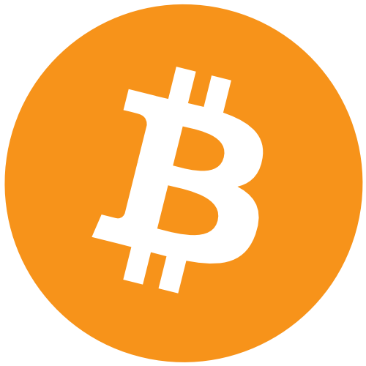
Cryptocurrency
Dmytro Bogatov, Isamu Nakagawa,
Nicholas Bradford, Tim Petri
https://socialimps.dbogatov.org/
Notes:
For the sake of this presentation, we will put much of our focus on bitcoin, but much of our discussions pertain to cryptocurrencies in general.

Slide 2
Introduction
Revolutionize the financial markets
Expand across economic sectors
Become a global competitor to fiat currency
Notes:
We think cryptocurrency will…
Economic sectors, other than financial

Slide 3


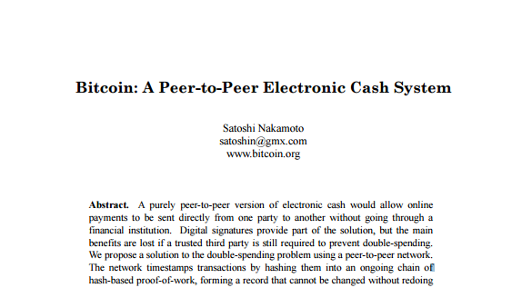
Before Cryptocurrency
‘90s centralized online currencies [1]
  Flooz.com, Beenz.com, DigiCash…
  Comparable to airline miles
  All collapsed in the .com bubble crash
Bitcoin Whitepaper (2008) [2]
[1, 11, 13]
Notes:
Before current cryptocurrencies,
‘90s centralized online currencies
Examples included Flooz.com, Beenz.com, and DigiCash…
They were Comparable to airline miles
All collapsed in the .com bubble crash, due to a combined lack of profitability and lack of widespread adoption by users.
Bitcoin is a cryptocurrency created by a currently unidentified programmer, or group of programmers, under the name of Satoshi Nakamoto. Bitcoin was released in 2008 along with a white paper describing the underlying technology.

Slide 4
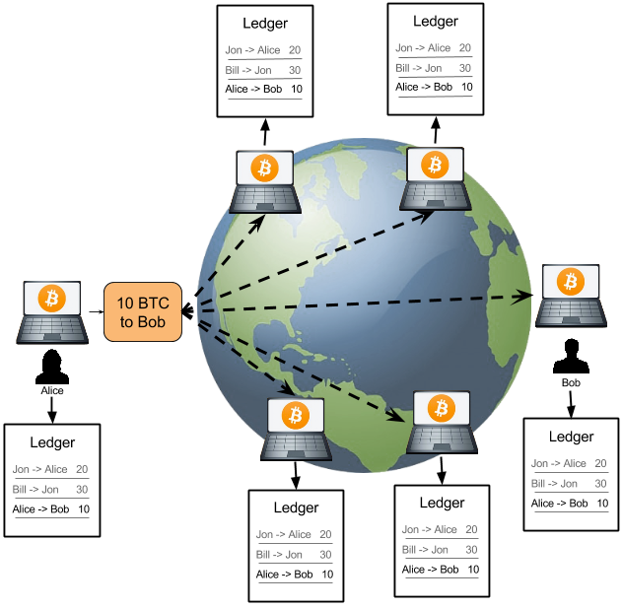
The Public Ledger
Peer-to-peer network of nodes [1]
Wallets [2]
  Public key uniquely identifies a user
  Software to interact with network and abstract away details of cryptography
Public ledger [1]
  Every transaction ever made
  New transactions must reference old transactions
[6]
Notes:
Tim
There are many cryptocurrencies out there today, and the underlying technology has many use cases, but we will focus on Bitcoin in understanding how it works. It was also the first truly distributed version that has seen wide adoption.
The bitcoin cryptocurrency relies on a network of nodes on which a list of all transactions ever made are maintained.
To use bitcoins, one needs a bitcoin wallet. It consists of a public and private key, and the public key acts as your identifier/address when you want to send coins. The wallet is the piece of software by which you interact with the network, hides the process of generating, storing and using your private key. If you happen to lose your private key, all the coins associated with your wallet become inaccessible.
The bitcoin ledger is a record of all transactions ever made since the invention of bitcoin in 2008. Each transaction consists of the two public keys (wallets) between which the money was sent, and an amount. Since all transactions are recorded, one can track the history and origin of all coins in circulation. Making a transaction is done by showing that you have the means, and then broadcasting the transaction information to the network. In reality, there is no record of how much money you have, but is instead computed on the go by summing up all incoming transactions to your wallet, and subtracting all previous outgoing transactions. So, in order to show that you can make a transaction, you use previous transactions that add up to the amount you want to send and “pass them on” to the receiver.

Slide 5
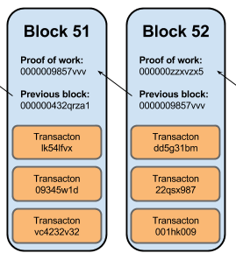
Generating Bitcoins (“Mining”)
Miners verify blocks of transactions [2]
  Every node in network competes to compute a valid hash for the block
  First node to compute a valid hash gets rewarded bitcoins
  The block then gets added to ledger (“blockchain”)
Bitcoin reward is halved every 210,000 blocks [4]
  16 out of 21 million coins have been mined
  Eventually, incentive to mine will come from transaction fees
Mining pools let miners can stabilize income [5]
  Reward becomes proportional to resources contributed
[7]
Notes:
Tim
The act of bitcoin mining, with which most of us are familiar, is the way all transactions are protected from fraud. Bitcoin miners work together to ensure that the distributed nature of the network can’t be exploited for double spending.
Recent transactions broadcasted on network are grouped into so called blocks and nodes in the network try to compute a hash that uniquely labels these transactions. Whoever computes the hash first, adds it to the public ledger. On average, the hash computation is set up to take around 10 minutes using all the resources in the bitcoin network. The correct hash can quickly be verified by all other nodes.
After verification, the node that mined the block is rewarded a number of bitcoins for the work done. This reward started at 50 and has been halved every 210,000 blocks, and is currently 12.5 BTC. In total, 16,000,000 out of 21,000,000 coins have been mined. Once the reward becomes so small that mining is no longer profitable from just the reward, an additional transaction fee will be used to incentivize the mining of blocks.
For the purpose of this presentation, some details regarding this has been left out. (blockchain branching, etc)
With many thousands of computers each trying to compute the correct hash, it is extremely unlikely that it’s your node that does it. Mining pools were created to deal with this. They are systems by which one cain join others and collectively pool resources to compute the hash. If any computer in the pool manages to get the hash, the reward is shared among all members based on the resources they provided. This effectively lets miners decrease the variance of their income rate from mining.

Slide 6
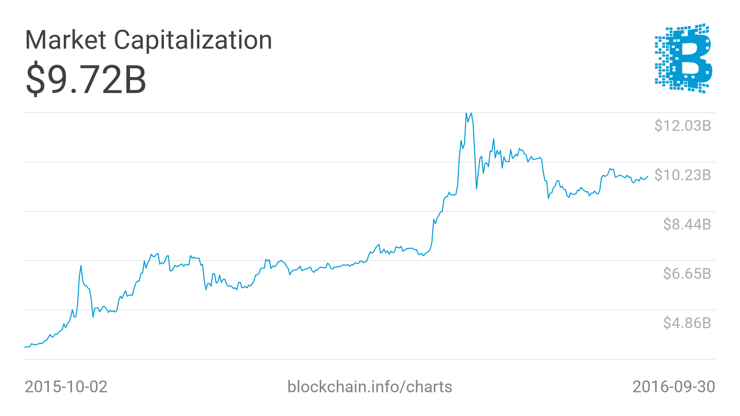
Current State of Cryptocurrency
There are hundreds of modern cryptocurrencies
  Monero, DogeCoin, Ripple, Litecoin
Most popular by Market Cap
  Bitcoin (~80%)
    Market cap: $9.7b
    Daily trading volume: $40-60m
  Ethereum (~10%)
    Market cap: $1.1b
    Daily trading volume: $2-6m
Growing acceptance of Bitcoin
  Microsoft, PayPal, Reddit, Newegg
  Most do not actually hold Bitcoin
Notes:
There are hundreds of modern cryptocurrencies, such as Monero, DogeCoin, Ripple, Litecoin...
Most popular by Market Cap
Bitcoin (~80%)
Market cap: $9.7b (see pretty graph)
Ethereum (~10%)
Growing acceptance of Bitcoin
Microsoft, PayPal, Reddit, Newegg
Most do not actually hold Bitcoin

Slide 7
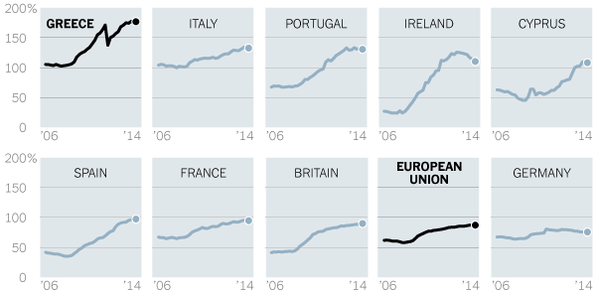
Implications of Bitcoin
Conventional $ = centralized
Cryptocurrency $ = decentralized
Euro
  Binds 19 nations to single currency
  European Central Bank
  Each country: budget and tax policy
  Economists believe doomed from the start
“Each user depends on the system and the system’s functioning depends on the users.” [1]
Gross government debt, 2014
[6, 9]
Notes:
Introduce the implication of bitcoin (and other cryptocurrencies)
Varying option on whether Cryptocurrency should become a mainstream currency.
Decentralized vs Centralized
Argument: People want a decentralized currency. All users act as a kind of joint bank.
Euro failing example.
Greece example - centralized currency failed.
Graphs show government debt has increased in these countries.
Bitcoin researchers believe, “the functionality of the currency includes all necessary qualities that have to have a world currency” [1].

Slide 8
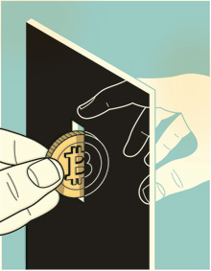
Implications: Controversies
Evade taxes
Violate U.S. law
Underground markets
No authority organization support
[5]
Notes:
Counter Argument:
Taxes:
“A direct exchange of digital coins over the Internet for the goods or services… The result is a secure, partially anonymous, and decentralized electronic medium of exchange with limited transaction fees” [3].
US law:
competes with the U.S. dollar
Unregulation:
“The lack of consolidated control also makes Bitcoin appealing to those wishing to engage in illegal activity or support dissident organizations, such as WikiLeaks” [3].

Slide 9

Underground Markets
Case Study: Silk Road
  9,519,664 Bitcoins exchanged
    2-6-2011 to 7-23-2013
  1,229,465 transactions
Disconnect of rules for criminal litigation
U.S. Supreme Court and Congress must design a balance
Governmental overstep and potential infringement upon the First Amendment rights of legitimate Bitcoin users
[1, 2, 7, 8]
Notes:
Introduce silk road, online marketplace on tor.
Used primarily for illegal drugs and services
A total of 1.3 million transactions within the two year period
Silk road shows the instability of a completely decentralized currency.
There has to be a balance between anonymity and intervention. US government
Tricky situation… government has potential to overstep
Violate first amendment possible.

Slide 10
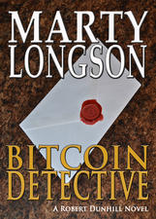


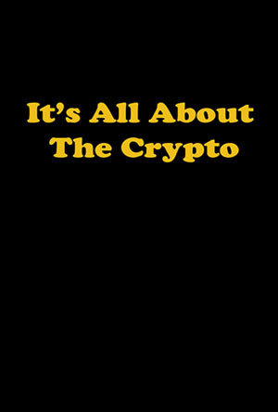
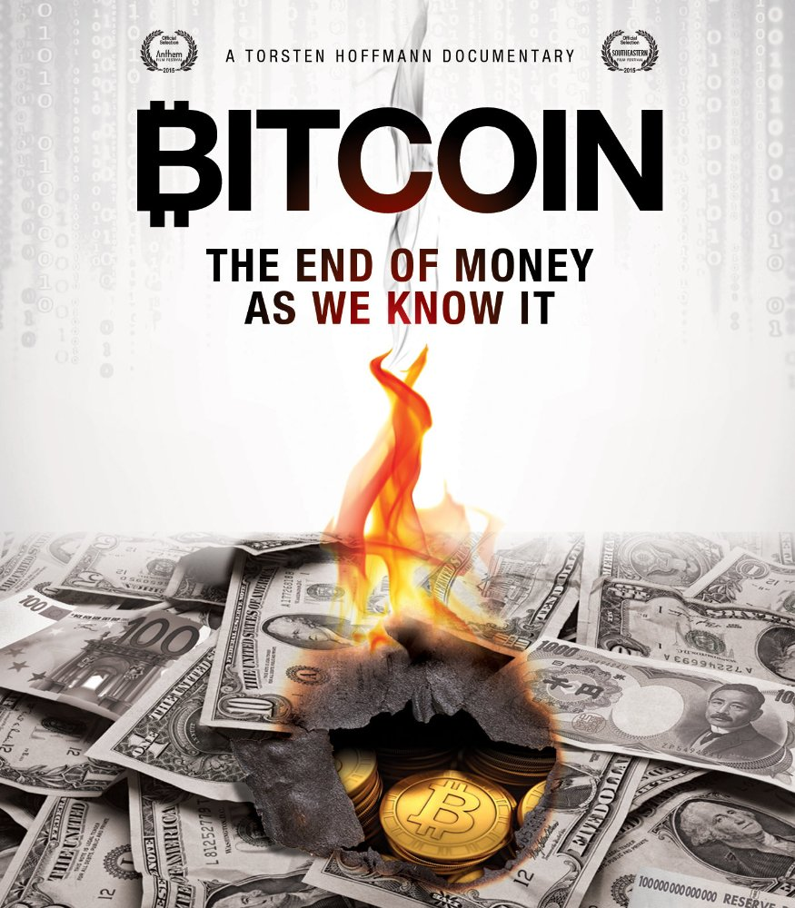




Popular Media
Notes:
There are a number of works in cinema and literature about blockchain technology, and BitCoin in particular.
While many movies and books mention BitCoin in some way, it is rarely the main topic of a work.
Instead, BitCoin is associated with something cryptographic, hack-ish or criminal.
In media, hackers use cryptocurrency because they can and it looks cool to use something unordinary, crimes are using BitCoin to hide their illegal transactions.
When it comes to literature, most of the works on BitCoin are documentary - those are scientific works, technical paper or textbooks.
However, there are a number of fiction and detective books that portray BitCoin the same way movies do.

Slide 11
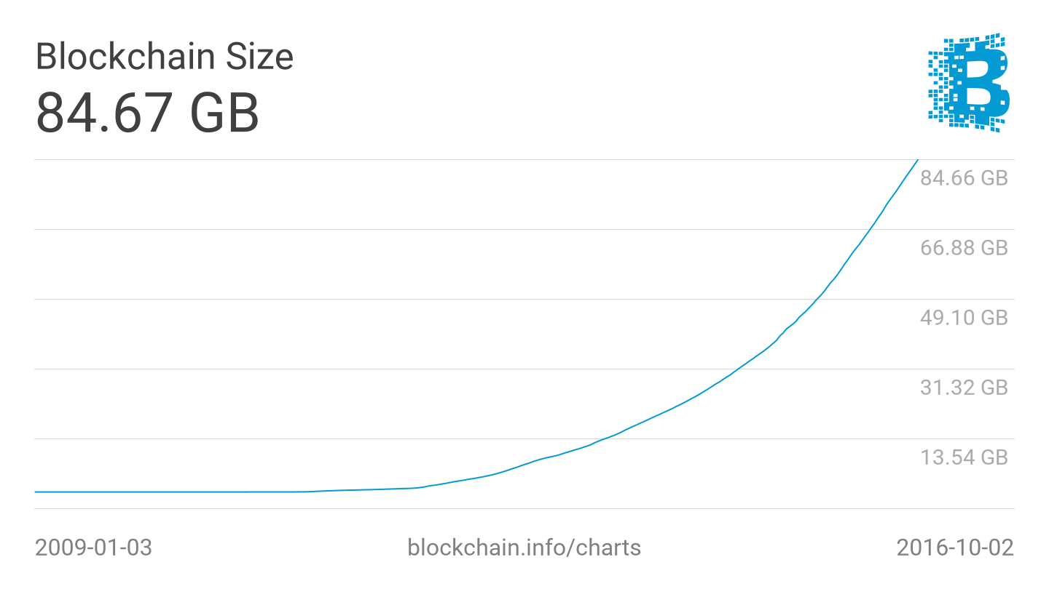
Obstacles for Cryptocurrencies
Opposition
  Existing institutions/governments [2]
  Value is too unstable [8]
Technical
  Explosion in blockchain size [3]
  High-speed, high-volume is unproven [3]
  No reversibility or recovery of lost wallet [4]
  Energy costs → high transaction costs [3]
[10]
Notes:
Cryptocurrencies such as BitCoin still have numerous significant obstacles to overcome before they could totally replace current currency systems.
The most immediate is the simple opposition from existing financial institutions, which wield great power and have incentives to discourage the proliferation of cryptocurrencies [2].
Other large corporations, even when amenable to the idea of cryptocurrencies, do not currently consider them stable enough to keep as assets for long periods of time [8].
In addition to battling the current economic system, cryptocurrencies have some internal challenges to overcome.
Attempting to convert the entire world financial system to the BitCoin model, for example, could cause such a massive growth in blockchain size that the distributed ledger model would become impractical [3].
It is also still unclear whether blockchain technology could be successfully adapted to use cases which require very high speeds with high volumes (on the order of seconds instead of hours), and would be poorly suited for any application which required some degree of reversibility [4].
Finally, because of the substantial energy costs and diminished rewards over time associated with the “mining” process, users may eventually be forced to bear increasingly high and unreasonable transaction costs [3].

Slide 12
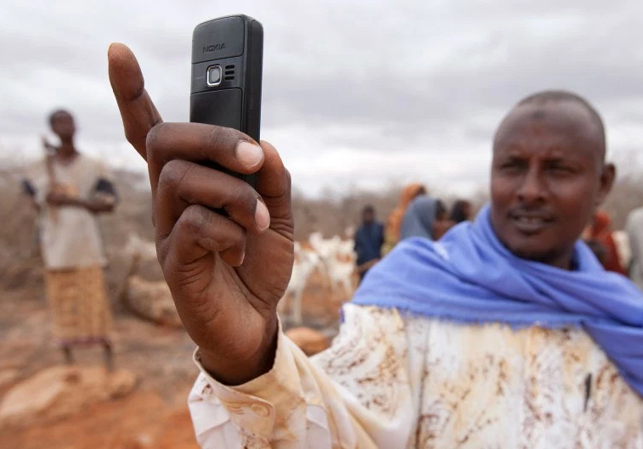
Short-term (3-5 years)
Increasing Efficiency in Finance
  Increased efficiency (up to $6 billion/year) [4]
    Increased transparency → less fraud [3]
    Creation of proprietary centralized cryptocurrencies [9]
Emerging Markets
  Serve as financial intermediaries where there is no financial system in place [3]
    Remittance service startups [10]
    Very high confidence among consumers [10]
[12]
Notes:
Since the 2008 financial crisis, large banks are increasingly feeling pressure to increase efficiency and cut costs wherever possible [6].
To that end, a May 2016 report from Goldman Sachs estimates that the financial industry alone could realize up to $6 billion/year in savings through use of blockchain technology [4].
However, this would not necessarily include decentralized cryptocurrencies such as Bitcoin, but may involve the creation of new proprietary centralized cryptocurrencies (such as the Bank of England’s newly introduced RSCoin) [9].
The introduction of cryptocurrencies may also lead to increased levels of transparency and few incidents of fraud. Under current systems, the correct identification of fraud is very manual-labor intensive and prone to error [4]. However, cryptocurrencies are designed to be explicitly transparent and automatically detect fraud, greatly alleviating the costs associated with managing associated systems [3].
Because cryptocurrencies require only an Internet connection, and are not dependent on established institutions such as banks, they are ideally suited for societies without a well-developed financial infrastructure [3].
As with how many individuals emerging markets skipped over landlines and went straight for mobile phones, the same individuals may skip the overhead of the traditional banking system and engage directly in mobile banking [3].

Slide 13
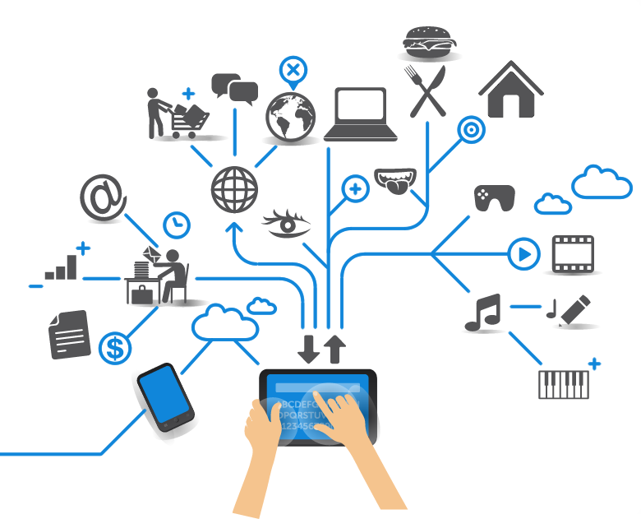
Long-term (5-10 years)
Financial Industry Disruption
  Role of large banks/institutions diminishes
  IoT integration
    What if your car could pay the gas station?
Blockchain gets picked up by other industries
  IP protection [4]
  Public profiles (AirBnB) [4]
  Any other service requiring record-keeping!
Very long-term (10+): Cryptocurrency replaces fiat currency
  Microsoft has facilitated large-scale simulations of a global economic shift towards cryptocurrencies [7]
Notes:
Long-term (5-10 years)
Financial Market Disruption
Within the cryptocurrency community, one of the most popularized goals is the total replacement of banks and other centralized financial intermediaries [4]. Although such institutions may never be fully replaced by a democratized network, their role (and associated profitability) may steadily diminish with rise of cryptocurrencies, hopefully leading to the prevention of future financial catastrophes on the scale of the 2008 crisis [7].
IoT Integration
Although cryptocurrencies have the possibility to replace functions of the existing financial infrastructure, their greatest potential may be in incorporating with other technologies to facilitate a true revolution [3]. The blockchain model is ideally suited for Internet of Things (IoT) transactions, which require both efficient simplicity and robust security [4]. For example, imagine if every time you needed to fill up a car with gas, your car could pay the gas station automatically.
Expanding Industries
In addition to revolutionizing the financial system, the blockchain technology of underlying cryptocurrencies has the potential to expand across nearly any industry that involves large-scale record-keeping.
Blockchain could be a massive boon to proponents of effective protection of intellectual property rights, such as with music and film. New companies such as Ascribe are pioneering methods for creating secure limited copies of digital media, in order to ensure that artists are properly compensated for their work, instead of being financial damaged by pirates [1]. Other examples include the growing “Sharing Economy” (including AirBnB) which can use blockchain to ease identity and reputation management, and “Smart Grid” utility companies which could use blockchain to introduce efficient microtransactions for energy consumption [4].
Far Future (10+ years)
In the very far future, global and democratized cryptocurrencies have the potential to replace government-backed fiat currencies as the primary means of conducting financial transactions. With that end in mind, Microsoft has also begun facilitating large-scale simulation tests on behalf of banks and other large corporations interested in understanding the potential ramifications for such a large-scale shift in the global economy [7].

Slide 14
Questions?

Slide 15
References: How it works
[1] 3 Pre-Bitcoin Virtual Currencies That Bit the Dust, by Stan Higgins. CoinDesk. Accessed 29 September 2016 from http://www.coindesk.com/3-pre-bitcoin-virtual-currencies-bit-dust/
[2] Nakamoto, S. (2008). Bitcoin: A peer-to-peer electronic cash system.
[3] How does Bitcoin work? https://bitcoin.org/en/how-it-works, Accessed 9/20/2016
[4] Controlled Supply, https://en.bitcoin.it/wiki/Controlled_supply, Accessed 10/2/2016
[5] Pooled mining, https://en.bitcoin.it/wiki/Pooled_mining, Accessed 10/1/2016.
[6] Image for Bitcoin network. http://www.ybrikman.com/assets/img/blog/bitcoin/bitcoin-send-message.png, Accessed 9/1/2016
[7] Image for Bitcoin mining. https://danims.com/wp-content/uploads/2015/06/bitcoin-block-chain-verified.png, Accessed 9/28/2016

Slide 16
References: Implications, Crime, Speech
Seitim Aiganym. “The Conceptual Principles of Bitcoin Crypto Currency” Bitcoin innovative principles that can be used in current financial situation. http://thescipub.com/abstract/10.3844/jcssp.2015.995.999
Alec Lui, With Euro Instability, “Can Bitcoin Now Compete with Hard Currency?”, MOTHERBOARD (June 12, 2012)
Thomas Slattery, “Taking a Bit out of Crime: Bitcoin and CrossBorder Tax Evasion”. 39 Brook. J. Int'l L. (2014)
Crosman, Penny. "Can You Really 'Know' a Customer Who Uses Bitcoin?" American Banker 2 Dec. 2015. Academic OneFile. Web. 28 Sept. 2016.
MAXIMILIANO GARCIA. Cryptortrust, JANUARY 21, 2014. https://cryptortrust.com/2014/01/21/buy-bitcoin-in-3-simple-ways/ Accessed 9/29/16
Giulio Prisco. “Ecuador Pushes Forward on Upcoming Electronic Currency System”. Jun 02, 2015 , https://bitcoinmagazine.com/articles/ecuador-pushes-forward-upcoming-electronic-currency-system-1433277129. Accessed 9/29/16
BY LORENZO FRANCESCHI-BICCHIERAI. “The Silk Road Online Drug Marketplace by the Numbers”. OCT 04, 2013. http://mashable.com/2013/10/04/silk-road-by-the-numbers/#3rUhaZGgniqb Accessed 9/29/16
Joris de Ruiter. “Four Charts That Suggest Bitcoin Value Could Be At 10,000 USD Next Year”, 27/06/2014. https://www.cryptocoinsnews.com/four-charts-suggest-bitcoin-value-10000-usd-next-year/ Accessed 9/29/16
THE NEW YORK TIMES. JUNE 17, 2016. http://www.nytimes.com/interactive/2016/business/international/greece-debt-crisis-euro.html Accessed 10/6/16

Slide 17
References: Obstacles and Predictions
Ascribe home page. Ascribe. Accessed 29 September 2016 from https://www.ascribe.io/
Dutch Central Bank Presents Results of Cryptocurrency Experiments, by Michael del Castillo. CoinDesk. Accessed 29 September 2016 from http://www.coindesk.com/dutch-central-bank-cryptocurrency-experiments/
Citi: Bitcoin is an Opportunity for Banks, Not a Threat, by Pete Rizzo. CoinDesk. Accessed 29 September 2016 from http://www.coindesk.com/citi-bitcoin-banks-remittances-wont-disrupt/
Goldman Sachs on blockchain, by Pete Rizzo. CoinDesk. Accessed 29 September 2016 from http://www.coindesk.com/goldman-sachs-blockchain-tech-save-capital-markets-12-billion/
https://hbr.org/2016/05/the-impact-of-the-blockchain-goes-beyond-financial-services
Banks find Blockchain hard to put into practice, by Kadhim Shubber. Financial Times. Accessed 29 September 2016 from https://www.ft.com/content/0288caea-7382-11e6-bf48-b372cdb1043a
Microsoft Bets That Bitcoin-Style Blockchains Will Be Big Business, by Tom Simonite. MIT Technology Review. Accessed 20 September from https://www.technologyreview.com/s/545806/microsoft-bets-that-bitcoin-style-blockchains-will-be-big-business/
No, Big Companies Aren’t Really Accepting BitCoin, by Jacob Davidson. Time. Accessed 29 September 2016 from http://time.com/money/3658361/dell-microsoft-expedia-bitcoin/
Central banks beat Bitcoin at own game with rival supercurrency, by Ambrose Evans-Pritchard. The Telegraph. Accessed 20 September 2016 from http://www.telegraph.co.uk/business/2016/03/13/central-banks-beat-bitcoin-at-own-game-with-rival-supercurrency/
Bitcoin Momentum Grows in Emerging Markets, by Min-Si Wang. Forbes. Accessed 29 September 2016 from http://www.forbes.com/sites/techonomy/2014/08/07/bitcoin-momentum-grows-in-emerging-markets/#34647161dd4f

Slide 18
Popular Media Image References
[1] http://a3.mzstatic.com/us/r30/Publication49/v4/b9/bb/8c/b9bb8c34-85b6-4356-f5da-cb3436934f00/cover225x225.jpeg
[2] http://a5.mzstatic.com/us/r30/Publication62/v4/ff/eb/36/ffeb36f9-62bf-18dd-c502-095c88c6d4b2/cover150x250.jpeg
[3] http://a4.mzstatic.com/us/r30/Publication20/v4/6b/62/36/6b623621-8a94-2c0f-3125-262ecc16dee8/cover150x250.jpeg
[4] http://a2.mzstatic.com/us/r30/Publication60/v4/0b/e6/c5/0be6c52e-f503-c445-63e9-606fac8b5fe4/cover225x225.jpeg
[5] http://a3.mzstatic.com/us/r30/Publication7/v4/09/f0/6b/09f06b59-b335-763a-18e6-0c43e19e904c/cover225x225.jpeg
[6]https://images-na.ssl-images-amazon.com/images/M/MV5BMjE1NTc4OTAzMl5BMl5BanBnXkFtZTcwMjU0ODA0OQ@@._V1_SY1000_CR0,0,652,1000_AL_.jpg
[7]https://images-na.ssl-images-amazon.com/images/M/MV5BNjU3MTM4ODU2OV5BMl5BanBnXkFtZTgwNDA1MjE4NTE@._V1_SY1000_SX875_AL_.jpg
[8]https://ksr-ugc.imgix.net/assets/011/512/580/592a095cc700996adc56788ef5a803e8_original.jpg?w=1536&h=864&fit=fill&bg=000000&v=1463683813&auto=format&q=92&s=28bf913b3294274e63066556ea8eab5f
[9]https://images-na.ssl-images-amazon.com/images/M/MV5BMTg5OTY0MjUzOV5BMl5BanBnXkFtZTgwNjg2NDY2NDE@._V1_.jpg
[10] https://blockchain.info/charts/blocks-size?timespan=all
[11] http://i2.cdn.turner.com/money/galleries/2010/technology/1003/gallery.dot_com_busts/images/flooz.jpg
[12] https://qzprod.files.wordpress.com/2013/01/africa-cellphone-1152013-web.jpg?w=940
[13] http://news.bbc.co.uk/olmedia/1495000/images/_1496810_beenza300.jpg

