Slide 1
Autonomous Driving and Machine Learning
Fainer, Farro, Hackett, Huot

Slide 2
History of Autonomous Vehicles
It’s only getting better

Slide 3
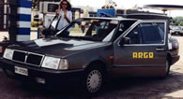
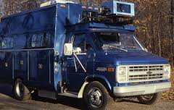
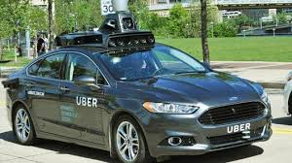
HISTORY OF AUTONOMOUS VEHICLES
1925 - radio controlled driverless car
1950s - electrical guide systems
1980s - first vision based systems
Present - Google, Tesla, Uber
Notes:
Turning back the clock, there were actually driverless cars on the road. This was do-able despite the less sophisticated technology because cars in that era drove much, much slower. They were essentially upscaled toy RC cars! Of course, that doesn’t mean they were self-driving; It wasn’t until much later that the technology for sufficient computing power came about, allowing cars to make decisions about how to drive themselves.

Slide 4
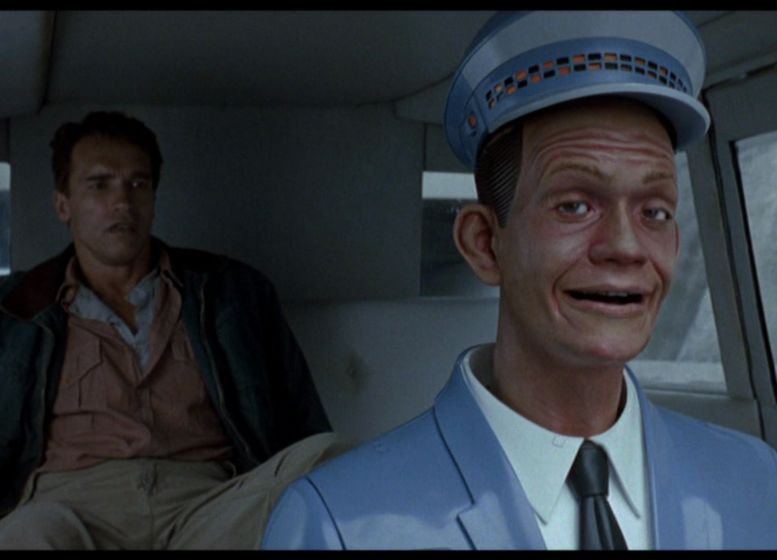

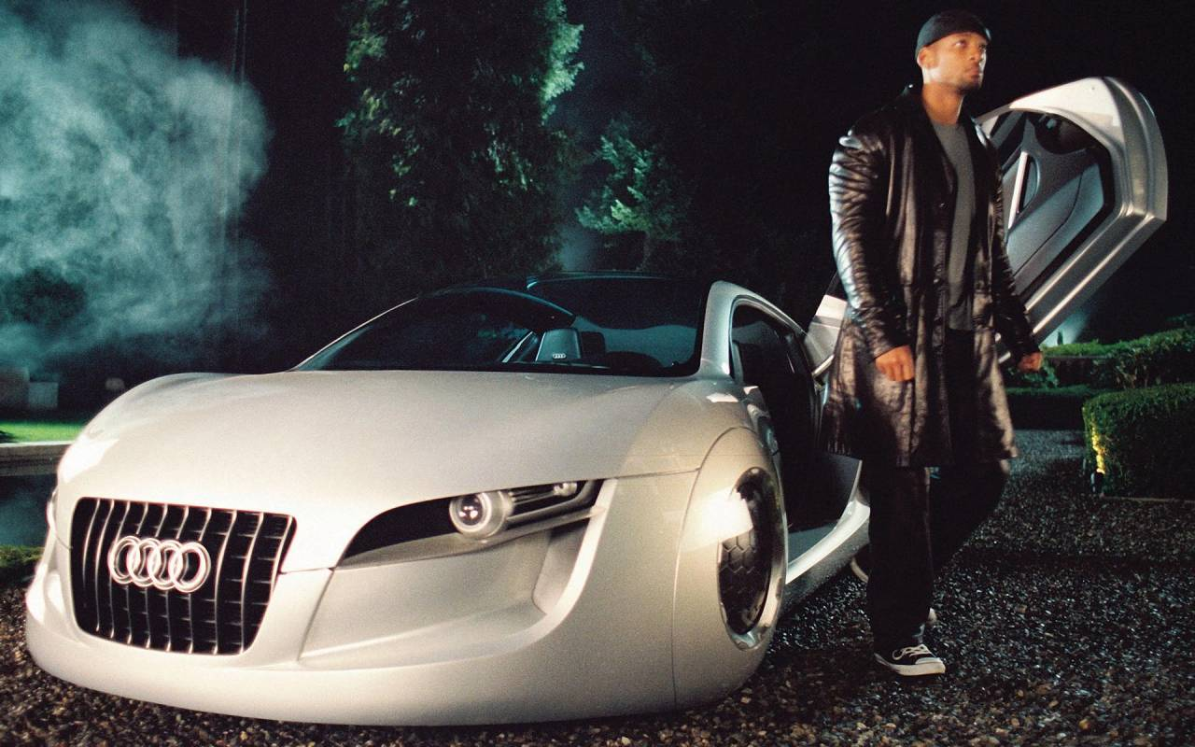
AUTONOMOUS VEHICLES IN FICTION
Total Recall (1980) Knight Rider (1982) I, Robot (2004)
[16][17][18]
Notes:
Just as Star Trek brought a lot of fantastic and imaginative tech to the public eye which eventually came to pass (like cell phones), Knight Rider did that for self driving cars. Although our cars are not self aware like KITT from Knight Rider (yet!), we see self driving cars in many other fiction movies as well such as Total Recall and I, Robot.

Slide 5
1 YEAR FROM NOW
Legislature catching up to evolving technology
More automotive companies attempting autonomous systems
Innovative arms race unfolds to seize market
[1][5]
Notes:
Legally dubious: “users were obliged to assume complete responsibility for riding in Uber’s AVs, including “any risks that may arise from the negligence or carelessness of [Uber and the ATC], operation of the AVs and/or dangerous or defective equipment”. They also had to release the company of liability from beyond the grave, with a clause that stated: “I hereby agree on behalf of myself, my executors, administrators, heirs [and] next of kin”.[1] In exchange for signing your life away. You get a free ride, though!
tl;dr Uber is crowdsourcing safety tests! Even if people agree to it, is that ethical? Can your average everyman passenger be expected to fully grasp the gravity of such a waiver?
Transportation officials say they “want Alphabet’s Google unit, Uber, Tesla and others to answer safety assessment questions within six months about self-driving vehicles and systems” [5]

Slide 6
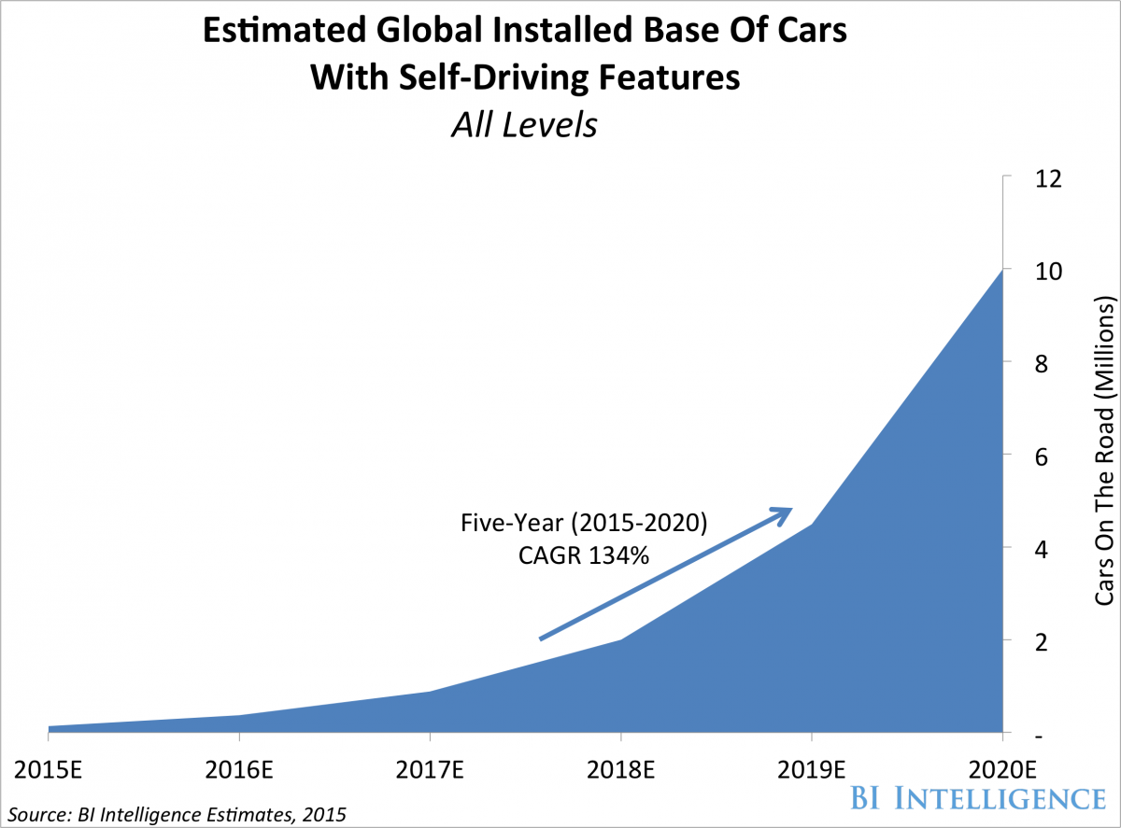
5 YEARS FROM NOW
10 million self driving vehicles on the roads
1% of all cars in the world
Less dangerous edge cases
[2] [3] [4]
Notes:
Current statistic is 1 billion cars on the road, assuming that stays about the same as old cars are scrapped and new ones replace them, 10 million cars would be about 1%.
Assuming autonomous cars drive at the current rate (a low estimate as more cars being made = more miles driven), edge cases would pretty much all have been accounted for by then.
An example of an edge case is the autonomous car that could not see the truck that had crossed in front of it.

Slide 7
10 YEARS FROM NOW
A majority of the automobile market consists of self driving cars.
The main issue now is getting them to communicate car-to-car instead of car-to-infrastructure.
Independent companies band together to develop universal protocols
Notes:
With the issues of actually driving likely having been solved by now, the focus becomes on optimization and accessibility. We may even see some open-source modules arise for interfacing with these kind of networks!
If lawmakers actually follow through with making safety regulations, it seems likely that some standard protocol will have to be agreed upon by major players for safety reasons, whether they like it or not.

Slide 8
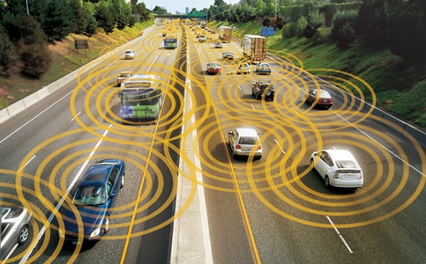
THE FAR FUTURE
Google seeks to reshape the “owner-operator” model of automobiles
Fewer cars on the road
In line with Uber’s business model
[6][7]
Notes:
Google looks to reshape how we think about automobiles fundamentally. Instead of everyone having their own car that’s parked for most of the day, there will be fewer cars that are always running in public transit. But to get Americans away from their deep-rooted culture of car ownership and freedom would take some real work.

Slide 9
Machine Learning Algorithms
The Core of Self-Driving
Notes:
So how’s all that possible? How can cars get to be that smart? What kind of systems need to be in place?
The answer, in a phrase, is Machine Learning.

Slide 10
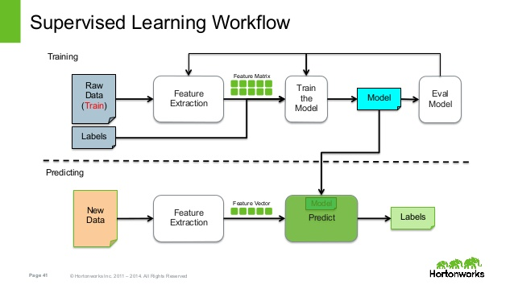
MACHINE LEARNING ALGORITHMS
[13]
Notes:
Machine learning algorithms are used to allow an autonomous vehicle to learn about its environment and what actions to choose. An autonomous car learns by taking in new information. From its sensors, information is transferred into a model for determining an action, and then the action is made. The models are constantly evaluated and updated as more information is gathered, in order to help the car adapt to newer decisions that were not previously considered.
There are two types of machine learning: supervised and unsupervised. In supervised machine learning, we give the model data that includes the desired output (labels) and it starts to perform feature extraction and pattern recognition.
This is our training, done on a subset of the data. We then take a different set of data and apply our model to that. We see how often the model predicts the correct output and, if it’s not enough, we do this all over again with different subsets of data until the program learns the patterns better.
As such, supervised learning is ideal for the self-driving car; we can teach cars how to identify other cars, humans, as well as situations.
However, learning adaptive behavior and being able to actually make real decisions presents us with one more problem, perhaps the preeminent problem associated with the technology

Slide 11
MACHINE LEARNING ALGORITHMS
Researchers are looking into ways to make cars smarter
Color
Sounds
Lights
Inter-car knowledge exchange
[12]
Notes:
Autonomous vehicles will not be perfect right away. There is only so much a programmer can plan for in advance. For the most part, the cars will have to learn on their own. However, researchers are looking for ways to make cars smarter. A few examples include teaching them to recognize colors (signs), sounds, and lights (traffic lights). Allowing cars to share knowledge with each other would also help them learn much faster than learning completely on their own.
A real interesting thing about the advancement of this tech is that we have to make cars that are compatible with our antiquated infrastructure. For example, we have to make cars that can respond to traffic signals, when it would be much more efficient to just beam signal data to the car. As such, we get these interesting kind of roundabout solutions as we begin introducing this kind of technology to the real world.

Slide 12
Potential Problems with Autonomous Vehicles
Not everyone thinks they are great
Notes:
Okay, so what if we’re right, and these milestones do come to pass? Will it all be positive? What kind of fallout should we prepare for?

Slide 13
PROBLEMS WITH AUTONOMOUS DRIVING
Data collection
  Behavior of car
  Behavior of passengers
  Can record destinations and history
Security threats
  GPS spoofing or jamming
  Alter behavior of car
  Camera blinding
[8],[9]
Notes:
One possible issue is privacy, since these autonomous cars can be programmed to record not only the behavior of the environment around it, but also the behavior of the passengers inside. The destinations and travel histories can also be recorded. Without regulation, passengers would have no means of controlling the information that gets communicated about themselves by the autonomous cars.
With the reliance for safe driving shifting from a human driver to a self-driving car, there are some possible security threats. GPS spoofing or jamming may not work as well on a human that is somewhat familiar with the correct routes, but for an autonomous vehicle that relies on the GPS, this could lead to terrible consequences. There is also the issue of altering the car’s behavior to, for example, drive into a wall. Finally, there is camera blinding, which will affect the sensors and impair judgement.
Many of these problems tie back to the core problems we hear about time and time again with the Internet of Things

Slide 14
PROBLEMS WITH AUTONOMOUS DRIVING
Job Security
  Over 233,000 taxi drivers
  Over 660,000 bus drivers
  Technological unemployment?
Google wants fewer cars
  Manufacturing Jobs at risk
[14],[15],[6]
Notes:
In addition to physical and cybersecurity risks, self-driving cars also present a risk of driving some of the nearly one public and personal drivers out of work through automation. Currently, these professions are on about a 6^% rise, which is considered extremely average. However, self-driving cars are still in their infancy. Once they take off, we may see those numbers quickly turn around.
As we mentioned earlier, Uber is in the process of introducing self-driving cars to their fleets, so it seems that they would be in favor of automating this profession. As is the argument in favor of all technological unemployment, automating the job means you no longer need to pay wages or provide benefits, allowing that money to be invested elsewhere.
Of course, we’re still legally a long way from truly independent cars. In almost all cases today, a “driver” is still required to be in the car, so as to act in case of an emergency. It is not impossible to suppose that displaced workers might find new work in these roles during the interim period

Slide 15
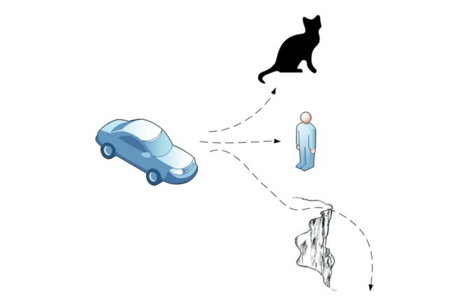
PROBLEMS WITH AUTONOMOUS DRIVING
Moral Dilemmas
  Who or what to hit
  Predetermined choice of programmer
  Moral Machine
[10],[11]
Notes:
There was a case with the Google Car where the car got into an accident. What happened was that there was an obstacle in its lane, and to avoid the obstacle, the car decided on a maneuver, which was approved by the test driver. However, the car miscalculated the bus’ behavior, resulting in a crash.
There will be cases where an autonomous car will have to make decisions of who or what to hit in case of an unavoidable situation. In this picture, the car has to choose between hitting a cat, a person, or driving off a cliff. However, there could be other situations, like having to make a choice between hitting one person or a different person or crashing. In general, the choices are predetermined by the programmer.
MIT very recently (October 2nd) put out a website called the Moral Machine, which asks users what they would do in increasingly less clear cut scenarios. The results reveal some interesting prejudices, which is a whole separate can of worms. As it turns out, it’s really hard for people to make these kinds of decisions too, so how can we expect machines that we made to know better than us?

Slide 16
Thank you!
Any Questions?

Slide 17
REFERENCES
[1] Mark Harris, “Passengers in Uber's self-driving cars waived right to sue for injury or death” from The Guardian, published Sept 26th 2016, accessed Sept 27th 2016 from https://www.theguardian.com/technology/2016/sep/26/uber-self-driving-passengers-pittsburgh-injury-death-waiver
[2] Image: http://www.businessinsider.com/report-10-million-self-driving-cars-will-be-on-the-road-by-2020-2015-5-6, accessed Sept 28th, 2016
[3] http://www.huffingtonpost.ca/2011/08/23/car-population_n_934291.html
[4] https://static.googleusercontent.com/media/www.google.com/en//selfdrivingcar/files/reports/report-0816.pdf
[5] Reuters, “Self-driving car design needs to involve regulators more, US government argues” from The Guardian, published Sept 20th 2016, accessed Sept 27th 2016 from https://www.theguardian.com/technology/2016/sep/20/us-government-regulators-self-driving-car-proposal
[6] Martin Ford, “The Rise of Automated Cars Will Kill Thousands of Jobs Beyond Driving” from Gizmodo, published May 17th 2015, accessed Sept 27th 2016 from http://gizmodo.com/the-rise-of-automated-cars-will-thousands-of-jobs-and-n-1702689348
[7] Jim Motavalli, “The Next Frontier for Self-Driving: Car-to-Car Communications” from Automotive IT News, published Mar 2nd 2015, accessed Sept 28th 2016 from http://www.automotiveitnews.org/articles/611059/the-next-frontier-for-self-driving-car-to-car-comm/
[8] Iqbal, Muhammad U., and Samsung Lim. "Privacy Implications of Automated GPS Tracking and Profiling." IEEE Technology and Society Magazine, vol. 29, no. 2, 2010., pp. 39-46, http://ieeexplore.ieee.org/stamp/stamp.jsp?tp=&arnumber=5475093&isnumber=5475068
[9] Petit, Jonathan, and Steven E. Shladover. "Potential Cyberattacks on Automated Vehicles." IEEE Transactions on Intelligent Transportation Systems, vol. 16, no. 2, 2015;2014;., pp. 546-556, http://ieeexplore.ieee.org/xpls/icp.jsp?arnumber=6899663#cited-by

Slide 18
REFERENCES
[10] Croy, B. (2016). IMPO's top 5 of the week: Tesla job labor dispute, google's autonomous car accident and more. Industrial Maintenance & Plant Operation, http://search.proquest.com/docview/1771016658?pq-origsite=summon&accountid=29120
[11] Slaw Co-operative. Can a Self-Driving, Autonomous Car really React in an Accident?, ACI Information Group, 2015, http://wpi.aci.info/view/1464f257c855c0c0128/151c518857c00110006
[12] Murray, Charles J. Teaching Autonomous Cars to Learn: Machine Learning Techniques Will Enable Self-Driving Cars to make More Effective use of Sensor Data, vol. 70, UBM Canon LLC, 2015, http://go.galegroup.com/ps/i.do?p=GRGM&u=mlin_c_worpoly&id=GALE%7CA443654030&v=2.1&it=r&sid=summon&userGroup=mlin_c_worpoly&authCount=1
[13] Types of machine learning algorithms. Proft.me. December 24th, 2015. http://en.proft.me/2015/12/24/types-machine-learning-algorithms/
[14] Bureau of Labor Statistics info on Taxi Drivers and Chaffeurs, December 17th 2015, http://www.bls.gov/ooh/transportation-and-material-moving/taxi-drivers-and-chauffeurs.htm
[15] Bureau of Labor Statistics info on Bus Drivers, December 17th 2015, http://www.bls.gov/ooh/transportation-and-material-moving/bus-drivers.htm
[16] Image: https://en.wikipedia.org/wiki/Knight_Rider_(1982_TV_series) Accessed October 3rd, 2016
[17] Image: http://www.thegeektwins.com/2013/11/10-amazing-things-you-didnt-know-about.html#.V_cCs-ArKUk Accessed October 3rd, 2016
[18] Image: http://motorchase.com/en/2016/03/bmw-celebrates-100-years-i-robot-audi-like-concept/ Accessed October 3rd, 2016

