Slide 1
Cybernetic Prosthetics and Augmentation
Joey Perez, Will Spurgeon, Dimitar Vouldjeff, Xia Li

Slide 2
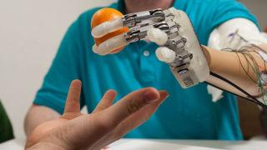
Cybernetic Prosthetics and Augmentation
Prosthetic: Biosensors detect and relay signals from nervous and muscular systems of users
Augmentation: attempts
to overcome the current
limitations of human
bodies
Notes:
Here comes the cybernetic prosthetics first, the cybernetic prosthetic has more powerful function than normal prosthetic to help disabled people to assist in the movement rehabilitation.
In order for a robotic prosthetic limb to work, it must have several components to integrate it into the body's function: Biosensors detect signals from the user's nervous or muscular systems.
It then relays this information to a controller located inside the device, and processes feedback from the limb and actuator and sends it to the controller.
As shown in the picture, this cybernetic prosthetic is the first to give amputees the sense of touch by converting electrical signal to nerves impulses that the sensory nerves can properly interpret.
The cybernetic prosthetics are getting closer and closer to approximating the function of human limbs.
And for cybernetic augmentations, this powerful technology is usually shown in sci-fi movies.
There are wearable armors like powered exoskeleton that be able to provide the user achieve the capabilities way more than the limitations of human bodies. But not like cybernetic parts being implanted into human bodies

Slide 3
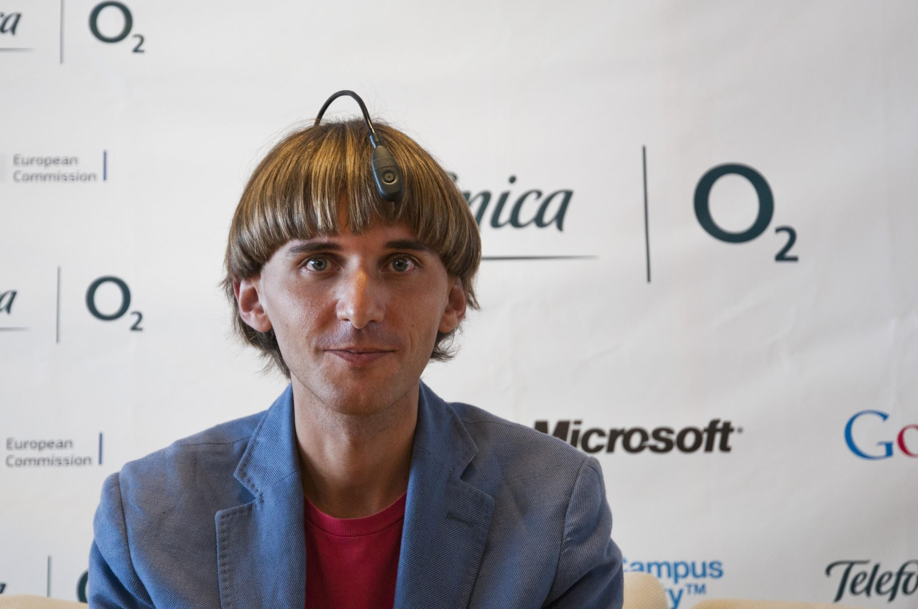
Cyborg
Definition
Neil Harbisson, officially being recognized as a Cyborg by a government
Notes:
And cyborg, according to its definition:
a person whose body contains mechanical or electrical devices and whose abilities are greater than the abilities of normal humans [Merriam Webster]
The term of cyborg was coined by Manfred Clynes and Nathan Kline and was firstly designed for human beings to survive in outer space.
And nowadays, the cyborg is usually used to call disable people with cybernetic prosthetics.
There are individual cyborgs, like Neil Harbisson in the picture who is best known for being the first person in the world
with an antenna implanted in his skull and for being officially recognized as a cyborg by a government.
He was born with extreme colour blindness and has always seen in grayscale.
The antenna allows him to perceive visible and invisible colours so he can listen to colorful objects.

Slide 4
Reliability
A minor glitch might cause real human suffering
Dominant of their own bodies
Notes:
And when we talked about the application of Cyborg, the first problem came into our mind would be the security concerns.
The major difference between a thing that might go wrong and a thing that cannot possibly go wrong is that when a thing that cannot possibly go wrong goes wrong it usually turns out to be impossible to get at or repair.
This is the preface of computer reliability chapter in the textbook.
Since a minor glitch might cause real human suffering, for instance, Imagine if the cybernetic limb stopped working while the user was hiking or crossing the road.
Any tiny mistake may cause an irreparable consequence to the users and their families.
anyway there is also a funny failure case about a person with the cybernetic arm accidently hit a wrong button of his arm and then his arm was out of control during a French TV show.
so Lets make a prediction about cyborg in the future, the security concern may become the major problem that the mechanical part of people will be controlled by hackers, and users will be powerless to take the control of their own bodies, just acting like puppets.

Slide 5
Work and Wealth
Not much effect on job market
Jobs requiring particular cybernetics or enhancements
  policemen
  hazard jobs
Notes:
Since all cybernetics are attached to humans that would hardly influence the number of jobs. At worst people will become more productive and less people will have to be employed
Many jobs might require you to install cybernetic prostheses or enhancements

Slide 6
Privacy and IP
Cybernetics inherently generates data
Third-party doctrine of ownership
Up-selling based on daily activity logs that you can’t opt-out
More widespread copyright issues and/or strict enforcement of EULAs
Notes:
Differences between human activity and cybernetic activity
How is privacy currently defined
Using logs of your limbs to upsell additional devices or show adds
Currently, there are ways to opt-out of ”monitoring”, but when you have a cybernetic limbs you would not have the opportunity to dictate the rules because you need the limb
Intellectual property and stricter EULAs

Slide 7
Government Involvement
Currently FDA regulates medical devices into Cat 1-3
Change future safety and privacy regulations
Easily surveillance and monitor one’s life
Government access to cybernetic limbs
Notes:
Currently, prostheses are defined as medical devices and as such are categoried into Cat 1-3
Medical device is something external so in future law will have to be altered to properly address cybernetic prostheses
Given the earlier mentioned activity logs, the government might ask companies to share those
no privacy even in home --- that 4th amendment guarnatees
What if the government is even able to turn off your limbs in the case of a crime for example

Slide 8
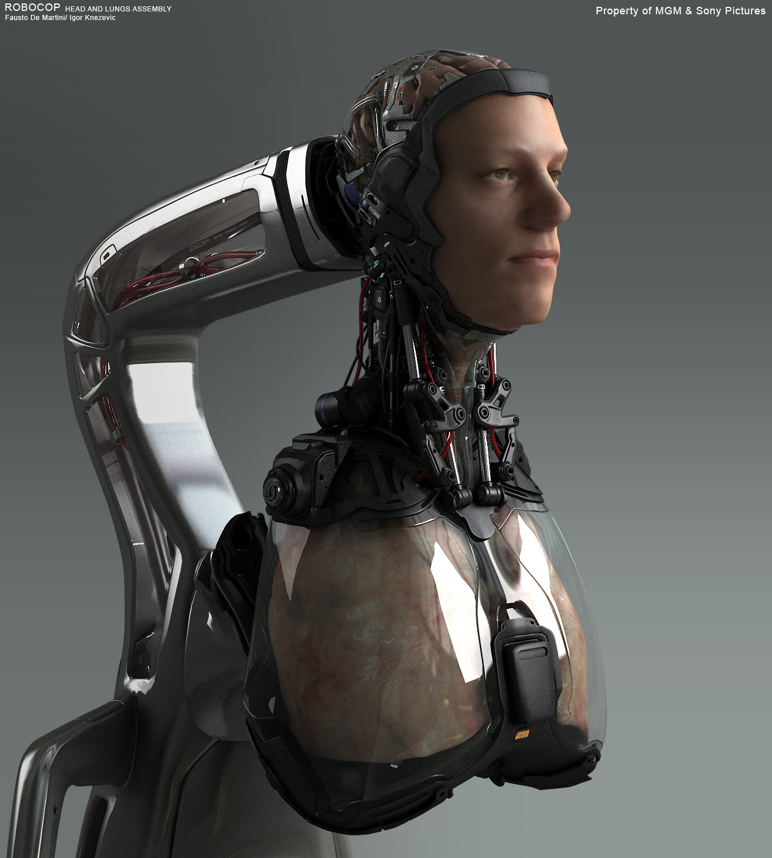
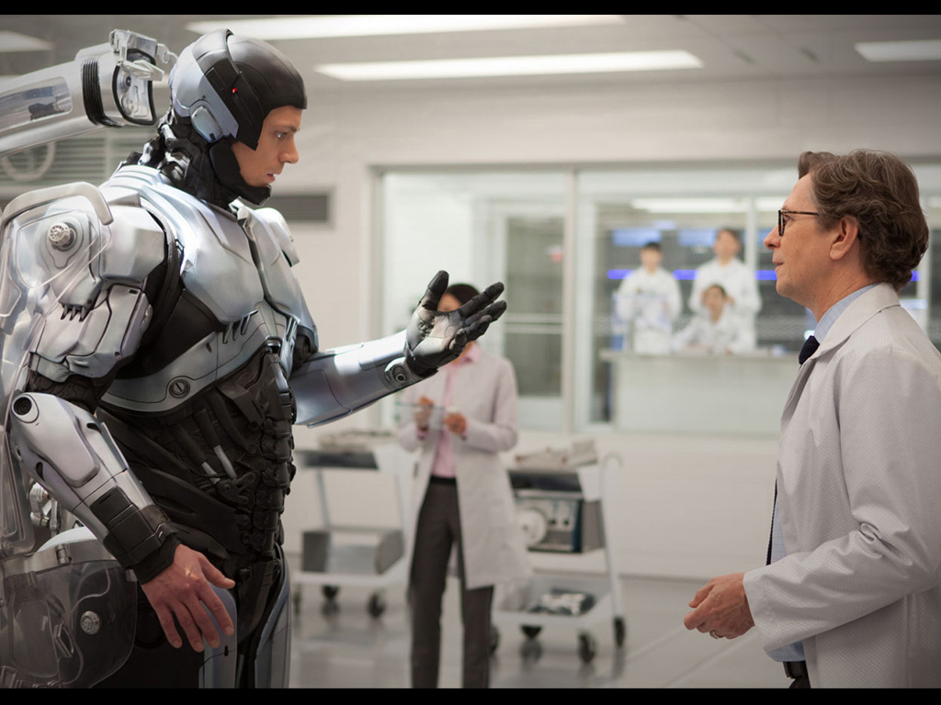
Media: RoboCop [5]
2028 - detroit cop nearly killed by gang bombing
Basically resurrected by having his nervous system and organs, interfaced with robotics technology
Company that created him decides his emotions are dangerous, and they suppress them by regulating his endocrine system
Eventually Murphy overrides the computer part of his body and investigates his own murder
http://i.imgur.com/8acYTea.jpg
http://wallpapers.filmibeat.com/ph-1024x768/2014/02/robocop-2014_139177087030.jpg
Notes:
In this movie, a detroit cop investigates gang activity and the leader of said gang retaliates by attempting to murder him by bombing. After his suspected death Alex Murphy is basically brought back to being by a OmniCorp, a robotics company trying to make advancements in robotic warfare, and also to bring some humanity to their weapons. The only human part of murphy left is his nervous system, and organs attached to a robotic skeleton and computerized implants. OmniCorp decides RoboCop is too unpredictable or controllable, so by way of the computer in his body, they suppress RoboCop’s emotions by reducing his hormones. At this point, the major relevant theme is the struggle between man and machine. While RoboCop is a combination of both, if the machine part can make the human part less human, then which part is really dominant? Further into the film, Murphy is able to overpower the programming and reconstitute his emotions in order to protect his family.

Slide 9
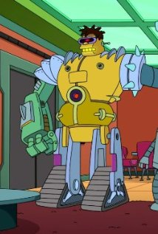

TV Show: Futurama: Six Million Dollar Mon
Epsiode about robotic implants
Keeps getting upgrades to be ‘more efficient’ and stronger
Can’t stop and eventually decides to ‘upgrade to a robot brain’
http://ia.media-imdb.com/images/M/MV5BMjA5MTQ3OTY3MV5BMl5BanBnXkFtZTgwOTk0MDIyMjE@._V1_SY317_CR104,0,214,317_AL_.jpg
http://vignette4.wikia.nocookie.net/es.futurama/images/b/bd/197_hermes-conrad.gif/revision/latest?cb=20100811031842
Notes:
Obviously the situations presented in the episode are very stretched from reality, but it does present an important theme in cybernetic prosthetics and the existence of cyborgs. Mainly this episode focuses on the character Hermes, who after deeming himself ‘too inefficient’ for his own job, fires himself. Later he is accosted by a crazy robot and decides to upgrade himself to get his job back and protect his family. It starts with the implantation of a harpoon into his chest cavity. Again the realism of these implants and the lack of science presented make this a definite work of fiction, but presents the theme of humanity in cybernetic implants. Once he gets a taste of being super human, and superior, he keeps upgrading himself for every little thing, much like that of inspector gadget. Eventually, he is a robot with a human brain, and determines the only thing holding back his full potential is his brain, he determines that he must need a robot brain so steals one from a freshly dead robot. Basically, we see the loss of Hermes’ humanity to materialized upgrades of his body. At what point is he more machine than man? At what point is not a man, but merely a robot? He changes so much that it is hard to define both states of the character as being attached to the same character. Later his brain and organic body are reconstituted and he realizes the errs of his ways.

Slide 10

TV Show: The Outer Limits: Stream[6]
The Data Stream sends information directly to users’ brains
A virus infects the Stream and it causes people’s implants to malfunction and for them to lose control and gather data until an abrupt death
Only the man who could not get the implant due to a head injury can stop it
http://i.ytimg.com/vi/DLnauJhim4A/hqdefault.jpg
Notes:
In the Outer Limits, a future world, with free access to the Data Stream or as it is more commonly known, ‘the stream’ everyone has cranial implants that allow their brains direct access to any of the information the stream has to offer. The main character of the episode was denied an implant as he has a medical complication prohibiting it. One day, a virus infects the system and it begins causing mysterious deaths, by making the user forcibly gather arbitrary data for the Stream. They are helpless and must seek all available data for the Stream. The main character discovers this and seeks to stop it. One of the few people left with the ability to read, he seeks the help of books, and is able to find an old manual in the archives of a library. He uses the book and a woman with an implant to force the system to process a written command that kills the Stream. This story shows the potential for disaster of humanity growing over dependent on a technology to the point of catastrophe upon failure of the computer. This relationship between man and computer is realistic and is perhaps just a step further than our current dependency on technology to make our lives easier. In this sense, some technological upgrades could be a disadvantage to survival in the sudden event of independency.

Slide 11
Common Themes in Media
Loss of control
Greater physical strength
Heightened senses
Notes:
Films and tv shows often focus on the possibility of losing control of one’s cybernetic enhancements. These may be serious concerns in the future, but today there is relatively little risk of this happening to the degree portrayed. Most enhancements are “dumb” in the sense that they cannot execute arbitrary computer code.

Slide 12
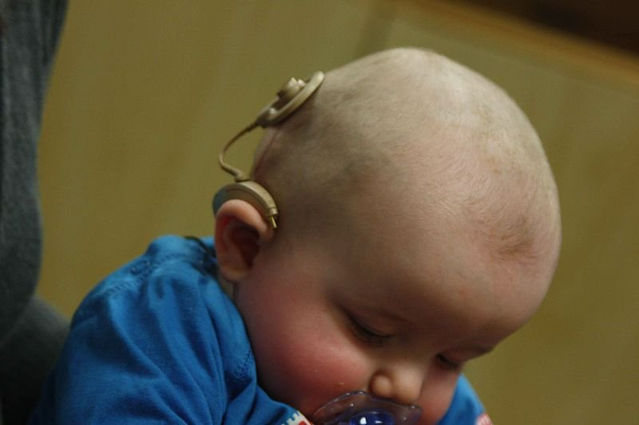
Today
Cochlear implants are relatively common
Other types of implants are currently risky
Robot arm control
72% US population is not interested in an implant that could improve memory
Notes:
The most common form of cybernetic implant is the cochlear implant. Cochlear implants stimulate nerves in the inner ear and can restore some amount of hearing to deaf patients. More than 300,000 people have received cochlear implants. They are effective, but leave much room for improvment. Other types of implants have been developed to improve sight, but are much less common. Drilling into the skull and placing implants is generally very risky, making it difficult to test new methods. However, many promising steps have been made. A paralyzed woman was able to control a robot arm using a sensor in her brain. The system was cumbersome, but successful. Ultimately, a better understanding of the brain is needed to create more complex and effective implants. Today, the market for these devices is small. 72% of the US population is not interested in an implant that could improve memory.

Slide 13
The Future
Advanced cybernetics are unlikely to experience mass adoption in the next 10 years
Early adopters should seriously consider the cost and risks associated with current implant technology
Notes:
In order for otherwise healthy people to want cybernetic enhancements, they need to be able to make accomplishing certain tasks easier. The benefits must outweigh the potential risks. Today, that is not the case. These opinions may change as the medical procedures become safer, more cost effective, and more beneficial to the user. I do not expect these types of enhancements to find a find a market for non-disabled people in the next ten years. Early adopters will always be willing to try new things, but the rudimentary nature of the technology and the danger involved currently prohibit a large market for these devices from forming.

Slide 14
Questions?

Slide 15
References
The future of artificial limbs, http://theweek.com/articles/448972/future-artificial-limbs
This cybernetic hand is the first to give amputees a sense of touch, http://io9.com/this-cybernetic-hand-is-the-first-to-give-amputees-a-se-1516032204
Cyborg Anxiety: Oscar Pistorius and the boundaries of what it means to be human, http://www.tandfonline.com/doi/full/10.1080/09687590701841232#abstract
Brain Implants Could Give People Perfect Memories And Night Vision http://www.businessinsider.com/brain-implants-will-give-us-superpowers-2014-4#ixzz2zoI6HE5K
Robocop (2014). http://en.wikipedia.org/wiki/RoboCop_%282014_film%29
“Stream of Consciousness” (The Outer Limits). 1997. http://en.wikipedia.org/wiki/Stream_of_Consciousness_(The_Outer_Limits)

