Slide 1
Augmented Reality
Arthur Lockman, Ethan Prihar, Phil Baumann, Robert McKenna

Slide 2
Overview
What is AR?
Practical Uses
Privacy Concerns
Personal Rights
Practical Concerns
Conclusions
From https://xkcd.com/1215/
Notes:
Arthur
The great thing is, the sentence is really just a reminder to the listener to worry about whatever aspects of the technology they're already feeling alarmist about, which in their mind gives you credit for addressing their biggest anxieties.

Slide 3
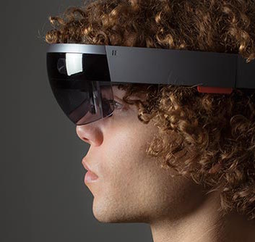
What is Augmented Reality?
Defines a group of technology that adds to or changes our perception of reality
Could be through audio, video, touch, etc.
Notes:
Arthur
What is augmented reality?
Augmented reality defines a collection of technologies that in some way adds to or augments what we see sense and perceive as reality.
This can be done through audio and video, like with the Microsoft HoloLens or google glass, or with physical touch like the taptic engine in the Apple Watch.
Our focus is on fully immersive AR devices like the HoloLens, and not on AR apps or smaller devices like the Nintendo 3DS.

Slide 4
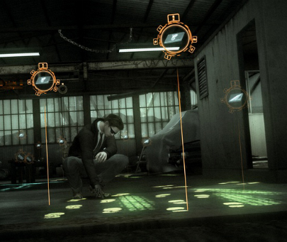
Practical Uses
Personal Use
  More communication
  Less need for memorization
Work
  Increased efficiency
  Increased quality control
Crime
  Document and solve crimes
  Commit crimes more discreetly
Notes:
Ethan
Augmented reality has many practical uses. First an foremost it has the potential to impact how we interact with others and organize our lives. Just like cellphones have become a vital part of our daily lives augmented reality can do the same. 90% of American adults own a cellphone(1), if augmented reality gains popularity then imagine that 90% of all adults in America have the ability to not only communicate verbally or via text, but to instantly appear in front of another person, or allow another person to experience exactly what they are experiencing. Augmented reality could make our society more interconnected than it has every been. Augmented reality could impact how we organize our lives because with augmented reality you can basically add things to a list, change your calendar, or set up a meeting with literally the blink an eye and this technology would be so integrated into our lives that it would be common to never have to remember anything because everything you need to know is instantly accessible and intractable with.
Augmented reality also improves the efficiency and quality of work. For example, you could give a group of construction workers a program that displays where different materials need to be placed in order to construct something and it could be build without needing to consult a chart. The program would tell them the moment that something is out of place so their productivity would increase and the amount of time spend fixing errors would drop dramatically.
There is also a great potential for augmented reality to effect how crimes are committed and how they’re solved. Already in development is a program that allows for detectives to save a crime scene by documenting evidence that they find and recreate the crime scene virtually later so that there is no deterioration of evidence over time(2). This program could be used to simulate crimes and give the detective better insight into what actually happened. The image is a screen cap from a popular videogame, “Heavy Rain” in which a detective has augmented reality glasses that allow him to highlight and examine evidence after a crime scene has been tampered with. The potential also exists for criminals to use augmented reality to quickly record people as they enter their pin numbers or recite banking information over the phone. The potential even exists to create programs that are put onto other people’s augmented reality devices that cause them to unknowingly commit crimes by creating a fake world around them.
"Mobile Technology Fact Sheet." Pew Research Centers Internet American Life Project RSS. Pew Research Center, 27 Dec. 2013. Web. 23 Apr. 2015.
Lee, Kevin. "Coming Soon: Augmented Reality Goggles for Crime Scene Investigations." TechHive. N.p., 1 Feb. 2012. Web. 23 Apr. 2015.

Slide 5
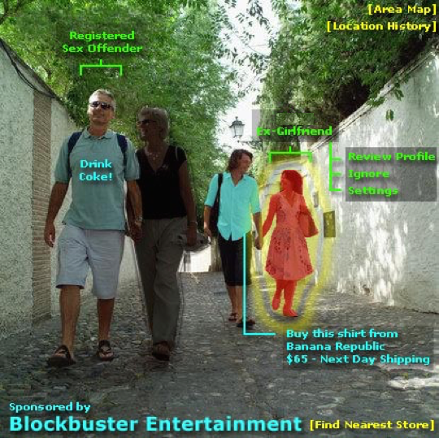
Privacy Concerns
    Computer Security
  New viruses
  New hacking techniques
    Government Surveillance
  Easy access to all aspects of life
    Personal Privacy
  Ability to record everything
  Access to personal information
Image from http://www.scoutnetworkblog.com/2009/07/8297/twittering-in-augmented-reality-bkk/
Notes:
Phil
Security
AR devices can collect data via machine noise and network monitoring
Surveillance
Government can use AR devices to spy on what people do, see, and say
Easy surveillance of environment
Privacy
Someone with an AR device can record videos and take pictures any time
Possibility to upload to internet means everything is public
Can see all personal information on people without effort –
could lead to companies like google using this information for marketing to you in your field of view.

Slide 6
Freedom of Speech
With the Integration of AR in society, freedom of speech could be limited.
  The NSA has been known to track individual’s social habits on Facebook.[2]
  Integration of AR opens a new means in which a government can monitor speech.
  If this were to become a norm, individuals may have to censor themselves for fear of who may be watching.
Notes:
Rob
Integration of social media, or messaging services onto AR devices may present another way for governments to track the speech of individuals. The new aspect that AR brings to the table is that it adds visual context to everything that they might already be recording. Right now they may have audio and text communication data, but no way to attach that to what the user is actually seeing. AR devices with cameras would bridge that gap in surveilance.
Similar to cellphone uses, governments can use data mining and processing techniques on large amounts of text exchanges, shared websites, and other data to detect patterns in users daily life.
A daily use AR can replace cell phones in this sense a provide a more centralized means of sharing data.
As this is already a documented occurrence, AR, as the technology is today may not worsen the situation, but it provides the same means for governments to limit freedom of speech.

Slide 7
Personal Rights
AR integration may also help protect personal rights
  Contextual data may become a popular new form of sharing experiences.
  Real Time data sharing would increase between users.
  Using Location tracking technology, Real time, contextual data and news can allow for a new level of information sharing.
Notes:
Rob
Contextual Data
Contextual data refers to the possibility of users sharing data based on a possible location, or action.
For instance, a user that walks into a restaurant may be presented with reviews of that restaurant on their heads up display. This is an example of the increased sharing of data and freedom of speech that AR allows.
Reat Time Data Sharing
Through the use of a heads up display data about a given location based on what is happening “now” can be shared with multiple users.
This can include protests, demonstrations, parties, etc.
Events can be managed in real time, without requiring the user to be constantly pulling their phone from the pockets to receive updates, as they would be notified immediately on the HUD.

Slide 8
Professional Ethics
Employee Privacy
  Companies have been known to monitor data on equipment used by Employees[ 3].
  This includes email, word documents, and cellular exchanges.
  Company owned AR may allow companies to view what the user is viewing.
Notes:
Rob
It is a documented fact that companies spy on employees through monitoring of the equipment they own.
AR in this regard could allow companies to visually monitor what the employee is doing based on the tech of the AR device.
It also allows possible monitoring of location, messaging etc.
This is an issue regarding professional ethics, and as it stands there are few regulations in regards to this sort of spying.
It is important that a line be drawn, so that companies follow a strict code of professional ethics when monitoring there employee’s through the use of advanced AR devices.

Slide 9
Practical Concerns
Software Reliability
  AR headsets run software that could show incorrect objects in a user’s view
  Would require extremely vigorous testing
Intellectual Property
  AR headsets usually have cameras
  Companies may be uncomfortable with employees wearing headsets around sensitive projects [1]
Notes:
Arthur
A number of concerns arise when using AR in real life. The biggest of these is a concern about software reliability.
If AR becomes sufficiently advanced in the next few decades, it’s possible that we might come to a point where it’s nearly impossible to tell what’s present in the AR world and what’s actually there.
To see the problem with this, take the concept of virtual road signs. It would save the government quite a bit of money if road signs could be virtual and updated with information with just a software update.
What would happen if a headset showed a road sign that wasn’t actually there? Or potentially neglected to display an important alert, and led to a fatality due to a stop sign not showing at an intersection?
These headsets would require an extreme amount of testing to make sure that something like this is extremely unlikely to happen. Even then, there is still a risk since no software can be 100% tested.
It also raises a number of intellectual property concerns.
Most of these headsets have cameras on them. The cameras could be “always on”, like with Google Glass, meaning that they might be capturing video and images always while the headset is turned on.
This raises an important concern – if a user has a camera strapped to their head at all times, what’s to stop them from taking and transmitting pictures of classified designs or projects?
What if a person walks into a movie theater wearing a headset and records a movie? What’s to stop this from happening?
Many companies and businesses will most likely ban people from using these devices on the premises to stop their intellectual property from being stolen.
This already happened with Google Glass being banned from most movie theaters.

Slide 10
Conclusion
1-5 years
  Low rate of adoption – in development
  Used primarily for entertainment
7 years+
  Large rates of adoption
  Divergent views of reality
  Decreased privacy
  Targeted to replace smartphones/tablets [6]
  Enormous market, $150 billion [6]
Notes:
Arthur
In one to five years, we predict that AR won’t be widely adopted.
Currently there are no devices being mass-produced for consumers. The closest is the Microsoft HoloLens, but it hasn’t been released yet and it is unclear at this point if it will live up to the hype. There are several solutions in development right now, but none commercially released.
If any of these devices are adopted, they will most likely be used only for entertainment.
In 7 or more years, AR will most likely be widely adopted.
The largest problem is that if everyone is wearing one of these devices, then what one person perceives as reality will be different than another person’s.
Most of these devices will have cameras on them, meaning that people have a potential to be monitored more than before. If the devices are networked then there is a possibility that malicious companies / governments could spy on whatever a user is doing.
These devices will most likely replace smartphones and tablets. If they provide a means of having a screen everywhere, then the smartphone will become obsolete. It’s possible that these devices could replace almost all screens eventually.
It is predicted that by 2020, there will be a $150 billion market for these devices. While we don’t agree with the date, the number is probably accurate.

Slide 11
References
[1] Condliffe, Jamie. "Google Glass Is Now Banned From Movie Theaters Across the U.S." Gizmodo. Gizmodo, 30 Oct. 2014. Web. 22 Apr. 2015. <http://gizmodo.com/google-glass-is-now-banned-from-movie-theaters-across-t-1652672187>.
[2] Simpson, David, and Pamela Brown. "NSA Mines Facebook, including Americans' Profiles - CNN.com." CNN. Cable News Network, 30 Sept. 2013. Web. 23 Apr. 2015. <http://www.cnn.com/2013/09/30/us/nsa-social-networks/>.
[3] Derene, Glenn. “Is Your Boss Spying on You? Inside New Workplace Surveillance.” Popular Mechanics. N.p., n.d. Web. 20 Apr. 2015
[4] "Mobile Technology Fact Sheet." Pew Research Centers Internet American Life Project RSS. Pew Research Center, 27 Dec. 2013. Web. 23 Apr. 2015.
[5] Lee, Kevin. "Coming Soon: Augmented Reality Goggles for Crime Scene Investigations." TechHive. N.p., 1 Feb. 2012. Web. 23 Apr. 2015.
[6] Gaudiosi, John. "How Augmented Reality and Virtual Reality Will Generate $150 Billion in Revenue By 2020." How Augmented Reality and Virtual Reality Will Generate 150 Billion in Revenue By2020 Comments. Fortune, 25 Apr. 2015. Web. 26 Apr. 2015. <http://fortune.com/2015/04/25/augmented-reality-virtual-reality/>.

