Slide 1
Assistive Robots
Helping You Help Us Help Ourselves
Peerapat Luxsuwong, Michael Andrews, Robert Alonzo Edwards, Hai Hoang Nguyen
Notes:
Hello, we’re here to discuss several assistive autonomous robots, and their relevant impact on society.

Slide 2
Outline
Introduction
Existing Assistive Robots
Privacy
Crime
Errors, Failures, & Risks
Quality of Life
Conclusions
Notes:
This is a brief outline of what our presentation will entail. We will first introduce a couple of currently existing assistive robots, to build some context on which we will base our conclusions. We will also discuss the roles assistive robots play in our society, and the issues that currently exist, and the issues that will come with their wide spread use.

Slide 3
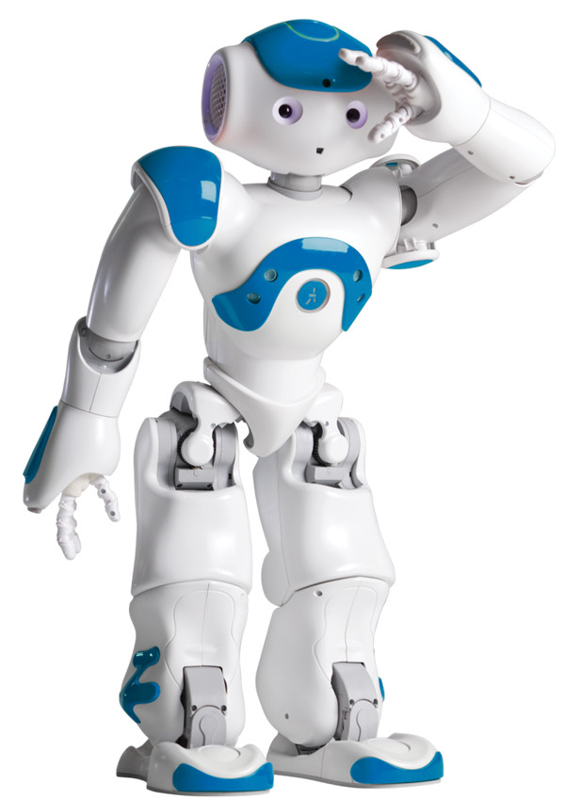
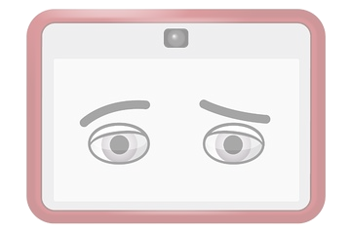
Introduction
What are assistive robots?
What can they do for us?
What have they done?
Where are they heading?
Image: http://s.wsj.net/public/resources/images/BN-CX997_confus_E_20140523184013.jpg
http://www.mathworks.com/cmsimages/77904_wm_nao-robot-matlab-gallery-image1.png
Notes:
Main points:
Assistive robots are machines that help us with something.
They can do our tasks, help us walk, help us talk.
They’ve been used to help children, they’ve been used to do basic things, they’ve been used to help the disabled.
They can help all of us, disabled, elderly, socially awkward, …
They can do our work, making our lives easier. They can save money, get things done, change the economy.

Slide 4
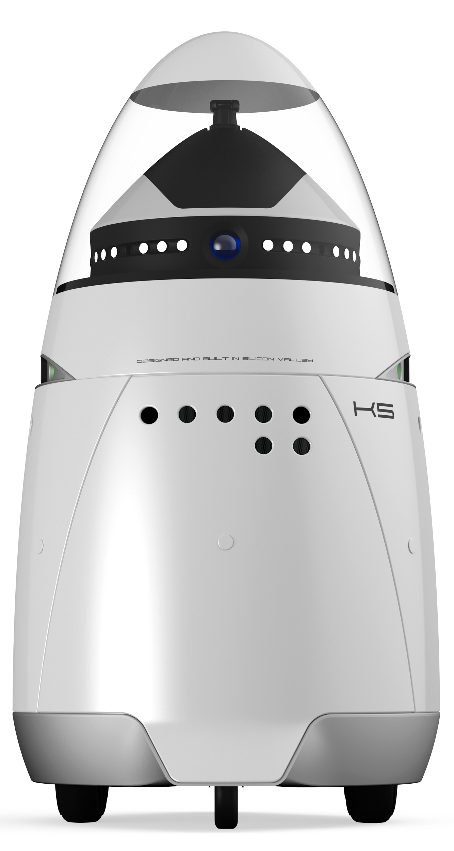
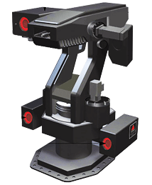
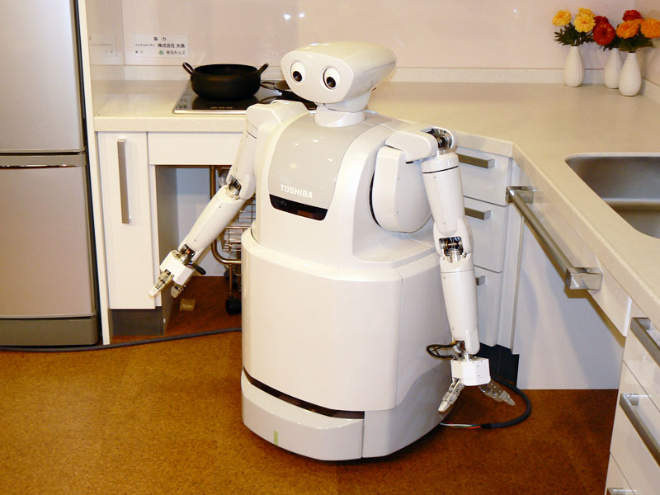
Security & Surveillance
Knightscope^{[10]} (left)
Samsung SGR-A1^{[9]} (right)
ApriAttenda^{[11]} (below)
http://kronpress.ro/wp-content/uploads/2013/12/Knightscope1.jpg
http://regmedia.co.uk/2007/03/14/sgr-a1.gif
http://www.roboticstoday.com/uploads/images/robots/robotpictures-all/ApriAttenda-ver.2_001.jpg
Notes:
Peerapat
Knightscope
Performs surveillance in public spaces. Data it stores allows for license plate and facial recognition, and an understanding of people’s movements.
Can provide real-time information to community and authorities.
Privacy issues may ensue due to facial recognition in public.
Developed since Dec 2013, and recently tested in Nov 2014
Will be adopted by the government, but not anytime soon. There needs to be a demand for it, similar to how increasing reports of police brutality led to body cameras. If test runs lead to success, then they will be more widely adopted, sooner.
Samsung Super aEgis 2
Already adopted by South Korea
Used to guard the South&North Korean border
Locks onto human-sized targets up to 3 km away
ApriAttenda
Can follow people around indoors for assistance/surveillance
Can lift objects/open doors for elderly
Due to young, undefined market for household robots, and the variable nature of household tasks compared to industry, will not be adopted for a long time.

Slide 5
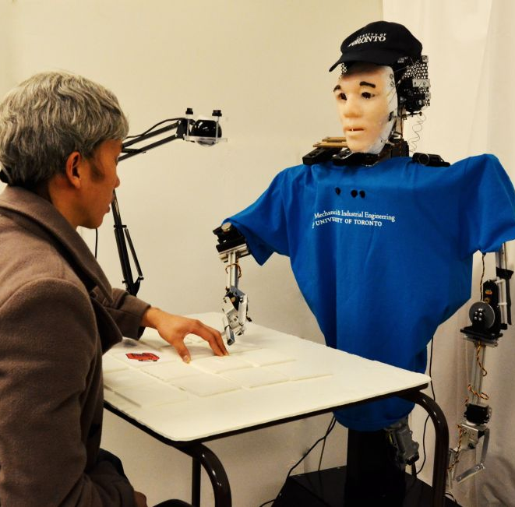
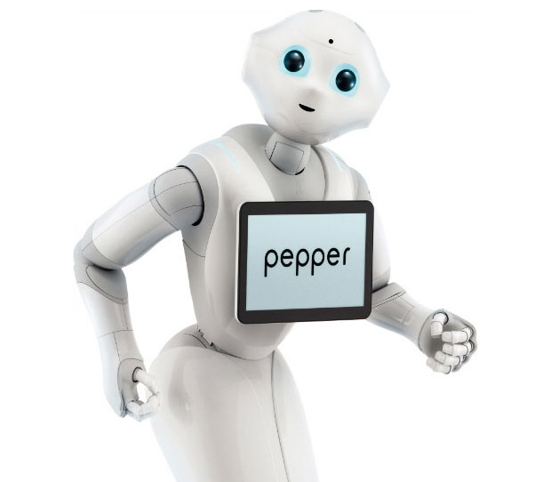
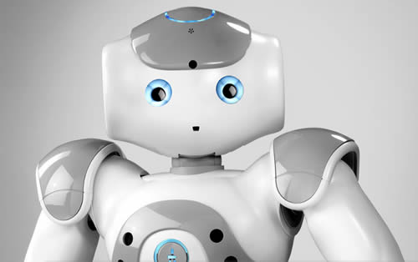
Social Assistance
Understand user social cues
Brian and Casper(L)
  Behavior patterns^{[6]}
  Determine user attentiveness^{[4]}
Aldebaran Robots
  NAO(BR)^{[13]}
  Pepper(TR)
Images: http://asblab.mie.utoronto.ca/sites/clover/files/geoff_bot.jpg
http://technabob.com/blog/wp-content/uploads/2014/06/pepper_robot_2.jpg
http://www.arobotforloganfund.com/wp-content/uploads/2014/08/nao_2g_robot.jpg
Notes:
Robert
Robot Notes:
Casper
Home task assistance, focused on meal preparation for elderly independence
Mobile platform and can navigate to the assisted user
Uses LED array in head to emulate human behavior
Predicts user location in house based off of time of day and recognize users
will call users by name
Brian
Stationary robot
Uses various sensors to read in user position and face
Can determine how “attentive” a user is (focused vs. distracted (short or long-term))
Will attempt to regain user focus on task
Human-like in appearance to best emulate human gestures
Both Casper and Brian were developed at the University of Toronto in the Autonomous Systems and Biomechatronics Lab (ASB Lab). Both of these robots are proposed solutions and are not commercially implemented(still research bots).
Nao Robot:
Education for autistic children (2012, UK school)
Primary school to university
Well received by programmers
Platform for developing applications
Pepper:
Read emotions through expressions and voice tone
Improves quality of life via facilitating relationships
Able to hold conversation (2014, SoftBank Mobile stores)
Designed to improve emotional well-being
NAO and Pepper are both developed by Aldebaran Robotics. there are currently ~ 5000 NAO units in use worldwide, and Pepper is only recently entering a limited release to 300 developers. Both systems run at approximately $8000 to $9000. The NAO is important in that the system has a variety of applications and capabilities due to its design. The key trait among these robots is that they are designed to be approachable, rather than solely utilitarian, in nature. There are also studies that show the effects of a robot within a home, when compared to interactions of just a smart house, measuring response time to requests and user positivity.

Slide 6
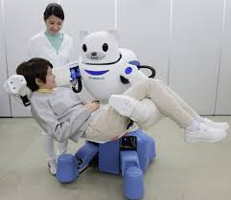
Rehabilitation
Help recover from physical injuries
Assist in daily activities
Robear:
  A bear-like, experimental nursing care robot^{[5]}
  Lift patients out of beds and into wheelchairs^{[5]}
  Assist to stand up^{[5]}
http://www.ibtimes.co.uk/japan-meet-robear-robot-bear-nurse-that-can-lift-patients-into-wheelchairs-1489337
Notes:
Hai
More details about Robear:
Developed by the RIKEN-SRK Collaboration Center for Human-Interactive Robot Research and Sumitomo Riko Company, Japan[5]
A bear-like robot
An experimental nursing-care robot
The institute is hoping that its creation can help people, particularly the elderly, regain some independence, as it gives them the power to move around the house without another person's assistance.

Slide 7
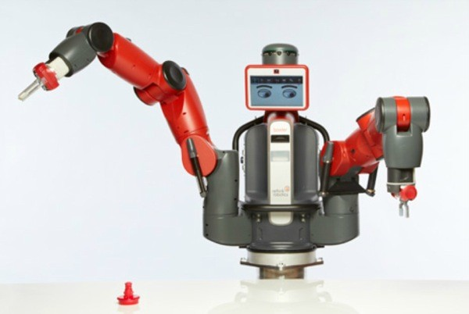
Baxter
Programmer-free learning
Features:
  Attachable tools
  Context aware
  Computer vision
  Human interaction^{[7]}
General applications
  Wheelchair robot^{[8]}
  Industrial worker
Image: https://www.engadget.com/media/2012/09/rethink-robotics-baxter-worker-robot.jpg
Notes:
Increasingly intelligent robots mean increasingly useful robots.
While you can build a robot to do your dishes, it won’t do much else, unless you spend months reprogramming it.
While that’ll save you some time in the long run, you still have to put a huge amount of effort for relatively little gain, outside of a huge industrial setting.
Baxter is an attempt to make a general purpose robot.
This is a robot that can learn new tasks, is context aware, and can even different tools.
It is a combination between computer vision techniques, machine learning, a human-friendly interface, a variety of sensors, a context aware system, and a plug-and-play toolset.
Baxter has already been used in industrial settings, and has even been used as an aid to a quadriplegic.
They’ve attached it to a wheel chair, and it has succeeded in acting as a person’s arms.
This robot is one in what will be a long line of increasingly intelligent robots.
It has massive industrial applications, and with more work, can be a household utility.

Slide 8
Privacy
Information privacy problems:
What can happen if a robot is subverted?
  Spy on people explicitly
  Access personal information
Capabilities of a robot:
  Information to release vs confidential information^{[14]}
  Privileged users vs unprivileged users^{[14]}
Notes:
Hai
Major point : Assistive robots can cause some serious problems about privacy.
While assistive robotics primarily carries benefits, there are significant problems with integrating a robot into your lifestyle. Because it is a computer, the robot can easily be subverted and under another's control. Robots could be used to spy on people explicitly, or may record daily activities and other sensitive information for later use. An intelligent attacker may gain access to this information, which may include troves of blackmail material, social security numbers, passwords, or more. As with all further integration of computers into our daily lives, assistive robotics presents tricky problems for privacy and keeping users safe.
Assistive robotics can also affect user's privacy. If an assistive robotic is not able to distinguish between the information that the user permits to release and confidential information, the robot may create an unitended user's privacy violation. In addition, a robot might lack the ability to distinguish between individuals who have privilege to receive information about user and those information who do not. Hence, it is very important to assure that the capabilities of a robot are specified clearly so that a user has a well inormed information about the robot as much as possible.

Slide 9
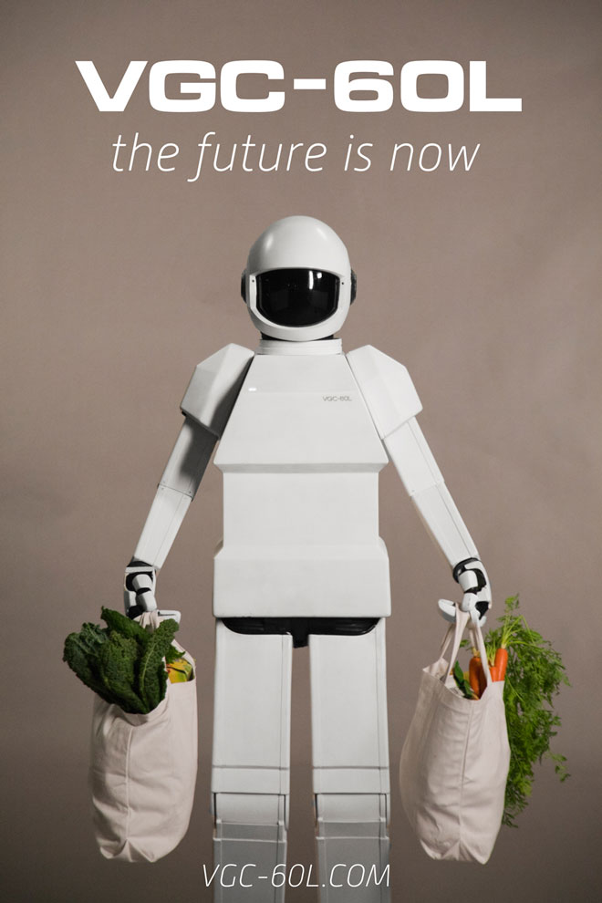
Crime
Physical/Mental impact on user
Media portrayals
  iRobot (Robot to blame?)
  Robot and Frank (Misuse of tech.)
No current potential to cause crime
  maybe 20 - 30 years down^{[15]}
Image: http://www.wired.com/images_blogs/underwire/2012/08/04-groceries.jpg
Notes:
Major points:
Crime is more substantial in its effect on humans. Damage or misuse of these systems will have a potentially negative physical or mental effect on human life. If a physically assistive, for example Casper, could not operate correctly, the user dependent on the robot may not be able to act as efficiently as they could be. As these robots become more sophisticated, the tasks that they perform in lieu of the user will become more sophisticated and as a result more important to their lives as well. What if one fails due to a virus or malicious attack?
-Most socially assistive systems isolated from internet/other sources
-not as susceptible to normal viruses as they are not commodities
We see many movies portray assistive robotics with increasingly human-like intelligence/capabilities. Robot and Frank show how a relatively harmless technology can be used in a harmful manner, such as the movie portrays Frank using his robotic companion assisting him in heists.
In iRobot, Sonny, the leading robot, is framed for the murder of his creator. In this instance, we are treating the technology itself as the suspect, not the creator. This places a much more human frame on the technology, which would make it easier for the user to be distrusting of the robot. A normal robot merely acts, and its actions can be predicted. Equating a robot to a human brings about technical and behavioral uncertainty. This, however, can fall under reliability as well. The movie still gives insight to our concept of crime involving technologies.
However, there are no suitable documented instances of real world attacks on assistive robots, especially socially assistive. This could be apprehension to the concept of (at least physically) assistive robots by society.
(May need to substitute another picture or rearrange slide all together. I think alot of the points covered may fall into errors and risks as well.)

Slide 10
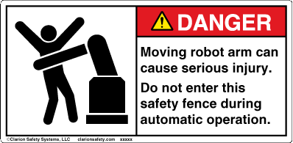
Errors, Failures, & Risks
Causes of Accidents^{[2]}
  Engineering
    Software
    Hardware
  Human
    Design
    Interaction
  Environment
Image: http://www.clarionsafety.com/assets/catalog/parts/5166-U96DHPJ.gif
Notes:
Peerapat
Errors and Failures:
Engineering
Software
Control System
Hardware
Sensors
Power
Communications
Effector
Human (Human Error)
Design
Software bugs
Physical design of robot
Interaction
Improper safety procedure
Improper use of robot (for wrong purpose)
Environment (Random Error)
Introduce redundant safety features to reduce chance of random error/failure
Risks:
Risk is present whenever there is HRI
Physical injury is primary risk
Robots like Romeo won’t be available to public for a while
Research into long-term effects of using robot to supplement mental/psychological/emotional well-being is still being done
Robots like Nao and Pepper already being used
Primary limiting factor is price, not safety
Ties into Conclusion:
The risk to humans that mental/psychological/emotional robots pose is low
The risk that physical assistive robots pose is high
Baxter has safety features, and is cheap, so may be adopted soon in the future
Similar robots to baxter may be adopted in households in ~5-10 years
Errors in sentry guns pose extreme threat, due to long range

Slide 11
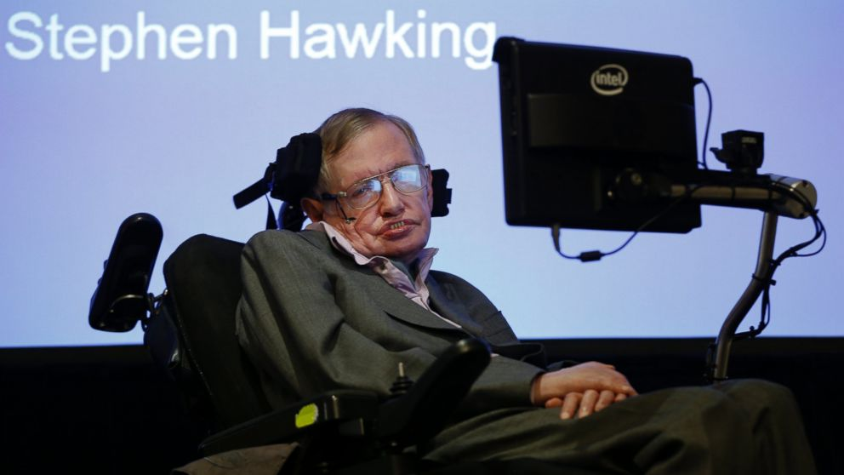
Quality of Life
Significant gains:
  Physically Disabled
  Elderly^{[5]}
Helps with:
  Mobility
  Communication
  Independence^{[7]}
Image: https://abcnews.go.com/images/Technology/ap_stephen_hawking_mt_141202_16x9_992.jpg
Notes:
Mike
Assistive robotics hits its ethical stride in improving the Quality Of Life for the elderly and disabled.
For the elderly:
Helps with tasks that become harder with age.
Helps with basic mobility.
Helps in cases of emergency.
For the disabled:
Gives means to communicate (Stephan Hawking-esk)
Helps with mobility / physical manipulation of objects
Assistive tasks

Slide 12
Conclusions
Assistive robots will be widely adopted in industry in ~1 - 5 years
Assistive robots will be widely adopted by households in ~25 - 30 years
Assistive robots will be widely adopted by the government in ~10 - 15 years
Effect of assistive robotics in the short term (1 year):
  The market for assistive robots is still poorly defined and immature.
    Assistive robots will have little impact in the near future.
Effect of assistive robotics in the mid term (5 years):
  Robotics will have started to grow, but will have a greater impact on industries
    Improvements in industrial robots will drive improvements in socially assistive robots
And the long term (10+ years):
  Socially assistive robots will begin to be more widely adopted, as more applications are created for consumer use
Notes:
Refer to previous examples

Slide 13
References
"Robots." Aldebaran Robotics. Web. 23 Apr. 2015. <https://www.aldebaran.com/en/robots>.
Vasic, Milos, and Aude Billard. "Safety issues in human-robot interactions."Robotics and Automation (ICRA), 2013 IEEE International Conference on. IEEE, 2013.
Greczek, Jillian, et al. "Graded cueing feedback in robot-mediated imitation practice for children with autism spectrum disorders." Robot and Human Interactive Communication, 2014 RO-MAN: The 23rd IEEE International Symposium on. IEEE, 2014.
McColl, Derek, Wing-Yue Geoffrey Louie, and Goldie Nejat. "Brian 2.1: A Socially Assistive Robot for the Elderly and Cognitively Impaired." IEEE Robotics and Automation Magazine (2013): 74-84. IEEE RAS. Web. 27 Apr. 2015.
Stuart Dredge, “Robear: the bear-shaped nursing robot who'll look after you when you get old”, Web Apr 27, 2015, http://www.theguardian.com/technology/2015/feb/27/robear-bear-shaped-nursing-care-robot
Bovbel, Paul, and Goldie Nejat. "Casper: An Assistive Kitchen Robot to Promote Aging in Place." Journal of Medical Devices 8.3 (2014): n. pag. ASME. 21 July 2014. Web. 25 Apr. 2015.
Hal Hodson. “Baxter the robot brings his gentle touch to novel jobs.” New Scientist. 13 Nov. 2014. Web Apr. 2015. <http://www.active8robots.com/blog/baxter-ebola-research/>
James Melik. “Robots: Brave New World moves a step closer.” BBC News. 03 Jan. 2013. Web Apr. 2015. <http://www.bbc.com/news/business-20800118>
Blain, Loz. "South Korea's Autonomous Robot Gun Turrets: Deadly from Kilometers Away." South Korea's Autonomous Robot Gun Turrets: Deadly from Kilometers Away. Gizmag, 7 Dec. 2010. Web. 28 Apr. 2015. <http://www.gizmag.com/korea-dodamm-super-aegis-autonomos-robot-gun-turret/17198/>.
Kee, Edwin. "Knightscope K5 Sentry Robot Undergoes Testing." Ubergizmo. Technologyreview, 13 Nov. 2014. Web. 28 Apr. 2015. <http://www.ubergizmo.com/2014/11/knightscope-k5-sentry-robot-undergoes-testing/>.
R, Mark. "ApriAttenda Robot Assistant." Coolest Gadgets. Dvice, 26 Mar. 2009. Web. 28 Apr. 2015. <http://www.coolest-gadgets.com/20090326/apriattenda-robot-assistant/>.
Secretariat E.Ronchi, Mr Josh Lazar.“The robotics innovation challenge”, Web. 27 Apr, 2015 <http://www.oecd.org/officialdocuments/publicdisplaydocumentpdf/?cote=DSTI/ICCP/IE%282012%296&docLanguage=En>.
Torta, Elena, Johannes Oberzaucher, Franz Werner, Raymond H. Cuijpers, and James F. Juola. "Attitudes Towards Socially Assistive Robots in Intelligent Homes: Results from Laboratory Studies and Field Trials." Journal of Human-Robot Interaction 1.2 (2012): 76-99. HumanRobotInteraction.org. 2012. Web. 26 Apr. 2015.
Feil-seifer, David, and Maja J. Matarić. "Ethical principles for socially assistive robotics." (2011).
Sharkey, Noel, Marc Goodman, and Nick Ros. "The Coming Robot Crime Wave." Computer 43.8 (2010): 116-15. Core.ac.uk. 2010. Web. 27 Apr. 2015.

