Slide 1
White House Down
Dalton Tapply, Daniel Benson, Himanshu Sahay, Ray Wang
April 25th, 2016
Notes:
[BENSON]

Slide 2
Conclusions
The film does not present a realistic approach to national security, technologically or militarily
The film’s portrayal of hacking is not accurate or realistic
Posting evidence of a crime could negatively affect the author of the content
  Turns people away from whistleblowing or vigilantism
Notes:
[BENSON]
We would like to start by quickly introducing our conclusions:
The film does not present a realistic approach to national security, technologically or militarily
The film’s portrayal of hacking is not accurate or realistic
Posting evidence of a crime could negatively affect the author of the content
Turns people away from whistleblowing or vigilantism

Slide 3
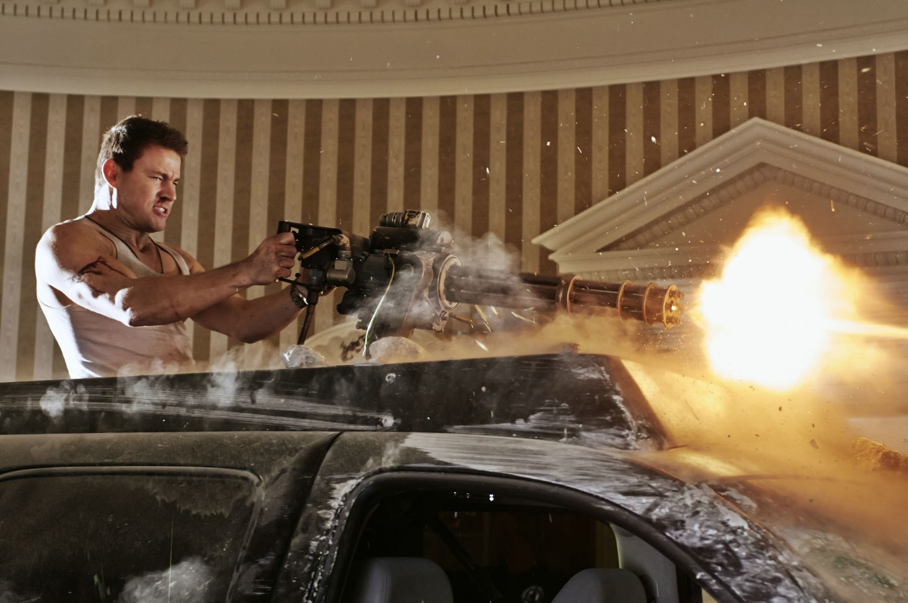
Plot
Mercenaries and hacker break into and take control of the White House
Head of Secret Service Martin Walker is a double agent
Skip Tyler hacks into the NORAD Missile defense system
Walker threatens to take control of the nuclear football and launch attacks at Iran
John Cale takes down the mercenaries from the inside, killing Walker, saving President Sawyer, and stopping the nuclear attacks
[c]
Notes:
[BENSON]
Quick description of the plot for those who haven’t seen it:
The plot of White House down follows John Cale, an army veteran turned US capitol police. He applies for a job with the secret service but is rejected. After his interview he and his daughter, Emily, go on a tour of the White House. During their tour a bomb explodes in the US Capitol building. In the ensuing chaos, a team of mercenaries and a hacker breaking into and take control of the White House. John is separated from Emily, so he begins searching for her. Instead he finds President James Sawyer being confronted by Martin Walker the head of the Secret Service who has revealed himself to be a double agent. He defends him and they hide in the White House. After many fight sequences, Sawyer and Cale are assumed dead. Meanwhile, the hacker Skip Tyler hacks into the NORAD Missile Defense system and uses it to shoot down the Air Force One carrying the Vice President. The Speaker of the House is then sworn in as President. Martin discovers that Sawyer is alive and threatens Emily in order to get Sawyer to surrender and open the nuclear football for him. The Speaker sends him the launch codes on his pager, and he begins the launch against cities in Iran, to take revenge for his son who was killder there. John manages to save them just before the launch happens, killing the mercenaries and stopping the attacks.

Slide 4
Director’s Intent
Director Roland Emmerich wanted to provoke political conversation [7]
The President’s peace plan threatens those who makes money from war
U.S. Foreign policy – communication with other countries in the event of a terrorist attack [7]
U.S. spending on military technology [8][9]
Original Script called out U.S. Budget deficit [7]
Notes:
[RAY]
Roland Emmerich is known for “crowd pleasing” films with huge explosions such as Independence Day, and the Day after Tomorrow. For this movie, he wanted to provoke political conversation much like his other films.
Original Script written by James Vanderbilt, had a scene talking about how the average CEO in the US makes 370 times more than its average worker
Interview with Roland Emmerich, [http://www.denofgeek.com/movies/roland-emmerich/27104/roland-emmerich-white-house-down-independence-day-2-more]
Defense Budget by Country, http://www.globalfirepower.com/defense-spending-budget.asp
CIA World Factbook, https://www.cia.gov/library/publications/the-world-factbook/rankorder/2034rank.html

Slide 5
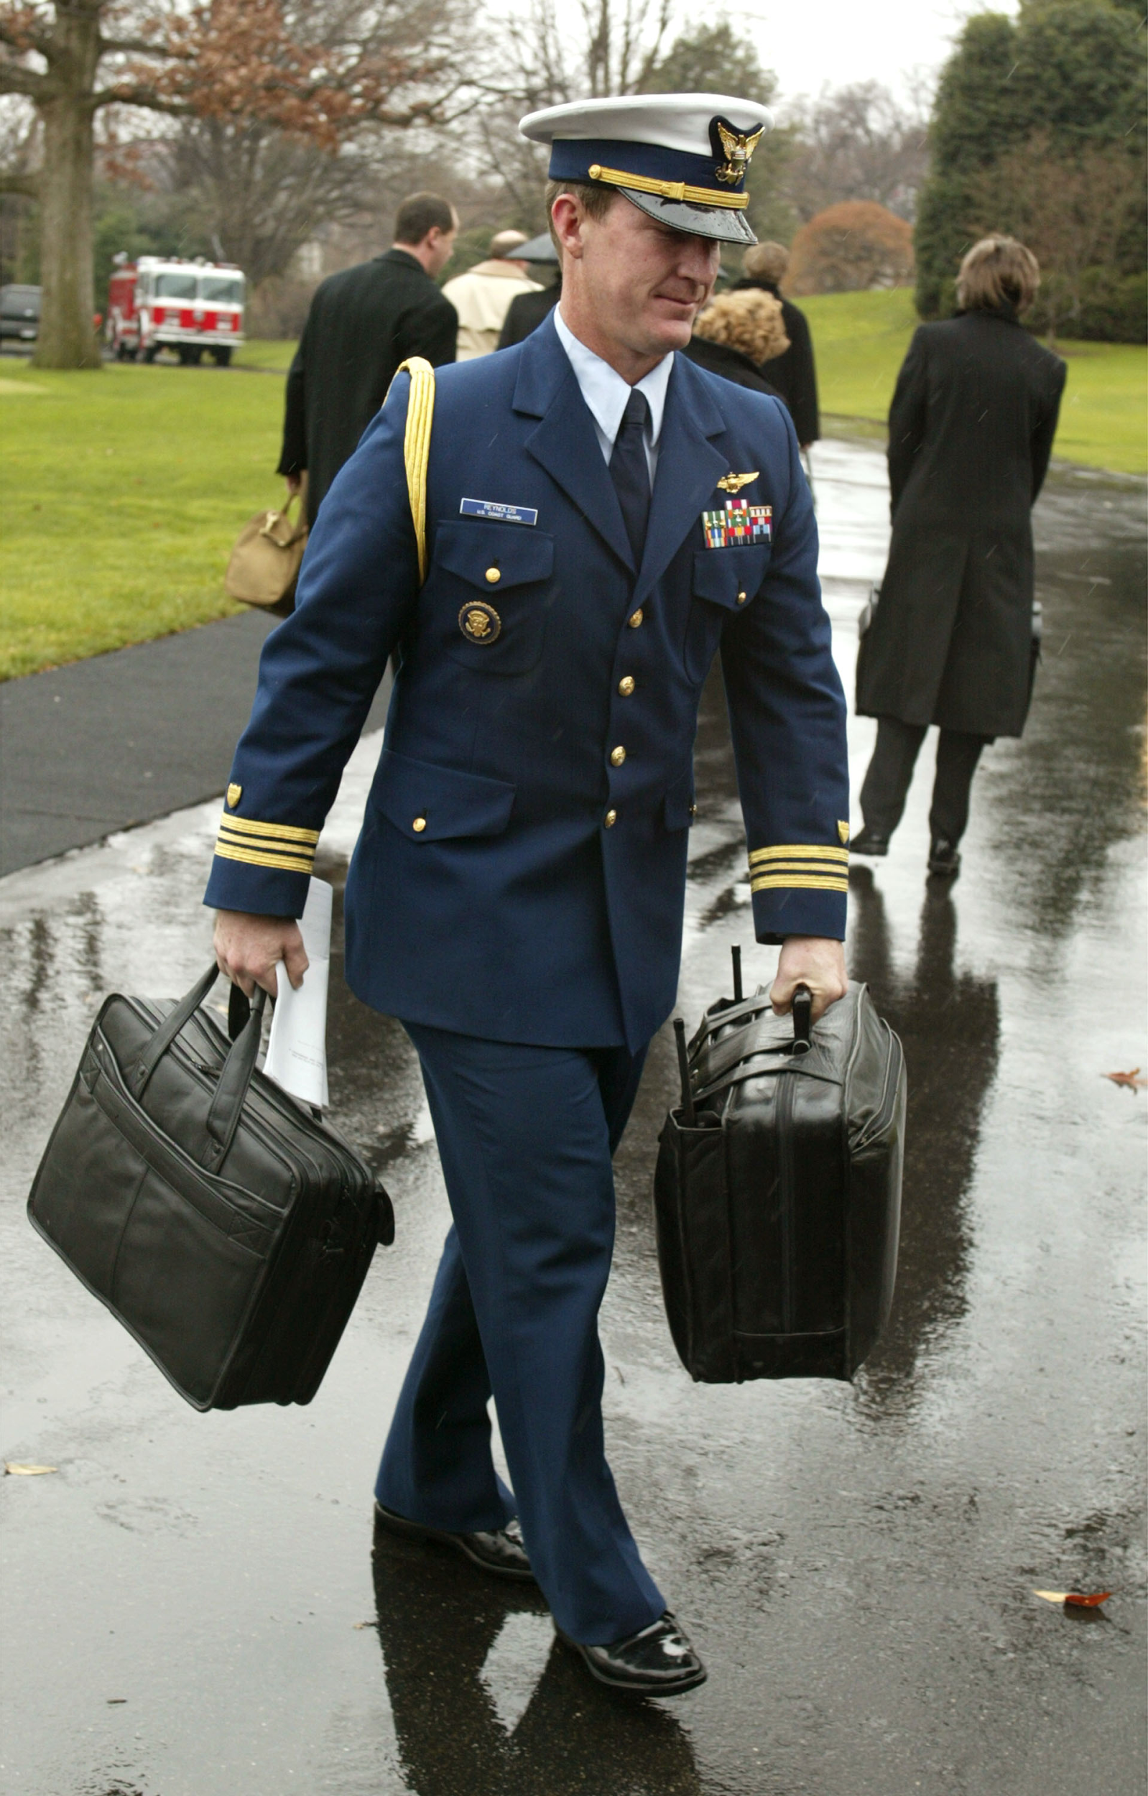
Computing Tech
City surveillance system
Nuclear football
Pager
White House network (connected to NORAD)
[a]
Notes:
[Himanshu]
City surveillance system - real, privacy concerns, always being watched, connected to white house network, so was hacked by Skip Tyler
Nuclear football - not as secure as it should be, older portrayal of it, more secure in real life now, old President’s biometric data still accessed it, shouldn’t have
Pager - did not visibly pose a big threat, was used to page the nuclear codes
White house network - too easily hacked, not so realistic, NORAD hacked through it too, not a safe place
White House control room was a single point of failure

Slide 6
Networked Communications
Satellite phone
  Used to connect to the command structure
Pager
  Used to send nuclear codes
Video conferencing with Vice President on Air Force One
YouTube
  Emily posted the video of the mercenaries to YouTube which immediately went viral
Notes:
[BENSON]
There are a few examples of networked communications being used in this movie, some of which are not accounted for in the security of the White House leading to breakdowns in security.
Satelite phone is used to call from the Executive Residence to the command structure by John and PResident Sawyer and figure out what they need to do
The pager is used by the speaker and Martin to send the launch codes for the nuclear football.
There is also video conferencing done between the speaker and the vice president so it appears that the speaker is not on the side of the mercenaries
YouTube is a form of social media. Emily posts the video of the mercenaries which immediately goes viral

Slide 7
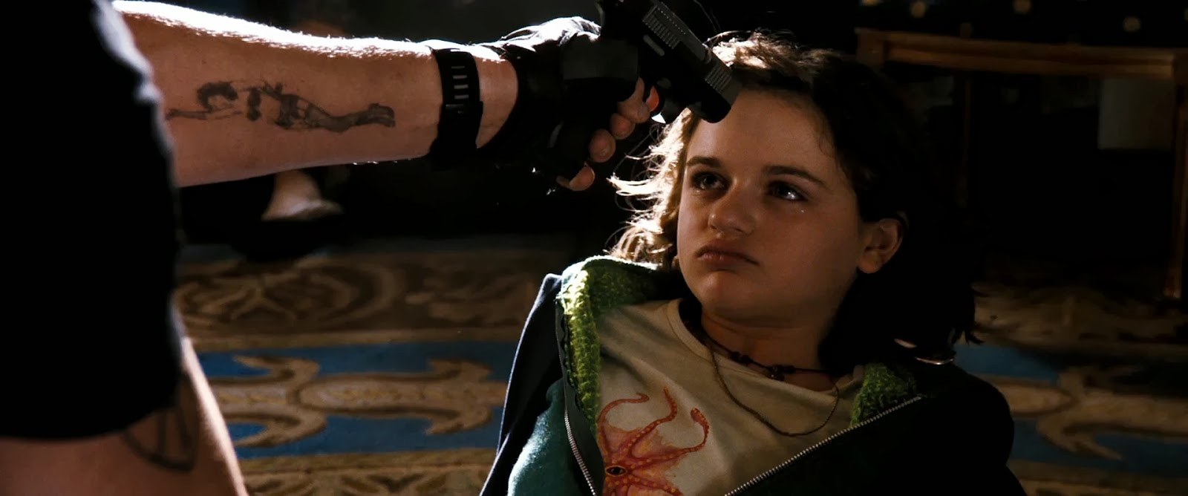
Emily Cale
Youtube savvy
Endangered herself by posting the video on her personal Youtube
[b]
Notes:
[Himanshu]
Has a political blog on Youtube
Even if she evaded the attackers today, they may have accomplices who could come after her
Would she have a bigger audience if she posted it somewhere else and the easiest way to get it out was her personal Youtube. Moreover, she wanted to grow her audience badly and was very politically oriented. Central character in the movie, shows the power of the Internet in spreading information and effectively saving the world.

Slide 8
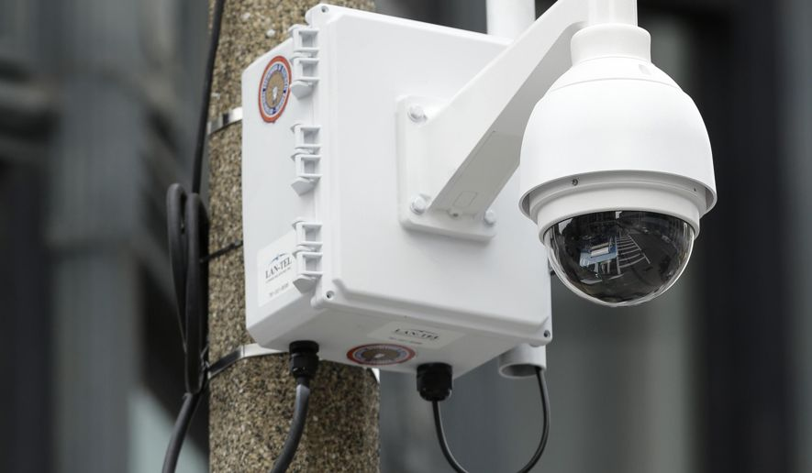
Privacy Concerns
City surveillance system
Facial recognition software
News crew in heli on no-fly zone (security concern too)
Notes:
[Dalton]
Facial Recognition software ran on the video captured by Cale’s daughter.
They were able to identify members of the terrorist group and government leaders being held hostage.
Potential problems with this:
Identified people from footage not legally posted
Problem is there is not much regulation behind Facial Recognition even nowadays. [1]
News Media was broadcasting footage of the terrorist activities while flying a helicopter in an anti-air zone.
Does this breach privacy guidelines? [2]
Was there consent?
No
Public Domain?
Yes?
Public interest?
Yes?
Tough to determine.
City Surveillance
There is good and bad with public surveillance.
Case when it was good: Reduced pollution in South Sioux City [3]
Problem: Innocent people don’t like to be tracked. [4]
Videos can be taken without consent of criminals can be used in the court of law
Image URL: http://www.washingtontimes.com/multimedia/image/ap_cffcf4e8a9955c0e510f6a706700a2e6jpg/

Slide 9
Security Concerns
Single point of failure - White House control room
Vice President sworn in as President without Cabinet approval
Previous president able to activate nuclear football even after new President was sworn in
System to activate nukes portrayed too simple
  Not completely realistic
Nuclear launch codes too simple (10 digit code given to President)
Notes:
[Dalton]
White House control room had access to many things:
City Surveillance Cameras
Able to gain access to NORAD network
White House security measures controlled here
Vice President sworn in without Cabinet majority present.
After new President was sworn in, the previous President’s nuclear activation codes were still active.
There are multiple flaws with the nuclear launch system portrayed.
A previous president can still activate a nuclear football
His code should be deactivated
To activate a nuke, two sources of authorization are supposed to occur (2 keys) [5]

Slide 10
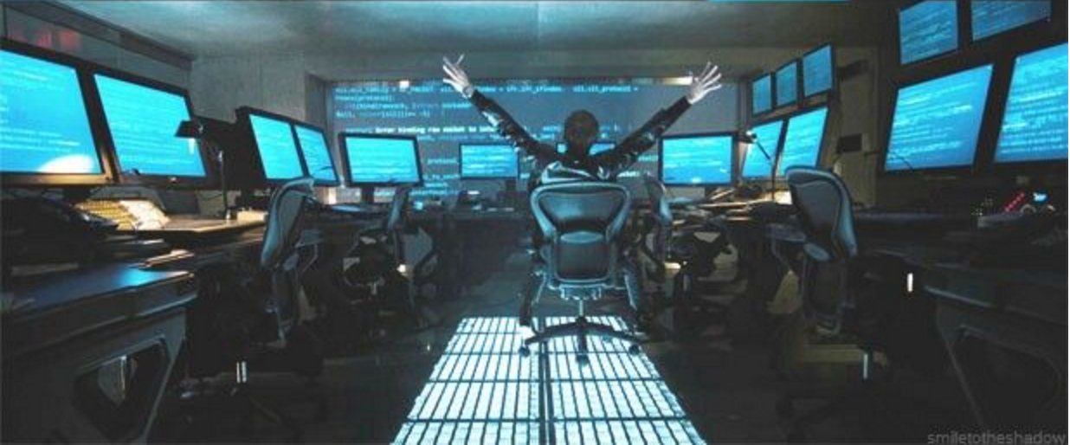
Security: Hacker
Ex-NSA Skip Tyler
Access into White House network too easy
  Just plugged in an ethernet cord
Uses packet injection code to upload into NORAD missile system
  Technique to get into system has some realism
Had access to city surveillance footage
Notes:
[Dalton]
Article Notes:
Author claims the code used in the background is his
Uses comment comparison as proof
Code demonstrates the use of raw sockets for packet injection
Hacker starts off by plugging his laptop into the network via ethernet.
He then proceeds to type “123456789” to initiate an upload.
The code scrolling on the screen is the same code repeated.
The way the movie indicates hacking progress is a little unrealistic.
There is some realism behind it:
Code appearing on screen is for packet injection
The progress bar is indicating current packet injected upload of something that gains him access into NORAD
He is ex-NSA meaning he could have obtained the knowledge to get into the NORAD system via security holes
Faults:
Is the NORAD network reachable from the White House Network?
Information is not publicly available (we don’t know)
Not a lot of information on what he is uploading to gain access
Portrayal of ease of hacking - pressing “123456789” and done, rather than opening a browser, etc.

Slide 11
Errors, Failures and Risks
NORAD was breached
White House network hacked easily by hacker
Single point of failure at White House control room
Facilities worker walked into Capitol building with bomb on his cart
No rescue forces when White House was initially being breached
Security tech in place but unused
Notes:
[Himanshu]
There were several errors, failures and risks portrayed in the movie. They were mostly to aid the fluidity of the plot.
For starters, the NORAD network was breached from within the White House control room, by typing "123456789" on a laptop connected to the network via Ethernet. This is a major failure of the most important missile control system in the country. Similarly, the White House network itself was hacked easily by hacker by connecting an Ethernet cable to his laptop. This is a single point of failure of the network, which is not recommended.
On a non technical level, the facilities worker was able to walk into the Capitol building with bomb on his cart, which is highly implausible. Moreover, no rescue forces were alerted when White House was initially being breached, very blatantly via the front gates.
One can conclude that even though security protocols and technology were in place, they were not appropriately used.

Slide 12
Secret Service
Realistic protocols were not followed [10][11]
The White House has the potential to be turned into a fortress [10]
Top security threats are chemical and bioweapons [10]
Even if realistic protocols were followed:
Several instances where Secret Service formation was breached [12]
  November 2011, individual fired several shots at the White House with semi-auto rifle [12]
  March 2015, armed individual rode in the same elevator as President Obama [12]
Notes:
[RAY]
Discover Magazine conducted an interview with former Assistant Director of Operations in which they questioned the movies portray of the secret service and the actions leading up to the event.
2011 Budget Control Act made budget cuts to the secret service caused the agency to become understaffed in recent years
http://blogs.discovermagazine.com/outthere/2013/06/30/a-secret-service-insiders-take-on-white-house-down/#.Vx6hxjArKhc
http://www.secretservice.gov/about/faqs/
https://oversight.house.gov/wp-content/uploads/2015/12/Oversight-USSS-Report.pdf

Slide 13
Thank you! Questions?

Slide 14
References
[1] https://epic.org/privacy/facerecognition/
[2] http://www.acma.gov.au/webwr/_assets/main/lib100084/privacy_guidelines-dec2011.pdf
[3] http://www.washingtontimes.com/news/2014/aug/10/surveillance-cameras-raise-privacy-concerns/?page=all
[4] http://money.cnn.com/2014/09/16/technology/security/fbi-facial-recognition/
[5] Maj Gen Margaret H. Woodward (April 23, 2013). "AIR FORCE INSTRUCTION 91-104" (PDF-136 KB). p. 2. Retrieved March 16, 2015 – via Federation of American Scientists @ fas.org.
[6] http://hackoftheday.securitytube.net/2013/04/my-code-made-it-to-hollywood-movie.html
[7] Interview with Roland Emmerich, http://www.denofgeek.com/movies/roland-emmerich/27104/roland-emmerich-white-house-down-independence-day-2-more
[8] Defense Budget by Country, http://www.globalfirepower.com/defense-spending-budget.asp

Slide 15
References
[9] CIA World Factbook, https://www.cia.gov/library/publications/the-world-factbook/rankorder/2034rank.html
[10] A Secret Service take on White House Down, http://blogs.discovermagazine.com/outthere/2013/06/30/a-secret-service-insiders-take-on-white-house-down/#.Vx6hxjArKhc
[11] Secret Service FAQ, http://www.secretservice.gov/about/faqs/
[12] United States Secret Service: An Agency in Crisis,, https://oversight.house.gov/wp-content/uploads/2015/12/Oversight-USSS-Report.pdf
Notes:
http://www.secretservice.gov/about/faqs/
https://oversight.house.gov/wp-content/uploads/2015/12/Oversight-USSS-Report.pdf

Slide 16
Picture References
[a] http://pix.avaxnews.com/avaxnews/df/33/000033df.jpeg
[b] http://vignette2.wikia.nocookie.net/white-house-down/images/9/9b/White_House_Down_2013_(4).jpg/revision/latest?cb=20140508204352
[c] http://www.aceshowbiz.com/images/still/white-house-down-image07.jpg
[d] http://www.washingtontimes.com/multimedia/image/ap_cffcf4e8a9955c0e510f6a706700a2e6jpg/

