Slide 1

WALL-E

Slide 2
Table of contents
01
02
03
Plot
Technology
Ethics

Slide 3
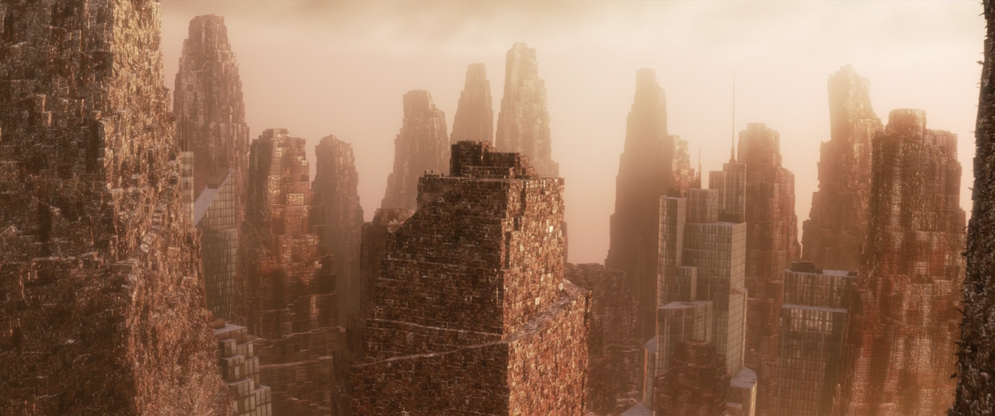
Plot
700 years into the future, after Earth has been destroyed by hyper capitalist actions, 2 Robots, WALL-E and EVE, embark on a journey to bring humanity back to Earth, once plant life has returned.
Notes:
Presented by: Alessandro
WALL-E, (or Waste Allocation Load Lifter Earth-class,) is the last robot left on Earth, meant to clean up the trash left on the planet. The movie starts after 700 years of isolation on the polluted Earth.
The story follows the adventures of a lovable robot named WALL-E, who lives on a deserted, garbage-covered Earth in the distant future. WALL-E spends his days collecting and compacting trash, while also showing signs of having a personality and a fascination with human culture, such as when he dances, or holds his own hands looking lonely. One day, a sleek robot named EVE arrives on Earth on a mission to search for plant life, and WALL-E falls in love with her.
EVE, (or Extra-Terrestrial Vegetation Evaluator,) is a state-of-the-art probe-droid sent back to Earth from the mothership, Axiom, to look for any surviving plant life. Upon spotting EVE, WALL-E immediately falls in love, offering one of his many treasures: a sprout.
As EVE prepares to return to the mothership where humans have been living for centuries, WALL-E follows her and inadvertently becomes involved in a larger mission to restore life on Earth. Along the way, the two robots encounter various obstacles and eventually discover the truth about humanity's fate and their own roles in the planet's future.
EVE takes this sprout back to Axiom, where all the remaining humans on Earth have escaped to after Earth became inhospitable. Following EVE, WALL-E ends up in an unfamiliar place in attempts to chase her down. Unknowingly, WALL-E has escaped from his lonely place on Earth and embarks on an adventure aboard the Axiom.

Slide 4
Technology

Slide 5
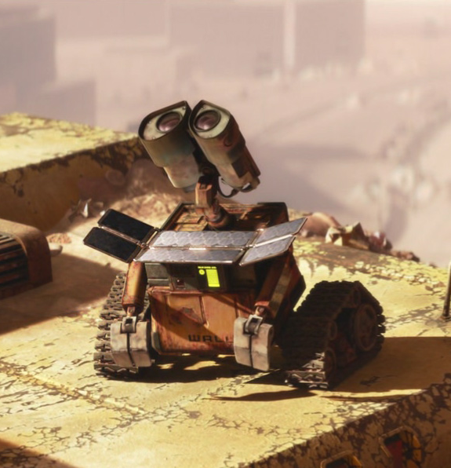
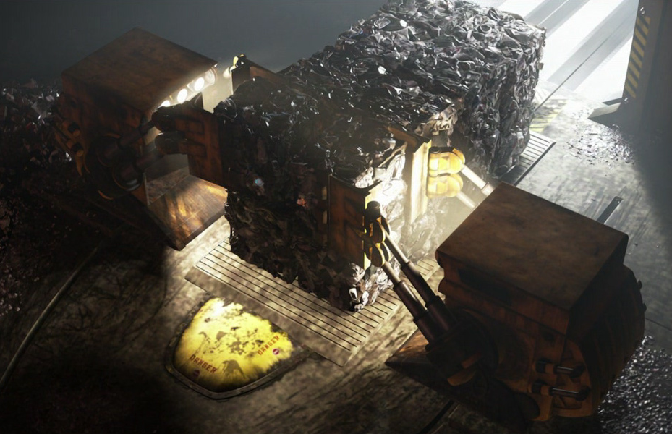
Resource Management
WALL-E & Solar panels
Overconsumption
Notes:
Presented by: Alessandro
Wall-E
Compresses the trash found on earth, is a cleanup robot
Solar panels
The technology found in the movie appears to be mostly solar powered
The panels are very efficient, charging Wall-E from 0-100% in a matter of seconds
Reactor
The axiom is powered by some sort of advanced reactor which allows them to stay self reliant
Overconsumption
Human habits of overconsumption hasn't stopped, and we see that they are still producing tons of trash that is being dumped into space.

Slide 6
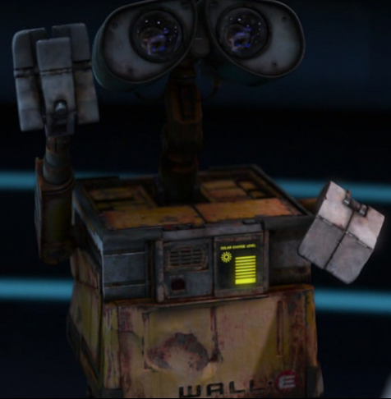

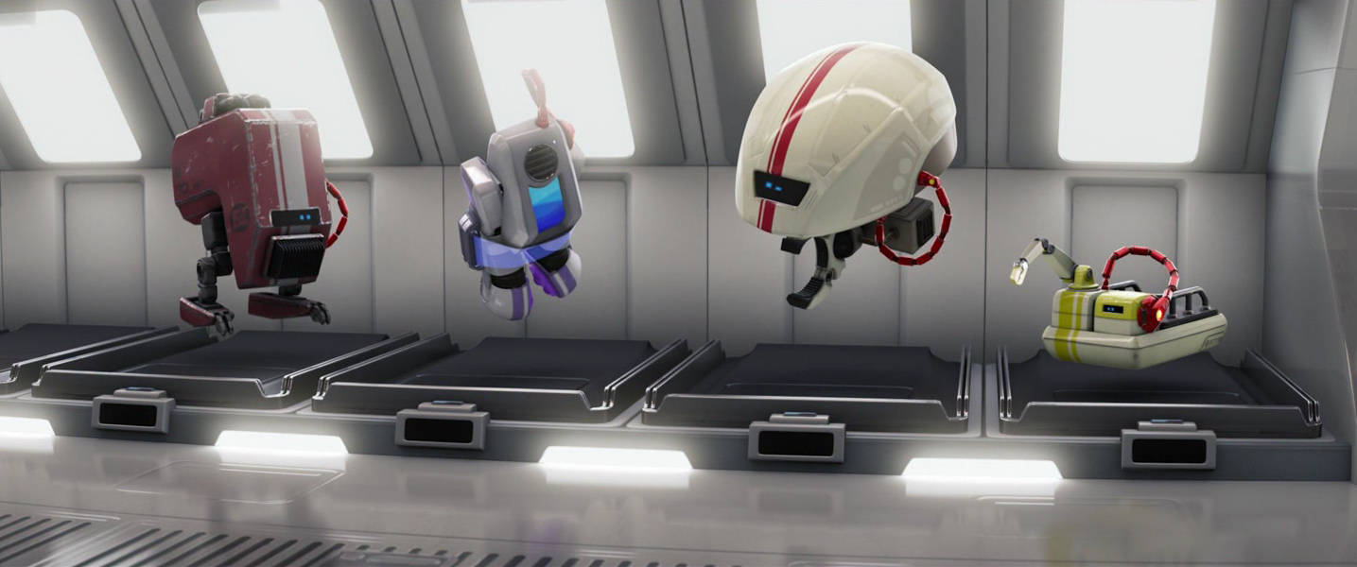
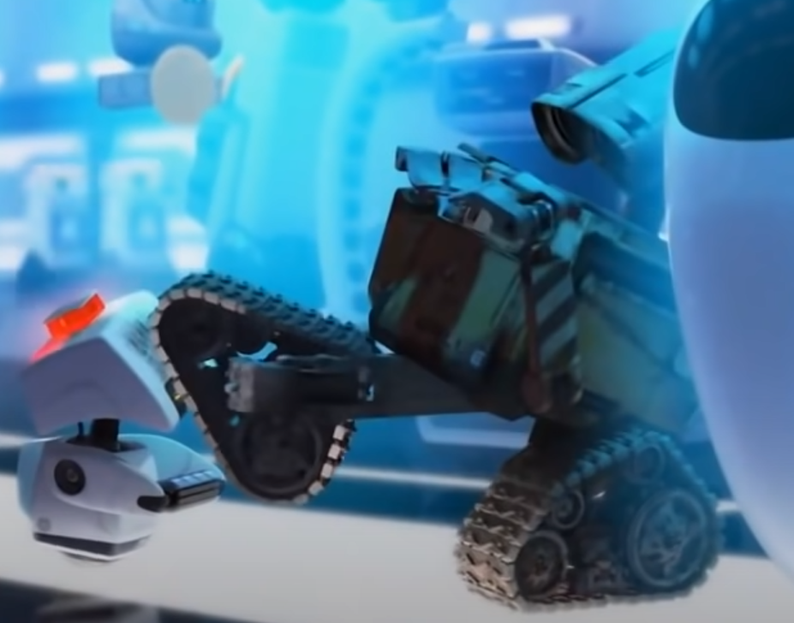
Drones + Robotics
WALL-E
M-O and various other robots
EVE
Notes:
Presented by: Yasin
WALL-E
A cleanup robot with the directive of compressing trash for better waste management
The humans heavily rely on robots of WALL-E's kind to get rid of the trash that is left on Earth, and aboard the Axiom.
EVE
A probe-drone who is designed to scan for plant life in order to return to Earth.
It's worth mentioning that the personalities that EVE and WALL-E have are glitches, as when WALL-E is restarted, his personality disappears until a shock from EVE triggers it at the end of the movie.
Various other robots
Many other robots appear throughout the film, such as MO, a cleanup robot, or Auto, the autopilot system for the ship.
In the picture shown for the robots, they are in the repair ward, seemingly for glitches, including a personality.

Slide 7
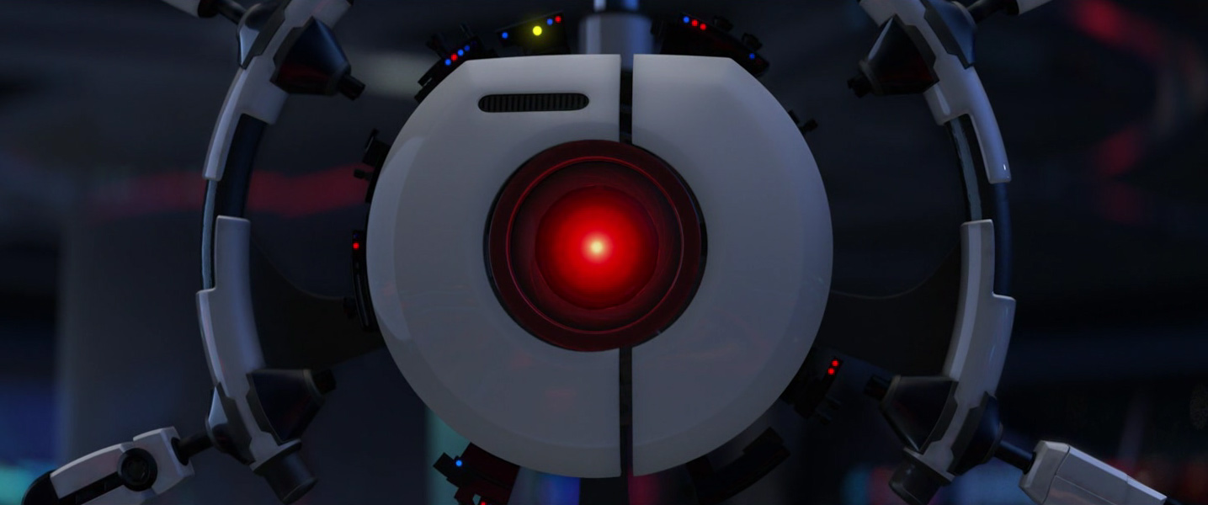
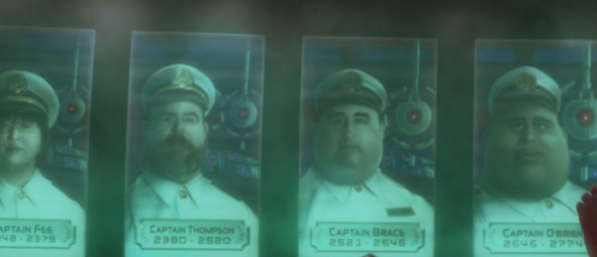
Artificial Intelligence
AUTO -to the audience, starts off as just seemingly the steering wheel on the ship, but eventually seems to be more than just that
Notes:
Presented by: Tanishka
The basic programming for AUTO at the beginning of the movie seems to align with following the directions of the captain, so we can assume he was designed to aid the captain with his visual design being that of a steering wheel and seems to be autopiloting the ship for him as well. He seems to follow his programming very closely, and we see this become extremely problematic towards the end of the movie, where in order to not steer from the instructions given to him from the global leader of Buy N Large, he endangers the ship in desperate attempts to stop the Captain from submitting the plant in order to chart the course for planet earth, all because he was aware of the classified information to not return. The iconic scene where he hits the captain, tries to trash the plant and destroy wall-e, and their fight afterwards where the ship’s tilt causes everyone on board to tilt over almost being crushed by objects, is one of the best examples of how dangerous AUTO became all because of the instructions he followed taking priority over even human safety.
*Additionally, we also see he refuse to share classified information with the Captain, the person that should definitely have access as he is the highest ranked and qualified human on the ship. AUTO’s directive taking precedent above human safety and his strict adherence to his programmed instructions put all of the crew and ship in danger, and raises some questions about how AI and robots should be making decisions..
*The Captain was able to analyze the message sent by the Ceo and realize and decide with the instructions being sent hundreds of year prior, things could have changed. However, AUTO’s instructions and programming don’t allow his to have these decision making skills, and believes in the same thing told to him over 700 years ago. over time the instructions they are given eventually endanger others and can’t change their decisions by analyzing the greater picture. If we want AI to help us, not hinder us, making sure that we create AI that can adapt and have better decision making skills that don’t endanger others is a huge ethical concern.
If we’re talking about auto’s visual design, the wheel is a tool for control.

Slide 8
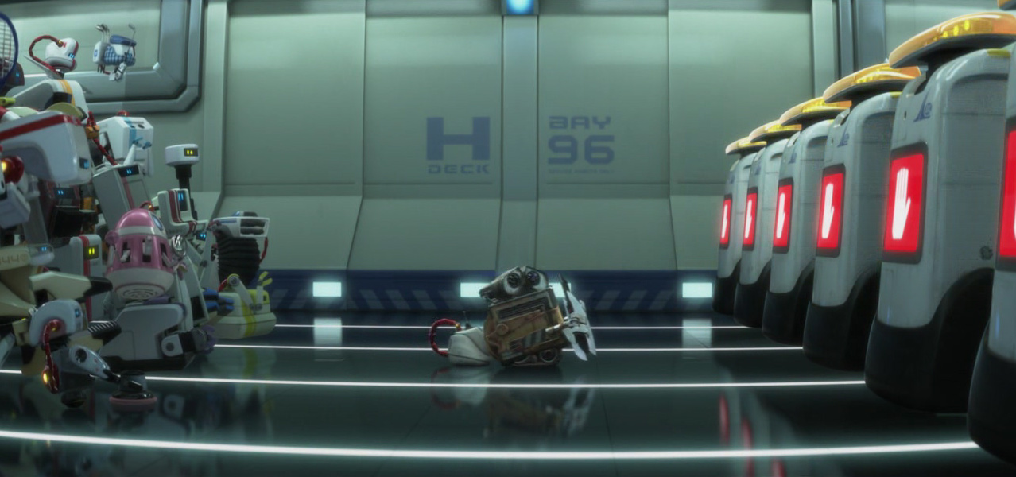
Robot Emotions
Due to a glitch in their programming, WALL-E and EVE have developed emotions, so they are not considered AI.
Onboard the Axiom, all of the main decision making is done by robots throughout the movie
Notes:
Presented by: Nathan
Both of them originally adhere to their directive, with WALL-E compacting trash, and EVE scanning for plant life.
Due to a glitch in their programming, Wall-E and EVE have developed emotions
We can see that a personalities are glitches since they are sent to the repair ward, where most of the robots have developed personalities, cheering for WALL-E when he sets them free.
All of the main decision making is done by robots throughout the movie
For example, EVE's constant decision to bring the plant to the captain, and WALL-E's decision to chase after the plant.
Also worth noting is EVE's decision to prioritize WALL-E over the plant when their bond had deepened.
AI aren't great at doing things outside of very specific areas, letting one AI run a ship might not have been the best idea

Slide 9
Ethics

Slide 10
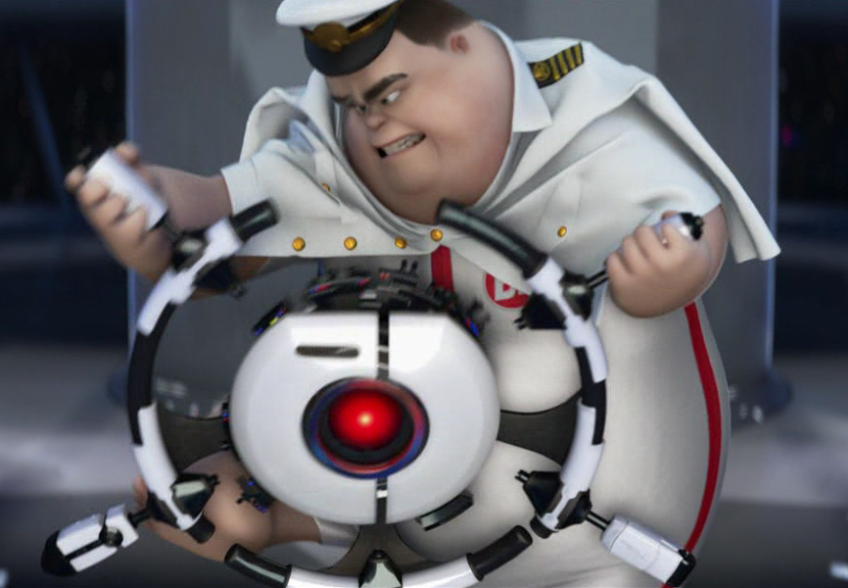
Ethics of AI
Privacy
Sentience
Professional Ethics
Computer Reliability
Notes:
Presented by: Tanishka
- Privacy: AI runs the entirety of the ship’s inhabitants lives. AUTO has complete knowledge and control over where people are and what they are doing, there is no privacy. Information is restricted due to this (transmissions from Earth and knowledge of Earth) Additionally, he violates the Captains right to access classified information, and the Captain is forced to order him to tell him - this could be seen as a breach of privacy, especially over who has permission to access information and the authority to hide it from others
Sentience: Many robots in the movie appear to be sentient. Is it ethical to own near sentient beings with personality (All bots exhibit personality quirks and divergent behaviour, just less than Wall-E and EVE)? Kantian thought would say that if you could reasonably define it as a being with wants then using it as a mean to an end would be immoral. Social Contract Theory would state that because if you had “limited” or misunderstood sentience you would want to be respected, so it is immoral to keep AI’s this way. Act Utilitarianism could go either way depending on how you contextualize the robots “want” to help people and do hardwired actions.
Professional Ethics: Multiple catastrophic failures occur with design oversights. AUTO fails the number one principle in the softwaring engineering code because it would have shown the critical flaws in its design with even minimal amounts of testing and simulation.
Computer Reliability: AUTO fails when it comes to reliability as well, seemingly making all the robots who are still under AUTO's control haywire, following AUTO's control only.
All the robots onboard the Axiom lack independence from AUTO, meaning that AUTO can take control of any robot aboard the Axiom, assuming that glitches do not reside in the robot. AUTO becomes a huge problem instead of the helpful autopilot we thought because later on because he only has regard for the instructions he’s given and not the context of the situation - basically his decision making skills are restricted within his programming - tried to making sure nothing conflicted with his programming (threw away the plant)

Slide 11

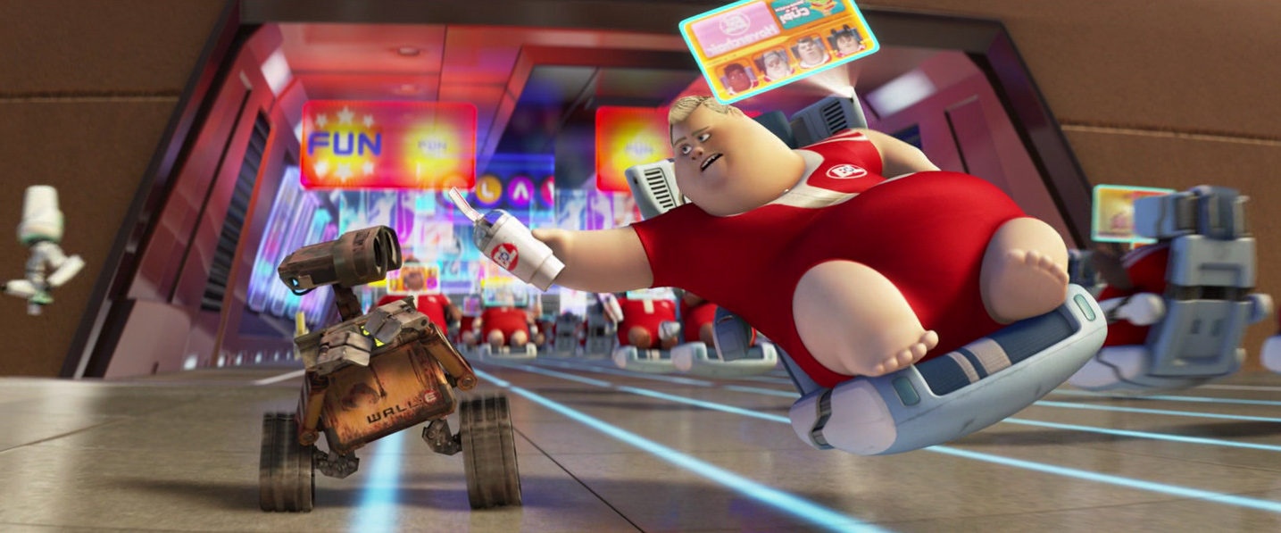
Ethics aboard the Axiom
Hoverchair, All-in-one internet, mobility, comfort
  Only time screens aren’t on is during sleep
  Screens are full of ads, even during facetime calls
  Nothing to prevent screen-peeking
Over-dependence on technology is bad
  Extreme loss of bone mass due to chairs & near-zero gravity
  Waiter-style robots trivialize everything
  5-year vacation turns into 700-year voyage
Notes:
Presented by: Yasin
Because hover chairs are used as transport, beds, and have built-in holographic displays they are relied on far too much and the people are overexposed, every waking hour is spent on computers.
Advertisements are prevalent everywhere on the ship, from captain’s coffee cup, his shirt, giant electronic billboards, and even 3-5 ads at once during calls with others. Provides opportunity for abuse like walmart targeted ads towards pregnant women
There are zero security measures put in place to prevent people from invading each others privacy either by looking at others screens or simply listening in.
Near zero gravity and permanent existence on hover chairs has led to ballonification and loss of social function. People facetiming each other while being 2 feet apart, having a very difficult time noticing anything behind the projections, like wallE. The two people in the movie that are almost snapped out of their trance finally notice things about the ship, like that theres a pool and play in it later too, showing how detached these people are with reality and their surroundings
Continuation of previous point, all people exist in a restaurant-style ship. Drinks, food, “entertainment” and purchase are all 1 click away. Leads to a complete lack of social awareness and lacking social development outside screens. The simple act of getting up after falling is extremely difficult, needing robotic aid at most times because of over-reliance.
Everyone knows the original goal of the axiom and ships like it, but only captain has authority to know the truth behind the extended stay. No real democracy or anything, lack of any need for one. All jobs taken care of, money doesn’t exist, and anything you want is a click away, so people don’t really care or need democracy. All kept in space under false pretenses. They exist in an ecosystem like a fish tank, with machines making sure all needs are taken care of and auto keeping every day like the last.

