Slide 1
Unfriended:
Dark Web
Aidan Bryar, Jonathan Hsu, Gus Montana, Cambria Pomeranz

Slide 2
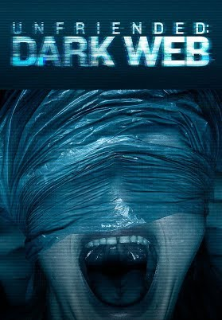
Movie Overview
Everything stemming from single laptop
  Movie displayed largely from perspective of group call
  Antagonist kills protagonist and friends after he discovers evildoing
  Protagonist and friends are framed for the crimes that Charon is committing
Themes
  Abuse of technology
  Lack of computer/network security
  Unfounded trust placed in computing devices
Notes:
For a brief recap of the movie, the protagonist Matias finds a laptop in a lost-and-found, the entire movie plays out from the perspective of a group call between him and his friends on this laptop. He discovers that the previous of the owner of the laptop was involved in illegal activities, and this antagonistic group called Charon start to warn him, asking for the laptop back. He ignores this, and using him and his friends, Charon end up killing them all and framing them for the crimes that they’ve committed, thereby pawning off the responsibility of their crimes onto Matias and his group of friends.
Throughout the movie, we see some themes that are already familiar to us, since they’ve been echoed by some of the other groups’ movies. There’s the abuse of technology, such as the use of the darkweb by Charon in order to facilitate communication between the group when they’re conducting illegal activities. There’s a complete lack of computer/network security when we see Charon finding ways to get images and videos of Matias and his friends, and then using these files/materials to frame them for the crimes. And finally, we see a completely unfounded trust placed in computing devices, as none of these events would have happened if Matias had decided to simply wipe the laptop that he had taken, instead of deciding to use a device full of the previous owners files and applications.

Slide 3
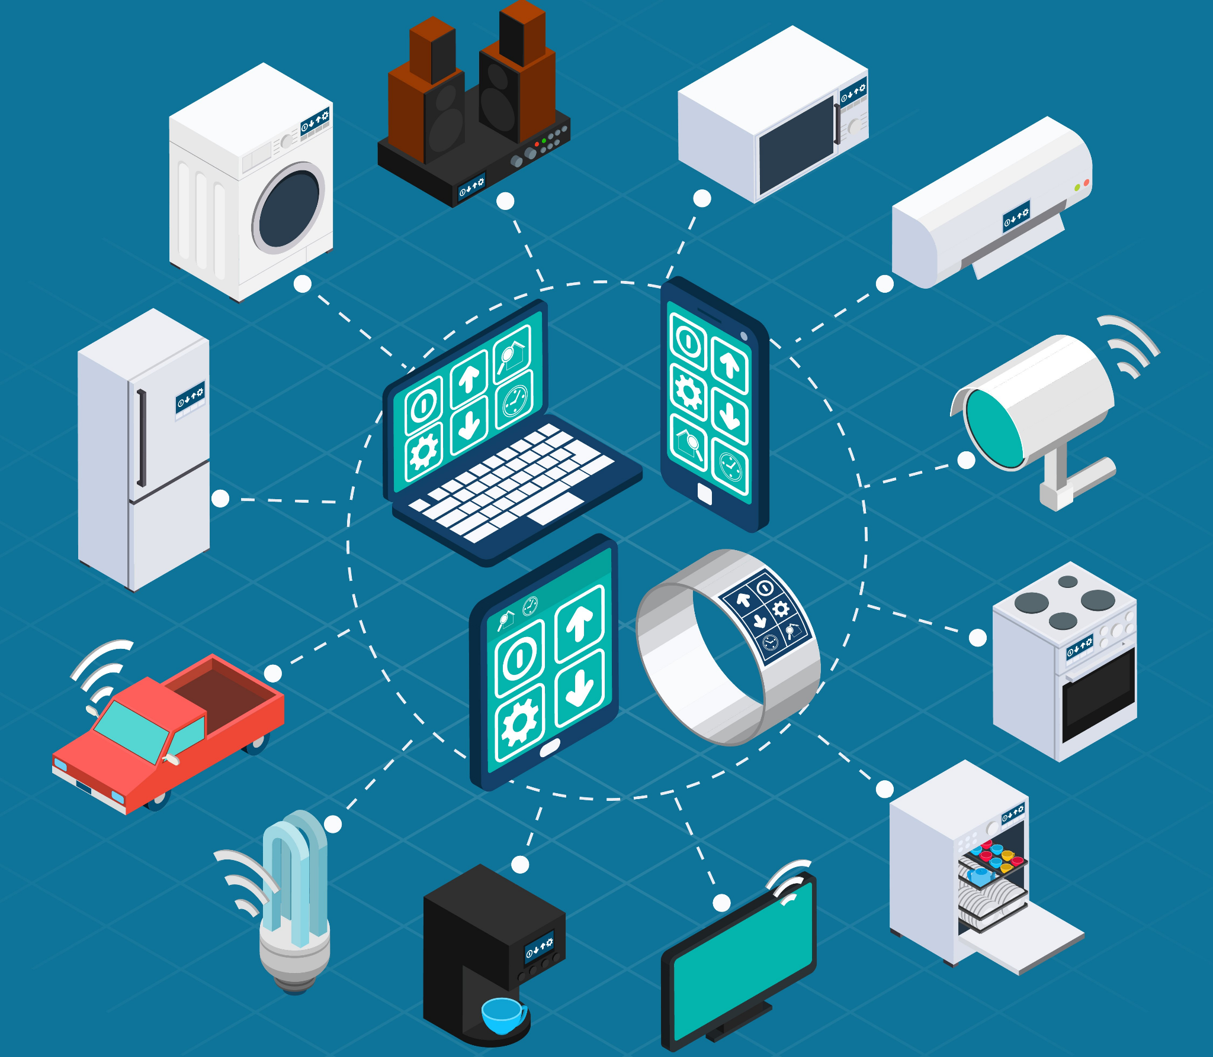
Computing Technologies
Social Media
Group Messaging
Mobile Cell Phones
Computers/Laptops
Surveillance Cameras
Dark Web
Cryptocurrency
Notes:
Aidan:Mobile Phones
Mobile Phones are used all around the world primarily for communication but have many uses now thanks to advancements in technology. In the movie we see Mobile Phones being used to communicate much like people would use a computer, by using apps like facebook messenger and ios messaging. We see one of the main characters, “Amaya,” use her mobile phone, while she travels to Matias. This is so that she can stay connected to him while traveling and update him on her progress immediately.
Jonathan:Social Media, Group Messaging
Social media and group messaging are used extensively through the movie, and it’s through the lens of a group call that the story unfolds. Social media in the real-world enables people to connect with one another, but it also leaves them susceptible to leaking information and can serve as an avenue for hacking, something that we’ll explore in one of our conclusions.
Gus: computers/laptops & surveillance cameras
The main story of the movie revolves around a stolen laptop which is being hacked into by the villains of the movie. The villains of the movie, called ‘The Circle,’ use hacked surveillance cameras to keep tabs on their victims (the main characters of the movie), when they are not around their computers.
Cambria: cryptocurrency and dark web
Dark web - “a network of websites that can only be accessed through special software that encrypts messages and provides users with anonymity” [1]. The
River was how the dark web was accessed in the movie
Cryptocurrency - digital form of currency commonly used on the dark web to maintain anonymity. Used for transactions on The River in the movie
References:
Michael J. Quinn, Ethics For The Information Age (8th edition) (Pearson, 2020), 304.

Slide 4
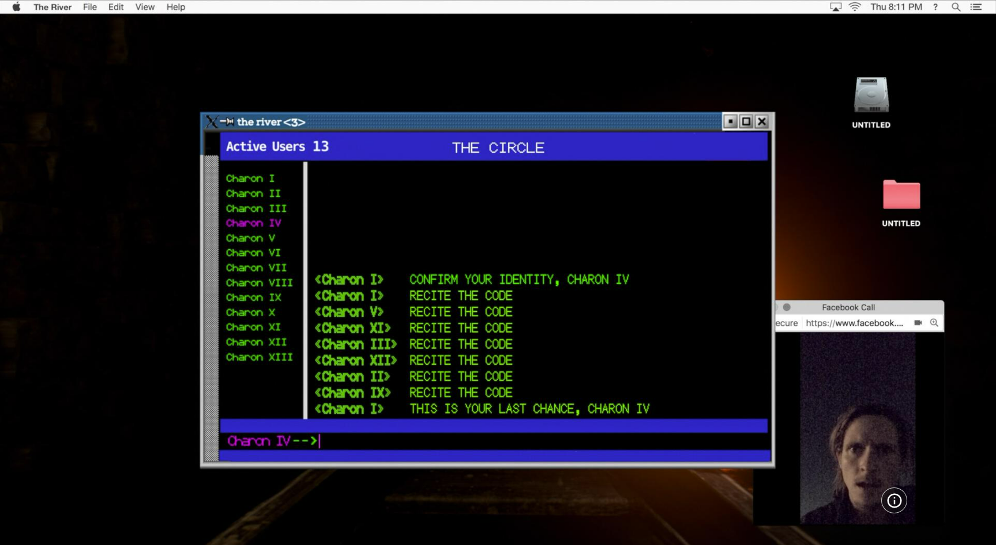
Conclusion 1: The movie is realistic, to a point.
Most of the events of the movie are possible in real life.
  Remote access to a computer
  Gaining access to networked cameras
  Exploitation of text chat vulnerabilities
  Phone tracking
  Deep fake videos
  Etc.
Seems unrealistic at first.
  Mainly due to the presentation
  Feels contrived at times
  Plays into the fear that many have about unknowns in technology
Notes:
The first conclusion that our group came to about the movie was that it is realistic, but only to a point.
What I mean by this is that when I watched the movie through the first time, I felt as though it was not realistic at all. This is mainly because of how the movie presents its subject matter to the audience. It’s presented in a way that makes it feel watered down for a more general audience– it is a hollywood movie after all. As you can see from the image from the movie, they make a ‘dark web’ looking window with a mysterious chat box. However this leads to feeling extremely contrived at times and, because it is a horror movie, it plays very heavily into its audience’s fear of the unknown; which in this case is the spooky scary ‘dark web,’ full of people who kill for fun apparently.
But presentation aside, when we sat down and looked at the individual events in the movie, most of them, if not all, are actually possible in the real world. As we touch upon in the next slide and on our website under computer and network security, there are plenty of real-world examples of malicious actors gaining remote access to computers, viewing camera feeds, and exploiting vulnerabilities in instant message applications. Additionally, hackers can exploit smart phones’ location services to track them and deep faking has become a very real issue in politics.

Slide 5
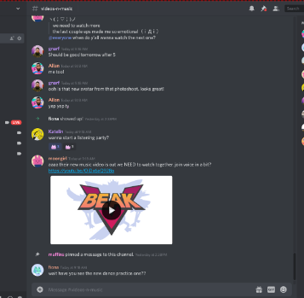
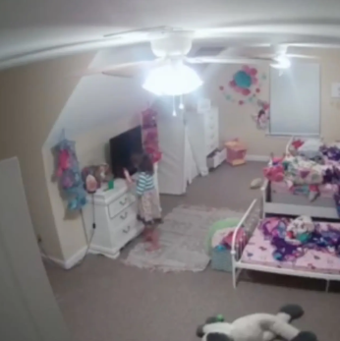
Conclusion 2: People Take Computer Security for Granted
Examples from Unfriended: Dark Web
  Blatant disregard for computer security on laptop
  Doctoring of videos to frame character as threat
Real-world Vulnerabilities
  TeamViewer backdoor [7]
  Discord embedded links [9]
  Ring camera account hijack [8]
  Passwords stored in plaintext
Notes:
The second conclusion that we drew from the film is that many people place too much trust in the computing technologies that help to streamline their work and social affairs.
In the movie, we see Matias place full trust in a laptop that he finds at a lost-and-found, and immediately starts to use it without first wiping the storage devices associated with the laptop. This allows for Charon to directly communicate with the laptop, be that with social messaging services that Matias logs into after acquiring the laptop, or with any of the other files and applications located on the laptop. Later on in the movie, we see that this antagonistic group has also acquired images and videos of Matias and his friends, and an avenue that they could have taken to get their hands on this material could have been directly through the computer.
The real-world analogues to these techniques are many. Some examples that I’m sure some of you are familiar with would be Discord, a popular social messaging application, as well as Teamviewer. In Discord, users are able to embed files and links directly into the chats that they are a part of, and due to security flaws in Electron, which is the underlying framework that the Discord desktop application is built off of, these embeds have been used in the past to push malware onto the devices of end-users. Teamviewer on the other hand, gives users remote access to devices. In the movie, Charon could have used such a service to gain access to Matias’ newly acquired laptop, thus giving them access to the chatroom, applications, and files on the computer. When acquiring a new device, or interacting with messaging board, I believe that many people wouldn’t give a second thought to clicking on a link that they believe their friends have sent them. Additionally, if you found that a laptop that you bought used had some leftover files on it, I’m sure that many would just delete them, and continue to use the device, oblivious to the possibility that the device could have services running in the background that keep track of keystrokes, or log other information.

Slide 6
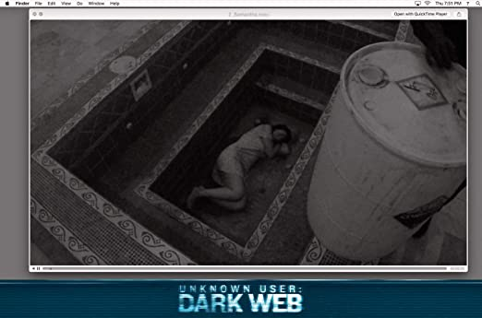
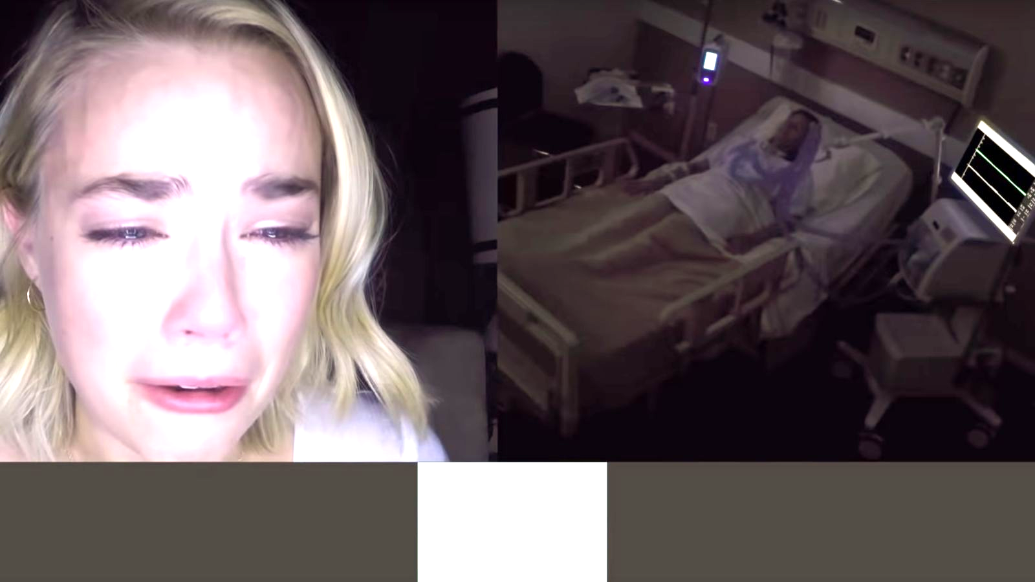
Conclusion 3: We Need Better Regulations on Privacy/Security to Protect People
Privacy does not exist without security
HIPAA passed in 1996
  4,419 Healthcare Data Breaches of 500 or more records between 2009 and 2021
FERPA passed in 1974
Privacy act of 1974
Cryptocurrency and hidden transactions
Leaked video feeds from hacked cameras
Notes:
Much of the tension in the movie “Unfriended: Dark Web,” comes from the fact that the group called the Charons need to keep their identities safe to be able to make money illegally and not get reported to the police. In the end, there are seemingly no consequences for those who committed crimes throughout the movie. The Charons were able to seamlessly hack into the friend group’s phones and computers in order to take their information hostage. The characters right to privacy was infringed upon by the Charons, and the Charons didn’t face any consequences. How could this have been prevented? Many laws already exist to uphold people’s right to privacy yet it still seems to not be enough.
One such law is HIPAA which is “a federal law that requires the creation of national standards to protect sensitive patient health information from being disclosed without the patient’s consent or knowledge [2].” HIPAA was created so that when you disclose sensitive information to medical institutions it is kept private unless you say otherwise. In the movie Serena’s mom is found to have cancer and the Charons use this to their advantage by tracking her down through the internet and obtaining her exact hospital room number in order to take her off life support remotely. HIPAA is far from perfect in real life and “Between 2009 and 2021, 4,419 healthcare data breaches of 500 or more records have been reported to the HHS’ Office for Civil Rights[7].”
Another law regarding privacy called FERPA deals with parent’s and student’s rights and “It prohibits educational institutions from disclosing “personally identifiable information in education records” without the written consent of an eligible student [1].”
In my opinion the most important legal precedent is The Privacy Act which is “a federal law that governs the collection and use of records the government maintains on you in a system of records [3].” These regulations decide what data can be taken from an individual and stored. When too much data is taken from us the people will naturally become upset, but on the other hand if too little is done to watch over those who might commit a crime. In the case of the Charons from the movie bad things happen and people become more upset over too little security.
Cryptocurrency is also a focus of the movie as the Charons use it to hide their transactions from law enforcement or other prying eyes. This gives the Charons even more freedom when it comes to committing crimes and this phenomenon is used a lot in the real world to trade illegal items.
Regarding leaks and hacks, when Matias uncovers the hidden files on the stolen computer he finds videos taken without people’s knowledge from their everyday household electronics. This can be related to how poorly companies design their security for these devices even at such a high cost of purchase.
1.“Family Educational Rights and Privacy Act (FERPA).” Centers for Disease Control and Prevention, Centers for Disease Control and Prevention, 27 June 2022, https://www.cdc.gov/phlp/publications/topic/ferpa.html#:~:text=The%20Family%20Educational%20Rights%20and,%2C%20or%20post%2Dsecondary%20school.
2.“Health Insurance Portability and Accountability Act of 1996 (HIPAA).” Centers for Disease Control and Prevention, Centers for Disease Control and Prevention, 27 June 2022, https://www.cdc.gov/phlp/publications/topic/hipaa.html.
3.“The Privacy Act of 1974 .” The Privacy Act of 1974, https://osc.gov/Pages/Privacy-Act.aspx.
4.“Healthcare Data Breach Statistics - Latest Data for 2022.” HIPAA Journal, 26 Aug. 2022, https://www.hipaajournal.com/healthcare-data-breach-statistics/#:~:text=Between%202009%20and%202021%2C%204%2C419,disclosure%20of%20314%2C063%2C186%20healthcare%20records.

Slide 7
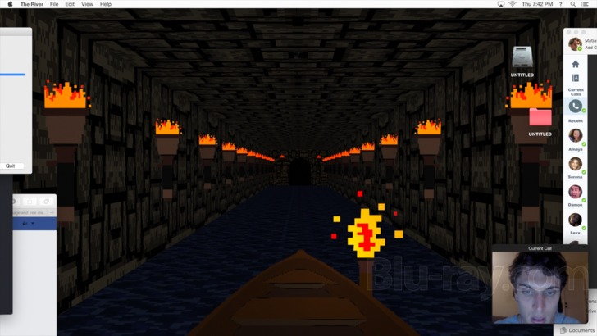
Conclusion 4: The Dark Web is Getting out of Hand
Hotspot for criminal activity
It’s anonymous and secure
The use of the dark web is growing
Dark web users buying drugs has increased to 25.3% in 2014 [4]
Number of dark websites has risen 20% from 2016 [2]
Law enforcement is struggling with tracking down the criminals [1]
Law enforcement must invest a lot of money to combat this crime
  Training, hiring more professionals
Notes:
In the movie, we see the use of the dark net. Possibly the most dangerous type of communication shown in the movie, the dark net plays an important part in the movie and real life. The dark net is ideal for criminals because they can illegally buy and sell contraband anonymously and securely. It’s a place where one “can buy credit card numbers, all manner of drugs, guns, counterfeit money, stolen subscription credentials, hacked Netflix accounts, and software that helps you break into other people’s computers” [2]. This list is just the surface of all trade going on on the dark web.
The use of the dark web is growing. The percentage of dark web users buying illegal drugs on the internet has increased from 1.2% in 2000 to 25.3% in 2014 [4]. The number of dark websites has risen 20% from 2016 [2]. One study found that “‘more than 50% of what’s hosted [on Tor] is illegal and illegitimate’” [1]. Because of how extensive and secretive the dark web is, law enforcement is struggling with tracking down and arresting those involved [1]. The dark web is certain to keep growing; therefore, to combat the rise of crime on the dark web, law enforcement needs to invest a large amount of money into hiring dark web experts and training officers across the nation on how to catch criminals on the dark web.
Resources:
Clayton Davis, Addressing the Challenges of Enforcing the Law on the Dark Web, (The University of Utah, Dec. 11, 2017), https://law.utah.edu/addressing-the-challenges-of-enforcing-the-law-on-the-dark-web/ (Oct. 9, 2022).
Darren Guccione, What is the dark web? How to access it and what you'll find, (IDG Communications, Inc., July 1, 2021), https://www.csoonline.com/article/3249765/what-is-the-dark-web-how-to-access-it-and-what-youll-find.html (Oct. 9, 2022).
Michael J. Quinn, Ethics For The Information Age (8th edition) (Pearson, 2020), 303, 304.
Pierluigi Paganini, Law Enforcement and the Dark Web: A Never-Ending Battle, (Infosec Institute, Inc., July 19, 2016), https://resources.infosecinstitute.com/topic/law-enforcement-and-the-dark-web-a-never-ending-battle/ (Oct. 9, 2022).

Slide 8
Concluding Thoughts
Conclusion 3: The Need for Better Regulation of Privacy/Security
Conclusion 4: The Dark Web is getting out of hand for law enforcement to manage
Conclusion 1: The movie is realistic, to a point.
Conclusion 2: Lack of Computer/Network Security

Slide 9
Citations and Resources
Clayton Davis, Addressing the Challenges of Enforcing the Law on the Dark Web, (The University of Utah, Dec. 11, 2017), https://law.utah.edu/addressing-the-challenges-of-enforcing-the-law-on-the-dark-web/ (Oct. 9, 2022).
Darren Guccione, What is the dark web? How to access it and what you'll find, (IDG Communications, Inc., July 1, 2021), https://www.csoonline.com/article/3249765/what-is-the-dark-web-how-to-access-it-and-what-youll-find.html (Oct. 9, 2022).
Michael J. Quinn, Ethics For The Information Age (8th edition) (Pearson, 2020), 303, 304.
Pierluigi Paganini, Law Enforcement and the Dark Web: A Never-Ending Battle, (Infosec Institute, Inc., July 19, 2016), https://resources.infosecinstitute.com/topic/law-enforcement-and-the-dark-web-a-never-ending-battle/ (Oct. 9, 2022).
Hundreds of GPS Location Tracking Services Leaving User Data Open to Hackers. (n.d.). The Hacker News. https://thehackernews.com/2018/01/gps-location-tracking.html
Four Ways the Internet of Things Can Impact Lives. (n.d.). FierceElectronics. https://www.fierceelectronics.com/components/four-ways-internet-things-can-impact-lives
"Florida Hack Exposes Danger To Water Systems". Pewtrusts.Org, 2021, https://www.pewtrusts.org/en/research-and-analysis/blogs/stateline/2021/03/10/florida-hack-exposes-danger-to-water-systems .
"Ring’S Services Have Not Been Compromised - Here’S What You Need To Know - The Ring Blog". The Ring Blog, 2019, https://blog.ring.com/2019/12/12/rings-services-have-not-been-compromised-heres-what-you-need-to-know/ .
"Researchers Found One-Click Exploits In Discord And Teams". Malwarebytes, 2022, https://www.malwarebytes.com/blog/news/2022/08/researchers-found-one-click-exploits-in-discord-and-teams .
Images:
Unfriended: Dark Web Blu-Ray. https://images.static-bluray.com/reviews/22545_5.jpg. Accessed 10 Oct. 2022.
"Somebody’S Watching: Hackers Breach Ring Home Security Cameras (Published 2019)". Nytimes.Com, 2019, https://www.nytimes.com/2019/12/15/us/Hacked-ring-home-security-cameras.html .
“Beginner’s Guide to Discord”. Discord.com, 2022, https://support.discord.com/hc/en-us/articles/360045138571-Beginner-s-Guide-to-Discord
Amazon.com: Dark Web : Películas Y TV. https://www.amazon.com/-/es/dp/B07KZ4MP7D .
“Unfriended: Dark Web.” IMDb, IMDb.com, https://m.imdb.com/title/tt4761916/mediaviewer/rm3636755712/ .

