Slide 1
The Zero Theorem
By: Oleg Zabolotnev, Marcus Gafka, Harrison DiAmbrosio and John Perveiler

Slide 2

Plot Summary
Qohen Leth is an talented entity cruncher at MANCOM tasked with solving the Zero Theorem
He craves meaning in his life and believes the phone will give him “his call”
MANCOM monitors Qohen and manipulates him to leverage his skill
Qohen finds out that the Zero Theorem is to prove that the universe will devolve into nothing
After Bob falls ill and is taken away, Qohen uses a special VR suit to destroy the Neural Net Mancrive
Qohen Leth played by Christoph Waltz
(https://www.nytimes.com/2014/09/19/movies/christoph-waltz-drowns-in-technocracy-in-the-zero-theorem.html)
Notes:
Qohen Leth is an talented entity cruncher at MANCOM tasked with solving the Zero Theorem. He was chosen due to his skill at crunching entities but also his great faith and persistence.
He craves meaning in his life and believes that he will receive a phone call that has his answers.
MANCOM monitors Qohen and manipulates him to leverage his skill. They send a woman named Bainsley who was initially hired to seduce Qohen in hopes that it would help him make progress on the Zero Theorem. He also thinks that management at his company is responsible for this phone call, which is another means they use to leverage Qohen into crunching entities for the Zero Theorem.
Qohen finds out that the Zero Theorem is to prove that the universe will devolve into nothing and when his friend Bob falls ill he seeks Management to answer his questions. He uses an upgraded VR suit he received from Bob to enter into the a supercomputer called the Neural Net Mancrive and destroy it. He arrives on a beach that he and Bainsley visited in a virtual reality experience

Slide 3

Ethical Plot Analysis
This movie takes a Kantian perspective of the topics presented.
Bob claims that he’s nobody’s tool
Management uses the Shrink-ROM and the VR suit to manipulate Qohen
Management’s plot to use the Zero Theorem and Neural Net Mancrive to invigorate consumer activity has negative imagery.
People aren’t means to an end.
“Management” played by Matt Damon
https://www.thisisbarry.com/film/the-zero-theorem-2013-movie-plot-ending-explained/
Notes:
This story supports a very Kantian perspective. One of the characters, Bob, is a child prodigy who is implied to be much smarter than Qohen is. The only reason he hasn’t attempted the Zero Theorem is because he’s nobody’s tool. This follows Bob’s carefree attitude at first glance, but upon further inspection this spells out the message the movie is trying to tell, which is that the meaning of life is dependant on how it is lived. By saying that he isn’t a tool he says that his life is his to live. Management, on the other hand, has a complete opposite philosophy. He uses the Shrink-ROM to monitor him and the VR suit to manipulate him. He plans to use the Zero Theorem and the Neural Net Mancrive to cause chaos in the general public that will make him money. The movie makes no mistake in labeling him as the villain through this negative imagery. Management completely disregards what might be good for any of the other characters in the movie, caring only for what makes him money. Management’s image and goals oppose the Kantian belief that people aren’t a means to an end. In this way, The Zero Theorem leans toward a Kantian perspective of freedom away from unempathetic corporations.

Slide 4
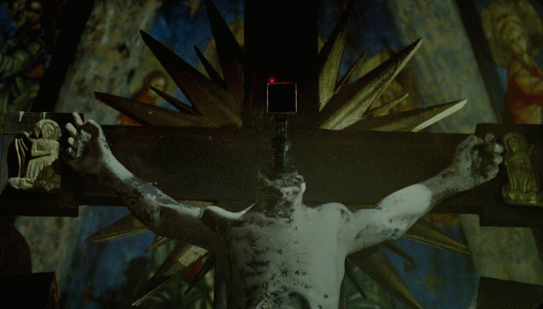
Technology as the Enemy of Religion
Many biblical references
  Themes from Ecclesiastes [2]
  The crucifix
  Qohen’s name [3]
“God is in all things”
Challenging explanations of the world [1]
Opposes rituals of salvation with tangible improvements [1]
21% increase in religiously unaffiliated adults in United States adults from 1974 to 2021 [5]
The security camera above Qohen’s desk
https://split-screen.net/the-zero-theorem/
Notes:
The movie rides the idea of technology becoming an enemy to religion.
The religious connection is made clear throughout the film through several biblical references. Themes of the Book of Ecclesiastes were used as a basis to the story and even Qohen is named after the teacher who is a character in Ecclesiastes: Kohelet. One of the most jarring examples of technology challenging religion is the crucifix that hangs above Qohen’s desk in his home where he works. The figure has had the head of Jesus replaces with a security camera which watches the man.
A common phrase present in Christianity is that “God is in all things” and Qohen's home seems to flip this on it’s head. MANCOM and its surveillance of Qohen infests his home, where numerous cameras are hidden.
These all point to an idea that has been studied before and that is the threats that technology poses to religion.
One example is that technology and progression in science produce results that are tangible alternatives to religious explanations of the world which typically rely on faith.
Additionally technology offers tested cures or support to the sick and debilitated while religious rituals are often more symbolic in regards to these.
This is made more obvious when between 1974 and 2021, the amount of religiously unaffiliated adults has increased from 5 to 26 percent.

Slide 5
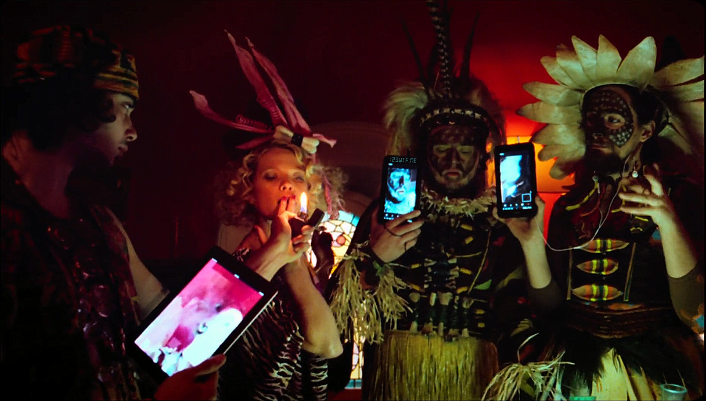
Key Theme: Human Dependence on Technology
Throughout the movie, nearly every character is shown relying on technology to function, communicate, and cope with reality.
Qohen’s spends his entire day working from a complex digital interface
Emotional support is outsourced to an AI therapist
Bainsley offers companionship through a VR
People in the streets and at parties are consumed by digital noise and entertainment
Qohen believes the meaning of his life will come via a phone line
Partygoers can’t get off their devices
https://wtfbabe.wordpress.com/2014/10/19/wtf-the-zero-theorem-2013/
Notes:
Speaker notes:
This world is filled with digital noise. People walking down the street or dancing at parties are glued to screens, consumed by entertainment and oblivious to their surroundings. Even spiritual meaning (the phone call) s
Background research write-up:
In The Zero Theorem, human dependence on technology is portrayed as not just a social trend, but a defining condition of modern existence. The film constructs a future where technology is integrated into every aspect of life—from work and relationships to therapy and spirituality—shaping the way people think, feel, and interact. Rather than being a tool to aid human progress, technology becomes a substitute for genuine connection, fulfillment, and meaning.
The society in the film is designed around digital infrastructure, where the virtual often takes priority over the real. People walk through neon-lit streets completely absorbed in screens, oblivious to their physical surroundings. Even interpersonal relationships are mediated through virtual platforms. For example, Qohen’s most emotionally significant connection is with Bainsley, yet their relationship unfolds primarily in a simulated beach world—a virtual reality environment designed for comfort, not authenticity. The fact that their bond feels real to Qohen despite the artificiality of their interactions highlights just how deeply people in this world have come to rely on technology for emotional fulfillment.
Technology also replaces traditional sources of existential meaning. Qohen, who is searching for a sign from “the phone call” (a metaphor for divine purpose or truth), waits endlessly for a literal phone to ring. His spiritual anxiety is filtered through a technological interface. Likewise, his therapy sessions are conducted by SHRINK-ROM, an AI program that uses pre-scripted interactions to address complex human emotions. These depersonalized encounters underscore how technology is used as a coping mechanism, promising quick solutions to psychological and philosophical dilemmas.
More than a convenience, technology in The Zero Theorem becomes a crutch—something people cling to because they no longer trust or know how to function without it. This dependency is encouraged by systems of power like Mancom, which use technology to both pacify and control. Work becomes a form of meaningless digital labor; entertainment becomes a constant distraction; therapy becomes an algorithm. The tools that were meant to liberate instead confine, offering simulated satisfaction while reducing the individual’s ability to think critically or act independently.
What makes this portrayal especially relevant is the subtlety of the control. People don’t realize they’re dependent on these systems because they’ve been integrated into every part of life. Technology promises ease, comfort, and connection—but the film reveals that this promise masks a deeper emptiness. The characters, especially Qohen, experience profound isolation and confusion despite (or because of) their constant digital engagement. They have traded human connection for technological simulation and lost something vital in the process.
Qohen’s increasing retreat into the virtual world is not just escapism—it is resignation. Unable to find meaning or connection in the physical world, he chooses to live inside a digital illusion, where he can at least control the environment. This final act illustrates the ultimate danger of technological dependence: it can lead individuals to abandon reality altogether. In the film’s closing moments, Qohen appears to find peace, but it is a peace built on disconnection, solitude, and unreality—a silent commentary on what happens when people rely too heavily on technology to fill the voids in their lives.
Ultimately, The Zero Theorem offers a bleak but powerful warning. Human dependence on technology, while often convenient or even comforting, comes with hidden costs. As people trade genuine experiences for artificial ones, and authentic emotion for programmed responses, they risk losing their autonomy, their relationships, and their sense of self. The film challenges viewers to reflect on the role technology plays in their own lives—and whether they’re still in control of it, or whether it’s already in control of them.

Slide 6
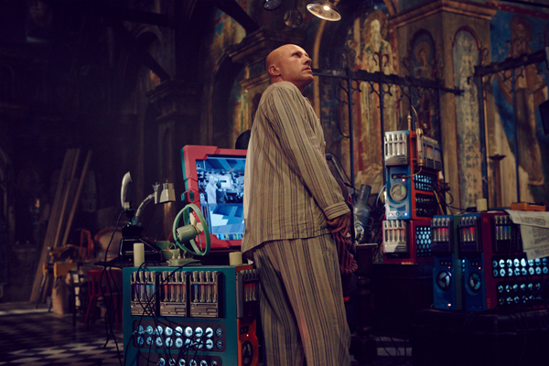
Key Theme: Human Dependence on Technology
The film shows a world where people have turned to technology to fill emotional, psychological, and even existential voids.
Qohen becomes increasingly isolated from real people and turns fully to the digital world for escape
Technology becomes a substitute for meaning, comfort, and control
Qohen is easier to manipulate because his only comfort (VR, work, digital contact) comes through systems controlled by others
This blind trust in tech leads to disconnection and confusion—Qohen is surrounded by machines but feels utterly alone
https://www.thinkingfaith.org/articles/film_20131022_4.htm
Notes:
Speaker notes:
This world is filled with digital noise. People walking down the street or dancing at parties are glued to screens, consumed by entertainment and oblivious to their surroundings. Even spiritual meaning (the phone call) s
Background research write-up:
In The Zero Theorem, human dependence on technology is portrayed as not just a social trend, but a defining condition of modern existence. The film constructs a future where technology is integrated into every aspect of life—from work and relationships to therapy and spirituality—shaping the way people think, feel, and interact. Rather than being a tool to aid human progress, technology becomes a substitute for genuine connection, fulfillment, and meaning.
The society in the film is designed around digital infrastructure, where the virtual often takes priority over the real. People walk through neon-lit streets completely absorbed in screens, oblivious to their physical surroundings. Even interpersonal relationships are mediated through virtual platforms. For example, Qohen’s most emotionally significant connection is with Bainsley, yet their relationship unfolds primarily in a simulated beach world—a virtual reality environment designed for comfort, not authenticity. The fact that their bond feels real to Qohen despite the artificiality of their interactions highlights just how deeply people in this world have come to rely on technology for emotional fulfillment.
Technology also replaces traditional sources of existential meaning. Qohen, who is searching for a sign from “the phone call” (a metaphor for divine purpose or truth), waits endlessly for a literal phone to ring. His spiritual anxiety is filtered through a technological interface. Likewise, his therapy sessions are conducted by SHRINK-ROM, an AI program that uses pre-scripted interactions to address complex human emotions. These depersonalized encounters underscore how technology is used as a coping mechanism, promising quick solutions to psychological and philosophical dilemmas.
More than a convenience, technology in The Zero Theorem becomes a crutch—something people cling to because they no longer trust or know how to function without it. This dependency is encouraged by systems of power like Mancom, which use technology to both pacify and control. Work becomes a form of meaningless digital labor; entertainment becomes a constant distraction; therapy becomes an algorithm. The tools that were meant to liberate instead confine, offering simulated satisfaction while reducing the individual’s ability to think critically or act independently.
What makes this portrayal especially relevant is the subtlety of the control. People don’t realize they’re dependent on these systems because they’ve been integrated into every part of life. Technology promises ease, comfort, and connection—but the film reveals that this promise masks a deeper emptiness. The characters, especially Qohen, experience profound isolation and confusion despite (or because of) their constant digital engagement. They have traded human connection for technological simulation and lost something vital in the process.
Qohen’s increasing retreat into the virtual world is not just escapism—it is resignation. Unable to find meaning or connection in the physical world, he chooses to live inside a digital illusion, where he can at least control the environment. This final act illustrates the ultimate danger of technological dependence: it can lead individuals to abandon reality altogether. In the film’s closing moments, Qohen appears to find peace, but it is a peace built on disconnection, solitude, and unreality—a silent commentary on what happens when people rely too heavily on technology to fill the voids in their lives.
Ultimately, The Zero Theorem offers a bleak but powerful warning. Human dependence on technology, while often convenient or even comforting, comes with hidden costs. As people trade genuine experiences for artificial ones, and authentic emotion for programmed responses, they risk losing their autonomy, their relationships, and their sense of self. The film challenges viewers to reflect on the role technology plays in their own lives—and whether they’re still in control of it, or whether it’s already in control of them.

Slide 7

Human Dependence on Technology: Conclusion
Warnings of the negative effects of a tech
3% of Americans Report being online “almost constantly” [12]
US adults average 6.44 hours/day on social media
Technology addiction has been found to:
  Lead to withdrawal symptoms
  Eye strain
  Headaches
  Social isolation
Excessive use is correlated to increased anxiety development (up to 2.8x odds)
The Zero Theorem. Directed by Terry Gilliam, performances by Christoph Waltz, Mélanie Thierry, and David Thewlis, Voltage Pictures, 2013. Image from YouTube, uploaded by Movie Station, 6 Oct. 2013, https://www.youtube.com/watch?v=SAlTHm3uNTY.
Notes:
The Zero Theorem demonstrates the dangers of reliance on technology. With no real connections, no fulfillment in his work, and no faith in anything outside the digital system, Qohen’s only comfort comes from a virtual world. The final scene, where he stands alone in a fabricated sunspace, suggests that even his last hope - technology as an escape - has failed him. What was meant to liberate instead isolates, leaving him trapped not just by the system, but by his own reliance on it.
31% of Americans report being online “almost constantly” according to the Pew Research Center in 2021 <<- Quohen uses the VR tech more and more often as the movie progresses (https://www.pewresearch.org/short-reads/2021/03/26/about-three-in-ten-u-s-adults-say-they-are-almost-constantly-online/)
Technological addictions have been studied to cause withdrawal symptoms if technologies are taken away. In some cases physical effects can manifest as well, causing trouble sleeping, eye strain and headaches. An addiction to technology can also lead to social isolation which then comes with all the negative effects of a lack of interpersonal communication. ← What if the Vr tech was taken away from Quohen? How would he react? Was he dependant? (https://www.psychiatry.org/patients-families/technology-addictions-social-media-and-more/what-is-technology-addiction)
In a study conducted on 563 United States Adults revealed that higher usage of social media when compared to the average of 6.44 hours per day on social media, and excessive use correlated to a 1.6 to 2.8 times higher odds of developing anxiety. (https://www.sciencedirect.com/science/article/pii/S0165032716309442?via%3Dihub)
Overall: human dependance on technology should be avoided if we do not want to end up like Quohen.

Slide 8
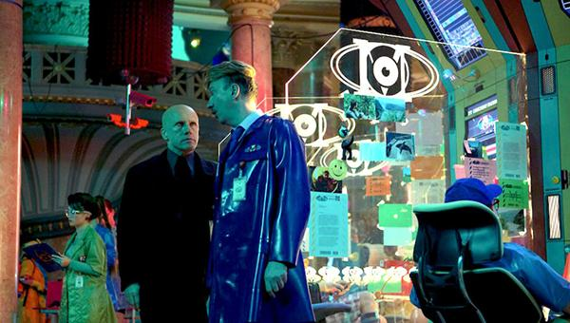
Key Theme: Surveillance and its effects
Throughout the movie, Qohen is never truly alone. Surveillance systems are everywhere, including his house.
Cameras everywhere
Constant communication with supervisors
Even Qohen’s mental state is monitored
This monitoring is used to manipulate him into compliance with the wishes of Management
Qohen’s church is filled with broken wires and systems - suggesting even more unseen monitoring
Normalized surveillance. "The Zero Theorem: Everything Adds Up to Nothing." Stand By For Mind Control, 14 July 2014, www.standbyformindcontrol.com/2014/07/the-zero-theorem-everything-adds-up-to-nothing/.
Notes:
Everywhere Quohen goes, he’s being watched by visible cameras, by his digital supervisor, and even by the systems monitoring his psychological health - and unlike the cameras, not all of the systems monitoring him are visible, or he is aware of.
Even in moments of supposed solitude, such as prayer in his church home, there is still evidence of pervasive surveillance - the wires and old tech.
Qohen’s mental state is monitored not out of concern for his well-being, but to assess how useful or compliant he is. Management exploits this data to control him: giving him false promises, pushing him toward virtual escapes, and nudging him into completing the Zero Theorem project
Quohen has no way to “disconnet” either - the systems around him are too ubiquitous for that. ← parallel with how difficult it is to reclaim privacy when it is lost in today’s online world (reference self-search paper and what students might have found about themselves)
people like (just like Qohen) become isolated, easily manipulated, and deeply confused about who is watching them and wh
Background research:
The protagonist's life is defined by the surveillance systems that monitor his every move. Cameras line the streets, and digital communication with supervisors is never-ending. His home, his workplace, and even his private thoughts are constantly under observation. This reflects a growing concern in our world about the power of government and corporate entities to collect and process data on individuals, often without their explicit consent or understanding. In The Zero Theorem, the loss of privacy is so ingrained that it becomes a norm. People don’t question being watched because it is simply a part of their existence.
More troubling is how surveillance in the film is not merely a tool for safety or regulation, it is used for social control. Through distractions like targeted advertisements, false promises of comfort, and an overwhelming flow of digital noise, the authorities keep people distracted, compliant, and dependent on the system. The film critiques the way modern technologies are used to shape society’s behaviors and beliefs. Rather than focusing on the protection of personal freedoms or the promotion of individual privacy, the surveillance mechanisms in the film are designed to prevent critical thinking, dissent, and personal autonomy. The loss of privacy is a tool to suppress individuality and keep the status quo.
The protagonist’s attempts to disconnect from the system only emphasize the futility of privacy reclamation in such a world. Even when he seeks solitude, the surveillance tools—screens, virtual assistants, and data reports—follow him, reinforcing the idea that privacy is no longer an option. This persistent intrusion symbolizes how the loss of privacy is built into the very fabric of the system, making escaping it impossible.

Slide 9
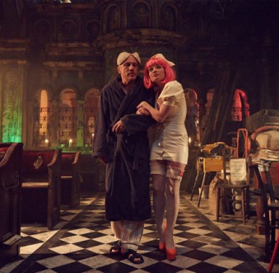
Key Theme: Surveillance and its effects
This movie shows a scenario in which surveillance has become fully accepted within society, and the adverse effects it has on the people involved.
Qohen feels like he cannot escape from his situation, so turns to the digital world (VR)
The information gained from surveillance is used to manipulate Qohen
Qohen is unaware of the non-obvious surveillance, and has no clue who sees or uses the data.
Bainsley was sent to manipulate Qohen
https://mossfilm.wordpress.com/2014/05/14/the-zero-theorem-film-review/
Notes:
Everywhere Quohen goes, he’s being watched by visible cameras, by his digital supervisor, and even by the systems monitoring his psychological health - and unlike the cameras, not all of the systems monitoring him are visible, or he is aware of.
Even in moments of supposed solitude, such as prayer in his church home, there is still evidence of pervasive surveillance - the wires and old tech.
Qohen’s mental state is monitored not out of concern for his well-being, but to assess how useful or compliant he is. Management exploits this data to control him: giving him false promises, pushing him toward virtual escapes, and nudging him into completing the Zero Theorem project
Quohen has no way to “disconnet” either - the systems around him are too ubiquitous for that. ← parallel with how difficult it is to reclaim privacy when it is lost in today’s online world (reference self-search paper and what students might have found about themselves)
people like (just like Qohen) become isolated, easily manipulated, and deeply confused about who is watching them and wh
Background research:
The protagonist's life is defined by the surveillance systems that monitor his every move. Cameras line the streets, and digital communication with supervisors is never-ending. His home, his workplace, and even his private thoughts are constantly under observation. This reflects a growing concern in our world about the power of government and corporate entities to collect and process data on individuals, often without their explicit consent or understanding. In The Zero Theorem, the loss of privacy is so ingrained that it becomes a norm. People don’t question being watched because it is simply a part of their existence.
More troubling is how surveillance in the film is not merely a tool for safety or regulation, it is used for social control. Through distractions like targeted advertisements, false promises of comfort, and an overwhelming flow of digital noise, the authorities keep people distracted, compliant, and dependent on the system. The film critiques the way modern technologies are used to shape society’s behaviors and beliefs. Rather than focusing on the protection of personal freedoms or the promotion of individual privacy, the surveillance mechanisms in the film are designed to prevent critical thinking, dissent, and personal autonomy. The loss of privacy is a tool to suppress individuality and keep the status quo.
The protagonist’s attempts to disconnect from the system only emphasize the futility of privacy reclamation in such a world. Even when he seeks solitude, the surveillance tools—screens, virtual assistants, and data reports—follow him, reinforcing the idea that privacy is no longer an option. This persistent intrusion symbolizes how the loss of privacy is built into the very fabric of the system, making escaping it impossible.

Slide 10
Act Utilitarianism analysis of Surveillance
Short-term gain from surveillance:
  Makes controlling employees easier
  Increases their efficiency
  Keeps employees in line
  Only benefits Management
Greater long-term harm:
  Psychological damage: ex: Qohen’s brilliant mind lost
  Creates a society filled with mistrust and social conformity
  Erasure of civil liberties, dignity and freedom.
Overall: Net utility loss: system results in despair rather than progress: unethical
Notes:
So we can see that surveillance is unpleasant - but let’s take a look at it through the lens of one of our ethical frameworks.
Stakeholders:
Quohen (the surveilled subject)
Management (the surveilling party)
Society at large
Other workers/individuals under similar surveillance
Viewers
Short-term benefits:
Management gains control over labor efficiency and psychological metrics
Society appears orderly and stable under constant oversight
Problems can be identified and managed quickly
Long-term harms:
Individuals experience emotional and psychological strain due to lack of privacy and autonomy
Normalization of invasive surveillance leads to societal complacency and erosion of civil liberties
People, like Quohen, feel trapped, isolated, and dehumanized
Genuine innovation, trust, and creativity are stifled as people conform to monitored expectations
The manipulation of private data for control undermines dignity and freedom

Slide 11
Relating to the Real World: Surveillance
Zuboff’s “Surveillance Capitalism” - personal data is commodified, undermining autonomy and democracy. Leads to behavioral prediction and modification[9].
Effect of surveillance on mental health and behavior explored in studies[10].
Algorithmic surveillance leads to individuals feeling less autonomous compared to human surveillance[11].
Notes:
Surv cap resonates particularly closely with the movie, interesting paper → real life effect has already been shown
For instance, 65% of students with physical disabilities and 61% with learning differences refrain from sharing their genuine ideas online due to monitoring concerns, compared to 44% and 43% of their peers without such disabilities, respectively . [10]
surveillance has, in some cases, led to the unwanted disclosure of private details about students' sexuality or the flagging of race-related content, raising significant privacy concerns [10]
Algorithmic surveillance - also ubiquitous in the movie - surv drones and the AI therapist
Erosion of trust due to invasion of privacy - creates society where no one trusts each other
Loss of autonomy → ties back into dependence on technology

Slide 12
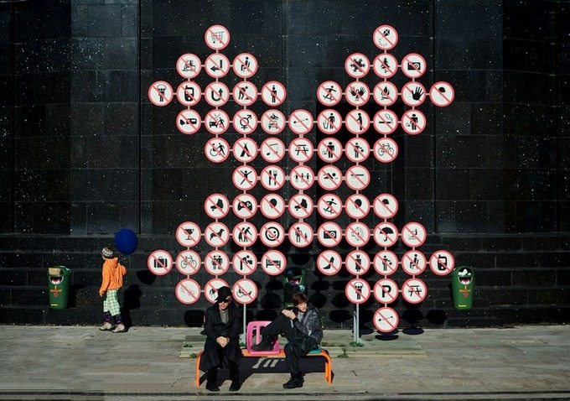
Surveillance: Conclusion
The film shows a world where constant surveillance is normal.
Qohen is trapped—monitored by his job, Management, and society.
Even his final escape into a virtual world becomes another form of control.
It warns us about losing privacy and freedom in a world that accepts total surveillance.
WTFBabe. “WTF: The Zero Theorem (2013).” WTFBabe, 19 Oct. 2014, https://wtfbabe.wordpress.com/2014/10/19/wtf-the-zero-theorem-2013/
Notes:
corporations and governments increasingly collect data without us fully realizing it, and use that data not just to serve, but to steer us. In the film, surveillance becomes so normalized that no one even questions it - and we must not allow this to repeat in our reality.

Slide 13
Key Theme: Intellectual property
The film presents a world where thought, creativity, and knowledge are treated like meaningless data. Qohen spends his days “crunching entities,” a task that involves manipulating abstract data with no context or purpose
The system reduces all intellectual output to productivity and profit.
Qohen’s work does not belong to him, but to Management
The Zero Theorem, despite seeming like a breakthrough in science or philosophy, is just another job. In this world, the only value to someone’s work is the value it adds to Corporate.
Notes:
The film presents a world where knowledge, art, and even groundbreaking ideas are reduced to meaningless data
The Zero Theorem is a deep issue with massive ramifications if solved - but it has been reduced to a banal profit driver. The only thing that matters is serving Management’s goals.
Qohen isn’t allowed to understand or take pride in what he does. The result is a profound emotional toll: he feels empty, isolated, and powerless.
By showing a future where all creative work is treated like data, The Zero Theorem warns us what’s at stake when we let corporations or algorithms define the value of ideas
In such a world, creativity dies.
Background research:
The Zero Theorem provides commentary on the commodification of intellectual property by depicting a world where creativity is stripped of its intrinsic value and repurposed for corporate interests. The film portrays intellectual work, knowledge, and thought as mere "crunching entities," or pieces of data without any meaning or purpose. This shift represents a broader critique of modern systems where intellectual property is extracted from its human context, resulting in a loss of significance and fulfillment for the individual.
The protagonist, a highly intelligent hacker, spends his time engaged in a task that has no personal reward, no collaborative interaction, and no opportunity for genuine expression. His intellectual abilities are relegated to the service of a system that processes ideas purely for its own gain. This scenario challenges the traditional discourse on the ownership of ideas and intellectual property by highlighting a deeper issue: the devaluation of intellectual work when it becomes separated from its human purpose. In this world, even if individuals technically own their ideas, their personal connection to those ideas is gone, leaving them to serve no greater meaning beyond their functional use to “the system”.
The film expands on this critique by illustrating the reduction of art, science, and philosophy into numerical formulas and corporate products. In contrast to today’s intellectual property landscape, where innovation, storytelling, and self-expression hold inherent value, The Zero Theorem presents a world where these forms of intellectual work are reduced to a commodity. This difference eliminates room for exploration, beauty, or mistakes. Creativity is only allowed if it can be measured and monetized by profit-driven corporations. In this dystopian environment, intellectual property is no longer a means of personal expression or societal progress, but rather a tool for maintaining corporate power.
Additionally, the film criticizes the lack of shared knowledge in this world. There is no public domain—everything is transactional and locked within private systems. Ideas, truths, and scientific advancements that should be shared for the common good are instead treated as proprietary assets. The concept of the Zero Theorem itself, potentially a profound and universal idea, becomes just another corporate project, stripped of its potential for meaningful exploration. Through this lens, the film critiques a world in which the ownership of ideas is prioritized over their meaning.

Slide 14
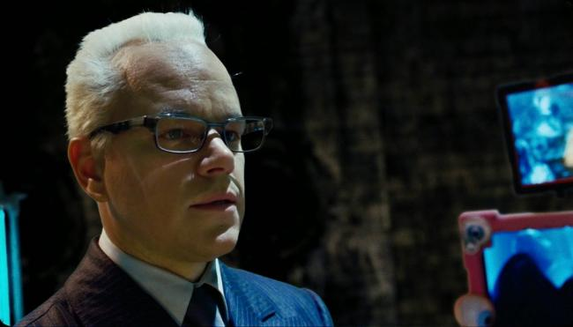
Key Theme: Intellectual property
The film critiques a society where ideas are treated only as commodities. Qohen isn’t allowed to understand or feel ownership over his work. This disconnection causes him to feel empty and powerless.
In a world controlled so tightly by surveillance, there is no room for personal expression, discovery or growth. The only approved activity is adding value to Corporate.
The Zero Theorem shows how this can lead to a future where creativity is lost, and people become tools rather than thinkers.
Management surveilling Quohen.
Eric. “The Zero Theorem.” Three Movie Buffs, 4 Nov. 2015, www.threemoviebuffs.com/review/zero-theorem.html.:contentReference
Notes:
The film presents a world where knowledge, art, and even groundbreaking ideas are reduced to meaningless data
The Zero Theorem is a deep issue with massive ramifications if solved - but it has been reduced to a banal profit driver. The only thing that matters is serving Management’s goals.
Qohen isn’t allowed to understand or take pride in what he does. The result is a profound emotional toll: he feels empty, isolated, and powerless.
By showing a future where all creative work is treated like data, The Zero Theorem warns us what’s at stake when we let corporations or algorithms define the value of ideas
In such a world, creativity dies.
Background research:
The Zero Theorem provides commentary on the commodification of intellectual property by depicting a world where creativity is stripped of its intrinsic value and repurposed for corporate interests. The film portrays intellectual work, knowledge, and thought as mere "crunching entities," or pieces of data without any meaning or purpose. This shift represents a broader critique of modern systems where intellectual property is extracted from its human context, resulting in a loss of significance and fulfillment for the individual.
The protagonist, a highly intelligent hacker, spends his time engaged in a task that has no personal reward, no collaborative interaction, and no opportunity for genuine expression. His intellectual abilities are relegated to the service of a system that processes ideas purely for its own gain. This scenario challenges the traditional discourse on the ownership of ideas and intellectual property by highlighting a deeper issue: the devaluation of intellectual work when it becomes separated from its human purpose. In this world, even if individuals technically own their ideas, their personal connection to those ideas is gone, leaving them to serve no greater meaning beyond their functional use to “the system”.
The film expands on this critique by illustrating the reduction of art, science, and philosophy into numerical formulas and corporate products. In contrast to today’s intellectual property landscape, where innovation, storytelling, and self-expression hold inherent value, The Zero Theorem presents a world where these forms of intellectual work are reduced to a commodity. This difference eliminates room for exploration, beauty, or mistakes. Creativity is only allowed if it can be measured and monetized by profit-driven corporations. In this dystopian environment, intellectual property is no longer a means of personal expression or societal progress, but rather a tool for maintaining corporate power.
Additionally, the film criticizes the lack of shared knowledge in this world. There is no public domain—everything is transactional and locked within private systems. Ideas, truths, and scientific advancements that should be shared for the common good are instead treated as proprietary assets. The concept of the Zero Theorem itself, potentially a profound and universal idea, becomes just another corporate project, stripped of its potential for meaningful exploration. Through this lens, the film critiques a world in which the ownership of ideas is prioritized over their meaning.

Slide 15
Virtue Ethics analysis: Intellectual property
Short-term mindset:
Ignores compassion toward creators
Sees creativity only as a tool for profit or control
Benefits Management, not the individuals who create
Greater long-term harm:
Disrespects the purpose of creative work
Undermines moral character and virtue
Discourages meaningful contribution to society
Overall:
Erodes shared meaning and spiritual value in creation
Reflects manipulation, exploitation, and moral indifference
Therefore, it is unethical
Notes:
Relevant Roles:
Management and the corporations
Quohen
Society as a whole
Relevant Moral Characteristics:
Respect: Honoring the original intent and personal meaning behind intellectual work
Integrity: Upholding the link between creative acts and human fulfillment
Compassion: Recognizing the emotional and existential needs of creators
Humility and wonder: Valuing curiosity, beauty, and exploration beyond profit
Virtue vs. Vice:
Respect vs. exploitation.
Integrity vs. detachment.
Compassion vs. indifference.
Wonder vs. utilitarianism.
The system ignores Quohen’s spiritual and emotional suffering, demanding productivity without purpose.
The work is disconnected from its purpose and its creator's humanity, reflecting a lack of moral integrity in how it is used.
Reduction of humans to tools
Creativity becomes a product

Slide 16
Relating to the real world: Intellectual Property
Theodorus Papaioannou argues that moral justifications for intellectual property rights such as natural law, personality development, just reward, and social utility are philosophically unsustainable[6].
Intellectual property rights as a new stage in commodification - a common theme throughout several papers - most notably in Pellerman [7] - undermines creativity and innovation.
Tension between protecting creators' rights and ensuring public access to information[8] - Himma Einar
Notes:
Theodorus paper: eerily similar to message sent in Zero Theorem: a highlight.
“The focus on copyright as a property right has led to a narrowing of conceptions of creativity, reducing it to individual ownership and control rather than collective, shared cultural activity.” ← We are have made some steps onto the path of IP in The Zero Theorem
IPRs serve to reproduce capitalist divisions of knowledge and labor, reinforcing corporate power and globalization policies. This critique parallels The Zero Theorem's depiction of a society where intellectual work is devalued and repurposed for corporate interests.
From a consequentialist perspective, IP rights are seen as incentives for creation and innovation, benefiting society at large.
Drawing from Lockean principles, these arguments suggest that individuals have rights over the products of their labor.
From a Helgian perspective, creations are extensions of the creator's personality, thus deserving protection.
Distinction between moral and legal protections and claims to IP

Slide 17
Key Theme: Intellectual property: conclusion
The film warns of a world where intellectual property is treated as a commodity, stripped of personal meaning.
Qohen is reduced to a machine—processing data he doesn’t understand and will never own.
The final scene, with Qohen alone in a virtual world, shows the loss of both connection and purpose.
When ideas are separated from their creators, meaning itself becomes unreachable.
A future where creativity is exploited and disconnected from its source is morally unacceptable.
Notes:
If IP is treated as a commodity, something that purely generates value and is dissatached from the creator entirely, creativity cannot survive. And who wants to live in a world without creativity? The Zero Theorem shows a bleak world where IP has become fully commercialized, providing an example of a worst-case scenario - once again, one that should be avoided.

Slide 18
References
Theodore John Rivers, Technology and religion: A metaphysical challenge, (ScienceDirect, November 2006) https://www.sciencedirect.com/science/article/pii/S0160791X06000388 (Accessed 04-22-2025)
Inventing The Zero Theorem (DREAMS the Terry Gilliam fanzine), https://www.gilliamdreams.com/ziptpatr.htm (Accessed 04-22-2025)
Pat Rushin: Making The Zero Theorem, (Pegasus Magazine of the University of Central Florida, Spring 2014), https://www.ucf.edu/pegasus/pat-rushin-making-zero-theorem/ (Accessed 04-23-2025)
Tim Mackie and Jon Collins of the BibleProject, Book of Ecclesiastes Summary: A Complete Animated Overview (YouTube, 6-10-2016) https://www.youtube.com/watch?v=lrsQ1tc-2wk (Accessed 05-04-2025)
Pew Research Center, How U.S. religious composition has changed in recent decades (Pew Research Center, 9-13-2022) https://www.pewresearch.org/religion/2022/09/13/how-u-s-religious-composition-has-changed-in-recent-decades/ (Accessed 05-04-2025)
Papaioannou, Theodoros. "Towards a Critique of the Moral Foundations of Intellectual Property Rights." Journal of Global Ethics, vol. 2, no. 1, 2006, pp. 67–90. Taylor & Francis Online, https://doi.org/10.1080/17449620600677270.
Perelman, Michael. "The Political Economy of Intellectual Property." Monthly Review, vol. 54, no. 10, 2003, https://monthlyreview.org/2003/01/01/the-political-economy-of-intellectual-property/.
Himma, Kenneth Einar. "The Justification of Intellectual Property: Contemporary Philosophical Disputes." Journal of the American Society for Information Science and Technology, vol. 59, no. 7, 2008, pp. 1143–1156. Wiley Online Library, https://doi.org/10.1002/asi.20853.
Zuboff, Shoshana. The Age of Surveillance Capitalism. PublicAffairs, 2019
Center for Democracy & Technology. "The Chilling Effect of Student Monitoring: Disproportionate Impacts and Mental Health Risks." 2021
"Algorithmic versus human surveillance leads to lower perceptions of autonomy." National Institutes of Health, 2023.
Andrew Perrin And Sara Atske, About three-in-ten U.S. adults say they are ‘almost constantly’ online (The Pew Research Center, 3-29-2021), https://www.pewresearch.org/short-reads/2021/03/26/about-three-in-ten-u-s-adults-say-they-are-almost-constantly-online/ (Accessed 05-06-2025)
James Sherer, What is Technology Addiction? (The American Physhiatric Association, February 2024) https://www.psychiatry.org/patients-families/technology-addictions-social-media-and-more/what-is-technology-addiction (Accessed 05-06-2025)
Anna Vannucci, Kaitlin M. Flannery, and Chirstine McCauley OhannessianSocial media use and anxiety in emerging adults (ScienceDirect, 1-1-2017) https://www.sciencedirect.com/science/article/pii/S0165032716309442?via%3Dihub (Accessed 05-06-2025)

