Slide 1

Noah Cyr, Jason Luc, Jonathon Chang, Olivia Kochol, and Piotr Skoczylas

Slide 2

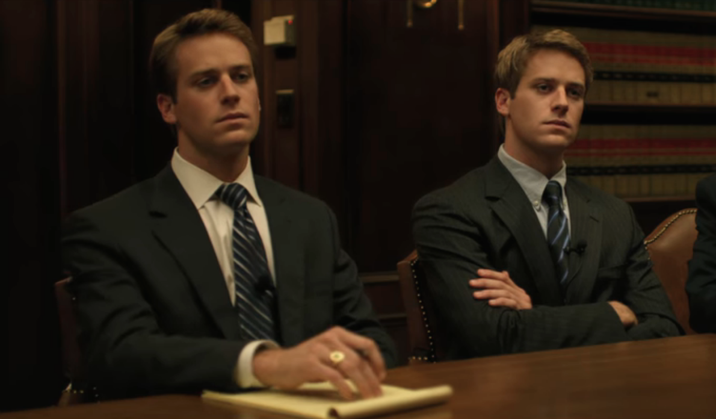
Synopsis
The Social Network
Mark Zuckerberg creates the website Facemash, which goes viral on and beyond Harvard Campus
His skills attract the attention of the Winklevoss twins and Divya Narendra, who commission him to build “Harvard Connection”
Zuckerberg and his friend Eduardo Saverin create “The Facebook”
Eduardo
Mark
Winklevoss Twins
The Social Network Main Characters
Notes:
OLIVIA
Facemash:
"Hot or Not" website where Harvard Students could rate other students attractiveness by comparing 2 photos and asking who is hotter [1]
Zuckerberg was reprimanded by the school for creating this website since it crashed the Harvard server, creating a security breach, violated the privacy of students and violated Harvard copyrights [1]
Harvard Connections:
Idea came from the Winklevoss twins (Tyler and Cameron) and with help from their friend Divya Narendra it came to life
After it was created they approached Zuckerberg asking for help (for pay) to expand their website to reach other college campuses to create a network [2]
In November 2003 they entered a verbal agreement that Zuckerberg would help and be a part of the company[3]
The Facebook:
In February 2004, Zuckerberg launches The Facebook with his 2 roommates Chris Hughes and Dustin Moskovitz and friend Eduardo Saverin[3]
Eduard Saverin was helping to fund the project and run the business side while Zuckerberg and his roommates focused on the product and coding

Slide 3
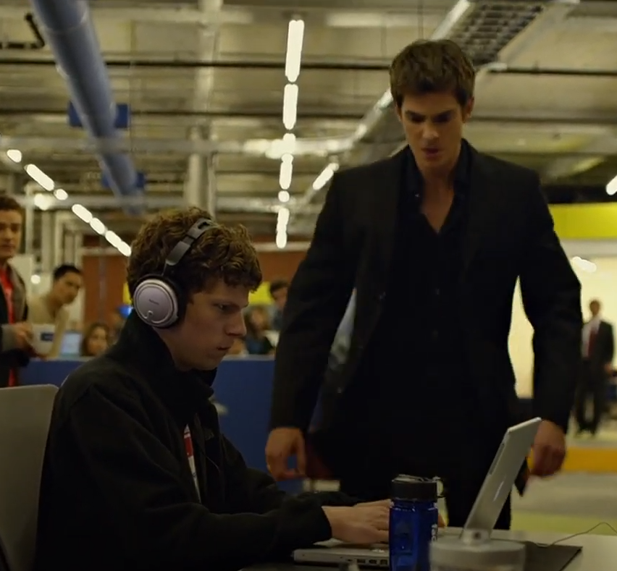
Synopsis
The Social Network
As “The Facebook” gains popularity, so do Zuckerberg and Saverin. “The Facebook” spreads to other colleges
With its rapid growth, Facebook starts to hire more people, and gains the attention of Sean Parker, founder of Napster
Facebook goes public, Zuckerberg plays Saverin for his shares
Saverin and the Winklevoss twins come back to sue Zuckerberg
The Social Network 1:42:52
Notes:
OLIVIA
The Facebook:
The Facebook grew very big very quickly, by the end of 2004 they had over 1 million users [4]
By spring 2004 the website expanded to the greater Boston area and the rest of the Ivy League [4]
Sean Parker joined the company, convinced Zuckerberg to drop the "The" in the name and drop out of Harvard and move to California to pursue Facebook full time [5]
Parker was able to help find financing for the project, going behind Saverin's back, and locked in angel investor Peter Theil (cofounder of PayPal) who invested $500,000 into the company [5]
Parker became the first president of Facebook (04-05) but then was asked to step down after getting charged with cocaine possession in 2005 [5]
After moving to California and adding Parker to the team, some conflict between Saverin and Zuckerberg started with Saverin wanting to put ads on Facebook and Zuckerberg wanting Saverin to provide the site with more funds [6]
Saverin was CFO of Facebook [6]
Eventually after securing new funds from their angel investor they had to restructure the company by creating a new one and when shares were redispersed so that Saverin was no longer a major share holder in the company and therefore no longer apart of Facebook [6]
Saverin later sued Zuckerberg for this
At the same time the Winklevoss twins sued Zuckerberg for intellectual property theft

Slide 4
Conclusions

Slide 5
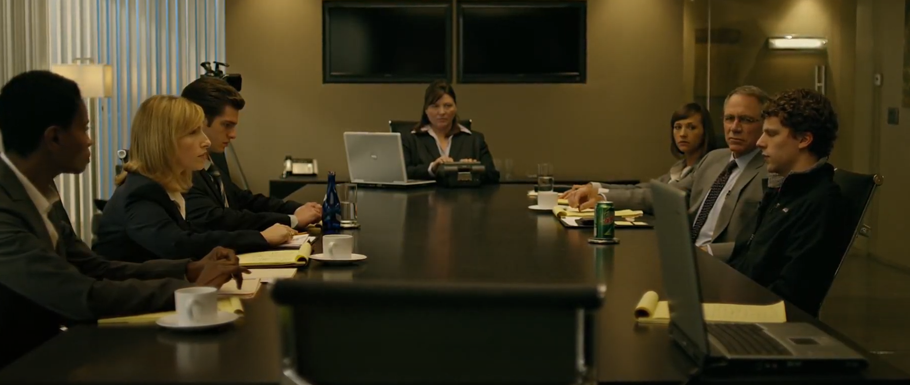
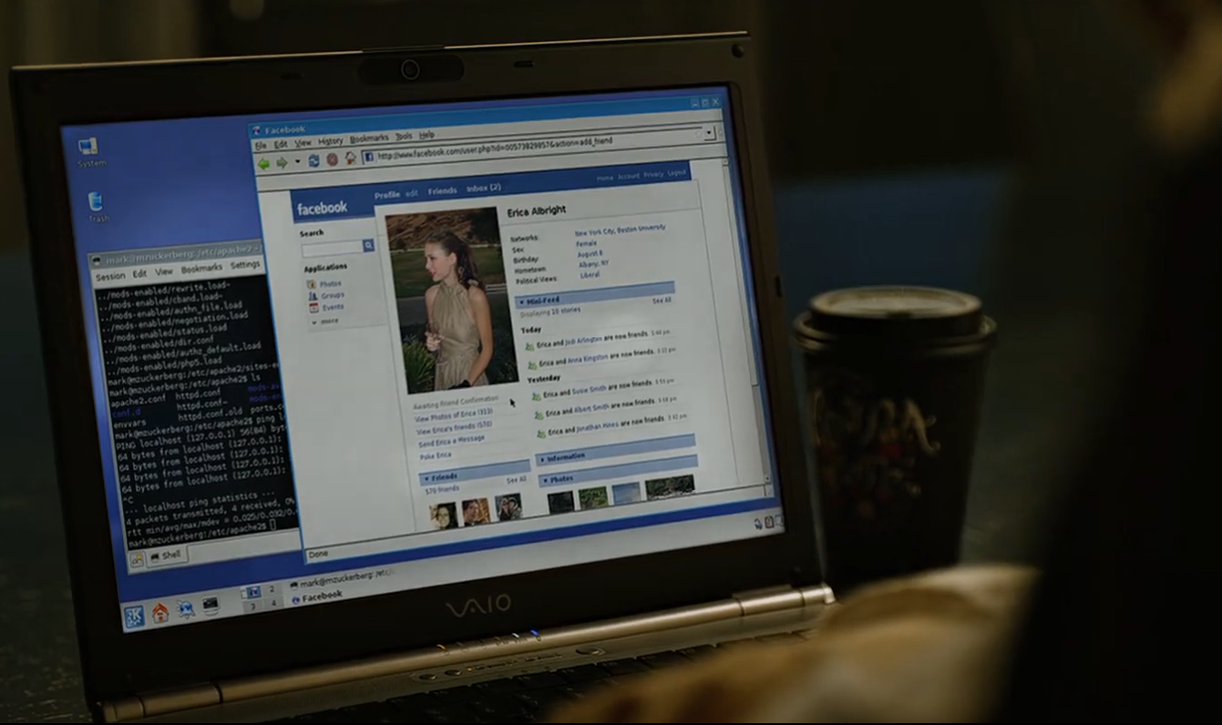
The Evolution of Technology has made information more difficult to govern
The Social Network
The Social Network (2010) highlights two specific aspects relating to
difficulties in information governance:
Intellectual Property Rights
Personal Information and Privacy
Notes:
NOAH
Larger conclusion we drew: The evolution of technology has made information more difficult to govern
Our movie highlights how information is difficult to govern in two aspects: intellectual property rights and personal information and privacy

Slide 6
Governance relating to intellectual property
Notes:
NOAH

Slide 7
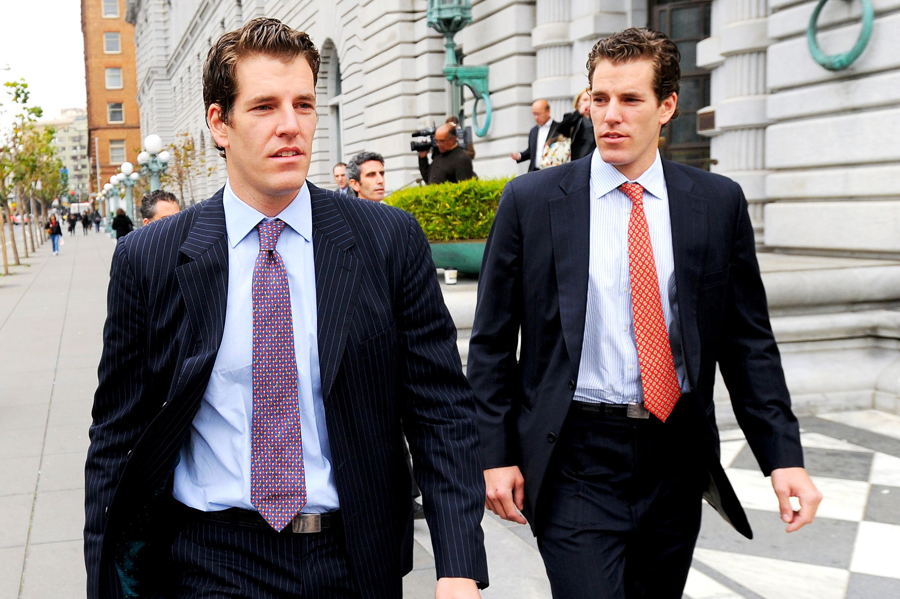
Intellectual property in the social network
The Social Network
Proprietary code
  HarvardConnection precedes TheFacebook
  Who has the intellectual property rights to the concept of Facebook?
Napster
  Sean Parker, founder of Napster, has a prominent role in The Social Network
  Music piracy
Tyler and Cameron Winklevoss, founders of HarvardConnection (link)
Notes:
NOAH
As mentioned previously, the Divya Narendra and the Winklevoss twins made a verbal agreement with Mark Zuckerberg that he would work on their project, HarvardConnection
They shared Zuckerberg their source code from previous programmers
Zuckerberg put off the project for months, sending the HarvardConnection group emails explaining that he has been busy with other commitments
During this time he has actually been working on TheFacebook, a website very similar in concept to HarvardConnection
Narendra and the Winklevoss' were exasperated when they found out about Facebook
They filed a lawsuit against Zuckerberg for intellectual property theft
This is although the HarvardConnection group had no copyrights, trademarks, etc.
So they argued on Zuckerberg breaching their agreement and stealing their idea
The HarvardConnection group reached a settlement of $65 million dollars
Napster was a popular filing sharing app for music, founded by Sean Parker, a prominent character in the movie
Napster did not store any audio files, but provided the tools copy songs from other computers without permission from record labels
The company became involved in a lawsuit with the Recording Industry Association of America, being targeted by many record labels
They said Napster infringed on copyright laws by facilitating the distribution of songs, their intellectual property, to make financial gains
Napster argued that they were not responsible for how their users utilized their service
However, the court ruled Napster's operations were not fair use, and as a result filed for bankruptcy
The Napster drama did not appear in The Social Network directly, but Sean Parker was closely connected to Facebook and it was discussed in the movie

Slide 8

Intellectual property Problems Today
The Social Network
Intellectual Property theft in the corporate world:
    “45% of all U.S. businesses have reported losses due to intellectual property theft.”
      Estimated $250 billion a year in stolen intellectual property
Facebook-Cambridge Analytica Scandal (2018)
  Facebook had data from “87 million users improperly accessed by Cambridge Analytica”, which was used for targeted political advertising.
Notes:
Image source: https://em360tech.com/tech-article/ai-art-copyrighted
https://thedirect.com/article/gta-6-florida-leonida-map-place-explained

Slide 9
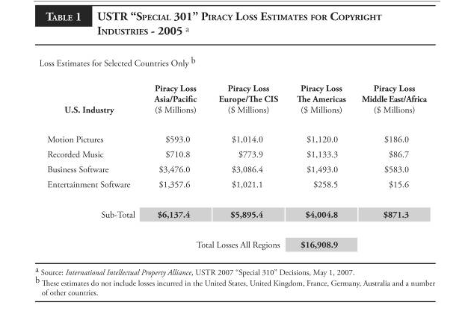
Intellectual property Problems Today
The Social Network
Digital Piracy and Copyright
    $17 billion in losses annually: The U.S. economy has a combined loss estimated by all four copyright industries for all regions.
Piracy and leakers
  GTAVI Leak (2022): The high-profile leak of early gameplay footage of Rockstar Games' Grand Theft Auto VI by hackers, costing the company potential revenue and reputation damage, is a modern-day example of how intellectual property theft impacts the gaming industry.
Notes:
Image source: https://em360tech.com/tech-article/ai-art-copyrighted
https://thedirect.com/article/gta-6-florida-leonida-map-place-explained

Slide 10
Governance relating to
Private information

Slide 11
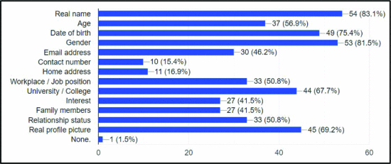
Private Information in the social network
The Social Network
Abuse of restricted information
  Facemash was created using databases that needed a harvard.edu clearance.
  A lot of data was used for this public domain before it was taken down.
Poor online privacy literacy
  “66% of Facebook users had no knowledge of privacy settings” [17]
  “Higher privacy concerns were associated with weaker intentions to use online services
    (r = −0.17, 95% CI [−0.27, −0.07]) ” [7]
Online stalking
  1 in 5 women, 20%, in Australia, aged 15 years and above, reported being stalked
  Perpetrators used Facebook's location features to track victims [18]
[16]
Notes:
Jason Luc
Facemash is the prime example of the abuse of restricted information. Information that required to be a harvard student was taken to then create an application not intended of the databases.
66% of Facebook users had no knowledge regarding privacy settings.
https://www.mdpi.com/1999-5903/7/1/67
1 in 5 women (20%) in Australia, aged 15 years and above, reported being stalked (Australian Bureau of Statistics, 2006).
Perpetrators used Facebook's location features to track victims in a U.S. study involving 10 women in a domestic violence shelter (Dimond et al., 2011).
https://journals.sagepub.com/doi/full/10.1177/1077801216646277
https://ieeexplore.ieee.org/abstract/document/9140098
(Graph/Figure)
"The chart above indicates that out of 65 respondents, the most commonly published their personal data on Facebook is real name, which indicated by 83.1% (54) of respondents. Secondly is gender which indicated by 81.5% (53) of respondents and following with date of birth which indicated by 75.4% (49) of respondents. Thirdly is real profile picture which indicated by 69.2% (45) of respondents. Fourthly is university or college which indicated by 67.7% (44) of respondents. Fifthly is age which indicated by 56.9% (37) of respondents and following with relationship status and workplaces which indicated by 50.8% (33) of respondents. Sixthly is email address which indicated by 46.2% (30) of respondents and for interest and family members indicated the same amount of respondents which are 41.5% (27).Seventhly is home address which indicated by 16.9% (11) of respondents and 15.4% (10) indicated for contact number. Finally, only one respondents indicated by 1.5% for none."

Slide 12
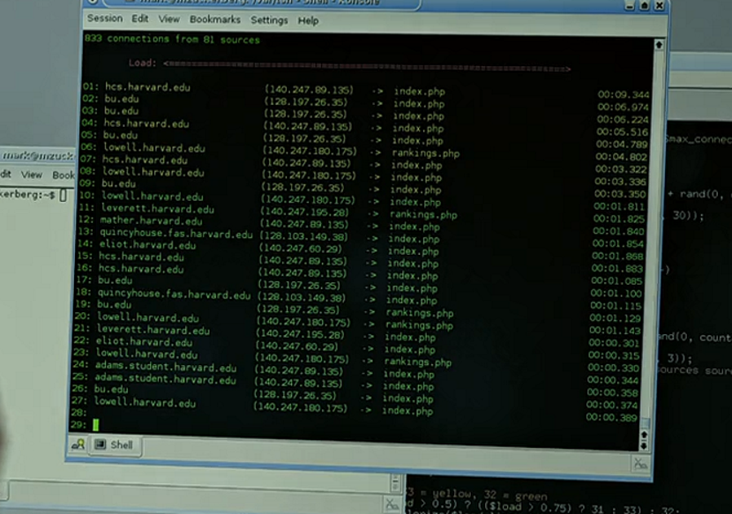
Note the “bu.edu” domains
12

Slide 13
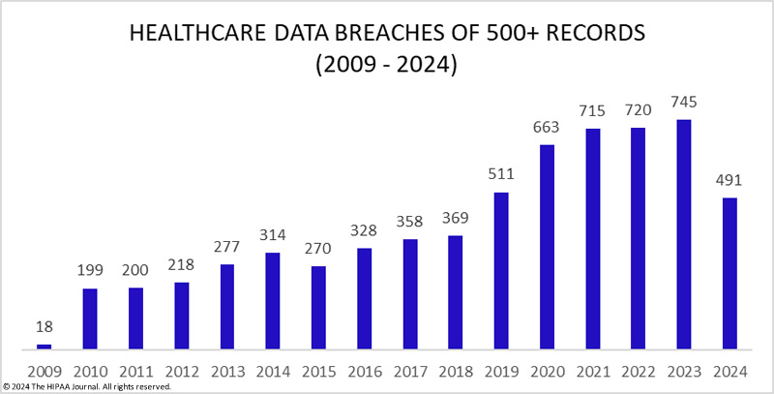
Private Information issues today
The Social Network
Facial recognition databases
  Social media is scraped to create biological profiles
  Violation of privacy laws
  40 billion images scraped [14]
Data breaches of large companies
  Facebook has suffered a large data breach of its own (530 million users affected) [13]
Facebook generated 114 billion dollars in advertising revenue [15]
  Targeted advertising, profiling each user
[12]
Notes:
https://www.hipaajournal.com/healthcare-data-breach-statistics/ (to be cited)
https://www.npr.org/2021/04/09/986005820/after-data-breach-exposes-530-million-facebook-says-it-will-not-notify-users
https://www.bankinfosecurity.com/dutch-regulator-fines-clearviewai-30m-for-data-scraping-a-26205
https://abc7news.com/clearview-ai-california-attorney-general-rob-bonta-consumer-watchdog/14231840/
https://www.statista.com/statistics/544001/facebooks-advertising-revenue-worldwide-usa/
https://tuta.com/blog/what-does-facebook-know-about-me

Slide 14
References
The Social Network
[1] Kaplan, Katherine. "Facemash Creator Survives Ad Board." The Harvard Crimson, Nov. 19, 2003. https://www.thecrimson.com/article/2003/11/19/facemash-creator-survives-ad-board-the/
[2] Farah, Lynn. "Who are the Winklevoss twins and where are they now? From scoring a US$65 million payout from Facebook’s Mark Zuckerberg and competing in the 2008 Beijing Olympics to crypto fraud and bankruptcy." Style Magazine, Dec. 31, 2023. https://www.scmp.com/magazines/style/people/celebrities/article/3246540/who-are-winklevoss-twins-and-where-are-they-now-scoring-us65-million-payout-facebooks-mark
[3] "Timeline: Looking back at 20 years of Facebook and CEO Mark Zuckerberg." ABC 7 NY, Feb. 3, 2024. https://abc7ny.com/facebook-20-year-anniversary-mark-zuckerberg-meta/14383883/
[4] Onion, A., Sullivan, M., et. Al. "Facebook Launches." History, Feb. 2, 2024. https://www.history.com/this-day-in-history/facebook-launches-mark-zuckerberg
[5] Gregersen, Erik. "Sean Parker." Britannica Money, Aug. 22, 2024. https://www.britannica.com/money/Sean-Parker
[6] "Eduardo Saverin Net Worth, Wiki, Age, Wife, Married and Facebook." Super B Hub, Nov. 20, 2017. https://superbhub.com/biography/eduardo-saverin-net-worth-age-wife-facebook/
[7] Baruh, Lemi, et al. “Online Privacy Concerns and Privacy Management: A Meta-Analytical Review.” Journal of Communication, vol. 67, no. 1, 17 Jan. 2017, pp. 26–53, https://doi.org/10.1111/jcom.12276.
[8] DelPonte, P. (2024, June 17). NCPC: Globalization Impacting Intellectual Property Theft. National Crime Prevention Council. https://www.ncpc.org/resources/ip-theft/trends/
[9] U.S. Copyright Office, "A&M Records, Inc. V. Napster, Inc., 239 F.3d 1004 (9th Cir. 2001)", https://www.copyright.gov/fair-use/summaries/a&mrecords-napster-9thcir2001.pdf
[10]“The great hack”: Cambridge Analytica is just the tip of the iceberg. Amnesty International. (2021, October 11). https://www.amnesty.org/en/latest/news/2019/07/the-great-hack-facebook-cambridge-analytica/
[11]The true cost of copyright industry piracy to the U.S. economy. (2007, October 3). https://www.ipi.org/ipi_issues/detail/the-true-cost-of-copyright-industry-piracy-to-the-us-economy
[12] Alder, Steve. “Healthcare Data Breach Statistics.” HIPAA Journal, 24 Sept. 2024, www.hipaajournal.com/healthcare-data-breach-statistics/. Accessed 8 Oct. 2024.
[13] Bowman, Emma. “After Data Breach Exposes 530 Million, Facebook Says It Will Not Notify Users.” NPR, NPR, 9 Apr. 2021, www.npr.org/2021/04/09/986005820/after-data-breach-exposes-530-million-facebook-says-it-will-not-notify-users. Accessed 8 Oct. 2024.
[14] Sierra, Stephanie. “AG Bonta Called to Investigate Clearview AI for Allegedly Selling Images to Police without Consent.” ABC7 San Francisco, 28 Dec. 2023, abc7news.com/clearview-ai-california-attorney-general-rob-bonta-consumer-watchdog/14231840/. Accessed 8 Oct. 2024.
[15] Statista. “U.S. Facebook Advertising Revenue 2021.” Statista, 2023, www.statista.com/statistics/544001/facebooks-advertising-revenue-worldwide-usa/. Accessed 8 Oct. 2024.
[16] Alkawaz, Mohammed Hazim, et al. “The Impact of Current Relation between Facebook Utilization and E-Stalking towards Users Privacy.” 2020 IEEE International Conference on Automatic Control and Intelligent Systems (I2CACIS), June 2020, https://doi.org/10.1109/i2cacis49202.2020.9140098.
[17] Gan, Diane, and Lily Jenkins. “Social Networking Privacy—Who’s Stalking You?” Future Internet, vol. 7, no. 4, 23 Mar. 2015, pp. 67–93, https://doi.org/10.3390/fi7010067.
[18] Woodlock, Delanie. “The Abuse of Technology in Domestic Violence and Stalking.” Violence against Women, vol. 23, no. 5, 2017, pp. 584–602, https://doi.org/10.1177/1077801216646277.

