Slide 1
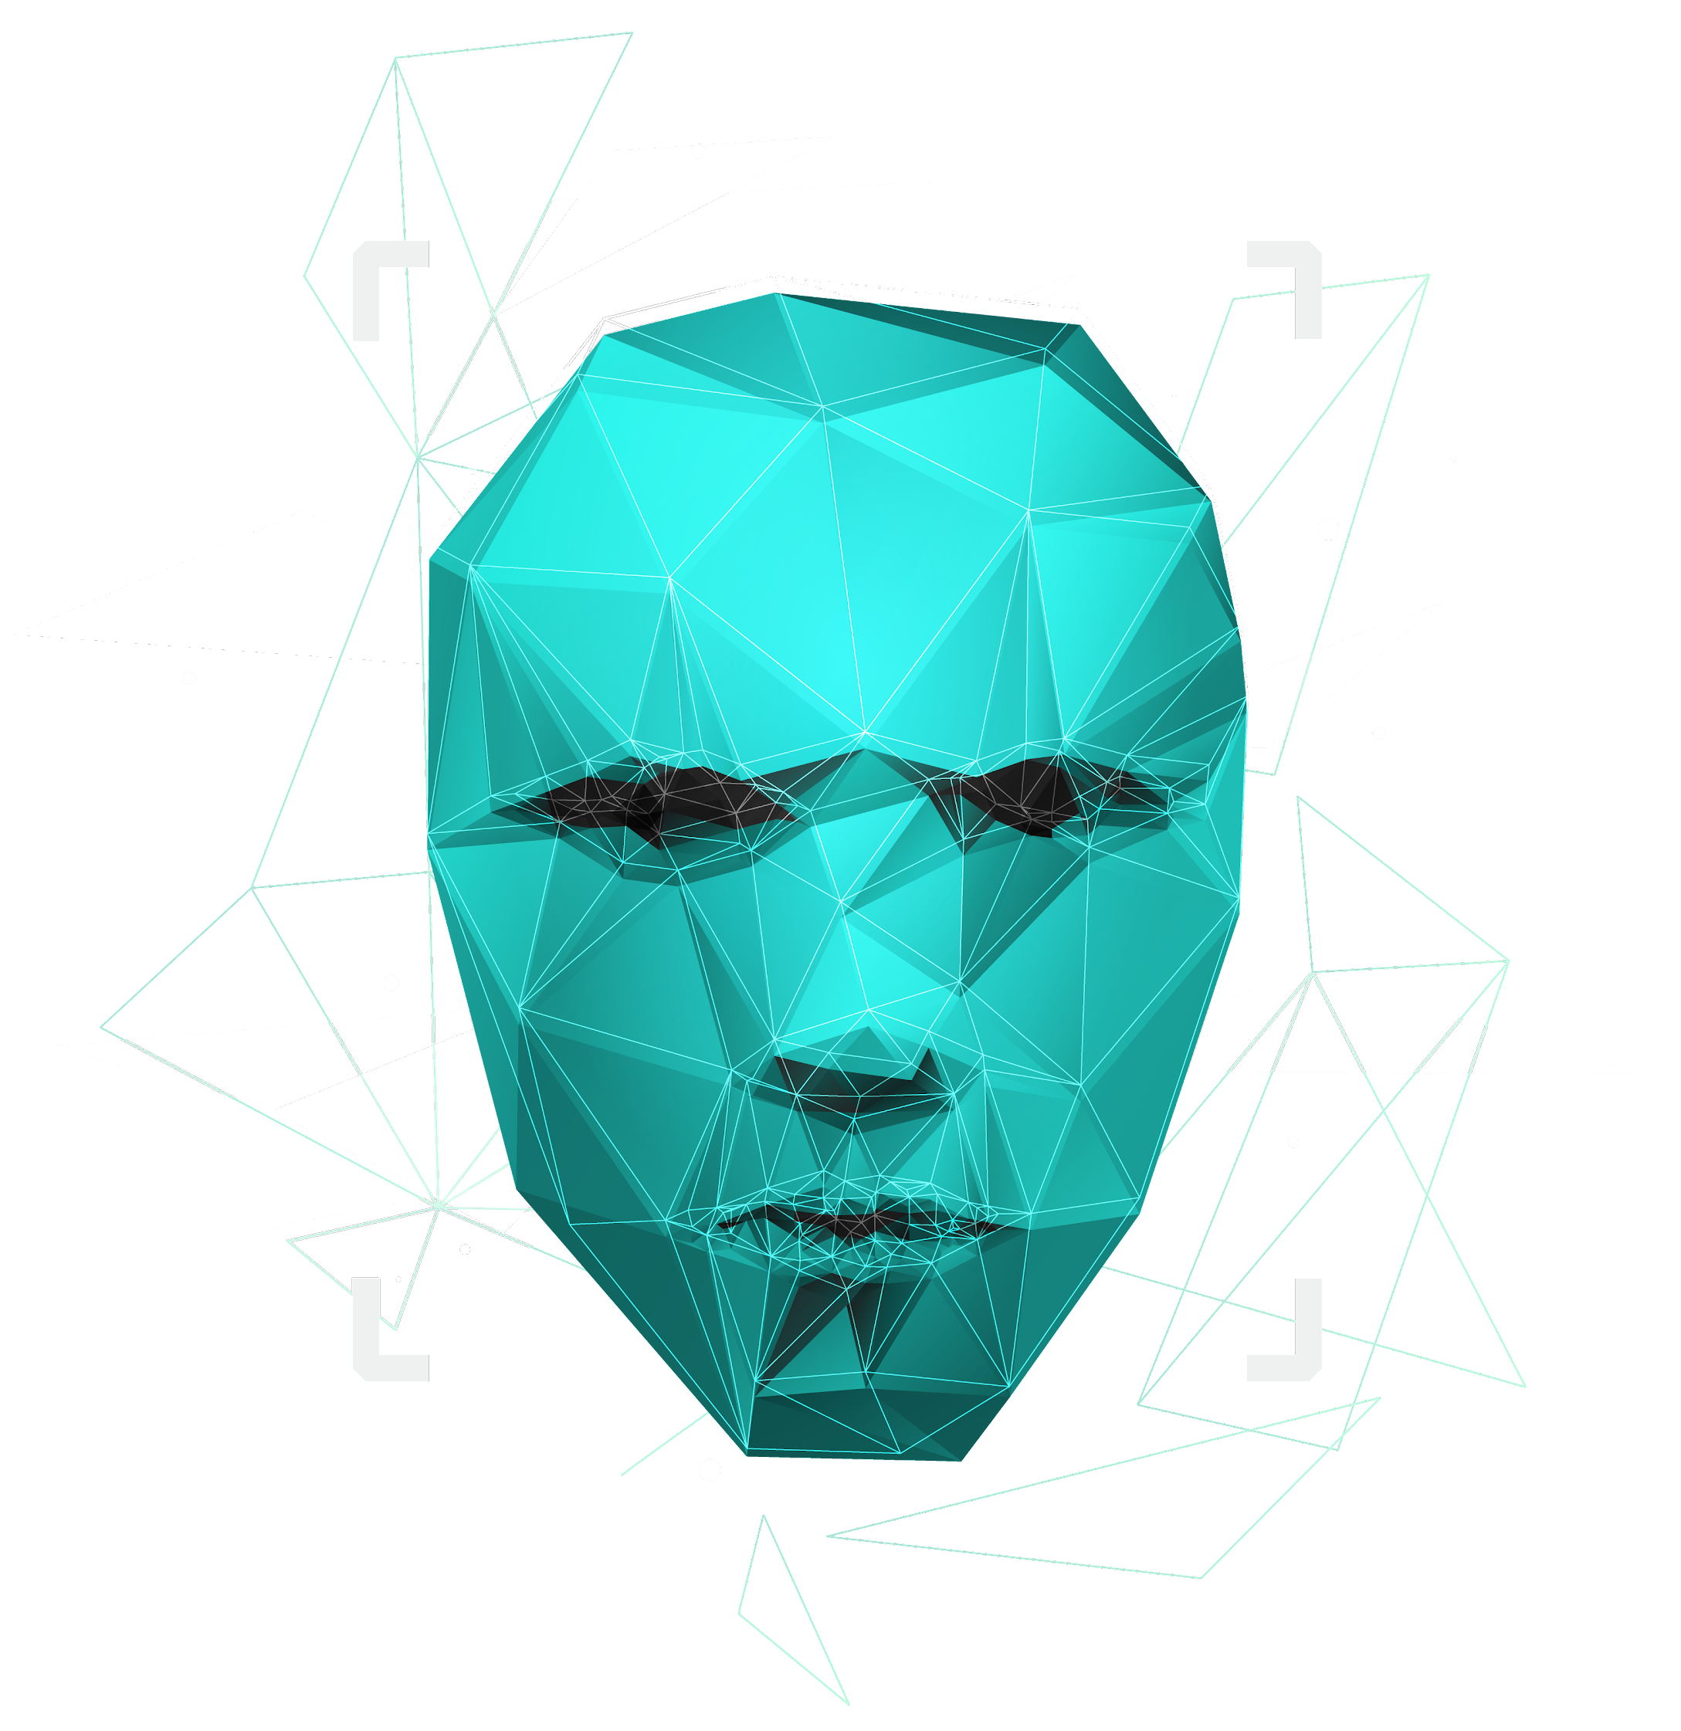
The Matrix (1999): A Warning About the Future
Ander Carbajo, Austin Rebello, Brianna Sahagian, Ken Nguyen, Shen Fang

Slide 2
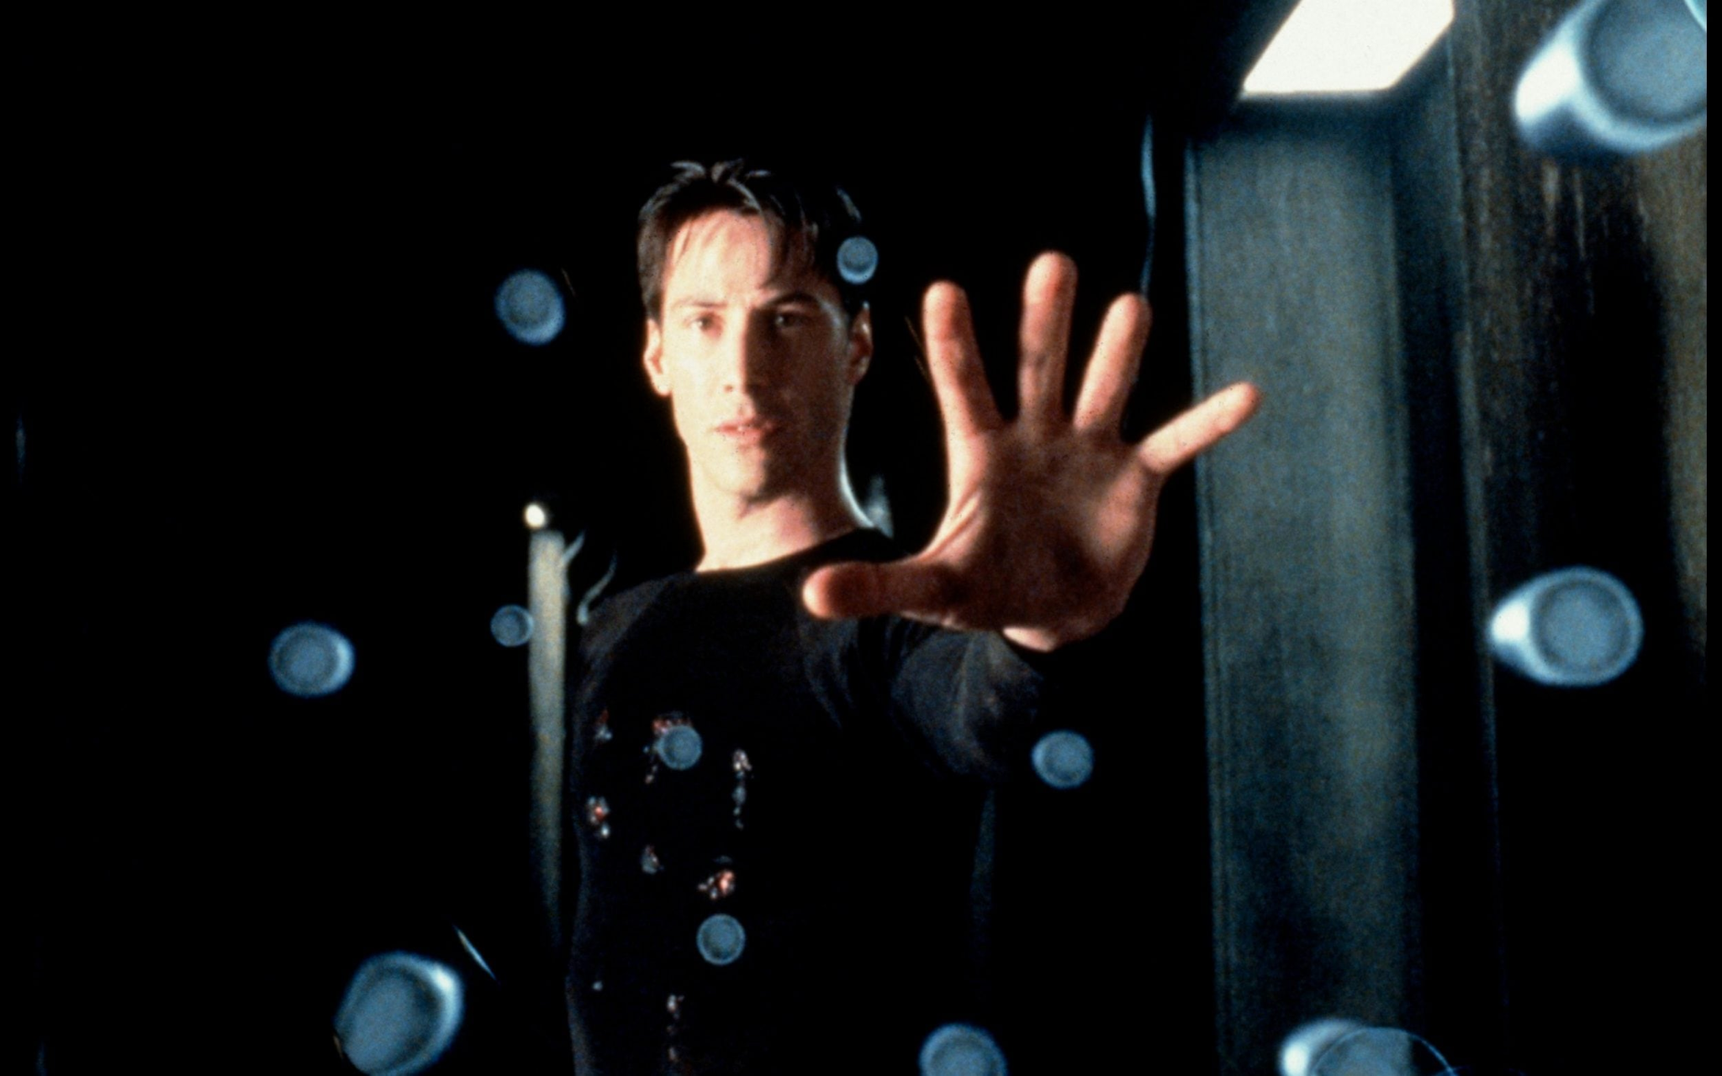
Synopsis
The Matrix
Morpheus and Trinity search for Thomas Anderson AKA “Neo” [7:20]
Neo takes the red pill to learn about the Matrix [29:05]
Neo meets the Oracle [1:12:35]
Agent Smith captures Morpheus [1:24:54]
Trinity and Neo launch a mission to save Morpheus [1:37:24]
Neo fights and defeats Agent Smith [2:05:10]
Neo stops bullets by manipulating the Matrix [16]
Notes:
Ken
A synopsis for The Matrix, Morpheus and his crew are in search for “The One”. Thomas Anderson AKA prominent hacker Neo is the The One. He takes the red pill in order to learn about the truth behind the Matrix. Then Morpheus and co bring Neo back into the Matrix in order to meet the Oracle. However, Agent Smith with the help of crew member Cypher captures Morpheus, slaughtering most of the crew in the process. Neo and Trinity return into the matrix to save Morpheus. After retrieving him, Neo encounters Agent Smith for a final showdown. Neo displays his reality bending power within the matrix to defeat Agent Smith. He leaves the matrix and makes a calls to arm for others to join the cause.

Slide 3
Timeline
Neo enters the construct (39:20)
  Loading program that hackers use to create anything they need to bring to the Matrix
  1993 First VR Headset -> 2021 Affordable VR Headsets
The Matrix system explained (42:20)
  AI created a simulation to channel a human source of energy to sustain themselves
  Approaching full immersion video games
With rapid advancements in VR technology, a Matrix-like simulation is plausible in the next century
Notes:
Ken
20 years after the release of the matrix, humanity has made great strides towards a matrix-like simulation. Through the lens of video games we already have a construct. The level of immersion from modern videogames is quite astonishing. In 1993, the first VR headset was made by SEGA. In 2014, Google Cardboard was released so customers can make their own VR Headset. In 2018, Vive Tracker has full body tracking and display on screen. Now in 2021, we have cheaper than ever peripherals on the market. You can have games in VR that are open sandboxes that allow you to place any item you have stored into Virtual space. It is not absurd to say that we are rather close to a near full body VR experience displayed in the movie Ready Player One. So it isn’t absurd that in the next century we can reach a matrix like simulation point.

Slide 4
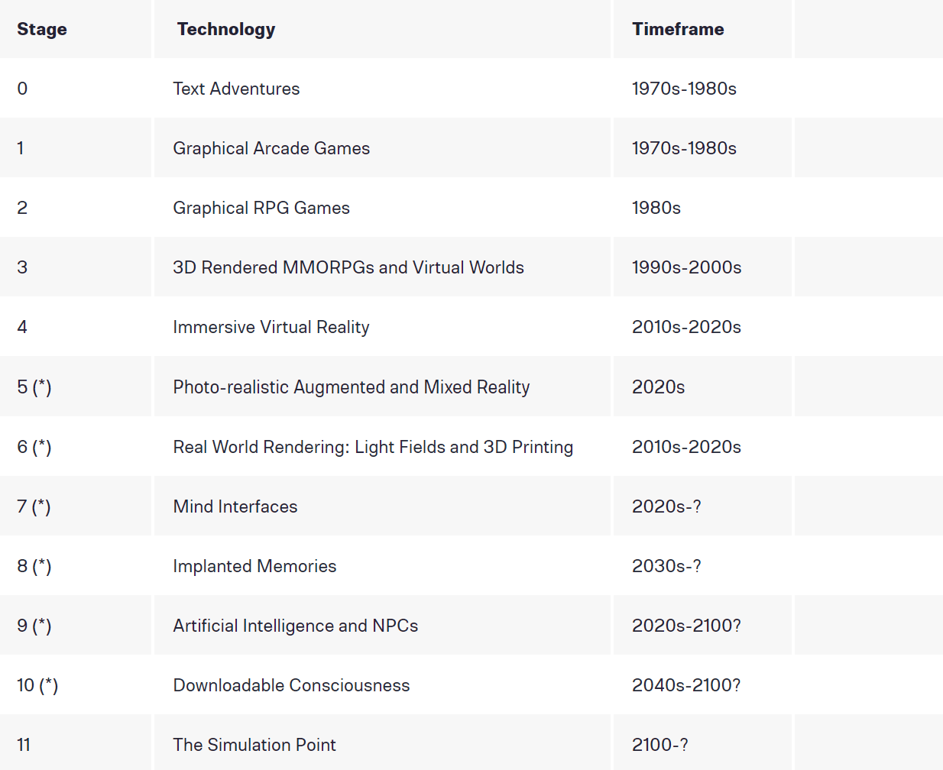
Timeline
With rapid advancements in VR technology, a ‘Simulation Point’ is plausible in the next century [23]
Notes:
Ken
Here is a roadmap to the Simulation Point from the book “The Simulation Hypothesis”. There are 10 stages that humanity requires to create a simulation resembling the Matrix. We have already passed the first 4 stages with text adventures, arcade games, modern RPGS, MMOs and Virtual worlds. We are currently in the 5th stage advancing photorealistic augmented and mixed reality. We argue that reaching the full immersion in a video game shown in Ready Player One would satisfy the 5th requirement on the list. For later stages such as Mind Interface and Implanted Memories, we have Elon Musk’s Neuralink developing implants that are “high bandwidth and safe” brain-machine interfaces. For stages 9 and 10, We already have extremely advanced AI beating professional Chess players and AI developed deepfakes. These are examples that we can reach a simulation point by the next century.

Slide 5
Overview & Conclusions
The Matrix
Morpheus’ group in The Matrix highlights the hacker’s tendency to disrupt systems and cause chaos for their targets.
  Increase of hacker power in the future poses a threat of severe monetary damage and loss of life
The Matrix lacks any privacy from the government, which parallels the power granted to the U.S. Government with the PATRIOT Act.
  Social norm: government spying on citizens through wiretapping/social media
  Risk of a government-led privacy lockdown in the future
Notes:
Shen
Our group’s conclusion toward The Matrix can be broken down into two parts. First, Morpheus’ group in The Matrix highlights the hacker’s tendency to disrupt systems and cause chaos for their targets. The Matrix serves as a warning about hacking power and its damage potential in the next decade. Then, The Matrix lacks any privacy from the government, which parallels the power granted to the U.S. Government with the PATRIOT Act. Real world government wiretapping capabilities and monitoring of citizen social media may grow into a Matrix-like privacy lockdown if left unaddressed.

Slide 6
Hacker Presence in The Matrix
The Matrix
Morpheus’ group characteristics
  Hidden base of operations
  Code ‘hacker’ names: ‘Trinity’, ‘Cypher’, ‘Neo’
  Recruit new members online [7:20]
Morpheus’ group & disruption/chaos
  Going to and leaving the Matrix freely
  Bringing weapons into the Matrix from the construct
  Neo destroys Agent Smith [2:05:10]
Notes:
Brianna: Morpheus’ group of rebels in The Matrix mirrors real world hacker groups in structure and actions. In the movie, Morpheus’ group has a base hidden from authority.
‘Neo’ is not the protagonist’s government recognized name of Thomas A. Anderson, but is actually a hacker alias that he goes by while committing cybercrimes.
The team recruits new members through computer messages as seen at 7:20 in the movie, messages that use online pathways undetected by the government.
Break the structure of the Matrix, causing disruption to the target system and the creators of the Matrix.
The group exploits the Matrix code in order to leave and get into the Matrix when they need to, bypassing the agent security.
Brings weapons into the Matrix that they create in the construct, inserting their own foreign code into the system.
Neo exploits the Matrix code to circumvent the laws of the Matrix and destroy the agents chasing him.

Slide 7
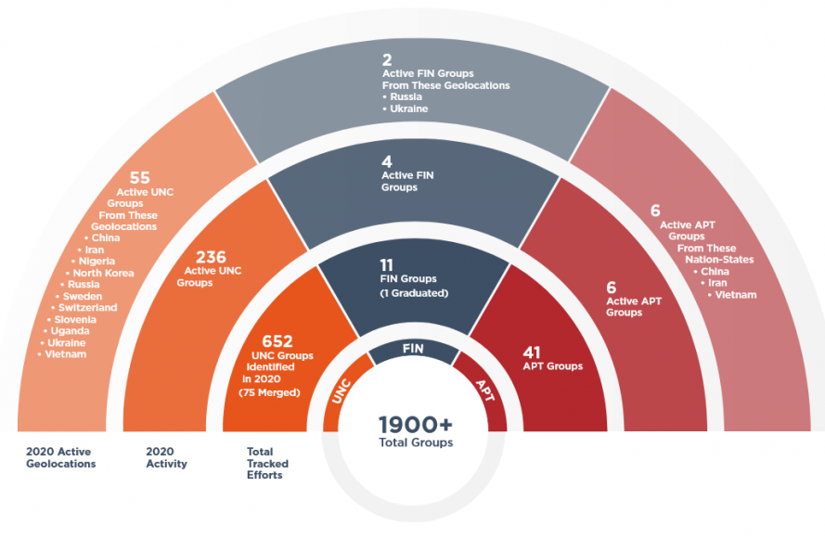
Hacker Presence in Reality
The Matrix
Hacker group characteristics
  Hidden base: Anonymous vs. MOD [1]
  ‘TriCk’ & ‘MTS’ aliases [2]
  100 million recruitment websites [3]
Hacker groups & disruption
  TeaMp0isoN attacks NASA forum [4]
  Anonymous shuts down 100 ISIS supporter Twitter accounts [5]
  $57,836,379 lost to phishing in 2019 [6]
1,900 hacker groups of 3 distinct types: UNC, APT, and FIN groups [7]
Notes:
Brianna: In reality, hacker groups are typically hidden from society in either centralized or decentralized structures.
Masters of Deception based out of New York are centralized
Anonymous is decentralized
In addition, hacker groups have code names just like the ones seen in The Matrix
TeaMp0isoN having leader aliases of ‘TriCk’ and ‘MTS’.
Hacker groups also recruit potential new members through job postings on the web and dark web,
100 million websites
Just as in The Matrix, real world hacker groups try to disrupt online systems
TeaMp0isoN led an attack against a NASA forum, exposing the credentials of the website admin
Anonymous led an attack against ISIS, shutting down 100 supporter Twitter accounts
Over 57 million dollars was lost to phishing attacks in 2019
While hacker group targets can vary, hacker groups strive to disrupt and exploit their targets.
Total of 1,900 active groups in 2020. The picture depicts the breakdown of some active hacker organizations in 2020 including Nation-State Sponsored Threat Actors (known as APTs), Financially Motivated Groups (known as FINs), and Uncategorized Groups (known as UNCs).

Slide 8
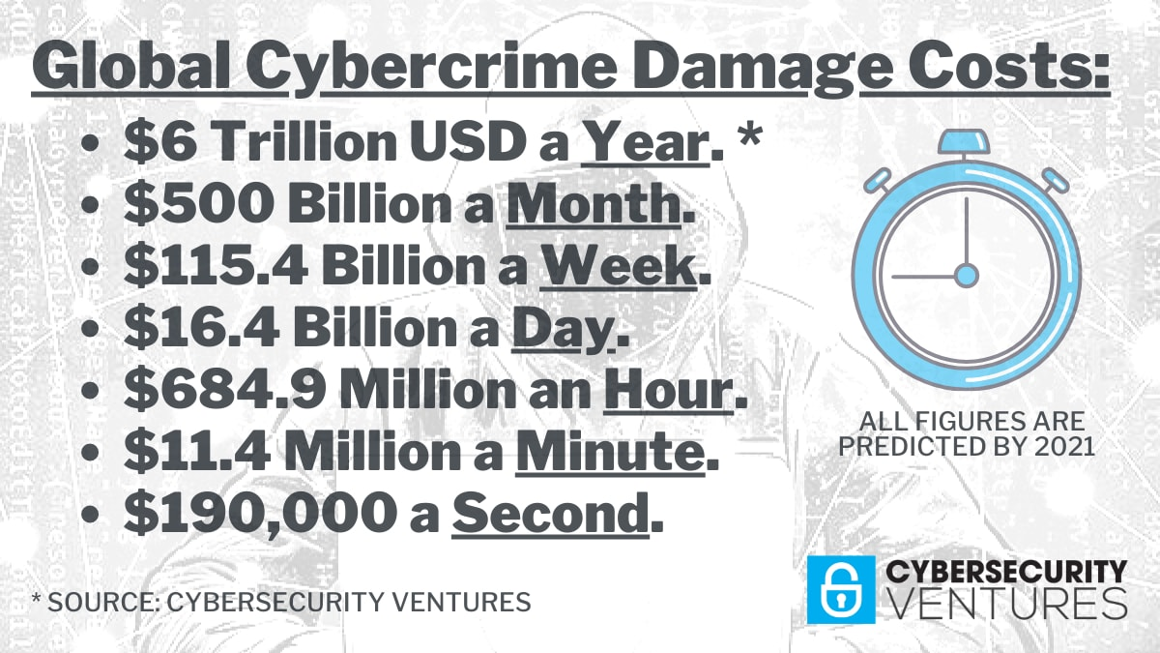
Future: Matrix Level Hacking
The Matrix
Global cybercrime costs to reach $10.5 trillion by 2025 [18]
Hacking to reach a life-threatening point
  2020 ransomware murder [19]
  COVID-19 vaccine targeted in 2020 [20]
Hacking to remotely commandeer nuclear/atomic bomb facilities
  Attack on Natanz [21]
  Potential to kill 34.1 million people [22]
Cyber attack damage equates to almost $200,000 per second by the end of 2021 [18]
Notes:
Brianna: The level of destruction that Morpheus’ group displayed through Neo’s hack of the Matrix could become a reality if hacking groups continue to grow in power and number.
Potential to damage the global economy and end human lives
Cybercrime costs estimated to reach up to $10.5 trillion by the year 2025 - 3rd largest economy
2020 ransomware attack on a German hospital = patient to be unable to receive a life-saving surgery
Hacking targets in 2020 included COVID-19 vaccine supply chains
Hackers of the future will have the potential to kill their victims = Neo was able to erase Agent Smith from existence in The Matrix
A hacking attack on Iranian nuclear weapon center Natanz by an Israeli hacker group demonstrates the power that hackers will be able to achieve over the military and government
Neo had control over the government’s most powerful weapon against humanity, the Matrix simulation
Parallel real world hackers have demonstrated their potential to hack into the most powerful weapons in the military
Cause 34.1 million casualties within the first few hours of a nuclear war
The statistics in the image depict the severity of current costs from cybercrime (as predicted by the end of 2021) with $190,000 dollars being lost to cyber attacks every second.

Slide 9

Government Spying in The Matrix
The Matrix
The Sentinels are an AI Program that see everything through the code that runs the simulation
This means they know everything about everyone
The AI knows Neo is a hacker and takes out his landlady’s trash [18:18]
Neo is interrogated by the Sentinels [15]
Notes:
Austin:
Since The Matrix is fully contained within a computer simulation, the AI that controls the simulation can see everything occurring inside, through the code itself. This means that every footstep taken, door opened or street crossed is able to be read and logged by the AI. Since the AI is the government in the Matrix, this removes any and all privacy from the citizens, and they know every little detail about everybody, including Neo himself. When he is brought in for questioning, it is revealed that the AI are already aware that Neo is a hacker, and they go as far as also sharing that they know he has good nature to him as he takes out his landlady’s trash. They use this information against him by trying to force him into a deal, which despite the threat of prison, he denies. They also use the information in the code to track his location upon his escape from custody, something governments today can do.

Slide 10
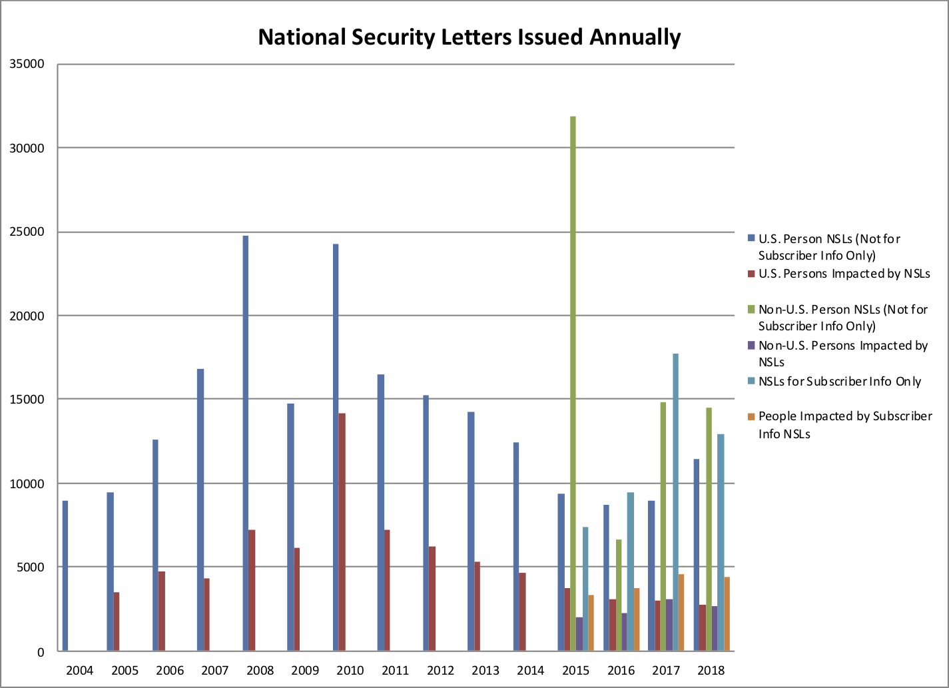
Present Day Government Monitoring
The Matrix
After 9/11, the United States passed the PATRIOT Act
This act gives powers to the FBI
  Wiretapping citizens and collection of personal information records [13]
The government also monitors your web traffic
  Almost 200,000 National Security Letters resulted in only 1 criminal [13]
  34,000 Law Enforcement Agencies have access to this information [13]
The number of total NSLs issued annually continues to gradually climb [14]
Notes:
Austin:
The real life government has similar capabilities that allows it to quickly and efficiently collect information on the daily lives of its citizens. This is because of the PATRIOT Act that Congress passed as a result of 9/11, expanding the powers of the FBI to grant them monitoring capabilities on anyone they want. The FBI is legally allowed to monitor citizens through wiretapping and online tracking, such as the collection of personal information records. They acquire this information through “National Security Letters” that can be obtained without any judicial review, and in the 200,000 letters filed, only one terrorist has been apprehended. However, the rest of the information gathered has been stored for “future use,” and is available to over 34,000 law enforcement agencies nationwide, allowing several agencies to monitor you as you pass from one to the other. On top of this, the number of NSLs is only increasing each year according to the graph, even if the types of NSLs are diversifying. This is incredibly dangerous because the government can begin to restrict your lifestyle based on what they learned from tracking you. A key example to this is anything involving the site Wikileaks, where your job or future career could be in jeopardy for so much as visiting their website. With monitoring technology continuing to develop, it is quite possible that the near future could mirror the authoritarian crackdown on personal privacy seen in The Matrix.

Slide 11
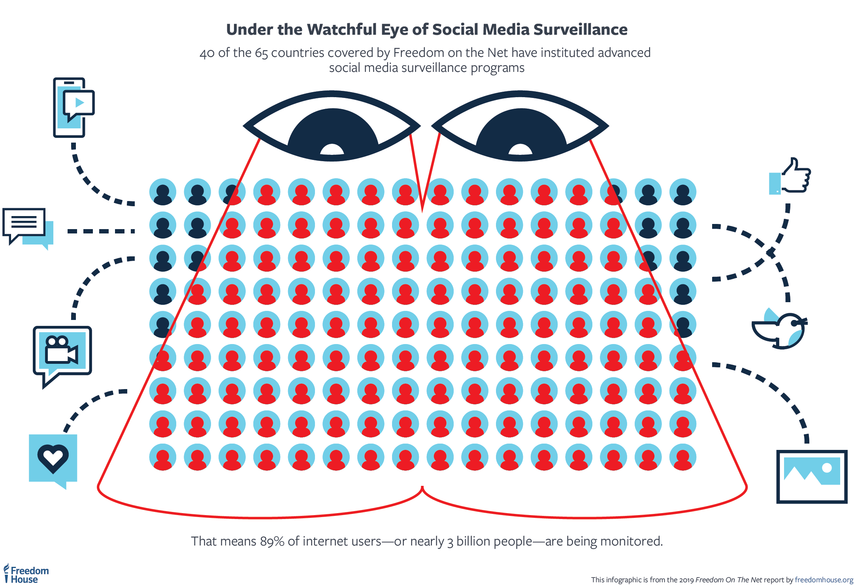
Social Network Monitoring In Reality
The Matrix
Cookies allow websites and social networks to generate a profile of the user [8]
  Government tracks citizens through cookies [27]
Interpol international voice biometric system matches voices to social media [25]
LAPD instructs officers to use social media to monitor/make arrests [26]
Image depicting scope of internet monitoring [28]
Notes:
Ander
But in the present government monitoring extends further than just facial recognition and web traffic, In the past years government's efforts to monitor social networks in order to track population have increased significantly. Detecting a user’s personality can facilitate knowing his potential needs on different occasions [8]. Therefore, adaptive applications may take advantage of models of users’ personality to adapt their behavior accordingly. Using standard personality traits, there is machines that model a person's personality. Using that model, a team of investigators was able to achieve 82.2% accuracy which was more accurate than previous studies that were able to foresee personality according to the variables in their profiles in five factors. Microsoft wants the US government to start thinking about laws around the use of facial recognition technology as a form of surveillance. Interpol is developing an international voice biometrics database that will be shared with various police bodies. Titled the Identification Integrated Project, the system includes voice samples from 192 law enforcement agencies. This will enable users to use voice recognition technology to match suspects against database records. [25]. The Los Angeles Police Department (LAPD) has authorized its officers to collect social media information on every civilian they interview, even if they are not arrested or accused of a crime, according to The Guardian and a new report

Slide 12
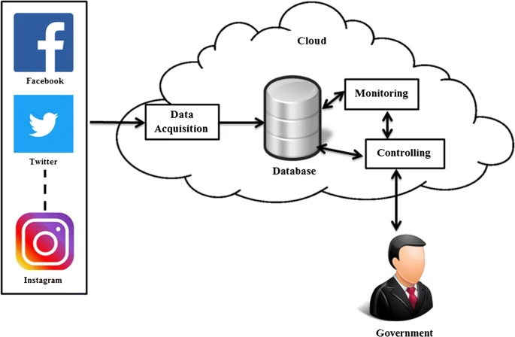
Future: Total Privacy Lockdown
The Matrix
Government attempts to wiretap Facebook messenger calls in 2019 [29]
  Start of an era of wiretapped social media
Facial recognition market to grow 12.4% from 2021-2025 [30]
Government policy implementation through cloud computing and social media [24]
Cloud Computing and Social Media Analytics for efficient monitoring and controlling of public policies[24]
Notes:
Ander
We might be on the way to a dystopian future where social networks privacy doesn't exist, the dangers of this are obvious, as in 2019 government attempted to wiretap facebook messengers calls which this was done through trying to force them to rewrite the code in order to make eavesdropping possible. The implications of this are as dangerous as they seem, they could generate a fingerprint of every user, as facial recognition gets more and more advanced, a database could be generated where governments and big agencies could have information of how you sound, the linguistics that you use, your facial expressions etc. Even if this can also be used in positive ways for example, they have tried to combine the selective capabilities of cloud computing and social media analytics towards efficient monitoring and controlling of public policies, as seen in the picture.

Slide 13
Summary
The Matrix
The Matrix group parallels real world hacker organizations in makeup and goals
  Displays a dynamic of hacker groups causing chaos to online systems
  Warms against the damage from all-powerful hackers in the future
The Matrix warns viewers of the possibility of the government becoming invasive in individual citizens lives
  Shows how citizens are all monitored, which is now possible under the PATRIOT Act
  Warns against a future complete privacy lockdown
Notes:
Austin:
The Matrix main character group parallels real world hacker organizations with their makeup and goals, as they respond well to the changing situations while continually causing chaos towards the system they are attacking. If hackers and hacker groups continue to proliferate and develop more advanced techniques in the near future, there will be monetary loss as well as loss of human life resulting from their cyber attacks.
The Matrix also warns of an overbearing government who pries into innocent and private citizens lives around the clock. This has become true today, through the PATRIOT Act, which allows the U.S. government to legally wiretap and request all information about a person with a simple request and NO judicial requirements.

Slide 14
REFERENCES
The Matrix
[1] Townsend, Caleb, “(In)Famous Hacking Groups”, (United States Cybersecurity Magazine, 2021), https://www.uscybersecurity.net/infamous-hacking-groups/ (9/29/2021)
[2] Cyware, “Top 10 Most Notorious Hacking Groups of All Time”, https://cyware.com/news/top-10-most-notorious-hacking-groups-of-all-time-32d01ba2 (9/25/2021)
[3] Waddell, Kaveh, “How Hackers Recruit New Talent”, (The Atlantic, 2016), https://www.theatlantic.com/technology/archive/2016/03/how-hackers-recruit/471729/ (9/29/2021)
[4] Internet Crime Complaint Center, “2019 Internet Crime Report”, https://www.ic3.gov/Media/PDF/AnnualReport/2019_IC3Report.pdf (10/2/2021)
[5] GMA News, “Hacker Group Hits NASA Site, Hints at Joining Hacktivists”, https://www.gmanetwork.com/news/scitech/content/228826/hacker-group-hits-nasa-site-hints-at-joining-hacktivists/story/ (10/2/2021)
[6] Hern, Alex, “Anonymous Claims Victory Over Jihadi Twitter Accounts in #OpIsis”, (The Guardian, 2015), https://www.theguardian.com/technology/2015/feb/10/anonymous-claims-victory-over-jihadi-twitter-accounts-in-opisis (10/2/2021)
[7] Cimpanu, Catalin, “FireEye: More Than 1,900 Distinct Hacking Groups Are Active Today”, (The Record by Recorded Future, 2021), https://therecord.media/fireeye-more-than-1900-distinct-hacking-groups-are-active-today/#:~:text=April%2014%2C%202021-,FireEye%3A%20More%20than%201%2C900%20distinct%20hacking%20groups%20are%20active%20today,at%20the%20end%20of%202019 (9/25/2021)
[8] Souri, A., Hosseinpour, S., & Rahmani, A. M. (2018). Personality classification based on profiles of social networks’ users and the five-factor model of personality. Human-Centric Computing and Information Sciences, 8(1). https://doi.org/10.1186/s13673-018-0147-4
[9] Agent. Matrix Wiki. (n.d.). Retrieved October 1, 2021, from https://matrix.fandom.com/wiki/Agent.
[10] Adhikari, K., & Panda, R. K. (2018). Users’ Information Privacy Concerns and Privacy Protection Behaviors in Social Networks. Journal of Global Marketing, 31(2), 96–110. https://doi.org/10.1080/08911762.2017.1412552
[11] Michael Dean(Sep. 5, 2018). “AI and the Future of Privacy”. https://towardsdatascience.com/ai-and-the-future-of-privacy-3d5f6552a7c4
[12] An Apocalypse of Total Communication: Utopian and Dystopian Perspectives in Star Maker (1937) and The Matrix (1999), 9) JOSÉ ÁNGEL GARCÍA LANDA. https://www.researchgate.net/profile/Jose-Angel-Garcia-Landa/publication/256023906_An_Apocalypse_of_Total_Communication_Utopian_and_Dystopian_Perspectives_in_'Star_Maker'_1937_and_'the_Matrix'_1999/links/00b4952b58bc22396a000000/An-Apocalypse-of-Total-Communication-Utopian-and-Dystopian-Perspectives-in-Star-Maker-1937-and-the-Matrix-1999.pdf
[13] ACLU, SURVEILLANCE UNDER THE PATRIOT ACT, (n.d.), https://www.aclu.org/issues/national-security/privacy-and-surveillance/surveillance-under-patriot-act (October 2, 2021)
[14] Electronic Privacy Information Center, Foreign Intelligence Surveillance Court (FISC), (n.d.) https://epic.org/privacy/surveillance/fisa/fisc/ (October 3, 2021)
[15] The Matrix Minute, Minute 18: “You help your landlady carry out her garbage.”, (n.d.), https://thematrixminute.one/minute-18-help-landlady-carry-garbage/ (October 3, 2021)
[16] Tim Robey, From bullet dodging to trench coats: how The Matrix shaped modern culture, (August 23, 2019) https://www.telegraph.co.uk/films/0/bullet-dodging-trench-coats-matrix-shaped-modern-culture/ (October 3, 2021)
[17] Karlo Broussard, How Do You Know You’re Not in the Matrix?, (n.d.), https://strangenotions.com/how-do-you-know-youre-not-in-the-matrix/ (October 3, 2021)

Slide 15
REFERENCES
The Matrix
[18] Morgan, Steve, “Cybercrime to Cost the World $10.5 Trillion Annually by 2025”, (Cybercrime Magazine, 2020), https://cybersecurityventures.com/cybercrime-damage-costs-10-trillion-by-2025/ (10/4/2021)
[19] Ellis, Casey, “Cyberwarfare, Ethical Hacking, and Ransomware: 2021 Predictions”, (Dataversity, 2021), https://www.dataversity.net/cyberwarfare-ethical-hacking-and-ransomware-2021-predictions/# (10/4/2021)
[20] Corera, Gordon, “Coronavirus: Hackers Targeted Covid Vaccine Supply 'Cold Chain'”, (BBC News, 2020), https://www.bbc.com/news/technology-55165552 (10/4/2021)
[21] Chulov, Martin, “Israel Appears to Confirm It Carried Out Cyberattack on Iran Nuclear Facility”, (The Guardian, 2021), https://www.theguardian.com/world/2021/apr/11/israel-appears-confirm-cyberattack-iran-nuclear-facility (10/4/2021)
[22] ICAN, “New Study on US-Russia Nuclear War: 91.5 Million Casualties in First Few Hours”, https://www.icanw.org/new_study_on_us_russia_nuclear_war (10/4/2021)
[23] Virk, Rizwan, “What Would It Take to Build a Matrix-level Simulation of Reality?”, (Digital Trends Media Group, 2019), https://www.digitaltrends.com/cool-tech/road-map-to-build-the-matrix/ (10/5/2021)
[24]Singh, P., Dwivedi, Y. K., Kahlon, K. S., Sawhney, R. S., Alalwan, A. A., & Rana, N. P. (2019). Smart Monitoring and Controlling of Government Policies Using Social Media and Cloud Computing. Information Systems Frontiers. Published. https://doi.org/10.1007/s10796-019-09916-y
[25] Theko, K. T. (2021). Future governance, the rise of data surveillance. Fluxtrends.Com. Published. https://www.fluxtrends.com/future-governance-the-rise-of-data-surveillance/
[26] Sept. 8, C. S. |. (2021, September 9). LAPD officers instructed to get social media data on every person. TheHill. https://thehill.com/changing-america/respect/equality/571399-lapd-officers-instructed-to-get-social-media-data-on-every
[27]Gervais, N. (2014). Governmental internet information collection: Cookies placing personal privacy at risk. Bulletin of the Association for Information Science and Technology, 40(2), 27–31. https://doi.org/10.1002/bult.2014.1720400209
[28]Freedom House. (2019). Social Media Surveillance. https://freedomhouse.org/report/freedom-on-the-net/2019/the-crisis-of-social-media/social-media-surveillance
[29] Granick, J. S. (2019, February 19). If the Government Had Its Way, Everything Could be Wiretapped. American Civil Liberties Union. https://www.aclu.org/blog/privacy-technology/internet-privacy/if-government-had-its-way-everything-could-be-wiretapped
[30] Burt, C. (2021, September 11). Facial recognition forecast at $8.5B in 2025, biometric payment cards breaking out. Biometric Update |. https://www.biometricupdate.com/202109/facial-recognition-forecast-at-8-5b-in-2025-biometric-payment-cards-breaking-out

