Slide 1
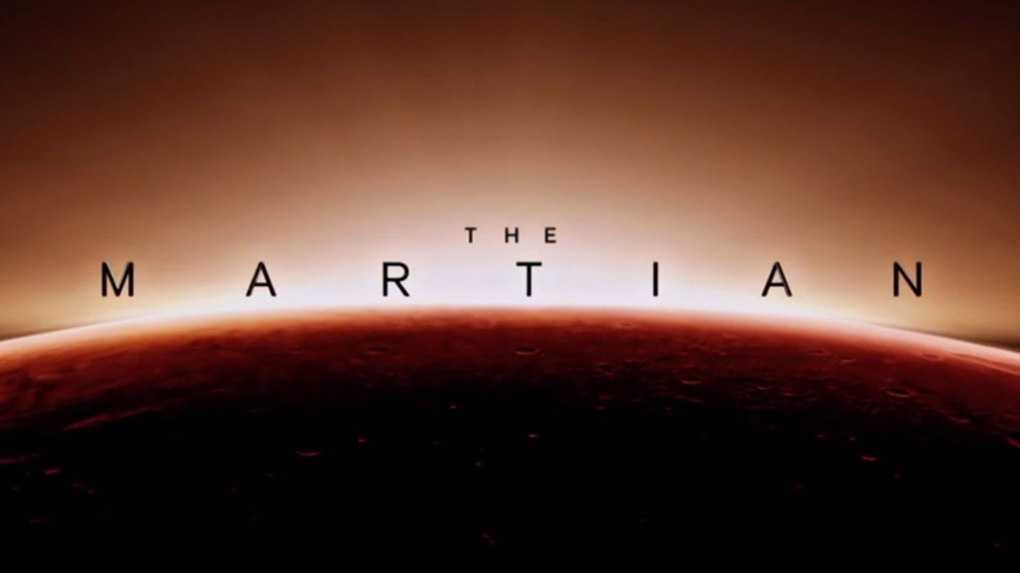
Jordan Feeley, Heric Flores-Huerta, Mengwen Li, Matt McCarthy, Yudi Wang
0

Slide 2
Overview
In “The Martian” stranded astronaut Mark Watney must use his knowledge of science to survive several years alone on Mars.
Worth the risk for NASA to send a mission to bring him back to Earth
Science & Technology available to keep him alive
Conclusion
  Each human being’s life matters
  Possible solution to replace human astronauts with robots in future
1
Notes:
In "The Martian," stranded astronaut Mark Watney must use his knowledge of science to survive for several years alone on the Red Planet, in a classic castaway scenario created by book author Andy Weir.

Slide 3

Creators Intention:
“Andy Weir's book is such an engineering manual of how you survive on Mars”[1]
Try and show authentitic science & technology
Emphasis on importance of a single mans life [2]
With the help of NASA present the future vision for trips to Mars (minus the drama)
Figure 1. The Martian Book [10]
2
Notes:
In the film's emphasis on the importance and value of a single man's life —a brother, really, to Lewis and the rest of the crew — it's hard not to sense an echo of Scott's own past. The director lost his brother Tony to suicide in August 2012, and Scott has understandably been grappling with that death in the years since (he also decided to dedicate his previous two movies to him).
“I think the film is about how no one is ever alone,” he said in a phone interview.
Space—and a wildly expensive, risky, and long manned mission to Mars in particular—cannot simply be cool. It must be compelling. It must be part of the conversation. Enough so that you maybe want to write your congressman or, at least, get angry about NASA’s dwindling budget. It has to be more than an idea, too. Everything is advertising and everything is political, particularly with a public agency funded by our tax dollars. So if you want to understand why it is that NASA loves The Martian and is so gung ho for this movie, you have to realize that this movie more or less presents exactly their future vision, minus all the drama.

Slide 4
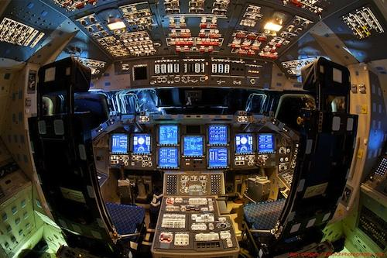
Computing Technologies
Spacecraft
Mars Rover & Pathfinder
NASA Jet Propulsion Laboratory
Mars Habitat
Gravity Assist
Camera Log
Figure 2. Cockpit of Spacecraft [11]
3

Slide 5
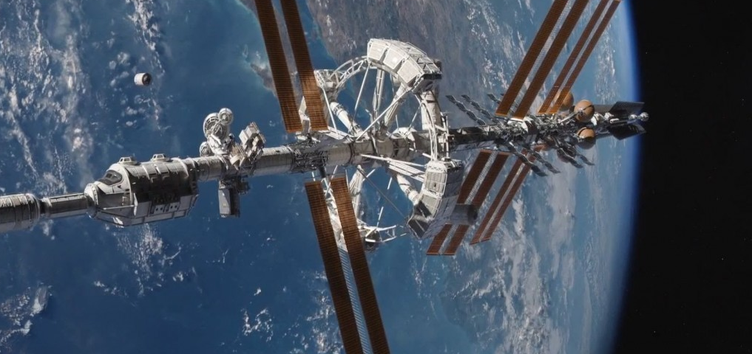
Spacecraft
The total journey time from Earth to Mars takes between 150-300 days, closer to 300 days in the movie [7]
Modeled after the International Space Station
Solar Arrays on side collect energy [6]
Airlocks & robot arms for spacewalks
Artificial Gravity
Communication
  Recieve video messages from family & NASA
Figure 3. Spacecraft “Hermes” in Martian [5]
4
Notes:
The total journey time from Earth to Mars takes between 150-300 days depending on the speed of the launch, the alignment of Earth and Mars
On the sides of the space station are solar arrays. These arrays collect energy from the sun. They turn sunlight into electricity.
Robot arms are attached outside. The robot arms helped to build the space station. They also can move astronauts around outside and control science experiments.
Airlocks on the space station are like doors. Astronauts use them to go outside on spacewalks

Slide 6
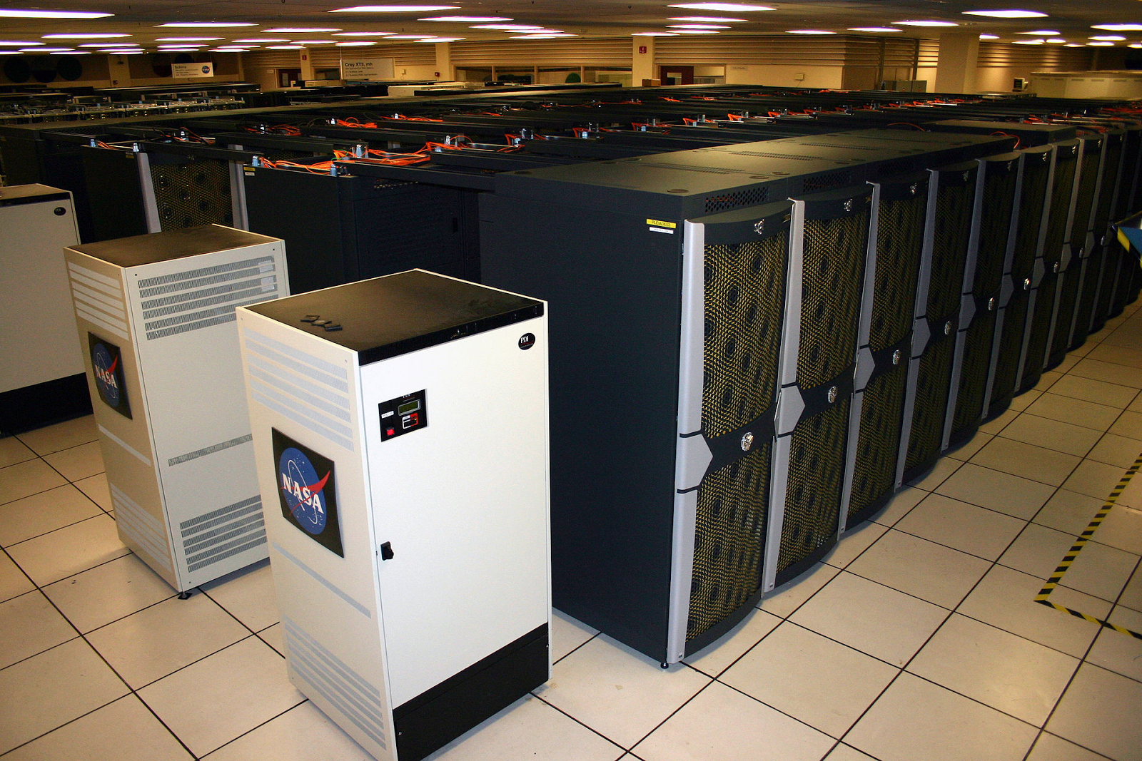
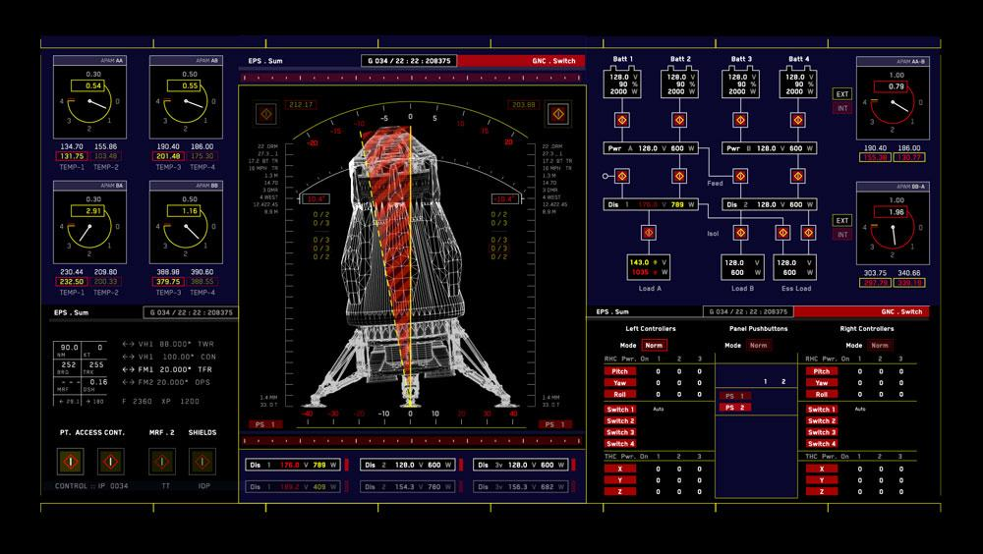
Jet Propulsion Laboratory
Super Computer
Computed trajectory for Earth slingshot
Deep Space Network
NASA is able to remotely control the spacecraft to save Watney
Figure 6. Pleiades Supercomputer
Figure 7. Movie scene of the shuttle monitor
6
Notes:
https://www.nas.nasa.gov/hecc/resources/pleiades.html
By 2014, NASA’s super computer, Pleiades Supercomputer, ranked 11th worldwide.
If a supercomputer is not used, the computation may not finish in time.

Slide 7
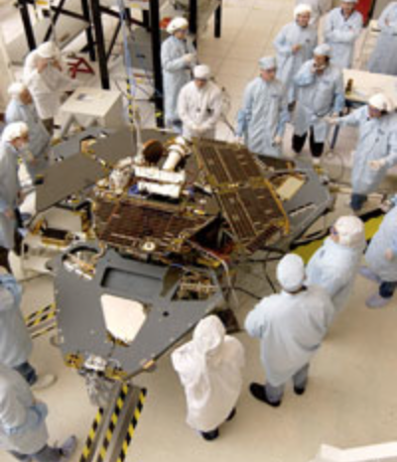
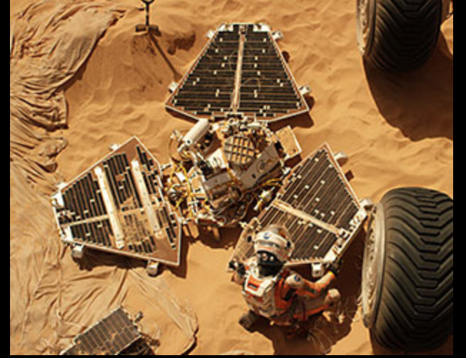
Mars Pathfinder
Small, six-wheeled rover touched down on Mars on July 4, 1997. [4]
Beamed back billions of bits of data, including images, before it fell silent after 3 months
In the movie Watney fixes the rover to communicate to NASA through still images and 360 degree rotating camera
Figure 4: Real NASA Pathfinder [3]
Figure 5: Watney working on the Pathfinder [4]
5
Notes:
The lander and the rover Watney found in the movie was launched by the Mars Pathfinder project on December, 1996.
This mission acted as a proof of concept for technologies such as airbag-mediated touchdown and automated obstacle avoidance.
Also, it demonstrated the possibility of constructing faster, better and cheaper spacecraft. The cost of Pathfinder in 3 years was $150 million, which is 1/15 of the Viking mission launched before.
Although the mission was planned from a week to a month, the rover operated for more than 3 month. The reason for its failure is because the battery may be discharged and recharged too many times.
In the movie, Waltney fixed the battery to get it working again. The stereoscopic camera on the lander was used by Waltney to communicate with Earth.

Slide 8
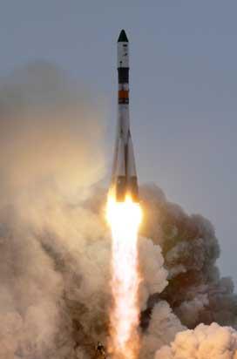
Computer Reliability
Mission to restock food failed
  SpaceX many failed launches
  Money & work goes into it
Mars HAB blew up
  Could’ve died
Mars Pathfinder failed
  Designed to work for a week to a month
  Failed after 3 months
Figure 8. Failed Mission Launch
7
Notes:
Computer Reliability is critical in The Martian as the cost of potential failure are incredibly high.
Failure in computer system while launching can cost hundreds of millions of dollars. For example, the launch failure of SpaceX rocket caused a lose of $110 million.
More severely, astronauts have a very high chance to be killed if some of their equipments went wrong.
There are several cases relating to computer reliability in the movie.
The first is that the rocket sent by NASA to restock Waltney blew up. One important reason is that JPL tried to get the work done as soon as possible, so the development period was shortened again and again.
In this process, the engineers are exhausted and this greatly increase the possibility of making errors.
The other reason is that the testing cycle was completely removed to launch the rocket sooner. If they spent 20 more days for testing, this could have be avoided.
The second failure is that part of the Mars Habitat blew up. Because of this, Waltney lost all the growing potatos and he could have been killed in this accident.
On the contrary, the Mars rovers are examples of having good reliability. As shown in the last slide, the Pathfinder worked for more than 3 months, which is 2 months longer than intended.
Also, for the Mars rovers launched by NASA after, the Opportunity and Spirit was launched in 2004 and were designed to work for 90 sols. However, Spirit remained functioning for 13 years, and Opportunity is still working until of today.

Slide 9
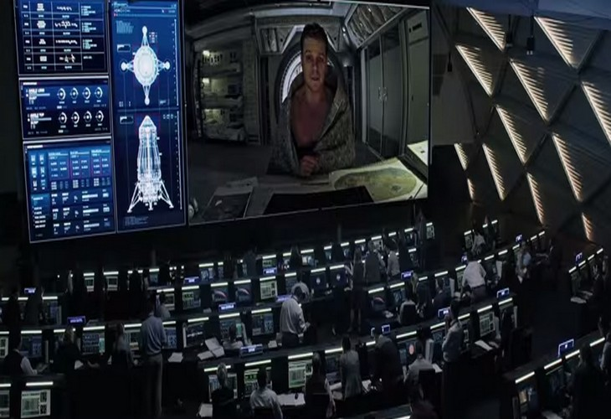
Privacy
When the crew is not informed that Watney is alive
Cameras set up around the HAB
Whole world watching Watney retrieval
  Media nightmare if they failed
Figure 10. Watney have conversation with NASA[13]
8

Slide 10

Ethics
Find Watney or not
  No vital sign
  Approaching storm
Worth it to save Watney or not
  Cost
  Publicity
Go against NASA to save fellow astronaut
  Possibly kicked out of Space Program
  Other astronauts could die in the process
Figure 9. Movie Slogan [12]
9

Slide 11
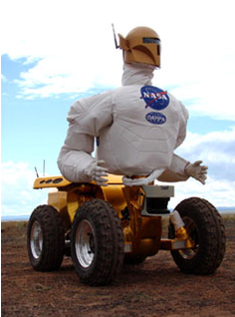
Conclusion
Ethics and Finance
  Each human being’s life matters
  Provide much more precious knowledge and information about Mars
Computer Reliability
  Robonaut 1 in 1997 [13]
  Probably use robots instead of human astronauts in the future
Figure 10. Robonaut 1 [13]
10
Notes:
Our main conclusions are closely related to these two topics: computer reliability and ethics.

Slide 12
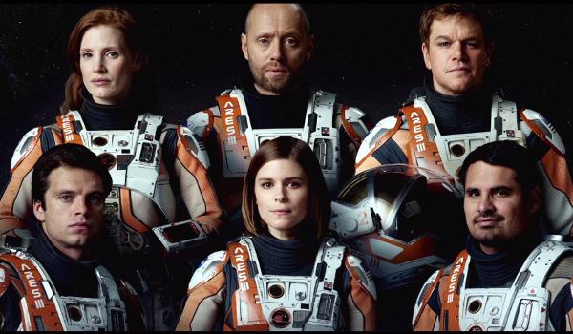
Questions?
11

Slide 13
Reference
Producer, D. B. (n.d.). Making 'The Martian': Exclusive Interview with Director Sir Ridley Scott. Retrieved April 25, 2017, from http://www.space.com/30644-making-the-martian-ridley-scott-exclusive-interview.html
Why Ridley Scott made 'The Martian' (n.d.). Retrieved April 25, 2017, from http://www.latimes.com/entertainment/movies/moviesnow/la-et-mn-ridley-scott-the-martian-movie-matt-damon-theaters-20151002-story.html
Technologies of Broad Benefit: Power. (n.d.). Retrieved April 25, 2017, from https://mars.nasa.gov/mer/technology/bb_power.html
The real Mars lander in 'The Martian': Fact checking the film's NASA probe | collectSPACE. (n.d.). Retrieved April 25, 2017, from http://www.collectspace.com/news/news-100215a-the-martian-mars-pathfinder.html
Sadri, A., Roelofs, G., Koberlein, B., H., M., Morgan, H., . . . S. (2015, October 08). The Science Behind 'The Martian' Hermes Spacecraft. Retrieved April 25, 2017, from https://briankoberlein.com/2015/10/06/the-science-behind-the-martian-hermes-spacecraft
Dunbar, B. (2015, May 20). What Is the International Space Station? Retrieved April 25, 2017, from https://www.nasa.gov/audience/forstudents/k-4/stories/nasa-knows/what-is-the-iss-k4.html
How Long Does it Take to Get to Mars? (2017, March 16). Retrieved April 25, 2017, from https://www.universetoday.com/14841/how-long-does-it-take-to-get-to-mars
Kain, E. (2015, October 07). Three Reasons To Read 'The Martian' Before You See The Movie. Retrieved April 25, 2017, from https://www.forbes.com/sites/erikkain/2015/10/07/three-reasons-to-read-the-martian-before-you-see-the-movie/#1a5709157462
5 Big Differences Between The Martian Book And The Movie. (2015, October 05). Retrieved April 25, 2017, from http://www.cinemablend.com/new/5-Big-Differences-Between-Martian-Book-Movie-86227.html
Menu. (n.d.). Retrieved April 25, 2017, from http://www.andyweirauthor.com/books/the-martian-mass-market-mti-mm/the-martian-hc
STS-134 Mission Coverage. (n.d.). Retrieved April 25, 2017, from https://spaceflightnow.com/shuttle/sts134
The Martian (2015). (n.d.). Retrieved April 25, 2017, from http://www.imdb.com/title/tt3659388/
(n.d.). R1 - Robonaut - NASA. Retrieved April 27, 2017, from https://robonaut.jsc.nasa.gov/R1/
12

