Slide 1
The Imitation Game
Josh Hebert - Thomas Grimshaw - Yael Rosenblum - Sam Mailand - Jonathan Leitschuh

Slide 2
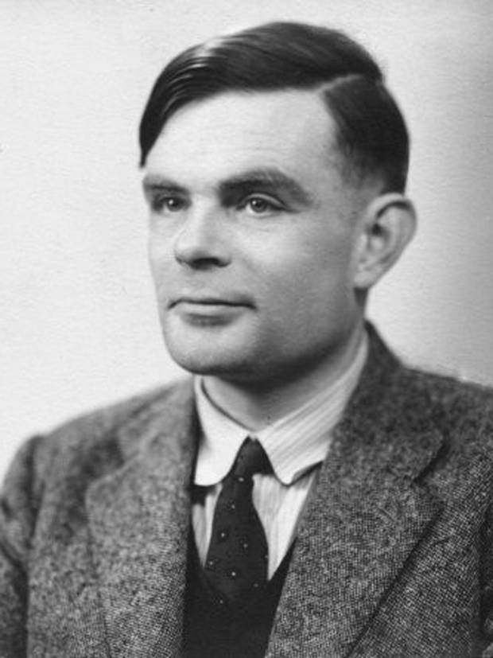
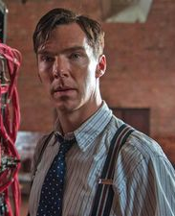
Movie Summary [1]
Based on the true story of Alan Turing’s life
Portrays Turing’s involvement in breaking the Enigma code during his work at Bletchley Park during WWII.
Also shows his arrest and subsequent punishment for being homosexual
Notes:
The Imitation game is based on the life of Alan Turing, a British mathematician and cryptanalyst during WWII. The story follows both Turing’s work during the war to develop a computer to crack the Enigma code the Germans were using, and also Turing’s life after the war when he is charged with indecency for being a homosexual.
Image Sources, Left to Right
http://www.brandeis.edu/now/2014/march/images/TuringPNAS.jpg
Screenshot from “The Imitation Game”

Slide 3

Public Reception
Current interests:
  Technology, Equality, and Biopics
Top-grossing independent film of 2014_{[2]}
Sparked social action campaign:
  Cumberbatch, Stephen Fry, Harvey Weinstein,
  and Rachel Barnes.
Honored by Human Rights Campaign
Notes:
During the films release in 2014, the hot-button issues of equality of both gender and sexual orientation, were and still are prevalent in society, making it well-received.
Additionally, the recent movies in technological advances (Her, Transcendence, Big Hero 6, Oblivion, etc.) have sparked audiences for more science-fiction and tech-films. With the included release of the biopic film, The Theory of Everything, about Stephen Hawkin within a similar timespan, led to a box-office hit. Won the Oscar for Best Adapted Screenplay.
The human rights issues discussed in the films were the forefront of public reception, where the actors and producers of the film joined the social action campaign to pardon 49,000 gay men convicted under the same law that led to Turing’s chemical castration.
Image Source: http://i1.tribune.com.pk/wp-content/uploads/2011/01/Oscar-Predictions-640x480.jpg

Slide 4
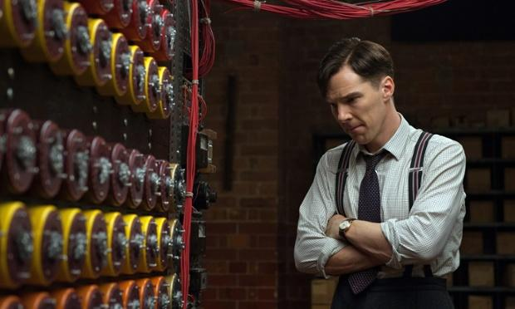
Key Points
Even the strongest secrecy can be weak
  Advancement of computational machinery
  Human error
  Human emotion
Notes:
Josh
Conclusion:
The correlation between events in Turing’s life, presented against the backdrop of the war show the significance of information privacy and security in the world, and the
consequences of it being broken. For example, the breaking of Enigma contributed to, in no small way, the defeat of Germany.
Additionally, it shows how fragile the entire system is, and how even the smallest weak link can compromise everything
Machines make secrecy weaker
Advancement of technology makes encryption techniques easier to break
Bombes-> Colossus -> Turing Test (AI)
Prior to the Bombe, Enigma was thought to be unbreakable. Since then, the technology has only gotten faster (in terms of analytical engines). Following the Bombe was Colossus, and today,
we are starting to explore artificial intelligence (we will come back to this later)
The human element weakens this secrecy
Germans failing to change codes in messages led to weakness of the system
Proneness to emotions makes secrecy of data more difficult.
Additionally, the human element plays a significant role in weakening both the ability to ensure security, and then, in the presence of secrets, keep them that way
Image: http://i.guim.co.uk/static/w-620/h--/q-95/sys-images/Guardian/Pix/pictures/2014/11/18/1416312708018/2a7ceb88-1896-4034-98d6-ca013d3aa6cd-620x372.jpeg

Slide 5
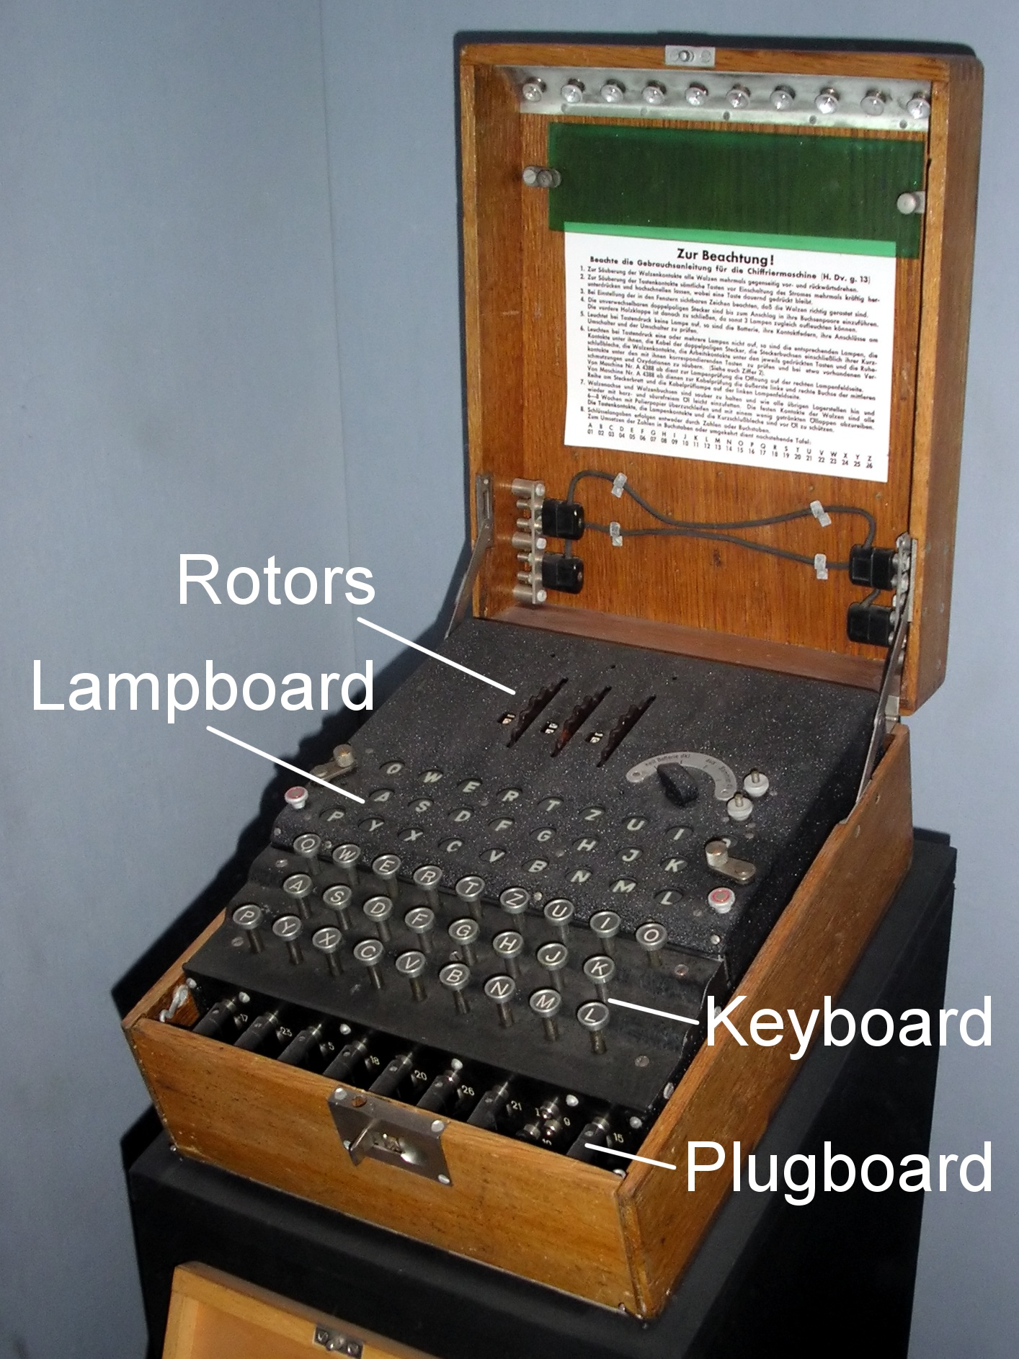
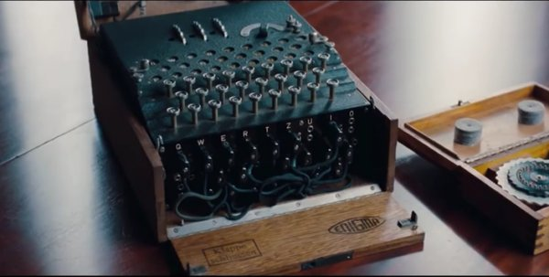
Enigma
Patented in Germany in 1918
  Arthur Scherbius
Two Parts to Encryption
  Machine
  Code Book
Notes:
Yael:
The core of this film were the Enigma Machines
Although the core idea of a device that used rotors to scramble messages had been patented in 1918, the models used by the
German military featured numerous enhancements, such as increased numbers of rotors. As a result, for the Allies to understand
how they worked, they had to capture one first.
During WWII, Germany sent almost all of its communications over radio; these could be and were intercepted by the Allies
Germany adopted the Enigma Machines to encrypt their messages before sending them over the air.
This is the context in which the movie takes place. Interestingly enough, based on firsthand accounts from the individuals working at Bletchley Park, the movie’s use and depiction of these machines is largely accurate. There were little, if any inconsistencies, between historical records and the movie, at least in this regard.
So let’s talk about the Enigma machines themselves and why the events the movie documented occurred --
Encryption with Enigma needs two parts: the machine itself and the settings of the sender. Throughout the course of the war, they were regarded as unbreakable by the Axis Powers.
These settings where supposed to be changed every day, so that the Allies would not be able to detect patterns
As a result, were used almost exclusively to secure communications until the end of the war.
In order to break the message, the Allies needed to be able to quickly figure out the settings used.
Image Source:
http://upload.wikimedia.org/wikipedia/commons/3/3e/EnigmaMachineLabeled.jpg

Slide 6
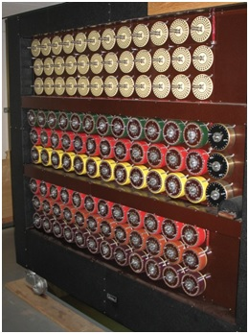
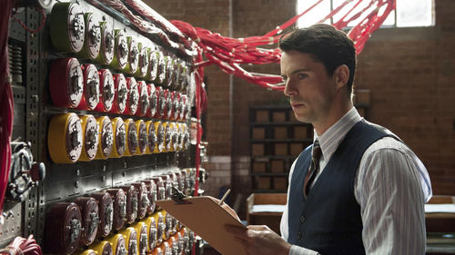
Bombe
Analytical Engine
  Enigma replication
Process of Elimination
Relied upon “Cribs”
Notes:
Josh
In the movie, called “Christopher”, reality, called “Victory”
The British countermeasure to Enigma, the Bombes, were analytical engines designed to decipher which settings were used to program the Enigma machine. They were able to quickly
test each rotor setting until the correct one was found. However, these weren’t simply brute force machines; it’s far more interesting than that. They logically eliminated potential Enigma
settings until only a few remained by replicating an Enigma machine, feeding in data with certain settings and looking for contradictions to rule out the current settings.
How did it determine what a contradiction was? Bombes relied on a “Crib”, which was some piece of the encrypted message already broken. Essentially, it was a tool for reverse
engineering Enigma settings from broken text. So, if, for example, you knew that every message started with “weather”, you could use that as the crib. The longer the crib, the faster the Bombe
worked
In this way, the early bombes didn’t necessarily crack Enigma so much as greatly reduce the possibilities. By ruling out a bunch of settings, it became trivial to manually test the few remaining
possibilities.
Finally, remember when I said “Bombes are kind of sort of not really brute force machines?”. Yeah, the principle of how the Bombes work seems to have been misunderstood by the moviemakers. The Bombe Turing builds is depicted as
attempting to crack German codes with no Crib whatsoever.
They later then use a crib to restrict the possible outcomes, not as the basis for the solution
This methodology is exactly what the Polish had been using prior, and Turing knew this. His entire solution was based on the idea of cribs being obtainable. It was never his intention to have the Bombe plug though
every possible cipher. As a result, the movie comes across as a bit fuzzy when it comes to the logic behind the Bombes.
However, the ultimate point is this: the Bombes represent an advance in analytical computation that took Enigma, an “unbreakable” cipher, and rendered it almost useless. As you will see in just a moment,
this trend doesn’t stop here.
Image Source:
http://www.airedalesprings.co.uk/wp-content/uploads/2014/11/bombe.jpg

Slide 7
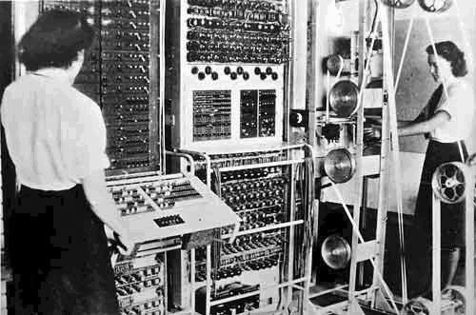

Advancement Beyond the Bombe
Turing Machine (Colossus)
The Turing Test
Notes:
So now I’m going to look into some of the technologies that have come about from the work of Alan Turing. The first one being the Turing Machine, also known as Colossus, and the second one being what has come to be known as the Turing Test.
Left image from:http://upload.wikimedia.org/wikipedia/commons/4/4b/Colossus.jpg
Right Image from: http://csunplugged.org/wp-content/uploads/2015/03/turing-test.jpg1246936875

Slide 8
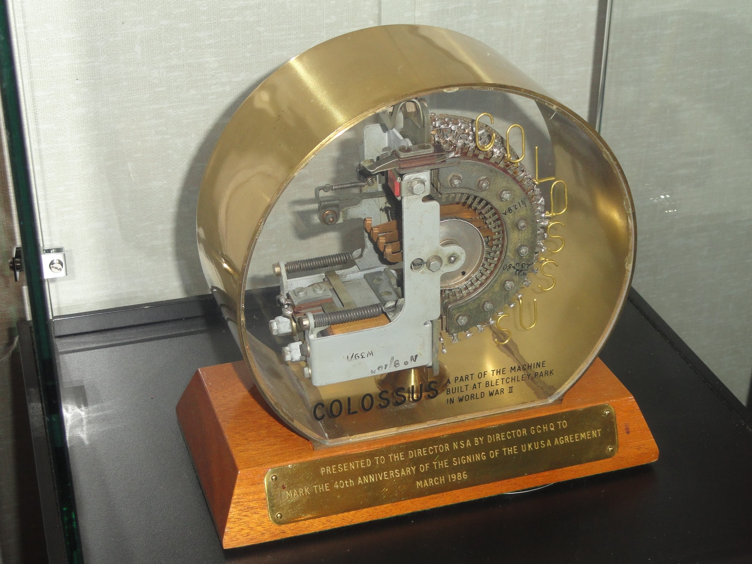
Colossus
World’s first programmable, digital, and electronic computer
Tommy Flowers
Used to break Lorenz SZ-40/42 ^{[5]}
Notes:
The Colossus is widely considered to be the world’s first programmable, digital, and electronic computer and was heavily inspired by the bombe computer designed by Turing. It was designed by Tommy Flowers and had 1700 valves. It was used to break the codes of the German Lorenz SZ-40 cipher machines used by the German High command during WWII. Allen Coombs, Sid Broadhurst, and Bill Chandler also had a large amount of input into the project, which was heavily inspired by Turing’s work on the Bombe. Many believe that this is what broke Enigma, but that’s simply not the case, as is probably clear from our presentation so far.
Bombe was electromechanical, Colossus was electronic/digital
--Tape transport and reading mechanism that ran loops key and message tapes between 1000 and 2000 characters per second
--Colossus mark 1 first shown to be working in Dec 1943. Mark 2 used shift registers to quintuple speed in June 1944.
--Overcame the problem of synchronizing the electronics with the message tape by generating a clock signal from the reading of the sprocket holes of the message tape. Speed limited by the mechanics of reading the tape
Bombe could not brute force because they did not know what was “valid” message and what wasn’t. Without a crib, they would come up with many, many possible results of what the message could decrypt to
However, in a scenario where the computer understands human speech patterns, this approach becomes viable. Using a fairly modern computer, breaking a standard 3-wheel enigma machine with a technique called
“hillclimbing”, which does not require a crib, can be done in somewhere between 10 and 60 hours.^{[1]} Keep in mind, this was not even possible to do in Turing’s time. Without a crib, it would’ve been impossible.
Also, this is an estimate for a consumer, albeit high end, computer. With a national intelligence level cluster, this time is reduced immensely.
Image from: http://upload.wikimedia.org/wikipedia/commons/4/4e/COLOSSUS,_part_of_the_machine,_presented_by_Director_GCHQ_to_Director_NSA_in_1986_-_National_Cryptologic_Museum_-_DSC07890.JPG

Slide 9

The Turing Test (Imitation Game)
Man or machine?
Passing the test
  Eugene (2014)^{[7]}
Variations
  Feigenbaum Test ^{[4]}
Notes:
--“Are there imaginable digital computer which would be able to do well in the ‘Imitation Game’” -- Turing … This is good, because the definition of “thinking” is difficult to grasp and not easily measurable, if even possible.
--The Turing test is fairly straight forward. It is essentially just a test of a machine’s ability to trick a human into thinking that it is also a human. A computer is considered to have passed the test if it tricks a human 70% of the time after 5 minutes of questioning.
--In 2014, a supercomputer was the first to pass the test… sort of. It tricked judges 33% of the time into believing that it was a 13 year old Hungarian boy. This may not seem like a huge success based on the 70% threshold that I mentioned earlier, but the results from this test show a huge improvement in artificial intelligence from the computers of Turing’s time. Turing also predicted that by the year 2000, a machine with 100MB of storage would be able to pass the test 30% of the time. While his prediction is 14 years off, and the computer was an expensive supercomputer, his prediction was still fairly close, all things considered.
--Current predictions don’t put a computer passing the test until approx. 2029
--It was first introduced by Turing in his paper “Computing Machinery and Intelligence” in 1950.
--It has sparked many variations, including the Feigenbaum (subject) test, which sees whether a computer’s responses can be distinguished from those of an expert in a specific field.
--IBM’s Watson [4]
--Ebert Test is whether or not a computer’s voice can accurately portray intonations, inflections, timing and so forth, to make people laugh
Bombe could not brute force because they did not know what was “valid” message and what wasn’t. Without a crib, they would come up with many, many possible results of what the message could decrypt to
However, in a scenario where the computer understands human speech patterns, this approach becomes viable. Using a fairly modern computer, breaking a standard 3-wheel enigma machine with a technique called
“hillclimbing”, which does not require a crib, can be done in somewhere between 10 and 60 hours.^{[1]} Keep in mind, this was not even possible to do in Turing’s time. Without a crib, it would’ve been impossible.
Also, this is an estimate for a consumer, albeit high end, computer. With a national intelligence level cluster, this time is reduced immensely.
Image from: https://xkcd.com/329/

Slide 10
Humans in Security
Germans use radio to send messages
  Anyone with a radio could intercept
All messages are encrypted using Enigma
  You could only read the message if you knew the code
The code changes every day at midnight
National pride message “Heil Hitler”
  Expected pattern the British used as the key
Notes:
[Jon]
German encrypted messages were using Morse Code.
The use of the Enigma machine to encrypted German messages is the best example of information privacy and the role that computers play in keeping information secure. The enigma also presents a unique social problem in that the Enigma machine itself was not what was flawed, it was the human operators, who did not follow best practices that allowed the code to be cracked. Operators were told to always use random characters for the first five letters and to avoid repeating phrases from one message to another. If the operators had followed these rules the code would likely never have been broken.
The use of the Bombe to break the Enigma code is also a good example of information privacy and the role the government plays in it. They bombe project was a government sponsored project that stripped the privacy from the german communications.

Slide 11
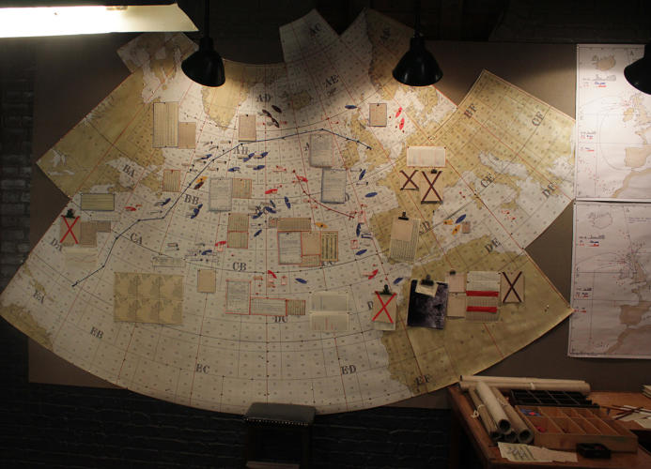
Humans in Secrecy
Human emotions is a risk to secrets
  The desire to save lives nearly outweighs the necessity to keep the decryption of Enigma a secret
  The Soviet spy betrayed Britain because he sympathised with the communist regime
Notes:
In the Imitation Game the human element of secrecy is one of the biggest risks to the secrets of the war.
After the team manages to decrypt the Enigma code, they realize that a British convoy is about to be attacked. One of the team members has a brother on one of the ships and wants to warn them. Turing has to stop the team before they compromise the secret that they have broken Enigma. If every move the Germans made was countered, then they would suspect that Enigma was broken and change their encryption.
Thus the project codenamed “Ultra” was developed to release the decrypted information. Statistical analysis was performed to determine what could be released without the Germans suspecting. Every bit of information that was released had a false backstory developed for where it was obtained.

Slide 12
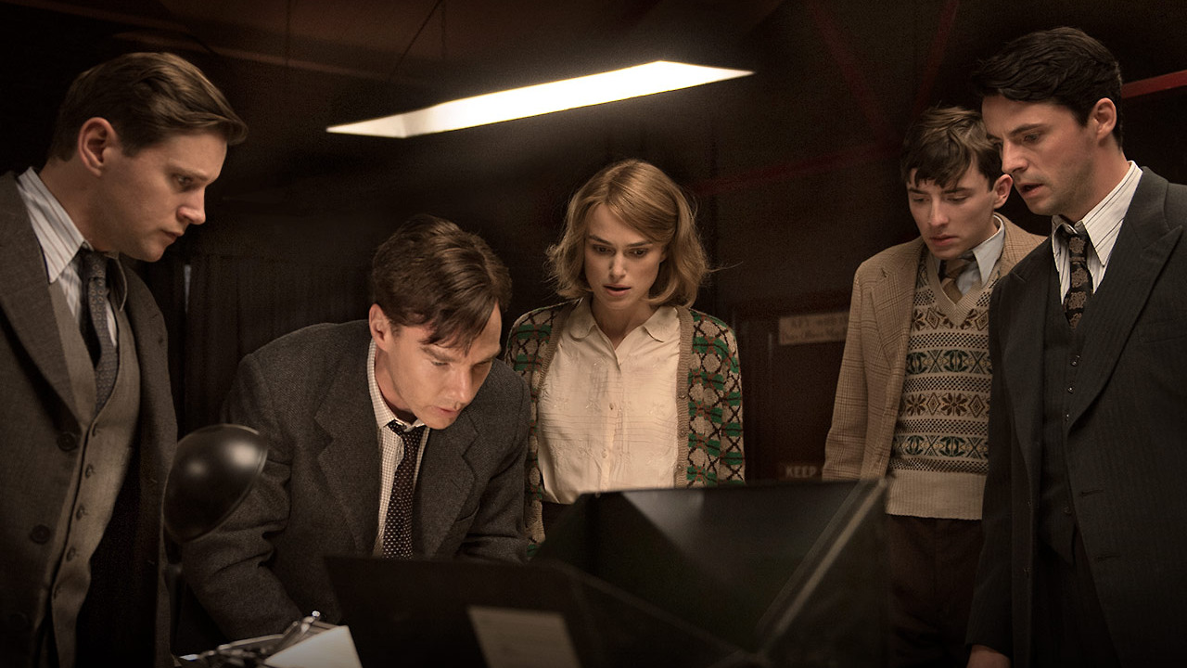
Conclusion
The correlation between events in Turing’s life, against the backdrop of the war present the significance of information privacy and security in the world.
Human element is unsecure!
Notes:
Yael
The social implication for the film display how secrecy and the human element affect even the most secure and encrypted technologies.
Image: http://www.liveforfilms.com/wp-content/uploads/2014/12/the-imitation-game-1.jpg

Slide 13
References
http://www.imdb.com/title/tt2084970/synopsis
Lang, Brent. ""The Imitation Game" officially became the top-grossing indie release of 2014". Variety.
https://cryptocellar.web.cern.ch/cryptocellar/bgac/HillClimbEnigma.pdf
Shah, Huma (2011), Turing's Misunderstood Imitation Game and IBM's Watson Success
Russell & Norvig 2003, pp. 2–3 and 948
Golden, Frederic (29 March 1999), "Who Built The First Computer?",Time Magazine 153 (12)
http://www.reading.ac.uk/news-and-events/releases/PR583836.aspx
Notes:
These just need to be copied in

