Slide 1

The Hummingbird Project
Andrew Hariyanto, Dov Ushman
Notes:
Dov
Hello everyone my name Dov, this is Andrew and our movie was the hummingbird project.
Next slide

Slide 2

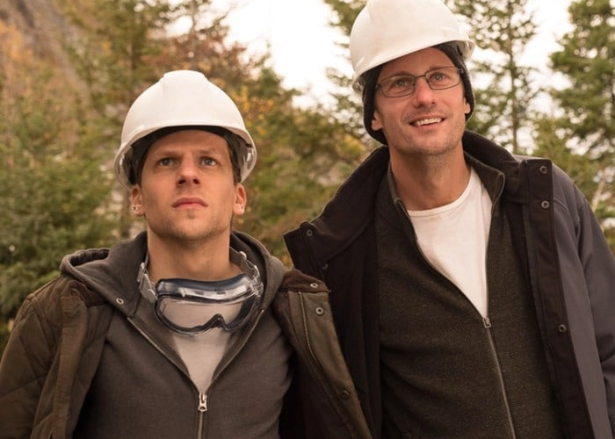
Vincent Zaleski & Anton Zaleski
Vincent: the mastermind of the project
Anton: the programming genius
Fig 1. Vincent (left) and Anton (right) Zaleski [1]
Notes:
Andrew
First, we would like to introduce some of the major characters in the movie, and we will talk more about them in detail in the plot summary.
The movie follows the story of these two cousins, Vincent and Anton Zaleski, and their journey to build a fiber optic cable line from the Kansas Electronic Exchange to the New York Stock Exchange. They plan to use this faster network connection to gain a time advantage over other high frequency traders.
Vincent: the one on the left, is the mastermind of the project who proposed the idea of a fiber optic line
Anton: the one on the right, is a programming genius who developed his own algorithms for high frequency trading
Next slide

Slide 3

Eva Torres
Eva: CEO of Torres & Thatcher Corp
Former boss of Vincent and Anton
Fig 2. Eva Torres [1]
Notes:
Andrew
Lastly, we have Eva Torres, the CEO of Torres & Thatcher Corp, which is one of the prominent stockbroker companies that Anton and Vincent worked for at the start of the movie. It can be inferred from the movie's plot that her company is the fastest in the industry.
Eva: CEO of Torres & Thatcher Corp, NY, a stockbroker company who hired Anton and Vincent at the start of the movie. She is obsessed with being the fastest stockbroker in the industry.
Next slide

Slide 4
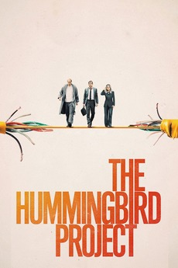
Plot Summary
2011
Anton and Vincent Valeski aim to build a fiber optic cable line from KAX to NY Stock Exchange
Target speed was 16 milliseconds for high frequency trading
Quit previous job
Raced against Eva's company who used microwave towers
Both of them realize their limitations
Fail to finish prior to Eva
Fig 3. Movie Poster [1]
Notes:
Andrew
Now, for the details of the plot. The movie is set in 2011 and shows how these two cousins built that fiber optic cable line from the Kansas Electronic Exchange and the New York Stock Exchange. At the time, the fastest transaction time that went to and from the Kansas Electronic Exchange and the New York Stock Exchange was 17 milliseconds. With this new fiber optic cable line, the target speed was 16 milliseconds, allowing them to get a millisecond advantage over other competitors. However, the two cousins knew that Eva would not agree to this as she was trying to find other faster networks like microwave towers to send transaction data. So, the two cousins quit the company to work for another company called Cobalt Fiber Tech who decided to fund their project. When Eva catches wind of this, she assembles a team to race against Vincent and Anton, and she decided to pursue the microwave tower idea even further and at a faster pace. Several obstacles blocked the cousins' progress. Vincent realizes that he has cancer, and Anton was put in jail when Eva accused him of using the company-owned code that Anton made for her when he was an employee for Eva. In the end, Anton gets Eva to drop the charges and Vincent seemed like he recovered. They managed to reach the 16 millisecond goal. However, they failed to finish before Eva. Even worse, Eva managed to bring down the transaction time to 11 milliseconds, crushing the cousins' original goal of 16 milliseconds.
Next slide
Anton and Vincent (cousins) work at same stock exchange company in NYC which is run by Eva Torres
Vincent AKA Vinnie quits and takes Anton with him to build a fiber optic line from Kansas Electronic Exchange to New York city stock exchange
Currently takes 17 milliseconds need to cut that down to 16
Vinnie makes deals with people along the route to put cables under ground while Anton works on cutting down time
Eva hires a person who apparently make towers to do it faster (was called impossible earlier in the movie)
Eva goes through any means for them to stop, blackmail, FBI etc
Vinnie has stomach cancer
Anton ends up in jail
Eva finishes towers before them
Anton blackmails Eva to get out of jail
They finish the project but its too late
They undo part of the cable which went underneath the Amish who were mad at them
https://letterboxd.com/film/the-hummingbird-project/

Slide 5
Conclusion
High frequency trading is detrimental for the financial market landscape
High frequency trading benefits the high frequency traders at the expense of investors in the market due to competition
Notes:
Dov
So onto our conclusions. From our movie we were able to draw two main conclusions. The first of these is that while high frequency trading is profitable for these traders, overall it is detrimental for the financial market. The second conclusion is that High frequency trading benefits the high frequency traders at the expense of investors in the market due to competition
Next slide

Slide 6
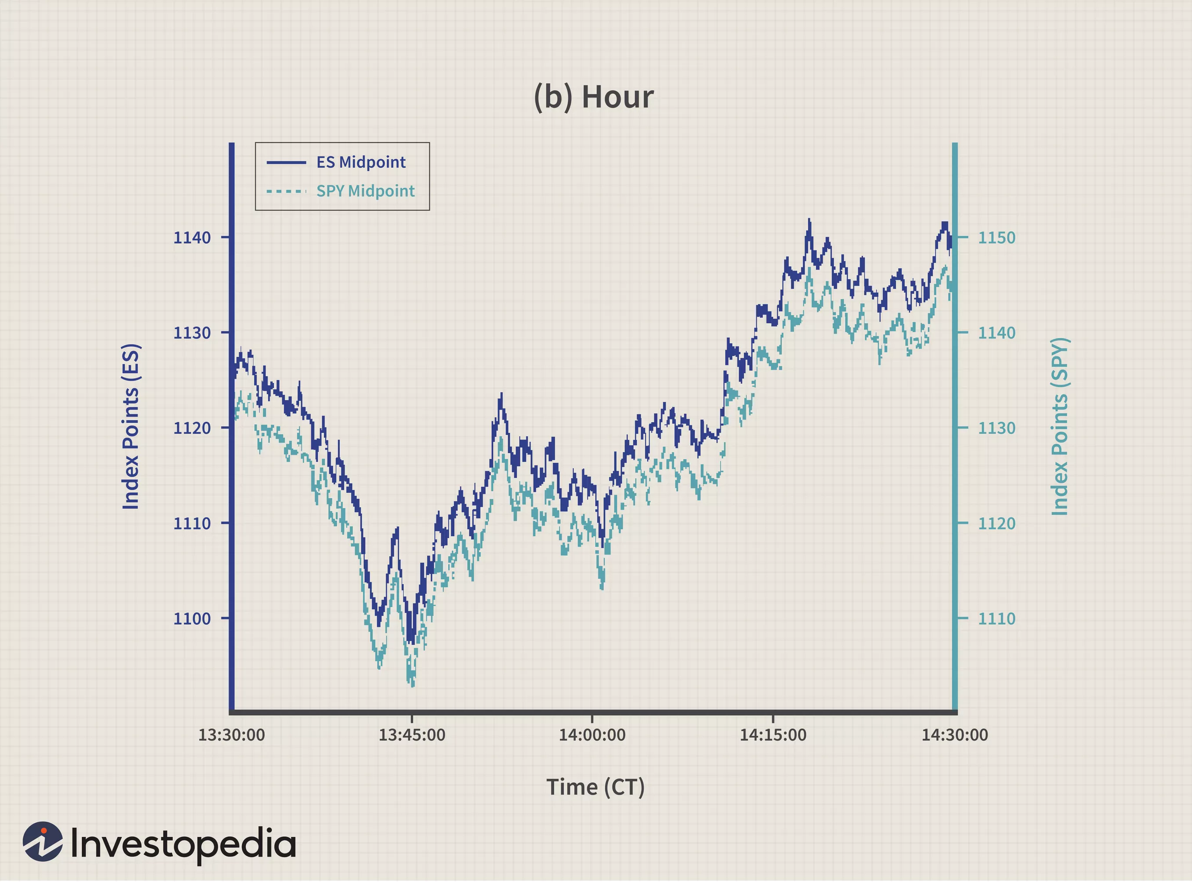
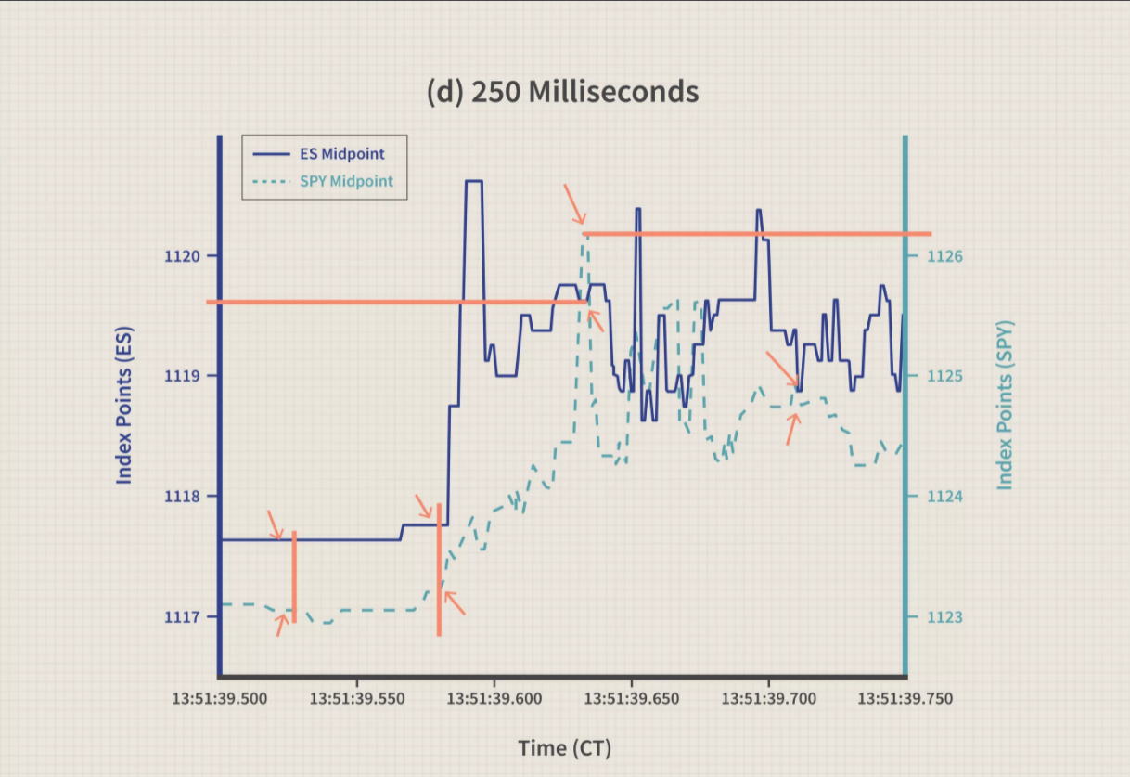
High Frequency Trading (HFT)
The use of algorithms that decide on executing orders based on market conditions [5]
In 2021, the average time for completing a high frequency trade is 64 microseconds [8]
Faster speed means greater advantage in placing and selling orders [5]
Fig 4. A comparison between stock prices in hours vs milliseconds [5]
Notes:
Dov
Before we jump into arguments for our conclusion, some background information is required. First of all, what is high frequency trading or otherwise known as HFTs> Well to begin, high frequency trading has been around since 1999 and is the use of algorithms that decide on executing orders based on market conditions. Through the use of these algorithms, traders are able to buy and sell stocks in microseconds. As a result, speed is crucial. In 2021, the average time for completing a high frequency trade is 64 microseconds. To go into more detail. High frequency traders use their advantage in speed to find disparities in stock prices, buying them at the lowest prices and selling them instantly at normal prices. Usually, each trade will profit the traders approximately half a cent. However, the transactions occur in microseconds. Theoretically, this means that at most 937,500 transactions could be made in a minute. Theoretically, if traders earn 0.5 cent per transaction, they earn $468,750 every minute. Of course, there won't be favorable orders at every single moment for the algorithms to find.
On the right you can see two graphics that show how powerful and quick these algorithms are. These two graphs show tick by tick changes on two different indices the E-Mini S&P 500 futures and SPDR S&P 500 ETFS at different time intervals. On the top image, the graph is in terms of hours while the bottom graph is in terms of 250 milliseconds. By looking at these graphs we are able to see how while the market might seem to be in sync and not changing to human eye, algorithms are able to look closer than we can and as a result identify where potential profit is and act on it with its extremely fast algorithms.
Next slide
-------------------------------------------------------------------------------------------------------------------------------------------------------------------------
High frequency trading is detrimental for the financial market
The use of algorithms that decide on executing orders based on market conditions
In 2021, the average time for completing a high frequency trade is 64 microseconds
Faster speed means greater advantage in placing and selling orders
High frequency trading has been around since 1999
https://www.ft.com/content/332c59bc-10d6-11e8-940e-08320fc2a277
High frequency traders use their advantage in speed to find disparities in stock prices, buying them at the lowest prices and selling them instantly at normal prices. Usually, each trade will profit the traders approximately half a cent. However, the transactions occur in microseconds. Theoretically, this means that at most 937,500 transactions could be made in a minute. If traders earn 0.5 cent per transaction, they earn $468,750 every minute. Theoretically. Of course, there won't be favorable orders at every single moment for the algorithms to find.
1 minute = 60,000,000 microseconds
1 transaction = 64 microseconds
1 minute = 937,500 transactions

Slide 7
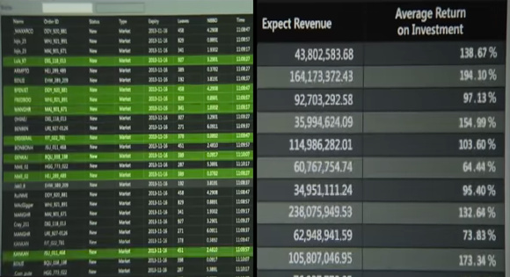
HFT in The Movie
The speed that Anton and Vincent want to beat is 17 milliseconds.
Anton and Vincent only cared about the profits
Anton realizes that the ones profiting from HFT are the traders
Fig. 5 High Frequency Trading in The Hummingbird Project [1]
Notes:
Dov
Next, lets talk about high frequency trading in the movie.
High frequency trading was the main technology in the movie, and going from 17 to 16 milliseconds was Anton and Vincents goal. The opening scene of the movie narrated the double edged sword that is high frequency trading. To quote, "The speed of transactions has become such an important variable in the whole market economy, that faster computer algorithms can make millions in a matter of milliseconds or can crash entire markets by triggering mass defensive responses from automated computer systems."
In the movie, Vincent and Anton regarded making millions more important than the consequences that high frequency trading has. However, as the movie progressed, Anton realized that their motive was selfish during a scene where he met a waitress at a bar. He explained the theory behind high frequency trading to her and mentioned that he would be making hundreds of millions of dollars a year. The waitress, however, asks about the benefits that other non- high frequency traders would get. This is when Anton realizes that not everyone might benefit from this project.
Next slide

Slide 8
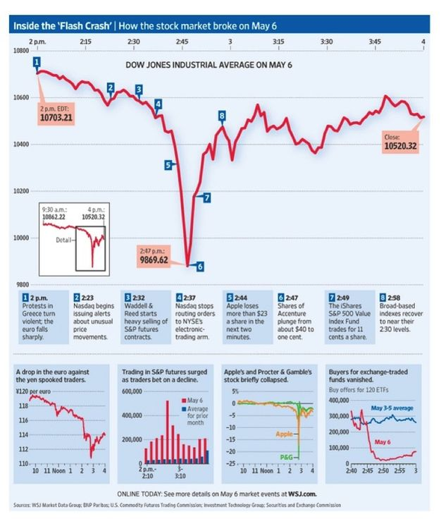
Dangers of HFT
Market volatility [6]
  2010 Flash Crash
  9% decrease in DJIA
  22.5% increase in S&P 500
  In total, $1 trillion was erased
Ghost Liquidity [7]
Fig 6. Drops in DJIA in 2010 Flash Crash [6]
8
Notes:
Dov
Alright, so back to our conclusion on how high frequency trading is detrimental to the financial market. Well to begin, high frequency trading causes the market to have incredible volatility. A prominent example of this is the 2010 flash crash. The crash originally began when a large selling order was made when the market was already fragile as a result of the fragile market in Greece. When the large selling order was made, because of the way that the high frequency algorithms work, they saw that the market was decreasing and they all sold because they believed the market was going down. The reason for this was because the algorithms are mostly based off the notion of buy low sell high. Because of the pure abundance of sales, the market value did decrease. What is interesting is that the algorithms did what they were supposed to do, the algorithms weren't defective they just misread the market.
In numbers, by 2:30 the Dow lost almost 1000 points and was only able to recover 600 by the end of the day. The S&P 500 volatility index skyrocketed by 22.5%. By the end of the day, the market indices and futures were down by a total of 4% and the market value decreased by 1 trillion dollars.
Another danger of high frequency trading has to do with ghost liquidity. Ghost liquidity is a phenomenon that occurs when the consolidated liquidity does not reflect the true liquidity of the market. High frequency trading algorithms sell their orders on different venues, but when one of the orders is bought in a venue, all the orders in the other venues will be cancelled. Because of how fast high frequency trading algorithms work, the liquidity is sold to the market and bought faster than any other normal trader could buy. Therefore, the liquidity is considered ghost liquidity as it is essentially not obtainable to normal traders.
As a result of ghost liquidity being created, measuring the market is becoming increasingly difficult. With ghost liquidity growing, it is causing to over estimate the amount of liquidity in the market by about 4%, this of course leads to incorrect estimates of the market size.
Next Slide
------------------------------------------------------------------------------------------------------------------------------------------------------------------------------------------------------------------------------------------
Ghost liquidity is a phenomenon that occurs when the consolidated liquidity does not reflect the true liquidity of the market. High frequency trading algorithms would sell their orders on different venues, but when one of the orders is bought in a venue, all the orders in the other venues will be cancelled. Because of how fast high frequency trading algorithms work, the liquidity is sold to the market and bought faster than any other normal trader could buy. Therefore, the liquidity is considered ghost liquidity as it is essentially not attainable to normal traders.
As a result of the ghost liquidity being created, measuring the market is becoming increasingly difficult. With ghost liquidity growing, it is leading to over estimates of liquidity in the market by about 4% which is leading to incorrect estimates of the market size. This is can affect the reliability of current liquidity measurements to ensure market fairness for the traders.
Next slide
Other sources to look at later if we need more points:
]
https://www.quora.com/Is-high-frequency-trading-good-for-the-economy-Does-it-make-the-market-more-efficient-Does-it-increase-liquidity-Have-there-been-any-studies-on-this-Are-there-negative-impacts-to-the-overall-market
https://www.reuters.com/article/us-commodities-highfrequency/analysis-high-frequency-trade-fires-up-commodities-idUSTRE75G0MT20110617
Img:
https://www.vox.com/2014/4/15/5616574/high-frequency-trading-guide-real-problems-explained

Slide 9

Competition in the movie
High frequency trading technology is constantly trying to be faster
  1 millisecond matters
Zaleski cousins vs. Eva Torres
Fig 7. The Zaleskis vs. Eva [15]
Notes:
For our second conclusion that states that high frequency traders profit at the expense of investors, one way we could see this is through the effect of competition among high frequency traders in the market
In the movie, there is a constant emphasis on the speed of transactions as a 1 millisecond advantage can make millions for the high frequency trader. The movie shows Vincent and Anton racing against Eva to establish a faster system to process trades. Both parties only focused on the monetary benefits that they could gain from faster networks. However, like the waitress pointed out to Anton, high frequency traders might be the ones benefitting while others do not.
https://www.consumer.ftc.gov/sites/default/files/games/off-site/youarehere/pages/pdf/FTC-Competition_How-Comp-Works.pdf
https://edisonawards.com/news/competition-drive-innovation/
https://www.gov.uk/government/publications/funding-competition-innovation-in-infrastructure-systems
https://scholar.harvard.edu/files/aghion/files/causal_effects_of_competition.pdf

Slide 10
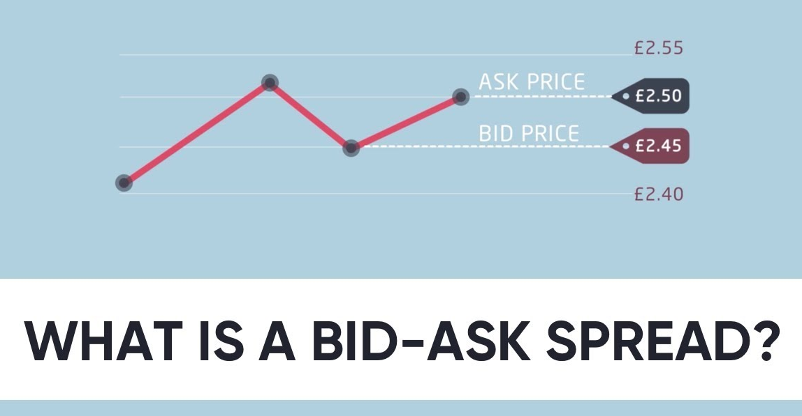
Competition in HFT
Market-makers and speculative traders
Market-makers match a seller's bid price to a buyer's ask price
  Profit from a bid-ask spread
Speculative traders target market-makers
  Capitalize on the price disparities when market-makers offer bids
Market-makers must increase the ask price to compensate for speculative traders
Fig 8. Visual Representation of Bid-Ask Spread [13]
Notes:
In competition its market makers vs speculative traders
The two types of players in high frequency trading are called market makers and speculative traders. The two players use hft algorithms for different purposes however.
Market-makers are responsible for putting out the bids onto the stock market. They use trading algorithms to match a seller's bid price with a buyer's ask or offer price very quickly. These buyers are normally investors. The market maker's profit comes from the difference between the ask price and the bid price, which is called the bid-ask spread and can be seen in figure 8.
Speculative traders target market-makers, and they use hft algorithms to predict whether the market-maker's bids would increase in price. After calculating the disparity in the price, they will purchase orders from the market-makers and resell that order quickly at a higher price.
In the market, speculative traders try to compete with other speculative traders on who can take advantage of the market makers quicker using faster algorithms and faster network speeds. Additionally, market-makers compete with these speculative traders by increasing their bid-ask spread to compensate for speculative traders purchasing and increasing the price of the offers intended for investors.
any change from a non-competitive high-frequency trading environment to an environment with two or more HFTs harms market liquidity since high-frequency speculative trading increases and liquidity providers incorporate the cost of getting sniped int
o the bid-ask spread they charge

Slide 11
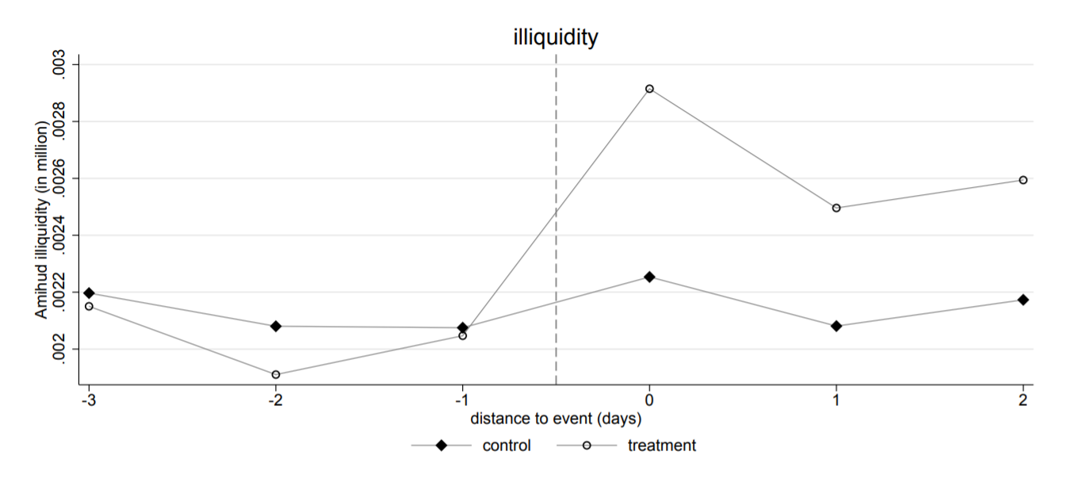
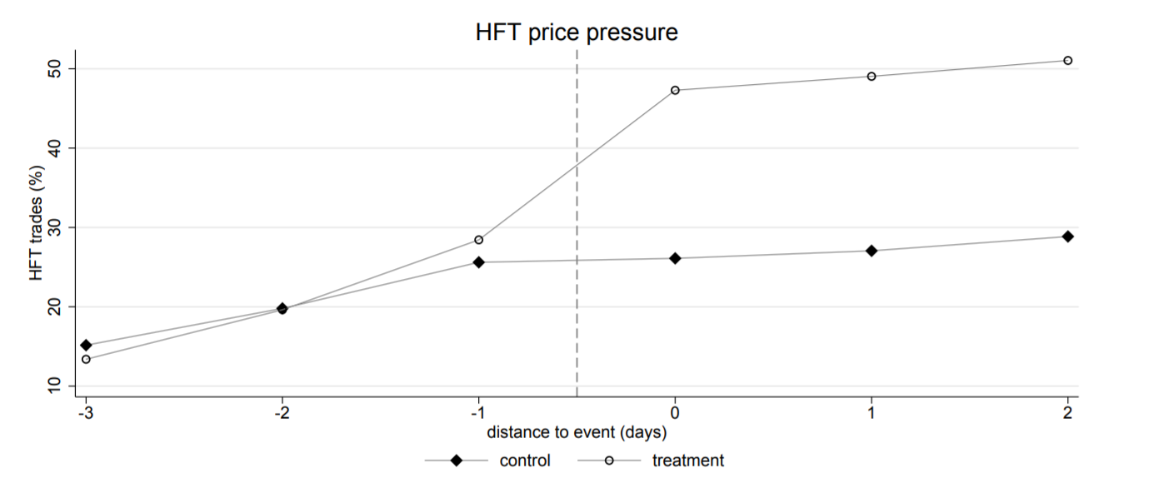
Competition in HFT
Fig 10. Illiquidity of market when second HFT enters [14]
Increases speculative trading by 12% [14]
Increases illiquidity by 18% [14]
Market-makers are forced to compensate for the illiquidity
Investors pay more
Fig 9. Volume of HFT trades when second HFT enters [14]
Notes:
A study conducted by the European Central Bank details the effect of competition in high frequency trading based on stock data from Nasdaq Stockholm. It measured the volume of high frequency trades and market illiquidity when another high frequency trader enters the market. The darker line represent a control group, which only has one high frequency trader. The lighter line initially has one high frequency trader, but a second trader was introduced at the vertical dashed line. The study found that the introduction of the second trader increases competition and, as shown in figure 9, it increased the volume of high frequency trades by 12%. It went from 29% to 41%. With this increase in high frequency trades, the illiquidity of the market also increases. Illiquidity is a phenomenon that occurs when a stock cannot be quickly sold because investors are not willing to buy it. When an increase in high frequency trades due to competition occur, the study showed that the illiquidity of the market increased by 18% using the Amihud measure of illiquidity, which is reflected in figure 10. When speculative traders buy stocks from the market-makers, they increase the price of the stocks that were intended for investors. This means that market-makers are forced to compensate for that illiquidity by having to increase the bid ask spread, which often meant that the ask price was increased. Ultimately, the investors are the ones that end up paying more as that ask price increases. Hence, high frequency traders profit at the expense of the investors.
Increases illiquidity
Increases speculative trading
Amihud illiquidity: ratio of absolute stock return to its volume in units of currency

Slide 12
Recap of Arguments
High frequency trading is detrimental for the financial market
High frequency trading benefits the high frequency traders at the expense of investors in the market
Notes:
Dov
To summarize our talk, while high frequency trading is clearly powerful the amount of downsides it has and the danger it has already brought to the stock market, it is overall a dangerous tool and can do harm than good
In addition, high frequency traders are at sonstant compeitition and while traders are benefiting, the investors themselves suffer greatly.
We hope you enjoyed our presentation, thank you very much for listening, and are there any questions?

Slide 13
References
[1] Nguyen, Kim. The Hummingbird Project. (Belga Productions and Item 7, 2019). (accessed 9/21/2021).
[2] Aghion, P., Bechtold, S., Cassar, L., and Herz, H. The Causal Effects of Competition on Innovation: Experimental Evidence. (Harvard University, 2014). https://scholar.harvard.edu/files/aghion/files/causal_effects_of_competition.pdf (accessed 10/1/2021).
[3] J.B. Maverick, How Amazon Competes With Google (AMZN, Goog), (December 23, 2020) https://www.investopedia.com/articles/investing/060215/how-amazon-competes-google.asp (accessed 10/1/2021)
[4] Lane, Matthew. How Competitive is the Tech Industry?. (Disruptive Competition Project, 2019). https://www.project-disco.org/competition/072919-how-competitive-is-the-tech-industry/ (accessed 10/3/2021).
[5] Seth, Shobhit. The World of High Frequency Algorithmic Trading. (Investopedia, 2020). https://www.investopedia.com/articles/investing/091615/world-high-frequency-algorithmic-trading.asp (accessed 10/3/2021).
[6] 2010 Flash Crash. (Corporate Finance Institute, 2015) https://corporatefinanceinstitute.com/resources/knowledge/trading-investing/2010-flash-crash/ (accessed 10/1/2021).
[7] Degryse, H., De Winne, R., Gresse, C., and Payne, R. High frequency trading and ghost liquidity. (35th Annual Conference of the French Finance, 2018). https://basepub.dauphine.fr/handle/123456789/18123 (accessed 10/1/2021).
[8] Reed, Eric. What is High-Frequency Trading. (Smart Asset, 2021). https://smartasset.com/investing/high-frequency-trading (accessed 10/1/2021)
[9] Chen, James. High-Frequency Trading (HFT). (Investopedia, 2021) https://www.investopedia.com/terms/h/high-frequency-trading.asp (accessed 10/1/2021)
[10] Photo by Linder Courtney. https://hips.hearstapps.com/hmg-prod.s3.amazonaws.com/images/homevecho-1568304636.jpg?resize=980:
[11] 2010 Flash Crash, (August 12, 2020) https://corporatefinanceinstitute.com/resources/knowledge/trading-investing/2010-flash-crash/ (accessed 10/1/2021)
[12] Tim Parker, Has High Frequency Trading Ruined the Stock Market for the Rest of Us?, (June 2, 2021) https://www.investopedia.com/financial-edge/0113/has-high-frequency-trading-ruined-the-stock-market-for-the-rest-of-us.aspx (accessed 10/1/2021)
[13] Photo by Capital.com. https://i.ytimg.com/vi/Pwi6292Wlkc/maxresdefault.jpg
[14] Breckenfelder, Johannes. Competition among high-frequency traders, and market quality. (European Central Bank, 2019). https://www.ecb.europa.eu/pub/pdf/scpwps/ecb.wp2290~b5fec3a181.en.pdf (accessed 10/5/2021)
[15] Photo by Entract Films https://www.lapresse.ca/cinema/critiques/201903/22/01-5219279-the-hummingbird-project-un-monde-absurde-12.php

