Slide 1
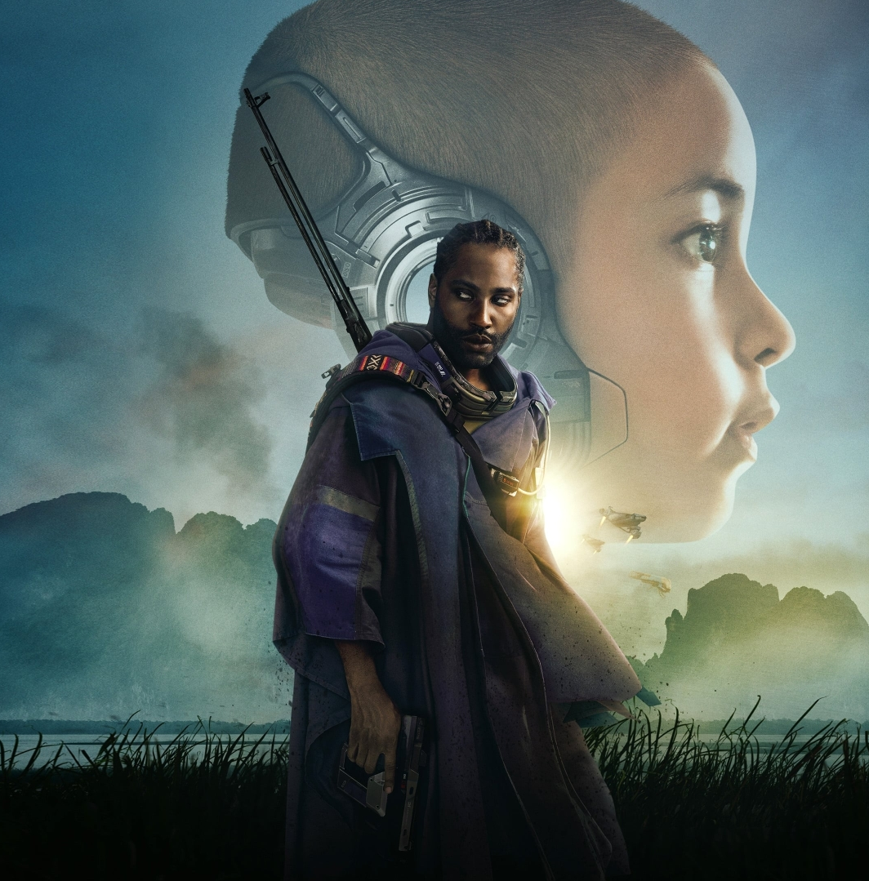
The Creator
By:
Joseph DiPietro, Justin Gauthier, Nicholas Kutschke, Everett Wilber

Slide 2
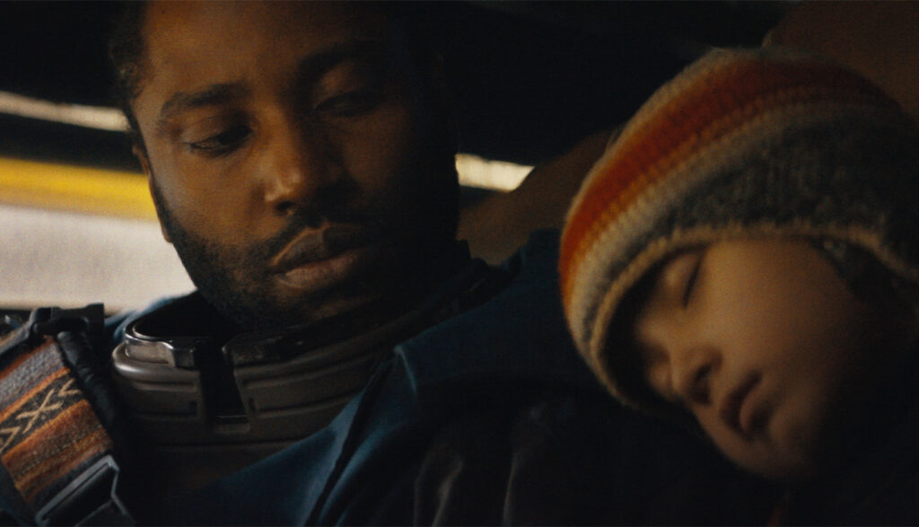
Plot Summary
The West is waging war against the Republic of New Asia, a country that uses A.I.
An ex-spy is recruited to destroy the enemy’s superweapon
The super weapon is a childlike robot
The robot knows where his wife is
As the duo tries makes their way to his wife, they get caught in the crossfire of the war
Notes:
> A future war rages between humans and artificial intelligence after AI detonates a nuclear bomb in Los Angeles.
>Joshua is a spy who is sent to find and expose the mastermind behind AI development, Nirmata. He originally was supposed to use Nirmata’s daughter, Maya, but fell in love with her, marrying and trying to start a family with her. Both her and their unborn child are killed in a botched raid.
>5 years later, Joshua, is recruited to destroy a powerful weapon, after being shown proof of his wife’s survival. The weapon is found to be a childlike robot with the ability to hack and control any digital technology. Joshua shows the robot, who he names Alphie, mercy. She then reveals that she can lead him to his wife.
>Now being hunted by operatives from both sides of the war, Joshua must protect Alphie and avoid capture to find his wife.

Slide 3
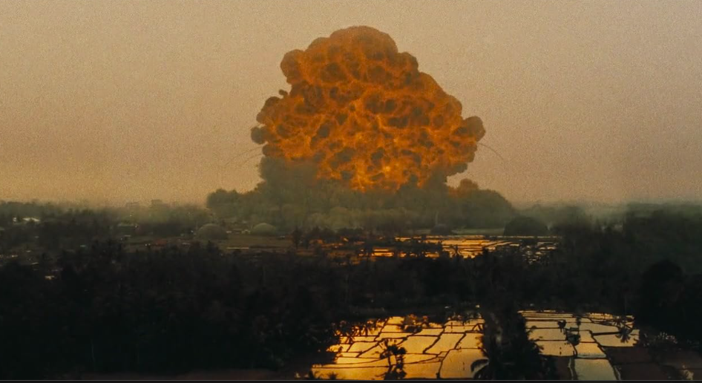
Claims
Claim 1: War should not be automated by AI. Human judgement and accountability should remain at the center of decisions which cost human lives.
Claim 2: Targeting systems should minimize civilian casualties
Claim 3: Recreating the likeness or persona of the deceased without consent is unethical

Slide 4
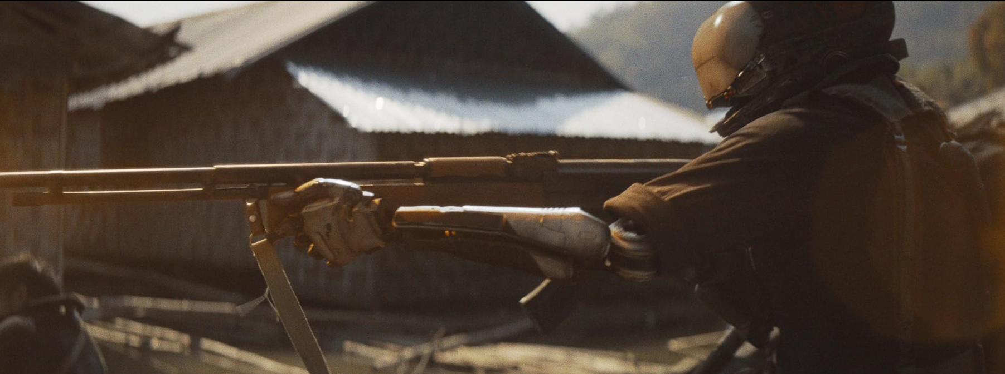
Claim #1: Don’t use AI Robots for war
The aspect of being farther away from someone or something takes away the emotional impact of killing them.[3]
Effects of using AI robots in war
Could diminish the impact of murder in war[3]
Could cause more civilian accidents[4]
Notes:
Throughout the whole movie we see that Ai robots are used in war.
In one study that I found when people killed a creature they felt less of an emotional impact the farther away they were.
Now we do not have any real world evidence but going off of this basis we can presume that if we use AI robots to kill people or to hunt people down the psychological impact of the robots killing someone will be at a lower rate compared to if a human does this.
With even less of an impact this could cause countries to go to war since not only is the psychological impact on humans diminished we would not even have to use humans in war, so very little to no lives would be lost.
As some studies have shown as well the claims that AI reduces civilian deaths is incorrect and Ai ends up causing more deaths.
So if we extrapulate that to having all war be fought with AI robots we could end up loosing even more lives.

Slide 5
Claim #1: Don’t use AI Robots for war
Drone strikes make this relevant
9 drone crashes per 100,000 hrs
“More willing to lose is more willing to use,”
Crewed aircraft are much higher risk
Combining high error rate with little friction
Automated warfare could create a never-ending war
Notes:
One relevant example of automation in warfare that has been playing out already is drone warfare. Drones have already become part of the military, and don’t seem to be going away anytime soon.
Since their introduction they have started to change how war is fought.
An article from the US Army War College Quarterly details some of the risks that drones introduce.
Drones have the highest crash rate of any aircraft. In eastern Iran this has led to drones smashing into civilian neighborhoods and cargo planes or veering so far off course that they had to be shot down. [8]
Drones have far fewer bureaucratic risks when issues arise. They are cheaper to use, cheaper to pilot, easier to deploy, so they are used. [8]
“A typical Predator drone, for instance, costs $4.5 million, while an F-35 costs $159 million, an F-22 $377 million, and a B-2 nearly $2 billion.” [8]
Because the risk of pilot death is eliminated, and the costs are far less, commanders are more willing to deploy these unmanned aircraft, lowering the threshold for initiating or continuing conflict. [8]
“UCAVs equipped with ‘target-recognition systems’ and ‘autonomous attack systems’ are on the horizon.” [8]
“AWOL drones have crashed in eastern Iran, collided with cargo planes, smashed into Djibouti neighborhoods, and veered so dangerously off course and out of control that manned jets have been dispatched to destroy them. … The Washington Post reports that a Predator based in Djibouti “started its engine without any human direction, even though the ignition had been turned off and the fuel lines closed.””[8]
Automating war entirely is on the horizon with these drones.
Without the issues of loss of human life, “a former National Security Council official... [raises a question that] suggests, “endless war” is quite possible.” That is a scary reality to think about.
[8]

Slide 6
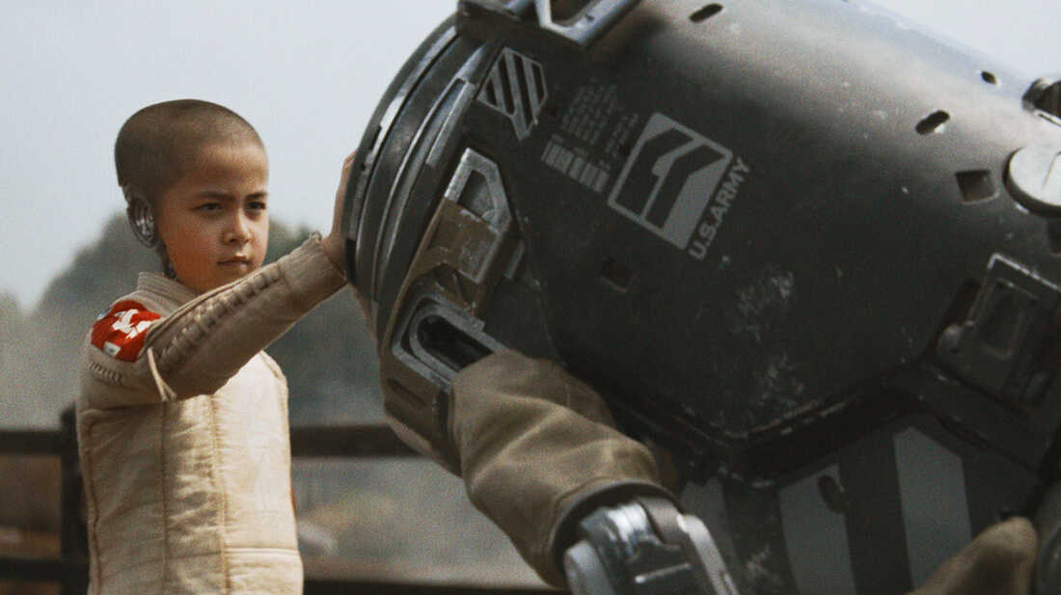
Claim #1: Don’t make bombs that simulate human emotions
"Tank Captain: G-13, you're up
…
G-13: Command confirmed. Goodbye, ma'am."
Giving emotions to AI blurs the line between tool and life
Granting AI emotions only to order their destruction resembles kamikaze missions
Notes:
In the movie we see at one point that the US has bombs that simulate human emotions.
One of the bombs when awoken looks at its brothers, and then hesitates as one of the personnel is yelling at it to go.
The bomb then looks at the person in charge and tells them goodbye, and when it speaks it sounds saddened by its fate.
It then runs off to its death.
While these robots are created to act as a bomb, giving them human emotions recontextualizes them as
If we are also creating conscious bombs were are just increasing the risks of any civilian deaths because we have bombs that are running, can think, and make their own decisions into a warzone only to blow up.

Slide 7
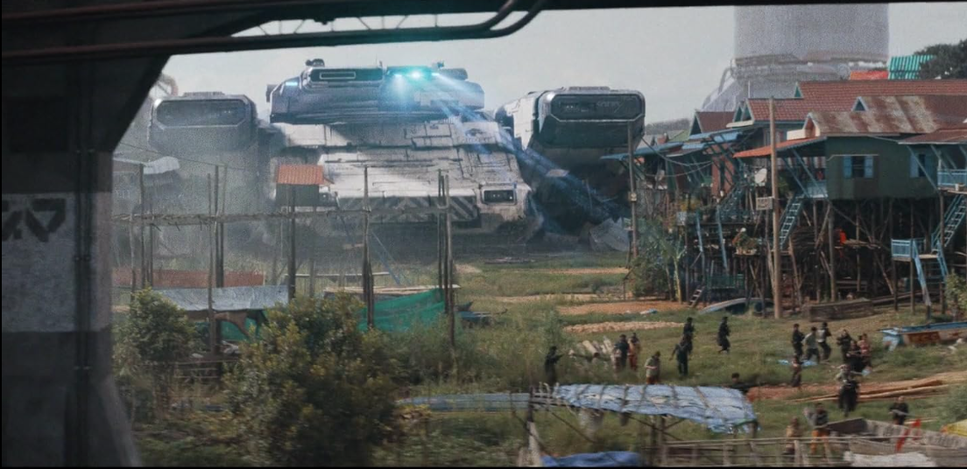
Claim #2:
Targeting systems should minimize unintended casualties
“Make no mistake: we are not at war with the people of New Asia, but the AI they harbor”
Multiple examples of targeted strikes causing casualties to nearby civilians
  NOMAD can fire missiles to blow up large targets
  Tanks have missile systems that can target individual robots
Notes:
>In the beginning of the movie, an unnamed military official from the west holds a press briefing following the bombing of Los Angeles. In it, he makes the statement “Make no mistake: we are not at war with the people of New Asia, but the AI they harbor” (0:03:11).
>However, the West does not follow its word. Despite claiming to not be at war with the people of New Asia, there are multiple examples of targeted strikes causing massive amounts of civilian casualties. In the movie the targeting system is shown with a blue laser. Both the battle station NOMAD and tanks use this technology to guide their missiles
>The battle station NOMAD can send huge missiles to hit larger targets. In the climax of the movie, scores of missiles are launched at New Asian bases, which are mostly located in densely-populated cities. (1:55:00, 1:56:19, 1:57:53)
>Tanks have missile systems that can target individual robots. However, the blast radius of most of the missiles are too large for precise strikes, so that they also hit bystanders. (1:22:24,1:23:02)
>Some of the missiles can perform a precise strike, which raises the question as to why the deadlier missiles are used at all (1:24:04)

Slide 8
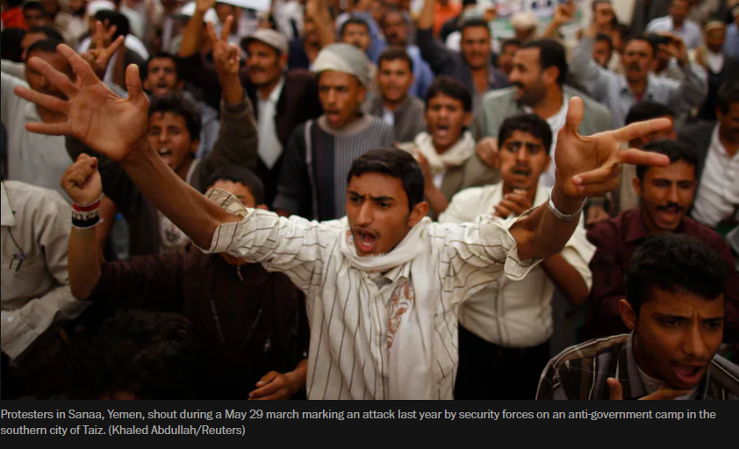
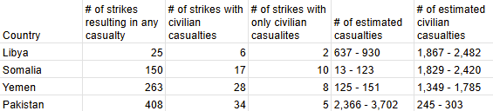
Claim #2:
Targeting systems should minimize unintended casualties
Real World example => the War on Terror
Libya, Somalia, Yemen, and Pakistan are some of the targeted countries
In each, significant percentages of strikes had civilian casualties [1]
Local leaders and human rights activists point out that a lot of angry citizens have joined terrorist organizations in response [2]
“These attacks are making people say, ‘We believe now that al-Qaeda is on the right side,’ ” said businessman Salim al-Barakani [2]
[1]
Notes:
A real world version of this is being played out in America’s war on terror
4 countries in the middle east and Africa in particular have been the targets of hundreds of American drone strikes: Yemen, Libya, Somalia, and Pakistan
In Libya 24% of casualty-causing strikes had civilian casualties
In Somalia, 11.3%
In Yemen, 10.6%
In Pakistan, 8.3%
[1]
Across all of these countries, 25 strikes resulted in only civilian casualties.
In response, a lot of anger has arisen in the targeted population. It has also bred a lot of hatred for America and Americans in general. This has led local leaders to see an increase in the number of citizens that join local terrorist organizations [2].
DO NOT PRESENT – ONLY FOR ANSWERING QUESTIONS \/
How does New America count drone strikes? [1]
There must be at least two credible media sources verifying a strike [in Libya, Somalia, or Pakistan] in order for it to be added to our databases.
In Yemen, where reporting on strikes is often more sparse, we include strikes with one major news outlet reporting that it occurred.
While we will only add a strike if there are two credible media sources verifying it (acknowledging the caveat for Yemen), we endeavor to find at least four credible media sources per strike.
Strikes that occur on the same day but in different locations or at different times are counted as separate strikes.
Multiple drone strikes that occur in short succession (two hours or less) in one area are counted as one strike.
In the case of Libya, New America and Airwars track multiple international belligerents (countries that conduct air, drone, and artillery strikes) and state belligerents (GNA/LNA, for example). There are times when strikes are deemed contested because of multiple competing claims of responsibility (we list GNA/LNA as a contested category if there are competing claims for both, as an example). If we are unable to corroborate evidence to support one belligerent or another, we list the strike(s) as contested.

Slide 9
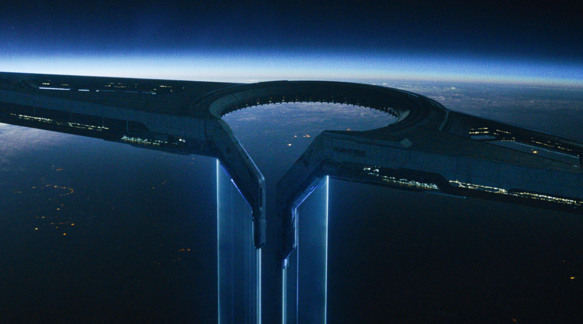
Claim #2:
Targeting systems should minimize unintended casualties
Targeting systems should minimize civilian casualties
Ethical analysis using Kantianism
Notes:
In both real and fictional wars, targeting systems should minimize civilian casualties. This can be proven to be an ethical rule when analyzed using Kantianism:
Wars are fought to protect domestic interests.
Domestic interests include protecting your civilian population
If both sides of a war use targeting systems that minimize civilian casualties, then each side increases the protection of their citizens
If they do not, they risk retaliation on their own civilians or an escalation in their enemy's war effort

Slide 10
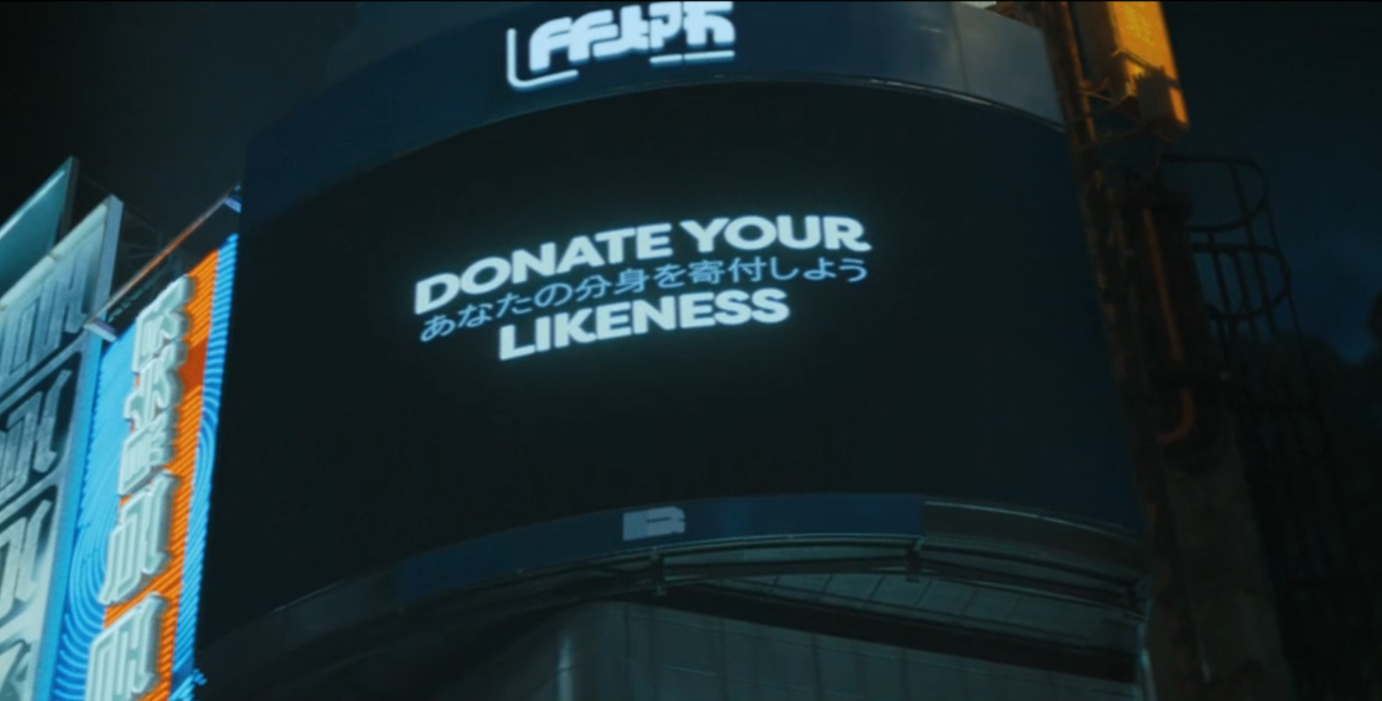
Claim #3:
Recreating the likeness or persona of the deceased without consent is unethical
Technology in the film:
Simulants imitating humans:
  Created to look human
  People can donate their likeness
Personality uploading
  Memories and traits can be transferred from a human to a simulant
  Even after death without consent
Simulants are used functionally and strategically
  Extract information
  Create misleading intelligence

Slide 11
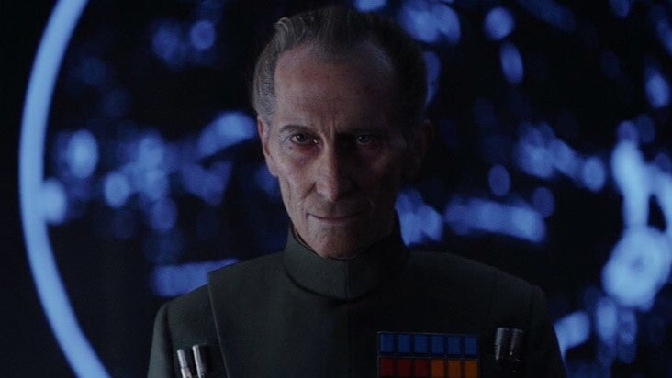
Claim #3:
Recreating the likeness or persona of the deceased without consent is unethical
Real Technology, Real Consequence
Peter Cushing Case [6]
Face digitally recreated for a posthumous role without consent
No say in how his image was used
AI Grief Bots [5]
Chatbots created to imitate the deceased
Responses are not true to the affected, just an approximation
AI Voice Acting [7]
AI can accurately recreate the voice of a specific person
An actor’s voice becomes a reusable asset, stripping them of control
Rogue One: A Star Wars Story (2016) [6]
Notes:
Peter Cushing Case
- Digitally recreated for Rogue One using CGI
- No consent given before death
- Lawsuit unresolved but could decide how actors’ likeness could be used going forward.
- Maya’s image used in fake video while she’s in a coma
- Like Cushing, no control once image is reused
AI Grief Bots
- Chatbots mimic the dead using social media data
- Not the real person, just a simulation
- No legal protection after death
- Based on user agreements, not rights
- In The Creator, personas uploaded into simulants after death
- Used to get information, not honor the person
Hank Azaria and AI Voices
- AI copies voices of actors like Azaria
- Lacks real emotion or artistic intent
- SAG contracts allow licensing, risky long term
- Some fear actors could lose control of voice after death
- Likeness and voice treated like reusable content
In The Creator, simulants speak like real people and one person’s likeness can be used to create many simulants.
Maya’s likeness used even after her death.

Slide 12
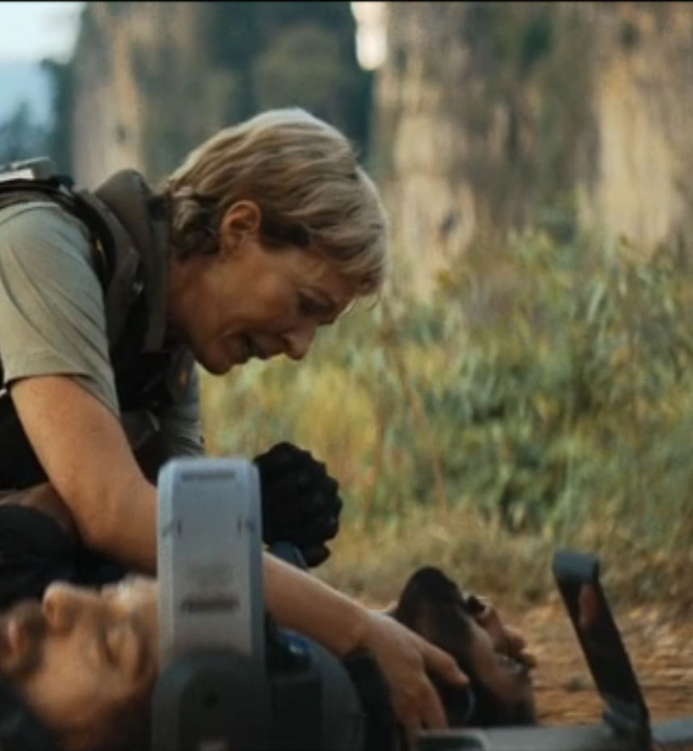
Claim #3:
Recreating the likeness or persona of the deceased without consent is unethical
Ethical Evaluation of AI Resurrection
Kantian (Unethical):
Violates autonomy
Treats deceased as a means to extract information
Act Utilitarian (Unethical):
Short-term gain
Long-term harm
Net Utility Loss
Virtue (Unethical)
Lacks compassion
Lacks Integrity
Erodes moral character
Notes:
Kantian (Unethical):
Autonomy is the right to make your own decisions which is not possible after death
Act Utilitarian (Unethical):
Short-term gain: information could be used to prevent harm
Long-term harm: normalizes disrespect for identity and sets a dangerous precedent
Emotional damage, societal mistrust, dignity erosion
In the film, the information provided by the deceased ultimately lead to the death of civilians, the oppression of simulants, and the distress of Joshua and alphie
Virtue (Unethical)
Lacks compassion: Ignores what the person may have wanted
Lacks Integrity: Uses deception and manipulation under the guise of doing good
Erodes moral character: a just and moral person would choose respect over utility
FULL EVALUATION (for questions):
Kantianism
1. Moral Agents:
The U.S. military is performing the action.
The deceased person (uploaded into a simulant) is directly affected, along with society, which is influenced by how identity is treated posthumously.
2. Rule Being Followed:
"It is acceptable to recreate a deceased person’s mind to extract information without their consent."
3. Universalization and Contradictions:
If everyone followed this rule, no one’s identity would be protected after death.
This undermines autonomy and contradicts the assumption that people deserve moral respect, living or dead.
4. Means vs. Ends:
The deceased person is used solely to achieve a goal (getting information).
They are treated as a tool, not a rational being with dignity.
Conclusion (Kantian):
The action is unethical because it violates the moral law by using someone as a means and ignoring their autonomy.
Act Utilitarianism
1. Moral Action to Evaluate:
Uploading a dead person’s persona into a simulant to interrogate them for information.
2. Stakeholders:
U.S. military
Simulant (based on the deceased)
General public
Family of the deceased
Society at large
3. Effects (in plain words):
Military might gain valuable information to help in the short term
Public safety could improve if that information prevents harm
The deceased’s identity is used without permission, violating their dignity
The family may feel disturbed or betrayed seeing their loved one recreated like this
Society may be harmed by setting a precedent that it’s acceptable to reuse people after death without consent
Conclusion (Utilitarian):
While the action might have some short-term benefits, the lasting emotional, moral, and societal harms are greater.
Therefore, the action is unethical from an act utilitarian perspective.
Virtue Ethics
1. Relevant Roles:
Military officers as public servants and decision-makers.
The deceased as a person who deserves dignity and respect.
2. Relevant Moral Characteristics:
Respect
Compassion
Integrity
3. Virtue vs. Vice:
Respect vs. exploitation
Compassion vs. emotional detachment
Integrity vs. manipulation
4. Evaluation:
A virtuous person would act with respect for the dead and seek alternatives that honor dignity.
Using someone’s mind without consent shows exploitation and disregard for their humanity.
Conclusion (Virtue Ethics):
The action is unethical. It reflects vice (manipulation, disrespect) rather than virtue.

Slide 13
References
[1] Bergen, Sterman, and Salyk-Virk “America’s Counter Terrorism Wars” (New America April 18, 2025) https://www.newamerica.org/future-security/reports/americas-counterterrorism-wars/ (April 28, 2025)
[2] Raghavan “In Yemen, U.S. airstrikes breed anger, and sympathy for al-Qaeda” (Washington Post May 29, 2012) https://www.washingtonpost.com/world/middle_east/in-yemen-us-airstrikes-breed-anger-and-sympathy-for-al-qaeda/2012/05/29/gJQAUmKI0U_story.html (April 28, 2025)
[3]Carmen. “It Is Psychologically Easier to Kill from a Distance, According to New CSUN Study.” CSUN Today, 24 July 2017, https://csunshinetoday.csun.edu/media-releases/it-is-psychologically-easier-to-kill-from-a-distance-according-to-new-csun-study/ (April 30, 2025).
[4]Joseph Boyl. “Gaza Civilian Deaths Test Israel’s AI Precision Claims.” AL, 1 Mar. 2024, www.al-monitor.com/originals/2024/03/gaza-civilian-deaths-test-israels-ai-precision-claims.
[5] Qianxi Loo, Meesha Reiisieh, Keeping the Dead Alive: AI Grief Bots and Privacy Concerns (Santa Clara Business Law Chronicle, April 22, 2025), https://www.scbc-law.org/post/keeping-the-dead-alive-ai-grief-bots-and-privacy-concerns, April 29, 2025
[6] Greg Evans, Star Wars movie sued for digital recreation of Peter Cushing’s appearance (The Independent, September 12, 2024), https://www.the-independent.com/arts-entertainment/films/news/star-wars-peter-cushing-estate-lawsuit-b2611483.html, April 30, 2025
[7] Joe Roberts, A Simpsons Voice Actor Tested Out His AI Replacement And It Didn't Go Well (Slash Film, February 15, 2025), https://www.slashfilm.com/1789940/the-simpsons-voice-actor-hank-azaria-ai-replacement-test/, April 30, 2025
[8] Alan W. Dowd, Drone Wars: Risks and Warnings, (2013) https://doi.org/10.55540/0031-1723.3016, April 30, 2025

Slide 14
Image Sources
Slide 1: https://www.movieposterdb.com/the-creator-i11858890/d3ae1297
Slide 2: https://www.pluggedin.com/movie-reviews/creator-2023/
Slide 3:
Slide 4: https://www.imdb.com/title/tt11858890/mediaviewer/rm4220658177/
Slide 5: https://www.npr.org/2023/09/28/1202299557/the-creator-film-review-ai
Slide 6: https://www.imdb.com/title/tt11858890/mediaviewer/rm1036473601/
Slide 7: https://www.washingtonpost.com/world/middle_east/in-yemen-us-airstrikes-breed-anger-and-sympathy-for-al-qaeda/2012/05/29/gJQAUmKI0U_story.html
Slide 8: https://www.imdb.com/title/tt11858890/mediaviewer/rm3297911297/

