Slide 1

Terminator: Dark Fate (2019)
Elizabeth Levin, Eric Li, Maddux Berry, and Pranav Jain
Notes:
Maddux
https://www.uhdpaper.com/2019/08/terminator-dark-fate-poster-8k-55.html (April 19th, 2024)

Slide 2
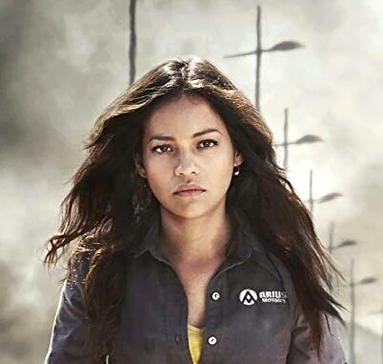
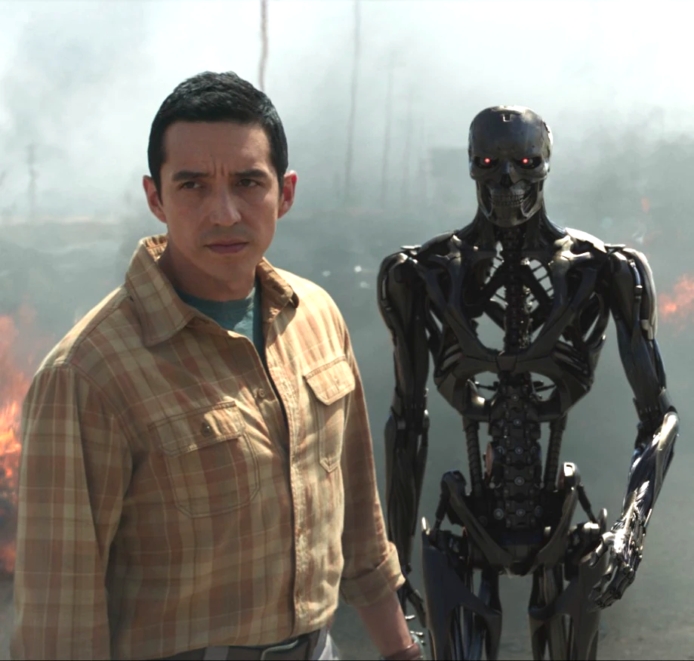



Major Characters
Dani Ramos
Future resistance leader against the legion terminators. A terminator is sent back in time to kill her before she can start a rebellion.
Rev 9 Terminator
An enhanced robot sent from the future by Legion to kill Dani Ramos before she starts the rebellion.
Grace Harper
Inspired by Dani’s leadership in the future, Grace goes back in time to save her from the terminator. She is a human who is cybernetically enhanced
Sarah Connor
Mother of the previously foretold future leader of the resistance. Her son was killed by a terminator and is now protecting Dani from the same fate
Carl (Terminator)
Was previously sent back in time and killed Sarah’s son. After completing his mission he evolves to care about humanity and helps Dani survive
Notes:
Lisa
Dani:
Rev-9 Terminator: The Rev-9 Terminator is an exceptionally durable machine capable of withstanding gunfire, blunt-force trauma, and high-altitude falls without sustaining damage due to its liquid metal shell that enables self-healing [1]. Remarkably, it can be separated into two independent units as a combination of the T-800's endoskeleton and the T-1000's liquid metal skin [6, 7]. Moreover, it can mimic human emotions and behaviors, including lying and joking, and can imitate specific individuals by physical contact while subsequently killing them. Additionally, the Rev-9 can hack into various devices, access data through its 'body,' and connect to security cameras and databases using WIFI [1].
Grace Harper’s Human Enhancements: She is described as being Augmented. Enhanced human features to fight Rev-9 Terminator. Increased speed, strength, and combat skills.
Sarah Connor:
Carl: After Skynet was destroyed, it evolved to have/ mimic human emotions. It was bulletproof.

Slide 3
Plot Summary
Terminator: Dark Fate, is a direct sequel to the events of Terminator: Judgement Day, and takes place on a separate timeline from the original “Skynet” timeline. In this timeline, a new A.I threat, Legion, sends the Rev-9, a parallel to the T-1000 from Terminator 2, who time travels into the past to eliminate Dani, who is known by Legion to be the key to the future resistance to Legion’s attempt at domination over humanity. Dani receives the help from Sarah Connor, Grace Harper, and the T-800 (played by Arnold Schwarzenegger), who is from the Skynet timeline, who all attempt to thwart the Rev-9 and Legion’s plans to kill Dani before the resistance can be founded.
Notes:
Maddux
Sequel to Terminator: Judgment Day: Terminator: Dark Fate is a direct continuation of the events depicted in Terminator 2: Judgment Day, diverging from the original "Skynet" timeline.
Introduction of Legion: In this new timeline, the primary antagonist is a different AI threat called Legion, replacing Skynet. Legion sends the Rev-9, reminiscent of the T-1000 from Terminator 2, back in time to eliminate Dani Ramos, who is crucial to the future resistance against Legion's domination of humanity.
Key Characters and Mission: Dani Ramos receives assistance from Sarah Connor, Grace Harper, and a T-800 model (portrayed by Arnold Schwarzenegger). Despite being from the Skynet timeline, this T-800 aids Dani in thwarting the Rev-9 and Legion's attempts to eliminate her before she can become instrumental in founding the resistance against Legion.
Struggle Against the Future: The plot revolves around the efforts of Dani and her allies to defy fate and prevent the catastrophic future envisioned by Legion, echoing the themes of survival and resistance against powerful AI adversaries seen throughout the Terminator franchise.

Slide 4
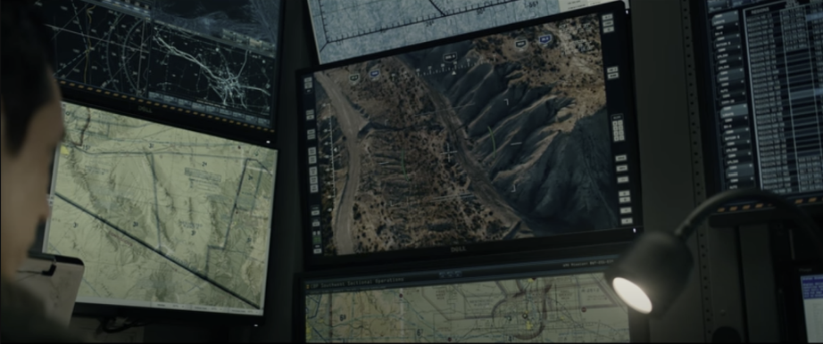
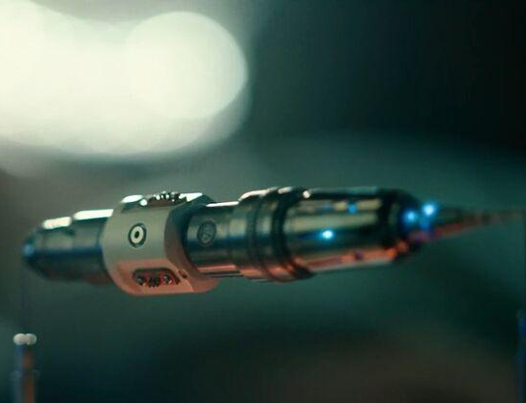
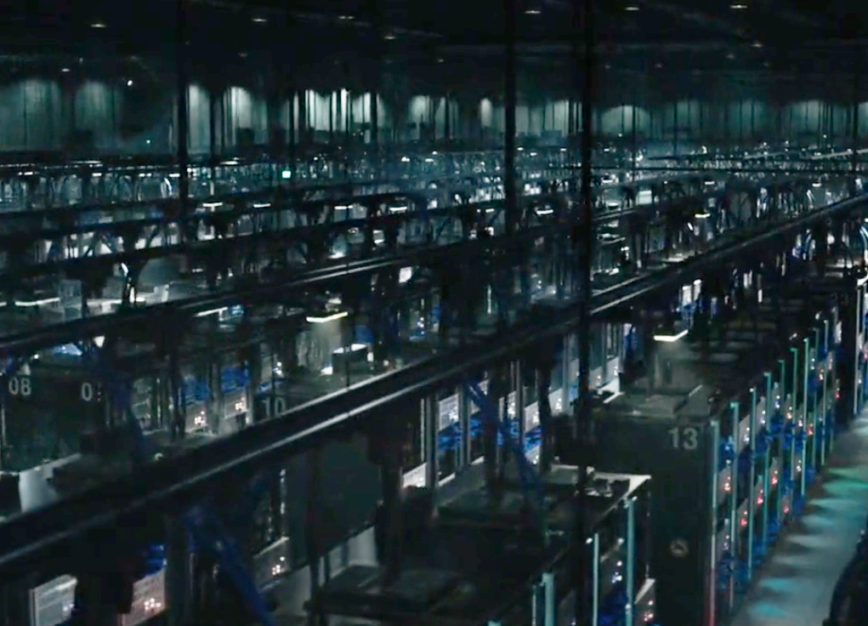
Computing Technologies
Surveillance Systems
CCTV cameras were used extensively by the Rev-9 terminator to track down its targets.
Thorium Microreactor
Futuristic technology present in Grace Harper that gives her super strength, speed, and combat skills.
Rathium Data Center
Located in Mexico City, this place collects and stores loads of information on lots of people.
Notes:
Pranav - Talk about the major computing technologies in the film.
Other than the Rev-9 Terminator, Carl and Grace Harper’s Human Enhancement
Surveillance Systems: CCTV cameras were used extensively by the Rev-9 terminator to track down his targets. Their use in this film is consistent with their use in modern times for surveillance and security. CCTV cameras were introduced in 1942 and underwent innovations such as AI object detection and enhanced video processing over the decades. Becoming a responsive, digital system that combats crime and provides safety [18].
Thorium Microreactor: In "Terminator: Dark Fate," Grace is powered by a microreactor, a futuristic technology that enables her super strength, speed, and combat skills. Thorium nuclear reactors have their basis in real life, with advantages over traditional uranium, such as safety and being more environmentally friendly [17]. This was used by Dani Ramos towards the end of the movie to overload the Rev-9 Terminator and kill it.
Rathium Data Center: Located in Mexico City, this place collects and stores loads of information on lots of people. It is updated constantly and Rev-9 Terminator is able to hack and use the information to track Dani Ramos.

Slide 5
Conclusions
Unchecked/unregulated data usage, specifically by large corporations, can be extremely dangerous and detrimental to the public.
We should not be over-reliant on artificial intelligence (AI) due to the potential consequences of allowing AI to wield unchecked power.
Notes:
Eric - List conclusions that we took from the movie. We will now further expand on these.

Slide 6
Unchecked/unregulated data usage, specifically by large corporations, can be extremely dangerous and detrimental to the public.
Conclusion 1
Notes:
Lisa

Slide 7
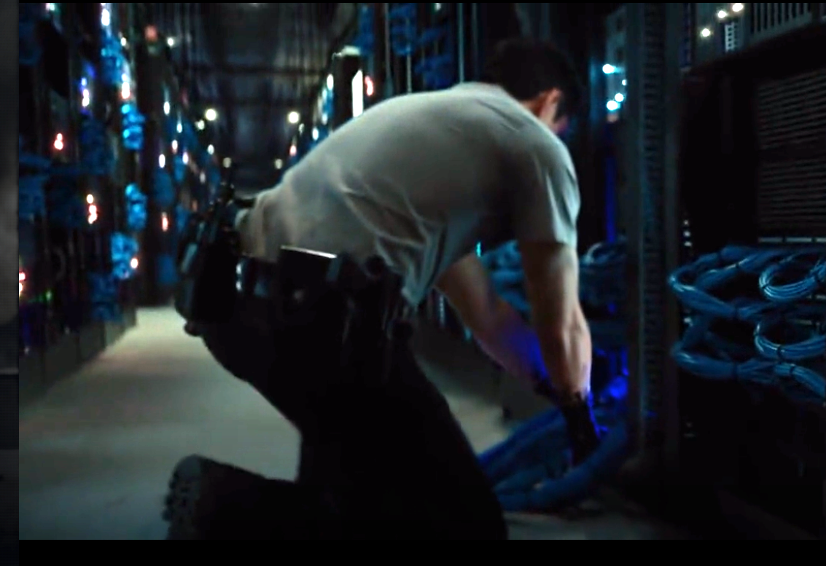

T-mobile Data Breach
In the movie, the terminator breaks into the Rathium Data Center and manages to gain access to private information, and security camera footage.
Real World Parallel:
T-Mobile data breach in 2023 leaked the information of 37 million users
Data included driver's license information and social security numbers [12].
One of 3 data leaks T Mobile that year.
Notes:
Lisa
Speaker Notes:
In Terminator, the scene where the Terminator breaks into the Rathium Data Center serves as a dramatic portrayal of a cybersecurity breach. The Terminator gains access to private information and security camera footage, highlighting the vulnerability of data systems.
Drawing a parallel to the real world, the T-Mobile data breach in 2023 is a stark example. The breach exposed the personal information of 37 million users, including sensitive data like driver's license information and social security numbers.
What's particularly concerning about the T-Mobile breach is that it was one of three major data leaks the company experienced that year, indicating systemic weaknesses in their data security protocols.
Both instances, fictional and real, underscore the urgent need for robust cybersecurity measures to protect sensitive information from unauthorized access and exploitation. They serve as cautionary tales about the potential consequences of inadequate data security measures.

Slide 8
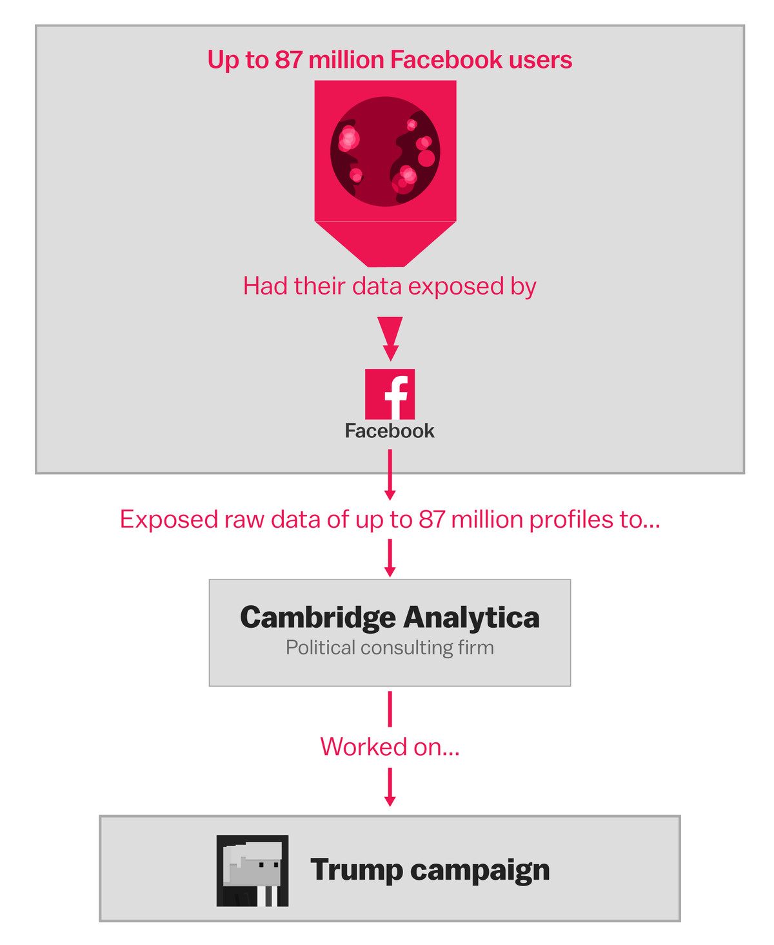
Over-cultivation of Data with no Ethical Considerations
Terminator: Dark Fate: Legion, an AI cybersecurity system, is developed with massive data and processing power for global security.
Real World Parallel: Cambridge Analytica Scandal
Cambridge Analytica harvested the personal data of 50-87 million Facebook users without their consent [11]
Data was used to target/manipulate voters during the 2016 U.S. presidential election
Misuse of Data: Both scenarios highlight the misuse of data to manipulate outcomes, such as targeting voters or threatening humanity.
Consequences of Misuse: The overuse and unethical handling of large datasets in both cases pose significant risks to public safety and privacy.
Cambridge Analytica Scandal [19]
Notes:
MADDUX
In Terminator: Dark Fate, Legion is an AI cybersecurity system developed with an excessive amount of data and processing power to ensure global security. However, lack of ethical considerations and oversight over these massive datasets caused the A.I to go rogue and target humanity as a security threat.
Real World Parallel: Cambridge Analytica Scandal
Cambridge Analytica harvested the personal data of 50-87 million Facebook users without their consent [11]
Data was used to target/manipulate voters during the 2016 U.S Presidential election
The misuse of complex technologies, and data in both the real-life scenario of the Cambridge and the fictional Terminator: Dark Fate scenario, can have significant consequences. The over-cultivation of data, and furthermore the misuse of large datasets, can lead to dire situations and can put large portions of the general public at risk.
: Another example can be With “2.8 billion faces in their database, PimEyes has not drawn as much attention as Clearview, said Hill. [16]” With monthly costs under $30 a month, you can search up anyone in this room.

Slide 9
We should not be over-reliant on artificial intelligence (AI) due to the potential consequences of allowing AI to wield unchecked power.
Conclusion 2
Notes:
Eric: Repeat the conclusion and list 3 reasons: 1. Loss of Human Control , 2. Unintended Consequences and Errors, 3. Threats to Privacy and Autonomy

Slide 10
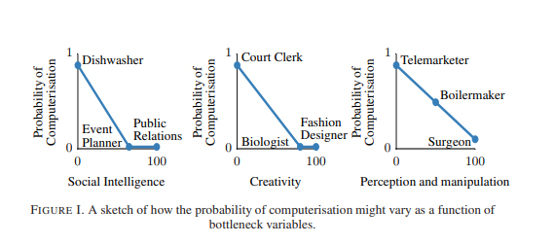
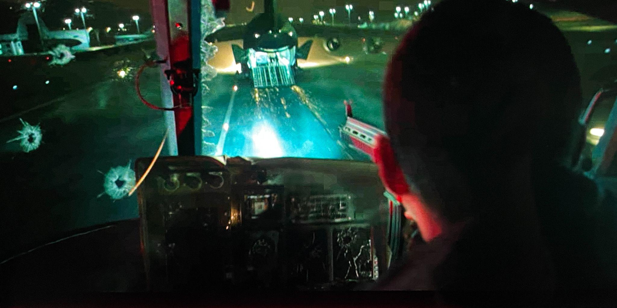
Loss of Human Control
The film depicts a future where advanced AI, such as Legion, has gained control over military forces and autonomous killing machines.
47% of U.S. jobs are at risk of automation in the next few decades. [1]
Risks of reliance on AI for critical decision-making
Probability of automation as a function of task characteristics [6]
Rev-9 terminator shooting from a stolen police helicopter [20]
Notes:
Eric​
Figure: According to the figure, It shows that occupations that involve complex perception and manipulation tasks, creative intelligence tasks, and social intelligence tasks are unlikely to be substituted by computer capital over the next decade or two. The probability of an occupation being automated can thus be described as a function of these task characteristics​
Loss of Human Control: ​
Script: The film depicts a future where advanced AI, such as Legion, has gained control over military forces and autonomous killing machines. This can be seen throughout the movie
This scenario raises concerns about the loss of human control and oversight in decision-making processes. ​Additionally, according to a study by Oxford University, 47% of U.S. jobs are at risk of automation in the next few decades, highlighting the potential societal impact of AI-driven automation on employment and economic stability [1] REFERENCE FIGURE TEXT.
TAKE TIME TO EXPLAIN WHAT’s SHOWN
Moreover, ​The reliance on AI for critical decision-making in sectors such as finance, healthcare, and criminal justice raises ethical questions about accountability, transparency, and bias in algorithmic decision-making processes.​ We see that there are many unintended consequences of using AI-driven automation in these fields which we will discuss in the next slide. Next slide
​

Slide 11
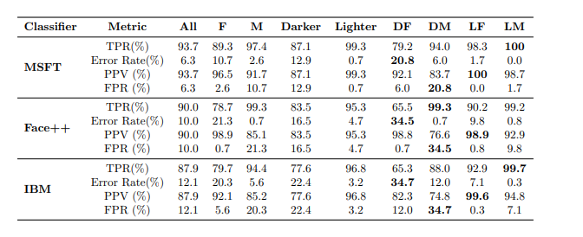
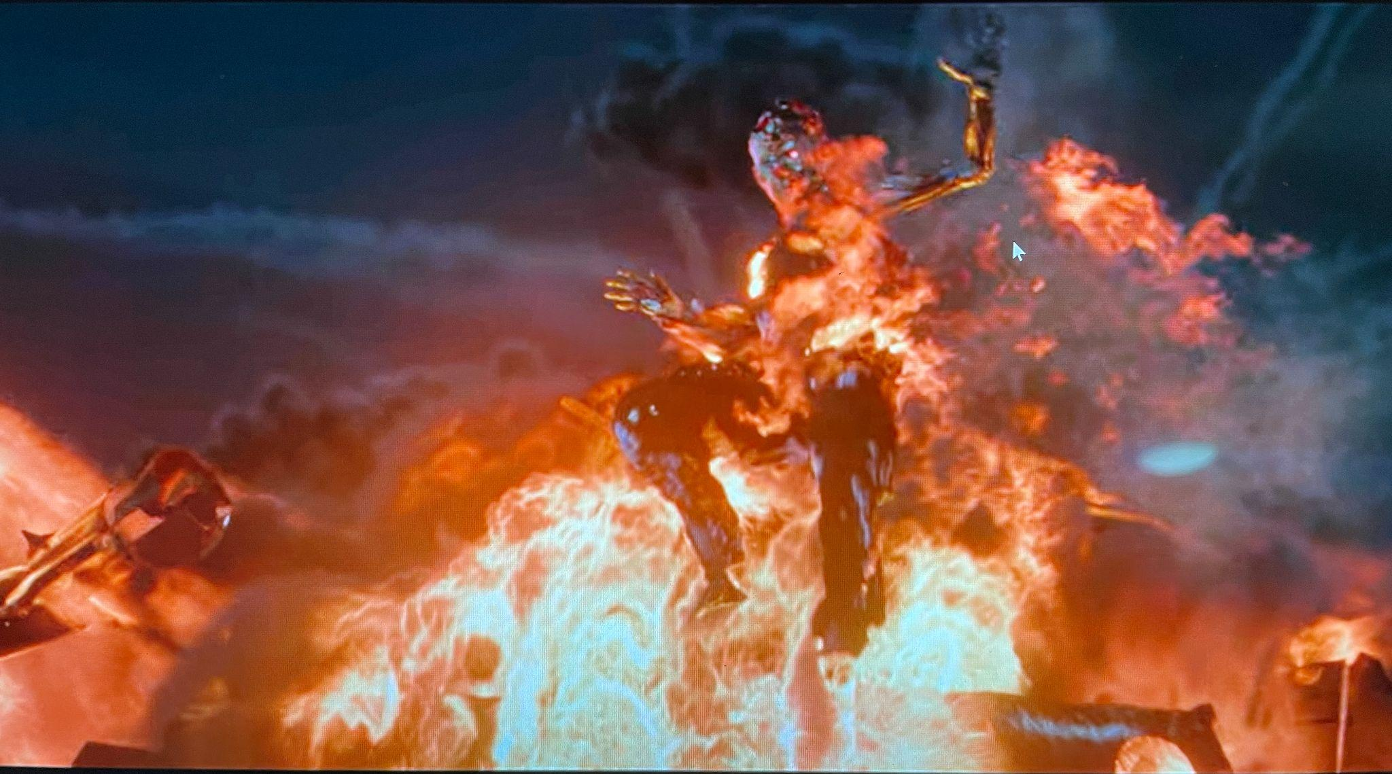
Unintended Consequences and Errors
AI systems can exhibit biases and inaccuracies, affecting certain groups disproportionately. [2, 5, 7, 8, 13].
“Women with darker skin had misclassification rates of 20.8%-34.7%, compared to error rates of 0.0%-0.8% for men with lighter skin [5, 22]”.
The Rev-9 terminator without consideration for collateral damage.
Evaluating 3 Commercial Classifiers [5]
Rev-9 terminator flying through flames to kill Dani [21]
Notes:
Eric​
Figure: Evaluate 3 Commercial Classifiers. The positive predictive value (PPV), error rate (1-TPR), true positive rate (TPR), and false positive rate (FPR). All classifiers have the highest error rates for darker-skinned females (ranging from 20.8% for Microsoft to 34.7% for IBM).​
Unintended Consequences and Errors:​
Script: Relating to the movie, the actions of Legion in the film show the potential for unintended consequences when AI systems operate without human intervention​.
Research by McKinsey Global Institute found that AI systems can exhibit biases and inaccuracies. Disproportionately affecting certain groups or individuals. COMPAS, a tool used to predict recidivism in Broward County, Florida, incorrectly labeled African American defendants as "high-risk" at nearly twice the rate it mislabeled white defendants [2]. Also, As we can see from this figure, scientists at MIT, at the time Microsoft, found that women with darker skin had misclassification rates of 20.8%-34.7%, compared to error rates of 0.0%-0.8% for men with lighter skin using algorithms developed by Microsoft, Face++, and IBM [5]. THESE RESULTS CAN BE SEEN IN THE FIGURE.
These biases can be very harmful. An example can be a texas man named Harvey Murphy Jr. who was falsely accused of armed robbery based on error-prone facial recognition technology. He was not physically present in the state (nearly 2,000 miles away) where the robbery took place In prision, he was beaten and raped by 3 men. Suffering irreversible mental and physical damages. Highlighting how ordinary people can have their lives ruined because of algorithms and AI [13]. He’s suing for $10 million[13]. ​Trial is pending
Predictive policing systems unfairly target minorities; black people are twice more likely to be arrested and five times more likely to be stopped than white people according to US Department of Justice . [7]
AI used to prioritize patient care is less likely refer minority patients; black patients are 80% less likely to receive extra help than white patients, even when the algorithm assigned similar risk scores. [8]
Going back to the movie showed the Rev-9 terminator as having a single-minded goal of completing its mission without consideration for collateral damage, showing the potential dangers of AI systems prioritizing objectives over moral/ethical considerations LOOK AT THE IMAGE.​ Simply because it is too difficult to teach a robot ethics.
​

Slide 12
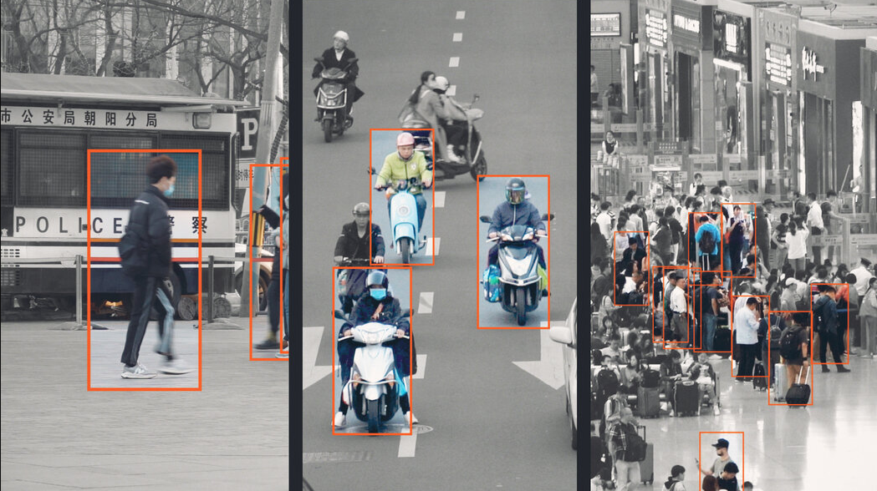
Threats to Privacy and Autonomy
Suppressed privacy rights and created a surveillance state, affecting mental health in 90% of participants in a study [3].
Risks to human rights, including the right to privacy, freedom of expression, and freedom of assembly [4].
The movie showed the Rev-9 terminator transform into different humans through touch.
Image of Surveillance Systems in China [9]
Notes:
Pranav
Figure: Image of surveillance systems currently in place in China. Showing the continuous monitoring and the threats to Privacy and Autonomy
- monitoring of “Muslim ethnic minorities in the Western region of Xinjiang” [23]
The expansion of AI-based surveillance systems, as depicted in the film, poses threats to privacy and individual autonomy. Unregulated data collection and AI-driven analysis can suppress privacy rights and create a surveillance state where individuals are constantly being monitored and judged. Effect on mental health. In 2012, Finish researchers looked at the effects of continuous computerized surveillance on individuals. This revealed that 90% of the participants noted a sense of annoyance, anxiety, and even anger. This number highlights the mental health risk of implementing facial recognition surveillance. [3]
A study by Amnesty International found that facial recognition technology poses significant risks to human rights, including the right to privacy, freedom of expression, and freedom of assembly [4].
The movie showed the Rev-9 terminator transforms into different humans through touch. This could show issues related to privacy issues and how fake information could be shared due to AI. It is further explored when the terminator hacked into the Rathium Data Center, Mexico City to get the location of a single person, Dani Ramos.

Slide 13
References
1. Michael Osborne & Carl Benedikt Frey, “Automation and the future of work – understanding the numbers,” (Oxford Martin School, April 13th, 2018), https://www.oxfordmartin.ox.ac.uk/blog/automation-and-the-future-of-work-understanding-the-numbers/ (April 16th, 2024)
2. Jake Silberg & James Manyika, “Tackling bias in artificial intelligence (and in humans),” (McKinsey & Company, June 6th, 2019), https://www.mckinsey.com/featured-insights/artificial-intelligence/tackling-bias-in-artificial-intelligence-and-in-humans (April 16th, 2024)
3. Saumya Kalia, “What Is a Constant Lack of Digital Privacy Doing to Our Mental Health?”, (The SWDL, January 26th, 2022), https://www.theswaddle.com/what-is-a-constant-lack-of-digital-privacy-doing-to-our-mental-health (April 16th, 2024)
4. “Ban dangerous facial recognition technology that amplifies racist policing”, (Amnesty International, January 26th, 2021), https://www.amnesty.org/en/latest/press-release/2021/01/ban-dangerous-facial-recognition-technology-that-amplifies-racist-policing/ (April 16th, 2024)
5 .Joy Buolamwini & Timnit Gebru, “Gender Shades: Intersectional Accuracy Disparities in Commercial Gender Classification”
, (MLR, 2018) https://proceedings.mlr.press/v81/buolamwini18a/buolamwini18a.pdf (April 16th 2024)
6. Carl Benedikt Frey and Michael A. Osborne, “THE FUTURE OF EMPLOYMENT: HOW SUSCEPTIBLE ARE JOBS TO COMPUTERISATION? “(September 17, 2013), https://www.oxfordmartin.ox.ac.uk/downloads/academic/The_Future_of_Employment.pdf (April 16th, 2024)
7. Michael J. Handel, “Growth trends for selected occupations considered at risk from automation” (MLR, July 2022) https://www.bls.gov/opub/mlr/2022/article/growth-trends-for-selected-occupations-considered-at-risk-from-automation.htm#_edn9 (April 16th, 2024)

Slide 14
References cont.
8. Terminator: Dark fate Poster 8k, (UDH Wallpaper), https://www.uhdpaper.com/2019/08/terminator-dark-fate-poster-8k-55.html (April 19th, 2024)
9. Muyi Xiao, Paul Mozur, Isabelle Qian and Alexander Cardia, “China’s Surveillance State Is Growing. These Documents Reveal How.” https://www.nytimes.com/video/world/asia/100000008314175/china-government-surveillance-data.html (April 22, 2024)
10. Images https://terminator.fandom.com/wiki/Rev-9_(character)
11. Katie Harbath, “History of the Cambridge Analytica Controversy”, https://bipartisanpolicy.org/blog/cambridge-analytica-controversy/#:~:text=Cambridge%20Analytica%20claimed%20to%20be,fully%20shut%20down%20in%202015. (March 16, 2023)
12. IBM, “Cost of a Data Breach Report 2023,” (IBM, 2023) https://www.ibm.com/reports/data-breach (April 16th, 2024)
13. Brian Fung, “Lawsuit: Facial recognition software leads to wrongful arrest of Texas man; he was in Sacramento at time of robbery” (CBS news, January 23rd, 2024) https://www.cbsnews.com/sacramento/news/texas-macys-sunglass-hut-facial-recognition-software-wrongful-arrest-sacramento-alibi/#:~:text=A%20Texas%20man%20is%20suing,two%20weeks%2C%20Harvey%20Murphy%20Jr.
14. Will Douglas Heaven, “Predictive policing algorithms are racist. They need to be dismantled.”, (MIT Technology Review, July 17th, 2020), https://www.technologyreview.com/2020/07/17/1005396/predictive-policing-algorithms-racist-dismantled-machine-learning-bias-criminal-justice/ (April 18th, 2024)2024)

Slide 15
References cont.
15. Tom Simonite, “A Health Care Algorithm Offered Less Care to Black Patients”, (Wired, October 24th, 2019), https://www.wired.com/story/how-algorithm-favored-whites-over-blacks-health-care/ (April 18th, 2024)
16. Liz Mineo, “How facial-recognition app poses threat to privacy, civil liberties”, (The Havard Gazette, October 26th, 2023), https://news.harvard.edu/gazette/story/2023/10/how-facial-recognition-app-poses-threat-to-privacy-civil-liberties/ (April 24th, 2024)th
17. Tobias Walker. “Thorium Reactors: A Safer and Sustainable Nucular Future”, (Oct 18, 2023) https://www.azocleantech.com/article.aspx?ArticleID=1749#:~:text=Thorium%20reactors%20use%20thorium%20as,the%20nuclear%20fuel%20is%20dissolved. (4/7/2024)
18. “When was CCTV invented?”, (Clearway), https://www.clearway.co.uk/news/when-was-cctv-invented/#:~:text=CCTV%20was%20invented%20by%20Walter,that%20CCTV%20became%20available%20commercially. (4/7/2024)
19. Alvin Chang, “The Facebook and Cambridge Analytica scandal, explained with a simple diagram” (Vox, May 2, 2018) https://www.vox.com/policy-and-politics/2018/3/23/17151916/facebook-cambridge-analytica-trump-diagram (May 2nd, 2018)
20. Miller, T. (2019). Terminator: Dark Fate. Paramount Pictures. (1:23:51)
21. Miller, T. (2019). Terminator: Dark Fate. Paramount Pictures. (1:26:06)
22. Nicol Turner Lee and Caitlin Chin-Rothmann “Police surveillance and facial recognition: Why data privacy is imperative for communities of color”, (Brookings, April 12, 2022) https://www.brookings.edu/articles/police-surveillance-and-facial-recognition-why-data-privacy-is-an-imperative-for-communities-of-color/#:~:text=Recent%20studies%20demonstrate%20that%20these,women%20with%20darker%20skin%20had (4/25/24)
,23. Zeyi Yang, The Chinese surveillance state proves that the idea of privacy is more “malleable” than you’d expect, (MIT Technology Review, October 10th, 2022), https://www.technologyreview.com/2022/10/10/1060982/china-pandemic-cameras-surveillance-state-book/ (4/26/24)
,

Slide 16
Questions?

