Slide 1
TPB AFK: The Pirate Bay
Away from Keyboard
Anthony Dresser, Ben Sharron, Andrew Mokotoff, Ruofan Ding
Notes:
Introduce ourselves

Slide 2
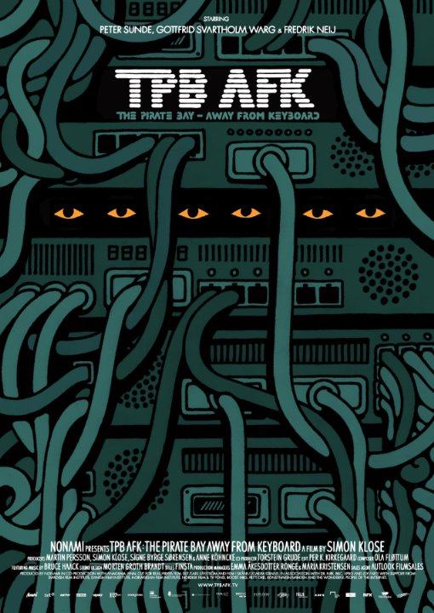
Synopsis
Follows the 2008 trial against Fredrik Neij, Gottfrid Svartholm, and Peter Sunde, the founders of the BitTorrent indexer The Pirate Bay.
http://ia.media-imdb.com/images/M/MV5BMjU4MzY4ODg0MV5BMl5BanBnXkFtZTcwNTE2MjY5OA@@._V1_SX640_SY720_.jpg
Notes:
The Pirate Bay Away From Keyboard is a documentary directed by Simon Klose which follows the founders of The Pirate Bay, Fredrik Neij, Gottfrid Svartholm, and Peter Sunde, during the trials of 2008 in which the Swedish government brought charges of breaking copyright law with The Pirate Bay (both criminal and civil). It documents their thoughts throughout the trial and also has interviews with people on the other side of the case. Throughout the documentary, it discusses the Pirate Bureau, previous raids on The pirate bay, and the technology behind the pirate bay.

Slide 3

Conclusion
The current implementation of copyright no longer protects content creators and is nearly impossible to reasonably enforce.
http://2.bp.blogspot.com/-DF1jEHYgLHQ/VIihTRy9kLI/AAAAAAAACPE/B6PbKPfrh0k/s1600/1125666854.png
Notes:
The conclusion we have made based on the documentary is that the current implementation of copyright no longer protects content creators and is nearly impossible to reasonably enforce; with the Pirate Bay and the technology behind it being the main reason.

Slide 4

BitTorrent Complicates Police Efforts
Peer 2 peer communications (Bittorrent) makes copyright infringement faster, easier, and more reliable than typical file downloading.
https://hacked.com/wp-content/uploads/2014/12/bittorrent.png
Notes:
Bittorrent is a peer 2 peer communication protocol that the Pirate Bay utilizes in order to provide the file sharing on their webserver. Because of how Bittorrent works, it makes it very difficult to track down the people downloading and makes it difficult to take down hosters.

Slide 5
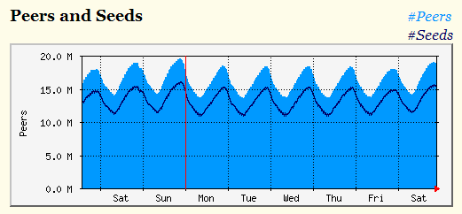
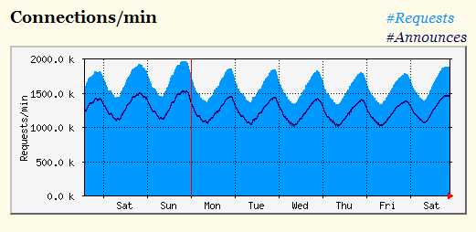
There are too Many People Torrenting to Stop it
Each minute 15-30 million people are simultaneously sharing torrents (leeching and/or seeding)
Over 2 million connections every minute, which is more than 3,333 connections per second
BitTorrent users connected (CET)
Source: https://torrentfreak.com/images/demoniipeer.png
Connections/min
Source: https://torrentfreak.com/images/demoniiconn.png
Notes:
Explain peers and seeds system
Excess number of people involved all trading intellectual property
Much harder to stop trade of intellectual property since everyone has it and can easily re-upload torrents
Hard to determine who is responsible for the initial upload

Slide 6
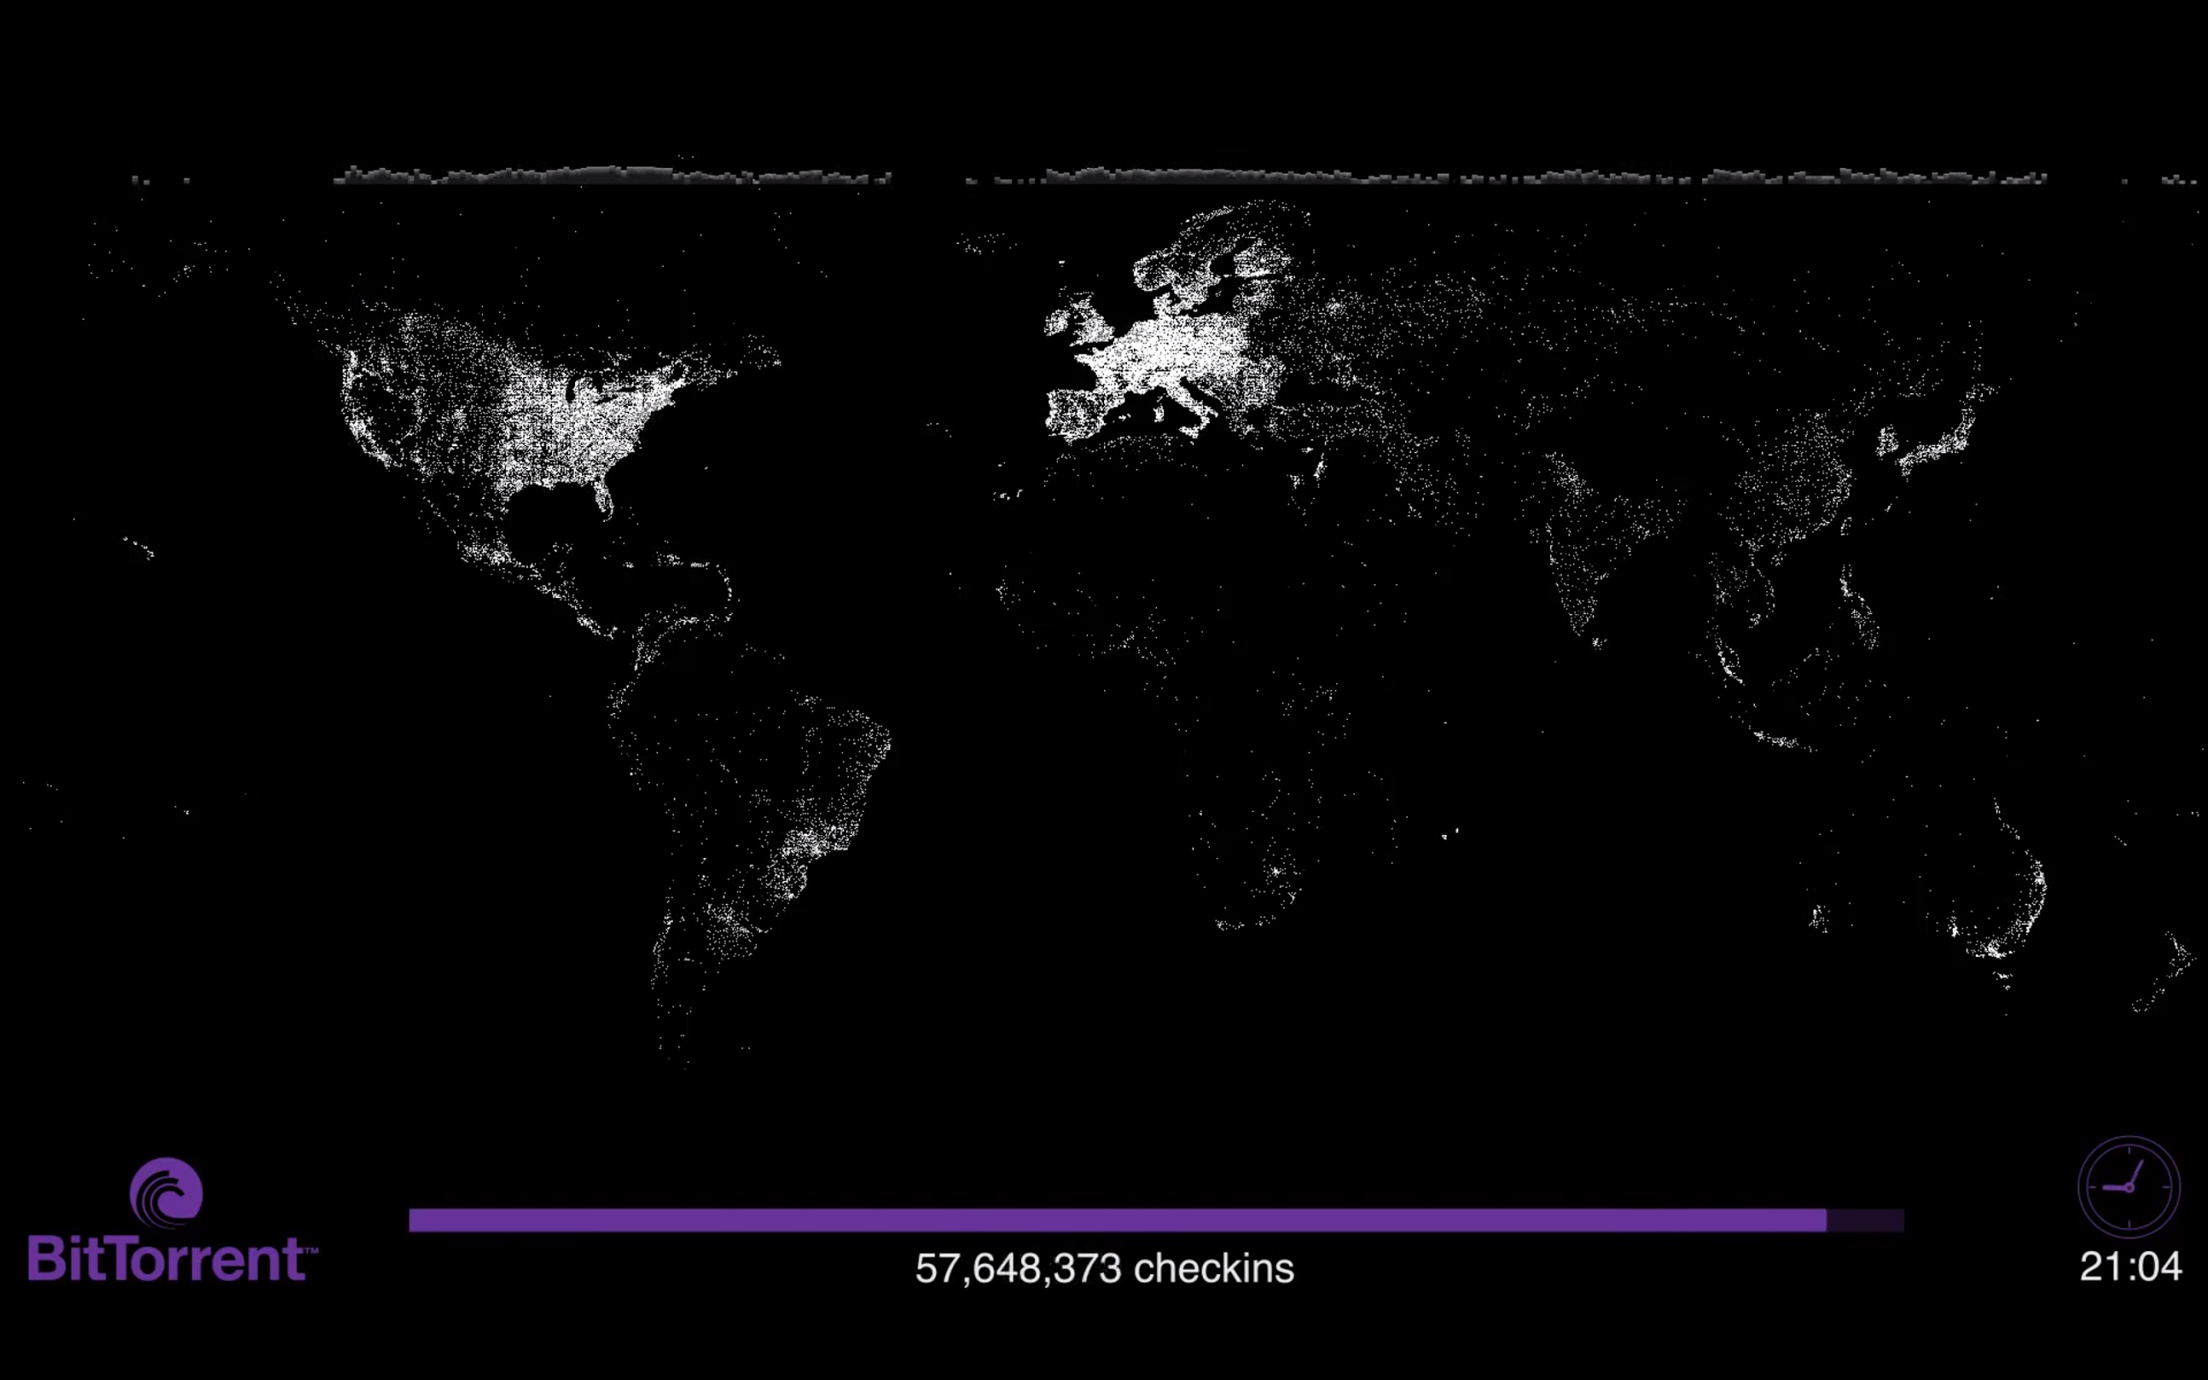
BitTorrent is Globally Popular
https://www.youtube.com/watch?t=221&v=55a7yeY0nH0
Notes:
This image shows a slice in time of the global use of Bittorrent. As you can see from the slide, during this 24 period in January of 2011, over 60Million users checked in all across the world. This shows the popularity of bittorrent across the globe and the massive scale at which copyright infringement is being done.

Slide 7
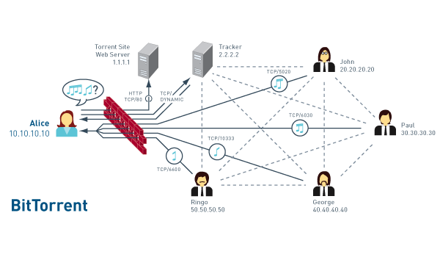
BitTorrent is Difficult to Track
Distributed Network
Faster
More Reliable
Maintainability
https://s-media-cache-ak0.pinimg.com/originals/08/5c/94/085c94872a69c0ebbb69dccb2cf3a708.jpg
Notes:
It works by connecting users together to download from each other instead of downloading from a central server. Instead the central server hosts tracking files which tracks which clients have the file a user wants to downloads and connects the user to those clients. This makes downloading large files much faster because the user is no longer bottlenecked by the server and instead is only bottlenecked by their own internet speeds. Additionally, because the server only contains the tracking information, if the server goes down, it is much easier to bring back up because the size of the server is smaller. This size difference also makes maintaining the server much easier with the high amount of traffic goes through them.

Slide 8
Cloud Computing Makes Copyright Enforcement Difficult
Hard to track down.
Easy and cheaper to maintain.
Distributed system assures accessibility and reliability.
Notes:
Since the police raid in 2006, they switched to Cloud Computing and mirroring
Pirate bay is designed around mirroring (cloud)
Pirate bay has been forced to take down sites by the police many times, but there are many mirrors
On domains from different countries, so it's legally more difficult to shut all of them down
//Users can download an image of all the torrents and lets other people host it wherever they desire
You cannot upload torrents to mirrors, but you can still download previous torrents

Slide 9
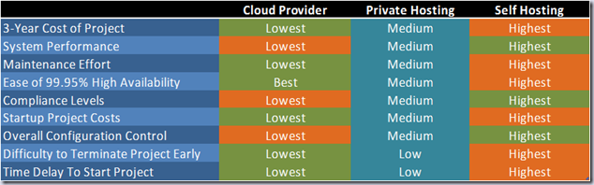
Cloud Computing is Cheaper
Lower price compared with self-hosting server
Easy to setup and maintain
http://geekswithblogs.net/hroggero/archive/2013/02/25/sample-pricing-comparison-on-premise-vs.-private-hosting-vs.-cloud-computing.aspx
Notes:
Lowest price
Maintenance is virtually non existent, requires no physical labor
Easy to configure
Lowest delay to start a project
No financial loss on hardware if the site is taken down by police.
Also, cloud computing would provide a significantly higher degree of freedom to upgrade, enhance or even terminate the project on demand. Software requires updates frequently, but the cloud provider handles that for you
https://torrentfreak.com/pirate-bay-moves-to-the-cloud-becomes-raid-proof-121017/
http://geekswithblogs.net/hroggero/archive/2013/02/25/sample-pricing-comparison-on-premise-vs.-private-hosting-vs.-cloud-computing.aspx

Slide 10
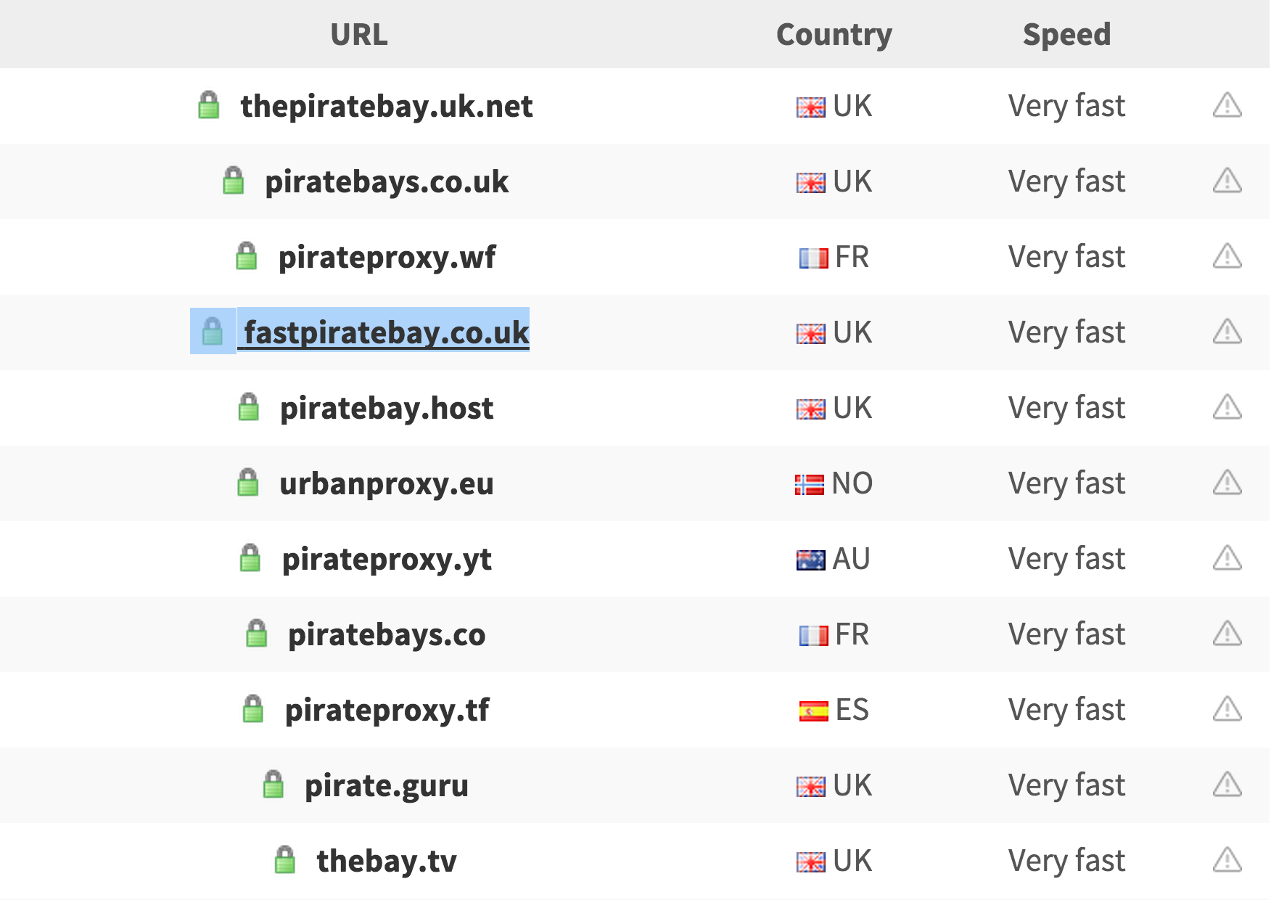
Pirate Bay Mirrors make Enforcement Impossible
At least 27 mirror and proxy websites running.
Across different countries.
https://thepiratebay-proxylist.org/
Notes:
Distributed system makes it harder to track and shut down all the servers.
Since the total size of all bit torrents of pirate bay is only about 90 MB, it's very easy to clone the whole pirate bay website and migrate to multiple mirror servers.
Anyone could host their own pirate bay
In December 12 2014, the Pirate Bay was taken offline due to the efforts of the Swedish police who raided the offices where the servers were reportedly kept.
However, those “server” were not that important due to the distributed system, and they simply switched it to another mirror
On December 12 2014, the Pirate Bay was taken offline due to the efforts of the Swedish police who raided the offices where the servers were reportedly kept. In only a few days, there have been many mirror websites that have popped up.
http://www.ubergizmo.com/2014/12/the-pirate-bays-shutdown-didnt-seem-to-have-affected-torrent-activity/

Slide 11
Government Intervention has Undesired Effects
Police raid The Pirate Bay servers
Site is reestablished within days
Media hype generates user boom
Little permanent damage is done
Notes:
Government has police intervene with the internals of The Pirate Bay
Police raid servers on multiple occasions
Site always back up very quickly
Media hype from raids increases traffic and user base for the site
Little permanent impact to the site or its users

Slide 12
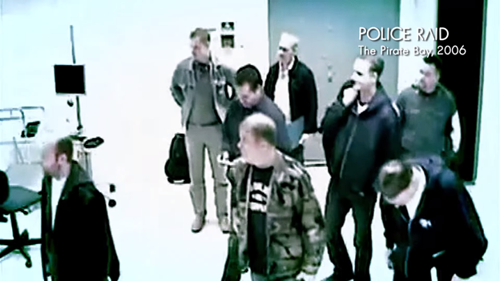
Government Tactics Harm Unaffiliated Parties
Police raided PRQ in 2006
  Targeted because of cross-ownership
  Confiscated 195 servers, 11 of which hosted The Pirate Bay
Other independent sites shut down in the process
  Tactics caused harm to people unaffiliated with TPB
Police unable to get customer info from encrypted servers
Klose, S. (Director). (2013). TPB AFK: The Pirate Bay Away from Keyboard [Motion Picture]. Accessed from https://www.youtube.com/watch?v=GfRFh_h5ICE.
Notes:
PRQ is an ISP and web hosting server hotel, owned by two of the founders of TPB, Gottfrid and Fredrik, which housed a number of websites not associated with TPB.
The legal action taken harmed third-party sites not necessarily involved with TPB, BitTorrent sites, or copyrighted material sharing.
Since the police were unable to get customer data (particularly about peers), the raid was an intelligence dead end.

Slide 13
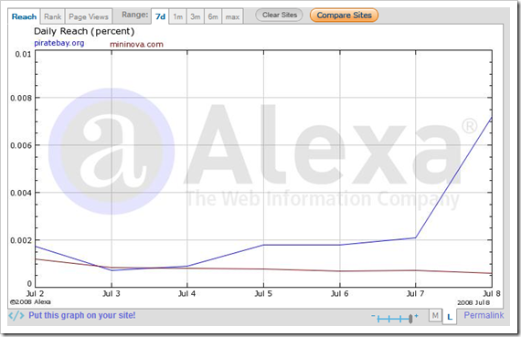
Police Raids Increase User Base
After Police Raid, The Pirate Bay received a lot of media attention
  Site back up only three days later [1]
After site came back up, user base spiked alongside attention
  Users grew from 1 million to 2.7 million
  Peers grew from 2.5 million to 12 million
  Alexa ranking in top 100
http://startupmeme.com/wp-content/uploads/2008/07/image501.png
Notes:
Police raid happened on May 31, 2006.
Spike in user reach is visible a week after the raid.

Slide 14
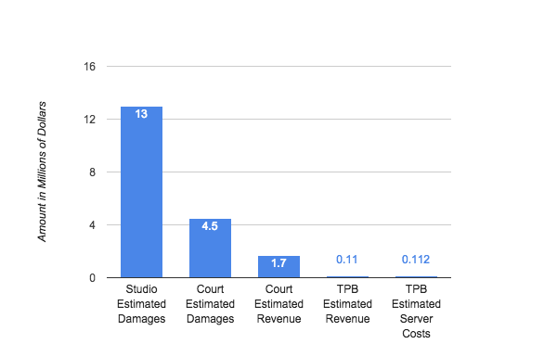
There are Few Productive Results from Lawsuits
During the 2008 trials of TPB:
Studios estimated $13M in damages
Court estimated $4.5M in damages
Court estimated $1.7M in TPB revenue
Founders estimated $110,000 in TPB revenue $112,00 server costs
Notes:
The Swedish government and companies including Warner Brothers, MGM, and 20th century fox all started lawsuits and attempted to claim copyright infringement on all their titles posted on the pirate bay and claimed that they were generating over $13 million worth of damages
The court estimated that it was $4.5 million in damages and $1.7M in revenue for the TPB
The Pirate Bay estimated about $110,000 in revenue from advertisements and $112,000 in costs
There is a discrepancy between the amount in damages and the amount TPB made from copyright infringement because in most cases the sites are doing it for free and really are not making any money off of doing this.
The Pirate Bay defended themselves by stating that they did not post the information and they are merely a system to allow other people to see posted files
Regardless if content creators use copyright rules to make back lost money, the money doesn’t exist to get back

Slide 15

Copyright Exposing Content Creators
Copyright no longer protects content creators and actually exposes them
  Pirated intellectual property very hard to track
  Once property is posted it is on numerous cloud computers and extremely difficult to fully remove
  Content creators seeking government/legal assistance can have unintended consequences
  Christopher Boffoli’s life work posted to TPB in revenge
http://artlawjournal.com/wp-content/uploads/2014/10/screen-shot-2014-10-23-at-10.37.53.png-396x400.jpeg
Notes:
The current implementation of copyright no longer protects content creators and is nearly impossible to reasonably enforce.
Christopher Boffoli (photographer) sued Imgur for posting 73 of his photos online without his permission
An anonymous pirate bay user was angry that he would sue them for that (it is likely the user worked at Imgur)
That user then uploads 20,754 of his copyrighted images to the Pirate Bay
The pirate bay gives people a lot of power, and lets any person easily and anonymously steal people’s work
The laws should protect people like him from this, but the pirate bay makes it pretty hard to enforce

Slide 16
References
[1] Klose, S. (Director). (2013). TPB AFK: The Pirate Bay Away from Keyboard [Motion Picture]. Accessed from https://www.youtube.com/watch?v=GfRFh_h5ICE.
[2] Cook, James. (23, Oct 2014). Business Insider. “The Pirate Bay is Trying to Ruin This Photographer’s Life”. Retrieved from http://www.businessinsider.com/this-photographer-had-his-life-ruined-by-the-pirate-bay-2014-10.
[3] Schlackman, Steve. (25, Oct 2014). Photographer Sues IMGUR and the Internet Retaliates. Retrieved from http://artlawjournal.com/photographer-sues-imgur-internet-retaliates.
[4] Khan, I. (2008, July 12). Should The Pirate Bay thank MPAA for its cult following? Retrieved October 5, 2015, from http://startupmeme.com/should-piratebay-thank-mpaa-for-its-cult-following.
[5] The Lip TV. Interview with "TPB AFK: The Pirate Bay Away From Keyboard" Director Simon Klose. Accessed from https://www.youtube.com/watch?v=1MNbnRgLf9o
[6] Filmmaking Review. An Interview with Simon Klose: Director of Pirate Bay - Away from Keyboard. Accessed from https://soundcloud.com/filmmaking-review/an-interview-with-simon-klose
[7] KrawczyK, K. (2014, July 18). Blockades Shmockades: Pirate Bay Traffic Reportedly Doubles Since 2011. Accessed from http://www.digitaltrends.com/computing/pirate-bay-web-traffic-reportedly-doubles-since-2011/.
[8] Andersen, I. (2009, March 2). Rättegången mot The pirate bay: Åklagaren yrkar på fängelse. Accessed from http://www.fria.nu/artikel/78204.
[9] Sundberg, S. (2009, March 2). TPB har tjänat tio miljoner om året. Accessed from http://blog.svd.se/thepiratebay/2009/03/02/tpb-har-tjanat-tio-miljoner-om-aret/
[10] Pouwelse, J. Garbacki, P. Epema, D. Sips, H. (2005). The Bittorrent P2P File-Sharing System: Measurements and Analysis. Accessed fromhttp://link.springer.com/chapter/10.1007/11558989_19#page-1

Slide 17
References
[11] ERNESTO, THE PIRATE BAY RUNS ON 21 “RAID-PROOF” VIRTUAL MACHINES, https://torrentfreak.com/the-pirate-bay-runs-on-21-raid-proof-virtual-machines-140921/ (Oct 1, 2015)
[12]Herve Roggero, Sample Pricing Comparison: On-Premise vs. Private Hosting vs. Cloud Computing, http://geekswithblogs.net/hroggero/archive/2013/02/25/sample-pricing-comparison-on-premise-vs.-private-hosting-vs.-cloud-computing.aspx (Oct 5, 2015)
[13] Tyler Lee, The Pirate Bay’s Shutdown Didn’t Seem To Have Affected Torrent Activity, http://www.ubergizmo.com/2014/12/the-pirate-bays-shutdown-didnt-seem-to-have-affected-torrent-activity/ (Oct 5, 2015)
[14] David Dressner, More than 80 percent of UB students admit to torrenting despite consequences, http://www.ubspectrum.com/article/2015/02/ub-students-torrenting (Oct 6, 2015)

