Slide 1




Summer Wars
By:
Robyn Domanico, Jillian Hennessy,
Stephen Lafortune and Sai Vadlamudi

Slide 2
Synopsis
The physical world is connected to a large virtual world called OZ.
US Army releases an A.I, called Love Machine, which hacks into OZ and takes control of users’ accounts.
Through the accounts, the A.I is able to control the physical world.
World safety is threatened by the A.I. and the main characters use the A.I’s thirst for knowledge against it to stop it from causing further harm.
Notes:
Summer wars is a film set in a world where the artificial world called OZ is the center of the physical world. OZ contains many booths which act as windows to the real world where its users can perform tasks pertaining to the physical world through the ease of the virtual world. The story begins when Kenji, a high schooler who is extremely adept at solving mathematical problems, receives a mysterious text asking him to solve a code. Thinking that the text is a math teaser, he proceeds to solve the code overnight and sends it before next morning. When he wakes up he is on the news as a wanted criminal for hacking into OZ, a crime he did not commit, and discovers his avatar is hacked and is unable to access his OZ account. The sender of the text and the one who hacked Kenji’s avatar is later found to be an AI called Love Machine who got responses to his text and with the solutions hacks into OZ. The AI begins taking control of OZ accounts and by extension the jobs of the actual people behind the accounts therefore controlling the physical world. It becomes uncontrollable in its thirst for knowledge and changes traffic patterns, disables GPS, signals random fire alarms and even threatens to crash a satellite into one of many nuclear energy reactor stations in the world throwing the world into a state of fear and chaos. In the end this worldwide crisis unites all of OZ’s user base to fight against the A.I. and disable it.

Slide 3
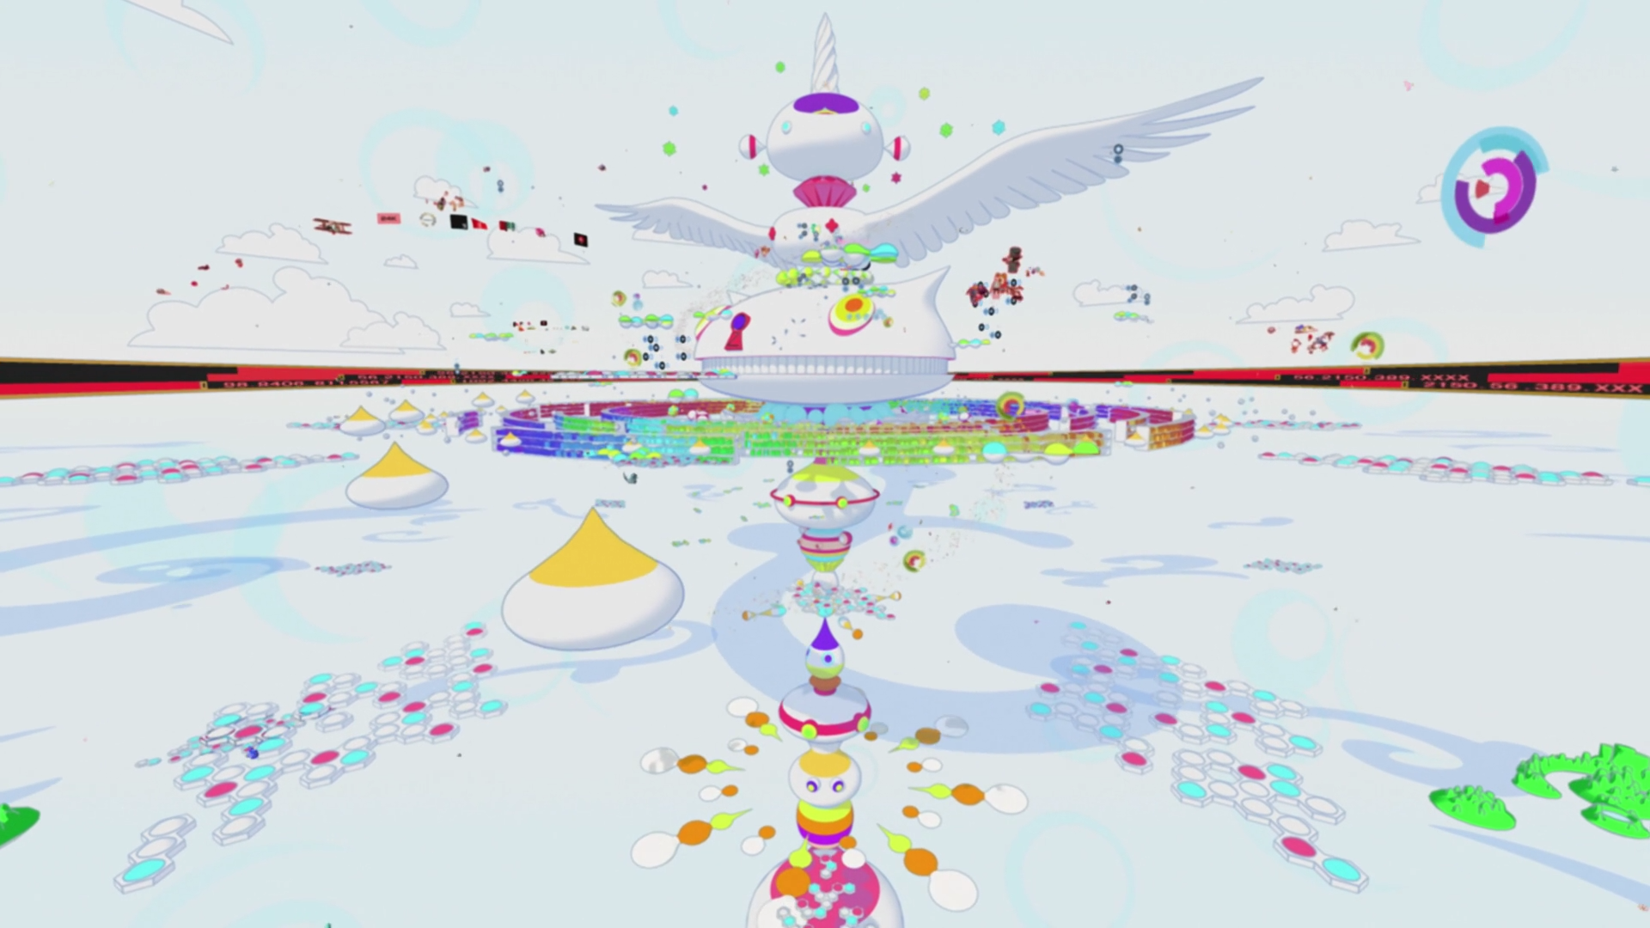
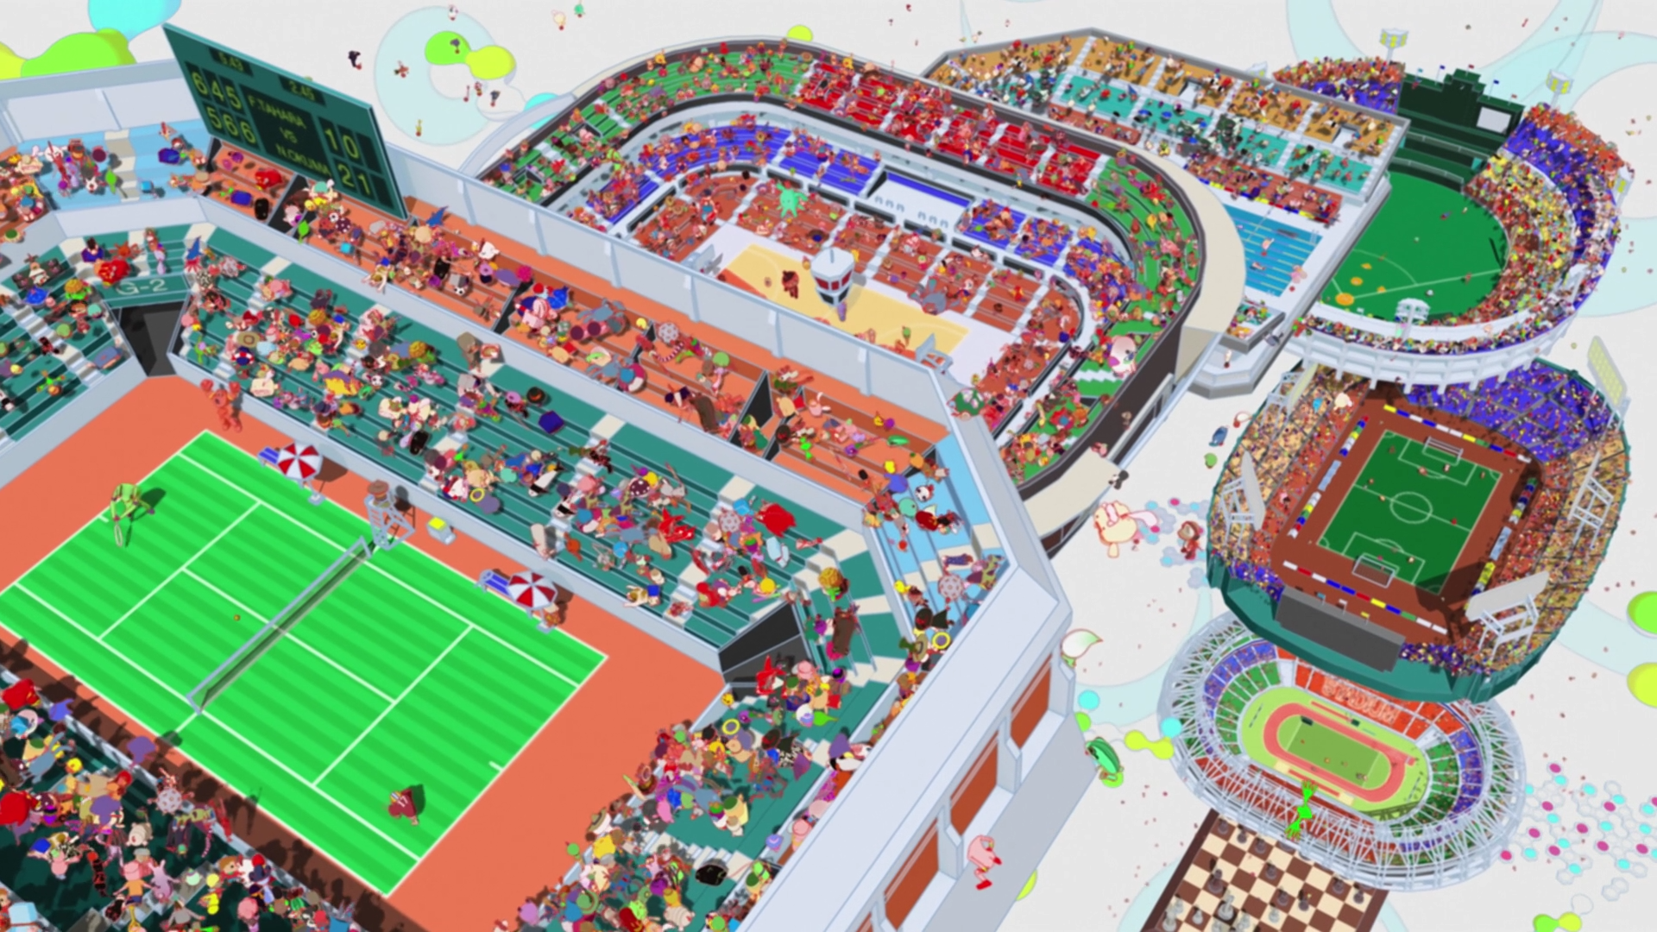
The World of OZ
Virtual world where users connect with avatars.
Users can shop, work and play.
Connect with a cellphone, computer, or any internet-connected device.
Avatars in OZ have as much privilege as their real life owner.
Examples:
  Second Life [2]
Notes:
OZ is a virtual world which is the center of the plot in Summer Wars. It is an all encompassing site where users create custom avatars who represent them in the virtual world similar to World of Warcraft, League of Legends etc but with much more customizability. OZ can be accessed from a personal computer and internet connected tvs, phones, consoles etc. Once in, a User has the ability to go shopping, socialize with users around the world, participate in tournaments of sports from around the world whether by watching or playing. In terms of productivity users also have the ability to telecommute and work in their real life jobs, pay taxes, file documents and complete many their real life tasks through offices in OZ. A user in OZ can perform all their responsibilities of their job through OZ and therefore their avatar has the same privileges as them.

Slide 4

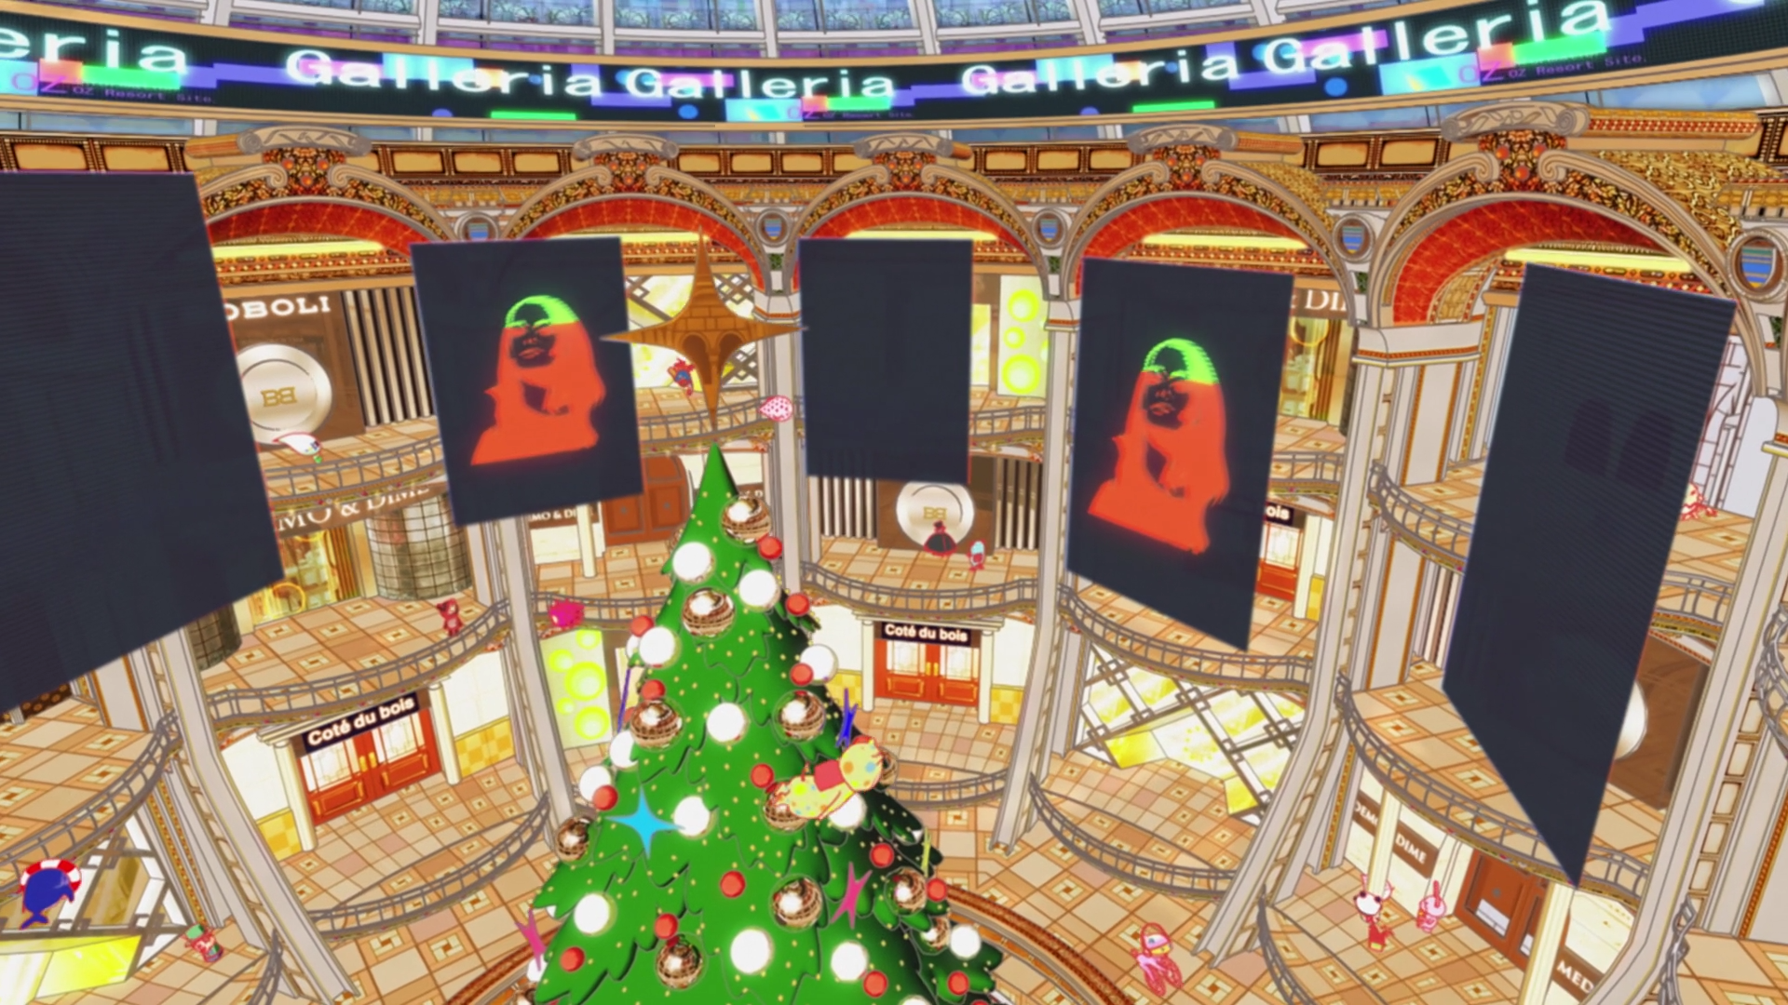
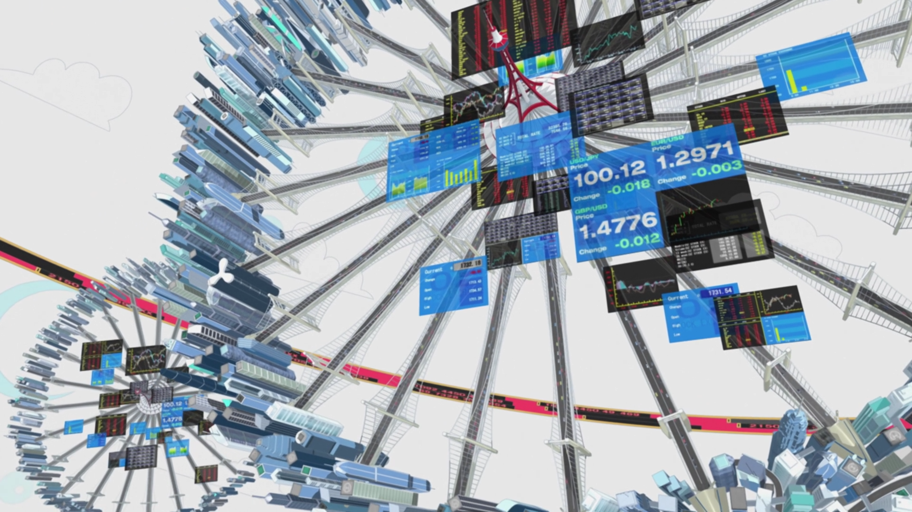
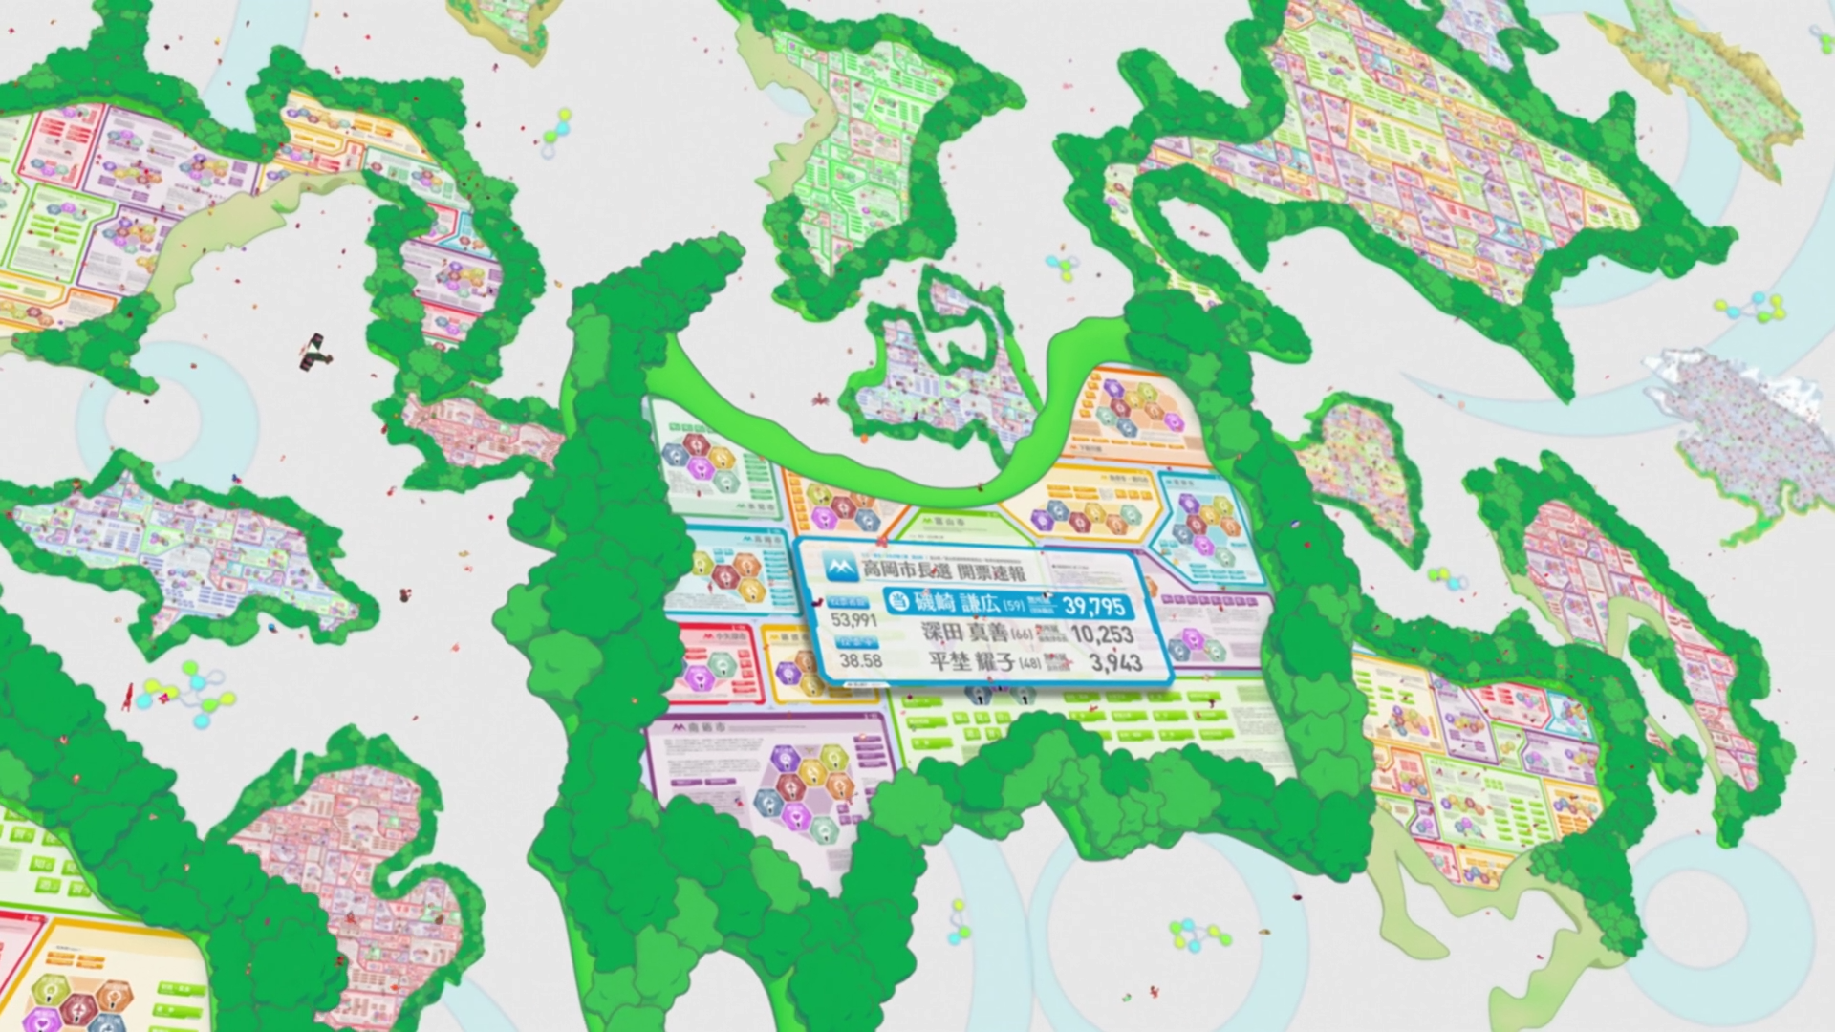
[1]
Notes:
The following pictures are examples of some of the tasks mentioned previously that can be completed through OZ. The top left and right pictures show the shopping aspect where a user can book a vacation, purchase property, clothes, cars etc.The bottom left picture shows company offices where users can telecommute and complete their real life jobs, exchange stocks etc and the bottom right picture is where the government offices are shown which allow users of OZ to pay taxes, file documents etc.

Slide 5
Good Systems Can be Used for Bad Deeds
AI is programmed to gain knowledge, not designed for malicious intentions
  It was released by the US Army as an experiment
  While not programmed maliciously, its intents became harmful to humans
OZ is meant to enhance users’ lives, but is exploited to cause harm
  OZ is still a good system, but had flaws that allowed it to be exploited
  Users have so much information and priviledge located on OZ, that stealing someone’s account is essentially stealing their identity
Real Life Example: iOS used to not ask for access to address book
  Made the experience more seamless
  Apple must approve submitted apps
  However some apps were accessing contacts without warning
Notes:
A system by itself isn’t bad but the environment it is released in or the way it used can result in a malicious system. This is true in the case of love machine which was simply designed to gain knowledge. The Army released the AI into a system holding personal information on many users across the world as well as government information. If they had released it into a system which held trivial facts such as an encyclopedia page for example it wouldn’t have resulted in a worldwide crisis.
-Experiment was a breach of the code of ethics (add example here)
-Quote Wabisuke: “I only developed the damn thing, it isn't like I told it what to do!”

Slide 6
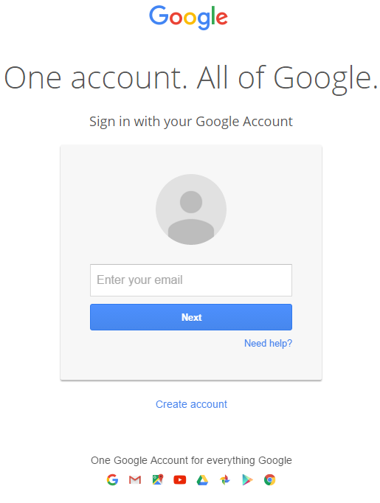
It is important to have control over isolation of systems
Hacking of OZ affected communication.
  Cell service
  Email
OZ accounts interact with GPS, water and gas supply etc.
  This led the AI to also maliciously alter these systems.
Medical devices or monitors were run on OZ
  Medical alarms were falsely set off.
  Medtronic CareLink Network for Cardiac Device patients [3].
https://accounts.google.com/servicelogin?hl=en#identifier
Notes:
OZ integrated a lot of systems into its service with the intention of provide its users a central location to perform all their activities leisure or required. As previously mentioned the users could shop for vacations, cars, clothes, property as well as perform government duties such as tax paying and filing documents as well as real life job duties with telecommuting etc.. Due to this integration when OZ was compromised by the AI it also hacked the user accounts and thus controlled jobs of the physical world through the avatars. For example Kenji the main character couldn’t use his phone due to his account being unable to be authenticated and the email and cell service is affected as reported by numerous news anchors in the film. This is similar to the One account for All of Google policy where if a user’s account is hacked their email, play store shopping, hangouts communication, youtube, and even drive with all their work would be compromised. An even scarier aspect is the internet connected medical devices which in the film result in the death of the Great Grandmother as her heart monitor was unable to signal an alarm due to OZ being chaotic and this may seem like a faraway event but with the internet connected health devices such as the medtronic carelink which allows things like pacemakers to connect to the internet and report their status to the doctors being available it is becoming closer. The software should be designed in such a way that a separate system can be disconnected at anytime if the base system is found to be compromised.

Slide 7
Blind Faith in a System is Dangerous
Understand ramifications behind entering personal information onto a site.
  Data can be encrypted for protection on a website among other security features, but encrypted data can still be breached and potentially decrypted
Invasion of privacy that came from the US Army’s decisions, and the accounts that were stolen and abused by the AI
  Implications for National ID
Kenji got defamed and arrested when the AI misused his account.
  In addition, when he tried to call the support center to get his account back, he could not be patched through as support could not verify his account information
Notes:
-OZ was encrypted, but 55 people were able to break the code in a single night (As OZ used a 2056 digit code, this is unrealistic, especially in Kenji’s ability to decrypt it on paper- in reality a 2048 bit key (a real world version) is very safe)
-Talk about the breach on Patreon: passwords, social security numbers, and tax information that was encrypted was stolen http://www.bbc.com/news/technology-34423932
This system contains everything about a user and therefore a security breach like in the case of the Love Machine can lead to stolen identities, fraudulent purchases and access to other personal information. It is dangerous to allow everything a person uses and wants protected should not all be hidden behind just one password, because once security is breached, users can lose their entire lives to someone or something else.

Slide 8
Summary
A system itself is not bad but the way it is used can be destructive, as seen with the A.I.
It is important to isolate information despite the ease of performing all tasks in a single location.
Consumers need to refrain from putting all their information into a system and understand the ramifications of doing so.
Notes:
In conclusion, the technology of a system itself is not bad or responsible for any negatives that come from it, but it can be used in a destructive manner and can be placed in the wrong hands. In the event that someone gains access to a system and decides to use something maliciously, it is important that what they can control is limited. While it may be convenient to carry out all important tasks in life in one centralized place, it is important to keep certain information separated for added protection. In the event of a security breach, there is more at stake, the more that is held in one location. People should try not to put all of their information together in one place even if they believe that a system is secure and they need to understand the potential ramifications of choosing to leave their information online.

Slide 9
References
[1] Summer Wars. Dir. Mamoru Hosoda. Perf. Ryunosuke Kamiki and Nanami Sakuraba. Madhouse, Warner Bros, 2010. Web.
[2] Linden Lab, What is Second Life, http://secondlife.com/whatis/ (10/5/15)
[3] Medtronic, Medtronic CareLink Network, http://www.medtronic.com/for-healthcare-professionals/products-therapies/cardiac-rhythm/patient-management-carelink/medtronic-carelink-network-for-cardiac-device-patients/index.htm (10/5/15).

