Slide 1
Star Wars Episode IV:
A New Hope
Ziyan Ding, Arthur Dooner, Christian Roberts, Ryan Wiesenberg

Slide 2
Plot Synopsis

Slide 3
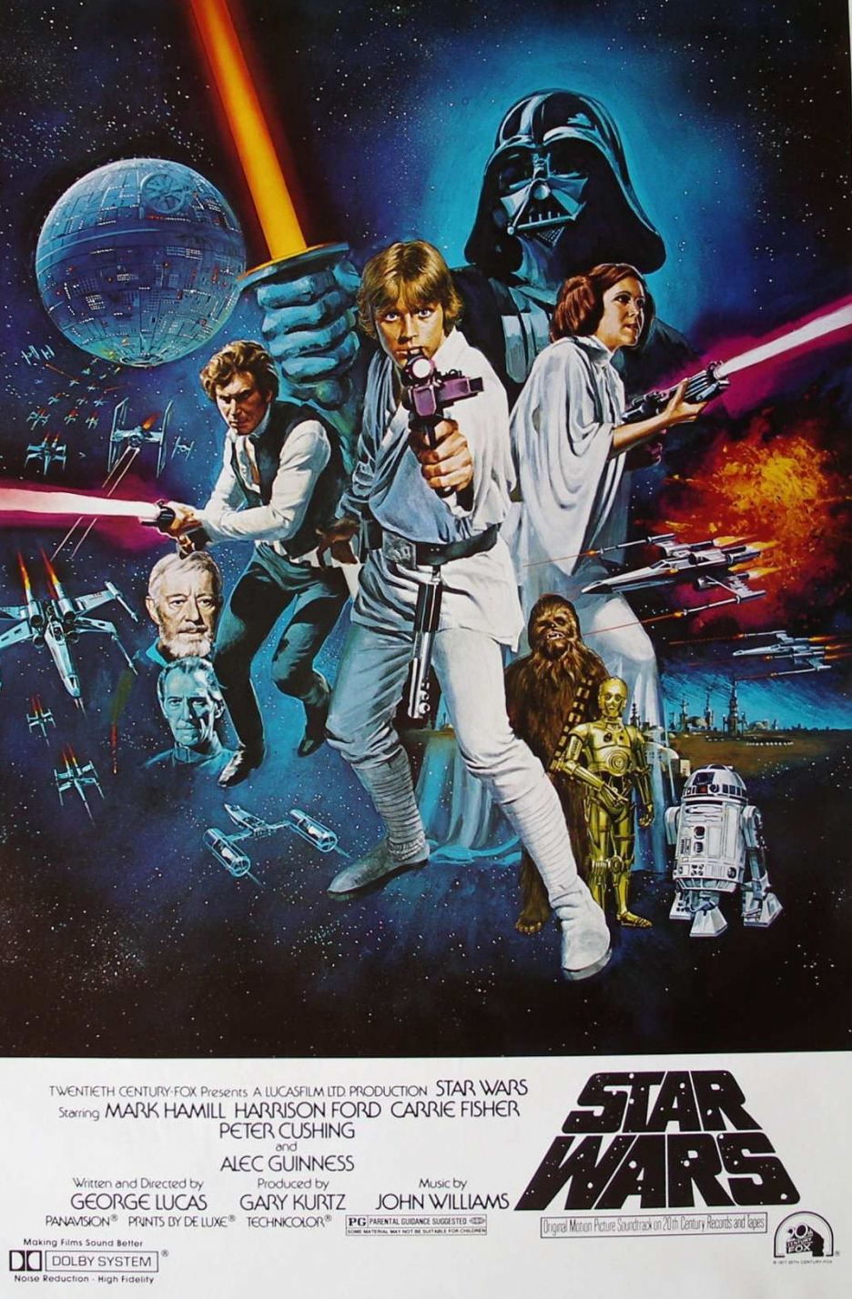
Plot Synopsis
Empire has control of the Galaxy
Rebel Alliance disagrees
Characters
C-3PO - Humanoid droid
R2-D2 - Messenger droid
Darth Vader - Imperial leader
Princess Leia - Rebel agent
Luke Skywalker - Farmer
Obi-Wan - Mysterious vagrant
Journey to Destroy the Death Star
Notes:
Ryan

Slide 4
Movie’s Purpose

Slide 5
Movie’s Purpose
Hero’s Journey
“War” Movie
  Not a pure Sci-Fi Movie
  Sci-Fi is intrigue, Star Wars is conflict
Humans over Technology and Insurmountable Odds
Technology
  Some Fictional
  Culture captured by the 1970s
    Technology either so far in advance it is implicit OR
    Not used to the potential that someone today would recognize
Notes:
Story of Luke through the Galaxy trying to find his place.
No real sci-fi themes, just a war set in space
As such some tech is fictional but none are used beyond a 1970s viewpoint if that
Arthur

Slide 6
Technologies and
Implications

Slide 7
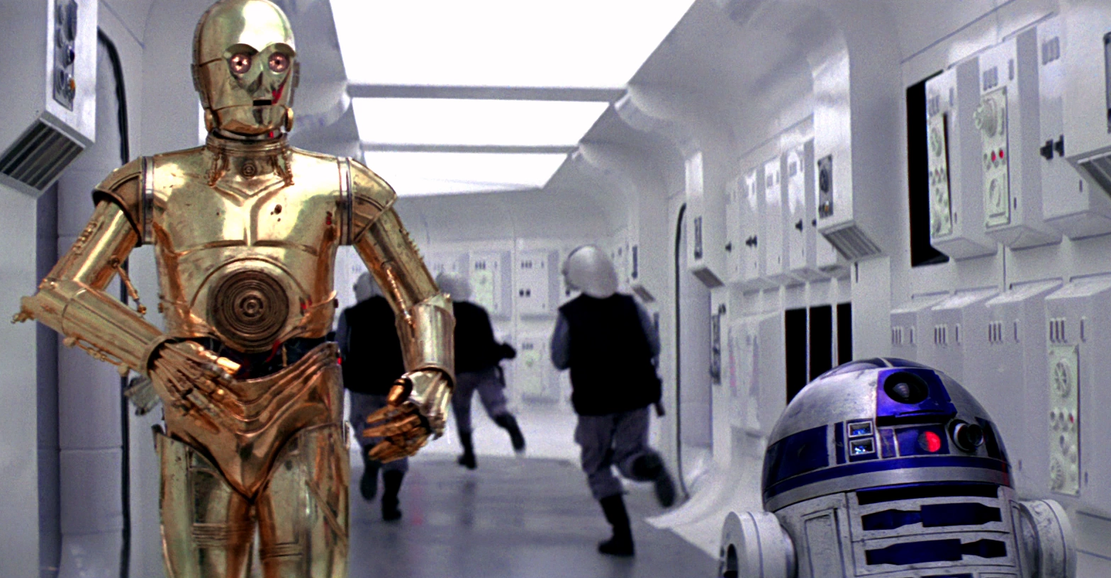
Droids
C-3PO
  Most human and humanoid droid
  Bridges the gap between tech and humans
  Incredibly expositional
R2-D2
  Universal interface with stations and ships
  Droid communication language
  Assistant on the X-Wing and other craft
Varying levels of intelligence based on function
C-3PO and R2-D2
Notes:
Christian

Slide 8
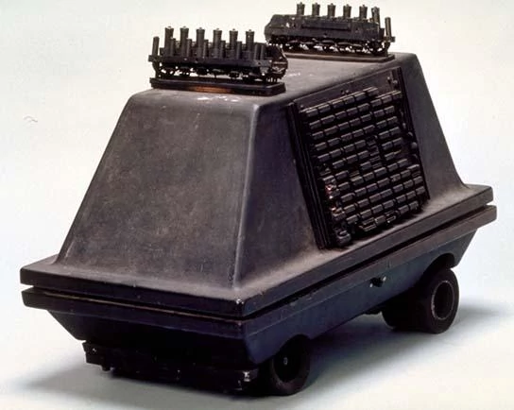
Droid Implications
Makes and Models
  R2, MSE
Implicit Trust in Droids
  Very Loose Security
  Can “Hack” Anything
Droid Treatment
  Stolen and Sold by Jawas as “Slaves”
  Used as a means to an end
  No Respect
  Basically left to die when they break, or salvaged
C-3PO is Network Connectivity
Questionable Code of Ethics
MSE-36 (Mouse Droid)
Notes:
Christian
Makes and Models:
Intellectual Property
Implicit Trust:
Errors, Failures and Risks
Information Privacy
Droid Treatment:
Network Connectivity
Freedom of Speech
Crime
Work
Professional Ethics

Slide 9
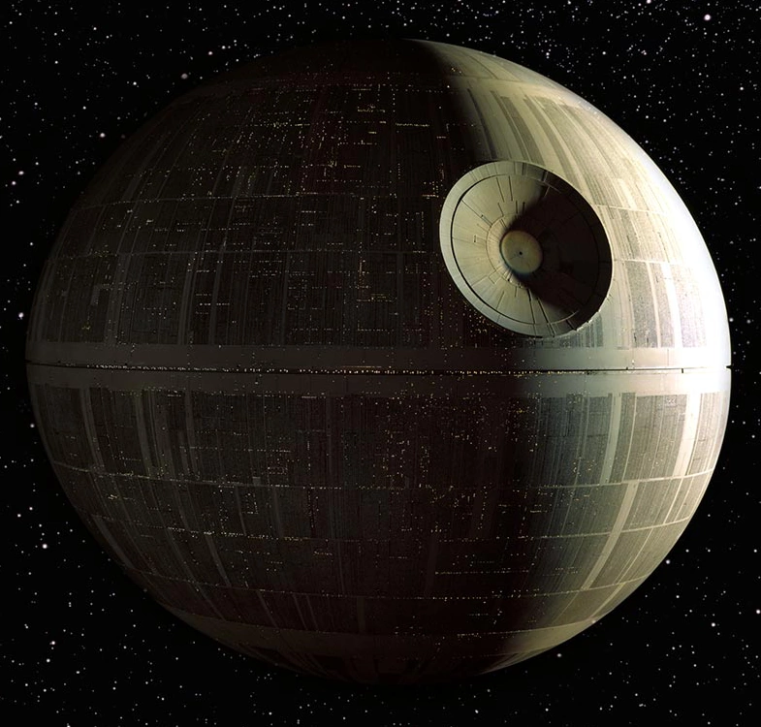
Death Star
Built to Destroy Planets
Large Integrated System
  Humans, Droids, Computers
  Prisons, Weapon, Army Base
  Fast, Large Scale Communication
  Computer-Aided Targeting
“Thats No Moon” - Obi-Wan
Death Star
Notes:
Ziyan

Slide 10
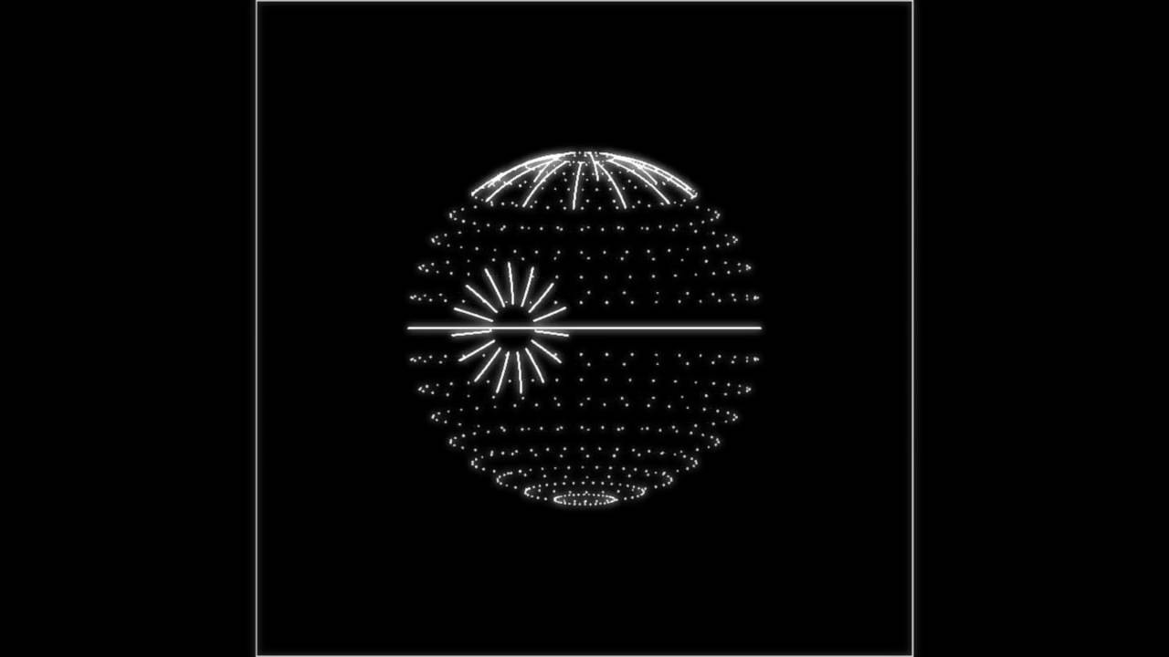
Death Star Implications
Symbol of Oppression
  Empire Rules by Fear and Force
  Interrogation
Death Star Plans- Trade Secret?
  Stolen from the Empire
  Full Layout of the Station
Design Flaws and Oversights
  R2-D2 can access an universal, unsecured port
  Tractor Beam- One point of failure
  One point of failure...to destroy the station
Fails the Code of Ethics
Death Star Plans
Notes:
Ziyan
Symbol of Oppression:
Freedom of Speech
Death Star Plans:
Intellectual Property
Information Privacy
Crime <- Treason
Design Flaws and Oversights:
Errors, Failures and Risks
Fails the Code of Ethics:
Professional Ethics

Slide 11
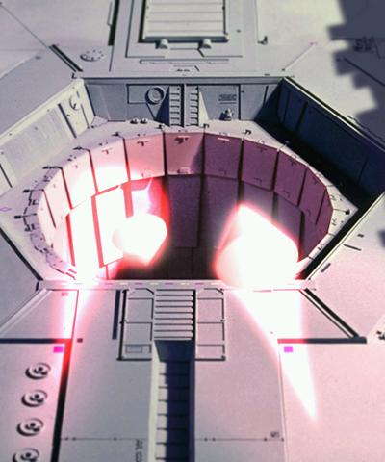
Computers
Targeting Computer
Homing Torpedos
Life-Form Scanning
Screens
Station-wide Interface
  Automated Trash Compactors
  Doors
  Tractor Beams
Guided Torpedos
Notes:
Arthur

Slide 12
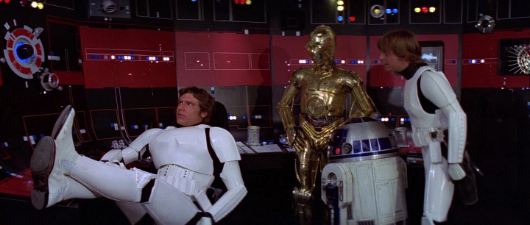
Computers’ Implications
Literally insufficient for the task
  Targeting Computers
Data is physically moved around
  No concept of digital network connectivity
Incapable of interfacing directly with one another
Enable information gathering, oftentimes people ignore them
  Empire overlooking life form scanning
Computer Terminals
Notes:
Arthur
Literally insufficient for the task:
Errors, Failures, and Risks
Professional Ethics

Slide 13
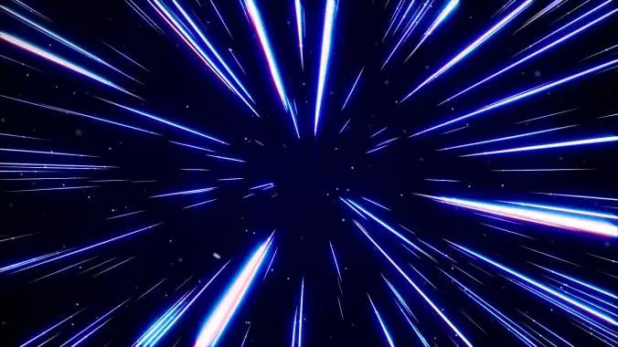
Other Technologies
Interstellar Ships
  Mass Produced or just IP?
Hyperspace Travel
  “Galaxyization”
Homing Beacon
  Galactic GPS
Radios
  Intra-Ship
Hyperspace Travel
Notes:
Ryan
Work Technology

Slide 14
Conclusion
Surface level understanding of these powerful technologies
  Implementation reflects culture of the era
  Humans are flawed, machines cannot be
Significant oversight in how people use the technology they have
  Technologies are used once then forgotten about
Notes:
Ryan
Scanning ship for lifeforms only happens once (and was arguably weird when it happened the first time).

