Slide 1
Spiderman: Across the Spider-Verse
SPIDERMAN
SPIDERMAN
SPIDERMAN
Ryan Agge, Adrian Cervera, Owen Hart, Alex Knox
0
Notes:
Adrian

Slide 2

TABLE OF CONTENTS
01
02
Timeline
Notable Tech
03
04
Claims
References
TABLE OF CONTENTS
TABLE OF CONTENTS
TABLE OF CONTENTS
1
Notes:
Adrian
Click again to trigger animation

Slide 3

Timeline - Prequel
Multiverse
opens
Colliderbuilt
“Spot” created
Objects and people begin to fall through the rifts. Miles gets his powers from a spider from another universe
Designed to open paths between universes, the collider breaks the barrier between worlds
The collider is destroyed by spidermen seeking to stop the damage between worlds
2
Notes:
Owen
Previous movie
Collider is built
Rips holes in multiverse
Collider destroyed by various, disorganized spider people
“The Spot” is created in its destruction

Slide 4
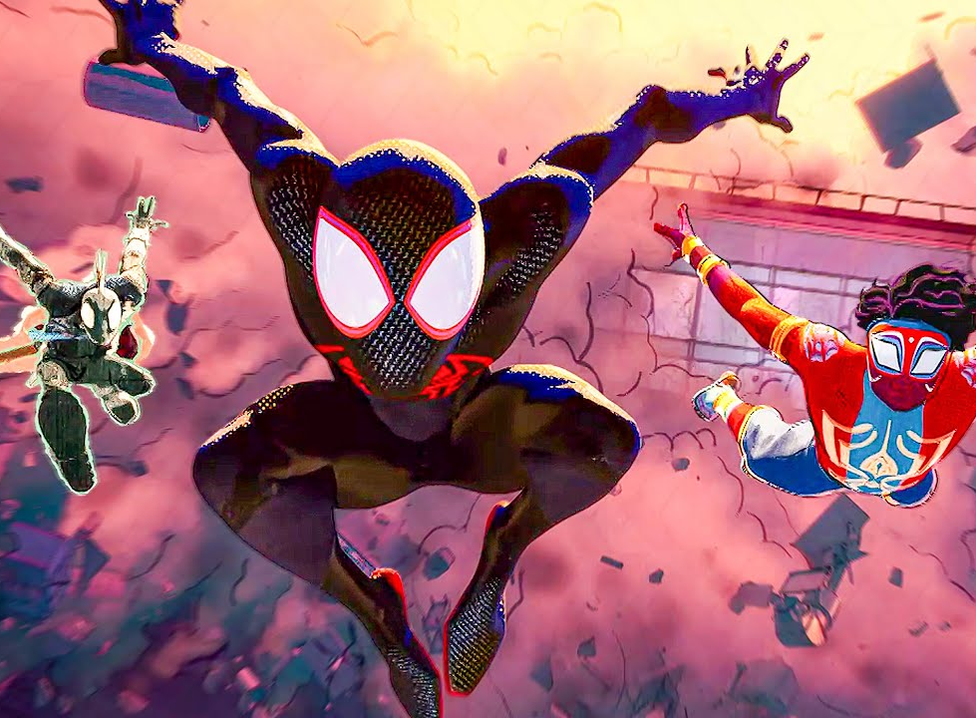
Timeline - General
Multiverse technology used to travel between universes
Spot triggers different colliders in the multiverse
Introduced to canon events and the spider people that work to fix tears in multiverse
Miles is sent back to “his dimension” after disobeying canon of the multiverse
3
Notes:
Owen
Miles is introduced to spot, who becomes the main antagonist
Originates from Miles’s universe
Spot moves from universe to universe, gaining more power
Miles works with other spidermen to travel between universes and try to stop spot
Brought to spider headquarters after causing damage to another universe unknowingly
Sent back to his own against his wishes
Ends on a cliffhanger

Slide 5

Notable Technologies
Collider
  Dark matter creator (mini collider)
Multiverse watch
  Hobie’s prototype watch
Predictive Forensics Scanner
Hologram assistant
Multiversal computers & prediction algorithm
DNA Analyzer
4
Notes:
Owen
We’ll go into detail about some of these later too
Collider in the prior and new movie
Based roughly off particle accelerators and creates dark matter
Multiverse watch
Communicate and travel through different multiverse
Predictive forensic scanner
Used to replay what has happened during an investigation scene
Hologram assistant
Visual manifestation of the computer system and prediction algorithm

Slide 6
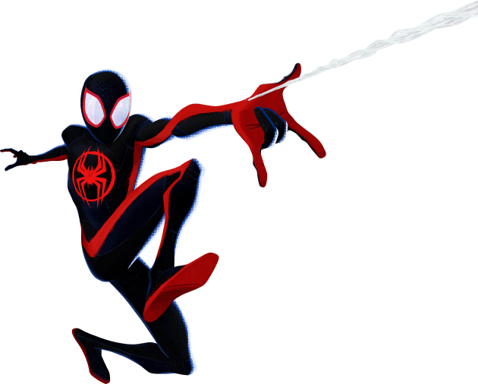
CLAIMS
CLAIMS
CLAIMS
CLAIMS
CLAIMS
CLAIMS
5
Notes:
Alex
Click again to trigger animation

Slide 7
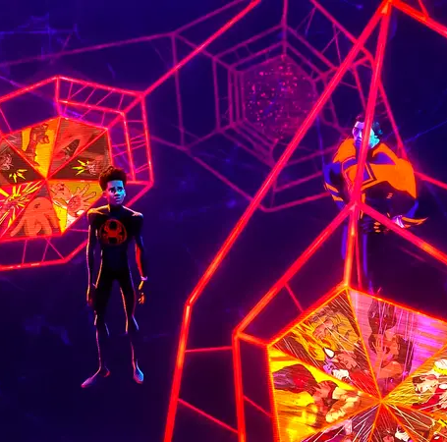
AI choosing who lives, who dies
Canon events predicted by an algorithm
If AI predicts a canon event, other spider people must not interfere
  Loss of life to save more in the future
Miles fights to follow what he thinks is right, not what a computer instructs him to do
6
Notes:
Alex
Part of the prediction algorithm is “canon events”
Events that must happen or the universe destabilizes
AI computer to predict what the events are
Essentially predicts if certain people have to die or not
Miles fights against this, not outright believing what he is told

Slide 8
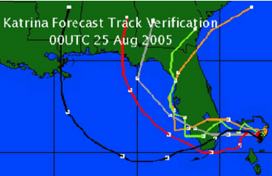
AI choosing who lives, who dies
Real-World Comparison
Weather prediction algorithms
Computer models predict path of storms to recommend evacuations
Error can cost lives or waste resources [2]
Prediction of Katrina’s Paths 4 Days out [7]
7
Notes:
Alex
For this we chose weather prediction algorithms
assuming people will be able to choose to follow algorithm’s advice
Software is constantly updated while predicting storm’s path
comparing changes in data and past error to predict future outcomes

Slide 9
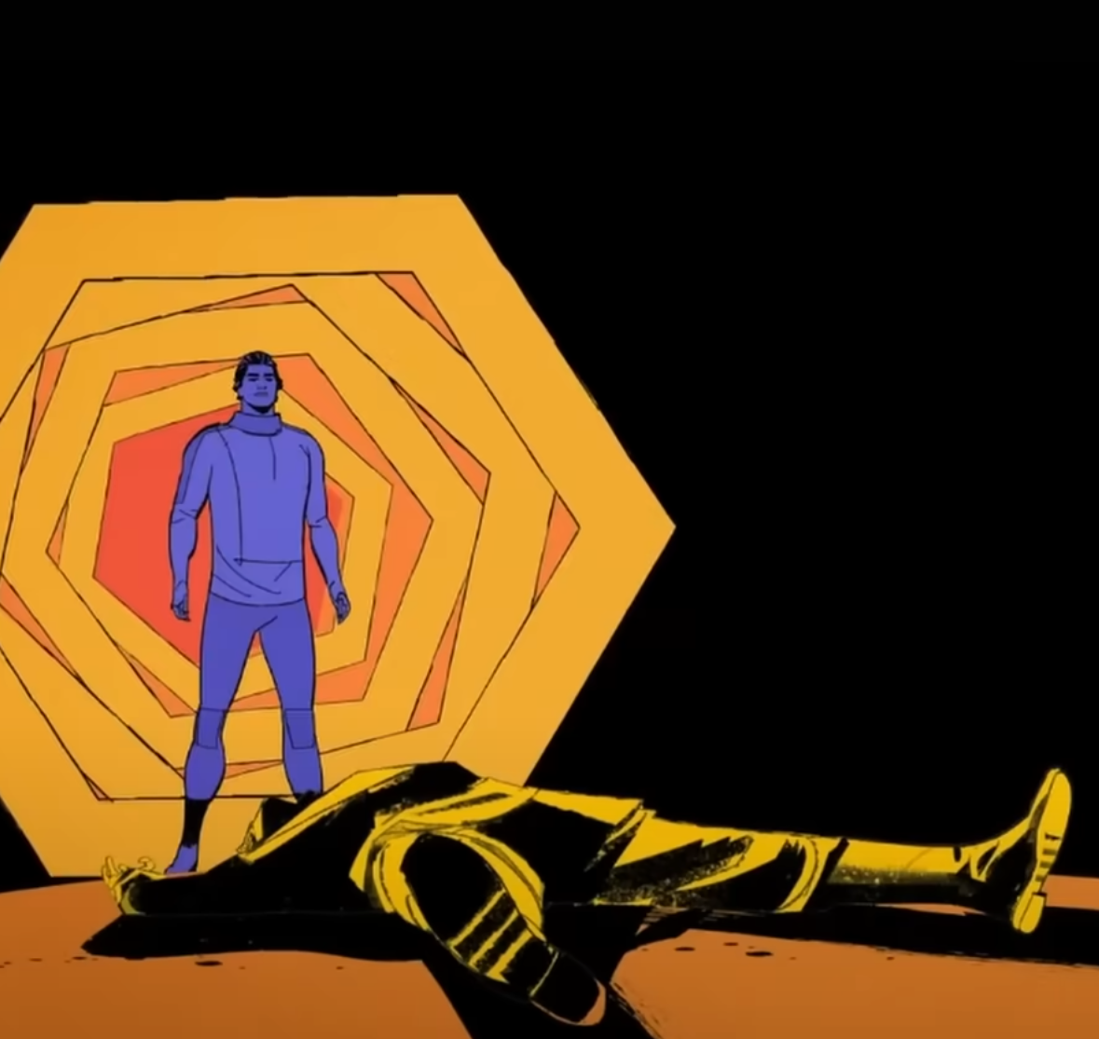
Claiming another’s identity
Replacing a deceased person with oneself
Miguel O’Hara tried to replace a dead version of himself in another universe
This universe did not follow its predicted canon event and by nature was destroyed
Harmed those in the universe while prioritizing himself
8
Notes:
Adrian
He wanted to have a family, as he lost his universe’s family
Goal was to replace his dead counterpart in another universe
Initially selfish
temporarily benefitted the other version of his family
Then broke universe and caused damage he had not foreseen

Slide 10
Claiming another’s identity
Kantian Analysis
Act Utilitarianism
Intention of the act was motivated by personal desire
Fails [3]
Went against the greater good of people in that universe
Fails [3]
9
Notes:
Adrian
Completed two different ethical analyses
Kantian
based on intent with respect to others
Motivated by his desire for a family
Act Utilitarianism
Based on benefit of end goal outweighing method
At first gave family from universe their dad/husband
Broke canon and unravelled the universe

Slide 11
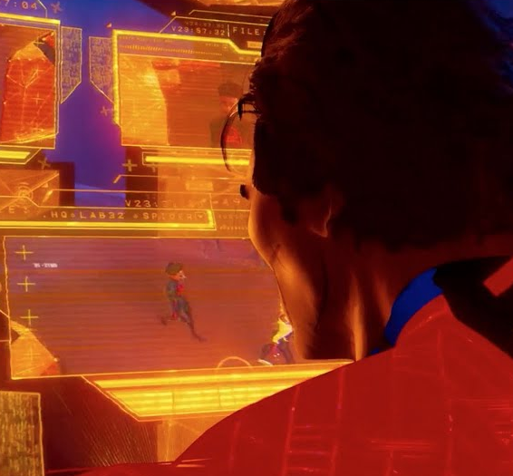
Surveillance without consent
Spider people watch throughout the multiverse for anomalies
  Any unauthorized travel between different universes
Everyone’s actions across the multiverse are monitored in case they become an anomaly
Those monitored are not informed, nor is a clear set of rules given for data collected
10
Notes:
Ryan
Primary part of keeping multiverse safe is knowing when something unsafe happens
Travel between universes is dangerous to those that do an those around them
Dealing a lot with the holes torn open in previous film
No set system or way to inform people in multiverse that they are being watched

Slide 12
Surveillance without consent
Kantian Analysis
Act Utilitarianism
Miles treated as a means to an end
Fails [3]
Keeps people happy preventing universal collapse, but security?
Debatable [3]
11
Notes:
Ryan - updating
Again we did another ethical analysis using same two set of ethics before
Kantian
Miles is treated as a means to an end to effectively investigate his universe
Act Utilitarianism
Stops damage to universe, but does not inform those being surveilled
No explicit rules or organizational structure

Slide 13
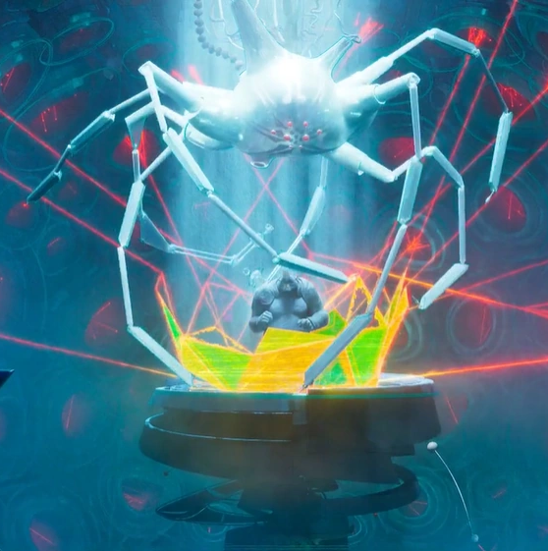
What safeguards are enough?
“Go home machine”
  Analyzes DNA to find universe of origin
Machine is used on anomalies, with minimal to no consent
Assumed flawless but sent Miles to wrong dimension
No repercussions or way to communicate with anomalies in case of error
12
Notes:
Alex
Machine used by spider people
Meant to send people and creatures back to their original univers
Does benefit those misplaced in the multiverse
Spider people do not use it themselves unless they are without a watch
No feedback system from those teleported

Slide 14
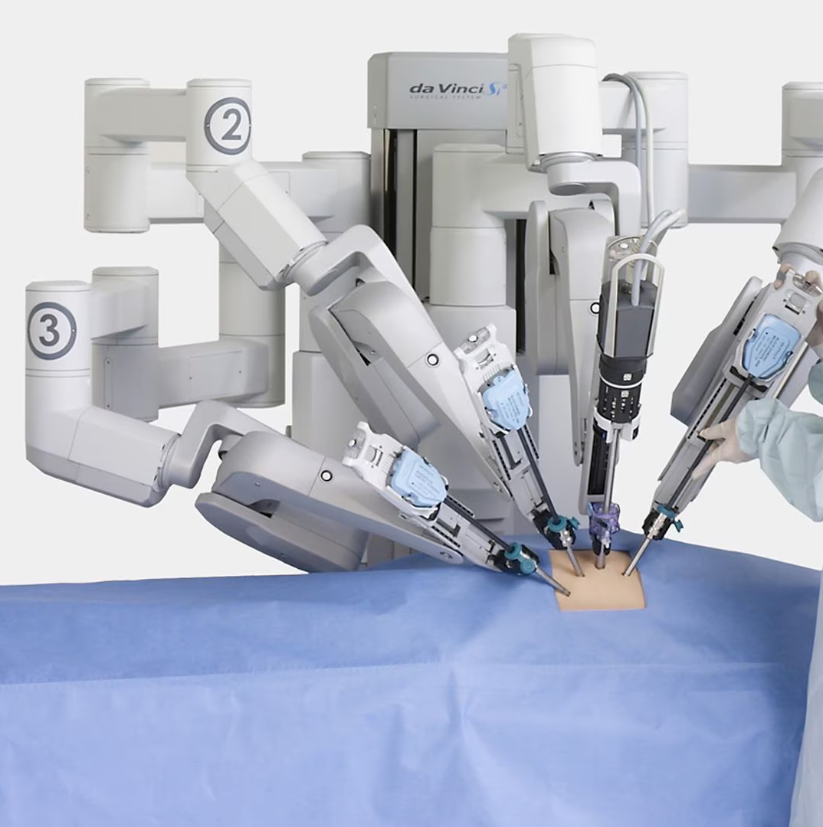
What safeguards are enough?
Real-World Comparison
Approval of devices in the medical industry
FDA 510(k) versus FDA PMA [6]
81% approved through 510(k)
19% approved through PMA
Higher recall rate in 510(k) devices [4]
Surgical robot, not shown on a real human [5]
13
Notes:
Alex
FDA 510(k) is essentially an improvements on an already existing device, only lab testing required
FDA PMA/pre market access is for entirely new products, lab testing and human testing through multiple trials
510(k) had a recall rate of 11.6% and PMA had a recall rate of 2.3%
Unlike shown in the movie, there’s clear pathways to be able to deal with defective technology
Impacts people’s health there are repercussions for mistakes and support for those affected

Slide 15
References
[1] Spiderman: Across the Spider-verse
All photos or content not otherwise cited contain information or images directly from the movie, accessed through cinemas.wpi.edu
[2] Price, I., Sanchez-Gonzalez, Probabilistic weather forecasting with machine learning (Nature 637, 84–90, 12/04/2024), https://doi.org/10.1038/s41586-024-08252-9 (accessed 4/30/2025)
[3] Michael J. Quinn, Ethics for the Information Age, Ninth Edition (Addison-Wesley, 2024).
[4] Shah, Olsen, Maurice, Review of approvals and recalls of US specific medical devices in general and plastic surgery, (Surgery in Practice and Science 12, 02/18/2025), https://doi.org/10.1016/j.sipas.2023.100158, (accessed 05/05/2025)
[5] Maxon, State-of-the-art surgical robots. (Maxon, 2024), https://www.maxongroup.com/en-us/knowledge-and-support/blog/state-of-the-art-surgical-robots-for-minimally-invasive-surgery-76728 (accessed, 05/05/2025)
[6] The FDA Group, PMA vs. 510(k): Everything You Need to Know (2024), (The FDA Group, 07/17/2025), https://www.thefdagroup.com/blog/pma-vs-510k#:~:text=FDA%20PMA%20(Premarket%20Approval),-The%20PMA%20process&text=It%20involves%20extensive%20clinical%20trials,decide%20on%20a%20PMA%20application. (accessed 05/05/2025)
[7] Lee, Gasster, Plaza, Chang, Huang, Recent Developments in High Performance Computing for Remote Sensing: A Review, (IEEE Journal of Selected Topics in Applied Earth Observations and Remote Sensing, 10/2011) 10.1109/JSTARS.2011.2162643 (accessed 05/05/2025)
14

Slide 16
References
Instructions for use
In order to use this template, you must credit Slidesgo by keeping the Thanks slide.
You are allowed to:
- Modify this template.
- Use it for both personal and commercial projects.
You are not allowed to:
- Sublicense, sell or rent any of Slidesgo Content (or a modified version of Slidesgo Content).
- Distribute Slidesgo Content unless it has been expressly authorized by Slidesgo.
- Include Slidesgo Content in an online or offline database or file.
- Offer Slidesgo templates (or modified versions of Slidesgo templates) for download.
- Acquire the copyright of Slidesgo Content.
For more information about editing slides, please read our FAQs or visit Slidesgo School:
https://slidesgo.com/faqs and https://slidesgo.com/slidesgo-school
15

