Slide 1

Robocop (2014)
Hongbo Fang, Qiaoyu Liao, Clark Jacobsohn, Gregory Port
Notes:
Introductions
This version of RoboCop is a modern take on the 1987 classic that we just heard about.
RoboCop presents a complicated future where technology is advanced, but not ethically developed.​

Slide 2
Outline
RoboCop (2014)
Plot summary
Key computing technologies
Benefits/costs of brain-computer interfaces
  Consequences of errors
  Free will
Benefits/costs of automated policing
  Problems solved by RoboCops
  Consequences of errors
Conclusions
[8]

Slide 3
Plot summary
RoboCop (2014)
Police detective Alex Murphy is critically injured in a bomb explosion
OmniCorp transforms Alex into Robocop
OmniCorp alters Alex's brain chip, removing his emotion
  Just like their military units
Alex investigates his attempted murder and gets revenge
Alex resists OmniCorp's control and regains his free will and emotion

Slide 4
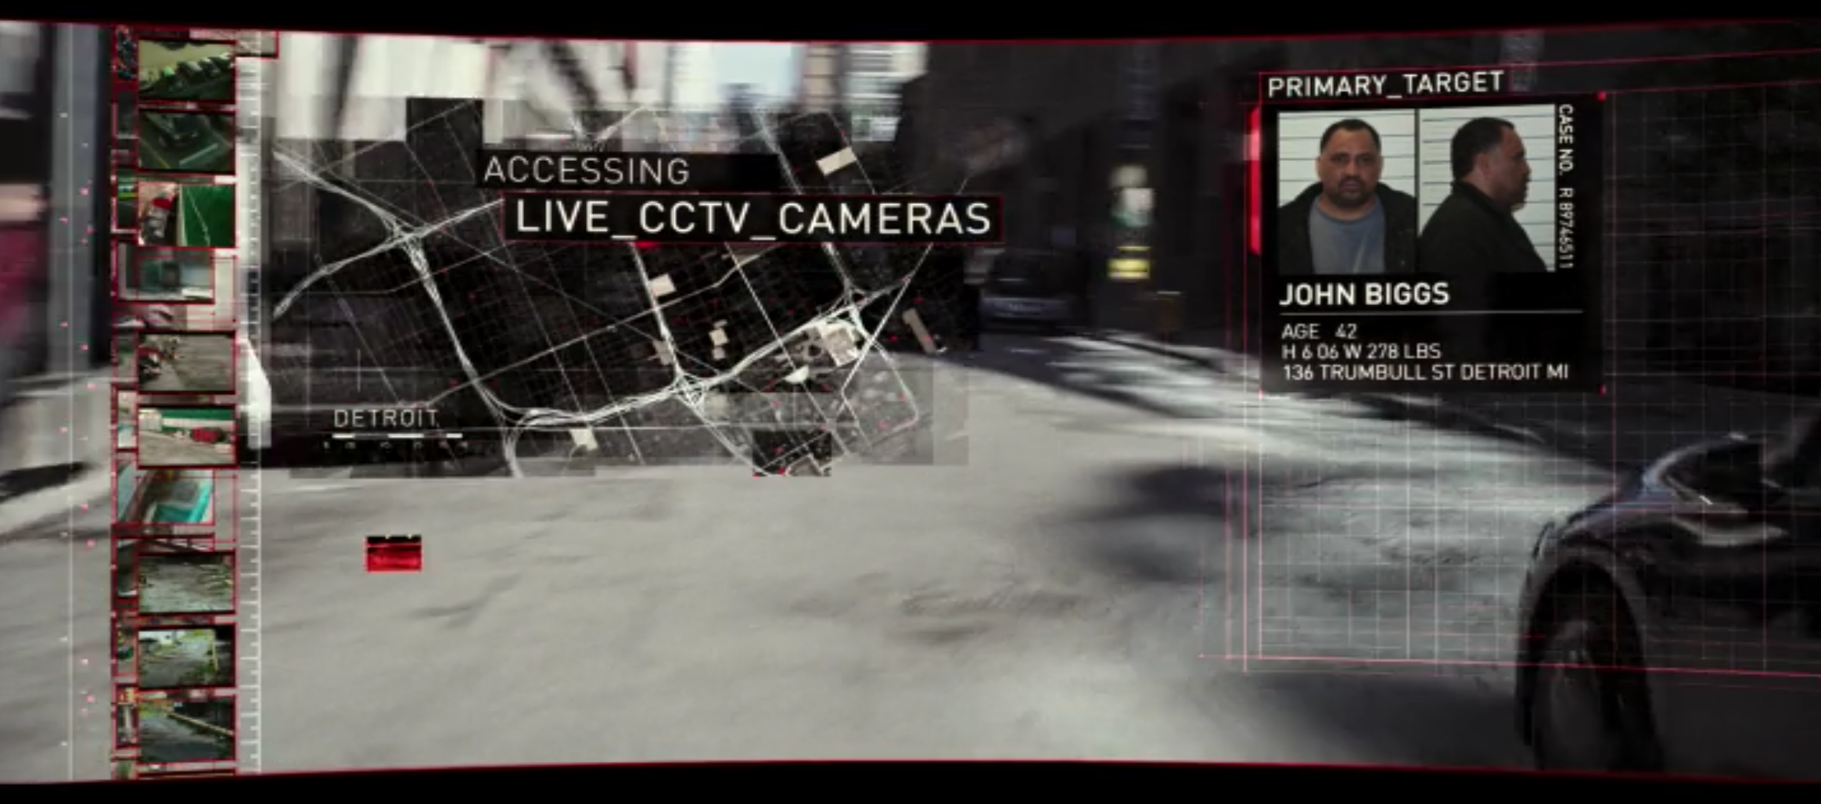
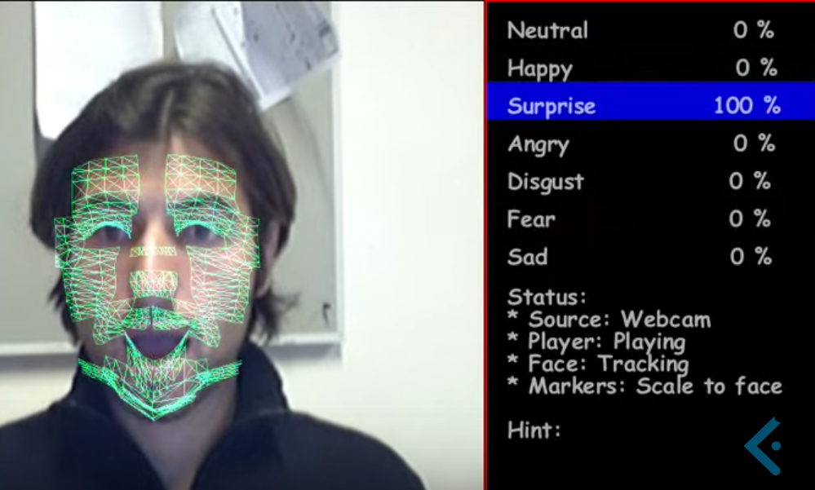
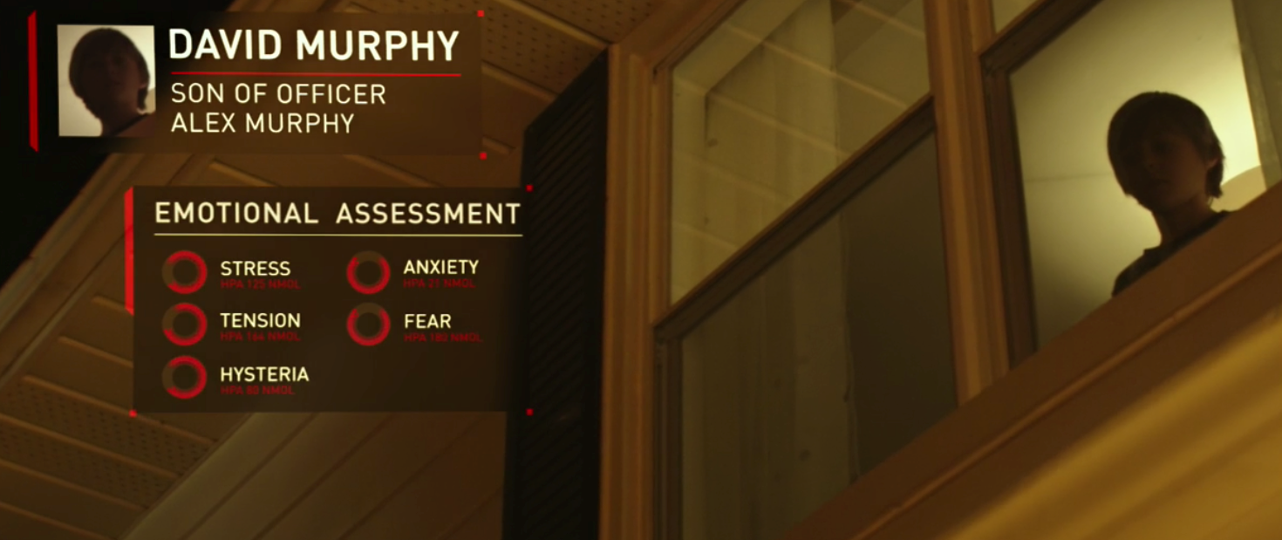
Key computing technologies
RoboCop (2014)
CCTV Data Mining
  Domain Awareness System
  Project Hostile Intent
Neuroprosthetics
  Auditory prosthetics
  Visual prosthetics
  Motor prosthetics
[12,13,14,15,16 ]
Notes:
In the movie, Alex Murphy perform use CCTV footage to perform investigation (screenshot).
NYPD has similar system called Domain Awareness System [12]
investigator have immediate access to info through live feed [13]
instantly see suspect arrest records [13]
access to 911 calls associated with suspect [13]
related crime occurring in the area [13]
In the movie, Alex used facial expression recognition to aim investigation (screenshot).
DAS doesn't use facial recognition technology according to Public Security Privacy Guidelines. [14]
In Project Hostile Intent, the facial recognition and facial expression recognition technology are used to detect individual's intent to do harm or deceive. [15]
Used as part of surveillance system in airport security check.[15]
one of the successful example of neuroprosthecis is cochlear implant.[16]
Stimulate proper neurons to create sound or images.
Alex mostly used motor prosthetics.

Slide 5
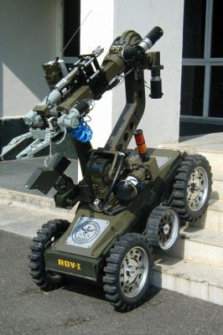
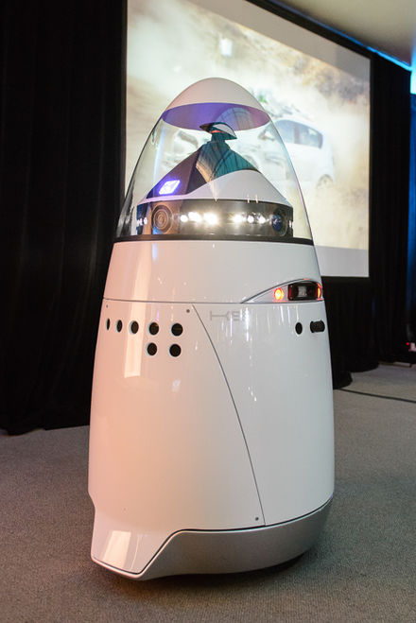
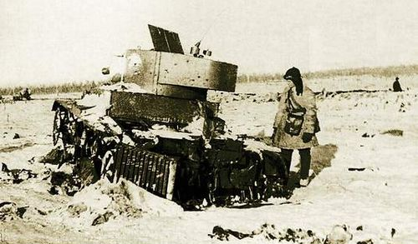
Key computing technologies
RoboCop (2014)
Military robots
  Teletanks
  Daksh
  Predator drone
Police robots
  Knightscope's K5
[17, 18, 19, 20]
Notes:
An early example of military robot is teletank in World War II. [17]
controlled by radio
equipped with machine gun and flamethrower and time bomb
Daksh for handling and destroying hazardous object. [18]
Predator drone is one of the combat military robot[19]
Previous example are all controlled by operator
Knightscope's K5 is automated[20]
Uses varies sensor, such as camera, microphone, air quality sensor, thermal imaging sensor to detect crime.
Once crime detected, it will report to the authority. Only used for monitoring crime, not for combat.

Slide 6

BENEFIT OF BRAIN-COMPUTER INTERFACE
RoboCop (2014)
Medical Interventions: help disabled people to regain abilities
Bright future:
  Fewer complications
  Improve quality of life
  Improve physical and mental abilities
  Deeper, more advanced communication between people
[9]
Notes:
brain computer interface already helped people in ALS, people who are blind, deaf and even people who have Parkinson.
mention the number of population who could be benefit from this technology.
In the future it can have far fewer complications than now when using new bio-friendly material
It can improve quality of life significantly:
especially 1 million deaf and 28 million people with hearing problems, also 8 million people with visual disabilities in United States
It can improve human's sensing ability and thinking ability
More information can be exchanged when the device is improved

Slide 7
Costs Of Brain-Computer Interface
RoboCop (2014)
BCI, neuroprothetics and neuroenhancement
BCI side-effects
  infection, disturbed sleep, mood swings, anxiety, hearing loss, visual problems, and tinnitus
Ethically
  Invasive and side-effects
  Enhancement really desired?
[10,11]
Notes:
Brain computer Interface now is only a one-way communication, different from the movie, which means that the device can only accept the signal and decode it. Neuroprothetics restore the current neuro abilities while neuroenhancement enhance the neuro abilities.
BCI side effects: infection, tissues around the sensor will be affected, also the neuro around the sensor will be affected
Ethically speaking: invasive BCI systems need procedure from doctor as well as consent from patient, it is invasive, it could lead to so much side effects makes it almost not worth it
Is neuro-ehancement really want people desire? is it going to make human less human?
But Overall, the BCI system has a bright future and the side effects and implications will drop significant after the technology advanced. Now the BCI already evolved from can only be temporary clinical trail to 2.7 years in use in a single trail.

Slide 8
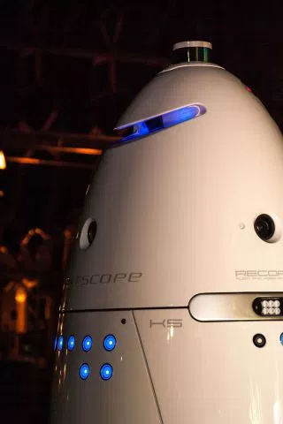
Benefits of Automated Policing
RoboCop (2014)
Could make policing more efficient
  More efficient paperwork
  Make finding/identifying criminals easier
  Predictive analytics
Take police officers out of danger
  Large portion of robotics dedicated to reducing risk
  Take place of human officers in violent situations
Knightscope K5 [3]
[1, 2, 3, 4]
Notes:
Currently, police technology is lagging behind modern technology.
"officers still struggle to retrieve the information they need" [1].
The Knightscope K5 is a robot currently used to help policing in Silicon Valley.
It is not meant to replace mall cops or security guards (yet), but can assist them by capturing behavior on video, read license plates, perform facial recognition, and use thermal imaging.
It is also being used to predict when a crime may occur in areas it is patrolling.
According the DARPA Robotics Challenge website, this challenge is meant to “generate groundbreaking research and development in hardware and software that will enable future robots, in tandem with human counterparts, to perform the most hazardous activities in disaster zones, thus reducing casualties and saving lives” [4].
These robots could take the place of human officers in violent situations, like what was seen in the beginning of the movie.
Furthermore, depending on the situation and the design of the robot, the robot could even use non-lethal force (such as stunning technology) to incapacitate violent criminals.

Slide 9
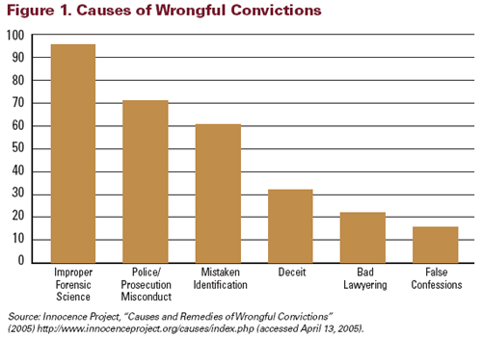
Common Policing Errors
Automated policing solves first two problems
Fails to address the third
These errors are dangerous

Slide 10
Costs of Automated Policing
RoboCop (2014)
Risk of error
  Unreliable records
  Mistaken identification
  Wrongful arrests
Systems could be compromised
  Identity theft
  Hijacking enforcement units
Corruption
Privacy
[5, 6, 7]
Notes:
The main risk with automated policing is risk of error.
One possible error is unreliable records, an issue that arises with current law enforcement computer systems.
A 1986 study of the FBI's computer systems found that in a sample of open arrest warrants in the FBI database, over 15% of them were invalid (!) , meaning that when checked against the local courts where the warrants originated, the arrest warrants were either already cleared or there was no record of them at all [5].
The same study found that in the identification division, only 25.7% of records from the division were "complete, accurate and unambiguous." [5]
And if there's one thing we all know as computer scientists, it's that computers don't handle ambiguity well.
Without human oversight, automated police systems could operate with this erroneous data and potentially cause harm through wrongful arrests or even use of authorized force. The textbook included many examples of how errors in the National Criminal Information Center database affected innocent people.
One solution might be ensuring the correctness of these databases, but doing so is extremely difficult. Auditing the databases is expensive and time-consuming, and even auditing couldn't detect all the errors in the system.
In addition to unintentional errors, automated police systems could be compromised for malicious purposes.
Government databases have been breached before. Just last year, 22.1 million records were stolen from the federal government's Office of Personnel Management, including a lot of sensitive information [7].
If an automated policing system was breached, hackers could use the system for identity theft or to slow down police by framing someone with a similar name, for example.
Hackers could also potentially hijack enforcement units and use them for malicious purposes. These units would need to be able to apprehend criminals to be useful, and that functionality could be dangerous in the wrong hands.
Lastly, automated police systems could be subject to corruption. Government workers with access to the databases could alter or delete information for nefarious purposes.

Slide 11
Conclusions
Brain-computer interfaces
  Widespread, profound benefits
  Dangerous risks
  Legislation and safeguards are necessary
Automated policing
  Solves many current problems
  Should complement, not replace, humans
  Limits for privacy and use of force
Notes:
Brain-computer interfaces will have widespread, profound benefits for those with disabilities.
However, there are dangerous risks with the technology.
Thoughtful legislation and safeguards are necessary for successful implementation.​
Automated policing solves many current problems with policing
However, computer systems should complement, not replace humans, since there are too many potential errors.
We also need limits for privacy and use of force to ensure the physical and emotional safety of citizens.
Lastly, this technology could conceivably be real in the future, so it is important for us as computing professionals to avoid these ethical pitfalls.

Slide 12
Questions?

Slide 13
References
<Your Name>
[1] Daly, Ger. "Embracing the Policy Force of the Future." CNN. Cable News Network, 19 Sept. 2013. Web. 21 Apr. 2016. <http://www.cnn.com/2013/09/18/tech/innovation/police-future-technology/>.
[2] Grossman, Lev. "Knightscope Police Bot Is Watching, Always Watching." Time. Time, 16 Apr. 2014. Web. 21 Apr. 2016. <http://time.com/65021/robot-cop/>.
[3] Buhr, Sarah. "Meet Knightscope's Crime-Fighting Robots." TechCrunch. AOL Inc., 31 Dec. 2015. Web. 21 Apr. 2016. <http://techcrunch.com/2015/12/31/meet-knightscopes-crime-fighting-robots/>.
[4] "What Is the DARPA Robotics Challenge (DRC)?" DARPA Robotics Challenge. DARPA, n.d. Web. 21 Apr. 2016. <http://www.theroboticschallenge.org/overview>.
[5] Kenneth C. Laudon. 1986. Data quality and due process in large interorganizational record systems. Commun. ACM 29, 1 (January 1986), 4-11.
[6] McFarland, Michael. "The Human Cost of Computer Errors." Markkula Center for Applied Ethics, Santa Clara University. 1 June 2012. Accessed 21 April 2016. <https://www.scu.edu/ethics/focus-areas/internet-ethics/resources/the-human-cost-of-computer-errors>
[7] Nakashima, Ellen. "Hacks of OPM databases compromised 22.1 million people, federal authorities say." Washington Post. 9 July 2015. Accessed 21 April 2016 <https://www.washingtonpost.com/news/federal-eye/wp/2015/07/09/hack-of-security-clearance-system-affected-21-5-million-people-federal-authorities-say>
[8] RoboCop (2014) Poster. Accessed on 20 April 2016. <http://t1.gstatic.com/images?q=tbn:ANd9GcRQ7uO0qFsZqVXui8D3oM8EtaHz4lF_NL8Awhwiz2r4vI6Q1Xk0>
[9] "Kicking off a New Er a for Neuroprosthetics, or Just the Warm-up?" Speaking of Research. 2014. Web. 22 Apr. 2016.
[10]"Brain-Computer Interface (BCI)." ALSA.org. Web. 22 Apr. 2016.
[11]Glannon, Walter. “Ethical Issues with Brain-Computer Interfaces.” Frontiers in Systems Neuroscience 8 (2014): 136. PMC. Web. 22 Apr. 2016.

Slide 14
References
<Your Name>
[12] NYPD expands surveillance net to fight crime as well as terrorism, Jun 21, 2013, <http://www.reuters.com/article/usa-ny-surveillance-idUSL2N0EV0D220130621>.
[13] MAYOR BLOOMBERG, POLICE COMMISSIONER KELLY AND MICROSOFT UNVEIL NEW, STATE-OF-THE-ART LAW ENFORCEMENT TECHNOLOGY THAT AGGREGATES AND ANALYZES EXISTING PUBLIC SAFETY DATA IN REAL TIME TO PROVIDE A COMPREHENSIVE VIEW OF POTENTIAL THREATS AND CRIMINAL ACTIVITY, A ugust 8, 2012, <http://www.nyc.gov/portal/site/nycgov/menuitem.c0935b9a57bb4ef3daf2f1c701c789a0/index.jsp?pageID=mayor_press_release&catID=1194&doc_name=http%3A%2F%2Fwww.nyc.gov%2Fhtml%2Fom%2Fhtml%2F2012b%2Fpr291-12.html&cc=unused1978&rc=1194&ndi=1>.
[14] Public Security Privacy Guidelines, 4/2/09, <http://www.nyc.gov/html/nypd/downloads/pdf/crime_prevention/public_security_privacy_guidelines.pdf>.
[15] The Realworld "Minority Report ", February 28, 2008, <http://www.dailygalaxy.com/my_weblog/2008/02/the-realworld-m.html#more>.
[16] New cochlear implant could improve hearing, Feb 07, 2006, <http://ns.umich.edu/new/releases/101>
[17] What is teletank?, September 9, 2004, <http://translate.google.com/translate?hl=en&langpair=ru%7Cen&u=http://www.odintsovo.info/news/?id=1683>
[18] Daksh Remotely Operated Vehicle (ROV), India, accessed date: April 28, 2016 <http://www.army-technology.com/projects/remotely-operated-vehicle-rov-daksh/>
[19] MQ–1 Predator/ MQ–9 Reaper, May 28, 2015, <http://www.bga-aeroweb.com/Defense/MQ-1-Predator-MQ-9-Reaper.html>
[20] The dawn of a REAL Robocop? Machines armed with thermal imaging, radar and cameras that its designers say could help prevent another Sandy Hook, Dec 2, 2013, <http://www.dailymail.co.uk/news/article-2516662/The-dawn-REAL-Robocop-Machines-armed-thermal-imaging-radar-cameras-designers-say-help-prevent-Sandy-Hook.html>

