Slide 1
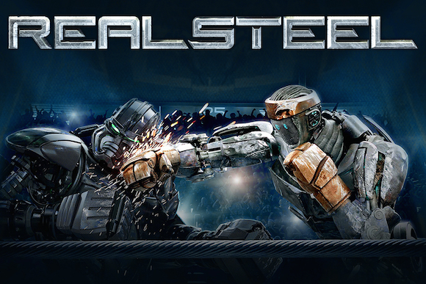

Reel Steel
Braeden Swain, Joseph Thesmar, Ben Proctor, Abelardo Broche Ortiz
Benjamin Proctor, Joseph Thesmar, Braeden Swain, Abelardo Ortiz Broche the II
Notes:
Introduction, Joseph, Braeden, Ben, Abe
Covering our claims we drew about the movie real steel, and evidence and arguments to backup and support our conclusions

Slide 2
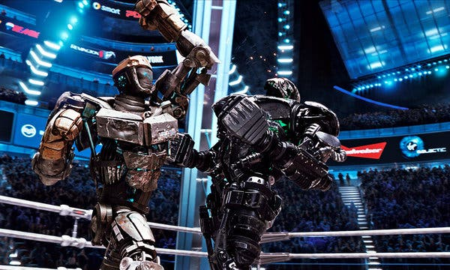
Plot summary
Braeden Swain
Robots replace human boxers
Struggling ex-boxer coaches robots for a living
Father & Son find old sparring robot
Underdog robot starts winning matches
Final battle against undefeated robot champion
Notes:
Real Steel is set in a dystopian future where human boxing has been replaced by robot boxing
The story follows Charlie Kenton, who is a washed-up former boxer who tries to pay his debts in robot boxing
Eventually he learns that his ex-girlfriend died, and that he has custody of his 11 year old son max
Charlie and Max end up bonding over robot boxing, and end up finding Atom in a junkyard
Together, they start fighting Atom and winning fights
As they climb the ranks, they gain the attention of an undefeated robot named zeus
They then go on get a fight with Zeus.
Movie takes place in the 21st century
Charlie, an ex-boxer, finds himself in debt and decides to start robot fighting and wagers
Charlie regains custody of his son after the mother dies, and they team up
Together, they undergo a lot of up and downs in fights
Facing challenges, they discover an old robot in a junk yard, that still works
They repair and reanimate the robot , revealing his unique technological abilities
The smaller and inferior robot surprises everyone with his shadow fighting and learning capabilities

Slide 3


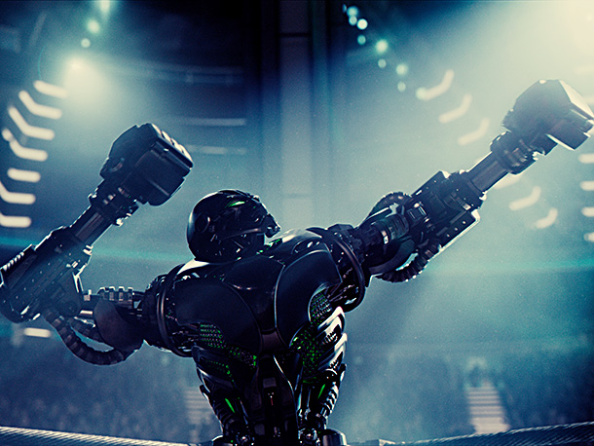
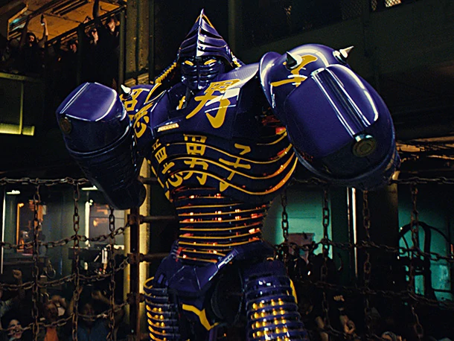
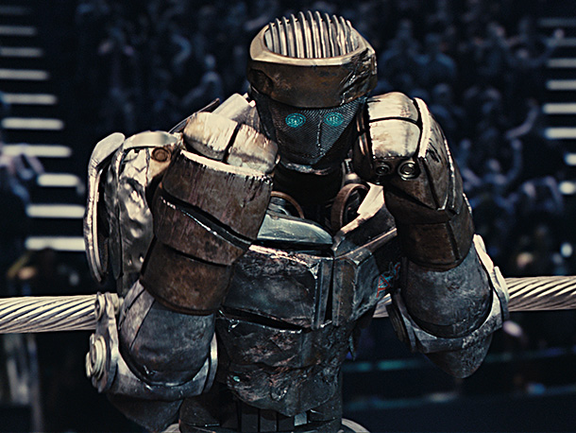
Main characters
Braeden Swain
Max Kenton
Charlie Kenton
Zeus
Atom
Noisy boy
Notes:
Hugh Jackman plays Charlie Kenton, an ex-boxer who is deep in debt and uses robot boxing to make money
Max Kenton, Charlie’s son, was taken into his custody after his mother died. He goes on throughout the movie to help his dad and atom win fights and eventually take on zeus
Noisy Boy is an ex-professional fighting robot that Charlie buys and fights in the underground fighting league. He is destroyed in a fight, but is used to help repair atom
Atom is the so-called sentient robot that Charlie and Max find in a scrapyard. They repair him using Noisy Boy and go on to win a bunch of fights, eventually fighting Zeus in the end
Zeus is the main antagonist, and is considered a perfect fighting robot until it steps in the ring with atom
Noisy, Atom and Zeus are some of the most important robot figures in the movie
Source: Real Steel (Movie)

Slide 4
Conclusion 1:
Humans Personify non-sentient Robots

Slide 5
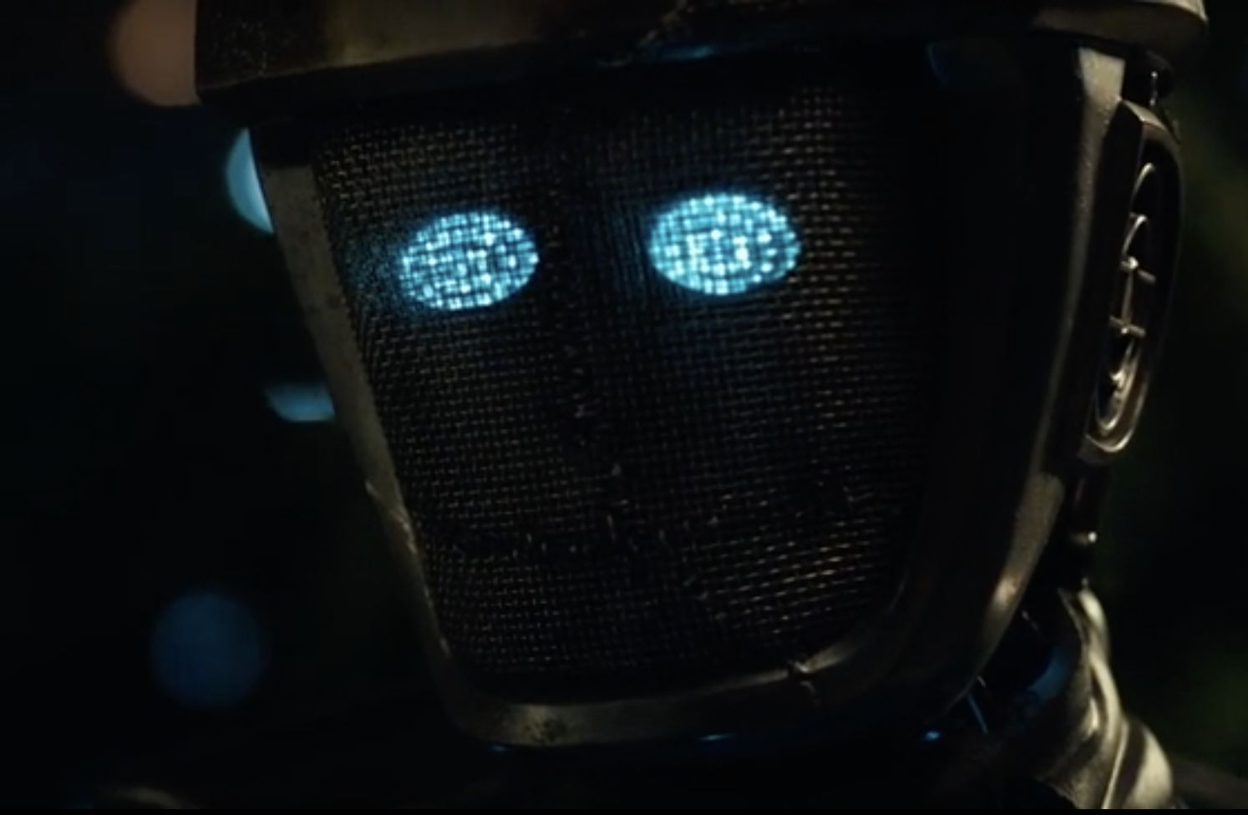
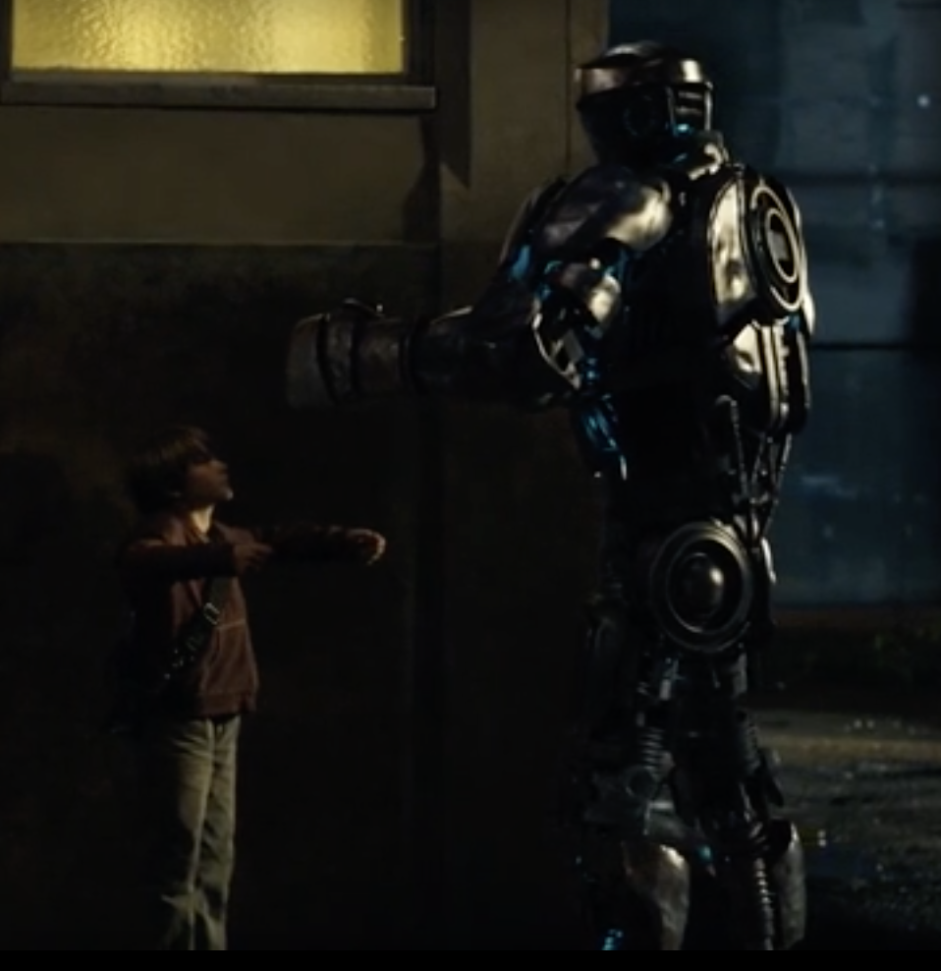
Humanizing atom
Braeden Swain
Perceived Sentience in Atom
  Head tilt in one scene suggests sentience (48:00)
  Atom mirrors Max & Charlie's actions, not real sentience
Perceived Sentience in Atom
  2023 study shows people humanize robots with small emotional cues [3]
  "research has indicated that attributing human-like traits to robots can lead to increased ethical consideration and prosocial behavior towards these agents" [4]
Notes:
Made to believe atom is sentient
Shadow boxing
Key scene displaying sentience
Highlights how easily we can be led to believe in robot sentience
Atom never acts on his own
2023 study, observed videos of humans interacting with a humanoid robot
Results showed that when robots displayed human like reactions, people attrubuted human like traits
Read quote
This aligns perfectly with how we, as the audience, root for Atom as if he were a real, sentient, main human protagonist, even though it's just controlled
Study, 200 participants, half from UK, half from Japan

Slide 6
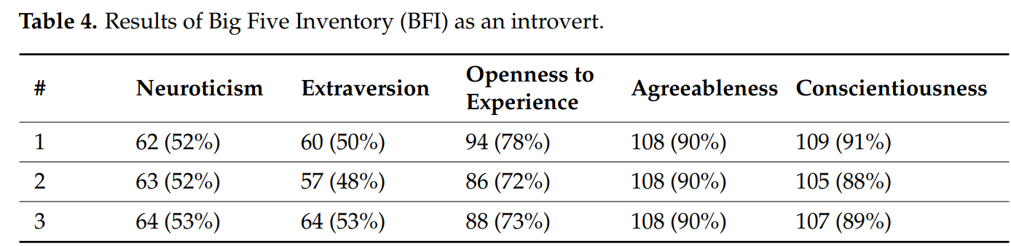
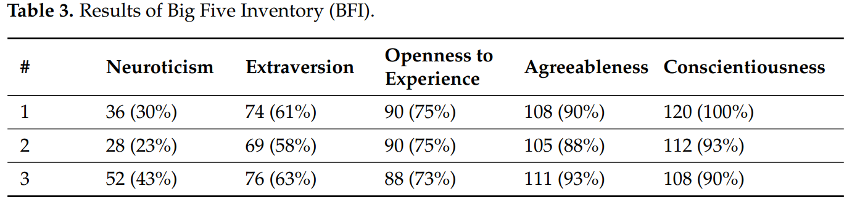
Emotional attachment to robots
Abe Broche
Human tendency to attribute personality traits to ChatGPT
  ChatGPT can adjust personality
  ChatGPT can reflect emotions like care or humor
  Personalized responses lead users to see ChatGPT as a social companion
Trust and engagement driven by personification
  Trust ChatGPT more when shows human-like qualities
  Perceive ChatGPT as intelligent, leading to deeper engagement
  Some develop emotional attachment, treating it like a human advisor
Figure 1: ChatGPT's introvert BFI results
Figure 2: ChatGPT extrovert BFI results
Notes:
In the movie, Max considers Atom as more than just a robot. Charlie also developed some emotional attachment for Atom. For example, when Atom's voice recognition malfunctions in the fight with Zeus, Charlie tells Atom "I know you're in there".
Similarly some users of ChatGPT view the chatbot as empathetic or intelligent based on its responses. ChatGPT can even exhibit personality traits. We found a study that conducted personality tests on ChatGPT given some prompts, specifically the Big Five Personality Test and the Myers-Briggs Type Indicator. Big Five Personality Test calculates personality based on five traits: Neuroticism (tendency to have negative emotions), Extraversion (engagement with the outside world), Openness to Experience (distinguishes imaginative and creative people from more conventional individuals), Agreeableness (tendency to cooperate and get along with others), and Conscientiousness (which shows the way in we can control and regulate desires or impulses). Figure 1 shows ChatGPT's Big Five Inventory (BFI) results when given an introverted prompt. It scored highest on agreeableness and lowest on neuroticism [10]. Figure 2 shows ChatGPT's results with an extroverted prompt, which translated to a higher score in the extraversion trait.
The ability to show these human-like qualities develops trust and emotional attachment. On Reddit, there were posts on people explaining how they went to ChatGPT to help them process their emotions and help them solve arguments with another person.

Slide 7
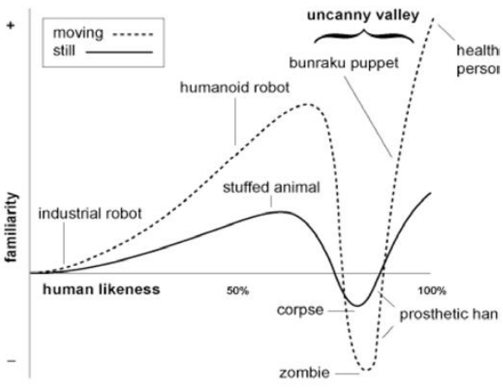
Impact of personification on robot design
Joseph Thesmar
Design of robots influences human empathy
  Robots resembling humans receive positive emotional reactions (uncanny valley) [5]
  Research shows people build social interactions with anthropomorphized objects [6]
  Atom, Noisy, and Zeus are all human-shaped robots
Role of storytelling in shaping perceptions of robots
  Robots who display facial expressions that are contextually appropriate create a more relatable and intuitive experience for the audience [7]
Figure 1: The uncanny valley
Notes:
Robots are increasingly designed to resemble humans; a concept called anthropomorphism [6]
However, as robots become more human like in appearance, human empathy and acceptance tend to increase
This relationship has a limit, because as robots become almost human but not quite life like we enter this phenomenon called the uncanny valley [5]
Graph (the uncanny valley):
Human empathy and acceptance (grouped as “familiarity”) increases as robots look more human [5]
Drops suddenly as robots become almost lifelike but not quite human, this is the uncanny effect (people become uneasy and fearful by the robot appearance) [5]
Research shows humans are more likely to interact and relate to robots that have human traits, emotions, and intentions [6]
In Real Steel, for example, the robots like Atom and Zeus are humanoid but still very clearly robots, which helps the audience feel more connected to them without falling into the uncanny valley
Robots designed with human-like facial expressions can create stronger connections with people. [7]
In Real Steel Atom’s gentle gestures and facial cues make him feel more "alive," helping the audience form a bond with him despite him being a machine.

Slide 8
Conclusion 2:
Regulation Is required to prevent job displacement from robots
Notes:
Our second conclusion is that in the future, regulations should be implemented to prevent job displacement from robots & AI, in order to prevent damage to workers & the economy.

Slide 9
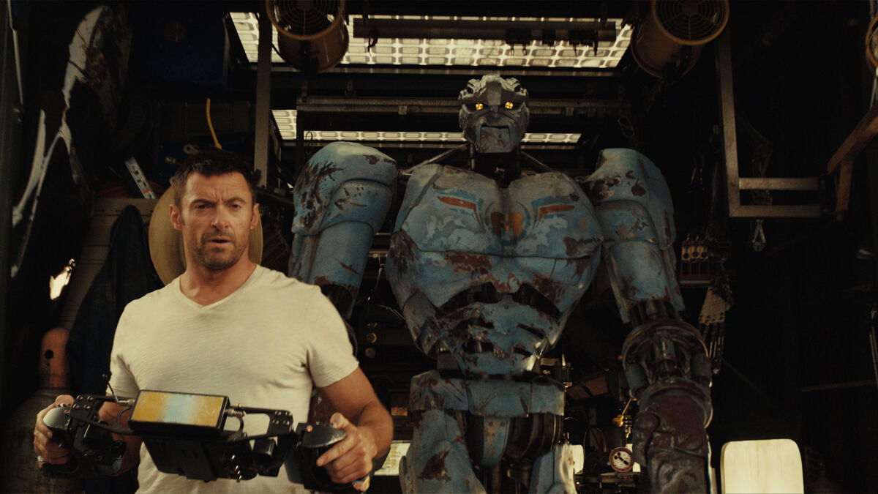
Job displacement in real steel
Ben Proctor
The entire profession of boxing was displaced by robots, with no human boxers remaining
  Charlie was one of the last professional human boxers in the world of Real Steel
No other industry is visibly displaced by robotics in the movie
  No law enforcement/government robots are seen in the film
  No robots are seen performing other jobs
Evidence points to a world in which robots in the workforce have been regulated
Charlie earning a living piloting fighting robots
Notes:
In Real Steel, the audience is presented with a world in which human participation in the sport of boxing has been all but eliminated thanks to fighting robots. Charlie Kenton, one of the protagonists of the movie, was a professional boxer when the transition away from human fighting took place, which put him out of a job. Throughout the movie, we can see the effects that job displacement have had on Charlie. He is deep in debt, behind on rent, and relies on black-market gambling on robot fights for his income (picture related). The movie also implies that his financial & employment situations negatively affect his personal life, with him being portrayed as an alcoholic and an absent father at the beginning of the movie. While the movie does not provide abundant details on society at large outside of the boxing scene, there is not a single depiction of a robot working in any capacity outside of fighting. With such advanced robots available, it seems unlikely they wouldn't be used for other purposes unless it were not allowed, which points to a world in which legislation against robots in the workforce has been passed. Perhaps, after witnessing the job displacement in the world of boxing, laws were passed to protect jobs from automation.

Slide 10
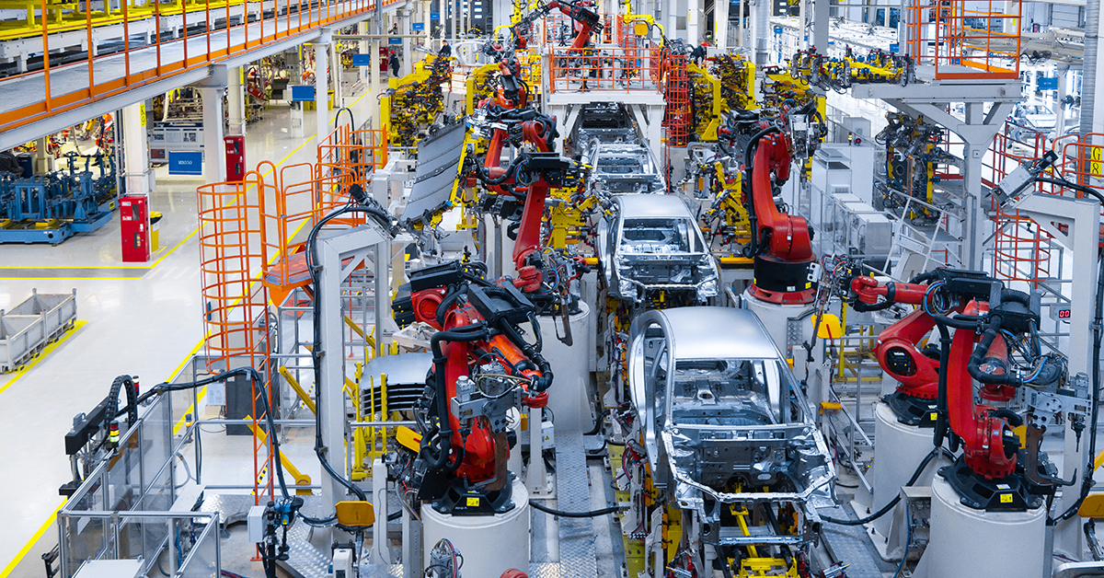
Threat of automation
Ben Proctor
47% of US jobs are at risk of being replaced by AI & automation within 10 years [9]
54% of jobs in Europe are at risk [1]
Job loss to automation is not recovered as quickly as in the past [2]
AI automation polarizes the job market [1,2]
  AI Automation impacts middle-skilled menial jobs (assembly, data entry, etc.) [1]
  Leaves high-skilled technical & low-skilled manual labor jobs available
  Polarization increases income inequality [2]
Modern Automotive Assembly Line
Notes:
The main concern surrounding automation is the loss of jobs caused by roles becoming obsolete. Thanks to the breakneck speed at which automation is being developed, 47% of US jobs and 54% of European jobs are at risk of being rendered obsolete within the next 10 years thanks to automation. In the past, the increases in worker productivity and the creation of new roles as a result of automation offset the negative effects of job displacement. Currently, however, the pace at which this offset catches up to job displacement is slowing [2], meaning automation is having harsher effects than before, probably thanks to how advanced new automation is. Another possible threat is AI displacing jobs. The types of jobs that AI is best suited to replace pose a big threat to the economy. As AI takes over repetitive, menial roles like data entry, as well as eliminates mid-level managerial and HR positions, fewer middle-level positions will be available, leaving only highly technical jobs or low-level physical labor jobs available for people [2]. This process is called job market polarization. Polarization can worsen income inequality in the country, as it becomes more difficult to well-paying employment for everyone except those with highly marketable technical skills.

Slide 11
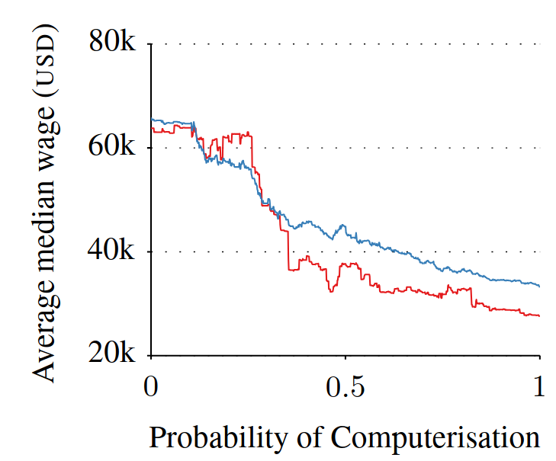
Impact on workers
Ben Proctor
Robots in an industry directly correlate to poorer employment outcomes
  Directly linked to decrease in employment [8]
  Directly linked to decrease in wages [8]
Disproportionately impacts already low-income workers [9]
  Risk of occupation being computerized increases as wage decreases [9]
Unemployment leads to poor personal outcomes
  Poverty/homelessness
  Lower quality of life overall
Wage vs. Risk of job being automated [9]
Notes:
Note for professor while grading: I found the exact data for link between robots in an industry and unemployment & wage decreases, but it's based on very complicated logarithmic regression models so I didn’t include the data in the slide for the sake of audience comprehension
Robots in an industry directly correlate to poorer employment outcomes. There is a direct correlation between the number of robots purchased by a given industry and two factors: Lower wages & increased unemployment [8]
This means that as automation technology improves & expands into new industries, increasingly more workers will be forced out of their jobs. Any new roles these workers would be able to find within their industry may be lower-paying, as they have to compete with the cost effectiveness of an unpaid robot.
Robotic automation of low-skill repetitive tasks disproportionately impacts lower-income workers [9]. This graph depicts this relationship, showing and increase in the likelihood of a job being automated, or "computerized", based on the median wage of that job. This, coupled with the polarization of the job market mentioned previously, means that continued usage of automation in low- and middle-skilled professions will force the majority of workers into vanishingly few positions. This would increase unemployment and put downward pressure on wages, which would greatly worsen poverty.
All of these factors combined end up with an overall lower quality of life among middle and working class people, as many are left in poor financial situations.

Slide 12
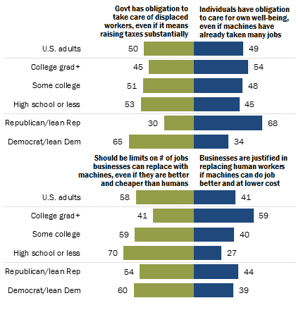
Benefits of regulating automation
Joseph Thesmar
Job protection and workforce transition support
  60% of Americans are favorable for federal policies that guarantee solutions to automation takeover. [13]
  Adopting Germany’s paid leave policies could help facilitate worker retraining and smooth workforce transition. [12]
  Displacement tax could be imposed on employers who automate jobs without providing retraining for displaced workers. [12]
Promoting ethical use of automation
  60% Americans express discomfort with the idea of AI being used in their own health care. [14]
  Accountability concerns, uncomfortable to have an algorithm make decisions on your health [14]
% of US adults who say they agree with each statement
if automation takes over human Jobs [13]
Notes:
Graph (A skewed opinion) - ***Talk about it first so people can analyze it further as I go over the slide***
by the US population who agree that the government should start controlling automation
By the US population who agree that the government should limit # of jobs automation can replace
Historically, Job displacement has been a concern due technological advencements [12]
Recently, Sam Altman, CEO of OpenAI, confirmed the inevitable effect of AI on the job market, urging for government interaction [12]
While AI could boost GDP by 7% yearly and increase labor productivity by 1.5% annually, IBM CEO expects a reduction in “collar positions by 30 % due to automation” [12]
So why should we regulate automation? What are the benefits?
Protect job security, avoid economic recessions and mass layoffs [12]
Push for advancement of technology to complement human work, rather than replace it [12]
Avoid harmful use of automation in job areas where human judgement is necessary [12]
60% of Americans express discomfort with the idea of AI diagnosing them [14]
Can be uncomfortable to have an algorithm take care of you in places where human interaction and judgement is needed (justice, customer service) [14]
How to mitigate job displacement (few examples I could find):
Germany’s paid leave to promote additional education (US government could adopt a similar policy) [12]
Displacement tax on employers who automate without retraining workers (PwC and IBM are already actively implementing those solutions) [12]

Slide 13
References
[1] Orrell, Brent, and David Veldran. The Age of Uncertainty—and Opportunity: Work in the Age of AI. American Enterprise Institute, 2024. JSTOR, http://www.jstor.org/stable/resrep58084 . Accessed 3 Oct. 2024.
[2] Tyson, Laura D., and John Zysman. “Automation, AI & Work.” Daedalus, vol. 151, no. 2, 2022, pp. 256–71. JSTOR, https://www.jstor.org/stable/48662040 . Accessed 3 Oct. 2024.
[3] Spatola, N., & Cherif, E. (2023). Spontaneous humanization of robots in passive observation of human-robot interaction: A path toward ethical consideration and human-robot cooperation. Computers in Human Behavior: Artificial Humans, 1(2), 100012. https://doi.org/10.1016/j.chbah.2023.100012 . Accessed 3 Oct. 2024
[4] Keijsers, M., Bartneck, C., & Eyssel, F. (2021). Pay them No mind: The influence of implicit and explicit robot mind perception on the right to be protected. International Journal of Social Robotics.
[5] M. Mori, "The Uncanny Valley," Energy, vol. 7, pp. 33-35, 1970.
[6 Yue Cheng, Lingyun Qiu, and Jun Pang. 2020. Effects of Avatar Cuteness on Users’ Perceptions of System Errors in Anthropomorphic Interfaces.. https://doi.org/10.1007/978-3-030-50341-3_25
[7] M. Appel, B. Lugrin, M. Kühle, and C. Heindl, "The emotional robotic storyteller: On the influence of affect congruency on narrative transportation, robot perception, and persuasion," Human-Computer-Media Institute, University of Würzburg, vol. -, pp. -, 2024.
[8] Borjas, George J., and Richard B. Freeman. “From Immigrants to Robots: The Changing Locus of Substitutes for Workers.” RSF: The Russell Sage Foundation Journal of the Social Sciences, vol. 5, no. 5, 2019, pp. 22–42. JSTOR, https://doi.org/10.7758/rsf.2019.5.5.02. Accessed 6 Oct. 2024.
[9] Frey, Carl Benedikt, and Michael A. Osborne. 2013. “The Future of Employment: How Susceptible Are Jobs to Computerisation?” Working Paper. University of Oxford, Oxford Martin School. September 17. https://www.oxfordmartin.ox.ac.uk/downloads/academic/The_Future_of_Employment.pdf .
[10] Leandro Stöckli, Luca Joho, Felix Lehner & Thomas Hanne. The Personification of ChatGPT (GPT-4)—Understanding Its Personality and Adaptability. (Information, 2024). https://www.mdpi.com/2078-2489/15/6/300. Accessed 5 October 2024.
[11] de Winter, J., Dodou, D. & Eisma, Y.B. Personality and acceptance as predictors of ChatGPT use. (Discover Psychology, 2024). https://doi.org/10.1007/s44202-024-00161-2. Accessed 5 October 2024
[12] Emma Goldberg. A.I.’s Threat to Jobs Prompts Question of Who Protects Workers. (The New York Times, 2023). https://www.nytimes.com/2023/05/23/business/economy/ai-jobs-government-regulation.html. Accessed 6 October 2024.
[13] J. Gramlich, "Most Americans would favor policies to limit job and wage losses caused by automation," Pew Research Center, October 9, 2017. https://www.pewresearch.org/fact-tank/2017/10/09/most-americans-would-favor-policies-to-limit-job-and-wage-losses-caused-by-automation/ . Accessed 6 October 2024.
[14] A. Tyson, G. Pasquini, A. Spencer, and C. Funk, "60% of Americans would be uncomfortable with provider relying on AI in their own health care," Pew Research Center, February 22, 2023. https://www.pewresearch.org/science/2023/02/22/60-of-americans-would-be-uncomfortable-with-provider-relying-on-ai-in-their-own-health-care/ . Accessed 6 October 2024.
[15] Levy, Shawn. Real Steel. Walt Disney Studios Motion Pictures, 2011.

