Slide 1


Carlos Medina Ryan Offstein
Myles Ku
Iris Nycz
Aksel Jensen
Notes:
Aksel - 10 seconds
Hello, We will be presenting on the Societal Implications of the Tech in the 2006 movie directed by Satoshi Kon, Paprika

Slide 2
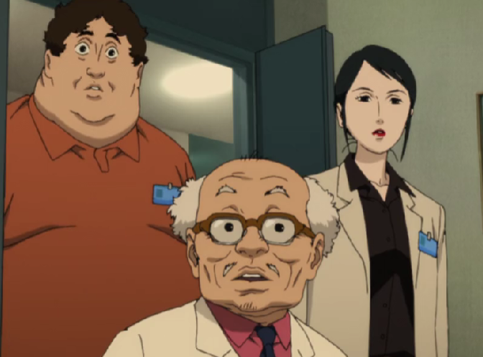


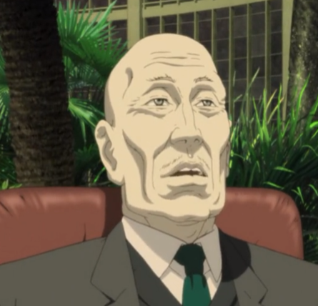
Import Tech Plot and Characters
DC Mini stolen - dream sharing
Thief invades minds with DC Mini
“Malfunction” traps those dreaming
Main characters invade dream state
Everyone’s dreams are invaded
[0] 53:17, [0] 3:10, [0] 10:20, [0] 26:20
Notes:
Aksel - 1 minute
The Major Plot points and Characters serve as background for the Tech’s Issues
The primary tech, a dream sharing device called the, DC Mini is stolen at the very beginning of the movie
The thief uses the device to invade the waking dreams of innocent people
Due to this mind invasion many are trapped in an insane state living through the collective dream world
The Main characters attempt to fix their mistake by recreating the device as a means to stop the perpetrator
Looking at the characters starting top left we have
Dr Chiba, main user and Head of Development for the DC Mini
Paprika, Dream persona of Dr. Chiba
The Inventor, Dr Tokita
Dr Shima, a supporting scientist
Konikawa, a psychotherapy patient and detective for the dream case
And the antagonist, the evil Chairman of the company

Slide 3

DC Mini Specs
Psychotherapy device for peering into one’s dreams
Issues with the tech:
No programmed access controls
Able to access non-users’ dreams
Use entails psychological dangers
Anonymity of users
[0] 38:48
Notes:
Aksel - 1 minute
Before we look at the implications let's talk about the main tech, The DC Mini,
The DC Mini is a psychotherapy device that allows the wearer to enter the dream of another connected user. This collective dream can then be recorded and played back for review.
The movie explores the implications of when the technologies capabilities exceed the creators intentions.
Several Issues arise due to it being an unfinished and untested product
The lack of access restrictions allows the thief to use the device easily
Tokita, the inventor notes a DC Mini user can enter the dream of an unconnected waking user if they have been previously exposed.
Tokita’s Assistant greatly over uses and becomes fused to the DC Mini leading to his attempted suicude
Finally, DC Mini users can obscure their identity through a different persona in the dream world.
This is a picture of Tokita and his DC Mini.

Slide 4
Movie Poses Societal Questions
Is there a need for greater technology regulation?
Should we be Responsible for Non-Physical Interactions with Other People?
Technology and Mental Health
Notes:
Aksel - 10 seconds
The movie poses various societal tech ideas however the main 3 we will focus on in this presentation are
The regulation of Technology
The accountability necessary for virtual world interactions
And the Association between Technology and Mental health

Slide 5
Is there a need for greater technology regulation?
Government should regulate private industry for the good of society
Notes:
Aksel -> Ryan - 10 seconds

Slide 6

1.1 Goods and Harms to Society
New technology has the potential to do great goods for society and cause lots of potential harm
Artificial intelligence in the real
world
The DC Mini in the movie
[0] 12:58
Notes:
Ryan - 1 Minute
Let's look at the potential for goods and harms of new technological innovations
One real world example of this is artificial intelligence
AI has the potential to greatly help in places of automation, information processing, manufacturing, and much more for the future (as we probably discovered in our recent papers)
On the other hand 37% of people said they are more concerned about the changes that come with AI than the potential benefits [1]
pr
The Parallel to this in the movie is the main piece of technology in the movie the DC Mini
This technology has the potential to be very helpful as seen through Detective Konakawa. By using the DC mini to process and grapple with his dreams, he gets lead through psychotherapy and calls it a blessing that he wish he knew about earlier([0] 24:00)
But this tech isn’t without its harms. As seen in the movie at many points people were driven mentally insane through their use of the technology. Especially when connected with the almost virus like dream parade. This caused people to lose a hold of themselves and make rash decisions. Our image there is of Dr Shima who in a crazed state, jumped out of a window.
Causing people to go mentally insane from their connection to the parade dream ([0] 27:10)

Slide 7

1.2 People in Regulation
Over 100x the people are working in AI in comparison to working on its regulations to keep it safe [2]
[0] 36:15
Not enough people knowledgeable of the risks and benefits of the DC Mini
Accessibility controls not a priority [0] (9:48)
Notes:
Ryan - 1 minute
Potential downsides are things that need to be considered when creating and innovating on things like new technology. And currently there isn’t enough people working on these issues.
Currently in AI Tech the ratio of people working on innovations in the technology is over 100x greater than the people looking into its safety of use.
This ratio isn’t acceptable given the technologies potential for harm.
Almost like say
In the movie, there or enough people in knowledgeable of the risks and benefits of the DC Mini, or willing to take the steps to implement safeguards
only a few people were on the DC Mini development team and fully knew how that worked. If and when things went wrong, only a few people had the knowledge to control it.
Plus even a introductory form of regulation (accessibility controls) was not developed before the technology was used.
Not enough: from the movie point of view, only the select researchers and doctors
Define too low
Does expanding knowledge about a technology (both size of dev team and public awareness) prevents misuse?
Deword

Slide 8
1.3 Privatization vs Government
Would any of the errors with DC Mini have happened if there were government regulatory bodies?
  Clinical studies have stringent entrance requirements [18]
Neuralink has tried to start human trials, but has not been successful
  FDA denial due to lacking safety procedures [19]
Notes:
Carlos - 1 minute
This slide isnt how government fails to regulate, but rather that it needs to regulate strongly, even for private companies
government regulatory bodies:
For human trials:
Investigational Device Exemptions:, covers the procedures for the conduct of clinical studies with medical devices including application, responsibilities of sponsors and investigators, labeling, records, and reports.
an investigational plan approved by an institutional review board (IRB) and If the study involves a significant risk device FDA;
informed consent from all patients;
monitoring of the study and;
required records and reports.
Protection of Human Subjects:, provides the requirements and general elements of informed consent;
Institutional Review Boards:, covers the procedures and responsibilities for institutional review boards (IRBs) that approve clinical investigations protocols;
Financial Disclosure by Clinical Investigators:, covers the disclosure of financial compensation to clinical investigators which is part of FDA’s assessment of the reliability of the clinical data.
Design Controls of the Quality System Regulation:, provides the requirement for procedures to control the design of the device in order to ensure that the specified design requirements are met.
Good Clinical Practices:
Example of where regulations have succeeded: human trials
Neuralink: fda cites concerns over “lithium battery; the potential for the implant’s tiny wires to migrate to other areas of the brain; and questions over whether and how the device can be removed without damaging brain tissue”. These issues sit unaddressed
Relevant Neuralink article: https://www.reuters.com/investigates/special-report/neuralink-musk-fda/
Fda clinical trials: https://www.fda.gov/medical-devices/premarket-submissions-selecting-and-preparing-correct-submission/investigational-device-exemption-ide
The Closer to biological functions we get the more we have to be careful.
[10] EFM Heart monitoring detecting fetal heart rate has lead to increased maternal morbidity

Slide 9

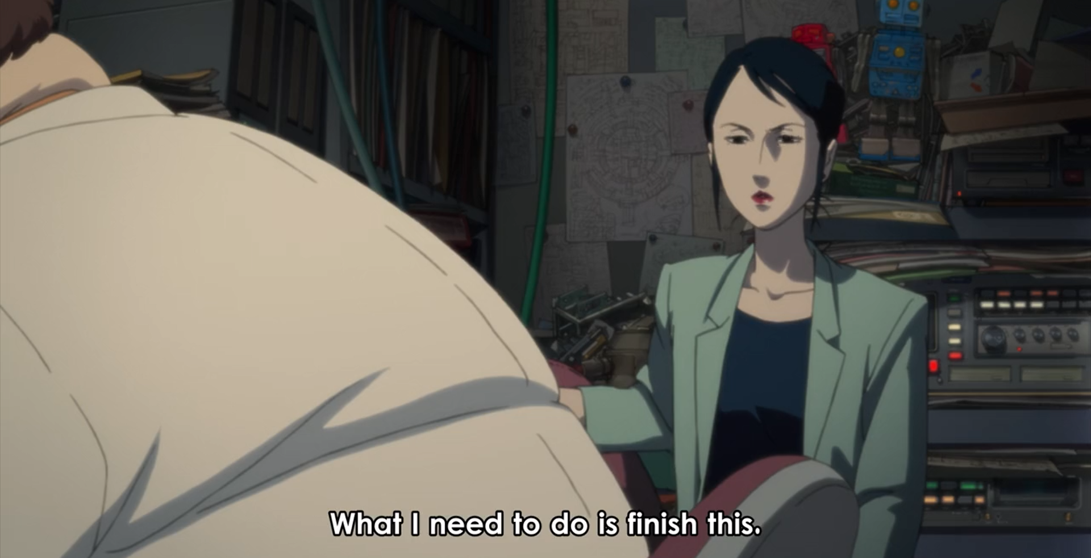
1.4 Delaying Deployment
Delaying deployment of socially impactful tech can lead to better consumer outcomes
Open letter for 6 month AI Pause [6]
In the movie, the safety of the technology was repeatedly compromised due to rushed production
[0] 11:45
[0] 37:33
Notes:
Carlos
Try and find the microsoft ceo/cfo thing on delaying product launch so that consumers have a better experience
[7] challenger failure due to wanting to launch as soon as possible not thinking of safety
[8] samsung battery failure recalled then sent out again with practically the same issue, need for sales not for safety
This delay of development, which is good, was ignored in order to get results faster. this Led to unintended consequences.
During initial development, they wanted to rush the production so they skipped the authentication functions.
The second time when himuro was trapped, tokita produced more dc minis to try and save him, not thinking about the implications of creating more defective units

Slide 10
Should we be Responsible for Non-Physical Interactions with Other People?
There should be accountability in digital worlds
Notes:
Carlos -> Ryan - 10 seconds

Slide 11
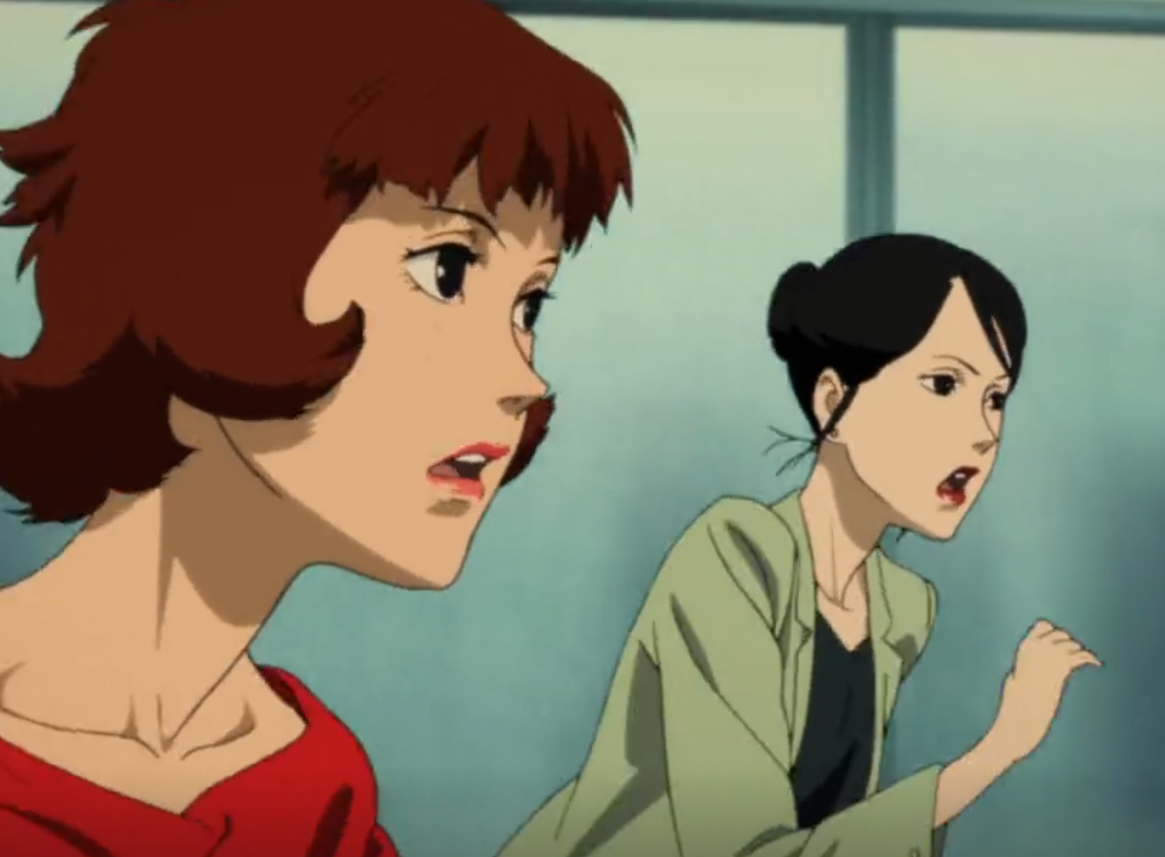
2.1 Internet Anonymity
The virtual world of the internet provides unparalleled anonymity
Many characters don’t know Paprika’s true identity until the end of the film
[0] 1:13:39
Notes:
Ryan - 1 minute
First
The internet is a world completely separated from the real world and with it comes a way to hide our true selves
Since technology has improved and we are able to communicate with people across the globe. It is easier than ever to remain almost completely anonymous to the people we interact with online.
From chat rooms to video games to blog posts, it is quite hard for the average technology user to know who is on the other end of the screen
This is also true for the virtual “dream scape” that is created by the DC Mini.
People are able to enter dreams almost like virtual reality, and people like Dr. ChEba are able to use this platform to hide behind a digital identity
Many of the main characters didn’t even know Paprikas true identity till the end (SPOILERS?)
People should be held more accountable
Should we be responsible for non-physical interactions with other people
Does what we do virtually have effects on the real world
Hiding behind an online persona (Paprika)
New picture 24:17

Slide 12

2.2 Anonymity in Misuse
Anonymity provides ease of misuse and abuse of technology
Cryptocurrency anonymity can lead to “crypto crimes” [9]
Online harassment is most common where anonymity is persevered [3]
[0] 24:17
Notes:
Ryan - 1 minute
With this anonymity comes a great ease of misuse of tech and the corresponding digital spaces.
This lack of connection to a physical person allows for cyber crimes to become much easier to perform
[9] cryptocurrency anonymity and encryption makes it very good for “crypto crimes” paying for crime via cryptocurrency
Alongside that, online Harassment and Cyberbullying are big problems because of their effects on people's well being outside of theses virtual spaces in greatly negative ways.
Cyberbullying/Stalking or other tech misuse lead to lasting levels of high distress in over 30% of victims, and over 25% report having troubles sleeping [4]
What makes it worse is that the anonymity provides little to no consequences for these actions.

Slide 13
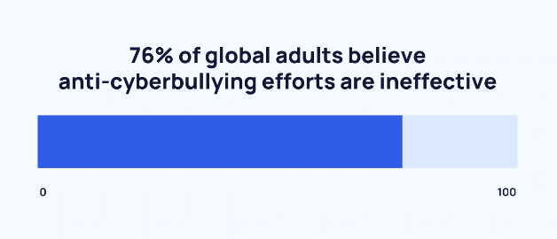
2.3 The Public Wants Accountability
81% of Americans say that laws holding cyber bullies accountable need to be strengthened [4]
Others advocate for increased identification online to protect youth and other groups at risk of exploitation [5]
[4]
Notes:
Ryan - 1 minute
Which is why people want some sort accountability for actions people take in the digital world
81% of Americans say that laws need to be strengthened to hold cyber bullies accountable for their actions. [4]
While other groups are clamoring for increased identification online in order to protect youth and other groups at risk to protect youth and other groups at risk of exploitation, antisocial, and fraudulent behavior
This is because, as we have seen in the movie as well, peoples actions in these online spaces can have effects significantly outside their virtual homes. Weather that be the mental instability of the DC mini users, or the dream world literally merging with the real world and causing havoc and destruction along the streets, what we do online matters and responsibility is needed.

Slide 14
Intersection of Technology and Mental Health:
Technology usage can provide deep insights into the user’s subconscious
Notes:
Ryan -> Iris - 10 seconds
When it comes to the intersection of technology and mental health…
We concluded that the way a user enguagues with technology can provide deep insights into the user’s subconscious

Slide 15
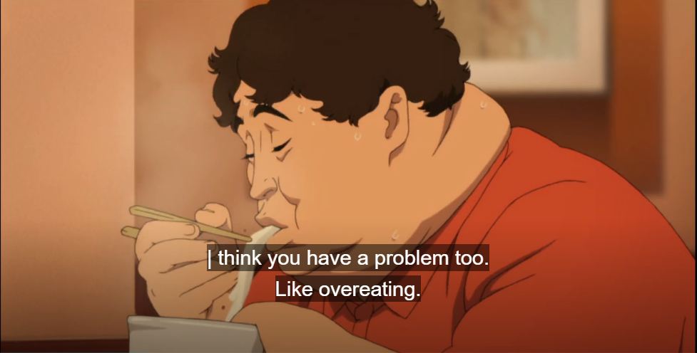
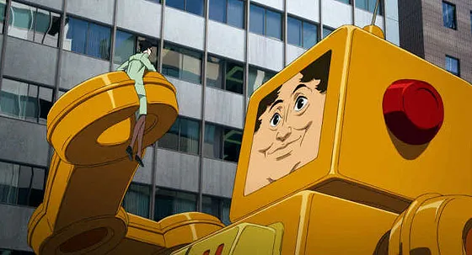
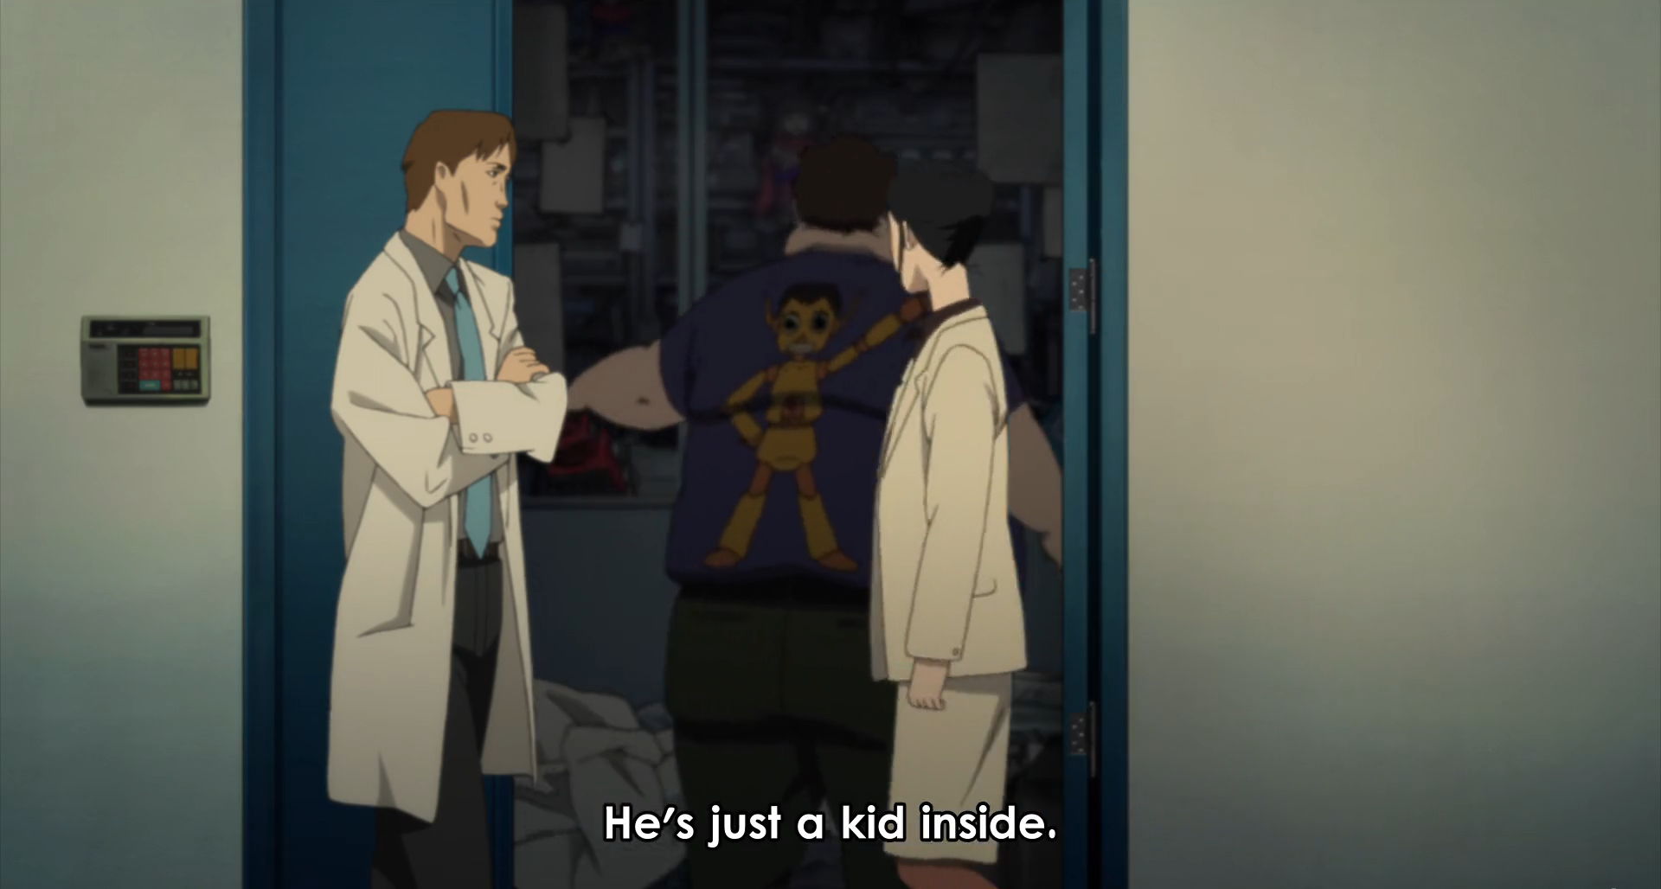
In the Movie…
Revealing addiction & immaturity:
Dr. Tokita displays addictive tendencies and overeating habits
Tokita ends up getting trapped in the dream world
[0] 19:48, [0] 1:16:17
[0] 28:44
Notes:
Iris - 1 minute
Throughout the movie we see Dr. Tokita portrayed as childish and prone to addiction. We see Dr. Chiba comment on Dr. Tokita’s excessive eating habits, and we also see Dr. Tokita’s obsession with the DC Mini, pursuing development of the device without concern for safeguards such as the access codes mentioned earlier, this obsession even goes as far as building more DC Minis after being advised not to by Dr. Chiba.
Subsequently, during the finale of the movie, Dr. Tokita’s naivety gets him trapped in the dream world as an avatar of a giant toy robot who eats people

Slide 16

3.1 Technology as a Therapy
“Don't you think dreams and the internet are similar? They're both areas where the repressed conscious mind vents.” - Paprika [0] 25:41
The dream world acts as a “mirror”
Konikawa:
Movie Maker vs. Detective
Paprika:
Doctor vs. Creative
[0] 44:20
Notes:
Iris - 1 minute
In contrast to Dr. Tokita, Dr. Chiba is not shown to struggle with many personal issues, she is generally portrayed as the most mentally healthy and competent character in the movie. And, despite the differences in personality between Dr. Chiba and Paprika–Dr. Chiba being professional and serious while Paprika is carefree and cheerful–Paprika appears equally as healthy, congruent with her real world counterpart.
Comparing this again to Dr. Tokita: where Tokita gets trapped in the dream, Dr. Chiba and Paprika are the ones who end up saving the world.
It’s also worth mentioning Konikawa, the detective. It is established at the beginning of the movie that Konikawa has some form of trauma and is receiving psychotherapy, he also speaks about how he’s had a dream of being a movie director. He also appears in the dream world as either a detective or a movie director.
There will be more about Konikawa in a later slide.

Slide 17
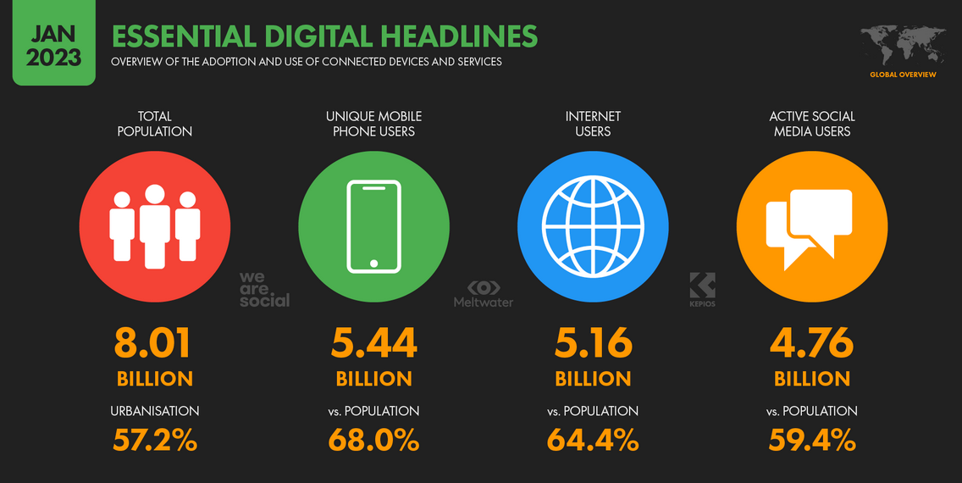
3.2 Prevalence of smartphones
Technology provides a new digital world
[11]
Notes:
Iris - 1 minute
We can see this idea of alternate personas in today’s world too.
The prevalence of smartphones in our world means that, similar to the dream world in Paprika, most people today have an alter ego.
According to an analysis done by DataReportal in January of 2023: out of the 8.01 billion people on earth, 68% of them own a mobile phone, 64.4% can access the internet, and 59.4% actively use social media and thus have a digital identity.

Slide 18
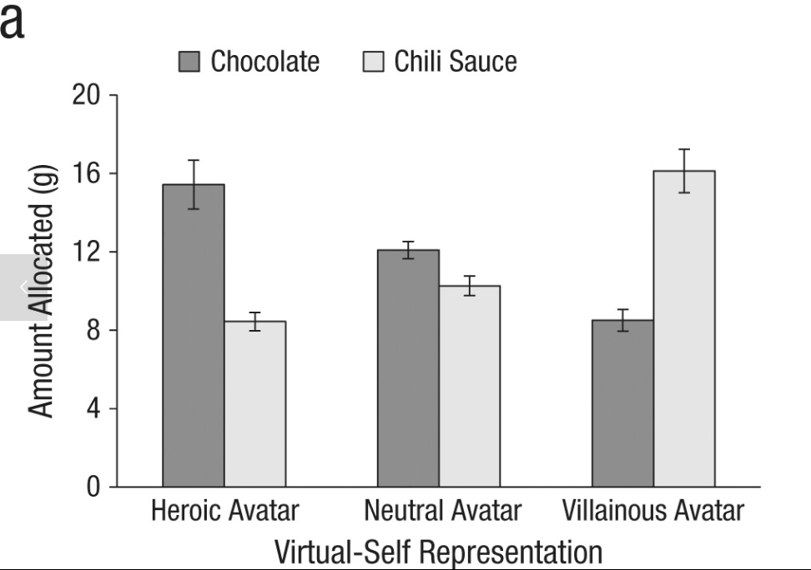
In Reality…
The “idealized virtual identity” hypothesis [12]
MySpace survey found we present idealized versions of ourselves online [12]
Validation through publicity
Strong correlation between avatar and in game behavior [13][14].
We model our behavior after our avatar [15][16]
[15]
Notes:
Myles - 1 minute
In real life, we can see that the idea of using a virtual persona as an outlet for expression is similar.
One example of this is the idealised virtual identity hypothesis, which was first presented after a study surveying MySpace users found that they tend to present ideal versions of themselves online.
The survey also found that the internet provided a place to “try on” new persona’s or experiment with identity in a non committal way, and that posting these images in a public forum can help to validate and legitimize these identities.
Additionally, the way in which avatars are presented in game has been shown to have a strong effect on player behavior (avatar appearance, first person vs. third person)
Even more surprising is the fact that studies have found that we tend to mirror our behavior in real life after these personas that we create online. One survey, for example, found that people with taller avatars in VR were more aggressive negotiators. The figure on the right shows a survey in which participants played as an avatar and then gave a participant a sauce to taste test. As the graph demonstrates, those who played as more villainous avatars were more likely to do the “evil” action and give the participant the chili sauce.

Slide 19

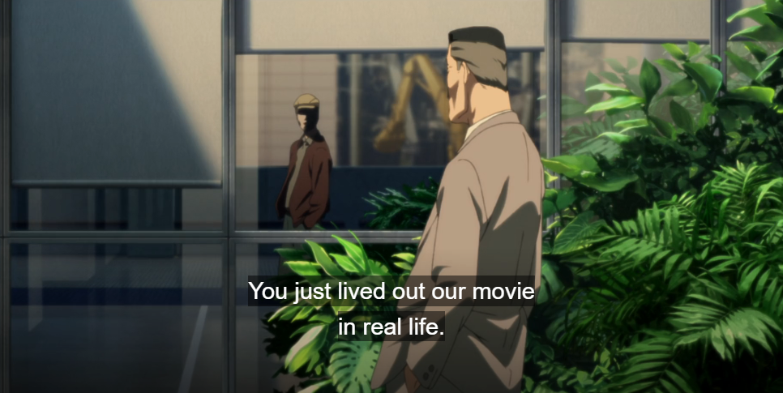
3.3 What Constitutes Healthy Behavior?
The DC Mini is neither good nor evil - it is a reflection of the subconscious
Excessive/unrealistic idealization
Low self esteem → Game addiction
Game addiction → Unhealthy idealization [17]
[0] 1:20:04 [0] 1:24:28
Notes:
Myles - 1 minute
So what constitutes healthy behavior?
What's important to realize is that the DC mini, and technology in general are just tools, and that these tools can provide useful insight into our subconscious.
The determining factor in healthy vs unhealthy behavior is what you choose to do with these insights.
Some people, like Chairman develop an unhealthy infatuation with their ideal self, and attempt to live their entire life vicariously through these simulations (hikikomori).
On the other hand Detective Konokawa was able to overcome the trauma of losing his childhood friend and his failed dream of becoming a movie maker through these insights.
It’s crucial to examine what place is the idealization coming from? Low self esteem has been linked to game addiction, and through this game addiction results unhealthy idealization.

Slide 20
Societal Conclusions
Government should regulate private industry for the good of society
There should be accountability in digital worlds
Technology usage can provide deep insights into the user’s subconscious
Notes:
Myles - 10 seconds
We hope you enjoyed our presentation, and we’d like to leave you all with these 3 conclusions:
Technological advancement demands greater government regulation
Digital worlds create gaps in accountability with should be accounted for
Technology usage is closely linked to the subconscious of the user

Slide 21
References
[0] Kon, S. (Director). (2006). Paprika [Film]. Madhouse.
[1] Janna Anderson and Lee Rainie, As AI Spreads, Experts Predict the Best and Worst Changes in Digital Life by 2035, Pew Research Center, June 21, 2023, https://www.pewresearch.org/internet/2023/06/21/as-ai-spreads-experts-predict-the-best-and-worst-changes-in-digital-life-by-2035/ (Accessed 9/24/23)
[2] Simon Hudson and Yoan Mantha, Global AI Talent Report, 2020, https://jfgagne.com/global-ai-talent-report-2020/ (Accessed 9/24/23)
[3] stopbullying.gov, Cyberbullying and Online Gaming, (U.S. Department of Health and Human Services, September 14, 2021), https://www.stopbullying.gov/cyberbullying/cyberbullying-online-gaming (10/3/2023)
[4] U.S. Department of Health and Human Services, 17 Scary Cyberbullying Statistics (2023), (Exploding Topics, December 5, 2022), https://explodingtopics.com/blog/cyberbullying-stats (10/3/2023)
[5] Citron DK (2014) Hate Crimes in Cyberspace. Cambridge, MA: Harvard University Press.
[6] Bender, E. M, Pause Giant AI Experiments: An Open Letter, (Future of Life Institute, March 22, 2023), https://futureoflife.org/open-letter/pause-giant-ai-experiments/ (10/3/2023)
[7] Roger Boisjoly, The Explosion of the Challenger, (Rector and Visitors of the University of Virginia, ~1990), https://onlineethics.org/cases/explosion-challenger (10/3/2023)
[8] Alyssa Newcomb, Samsung Finally Explains the Galaxy Note 7 Exploding Battery Mess, (NBCNews, Jan. 22, 2017), https://www.nbcnews.com/tech/tech-news/samsung-finally-explains-galaxy-note-7-exploding-battery-mess-n710581 (10/3/2023)
[9] Valentina Covolo, The EU Response to Criminal Misuse of Cryptocurrencies: The Young, already Outdated 5th Anti-Money Laundering Directive, (Brill, 29 Sep 2020), https://brill.com/view/journals/eccl/28/3/article-p217_217.xml (10/3/2023)
[10] John M. Freeman, Beware: The misuse of technology and the law of unintended consequences, (Springer Nature, July 2007), https://link.springer.com/article/10.1016/j.nurt.2007.04.003 (10/3/2023)
[11] Simon Kemp, DIGITAL 2023: GLOBAL OVERVIEW REPORT, (Kepios, January 26, 2023), https://datareportal.com/reports/digital-2023-global-overview-report (10/4/2023)
[12] A.M. Mangao et al., Self-presentation and gender on MySpace, (Journal of Applied Developmental Psychology, 2008), https://www.sciencedirect.com/science/article/pii/S0193397308000749?via%3Dihub (10/4/2023)
Notes:
N/A

Slide 22
References (Cont.)
[13] Boram Yoon et al.,The Effect of Avatar Appearance on Social Presence in an Augmented Reality Remote Collaboration, (IEEE, March 2019) https://ieeexplore.ieee.org/document/8797719 (10/4/2023)
[14] Ellen Schuurink et al., Effects of Third Person Perspective on Affective Appraisal and Engagement: Findings From SECOND LIFE, (SageJournals, April 2010) https://journals.sagepub.com/doi/10.1177/1046878110365515 (10/4/2023)
[15] Gunwoo Yoon et al., Know Thy Avatar: The Unintended Effect of Virtual-Self Representation on Behavior, (SageJournals, February 2014) https://journals.sagepub.com/doi/10.1177/0956797613519271 (10/4/2023)
[16] Nick Yee et al., The Proteus Effect: The Effect of Transformed Self-Representation on Behavior, (Human Communication Research, July 2007) https://academic.oup.com/hcr/article-abstract/33/3/271/4210718 (10/4/2023)
[17] Tagrid Lemenager et al., “Who Am I” and “How Should I Be”: a Systematic Review on Self-Concept and Avatar Identification in Gaming Disorder, (Springer, 2020) https://link.springer.com/article/10.1007/s40429-020-00307-x#article-info (10/4/2023)
[18] Investigational Device Exemption (IDE). October 03, 2022. U.S. Food and Drug Administration. https://www.fda.gov/medical-devices/premarket-submissions-selecting-and-preparing-correct-submission/investigational-device-exemption-ide
[19] Rachel Levy and Marisa Taylor. March 2, 2023. U.S. regulators rejected Elon Musk’s bid to test brain chips in humans, citing safety risks. Reuters. https://www.reuters.com/investigates/special-report/neuralink-musk-fda/
Notes:
N/A

