Slide 1
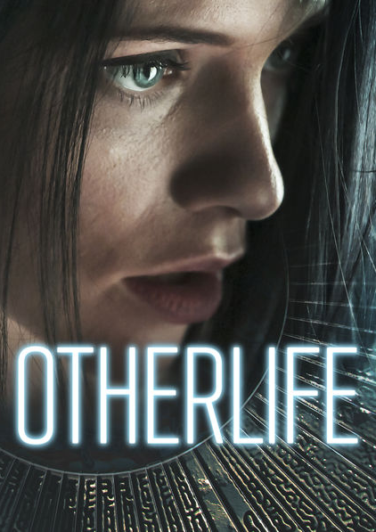

OtherLife
By jair meza, Nicole burgess, joseph rozman
Notes:
Hello everyone, our names are Nicole Burgess, Jair Meza, and Joseph Rozman. Today we will be talking about the film OtherLife.

Slide 2
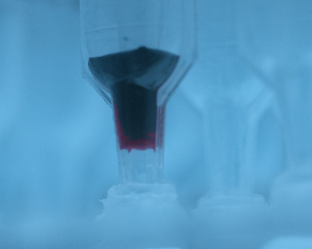
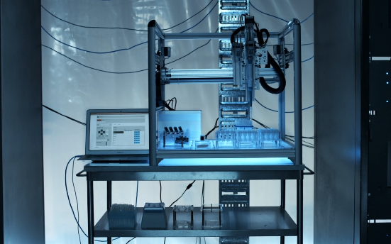
OtherLife Technology
Notes:
OtherLife follows the struggles of lead programmer Ren Amari, as she and her business partner Sam are 5 days from launching their bio-software product, OtherLife. The product uploads experiences to the brain, allowing someone to have experiences that last a few minutes, but in reality, only last a few seconds. Ren is the creator of the technology, and she struggles with Sam as he wants to use it for a solitary confinement government program that could bring in a lot of capital for the company. However, she only wants to use it to save her brother who is stuck in a coma after a scuba accident.
The actual technology is considered “bio-software” and according to Ren, uses nanite technology to upload code to the brain, altering memory which is just a chemical. Here is a picture of the bio-software being produced, and the left is the software, in the form of an eye drop

Slide 3


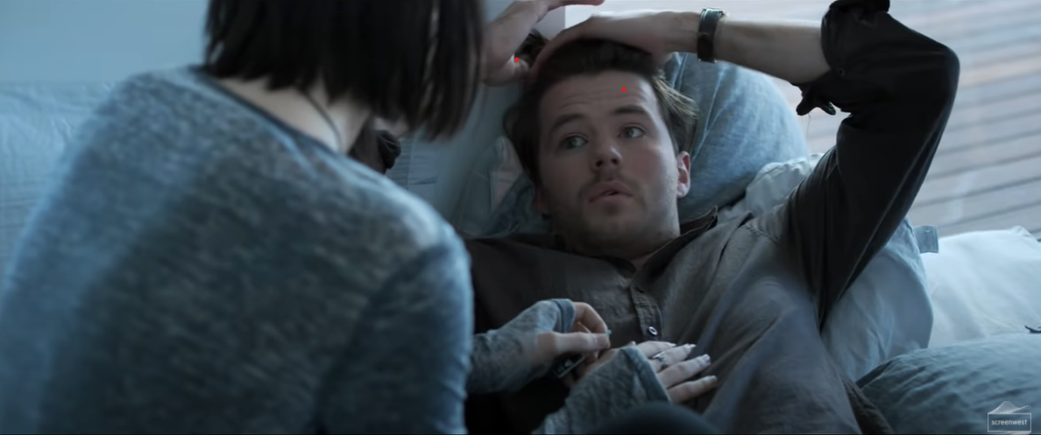
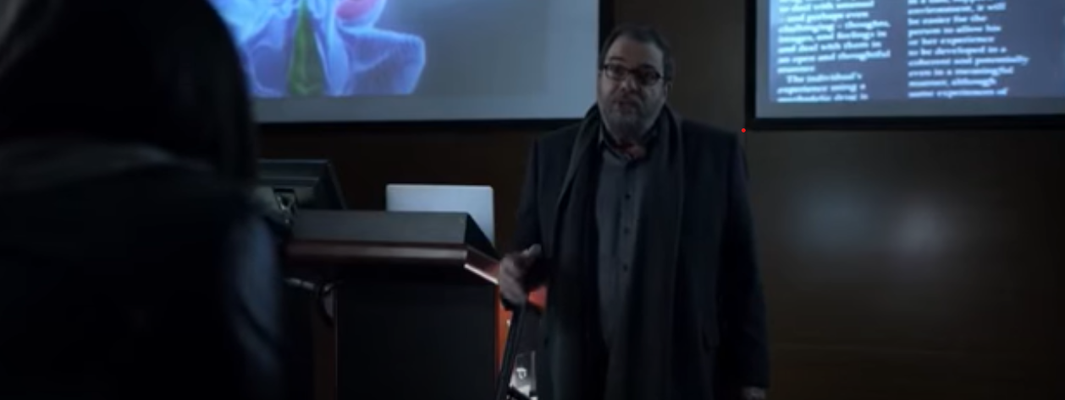
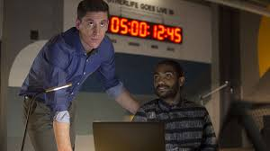
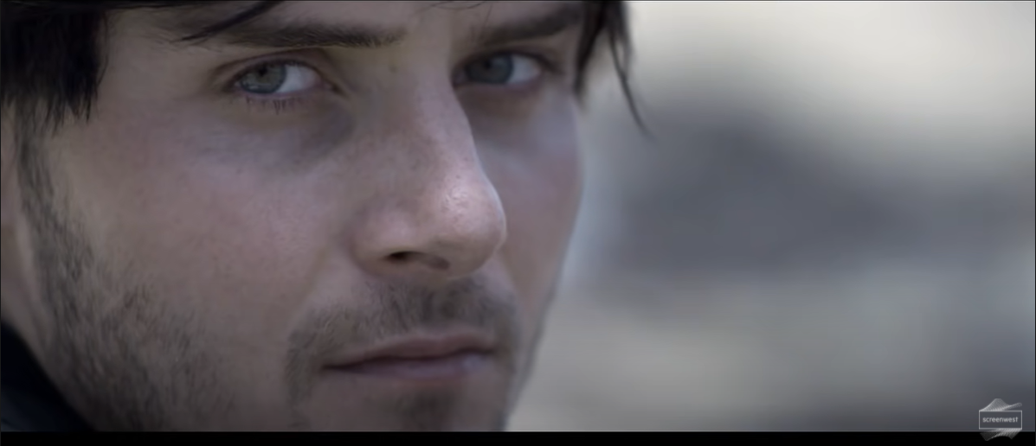
C
H
A
R
A
C
T
E
R
S
- Ren: A programming prodigy, took her father's work to create OtherLife bio-software
- Sam: The other co-founder of OtherLife, wants to use OtherLife for purposes Ren disagrees with
- Danny: Ren’s Boyfriend, also works at her OtherLife
- Ren’s Father: Leaded the research and discovery for OtherLife’s technology
- Byron: OtherLife worker, tests the product with Ren
- Jared: Ren’s brother who got put into a coma from a scuba diving accident
Notes:
Here are the main characters of the movie.
On the left you can see Ren, who is the lead programmer and creator of the technology. She used her father’s research as a basis for this technology, as he did not want to develop it due to the risks involved.
On the right you can see Sam, OtherLife’s other co-founder, handles the business side of things at the company, which includes talking with the head of the department of corrections (a potential lifeline for the company) which gives him a contract for a solitary confinement program using their technology.
Back to the left you can see Danny, who is Ren’s boyfriend who also works at OtherLife. We’ll explain why he’s more important later.
Back to the right you can see Ren’s Father, Dr. Amari leads to the discovery of what makes this technology possible and he leads the research field on this subject. Most of the research comes from him, including research about the negatives.
Back to the left you can see Byron, who is also a programmer and helps Ren test the product. He takes orders from anyone and is somewhat neutral, as he, “just works here, obviously”.
Lastly you can see Jared, Ren’s brother who is in a coma because of the scuba accident at the start of the movie.

Slide 4

Plot
- Ren uses her bio-software to relive the accident
- Creating experience for her brother
- Testing bio-software
- Sam and Ren disagree
Act I
- Introduction of characters, and the bio-software
Act II
- Danny dies, Ren gets cornered by Sam
Act III
- Ren goes under human trial, interactivity found to be possible
Notes:
Now onto a bit of the plot.
In the beginning, we see Ren and her Brother scuba diving, where he nearly drowns. Interestingly enough, the scene fades from that scene to an odd transition, that we later connect to the use of the bio-software. Ren was most likely using her product to re-experience that event. We see her continue her work on the product which is launching in 5 days, but she is also working on her experience that she is custom tailoring for her brother, which she hopes will allow him to break free of his coma. We find Sam talking with the department of corrections, which Ren disagrees with. She also pulls many files from the code which unlinks projects and upsets Sam, and Ren and Danny meet up. You can see a picture of Ren looking at Jared in the picture on the left.

Slide 5
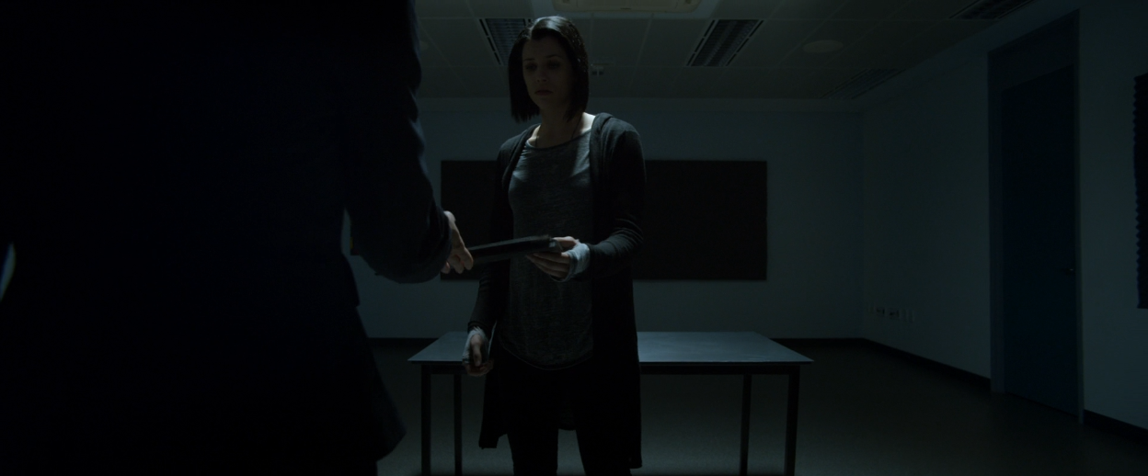
Plot
- Danny takes an untested sample and dies from a seizure
- Sam persuades to drop charges for Ren
- Ren undergoes solitary confinement trial for 365 days
- She breaks out of her cell, but later realizes the cell was a real building
- Ren the goes on to find out what happened to her company and makes amends with her father
- She then wakes up, realizing that it was a glitch and the entire experience was OtherLife
Act I
- Introduction of characters, and the bio-software
Act II
- Danny dies, Ren gets cornered by Sam
Act III
- Ren goes under human trial, interactivity found to be possible
Notes:
Ren then shows Danny the OtherLife experience, and he becomes so interested, he takes a sample of Ren’s partially tested program, which has a glitch and he dies from a seizure. Since she was somewhat responsible for his death, she meets with lawyers to discuss the trial. At the meeting, Sam brings in the Head of the Department of Corrections, which gives Ren the opportunity to test a solitary confinement experience that Sam has been secretly developing, while also dropping charges. With no other options, she reluctantly agrees to a 365 day simulation, which can be seen in the picture on the left. As the experience reaches the last day, there is a glitch that makes it roll over to the next year. Ren is furious, but somehow manages to find a hole in the box.

Slide 6
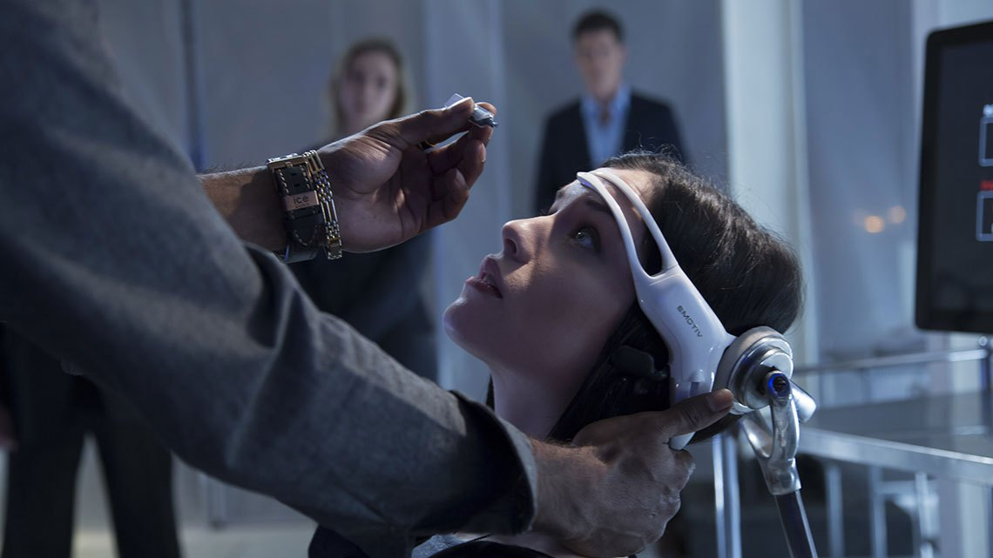
Plot
- Sam, Byron and Ren find that interactivity is possible within the experiences
- Sam forces Ren into another cycle hoping to find data that correlates with the interactivity
- Ren escapes the experience again and tackles Sam, putting him into his own 365-day cycle
- Sam recovers, but Ren leaves the company
- Ren and her father decide to terminate Jared’s life support
Act I
- Introduction of characters, and the bio-software
Act II
- Danny dies, Ren gets cornered by Sam
Act III
- Ren goes under human trial, interactivity found to be possible
Notes:
She later realises that there was no simulation or experience, it was actually a real life box she was trapped in. She manages to escape the prison, and gets chased by Sam. She finds Danny is actually alive, and along with another co-worker’s help, they steal Ren’s files back from the company and she gives the new version of the bio-software to Jared, who manages to wake up, but to Ren’s surprise, attempts to suffocate himself as he would rather choose death than suffer. Ren recognizes this decision and she pulls the plug.
She begins to hear voices, and later she awakens and realises that she was just experiencing this through the bio-software. Danny is still dead, but Sam loses his opportunity for the solitary confinement contract because of these glitches. As Ren arranges to actually terminate Jared’s life support with her father, Sam convinces her to look at a new discovery. Desperate, he forces Ren’s head back and puts in the drops in and puts the brain scanning device, in order to get more data for this revelation. She manages to speed up time by concentrating and repeating, “it’s just code”, and then tackles Sam and puts the drop into his eye forcing him into a 365 day confinement. She lets the time tick past the 365 day mark like what happened to her, finally releasing him from the experience. Sam is stunned, and Ren meets with her dad to end Jared’s life support.

Slide 7
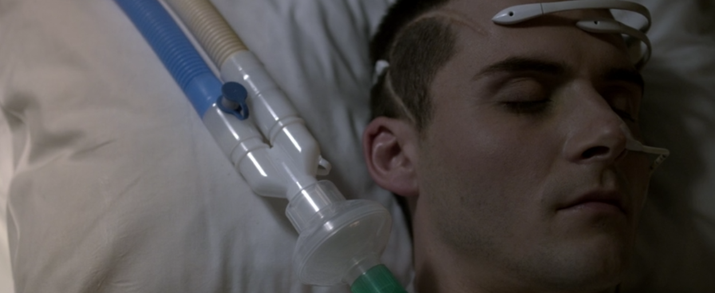
“I started OtherLife. I was going to do what he couldn’t. I was going to bring my brother back and we would be a family again”
Notes:
First off I wanted to start with the quote [QUOTE], said by Ren, which pretty much summed up the movie and the conclusions that we draw. Ren, the main character, develops this bio-software in order to bring back her brother. Although this technology does not exist in the real world, the closest thing to simulating experiences is Virtual Reality.

Slide 8
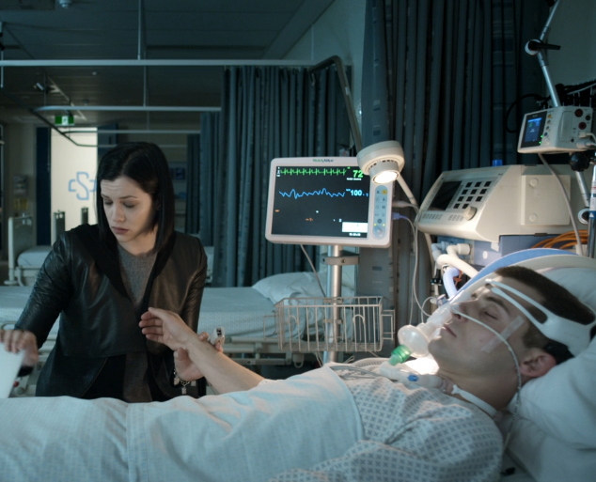
Virtual Reality
Ren attempts to bring her brother back through the experiences.
Jared’s eye twitches, “tricks me too sometimes”
Alzheimer’s. ALS, dementia?
Burn victims treated with VR to help reduce pain during surgery. Reduces activity related to pain in the brain [1]
Fear of public speaking can be improved [1]
Notes:
Throughout the movie, Ren is testing and developing her own ‘side project’ that she uses on her brother. She hooks up monitors and admits the drops to his eye in order for him to feel an experience which she believes is the key to unlocking his coma. She even notices his eye twitch, but later the incident is dismissed by her father and the nurse that walks in. Here, Ren is using Virtual reality for therapeutic reasons which is even being used today. During her meeting with the Department of Health Services, the interviewer asks her about the potential to treat ALS, Alzheimer’s and even Dementia. In reality VR is actually being used to treat patients in many ways. One study actually used virtual reality as a distraction during procedures on burn victims. And even fear of public speaking can be improved by giving patients a virtual audience.

Slide 9
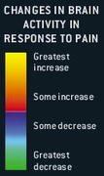
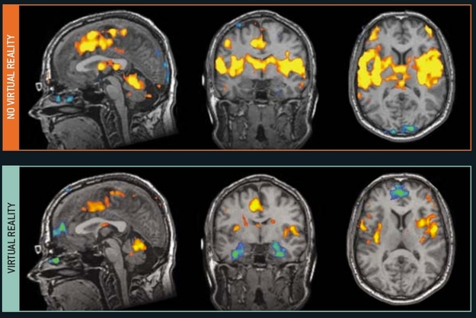
“fear-provoking stimuli similar that mimic their real world experiences.” [1]
MRI imaging shows decrease in brain activity
Immersion in a 3D, VR world, more effective than 2D video games [1]
Notes:
On the right, we can see an MRI of a patient's brain during surgery with and without VR. As you can see, the amount of activity is reduced when the patient uses VR. This reduction is also included in areas of the brain that deal with pain, resulting in less pain ‘felt’ by the patient. These MRI scans allowed the researchers to conclude that pain related brain activity is actually being reduced, and that VR was not just distracting the patients. It was quite literally reducing their pain. The same study also found that using 2D video games was much less effective than using 3D Immersive games.

Slide 10
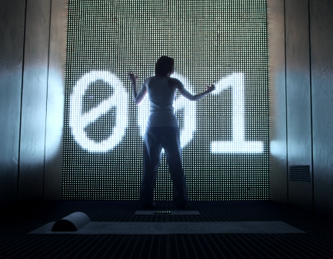
Virtual Reality
“technology is constructing increasingly lonely worlds for humans to inhabit”[4]. based on Kelley Eskridge’s Solitaire
“the central idea of virtual confinement, and Ren’s emotional journey are what I thought was important to carry over into the film” [5] - Kelley Eskridge
Notes:
Despite the movie portraying the positives of Virtual Reality, the main theme the author and screenwriters wanted to convey was the negatives of Virtual Reality. The movie itself is based off of Kelley Eskridge’s Solitaire, which is about virtual solitary confinement. We see Ren struggling with allowing OtherLife to become a virtual confinement product, but her business partner Sam wants to take a government contract that will give the company much needed capital, in return for a solitary confinement program. In an interview, Eskridge says “that technology is constructing increasingly lonely worlds for humans to inhabit.” and that, “the central idea of virtual confinement, and Ren’s emotional journey are what I thought was important to carry over into the film”.

Slide 11
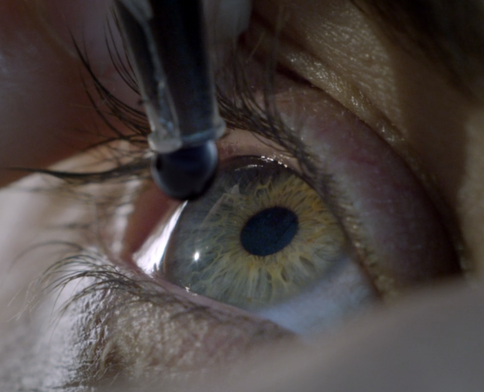
“we are here to broaden minds, not confine them”
- Ren amari
Notes:
Here’s another quote from Ren, she says “we are here to broaden minds, not confine them” while arguing with Sam in the meeting room after he talks to the head of the department of corrections. She only wants to use Virtual Reality to help her brother, but society views its uses differently.

Slide 12
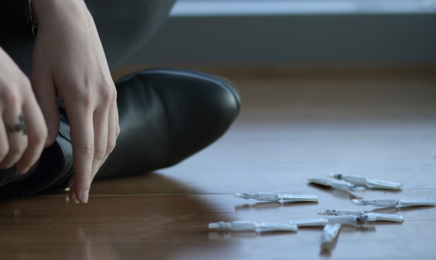
Negatives of VR
“Prolonged exposures could lead to a range of physical symptoms from arrhythmia to seizures, even brain death” – Dr. Amari
“Trapped by the fantasy, and disassociate from reality all together” – Drug Administration Interviewer
Cybersickness
Virtual confinement
Addiction [3]
Notes:
Even her father, Dr. Amari does not believe in the technology. He has many technical reasons for why he did not want to continue research, as one of his studies states that, “Prolonged exposure could lead to a range of physical symptoms from arrhythmia, to seizures, even brain death”. Even the drug administration that is interviewing Ren is concerned about these side effects. The interviewer points out that the users are, “trapped by the fantasy and dissociate from reality altogether”. Although some of the more serious side effects are based on the fictional bio-software, this concern brought up by the administration is actually a real thing.

Slide 13
Negatives of VR
Addiction to VR
Neglect the real world
Incidents where players develop serious medical issues, or even death by not caring for themselves
Forget about children
“Engrossing”
DSM-5, (300.6)
Depersonalization detachment or unreality of one’s own thoughts and feelings
Derealization
detachment or feeling of unreality of the environment
Notes:
The Diagnostic and Statistical Manual of Mental Disorders defines the terms, Depersonalization as a detachment from one’s self, such as detaching from their emotions and thoughts, and Derealization is a detachment from one’s environment. Researchers are becoming increasingly worried about these disorders being a result of Virtual Reality because they are already becoming prevalent in the gaming industry as a whole. Some parents have forgotten to take care of their children because of video games, such as a couple living in California that were so “engrossed” in the game WoW, that they were imprisoned. There have been other reports about people collapsing and even dying because they were so immersed in their games. Michael Cranford, a researcher on the ethics of virtual reality, states, “The greater our degree of participation, the more engrossed we become in the virtual world”, and ironically Ren did not want to allow Sam to develop interaction in their product because of this reason.
The source that I read used the term “engrossed”, which I thought was very appropriate to this addiction to immersion.

Slide 14
Nanotechnology
Deals with materials and interactions at a low level.
Nanotechnology is on the borders between physics, chemistry, biology, and engineering sciences.
The example of technology we are going to be focusing on is neural implants [9]
What is it?
Notes:
Next, I wanted to relate Nanotechnology with OtherLife. To start off, what is nanotechnology? Nanotechnology is technology that deals with materials and interactions on a molecular, or even atomic level. Because of this, nanotechnology is on the borders between physics, chemistry, biology, and engineering sciences. Today, we will be focusing on a specific nanotechnology, neural implants

Slide 15
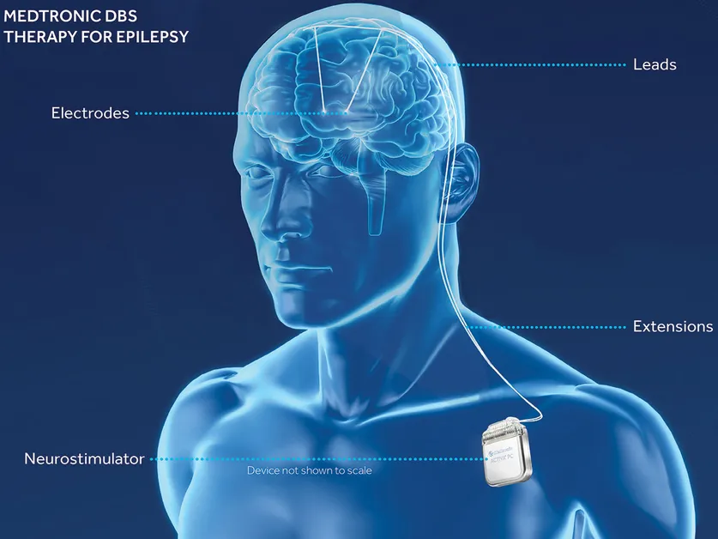
Neural Implants
A neural implant is a device that contacts tissues that contain neurons
Neural implants can affect any part of the nervous system
Common use is for deep brain stimulation to reduce symptoms of brain disorders and physical ailments
Neural Implants are invasive [8]
Notes:
Now you may be asking, what is a neural implant? A neural implant is a device that comes into contact with tissues that contain neurons (cells that use electrical impulses and chemical signals to transfer messages) and the implants can record neural activity and override signals by sending pulses of electricity. Neural implants can affect any part of the nervous system, including movement, sight, hearing, and feeling. Common use is for deep brain stimulation (DBS) which is where electrodes are surgically placed into the brain where they electrically stimulate specific structures. DBS has been used to reduce symptoms of brain disorders, including Parkinson’s disease, dystonia, tinnitus, epilepsy, obsessive compulsive disorder (OCD), and neuropathic pain. An example of a DBS device can be seen in the picture at the bottom, which shows a neurostimulator connected to extensions and leads that go to the brain, where the electrodes electrically stimulate the brain. The only thing limiting neural implants is the invasiveness of the procedure.

Slide 16
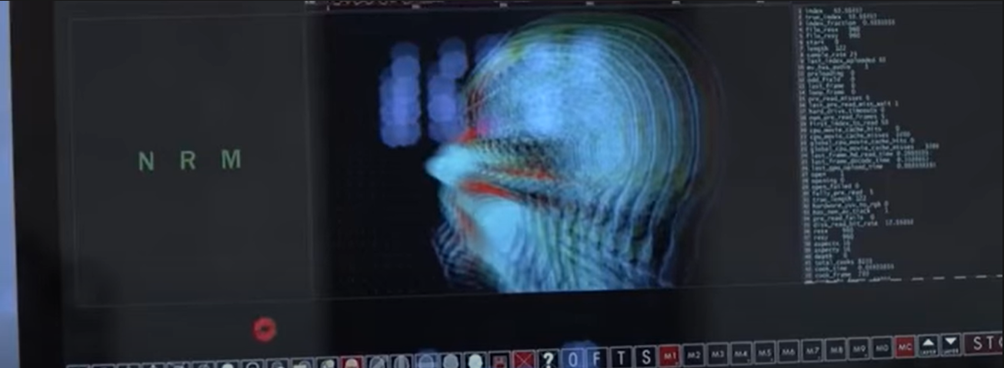
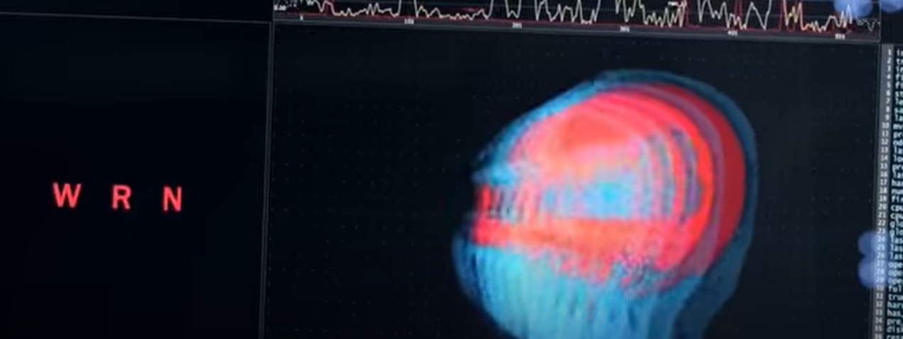
Relation Between OtherLife and Nanotechnology
Ren continuously says that it is "Just Code"
OtherLife also monitors brain activity
Notes:
Now, to relate this back to OtherLife, we can first look at the technology itself. OtherLife’s technology is based on nanotechnology itself, as the liquid contains natites. Also throughout the film Ren continuously states how any glitch in OtherLife is “just code”, relating back to nanotechnology as the code would be an engineering science. Lastly, OtherLife also interacts and stimulates the brain, similarly to neural implants. The pictures on the right show the monitoring of Ren’s brain before and after a glitch.

Slide 17
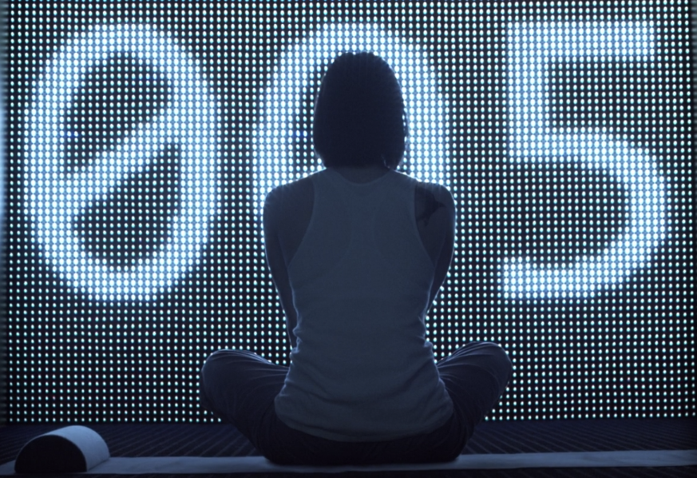
Human Testing
They must use human testing in order to test the OtherLife code.
Using human testing to see if a person can control a robotic arm just by thinking about it.
Paralyzed participant is able to feel the objects being held by the robotic arm. [6]
Human testing of the confinement program of OtherLife
Notes:
Next I wanted to talk about the use of human testing in OtherLife. Human testing is necessary in order to test the OtherLife technology. All of the software is fully visual so there is no way to truly know if it is working unless you actively go into the simulation and see it for yourself. In the movie she went into the snowboarding experience and when there were bugs in it, it felt so real that she had to convince herself that it was just the code and she was going to be okay. Sometimes human testing can be controversial and it doesn’t happen very often in reality. One use of human testing is in robotic arms. One participant, an 18 year old who was paralyzed in a car accident, volunteered to be a participant in the study to see if someone could control a robotic arm just by thinking about it. The participant had to go through a surgery in which they put electrodes onto his motor cortex and somatosensory cortex which allowed them to read the electrical patterns in his brain. They found the patterns which were created when he had the intention of moving his fingers and wrist and these patterns were used to control the robotic arm. The participant was able to feel the objects he tried to pick up through the robotic arm. The only way for this robotic arm to be tested was through human testing because a lot of the code may have worked in theory but they wouldn’t have known if it actually worked without testing it on a live person. In OtherLife one of the controversial uses of the human testing was when they needed to test the confinement program. They gave Ren the option to serve time in prison or test the confinement for 365 days. It was unethical to put someone in confinement for a whole year when they had done nothing wrong so when Ren accidentally killed her boyfriend with the OtherLife software, this gave them a good opportunity to test the program. However once Sam and Byron figured out that Ren was able to break out of the jail cell, they needed more data to figure out how to replicate the code so they put her back in against her will for another full year. Human testing can be really useful when testing technology but before you test things on humans you have to think about the ethical consequences that may come from the testing

Slide 18
Conclusions
  Virtual Reality can be used to help treat patients.
  Virtual Reality is creating increasingly lonely worlds.
  Nanotechnology can be used to treat many illnesses better than ever before.
  Neural Implants are limited because of their invasiveness.
  Human testing can be useful, but you must be prepared to deal with the ethical consequences

Slide 19
References
OtherLife. 2017. [film] Directed by B. Lucas. Australia.
[1] HOFFMAN, H. G. (2004). VIRTUAL-REALITY THERAPY. Scientific American, 291(2), 58–65. http://www.jstor.org/stable/26060647
[2] Max M. North, Sarah M. North, Chapter 6 - Virtual Reality Therapy, Computer-Assisted and Web-Based Innovations in Psychology, Special Education, and Health, Academic Press, 2016, Pages 141-156, ISBN 9780128020753,
https://doi.org/10.1016/B978-0-12-802075-3.00006-1.
[3] Spiegel, J.S. The Ethics of Virtual Reality Technology: Social Hazards and Public Policy Recommendations. Sci Eng Ethics 24, 1537–1550 (2018). https://doi.org/10.1007/s11948-017-9979-y
[4]Buckmaster, L. Otherlife review – virtual reality goes bad in ambitious Australian sci-fi thriller. https://www.theguardian.com/film/2017/jun/19/otherlife-review-ambitious-australian-sci-fi (accessed Oct 8, 2021).
[5] Holmes, T. Interview with otherlife screenplay author Kelley Eskridge. https://taylorholmes.com/2017/12/07/interview-with-otherlife-screenplay-author-kelley-eskridge/ (accessed Oct 8, 2021).
[6] Levy, Max G. “This Brain-Controlled Robotic Arm Can Twist, Grasp-and Feel.” Wired, Conde Nast, 20 May 2021, https://www.wired.com/story/this-brain-controlled-robotic-arm-can-twist-grasp-and-feel/.
[7] Nikolova, M., Slavchov, R., & Nikolova, G. (2020). Nanotechnology in medicine. Drug Discovery and Evaluation: Methods in Clinical Pharmacology, 533-546.
[8] Waltz, E. (2021, June 24). How do neural implants work? IEEE Spectrum. Retrieved October 8, 2021, from https://spectrum.ieee.org/what-is-neural-implant-neuromodulation-brain-implants-electroceuticals-neuralink-definition-examples.

