Slide 1
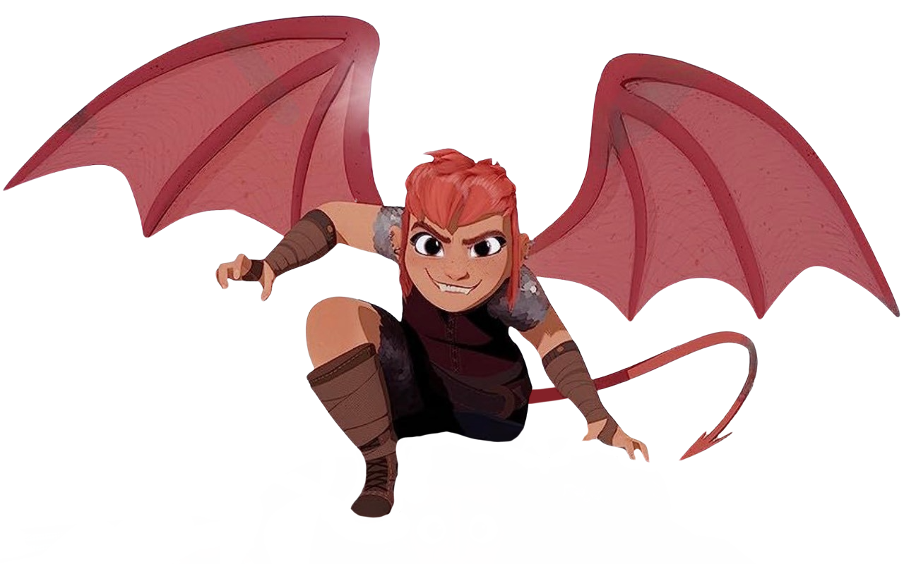
NIMONA
Matt Hagger Lana Cagle April Zingher Silas Joy​

Slide 2
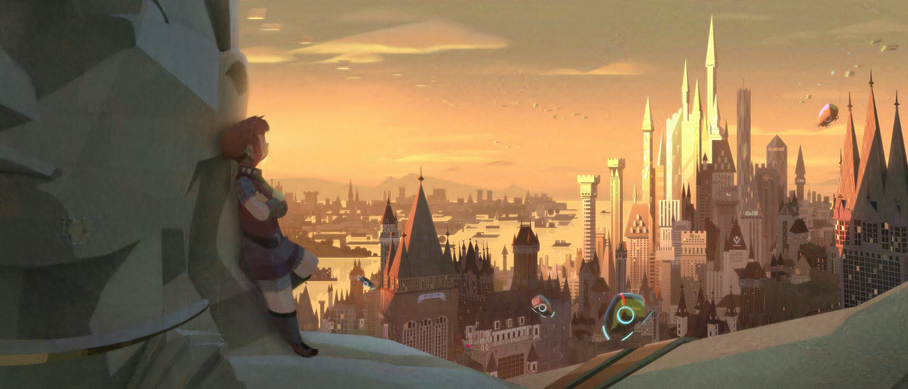
The World of Nimona
Nimona takes place in a technologically advanced, medieval society.
Notes:
The setting of Nimona is one of its most interesting creative choices. It takes place in a place only referred to as “The Kingdom.” The Kingdom is a technologically advanced, medieval society. Medieval in this case is referring to both the culture and government of the kingdom. The Kingdom is a monarchy, ruled by queen Valerin at the start of the movie. While they are incredibly advanced, the Kingdom is still defended by knights, armed with swords and fully automatic crossbows.

Slide 3
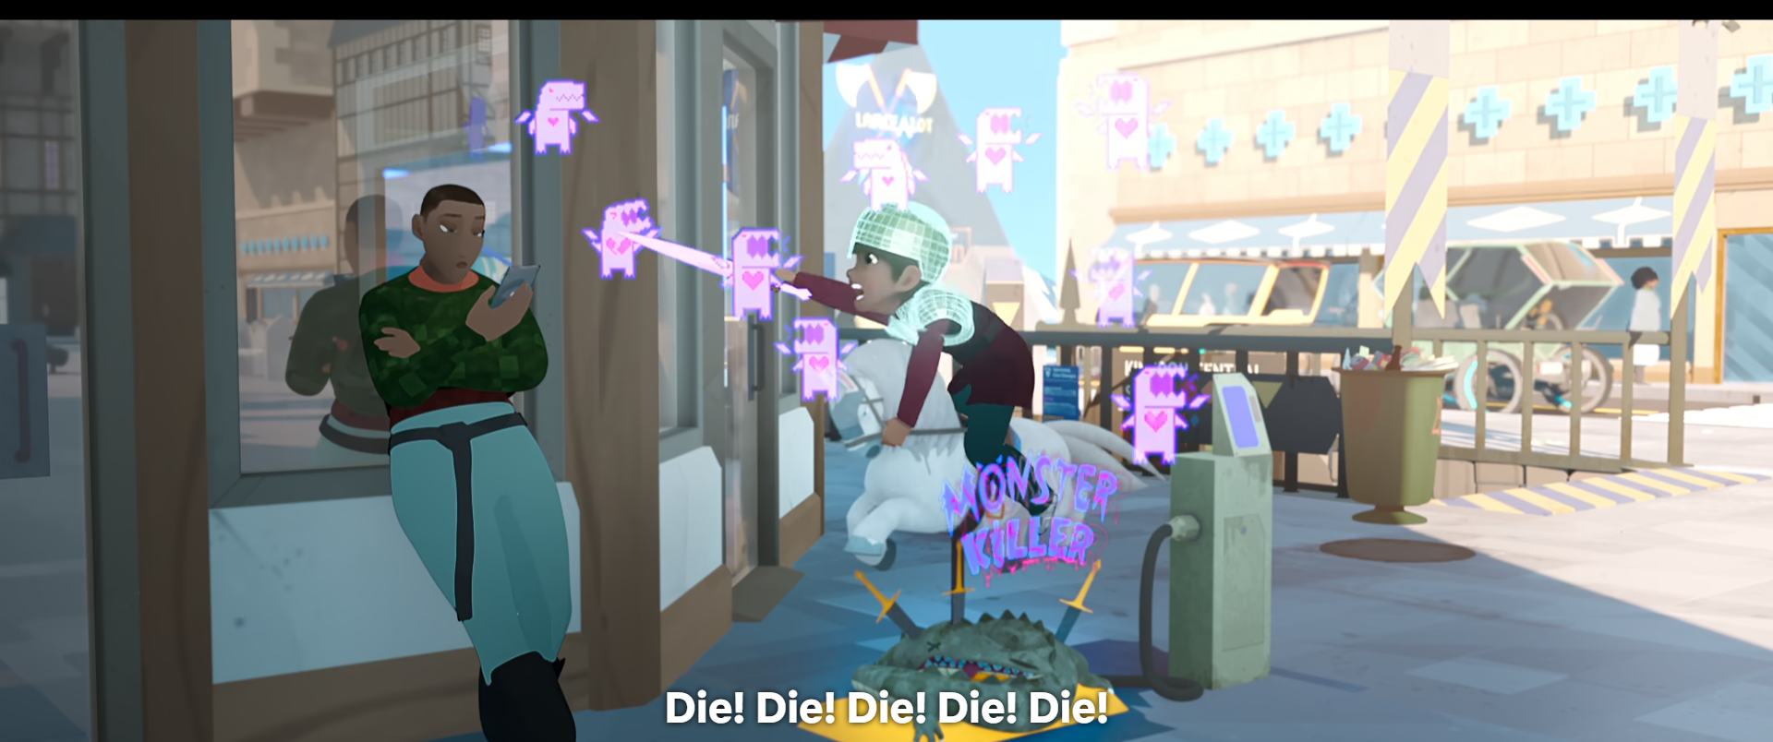
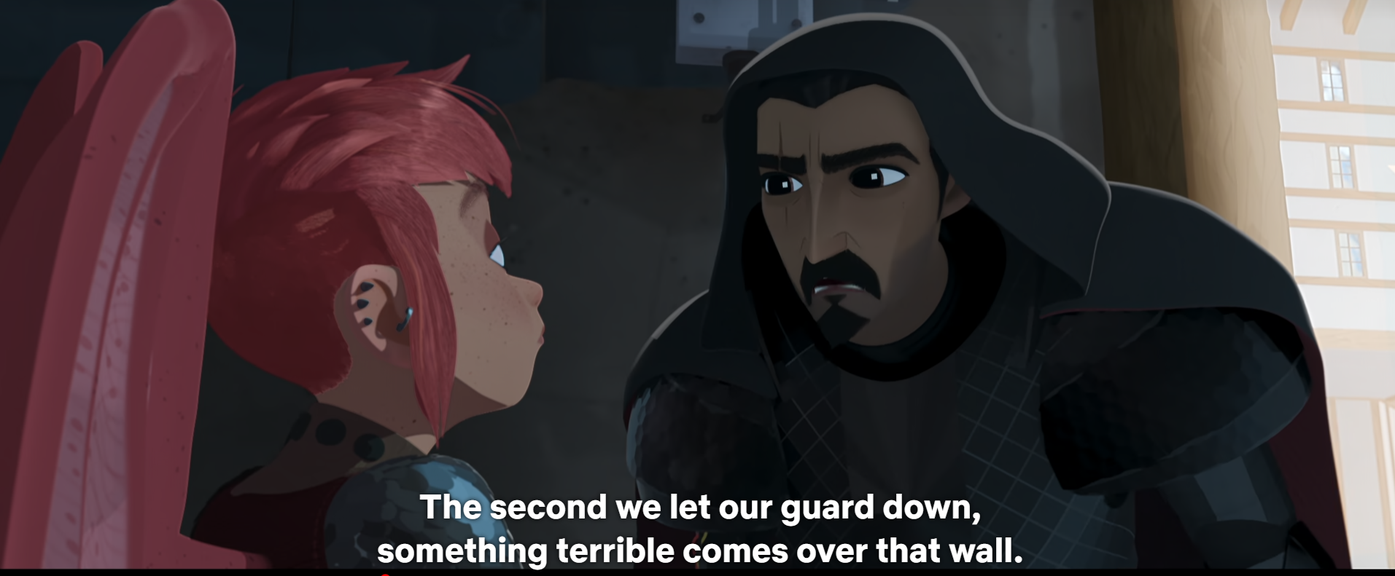
Citizens are brought up to believe the world is infested with monsters
As such, they are taught that slaying monsters is one of the highest callings.
Notes:
The inhabitants of the kingdom are taught from a young age that the word is infested with monsters. As such, the Kingdom exists as a safe haven for all of its residents, with a wall (once again just referred to as “the wall”) to keep them safe from all harm. Because safety from these monsters is so important to the people of the kingdom, the royal guard is solely composed of those of royal blood (as in, decendants of Gloreth, the original queen). This is the information required for the story explanation.

Slide 4
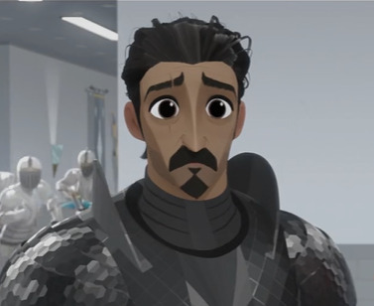
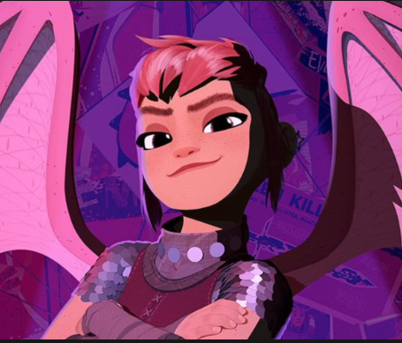
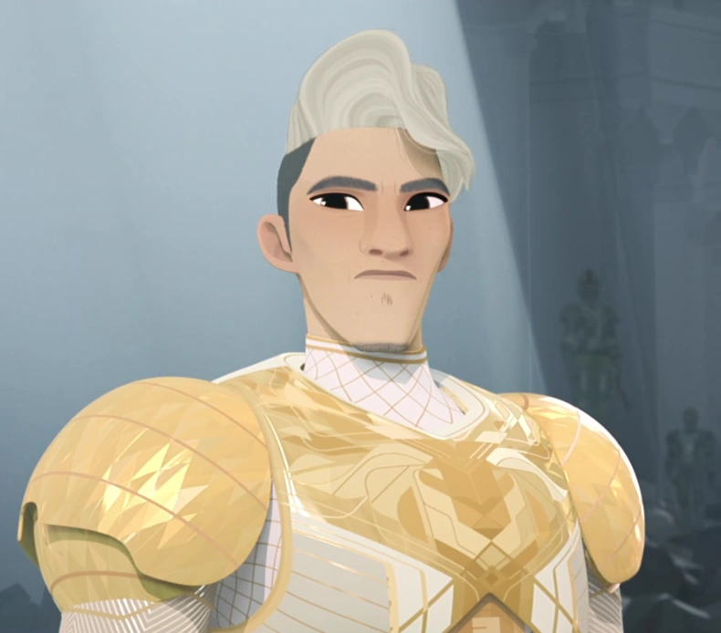
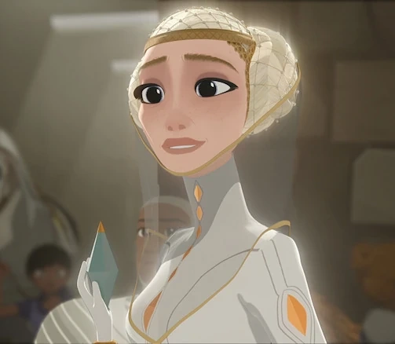
Ballister Blackheart
First non-royal to become a knight, framed for murdering the queen at his knighting ceremony.
Nimona
Shapeshifter, aids Ballister in clearing his name. Knew the original queen when they were children.
Ambrosius Goldenloin
Popular knight and Ballister’s boyfriend, helps track him down after the queen is murdered.
The
Director
The Director is the Director of the Institute, the school that trains the Kingdom’s knights.
Notes:
Ballister, once a commoner, was chosen by the queen to become a knight. Being the first person to ever be considered for knighthood that wasn’t of royal blood, he was disliked among many from the kingdom. During his knighting ceremony, the sword he was knighted with turned into a weapon that killed the queen. The movie’s plot revolves around his quest to clear his name
Nimona is a shapeshifter who usually takes the form of a young girl. Being an outcast herself, she relates to ballister. Due to the kingdom’s immense anti-monster rhetoric, she is rarely seen by the public, as when anyone finds out she is a shapeshifter, they assume her to be a monster. Despite appearing to be young, Nimona is actually as old as the kingdom itself, as she was friends with the queen who founded it. The anti-monster rhetoric that the movie repeats is centered around her, as she is the only “monster” pictured. The movie suggests she is the only monster at all.
Ambrosius Goldenloin, Ballister’s boyfriend, becomes a knight around the same time Ballister does. For most of the movie, he believes that Ballister was responsible for killing the queen, so he aids the director in trying to capture him, but Ambrosius usually stops before bringing any harm upon ballister.
The woman known as The Director is the lead on the knight training program that brought up both Ballister and Ambrosius. The Director believes in the original image for the kingdom set up by Gloreth, where only those of royal blood are allowed to become knights, as other are unqualified and would be more inclined to support monsters. She was the one who was responsible for killing the queen and framing ballister, all in an attempt to keep commoners out of the guard. She is directly opposed to Nimona, as she is the original monster that Gloreth created the kingdom to guard from, and a representation of all she is against.

Slide 5
Tech in the world of Nimona
Mass Media:
Live-Streaming 24/7 News
  Social Effects
Both traditional and social media
  Government and companies influence traditional media narrative, for better and for worse
The Internet
  The most Networked of Communications
Notes:
Introducing the world and setting of nimona and its most relevant technology

Slide 6
Privacy & Government in Nimona
Surveillance:
City-wide, Government-accessed CCTV
ID database of civilians
  Including facial recognition run on cameras
Government Control
Unchecked usage of police tools and declaring of laws
  Even at the end, monarchy remains intact
Utilizes computer networks to pursue state enemies
Notes:
In Nimona, there is CCTV used by the government across the entire city, equipped with facial recognition technology. These tools see widespread usage to cement government control.

Slide 7
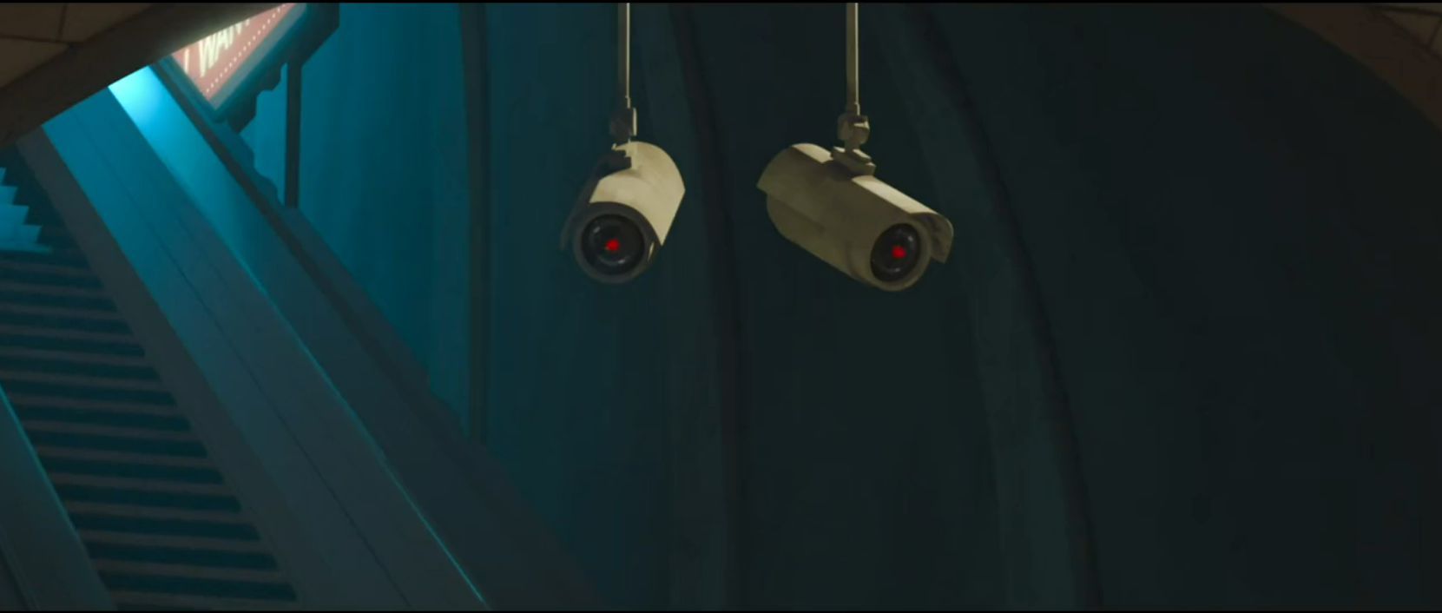
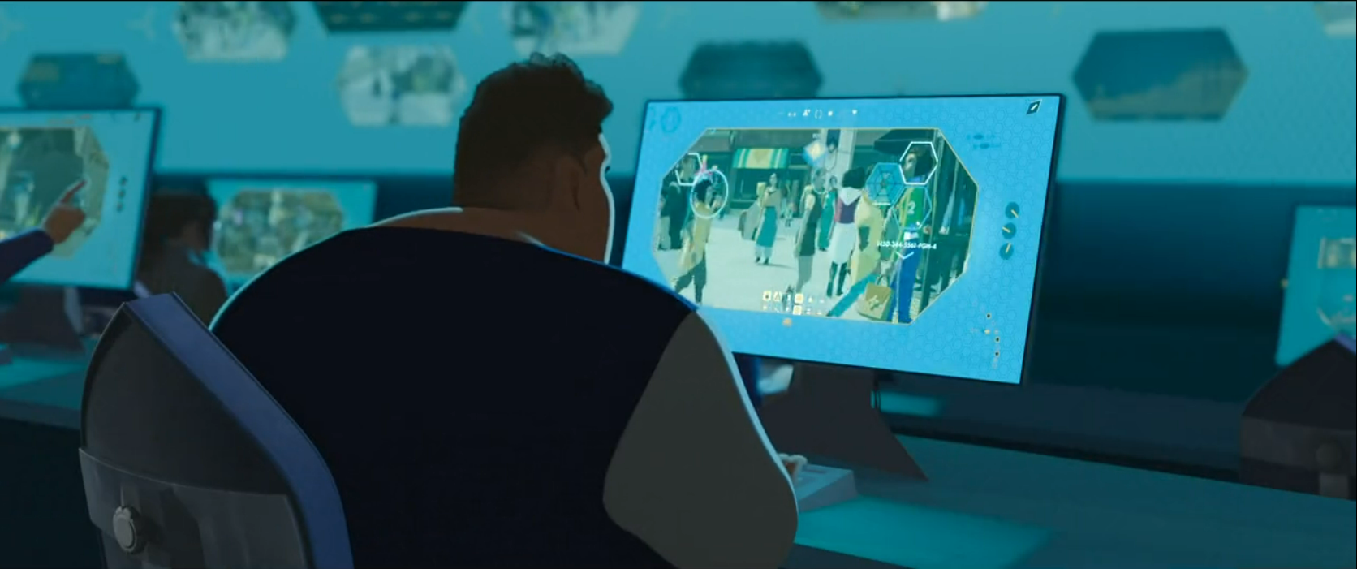
Kingdom-wide CCTV
Watched by the government at all times with facial recognition

Slide 8
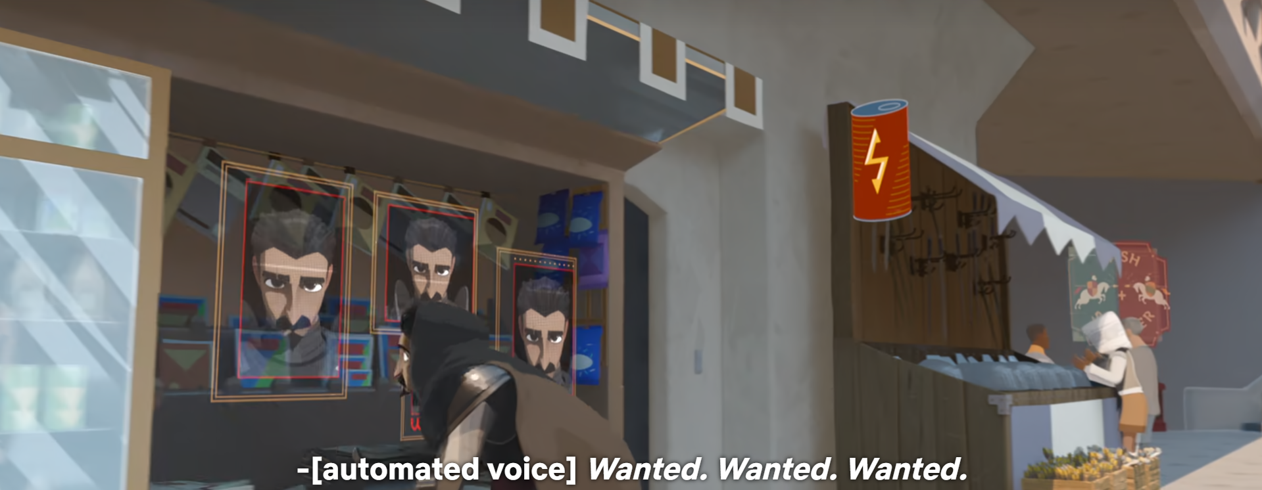
Public alerts can be sent to any surface, government owned or not

Slide 9
Conclusion: Media is often used by governments to spread propaganda and surveillance
Notes:
Examples of news and social media

Slide 10
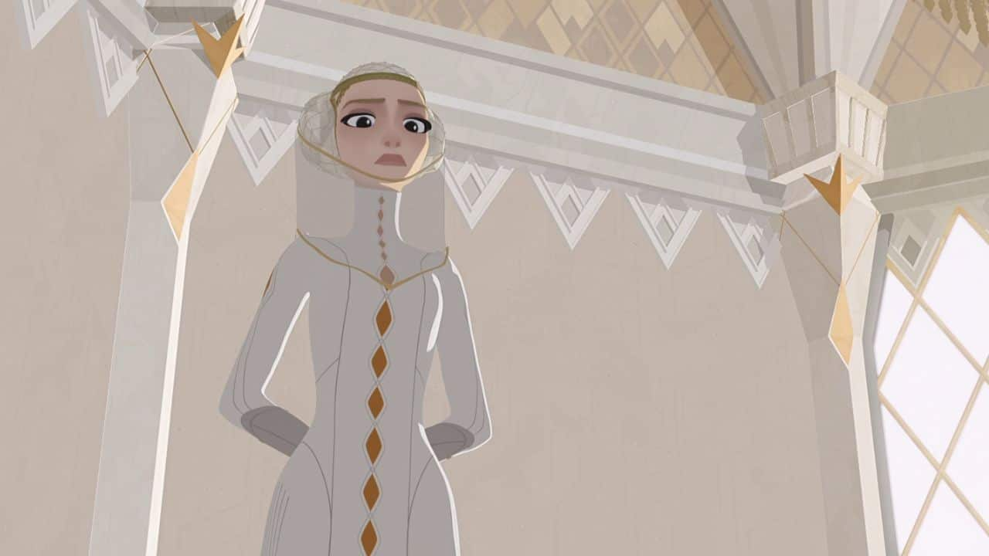
The Director’s betrayal & framing of Ballister
Distrust in Ballister already common belief - he didn’t grow up as nobility
Director gives Ballister trapped sword for ceremony which kills the Queen
The Director seizes on the power vacuum and tightens grip on society, using commoners and shapeshifters as scapegoats responsible for the attack
Conservative reforms are passed– new allowance of commoners as knights is retracted, police/knights strengthened in power
Notes:
Around 41 minutes into the movie, we learn from a character known as the Squire that the Director framed Ballister by planting the trapped sword in the ceremony. She then utilized the power vacuum left by the death of the Queen to take control herself, after which she implemented conservative reforms which put a complete stop to the opening up of the knighthood to commoners and ramped up security efforts, while also cracking down on those living in the poorer citizens and magic beings such as shapeshifters.

Slide 11
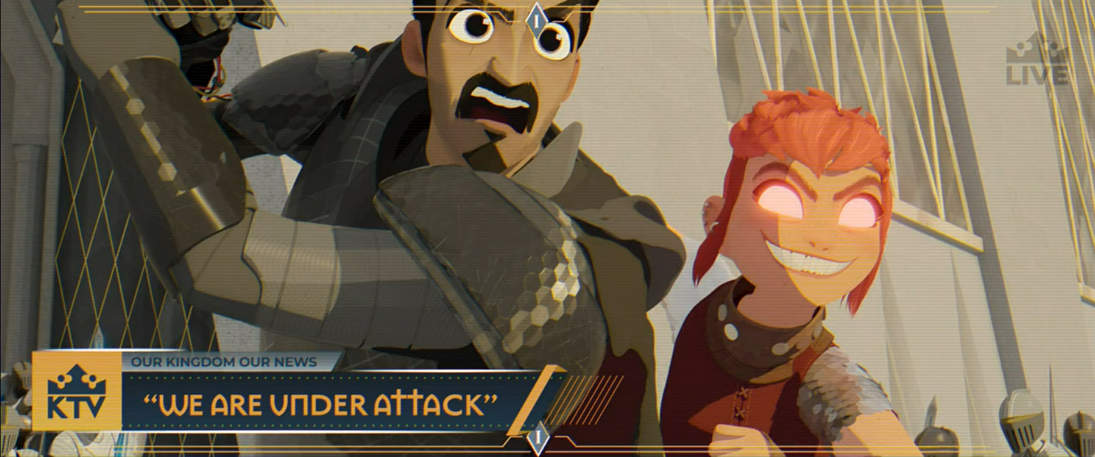
The kingdom broadcasts civilian footage with false context to reinforce public opinion on Nimona and Ballister
Notes:
Examples of news and social media

Slide 12
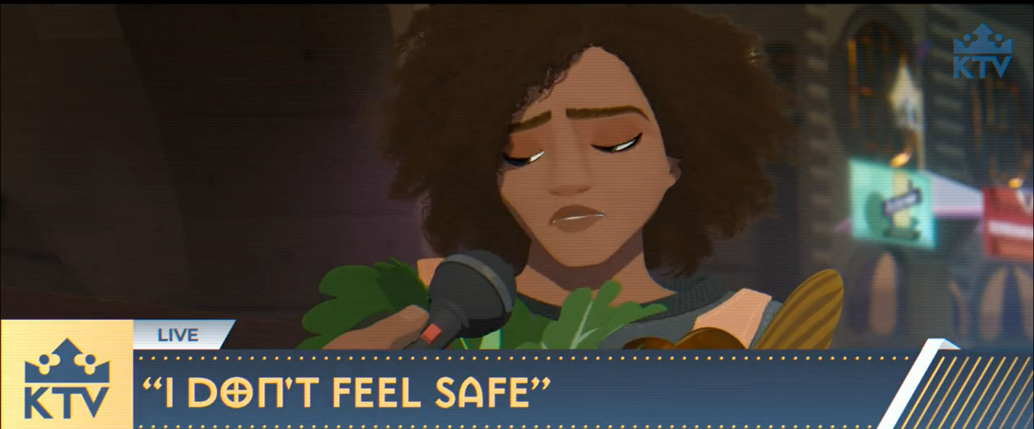
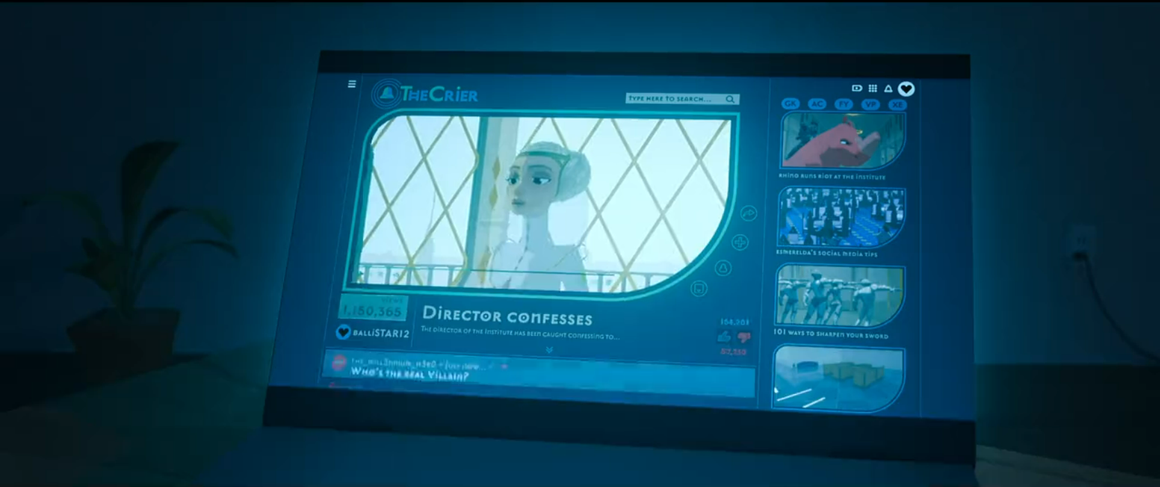
News companies broadcast across TV, influencing the public
A YouTube stand-in is the method used to expose the Director of her crimes
Notes:
Here are a couple examples of news and social media: A broadcast from the official news channel about how people feel unsafe because of Nimona, versus the social media, where the Director’s exposure by Nimona and Ballister is shown via a Youtube equivalent.

Slide 13
Propaganda
From an Interview with Director Nick Bruno:
“It was a thing that was fun to think about, and we were able to, unfortunately, pull from our own world. Like "Slaytorade", and "If you see something, slay something."
“There's unfortunately too many examples in our own world, of how we will judge people and hold them back. But it was, at the same time, fun to parody that.”
[7]
Notes:
Propaganda is a core element of Nimona and what it says about society. Advertisements and direct propaganda alike are all across Nimona, plastered on nearly every screen across countless surfaces in the city. These constantly reinforce the messages of fear and violence towards “monsters” and other outside groups to the people who spend their daily lives inundated by this messaging.

Slide 14
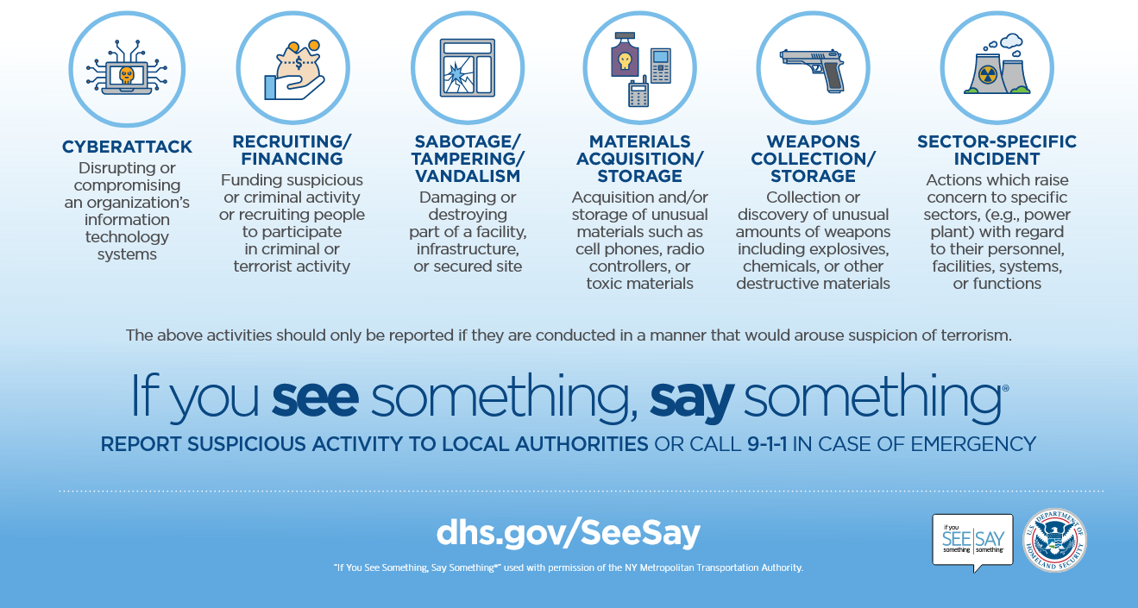
“If you see something, slay something”
“If you see something, say something” - common saying in U.S.A.
According to Homeland Security, is designed to “raise public awareness of the signs of terrorism and terrorism-related crime, and how to report suspicious activity to state and local law enforcement” [6].
Along with digital forms, surveillance is crowdsourced to average people, and this has been shown to disproportionately target minorities. [5]
Excerpt from official materials provided on dhs.gov [6]

Slide 15

Notes:
The movie uses a play on that phrase, “If you see something, slay something,” as a slogan of the Kingdom’s propaganda. This clip shows Ballister yelling it as a way of getting people’s attention. [I wanna phrase that last bit better but can’t figure out a good way to]

Slide 16
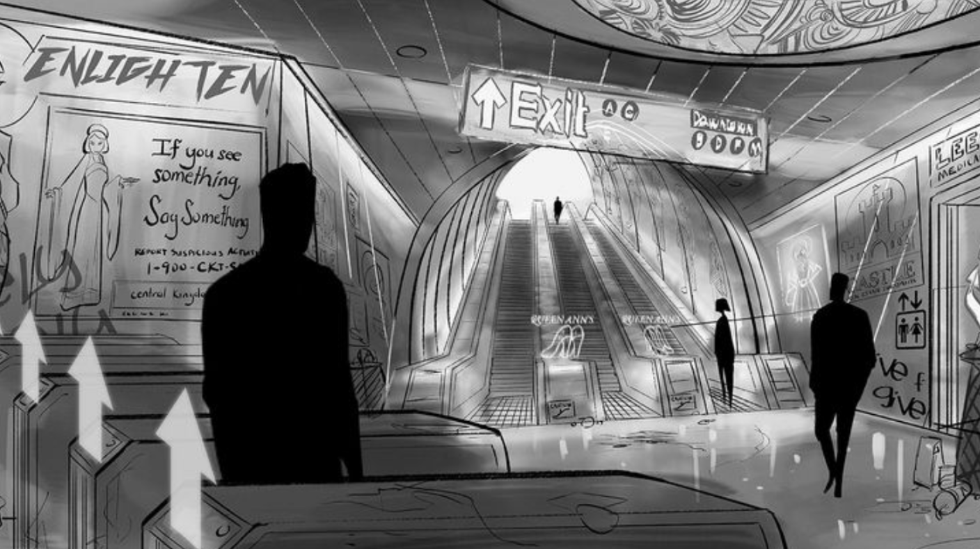
Concept art shown in the official Nimona art book
Notes:
Original concept art actually directly featured the quote originally used by Homeland Security, making the comparison the movie is trying to draw even clearer.

Slide 17
Conclusion: Restrictive surveillance isn’t just carried out by governments, but by private citizens as well.
Improving computer technology and communications make this increasingly prevalent.

Slide 18
The Patriot Act and Surveillance
The Patriot Act:
2001 American legislation in response to 9/11 [3]
Eroded protections for “due process, physical attacks, and freedom of speech” [3]
Used the attacks and muslims categorically as scapegoats to leverage and direct the anger of the American people [3]
These justifications lead to both these shrinks in rights for people in America through the Patriot Act and the third Gulf War / War in Iraq [4]
Act lead to Government’s ability to track private data, spy en masse on US civilians, widespread increase in CCTV and automated security [3]
Notes:
The Patriot Act is perhaps the clearest example of the mechanisms of leveraging fear for control in terms of United States legislature, especially as a parallel to that depicted in Nimona. It is a real-world situation where a major tragedy was seized on by those in power to scapegoat marginalized groups and greatly expand security measures (and therefore privacy invasions). The act enabled the government to engage in many forms of surveillance, from expanding CCTV access to mass data tracking to airport security checks.

Slide 19
Real World Surveillance: The Stingray
The computing technologies used for surveillance in Nimona are not a far reach from the real world–
Notes:
Nimona features a real-world surveillance technology, large-scale CCTV and facial recognition systems, as a major method of control for the government. However, this is not the only real-world technology which enables violations of your privacy en-masse in a similar manner.

Slide 20
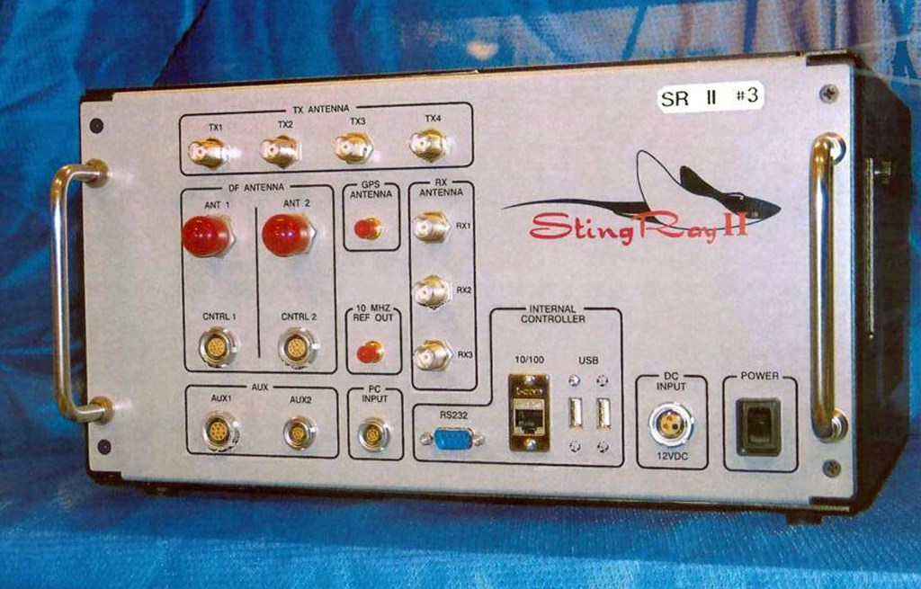
Real World Surveillance: The Stingray
Stingray II Cellular Site Simulator used by police to capture IMSI numbers, which match a user to their name and address [8].
Photo credit of U.S. Patent and Trademark Office via the Associated Press
Notes:
This is the Stingray 2 Cellular Site Simulator, a device used by the police to capture IMSI numbers which are linked to your phone number, name, and address through your phone provider and SIM card.

Slide 21
Real World Surveillance: The Stingray
In deployment since the 90s, but information was scarce until recent years [8]
Government and manufacturers worked to conceal information [8]
Justice Department requires a warrant in most scenarios, but there is an exception for “national security” [9]
Deployed by 52 agencies by 2015; “a detective testified that Baltimore City police officers have used the device over 4,300 times since 2007.” [9]
The cost of security through these systems is your privacy
Notes:
The Stingray has been around since the 90s, but we really only learned more about it in recent years, especially following use in the Black Lives Matter protests of 2020 and the Dakota Pipeline protests. While usage requirements vary by court and state, the US Justice Department doesn’t require a warrant in situations which officers claim is for national security. The device has seen widespread use across the United States by both federal and national law enforcement with little to no oversight.

Slide 22
Conclusion: The fear that citizens feel is leveraged by their governments to restrict civil liberties.

Slide 23
Citations
Viktoria Spaiser, (April 20, 2017), https://www.tandfonline.com/doi/full/10.1080/19331681.2017.1308288, April 22, 2017
Sezen Ravanoğlu Yılmaz, (July 13, 2017), https://dergipark.org.tr/en/pub/ijsi/issue/30400/328298, April 21, 2024
Madison Wadsworth, University of Utah, (December 2020), https://doi.org/10.26076/97d5-1a35, April 28, 2024
Youssef Bassil, IOSR JHSS (December 2012), The 2003 Iraq War: Operations, Causes, and Consequences, http://www.lacsc.org/papers/papera1.pdf, April 28, 2024
Haner, M., Sloan, M. M., Pickett, J. T., & Cullen, F. T. (2022). When Do Americans “See Something, Say Something”? Experimental Evidence on the Willingness to Report Terrorist Activity. Justice Quarterly, 39(5), 1079–1103. https://doi.org/10.1080/07418825.2021.1942162
Department of Homeland Security, (November 9, 2023), “If You See Something, Say Something®” Recognize the Signs Infographic”, https://www.dhs.gov/publication/if-you-see-something-say-something-recognize-signs-infographic, April 28, 2024
Jenna Anderson, Nimona Directors Talk Designing the Film's Unique Medieval Future, Comicbook.com (June 30, 2023), https://comicbook.com/movies/news/nimona-directors-movie-design-nd-stevenson-interview/, April 29, 2024
Kim Zetter, How Cops Can Secretly Track Your Phone, The Intercept (July 31, 2020), https://theintercept.com/2020/07/31/protests-surveillance-stingrays-dirtboxes-phone-tracking/, April 29, 2024
Justin Brown and Kasham Leese, StingRay Devices Usher in a New Fourth Amendment Battleground, C.J.Brown Law (June 2015), https://cjbrownlaw.com/wp-content/uploads/2015/07/Brown-Leese_p12-20_June_2015_Sting-Ray_devices_06222015_431_BCX.pdf, April 29, 2024

