Slide 1
Social Relations in Neon Genesis Evangelion
Chandler Garcia, Ash Kittur, Najum Soofi
Notes:
Chandler

Slide 2

The End of Evangelion
Chandler Garcia, Ash Kittur, Najum Soofi
Anime Series released in 1995
The End of Neon Genesis movie released in 1997 [1]
  Based on the last 2 episodes of the series [2]
Met a lot of backlash and was seen as incomplete [3]
  Directors defended artistic integrity of finale and movie [4]
Notes:
Chandler
Anime series was released in 1995, movie released in 97 based on the last two episodes of the series
The movie itself strayed from the anime and manga finale’s brought by both director and creator decisions,
causing backlash and being seen as incomplete by mainstream fans
The directors defended and supported the artistic choices made, and the movie is seen as its own alternate ending to the series

Slide 3
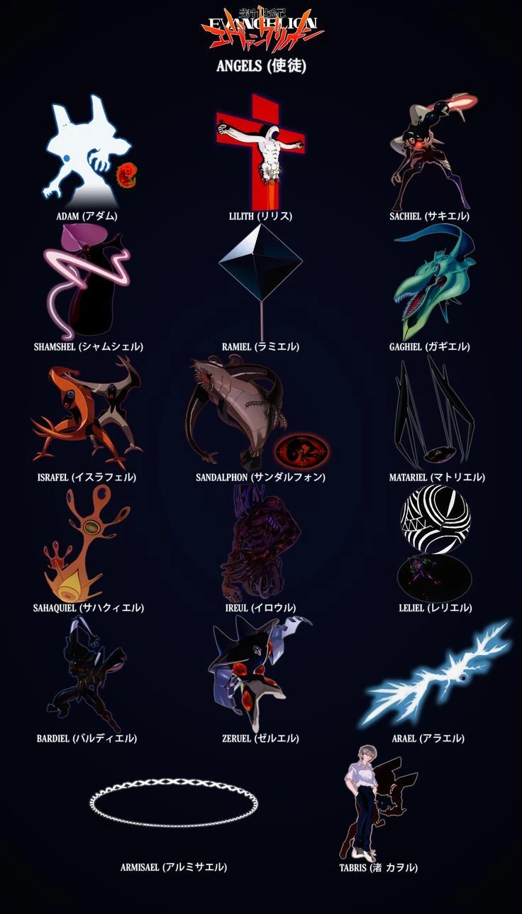
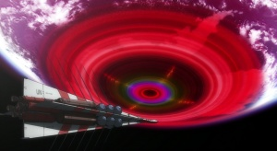
Worldbuilding
Chandler Garcia, Ash Kittur, Najum Soofi
Second Impact
Angels
Notes:
Let’s first hop into the actual world of Neon Genesis Evangelion
The movie and series takes place in a post apocalyptic world after an event called the Second Impact
The Second Impact brought about these godly geometric beings called angels that tried to eradicate all life on earth

Slide 4
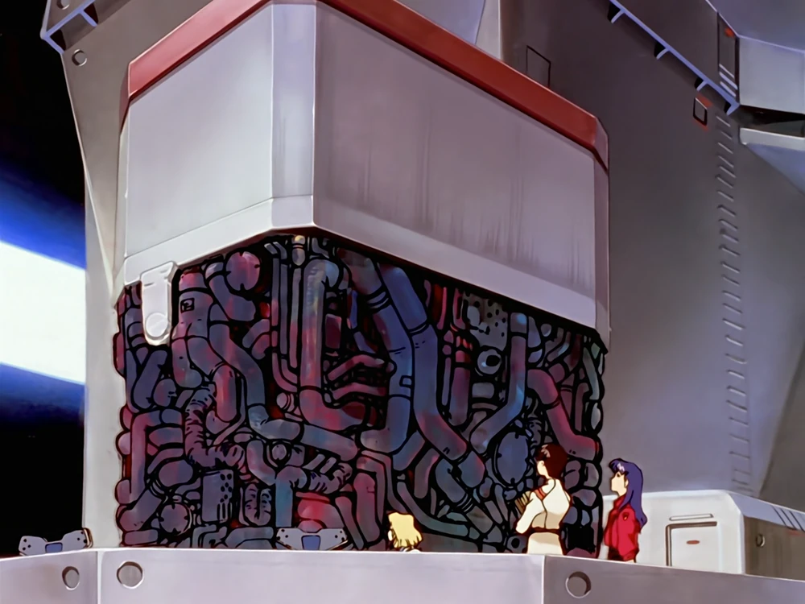
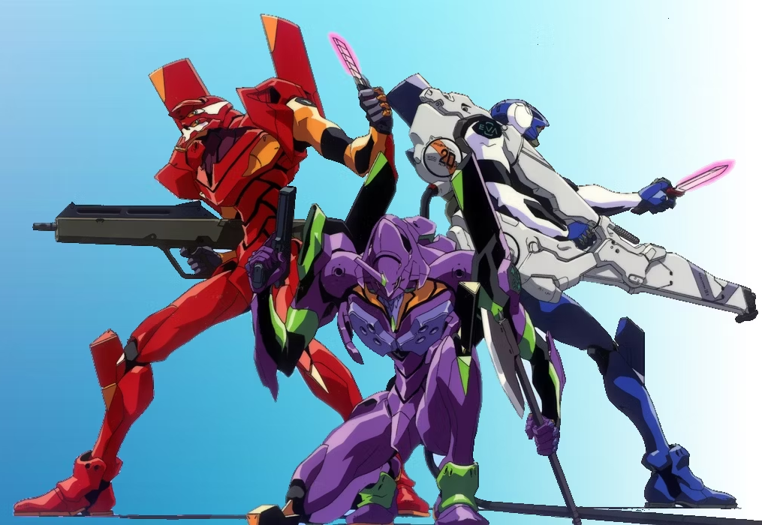
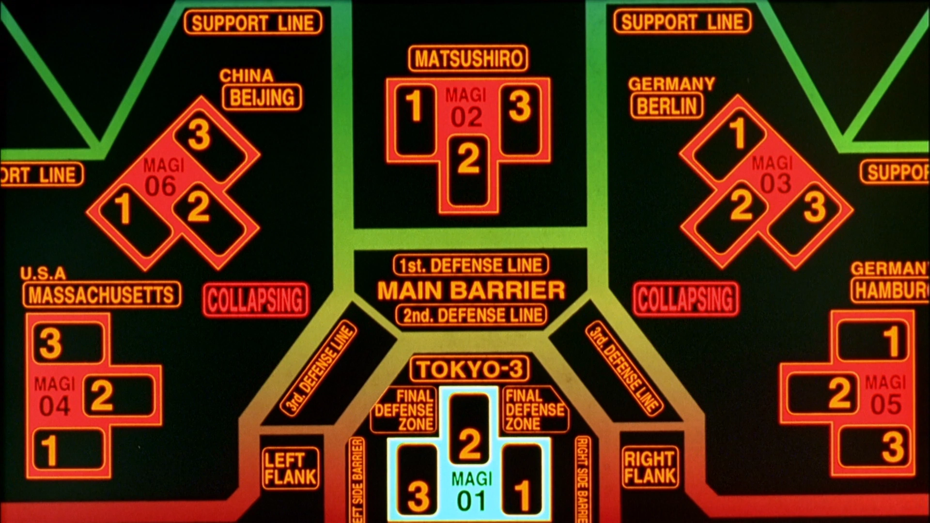
Worldbuilding
Chandler Garcia, Ash Kittur, Najum Soofi
Notes:
To prevent the angels from destroying the world, a government organization called NERV was created and developed the Evangelions, half mech half biological giant humanoid godling, interfaced through a supercomputer system called the Magi. The evangelions, also known as EVA’s are un-usable without their pilots, and can comparable to mindless beasts
The Magi allowed 14 year old child soldiers Shinji and Asuka full control over the Evangelions

Slide 5


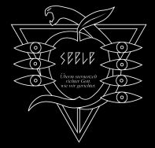
Worldbuilding
Chandler Garcia, Ash Kittur, Najum Soofi
Notes:
In the series, there are three major organizations, the UN government, NERV, the developers of the EVA and protectors of the world, and SEELE, a mysterious global shadow organization whose goals are unknown

Slide 6

The End of Evangelion Setting
Chandler Garcia, Ash Kittur, Najum Soofi
Post Apocalyptic Earth caused by the “Second Impact” [7]
Shadow organization SEELE is trying achieve the “Human Instrumentality Project” [8]
  Forced evolution of humanity for human transcendence
NERV is trying to prevent the “Third Impact” [8]
  EVA’s, Magi, Shinja & Asuka
  NERV fears irresponsible use of the EVA’s
Global population has no idea what’s going on
Notes:
The movie is set in the post apocalyptic earth caused by the second impact
In the movie, SEELE’s intentions are uncovered; to enact the human instrumentality project or the forced evolution of humanity trying to achieve human transcendence. This ascendance will both cause the end and beginning of the world, and will create the third impact
NERV is trying to prevent the third impact, and attempt to defend against SEELE with everything in their arsenal, including the evangelions, the Magi supercomputers, and their two child soldiers who use the EVA’s Shinji and Asuka
They are trying to fight as much as they can as NERV fears SEELE’s improper use of the EVA’s, since SEELE needs the EVA’s to be used to cause the third impact
Whilst all of this is happening, the global population has no idea what’s happening

Slide 7
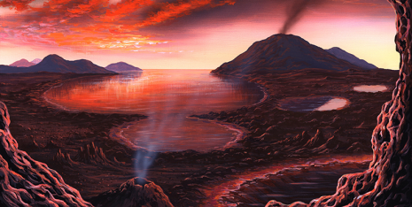
Themes in Movie
Chandler Garcia, Ash Kittur, Najum Soofi
(Primordial) Soup
  Human unity in the soup [1]
Technology has caused humanity’s mind to fracture [6]
Regret of technology creation [8]
Loneliness[7]
Notes:
Ashton
Primordial Soup is a solution of a set of compounds from which all life on Earth originated.
Human Instrumentality Project
Our very consciousness is from the result of a bunch of chaotic chemical reactions.
There is an argument to be made that the advancement of technology caused the events of the movie to happen, resulting in a regression of life on Earth to its primal form.
Shinji & Asuka are CHILD SOLDIERS
Separation between Shinji & his father
NERV recognizes the EVA’s can be used against humanity
Giving the wrong person control over tech is bad
The responsibilities, relationships, and world has caused all these characters to remove themselves from each other, becoming detached and lonely

Slide 8

Connections to Real Life
Chandler Garcia, Ash Kittur, Najum Soofi
Social media is our soup
Technology protects us but can be misused and abused
Governments do things in secret to “protect” us
NGE represents it’s creator’s Self identity [6]
Separation of faith and science [7]
Notes:
Ashton
Social Media, which connects most individuals together, can be used as a metaphor to primordial soup.
SM is potentially very beneficial and potentially harmful.
Like in Evangelion, the government operates in secret in the name of national security.
NGE represents is creator’s self identity because the creator put himself into the movie and anime, depression, stress, lack of sense of self
There is a perpetual power struggle in politics concerning a legal distinction of the separation of church and state.

Slide 9
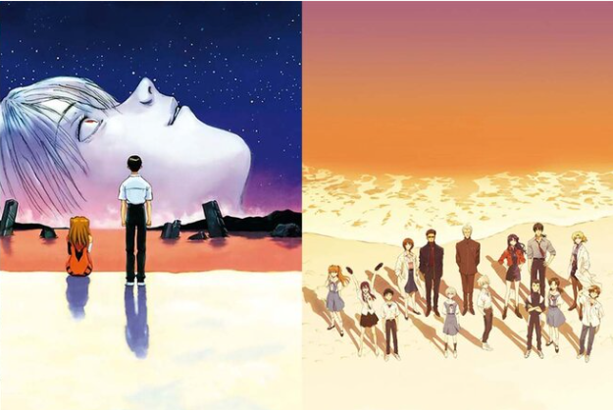
Social Media is our Primordial Soup
Chandler Garcia, Ash Kittur, Najum Soofi
Loneliness [6]
Digital & analog media connects us
Orange LCL (soup) represents our bond
We can make our soup how we want it [7]
Notes:
Najum
All the characters are combating loneliness , coping through technology
We connect through social media, music, newspapers, books, art
Connects the EVA but also connects all the souls together
We can choose whether or not to get lost in the sauce of media
Our own self identity (AT field) is what keeps humans from turning into soup

Slide 10

Individuality
Chandler Garcia, Ash Kittur, Najum Soofi
Collective consciousness
Human individuality [7]
EVA units have no soul [6]
Removal of individuality ?
<Graphic as big as will fit>
Notes:
Najum
Collective consciousness we have in our society from uses of technology
individuality is what makes us human and stops the tech from going beserk
Units have to be connected to human
Within the soup of life we are no longer lonely as we are one within each other

Slide 11
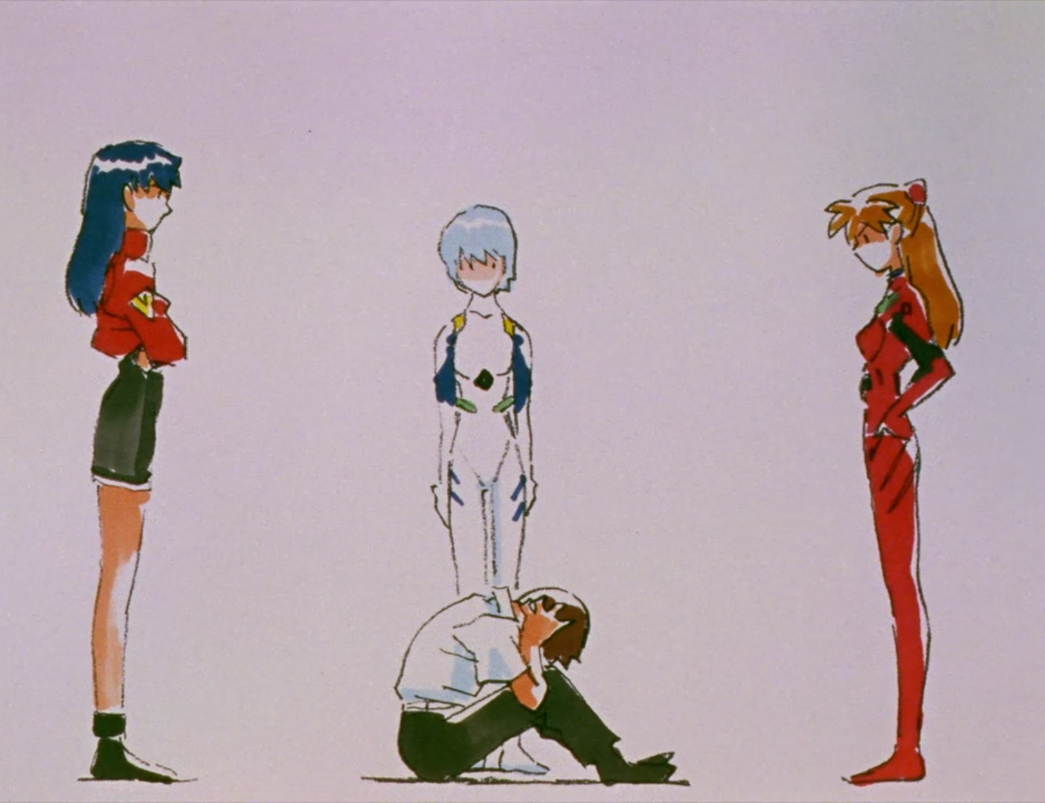
Power Struggles
Chandler Garcia, Ash Kittur, Najum Soofi
Shinji’s low self
Selfishness and altruism [7]
Underlying patriarchy [9]
Responsibility to use the tech ethically
Notes:
Najum
Shinji struggles finding meaning in life; peers only wanna be friends w him cuz pilot, coping through piloting the EVA
Shinji acts selflessly to save those he loves, Ikari acts in his own interest to see
Ikari takes advantage of his subordinates to gain technology access (Seele)
Akagi tried to defy NERV & self destruct but the system betrayed her
Shinji holds both the fruit of life and knowledge from Adam/Lilith, he has the power to destroy or save the human race

Slide 12
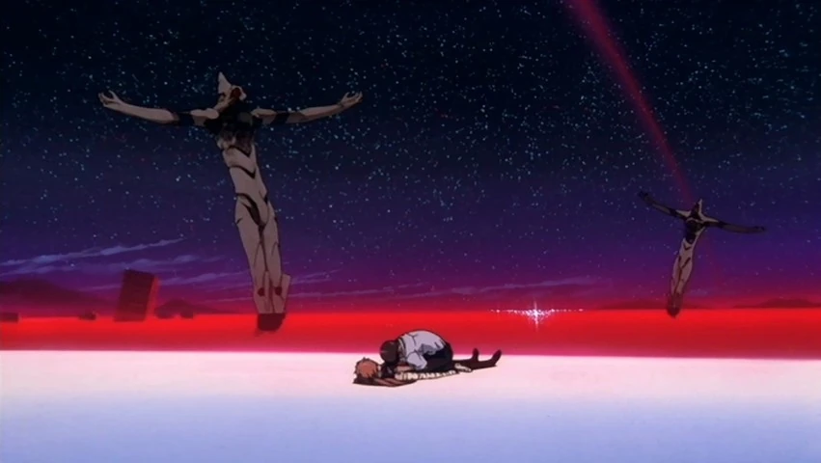
Conclusion
Chandler Garcia, Ash Kittur, Najum Soofi
Our individuality is what makes us human [8]
Must be responsible with the advancement of technology
Technology has human characteristics
Coping through technology [9]
Notes:
individuality makes us human, that's all we know
wanted to destory EVA b/c fear of misuse
magi systems brains representing woman, mother, and scientist
Rei rejects ikari
magi betrays akagi
Loneliness solved through technological fulfillment

Slide 13
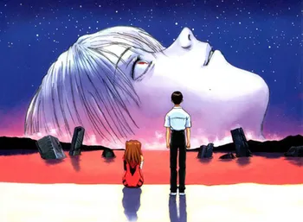
Questions?
Chandler Garcia, Ash Kittur, Najum Soofi
Notes:
<speaker notes>

Slide 14
REFERENCES
Chandler Garcia, Ash Kittur, Najum Soofi
[1] Neon Genesis EVANGELION. (2001, February 12). https://web.archive.org/web/20010212010121/http://ent.nikkeibp.co.jp/ent/bn/9704/report/evan.html
[2] The End of Evangelion. (n.d.). Evangelion. Retrieved April 27, 2023, from https://evangelion.fandom.com/wiki/The_End_of_Evangelion
[3] The Evangelion Otaku Page ::: (n.d.). Retrieved April 27, 2023, from http://www.evaotaku.com/html/rcb-commentary.html
[4] CJAS Newsletter Archives—In the Eyes of Hideaki Anno, Writer and Director of Evangelion. (n.d.). Retrieved April 27, 2023, from https://www.cjas.org/~echen/articles/spring97/05_03b.html
[5] https://gmwgroup.harvard.edu/chemical-origins-life#:~:text=Several%20theories%20of%20the%20origins,in%20complex%20mixtures%20of%20molecules
[6] Smith, Claude. "You Are Not Alone: Self-Identity and Modernity in Neon Genesis Evangelion and Kokoro." (2008). https://diginole.lib.fsu.edu/islandora/object/fsu%3A253836/datastream/PDF/view
[7] Райхерт, Костянтин. "The postmodern theology of “neon genesis evangelion” as a criticism." (2018). http://doksa.onu.edu.ua/article/view/146569 (pdf download)
[8] Afanasov Nikolai. "THE DEPRESSED MESSIAH: RELIGION, SCIENCE FICTION, AND POSTMODERNISM IN NEON GENESIS EUANGELION" State, Religion and Church, vol. 7, no. 1, 2020 https://cyberleninka.ru/article/n/the-depressed-messiah-religion-science-fiction-and-postmodernism-in-neon-genesis-euangelion
[9] Savoy, Katherine. "The Artificial Restoration of Agency through Sex and Technology in Neon Genesis Evangelion." electronic journal of contemporary japanese studies (2014) http://japanesestudies.org.uk/ejcjs/vol14/iss3/savoy.html#Author

