Slide 1
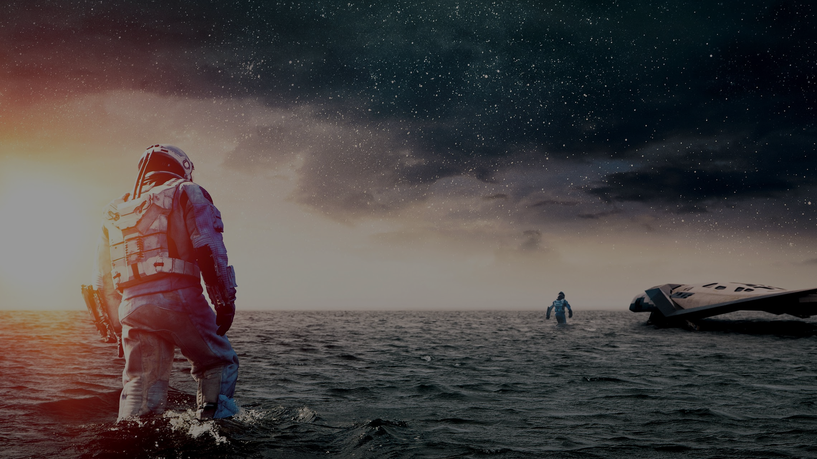
Interstellar
Yao Chow, Dasheng Gu, Alonso Martinez, Seth Norton
[P15]
Notes:
-Seth-

Slide 2
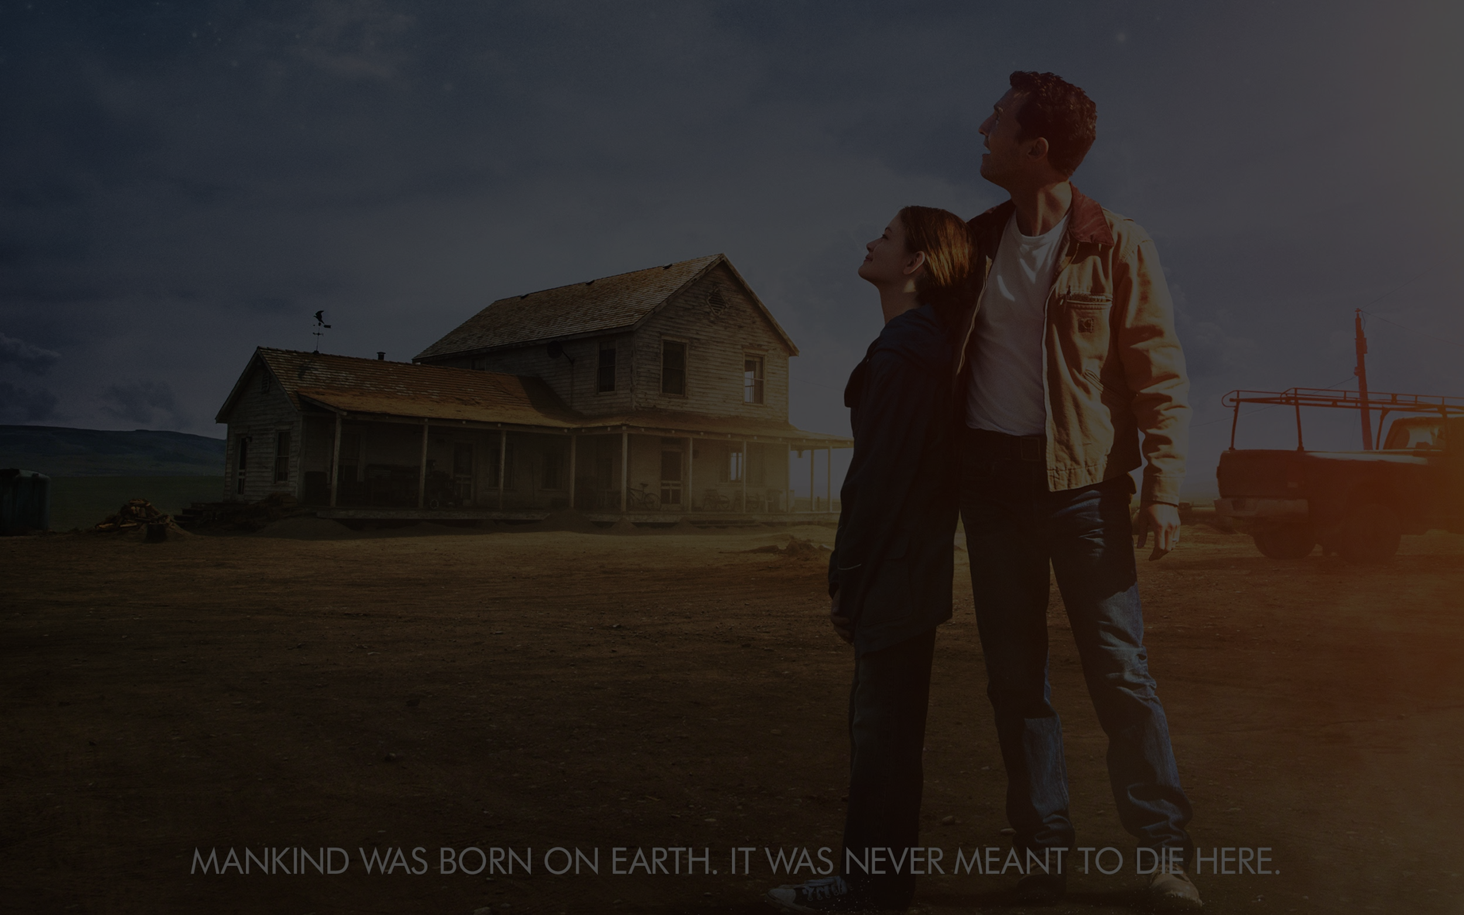
Plot Summary
On Earth
Blight causes crops to wither
NASA sends Lazarus mission
Cooper is a “farmer”, relies on robots
Cooper finds location of NASA via gravitational anomaly
In Outer Space
Space team (four humans, two robots) is sent through wormhole
The mission visits two Lazarus planets that are uninhabitable
[P3]
Notes:
-Seth-
Environmental stress
NASA decides to try to find habitable planets outside of our solar system
We follow Cooper, a past pilot, now farmer

Slide 3
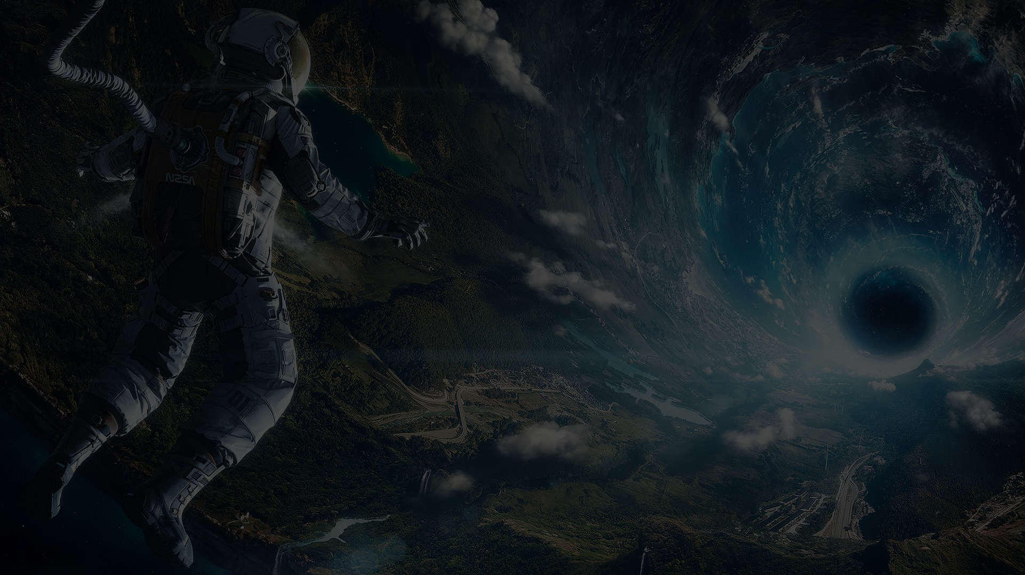
Plot Summary
Still In Outer Space
Dr. Mann on second planet betrays the team to save himself
Cooper is sent into black hole
Cooper’s daughter figures out gravity equation through Cooper
Dr. Brand finds a suitable planet to restart humanity
[P2]
Notes:
-Seth-
During their travels they find one of the original excursion members
He tries to sabotage the mission and save himself
Our protagonist Cooper is sent through a blackhole and ends up on an enormous space station that was made possible by “solving gravity”
We’ll won’t be discussing the time travel so don’t worry

Slide 4


Post-Truth Society
Communication lacking between
government/citizens
Post-truth - blatant lies being
routine across society [5]
Government Censorship
NASA Cover-up
[P1]
[P9]
Notes:
-James-
It is noted that Interstellar takes place in a post-truth society where there are blatant lies prevalent throughout society, almost expected behavior. Because of the blight, the march technology comes to a halt and we see that in the lack of communication between government and citizens.
In the movie, evidence of a post-truth society lies in the government censorship and NASA cover-up. This concept is not too far from our own society. Oxford Dictionaries voted post-truth to be the word of the year for 2016.
Consider delving more into the whole government censorship concern (changing text books to say the moon landing was a hoax, lying about NASA because nobody would want to “waste” money on that) Perhaps if people were better educated they be willing support space travel (consider connecting to society and budget cuts today) or are people to self-centered to think beyond today and themselves (which is a central theme of the movie)

Slide 5

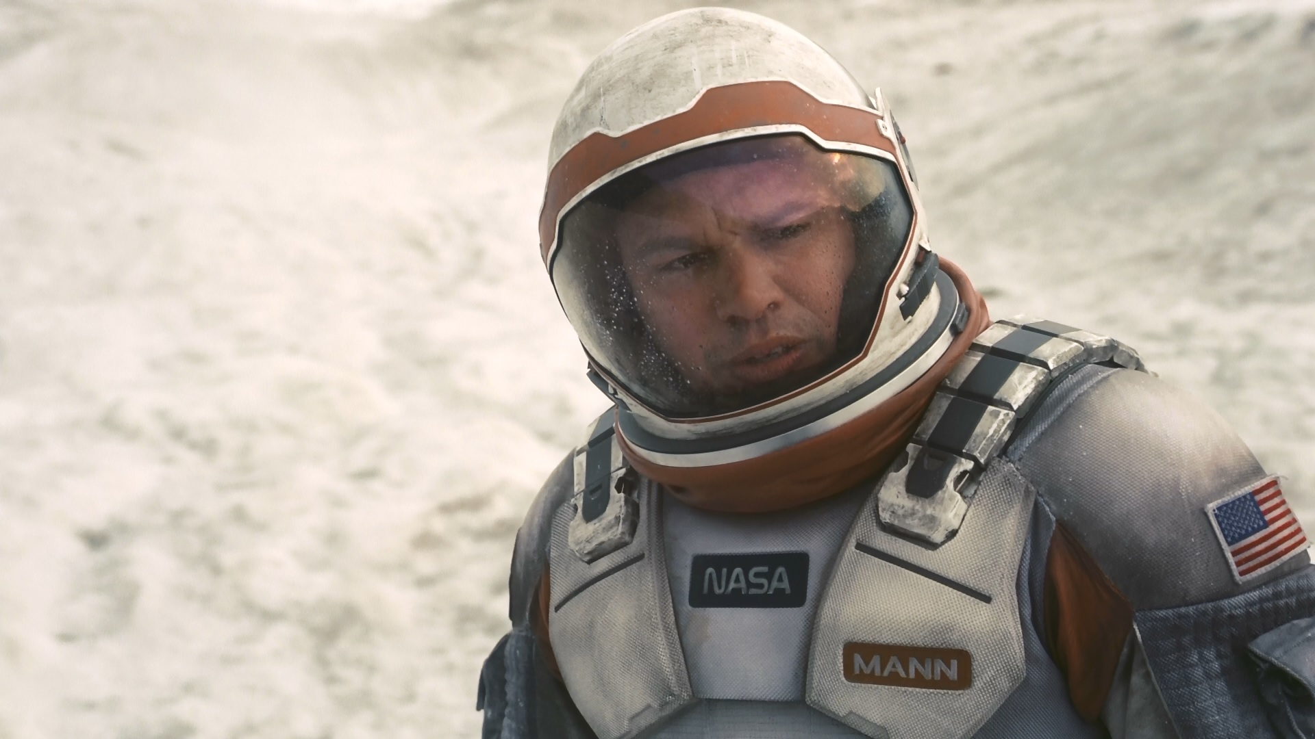
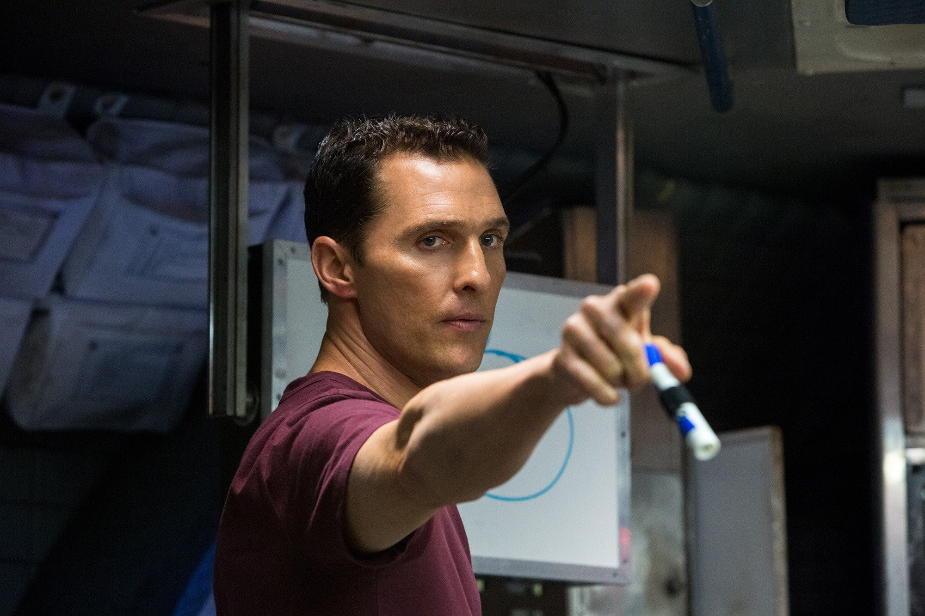
Ethical Dilemma
Abandon all life on Earth
Find suitable planet
Develop colony from frozen embryos
Save humans on Earth
Solve gravity equation
Create and launch giant space station
[P14]
[P5, P6]
Notes:
-James-
The movie delves into the question of are people too self-centered to think beyond today and themselves (which is a central theme of the movie). One side, we have abandoning all life on earth and looking for another suitable and hospitable planet to preserve our species. On the other side, we have saving all humans through a giant space station that can sustain the remaining populace. The characters in favor of abandoning life were Dr. Mann and Dr. Brand (started the program). Everyone else was on the other side.

Slide 6
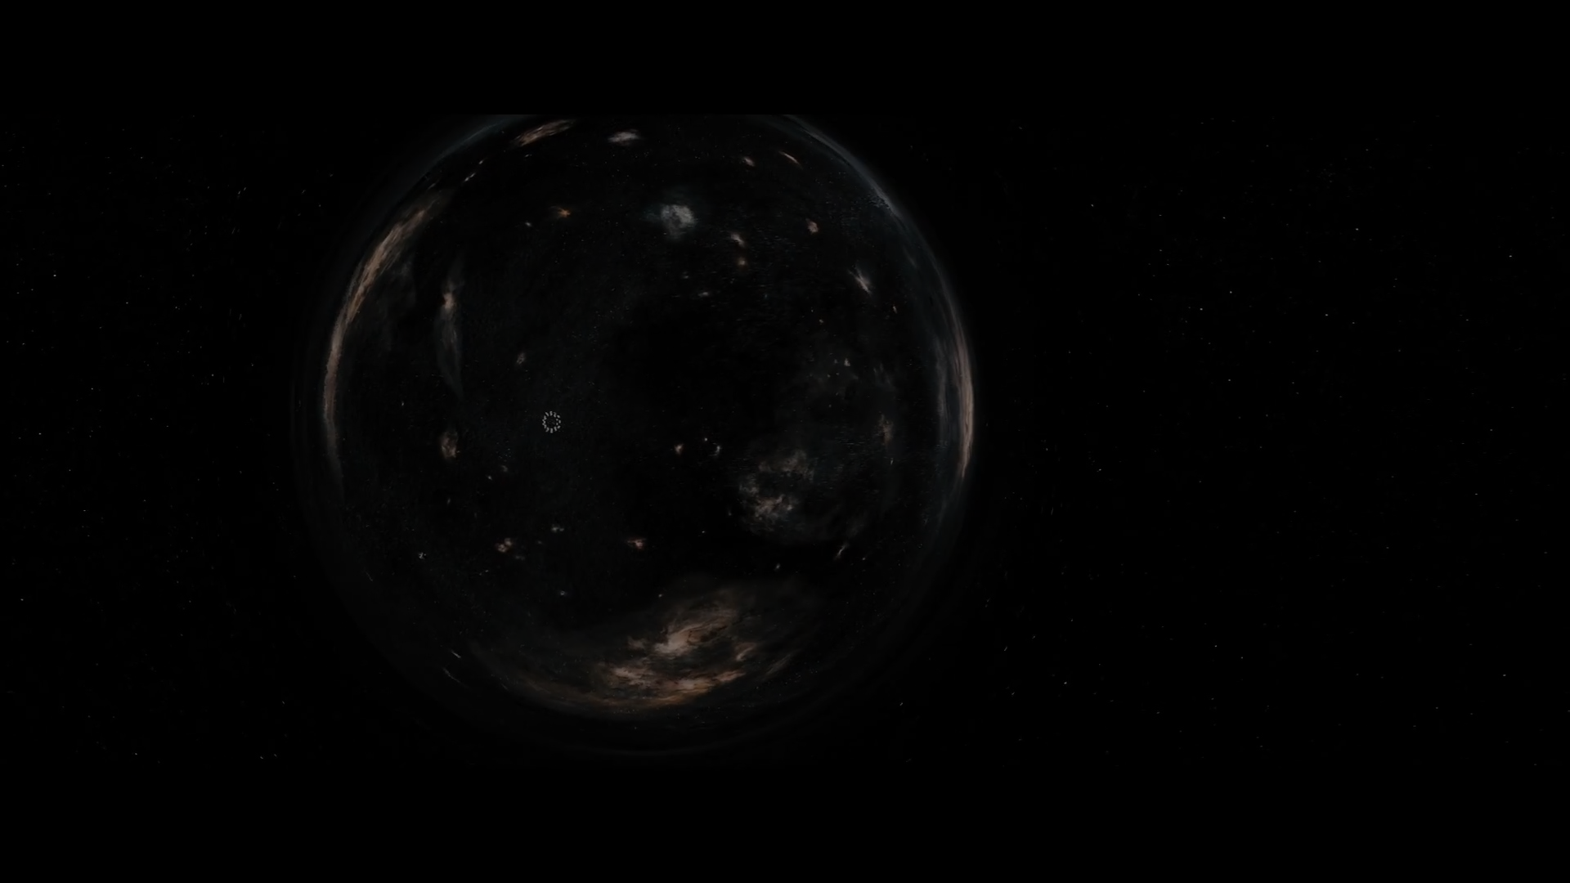

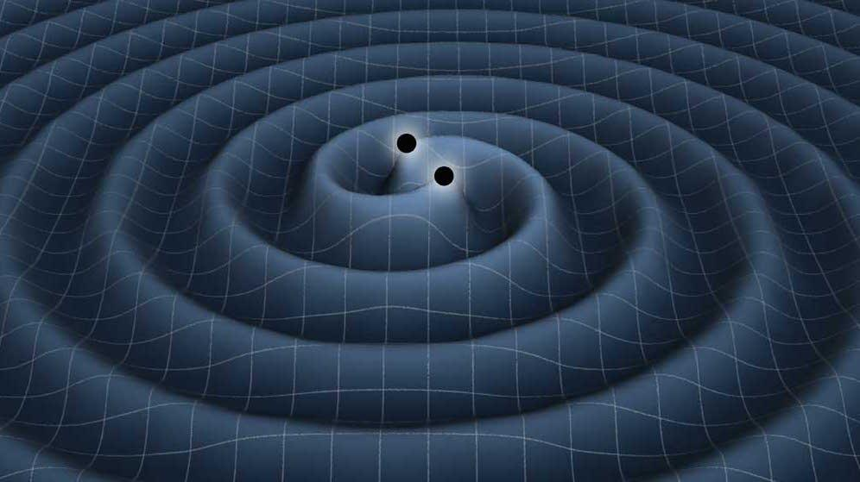
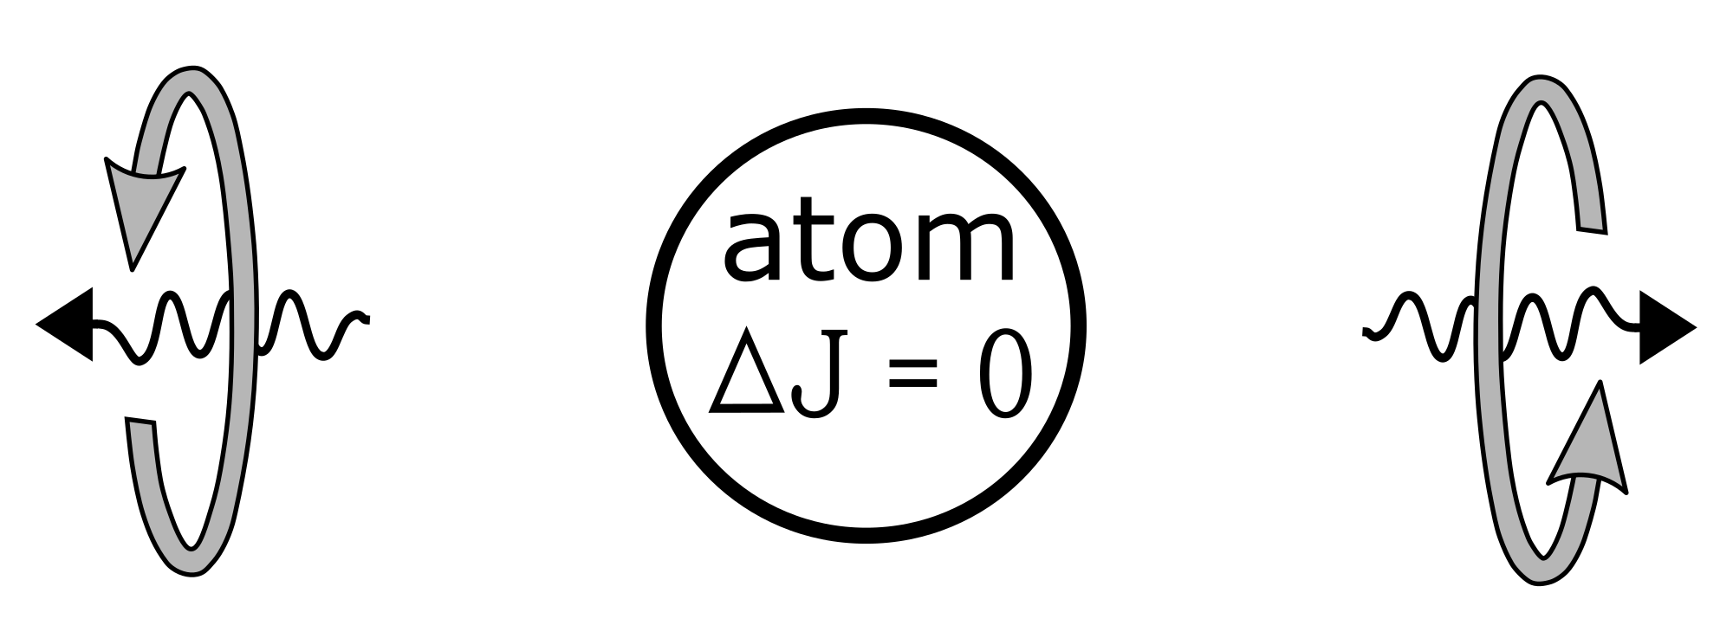
Communication Technologies
Radio Waves
Gravity Waves
Quantum Entanglement
C
[4, P2, P3, P4]
[P10]
Notes:
-Seth-
Radio Waves - Current technology but limited to speed of light
Gravity Waves - Now detectable but also limited to speed of light and we can’t generate them yet
Quantum Entanglement - Don’t have the ability yet and scientists believe it won’t lead to faster-than-light data transmission

Slide 7


Communication Implications
Loss of connection with people on Earth
Relativity affects message arrival [11]
Breakthroughs or emergencies cannot be shared for a long time
Lack of instant command and control creates a greater role for autonomous missions and autonomous robot exploration
  Mars Rover has a 20 minute delay on average in communication [6]
[P13]
[P16]
Notes:
-Dasheng-
Communication is a big issue in interstellar trip. In the movie, there is an experience losing connection with people on Earth. When cooper and the team reach the first Miller’s planet, the huge gravitational potential makes 1 hour on the planet 7 years passed on Earth. The relativity can be explained by the concept of gravitational time dilation. The movie show the effect of this theory by showing that when cooper came back to the spacecraft, he found time on Earth has passed nearly 21 years.
As a result of this, most of the message cannot be sent or received in time. This let these space explorers isolated with the society on Earth. This lack of real-time communication makes harder for human make interstellar trip real. The Mars Rover, designed to trek up to 100 meters across the martian surface, has a challenge moving safely from rock to rock due to the communication delay about 20 minutes.
The picture here is taken at the end of movie, when cooper back to Earth, his daughter is even older than him. Obviously the one who experience similar things is Captain America.
Space travel makes astronaut isolated from society.

Slide 8
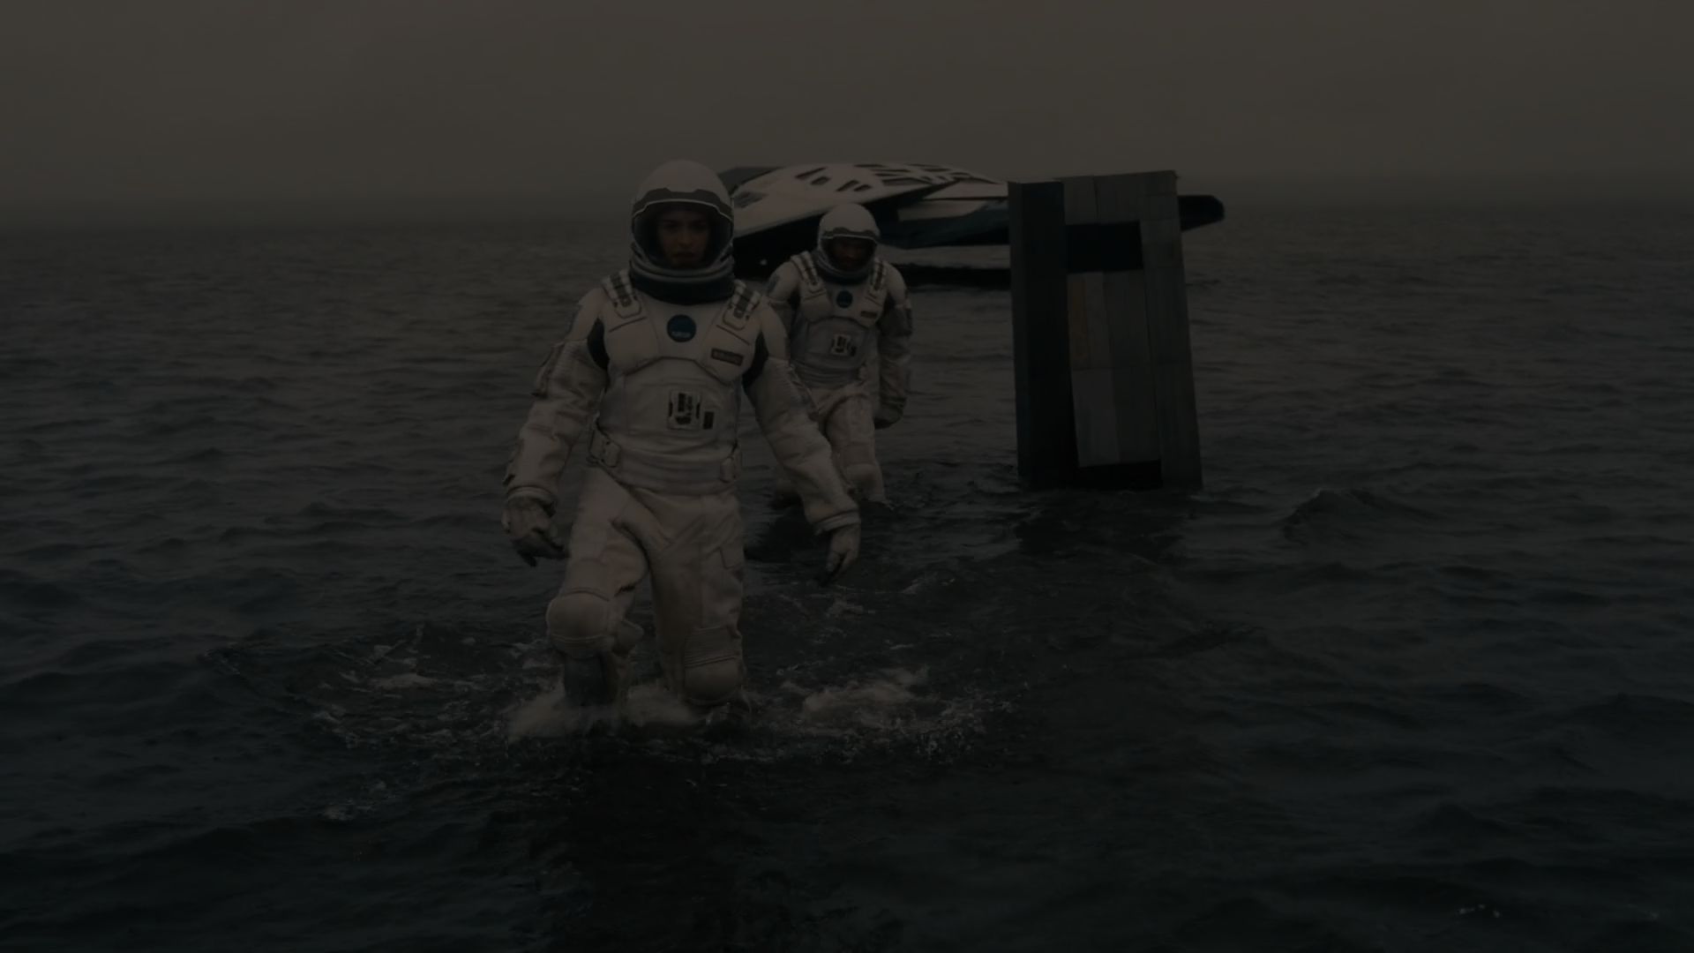
Dependence on Robots
Deep space missions will require robots [9][10]
Humans are likely to enter cryosleep
Spaceships will need to be operated by robots
Robotic technology will need to be reliable for long spans
Robots should be tamper proof
Robots should still require some human in the loop
Interstellar travel creates a need for companionship [8]
Giving personalities to robots assists crew with loneliness
[P12]
Notes:
-Alonso-
Deep space missions require a lot of time and resources. It takes roughly 5 years to fly a spaceship from Earth to Jupiter, another 5 years to get back. In total, an entire decade to explore a planet within our own solar system.
Because of this, there is a dependence on robots. Robot’s do not require sleep. Robots do not require resources like food and water. Robots can be exposed to more hazardous and dangerous situations than humans and are capable of obtaining more information through sensors. Instead of sending humans out to space, sending robots is a lot less expensive. As robotic technology improves, so do the changes of exploring more distant planets. Currently, NASA is pouring money into robotics
If robots are to be used in space travel, it brings up the issue of reliability. The robots cannot suffer from errors that we see in robots nowadays. They need to be held at a high standard. The robot’s components will need to be able to survive through the harsh environment and the degradation of time.
Furthermore, the robot’s should be tamper proof. In the movie we saw how Dr. Mann reprogrammed KIPP to explode when the robot was turned on in order to hide the truth about the planet. Because of this, if robots are working in the same environments as humans, the robots should not be able to be tampered with in such ways to ensure the integrity of the mission. The robots can act like a surveillance mechanism to ensure that the mission is progressing properly and robot odd crew behavior back to important individuals.
At the same time, the robot’s should not be completely autonomous. In this movie, we saw how the robots had to do everything that was instructed to them; they did not express free will. The robots also had various settings that could be set by the humans to control how they acted and responded. It is important to still maintain a human in the loop because as we have seen in various other movies, robots/AI can go awry and believe they know what the best action is in a given scenario. If the robots had full autonomy in this mission and carried out the goals no matter what, the robot could have ended in a signficantly different way.
Lastly, we see a need for robots in interstellar travels when it comes to companionship. Prolonged time in outer space affects the austronauts, and many astronauts say that they feel very lonely and isolated. Because of this, they need an outlet to relate to and speak with besides their own crew. In this case, robots like the ones portrayed in the movie are really beneficial because they have such vivid personalities but this brings up an ethical concern.

Slide 9

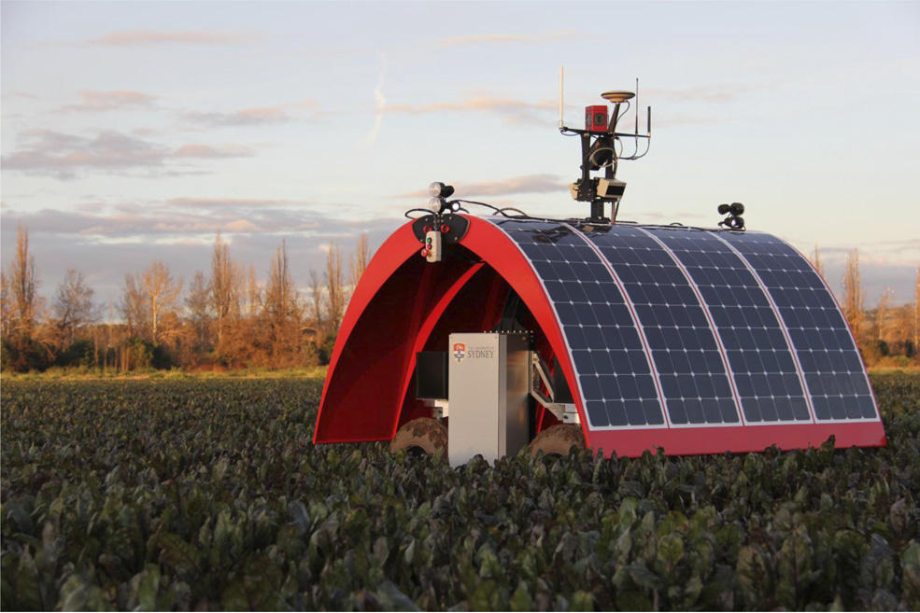
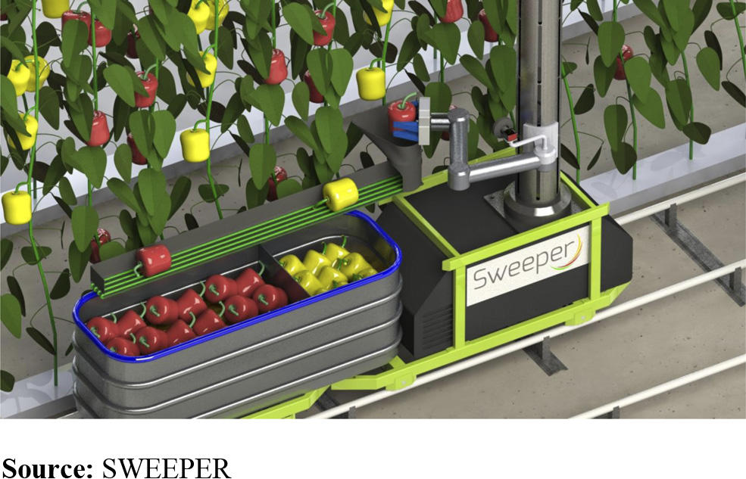
Precision Farming and Robotics
Precision Farming (PF) - Act based on
local crop needs and soil conditions
Economic Benefits
Environmental Benefits
Increased productivity
Role of Robotics [1]
Weed and fertiliser application
Harvesting processes
Current State: Farmbot [3]
[P11]
[1, 3]
Notes:
-Alonso-
In the movie, Cooper uses robots to farm his crops. The process is entirely automated and allows him to harvest all of his crops in a fast manner. We are starting to see a shift towards robots in farming. On the right hand side you have Ladybug, a robot that tends crops and determines their needs and Sweeper, a harvesting robot that can harvest crops autonomously.
The style of farming is called Precision Farming in which you act based on local crop needs and conditions. There is a lot of benefit to this because it increases the quality of the crops and reduces costs, it is better for the environment because less resources are used, and it increases farming production because the needs of the crops are being met on a local scale.
Robots can aid in this process very well. Robots can do all of the work a farmer does without needing to be paid and without needing to rest. Robots have sensors and cameras that can spot out weeds, apply fertilizer, determine moisture and apply an action based off of the plants local environment. They can also simplify the harvesting process by being fully automated and can determine accurately when crops are ready based off of visual feedback. Removes humans from being needed.
Robots have the potential to take over tasks that were previously undertaken by machines and
https://farmbot.io/
Look for source on sustainability of robotic farming
[11] http://wwf.panda.org/what_we_do/footprint/agriculture/impacts/soil_erosion/

Slide 10
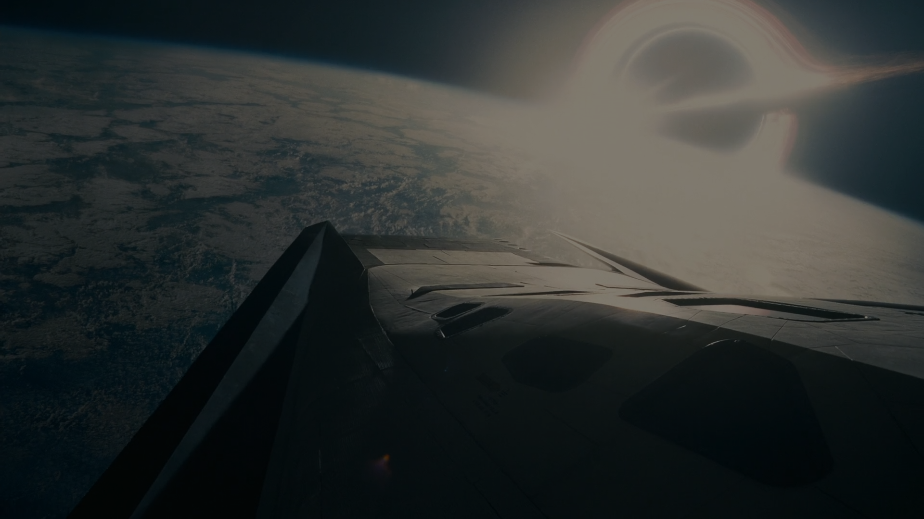
Conclusions
Interstellar travel isolates societies
Robotic farming is coming
Robotic technology enables interstellar travel
[P8]
Notes:
-Dasheng-
Basically these are our conclusions about Interstellar.
Due to the delay of communication and scientific phenomenon in space, space travel might isolates the astronauts from Earth.
From the movie, the application of robotic farming can be developed in reality.
And for interstellar travel, the help of robotic technology and artificial intelligence would be great help.

Slide 11
References
Bogue, Robert (2016). "Robots poised to revolutionise agriculture". Industrial Robot: An International Journal, Vol. 43 Issue: 5, pp.450-456, doi: 10.1108/IR-05-2016-0142. Date Accessed: 4/23/17
Bogue, Robert, (2013). "Can robots help to feed the world?". Industrial Robot: An International Journal, Vol. 40 Issue: 1, pp.4-9, doi: 10.1108/01439911311294200. Date Accessed: 4/23/17
"Meet FarmBot - Humanity's First Open-Source CNC Farming Machine." FarmBot. Web. 02 May 2017.
Eberhard, Phillippe H.; Ross, Ronald R. (1989), "Quantum field theory cannot provide faster than light communication", Foundations of Physics Letters, 2 (2): 127–149, doi:10.1007/BF00696109
Higgins, K. (2016). Post-truth: a guide for the perplexed. Nature, 540(7631), 9-9.
NASA. Moving around Mars. Retrieved May 02, 2017, from https://mars.nasa.gov/mer/mission/tl_surface_nav.html
Harrison, A. A., & Connors, M. M. (1990). Human factors in spacecraft design. Journal of spacecraft and rockets, 27(5), 478-481.
Geuna, S., Brunelli, F., & Perino, M. A. (1995). Stressors, stress and stress consequences during long-duration manned space missions: a descriptive model. Acta Astronautica, 36(6), 347-356.
Harbaugh, J. (2017, February 07). Top 20 Teams Prepare for Space Robotics Challenge Finals. Retrieved May 02, 2017, from https://www.nasa.gov/directorates/spacetech/centennial_challenges/space_robotics/top-20-teams-prepare-for-final-competition.html
Hall, L. (2016, August 15). NASA Space Robotics Challenge Prepares Robots for the Journey to Mars. Retrieved May 02, 2017, from https://www.nasa.gov/directorates/spacetech/centennial_challenges/feature/space_robotics_challenge.html
Einstein, A. "Relativity : the Special and General Theory by Albert Einstein". Project Gutenberg.

Slide 12
Picture Sources
i.ytimg.com/vi/3xcW7Tg5E34/hq720.jpg
http://7wallpapers.net/wp-content/uploads/6_Interstellar.jpg
https://wall.alphacoders.com/big.php?i=547267
upload.wikimedia.org/wikipedia/commons/thumb/8/8a/Radio_waves_hazard_symbol.svg/600px-Radio_waves_hazard_symbol.svg.png
asd.gsfc.nasa.gov/blueshift/wp-content/uploads/2015/11/figure1.jpg
upload.wikimedia.org/wikipedia/commons/thumb/6/62/Entangled_spins.svg/2000px-Entangled_spins.svg.png
https://mtbifiction.files.wordpress.com/2015/09/interstellar05.jpg
https://images8.alphacoders.com/585/585646.png
https://images7.alphacoders.com/585/585602.png
https://imgur.com/3znu3wF
https://i.imgur.com/0XaXiRk.png
https://wall.alphacoders.com/big.php?i=585659
https://images8.alphacoders.com/585/thumb-1920-585651.png
https://images4.alphacoders.com/585/585635.png
https://images7.alphacoders.com/550/550739.jpg
http://www.agonybooth.com/wp-content/uploads/2016/05/interstellar2014part3.0118.jpg

