Slide 1
In Time (2011)
Lily Bromberger, Raman Kaushik, Akshay Shinde, Ryan Suarez

Slide 2
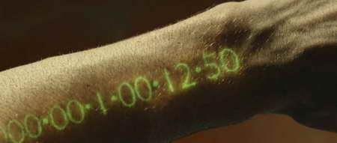
Plot
Lily Bromberger
Year 2169
Humans are genetically Engineered.
Time is currency
Time Zones separate people in different classes.
The poor die young, the rich live forever
main characters fight against inequality
Notes:
The movie opens up to the year 2169.
We learn that humans have been genetically engineered to stop aging at 25 and after they turn 25, their one year timer starts ticking down. If the timer ever reaches 0 they will die or as they call it, “time out”. The only way people can die is either timing our or through rare cases force, for example a gunshot wound. If you have enough time though, you can essentially live forever.
Time is not only how long they have left to live, but the currency used for everything. A coffee costs 4 minutes and you would get a day or two added to your timer for a shift at work.
Despite the universal currency, we do not have equality. There are divisions called time zones which split people up by wealth. We see only two of these zones in depth, New Greenwich → the richest time zone and Dayton→ the poorest time zone. To pass through these zones, you have to pay toll fees which many cannot afford, keeping them trapt in their original zone for life.
We see a constant theme of people in Dayton fighting for their lives, trying to make it one more day, living honestly like they might die tomorrow and people in new greenwich “never living a day in their lives” which are centuries long. People live very extravagant lives with no worries, but they are not happy.
In New Greenwich, Will teams up with a girl Sylvia, daughter of the one of the bank owners and they live day to day, working to fight against inequality and to allow citizens to have the right to know they will live until tomorrow.

Slide 3

Intent
Lily Bromberger
Show the negative effects of having little information privacy
Display effects of inequality
  Criticize people who allow injustice to occur
  Urge people to look into purpose/purity of government policy
  Draw attention to Companies and Rich individuals benefiting from harm of the masses
Notes:
In Time (2011) has two main themes throughout this movie: Information Privacy, and economic and social inequality. It shows the horrors of having no privacy and how people are able to become exploited through absolute knowledge. This can be seen with individuals exploiting each other as well as through the government control. Not only does violence run rampant in the poorest time zone, the Time keepers actively do not stop it. The thought is that in this poor time zone, people will die anyways so why prolong it.
Additionally, through the inequality, we see criticisms of people, the government and companies who allow this injustice to continue to occur, either through inaction or through laziness. This looks at the rich who live ignorantly and the time keepers who see the disparity and enforce it. The poor do not have enough resources to get out of their current situation and they cannot receive any help either.
The commentary on the government actions not only ask people to look at the government and not accept injustice, but just to critically analyse the law and realize that it is not always right. Just because something is a law does not mean that we have to stand for it and live in a world where that is reality. They couldnt change the money system or the fact that they are genetically engineered, but they could change the social system.
Large banks in the are called on the release money to disperse the wealth to help save people from dying. While this may be a little too literal compared to our reality, it gets the point across that the companies who fund the world and are perceived to improve our lives, may be harming us more than we know.

Slide 4
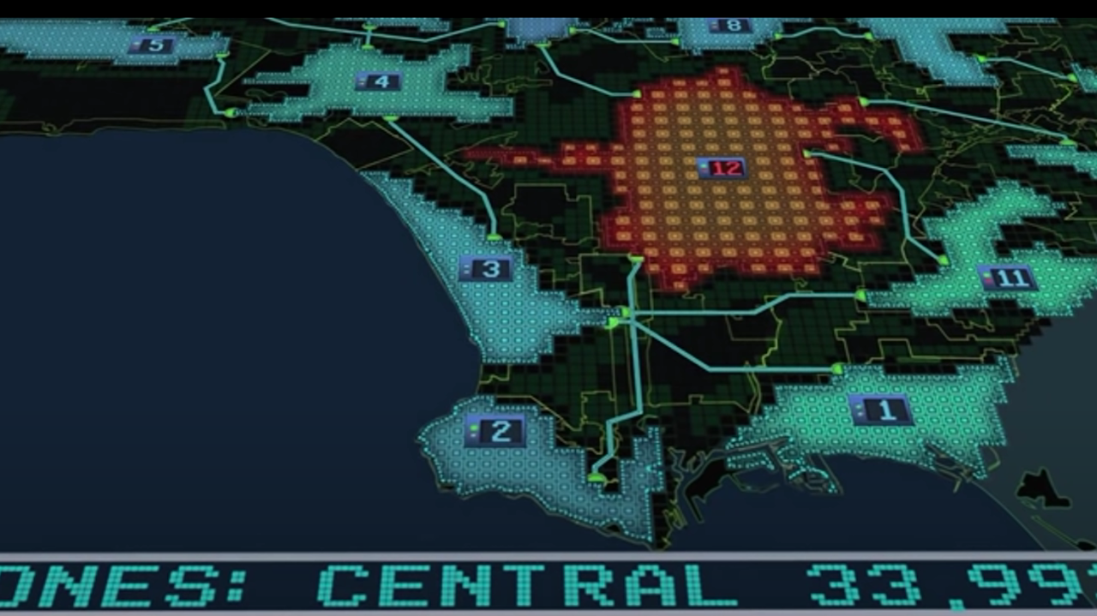
Computing Technologies
Akshay Shinde
Existing Technologies
  Facial Recognition
  Payphones
  Biometric Scanners
Emerging Technologies
  Genetic Engineering [6]
Plausible Technologies
  Time Zone Display Board
Fictional Technologies
  Time as Currency
Notes:
Akshay
The film In Time(2011) contains a multitude of computing technologies including existing, emerging, plausible, and fictional technologies.
The existing technologies from this film include:
Facial Recognition which is used by the Time Keepers to identify the identity of the suspect of time theft (Will Salas) in the film.
Payphones, which for a advanced technological world, is the most common mode of communication between person to person especially in poorer districts.
Biometrics Scanners that are used throughout the film to identify people, either through finger scanners for security systems or biometric wrist scanners to identify the time they have left.
The emerging technologies is genetic engineering. In the movie, advanced genetic engineering allowed humans to stop aging after the age of 25, allowing them to potentially live forever with enough time. While this level of genetic engineering is not been reached, studies have shown that silencing certain genes in our DNA can increase our life expectancy. [5]
Plausible Technologies include the time zone display board. In the movie, there was a screen that displayed the total time that existed amongst the population in each time zone. This allowed the Time Keepers to determine if there was a large breach in security between time zones. Whilst there is no reports of such technologies existing, government and law enforcement technologies definitely have access and resources to data on monetary assets amongst certain populations. Therefore, creating such a technology could be plausible.
Fictional technologies include the concept of time as a currency. The idea that time can be manipulated to the point where it can be stored in banks and be used expand our life span infinitely is too unrealistic in our current society.

Slide 5
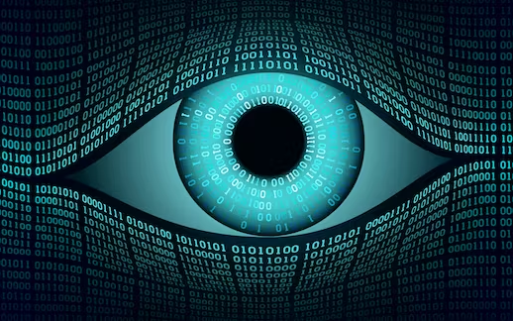
Conclusions: Privacy
Ryan Suarez
Lack of information privacy leads to the harm of individuals
Time keepers keep track of all time without due suspicion
Obtaining large amounts of info without a warrant can lead to misinterpreted data
Genetic Information Non-Discrimination Act of 2008 [1]
  Prevents employers and insurance companies to discriminate
Notes:
In the film In Time, the elites employ “Time Keepers” to keep social classes divided by enforcing strict laws through various surveillance technologies. By monitoring metadata through “Time Boards”, the Time Keepers are able to target individuals who pose a threat to their ability to restrict social mobility. The Time Keepers misinterpret Will’s acquisition of a large sum of time as theft and this leads them to and apprehend him and take most of his time away.
This is unethical because individuals should be able to use their Time at their own discretion and not have to worry about being persecuted without committing a crime. In 2008, the Genetic Information Non discrimination act was passed which prevented Health Insurance companies from using individuals genetic information to set insurance rates and prevented employers from considering genetic information when hiring staff. If the Genetic Information Non Discrimination Act did not exist, individuals who do not participate in biotech enhancements, like the digital watch implants seen in the film, would become unable to compete in the workforce.

Slide 6
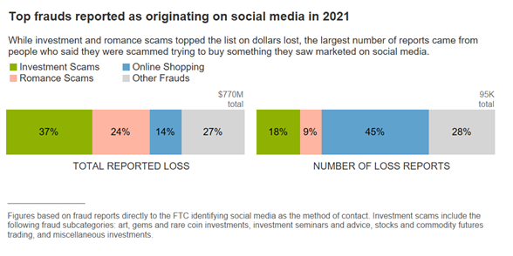
Publicly Available Personal Information
Lily Bromberger
2020: 67% of employers look at social media in the hiring process [2]
  57% of those who look at social media have used their findings to reject a candidate [2]
2021: $770 Million lost to fraud from social media [3]
  25% of all fraud in 2021 was from social media [3]
Notes:
The publicly available information for us is not our wealth but our social media presence. We, as a society, are getting more and more comfortable posting online, and having profiles that are open to the public. Not only can this information be seen by friends and family, but anyone who wants to learn more about you. Most notably, strangers who want to learn more about you include future employers and people with ill intentions.
When looking for a job, your skills and charm may no longer be enough. Employers want to know if culturally you can be a good long term fit so they dig deeper and they can do this without a private detective or a search warrant. They look to see if you are posting any activities that they simply don’t agree with. Are you partying too much? Have you posted inappropriate things politically?
Social media collects an astounding amount of information on individuals. The social media companies sell your information to advertisers and they will sell that to anyone willing to pay. This will lead you to getting customized ads that you are more willing to purchase but the companies providing the products may not be fact checked. They could be real, profitable businesses or they could be made up or selling products that do not exist.

Slide 7
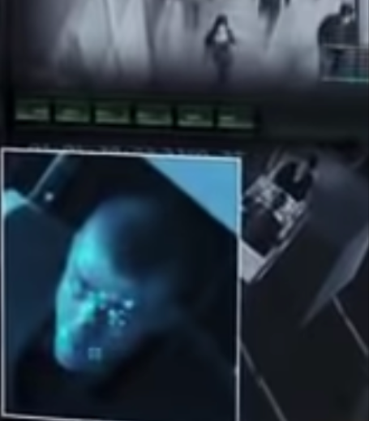
Digital Surveillance
Ryan Suarez
Faulty systems creates false sense of security
  “2005 study of 13 CCTV systems funded by the U.K. government for crime prevention, concluded they had little or no impact on crime recorded by the police, or on citizens’ perception of crime”
“On an annual basis, about one crime was resolved for every 1,000 cameras in operation” (London police, 2009) [5]
Shortcomings of The National Crime Information Center
Patriot Act
Notes:
In the film, the Time Keepers use digital cctv surveillance and facial recognition to track Will. These tactics are dangerous if not properly regulated since studies have shown that large scale use of CCTV cameras in the UK has been inefficient in solving crime. Only 1 crime is solved for every 1,000 camera installed and the system also has a negative effect on society because people do not feel more safe and their right to privacy is impeded on.
Furthermore, the US has had controversy over The National Crime Information Center is a collection of databases from local and federal law enforcement agencies, that holds millions of records on crime. The NCIC has been used to store information on individuals that is not related to crime such as an individual's political affiliation. The data entered by local agencies is not verified to be accurate or complete by the FBI. The NSA was able to use the Patriot Act to secretly order internet service providers to regularly provide law enforcement officials with records of all of their users activities.

Slide 8

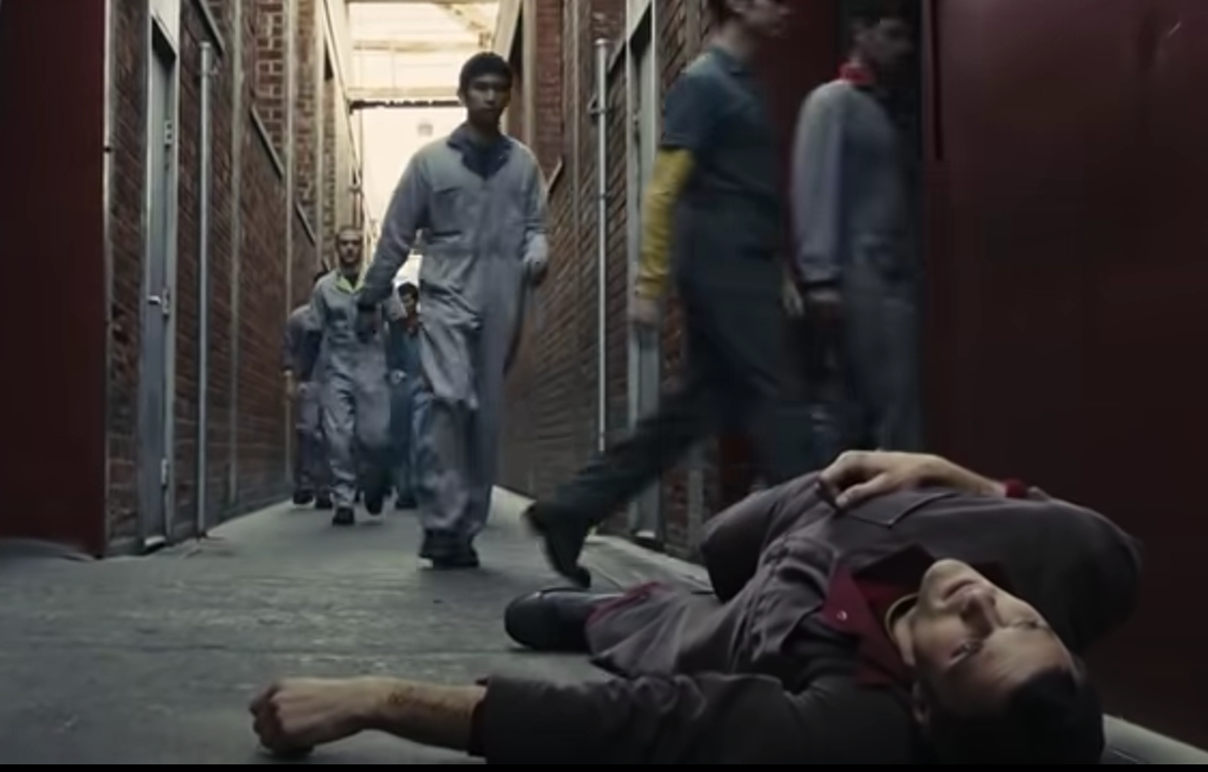
Conclusions: Inequality
Akshay Shinde
Control over Time → Control over Power
Disparity between Employment, Development of Zone and Culture
“Time Versus Possessions”
As automation technology promotes consumerism, the workforce becomes more competitive
Notes:
Another conclusion from the movie is the disparity from the elite and the poor which is widen by technology available to the rich compared to the poor. The elite has control over time: they control pricing for transportation, food, etc. and wages for all districts. This gives them total control over the lower districts, essentially using the lower districts as population control, while they live infinitely in peace. The separation of each socioeconomic classes into the zones also creates an easy barrier to keep technological advancements through having to pay to get out of zones and inflated prices of commodities from zone to zone.

Slide 9
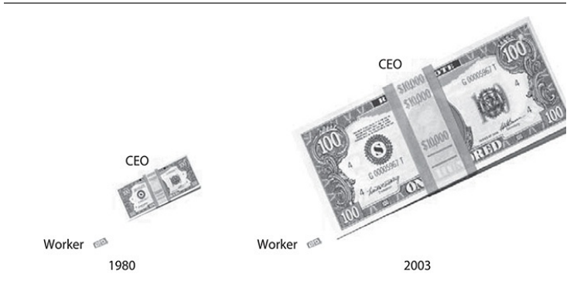
Disparity Between Time-Zones
Raman Kaushik
Downsides of “Winner Takes All Society”
Jobs have increased but wages have decreased.[4]
Wage increased dependent on position hierarchy.[4]
·
Average pay for CEO vs production worker [7]
1980: 40x pay
2003: 400x pay
[6]
Notes:
The movie depicts that whoever has control over time essentially has control over the other time-zones, and people’s lives.
Essentially, it depicts the Winner Takes All Society concept, where certain people receive a disproportionate share of the rewards.
Two studies which show this concept in a practical situation
In one study where broadband was adopted to make certain business functions automated and ultimately make communication more efficient ,estimates depict directors earn 17 percent more following firm adoption of broadband and managers earn 9% more.
Study in the book shows that CEO’s pay has exponentially increased compared to production workers.
This is due to CEO’s being seen as the people responsible for a company getting the slight edge over their competition to make their product the best in the market.
Consequently, even if the production worker does more labour and time intensive work, the CEO’s are seen as the ones who will make the product a winner.
A harmful consequence of this is the drastic gap between the rich and the poor.
As seen in the movie and previously discussed, this sort of control on time means they have access and power to control how employment, development of the region and etc due to their excess of time/power.

Slide 10

Ethicality of a Universal Currency
Raman Kaushik
A universal currency should level the playing field.
In contrast it led to a means to control
Kantianism → Not Ethical
Act Utilitarian → Not Ethical
Notes:
These conclusions pertain from having a universal currency in the first place
Technically and theoretically, a universal currency should level the playing field of everyone.
Instead, it lead to an almost monopolization of all the time zones controlled by the elites who essentially are the governing body.
With kantianism rules, it states that it is not ethical because when this case is applied universally, it is not morally sound.Additionally, people in lower time zones are being used as means to an end by the elites giving more reason to why it is not ethical via Kantianism.
Act Utilitarianism is more controversial as there are pros and cons. If implemented successfully, it would provide equality to access of resources.However, if implemented negatively than it would be controlled by a certain group of people-elites. Evidently, the negative aspect did occur, leading to the cons outweighing the positive and consequently even in this case, it is not ethical.

Slide 11
Key Takeaways
Raman Kaushik
Summary and Intent
The Currency is Time
There are various time zone to separate people by classism
Movie depicts the issues with lack of privacy
Ethicality of Universal Currency
Kantianism → Not Ethical
Act Utilitarianism → Not Ethical
Conclusion 1
Lack of information privacy leads to the harm of individuals
Conclusion 2
Technological advancements have widened the disparity between elites and everyday people.

Slide 12
REFERENCES
[1] “Genetic Information | HHS.Gov.” HHS.Gov, U.S. Department of Health & Human Services, 7 May 2008, https://www.hhs.gov/hipaa/for-professionals/special-topics/genetic-information/index.html#:~:text=The%20Genetic%20Information%20Nondiscrimination%20Act,health%20coverage%20and%20in%20employment.
[2] - Harry Kazakian - “How Social Media Can Reveal The Best (and Worst) Of Your Employment Candidates”, (Forbes, September 26th, 2022), URL, Accessed April 24th, 2023
[3] Emma Fletcher, “Social media a gold mine for scammers in 2021”, (FTC, January 25th, 2022), URL , accessed April 24th, 2023
[4] Poliquin, C. W. (2021). The Wage and Inequality Impacts of Broadband Internet. University of California, Los Angeles. https://poliquin.xyz/files/poliquin_jmp.pdf
[5] M. Angela Sasse. “Privacy and Security: Not Seeing the Crime for the Cameras?” Communications of the ACM, pp. 22–25, February 2010.
[6] Lois Zoppi, “Genetic manipulation can double life expectancy and increase health of offspring”, (Medical Life Sciences News, 2019), https://www.news-medical.net/news/20190306/Genetic-manipulation-can-double-life-expectancy-and-increase-health-of-offspring.aspx
[7] Quinn, M. J. (2020). 10.6. In Ethics for the information age (pp. 797–798). essay, Pearson.

