Slide 1
Gattaca
Benson, Bella, Colin, Michael, Vasilii

Slide 2

synopsis
“Not too distant future”
Society Split: "valid" (genetically engineered) and "invalids" (naturally born).
Vincent Freeman: born naturally, is labeled an "invalid" due to his perceived genetic inferiority
Problem? Only "valids" get into places like elite Gattaca space program.
Notes:
Plot Rundown:
Set in the not too distant future
Genetic engineering has advanced to the point where “perfect” humans can be created
Vincent Freeman is born naturally (an "in-valid"), meaning his genes say he’s weak, sickly, and useless. Still, Vincent's dream is to space travel.
Problem? Only "valids" get into places like the elite Gattaca space program. So, what does Vincent do? He basically says screw the system and starts using Jerome Morrow’s perfect DNA to fake his way in.
The movie is abouts Vincent’s journey overcoming his “shortcomings” trying achieve his dream

Slide 3




Characters
Vincent
Irene
Jerome
Anton
Notes:
Character overview
Vincent – main character, natural genetics, dreams of going to space
Irene – Vincent’s love interest, engineered genetics, but has heart condition
Jerome – engineered genetics, former swimmer, lost use of legs in attempted suicide, lends identity to Vincent
Anton – Vincent’s brother, engineered genetics,

Slide 4

Themes
Genetic discrimination
DNA is like your resume, good genes = good life. Bad genes = stay in your lane
“Discrimination down to a science”
Notes:
The introduction of genetic engineering has opened the door for discrimination based on genes
Your social status, societal standing, life outlook completely determined by your genes
In-valids face overt discrimination in several areas
job discrimination – genes determine employability
scene in movie where job interview only consists of DNA test
social prejudice – relationships – Irene reluctant to continue relationship with Vincent
after it is discovered, he is an invalid
valids only associate with other valids
Vincent’s dad does not want to give Vincent his name – he is not worthy
Represents common types of discrimination seen in real life
In general – the societal organization of valid / invalid people is oppressive in nature
As Vincent says – “we now have discrimination down to a science” – represents the impact of genetic engineering

Slide 5
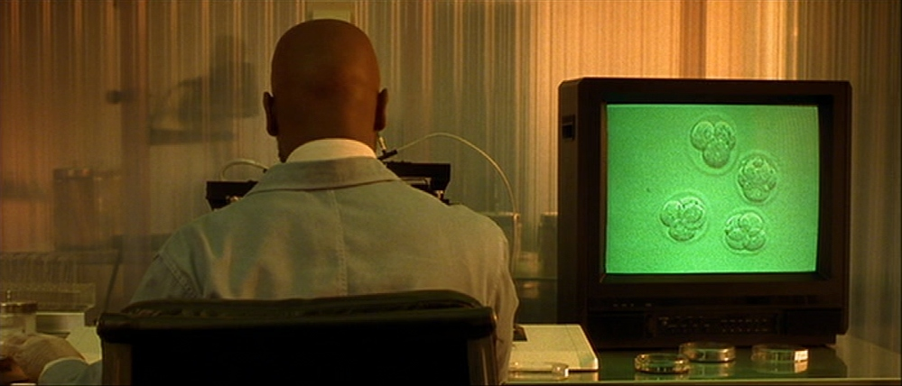
Computing Technology
Genetic Engineering
  Hand select traits and qualities
  Eliminate defects and diseases
Life Prognosis Analyzer
  Predicts likelihood of disease, disability
  Life expectancy
Notes:
Decidable qualities
physical traits - eye, hair, skin color, gender, height, athleticism
cognitive traits - intelligence level, mental health, emotional and behavioral stability
Eliminable diseases/conditions
obesity, myopia (poor eyesight), alcoholism/addiction, baldness
Predictable life outcomes
probability of disease – neurological condition, depression, ADHD, heart disease
life expectancy – early fatal potential
These are the main technologies that facilitate the divide between “valids” and “invalids”

Slide 6
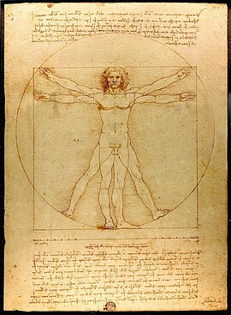
Humanistic arguments
For the technology that improves life quality [13]
Against the change of human nature [13]
Vitruvian Man [15]
Notes:
Humanism is an ideology that centers itself around the human perspective and the welfare of all humans
Humanists want to use technology to improve the quality of life of humans,
The movement limits itself, saying technology should not be used enough to eliminate the "human experience"
This ideology guided us in finding our conclusion.

Slide 7
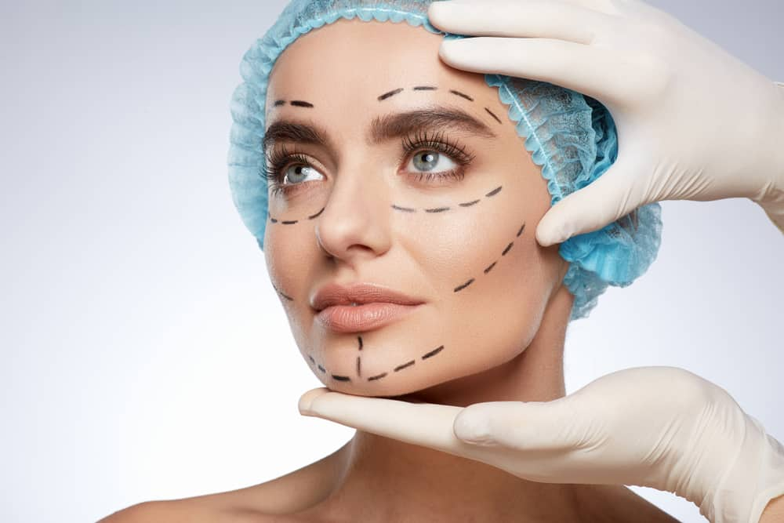
Genetic Editing should be used with restrictions
Gene therapy should be used to diagnose potential future diseases, or cure potential hereditary diseases
Draw the line at cosmetic changes, athletic changes
Cosmetic surgery should be optional [14]
Notes:
Gene editing should be used to eliminate the risk of certain diseases before birth
Gene therapy -> dementia, cystic fibrosis, myopia
Gene editing should not be used to make cosmetic changes or athletic changes before birth
Cosmetic changes -> eye color, height, hair color
Athletic changes -> height, testosterone levels, lung size/capacity
Cosmetic changes should be chosen by the person receiving those changes, gives more autonomy to those with edited genes
The goal is to improve quality of life, not make superhumans
The assumption is that this technology would be available to everyone.

Slide 8
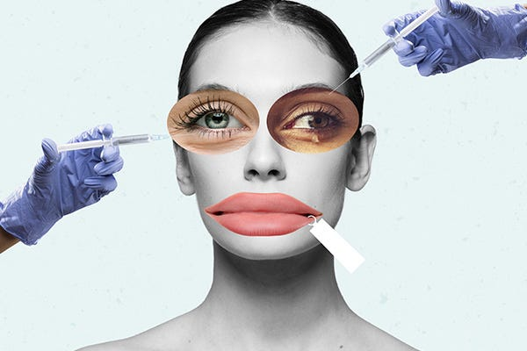
WHY NO COSMETIC/ATHLETIC MODIFICATION
Altering height/appearances promotes unrealistic beauty standards and could deepen social divide
Genetically modifying athletic changes undermines fairness in competition
Reduced genetic diversity and compromises on features that makes people unique
Notes:
First, messing with your genes to change appearances—like making yourself taller or sculpting the perfect jawline just fuels unrealistic beauty standards. This also makes it worse for people that are already struggling with the feeling that they don't measure up and can seriously mess with people's self esteem and push body dysmorphia to a whole new level.
Next is sports. Genetically modifying athletes to run faster, jump higher, or be stronger would cause massive fairness problems. We already have ongoing issues with doping and this would essentially be doping 2.0. It's like, what's the purpose of hard work or even natural talent when someone can just tweak their genes and get ahead? And ultimately, it destroys the integrity of competition. Sports are supposed to be about pushing human limits and not genetically modifying them in a lab.
And lastly, if everyone starts picking the same traits, like wanting to be tall, jacked, and with the same features, we're gonna lose a lot of what makes people unique. This would undermine genetic diversity and that's a problem for both health and cultlure. Humans are meant to be different—that's what gives us our identity, and if we start narrowing on what's acceptable, we lose the diversity that makes us interesting in the first place.

Slide 9
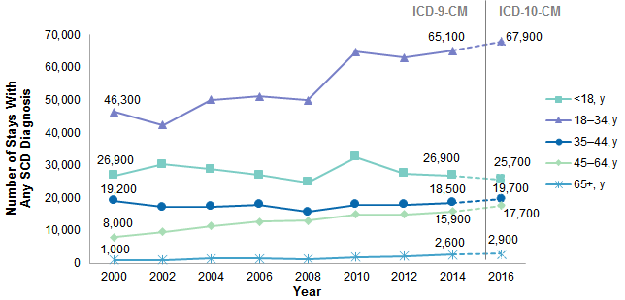
IMPROVING QUALITY OF LIFE
42.5% of healthcare paid claims in 2014 for a pediatric population in an Accountable Care Organization (ACO) were attributed to patients with genetic diseases [1]
21% of infant deaths are attributable to genetic diseases [2]
Sickle cells disease affect around 100,000 in USA and millions globally [3]
SCD reduces lifespan by more than 20 years [3]
The average life expectancy is 77.5 years [4]
[8] DESPITE SIGNIFICANT MEDICAL ADVANCES, MANY PEOPLE WITH SCD STILL SUFFER FROM HOPSITIALIZATION
Notes:
Alright, now let’s shift gears and talk about how gene-editing technology can actually be used for good—specifically, to improve people’s quality of life. We’re talking about tackling severe genetic diseases head-on.
In 2014, 42.5% of pediatric healthcare claims were tied to genetic diseases. That’s a huge chunk, especially when you’re looking at the burden it puts on healthcare systems. Think about how much gene-editing could help here. If we can prevent or even cure these diseases before they become a major issue, that number could drop dramatically. This would take a massive weight off the system and improve the lives of thousands of kids.
In addition, 21% of infant deaths are due to genetic conditions. That’s over one-fifth of babies who don’t make it because of something we might be able to fix with gene-editing. By using this tech to intervene early, we could save so many lives. These kids could go from facing almost certain death to having a chance at a healthy life.
Let’s take sickle cell disease (SCD) as a specific example. Over 100,000 people in the U.S. deal with this brutal condition, and it seriously messes with their quality of life. Think constant pain, infections, and hospitalizations.
Even worse? It cuts their lifespan by more than 20 years.. Imagine losing two decades off your life just because of a genetic mutation. And this is all with the fact that the average life expectancy in the U.S. is almost 78 years.
We’re not just talking about longer lives—we’re talking about giving people with genetic diseases a shot at living the kind of life the rest of us take for granted.
REFERENCE TO THE CHART
Now, if you look over at the chart here, you can see that despite all our medical advances, people with SCD still have high rates of hospitalization and a reduced quality of life.
The goal should be to eliminate these conditions altogether, and that’s where gene-editing comes in.

Slide 10
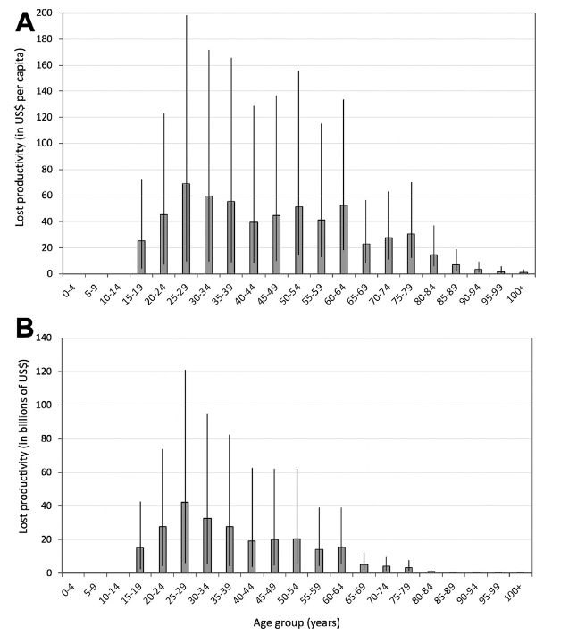
REDUCED cost of HEALTH care
People with SCD pay 4x more out of pocket with average of 44k compared to those without [5]
Insurers pay 1.7 million per person over the lifetime of someone with SCD [50]
23% of world population has myopia and predicted to increase to 50% by 2050 [6]
The global cost of productivity due to uncorrected myopia-related impairment is $244 billion [7]
[9] SHOWS GLOBAL PRODUCTIVITY LOSS ATTRIBUTED TO MYOPIA ACROSS VARIOUS AGE IN 2015
Notes:
Another benefit of gene-editing is that it cuts down healthcare costs.
Let’s continue with SCD. People with SCD are paying 4x more out of pocket compared to those without it. We’re talking about an average of $44,000 per year.
That’s a huge burden on families, and gene-editing could help by potentially curing the disease, which means way fewer doctor visits, fewer medications, and of course, way less out-of-pocket spending.
Now, think about it from the insurer’s perspective. They’re paying around $1.7 million per person over the lifetime of someone with SCD.
If we could use gene-editing to eliminate SCD from future generations, that’s money saved—not just for individuals but for the healthcare system overall. We’re talking millions of dollars saved per patient.
Another example that’s more prevalent is myopia. About 23% of the world’s population is already dealing with it, and that number is predicted to hit 50% by 2050. That’s half the planet needing glasses or contacts if we don’t address it.
And again, gene-editing could step in here by preventing them from developing myopia or at the very least make them more resistant to it.
Some might brush off myopia as no big deal, but the global cost of lost productivity from uncorrected myopia? That’s a staggering $244 billion. Think about how much we could save if we fixed this with gene-editing technology. Not only would people be able to see better, but they’d also be more productive, cutting down on economic losses.
REFERENCE TO CHART
So if you check out the graph, it’s showing us the productivity loss across different age groups, and you can see just how much of a hit it takes in certain key age ranges.
To put it simply, gene-editing has the potential to dramatically reduce both personal and system-wide healthcare costs. It saves both life and cost.

Slide 11
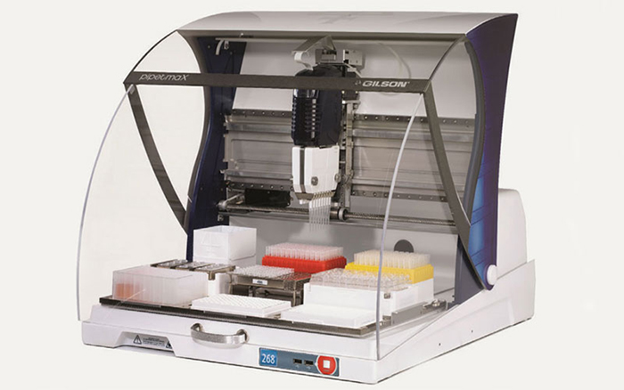
Ethical use of Gene Editing Technology
It is illegal to discriminate based off genetic information
Concerns about greater class divide [10]
Availability to everyone would cost about $100 billion a year [11]
CRISPR Machine [12]
Notes:
Illegal to discriminate on basis of genes according to the Genetic Information Nondiscrimination Act (covered in book)
Still important to put measures in place to protect against discrimination
For example, if gene editing technology, which is already expensive, were to essentially only be available to the upper class?
Therefore, would need to be available to everyone – likely means government would need to pay to guarantee every baby is able to get it.
Price for every baby in the US to get this treatment would be $100 billion yearly, assuming 5 million babies per year at $20,000 per baby
Sounds expensive, but amounts to just 2% of the national budget yearly.
When the amount of money saved in the future is considered, gene therapy seems cost effective.

Slide 12
References
[1] [Miller, K. E., Hoyt, R., Rust, S., Doerschuk, R., Huang, Y., & Lin, S. M. (2020). The financial impact of genetic diseases in a pediatric accountable care organization. Frontiers in Public Health, 8(58). https://doi.org/10.3389/fpubh.2020.00058]
[2] [Kingsmore, S. F., Henderson, A., Owen, M. J., Clark, M. M., Hansen, C., Dimmock, D., Chambers, C. D., Jeliffe-Pawlowski, L. L., & Hobbs, C. (2020). Measurement of genetic diseases as a cause of mortality in infants receiving whole genome sequencing. npj Genomic Medicine, 5(49). https://doi.org/10.1038/s41525-020-00155-8]
[3] Centers for Disease Control and Prevention, "Data and Statistics on Sickle Cell Disease," (May 15, 2024), https://www.cdc.gov/sickle-cell/data/index.html(Accessed October 3, 2024).
[4] Centers for Disease Control and Prevention, "Life Expectancy," (May 2, 2024), https://www.cdc.gov/nchs/fastats/life-expectancy.htm (Accessed October 3, 2024).
[5] National Institutes of Health, "Researchers identify the high costs of living with sickle cell disease," (May 16, 2022), https://www.nih.gov/news-events/news-releases/researchers-identify-high-costs-living-sickle-cell-disease (Accessed October 3, 2024).
[6] Erin Tomiyama, "Myopia: An Epidemic of Global Proportions," Optometry Times Journal, Volume 16, Issue 03, March 21, 2024, https://www.optometrytimes.com/view/myopia-an-epidemic-of-global-proportions (Accessed October 3, 2024).
[7] Mara Sugue, "Global Prevalence of Myopia (2024)," Vision Center, May 30, 2024, https://www.visioncenter.org/resources/myopia-prevalence-statistics (Accessed October 3, 2024).
[8] Here is the citation for the source you requested: Fingar KR, Owens PL, Reid LD, Mistry KB, Barrett ML. Characteristics of Inpatient Hospital Stays Involving Sickle Cell Disease, 2000-2016. Healthcare Cost and Utilization Project (HCUP) Statistical Brief #251. September 2019. Agency for Healthcare Research and Quality, Rockville, MD. https://hcup-us.ahrq.gov/reports/statbriefs/sb251-Sickle-Cell-Disease-Stays-2016.jsp (Accessed October 3, 2024).
[9] Naidoo, K. S., Fricke, T. R., Frick, K. D., Sankaridurg, P., Naduvilath, T. J., Resnikoff, S., & Jong, M. (2018). Potential lost productivity resulting from the global burden of myopia: Systematic review, meta-analysis, and modeling. Ophthalmology, 126(3), 338-346. DOI: 10.1016/j.ophtha.2018.10.029 (Accessed October 3, 2024).
[10] Fenn, Kirsten, "Gene editing could make social inequalities worse if misused, warns author", (CBC Mar 23, 2021), https://www.cbc.ca/radio/thecurrent/the-current-for-march-23-2021-1.5960200/gene-editing-could-make-social-inequalities-worse-if-misused-warns-author-1.5960568#:~:text=Benefits%2C%20drawbacks%20of%20gene%20editing&text=If%20we%20start%20using%20gene,a%20nightmare%2C%22%20Isaacson%20said, (Accessed Oct 3, 2024).
[11] Smith, Noah, "Gene Editing Needs to Be Available to Everyone", (Bloomberg Jan 25, 2018), https://www.bloomberg.com/view/articles/2018-01-25/gene-editing-needs-to-be-available-to-everyone, (Accessed Oct 3, 2024).
[12] "CRISPR/CAS9 Genetic Engineering", (Biomedical Scientist May 24, 2024), https://thebiomedicalscientist.net/2019/05/01/crisprcas9-genetic-engineering, (Accessed Oct 3, 2024).
[13] Bulger, Matthew, "Will Humanists Embrace Emerging Technology before Others?", (The Humanist May 19, 2014), https://thehumanist.com/features/articles/will-humanists-embrace-emerging-technology-before-others/, (Accessed Oct 3, 2024).
[14] "The Biggest Differences Between Plastic and Cosmetic Surgery", (Dental Implant 2021), https://goldcoastimplantspecialist.com.au/news/what-is-the-difference-between-plastic-and-cosmetic-surgery/, (Accessed Oct 3, 2024).
[15] "The Vitruvian Man – by Leonardo da Vinci", (LeonardodaVinci.net), https://www.leonardodavinci.net/the-vitruvian-man.jsp, (Accessed Oct 3, 2024).

