Slide 1

Free Guy
By Eleanor, Keagan, Teddy, Natalie and Jack

Slide 2


General Plot (Part 1)
Free Guy is about an NPC character, Guy, who becomes self aware and decides he wants to take control over his life. Guy is in the video game Free City where he meets Millie, a player, who is trying to find pieces of her game’s code in Free City. Guy develops a crush on Millie which leads him to help her out.
[2]
[1]
Notes:
Eleanor - will say the general plot of Free Guy (shouldn’t be difficult we all watched the movie)

Slide 3
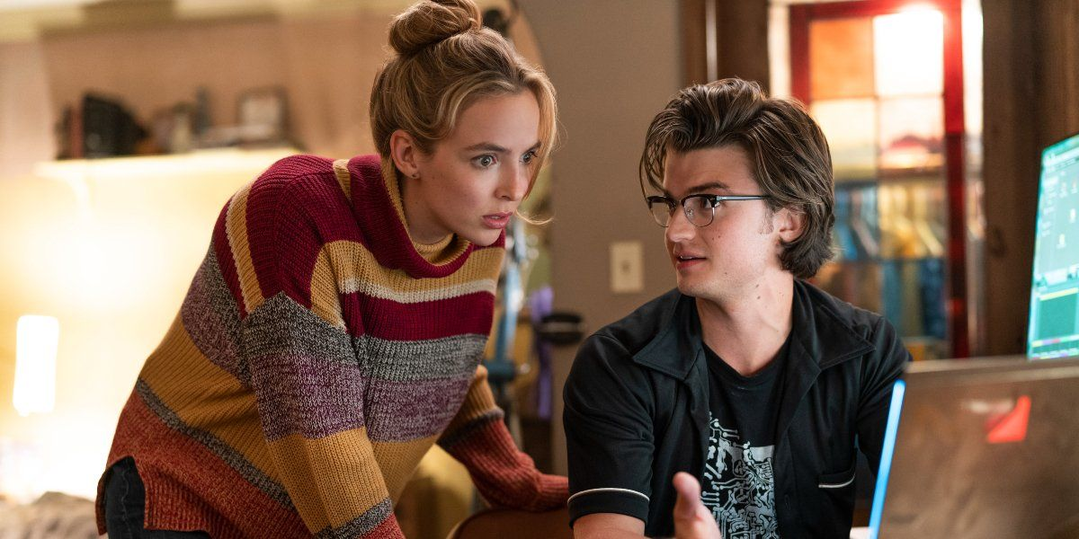

General Plot (Part 2)
Millie then finds out Guy is a NPC character from Keys, the co-creator of their previous game. Keys now works for the creator of Free City, Antwan. With the revelation of there being NPCs who have gained artificial intelligence, Millie and Keys know their code is copied for a fact. They work with Guy to bring this to light before Antwan deletes the game. In the end, they succeed.
[12]
[3]
Notes:
Eleanor - will say the general plot of Free Guy (shouldn’t be difficult we all watched the movie)

Slide 4

Director’s Intent
Shawn Levy
Appealing to gaming community[9, 10]
Video game chaos/digital beauty[11]
Good/Bad actions in games
Moral conundrum of AI rights
[8] Picture from cast interview
Notes:
The director wanted the movie to
appeal to gaming community
Display a dichotomy between chaos in videogames and the potential for digital beauty
Show how players deal with moral choice in their actions when they have no consequences(players start in the movie almost entirely evil, without care for the environment in which they play, but progress towards less violent methods of progression)
Poke fun at the speed of trends and how things go viral(through the “blue shirt guy” phenomenon)
Show how people may react to the emergence of AI, some compassionate and others indifferent(Game company CEO essentially holding guy hostage in order for milly not to sue him)

Slide 5
Main Takeaways
Free Guy reflects real life for the general lack of safety on the internet. It is easy for our data to be collected and used to manipulate our online world just like in the movie. Also, intellectual property isn’t properly protected and it’s easy for big corporations to steal it and how we need more laws to protect it.

Slide 6
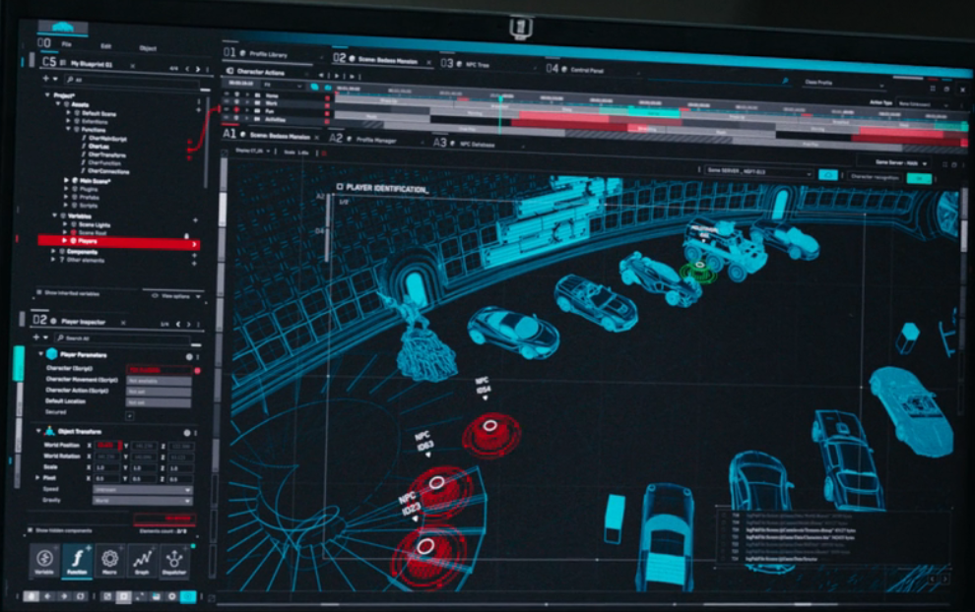
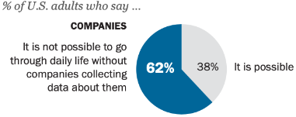
Data Collection
Any information in game can be monitored
  Similar to real world tracking by tech companies - any information can be held [6]
Players and NPCs are unaware of the surveillance employed on them
  Agreed to under “Terms and Conditions” for players, but NPCs have no rights
  Lack of transparency - 22% of adults say they read the terms and conditions [7]
  62-63% of Americans say it is not possible to avoid companies or the government collecting personal data [7]
[13]
[7]
Notes:
Free Guy shows a world where all data can be collected easily. Any information that a player or NPC puts into the game can be monitored by the developers, including their locations, level, and any other actions taken in-game. The picture shown here (point to bottom left picture) has the view of a developer in-game, where the red dots represents each NPC or player and all the blue shows the in-game objects. This can be compared to the real world, where if you use a product online, it is expected that the company who creates the product has access to your usage of the product. In addition, there is no restriction on the type of information that can be collected by a private company and consumers have no right to know what companies hold what data [6].
Also, many people are unaware that their data is being collected. In Free Guy, the players likely accepted some Terms and Conditions where they agreed to have their in-game data collected, but the NPCs have no idea that they are in a game and did not agree to have their data collected. This also shows that there is a lack of transparency about data collection, as even for the players who accepted a Terms and Conditions, they likely did not read all of it and do not have an exact knowledge of what data is being collected and for what. A 2019 survey from Pew Research showed that 22% of adults say they read the terms and conditions all the way through, and 62-63% of Americans say that it is not possible to go through their daily life without companies and the government collecting personal data [7]. Despite appearing as if these “agreements” maintain transparency from both sides, it instead becomes relatively unrestricted data collection on consumers from the government and private companies.

Slide 7
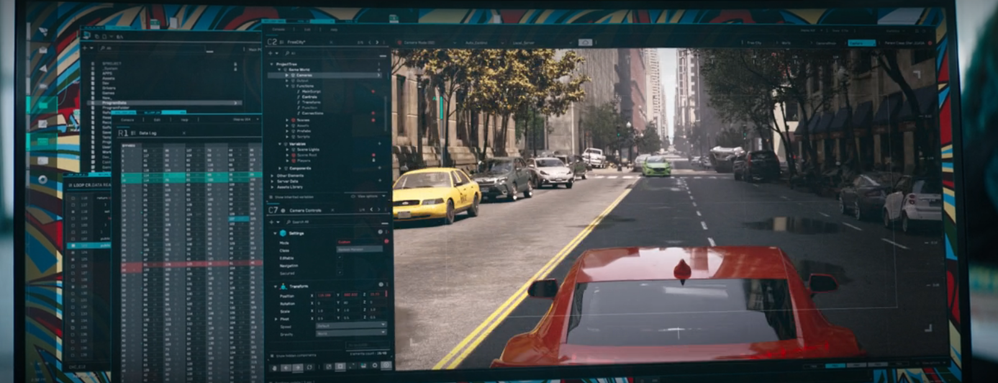

World Manipulation
Players can interact with the world in a way NPCs cannot, and developers can modify the world in a way players cannot
  Like class differences in real world - who has the most power?
  Corporate lobbying can increase power of corporations [14]
Developers and Antwan can directly modify the world, but not directly kill Guy or other NPCs
  Government has power and can oppress its people but not unlimited power
[13]
[13]
Notes:
Another comparison between Free Guy and the real world lies with the way players and developers can manipulate the world. Players can interact with the world using their glasses, and although NPCs can theoretically take the glasses like Guy did in the movie, NPCs are programmed to avoid doing that, so players have more inherent power than NPCs. Meanwhile, the developers have even greater abilities - the left picture shows a developer of Free City taking advantage of these abilities to summon a car in an attempt to stop Guy, causing the explosion shown on the right side. This can be compared to class differences in the real world, where although on the surface it may seem like people have equal rights, many people have privilege that gives them an advantage over others. This privilege can come from many sources, such as race, gender, or sexuality, or other class differences that allow the rich to control the economy and influence policy. For example, corporate lobbying is when a company hires people to influence the decisions of the government, and this is usually done to allow these corporations to hold more power and earn more money [14].
The developer abilities shown by the developers and Antwan, who tries destroying the servers fully and deleting the world, have more power than the player but are still unable to kill Guy or the other NPCs. This can be compared to how the government has power and can oppress its people, but it does not have unlimited power as it cannot do certain actions either under its own rules, physical limitations, or in fear of its people revolting.

Slide 8

Individual and Intellectual Property [4][5]
IP is the plot’s driving theme
  Millie and Keyes sell their game to Antwon
  Antwon shelves it, releases a similar game
  Similar game had stolen their code without paying royalties
  Search for proof drives plot
Important discussion on protecting IP and who owns what in the digital era

Slide 9
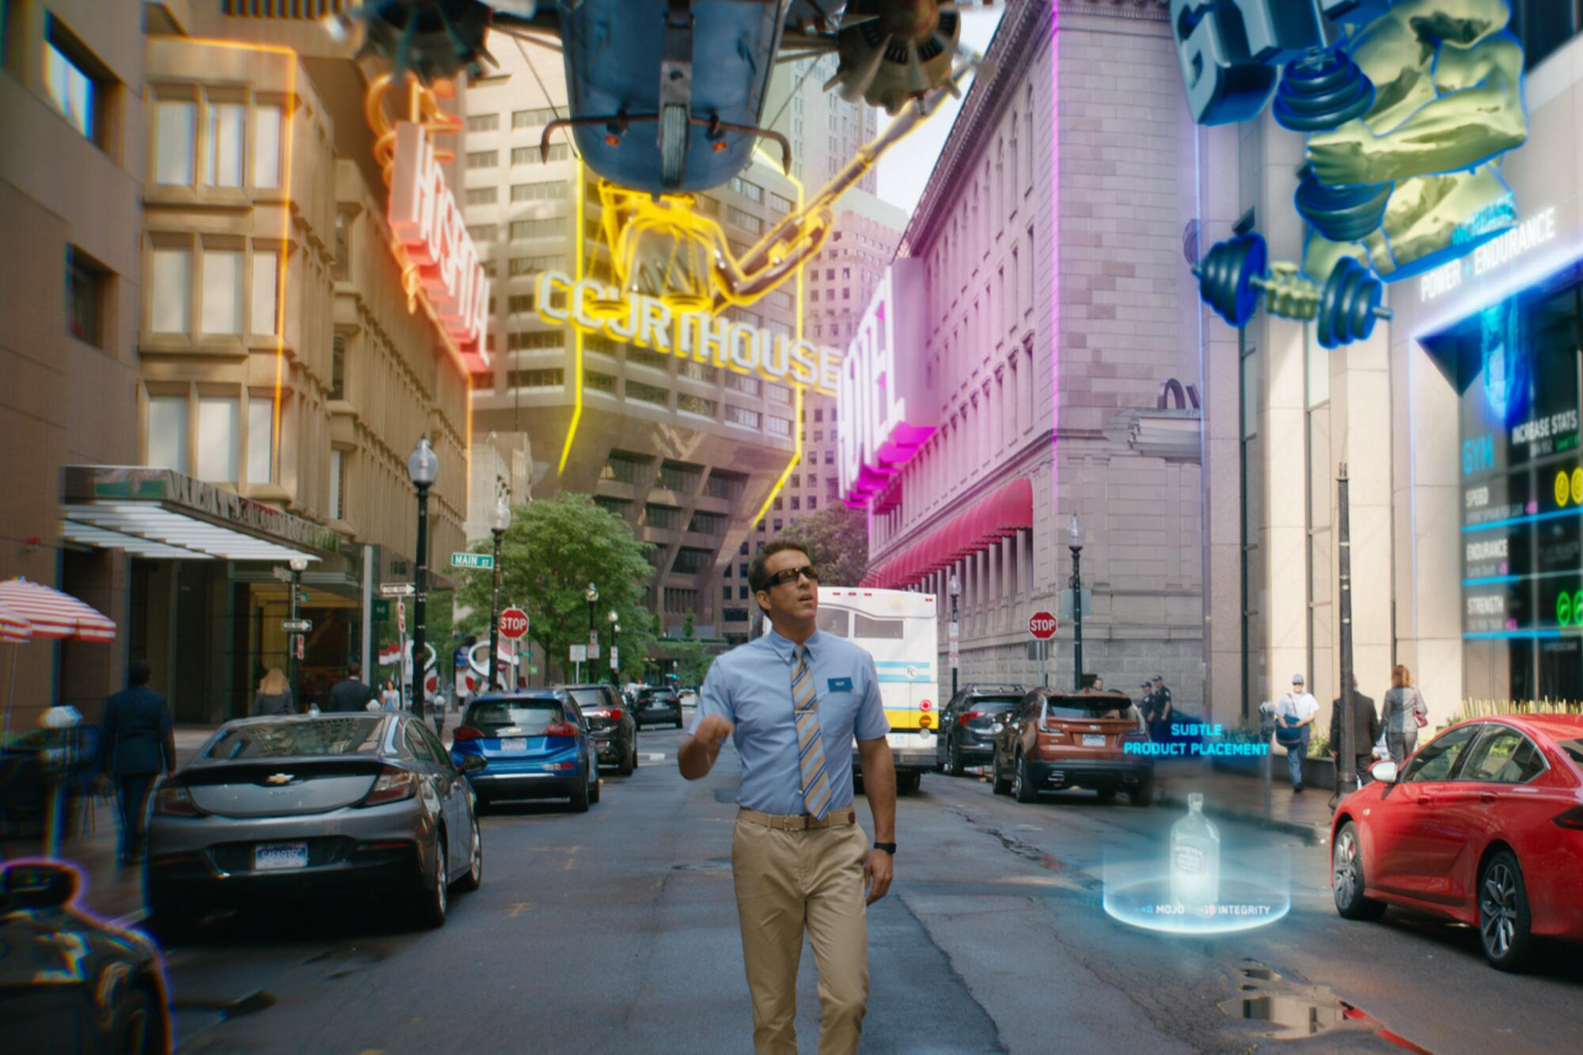

Overall Conclusions (Natalie)
Free guy relates to this class:
Data Collection
World Manipulation
Intellectual and individual Property
Notes:
Free Guy reflects real life for the general lack of safety on the internet, It is easy for our data to be collected and used to manipulate our online world just like in the movie. Also, intellectual property isn’t properly protected and it’s easy for big corporations to steal it and how we need more laws to protect it.

Slide 10
References
“Free Guy.” Movieposters.Com, https://www.movieposters.com/products/free-guy-mpw-125811. Accessed 7 Oct. 2024.
Dodge, John. “Jodie Comer Rumored to Join Cillian Murphy in 28 Years Later.” CBR, 5 Apr. 2024, https://www.cbr.com/jodie-comer-cillian-murphy-28-years-later/.
Jennings, Collier. “‘Free Guy’: Why Millie and Keys Are the Heart of the Movie.” Collider, 15 Mar. 2022, https://collider.com/free-guy-keys-millie-relationship/.
https://heinonline.org/HOL/Page?collection=journals&handle=hein.journals/sjjlc11&id=649&men_tab=srchresults
https://www.sciencedirect.com/science/article/pii/S1877050921003902
“Protecting Personal Privacy.” U.S. GAO, U. S. Government Accountability Office, www.gao.gov/protecting-personal-privacy. Accessed 6 Oct. 2024.
Auxier, Brooke, et al. “Americans and Privacy: Concerned, Confused and Feeling Lack of Control over Their Personal Information.” Pew Research Center, Pew Research Center, 15 Nov. 2019, www.pewresearch.org/internet/2019/11/15/americans-and-privacy-concerned-confused-and-feeling-lack-of-control-over-their-personal-information/.
Peter Gray, Interview: Free Guy director Shawn Levy and the creative team on bringing their unique world to life (Aug 10th, 2021) https://www.theaureview.com/watch/interview-free-guy-director-shawn-levy-and-the-creative-team-on-bringing-their-unique-world-to-life/ (Oct 4th 2024)
Siegel, Tatiana. “The Low-Key Hustle of ‘Free Guy’ Filmmaker Shawn Levy: ‘I’m Willing to Outwork Anybody.’” The Hollywood Reporter, 5 Aug. 2021, https://www.hollywoodreporter.com/movies/movie-features/free-guy-filmmaker-shawn-levy-1234992187/ .
BBC Click. “Free Guy: How We Did The Visual Effects” YouTube. 2022, https://www.youtube.com/watch?v=bKBSi4Zj7x8&feature=youtu.be .
Hullfish, Steve. “Behind the Scenes of Ryan Reynold’s ‘Free Guy.’” Frame.Io Insider, 26 Aug. 2021, https://blog.frame.io/2021/08/26/ryan-reynolds-free-guy-dean-zimmerman/ .
Schaefer, Sandy. “Free Guy Director Teases His Taiki Waititi Improvisation Super Cut.” CBR, 12 Aug. 2021, https://www.cbr.com/free-guy-taika-waititi-improvisation-cut-scenes/ .
Levy, Shawn, director. Free Guy. Disney Plus, 13 Aug. 2021, https://www.disneyplus.com/play/7097fb34-995b-4690-bf44-00be956b426a . Accessed 7 Oct. 2024.
Nazur, Facundo Jose. “Corporate Influence: Exploring the Relationship Between Lobbying and Corporate Power.” Harvard Law School | Systemic Justice Project, July 2021, https://systemicjustice.org/article/corporate-influence/ .

