Slide 1
Don’t Look up
Winston Lewis, Oliver Reera, Xiao Xiao

Slide 2
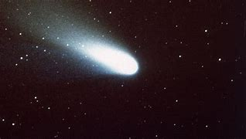
Plot summary
Winston Lewis, Oliver Reera, Xiao Xiao
NASA scientists discover a comet will strike and wipe out Earth
Gov. does not want to tell the entire truth to the public
NASA scientists reveal the whole truth to the public
Notes:
“Don’t Look Up” is about two astronomers who learn that there is a comet approaching that would likely obliterate the entire planet. The astronomers wanted to tell the world about their findings, but the government advised them not to because they did not want to send the world into a frenzy. The government worked to downplay the severity of the comet after it was revealed that the comet was coming, and became upset when the astronomers emphasized the true danger of the comet anyway.

Slide 3
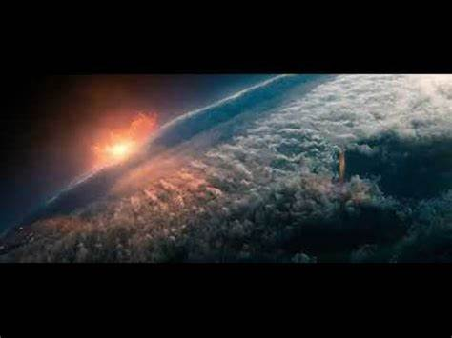
Plot summary (Continued)
Winston Lewis, Oliver Reera, Xiao Xiao
Gov tries to stop the comet but changes their mind
Gov tries to mine the comet for valuables
  They are unsuccessful
Clash between 'comet believers' and 'comet deniers'
Planet is almost entirely wiped out along with most technology
Notes:
The government later decided to try and stop the comet, but only because a scandal happened that could potentially have cost the president her re-election. The government planned to destroy the comet with rockets, but changed their minds once they noticed the comet was embedded with valuable materials that could help the economy. The government tried mining the comet but failed, and the government started a movement to convince people the comet was a hoax and that no one’s lives were at stake. The astronomers also started a movement, but theirs was to persuade people the comet was real and everyone was in danger. Eventually the comet hits, killing almost all life forms.

Slide 4
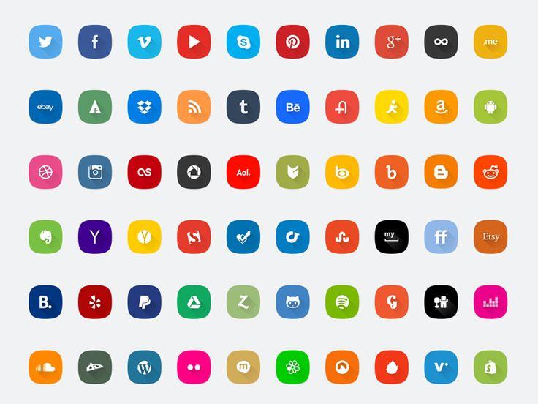
CONCLUSIONS
Winston Lewis, Oliver Reera, Xiao Xiao
Computing tech. often influences our decisions in beneficial ways
Social media and technology often shape the public’s opinions
The wealthy are unaffected by the problems they create, through technology
Notes:
After watching the film, my group and I derived three main conclusions: READ OFF SCREEN

Slide 5
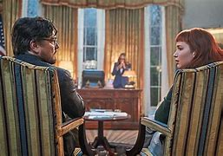
Comet discovery
Winston Lewis, Oliver Reera, Xiao Xiao
Dibiasky uses computing tech. to adjust her view of outer space
She notices the comet is headed toward Earth
Info. uncovered influenced decision to inform others
Notes:
Towards the beginning of the film, astronomer Kate Dibiasky uses computing technology to adjust her view of outer space and looks at her computer screen. She then zooms in and notices that there is a comet, and that it is headed toward Earth. Because computing technology helped her learn that a comet was headed toward Earth, Dibiasky felt the need to reach out to colleagues and study it more, which led to her and her colleagues understanding the true nature of the comet, and to them collaborating with the government to try and resolve the issue. Without her computing technology, Dibiasky definitely would not have made the decision to inform others, as she would have been unaware of the comet in the first place.

Slide 6
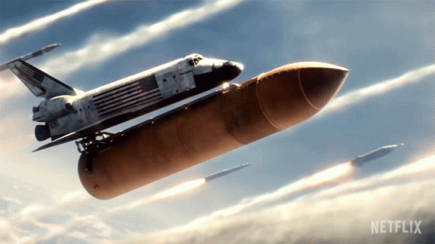
Comet Destruction
Winston Lewis, Oliver Reera, Xiao Xiao
Gov. acknowledged the threat of the comet in public
Rockets were created and sent to destroy the comet
Plan was aborted
Notes:
When the government finally acknowledged the threat of the comet in the public eye, they worked with astronomers and scientists to develop rockets and obliterate the comet. While the rockets were flying to the comet, however, the government learned about the various metals within the comet, and this compelled the government to abort the mission...
*SWITCH QUICKLY!!!!!!*

Slide 7
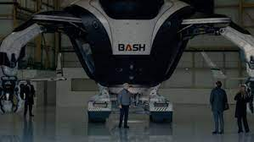
Comet mining
Winston Lewis, Oliver Reera, Xiao Xiao
Later realized the comet was profitable
  Possessed all kinds of metals
BASH company created drones to mine the comet
Notes:
This also would be the reason why BASH, a phone company, utilized CASE (computer-aided software engineering) tools and simulations to develop, verify, and validate drones to mine the comet for its metals (that would give the country an advantage in the phone market). The government worked with BASH and felt great about the plan.
The irony of this scene is that computing technology was used to create a course of action against the comet, but the same type of computing technology influenced the same people to cancel its destruction and profit off of it instead.
*Mention how this decision would be not considered positive in the eyes of most, but those who were directly influenced did what they considered to be positive.

Slide 8
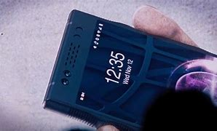
EMOTIon REmEDIES
Winston Lewis, Oliver Reera, Xiao Xiao
BASH LiiF 14.3 phone
Device determines your emotions then treats you accordingly
Device sensed the CEO was sad, then provided a video
  The video cheered the CEO up
Notes:
There is also a scene in the film when a new phone is unveiled called “BASH LiiF 14.3”.
One of the main features of the phone is that it has sensors that allow it to determine what emotion you are feeling, and then treats you accordingly. The phone was held by the CEO of BASH, the phone determined that the CEO was sad, then it recommended a video for the CEO to watch.
The CEO then watched the video, and he gained some joy from it. In this instance, the computing technology influenced the CEO to take action to better himself. If he did not take action, he would have continued to feel sad.

Slide 9
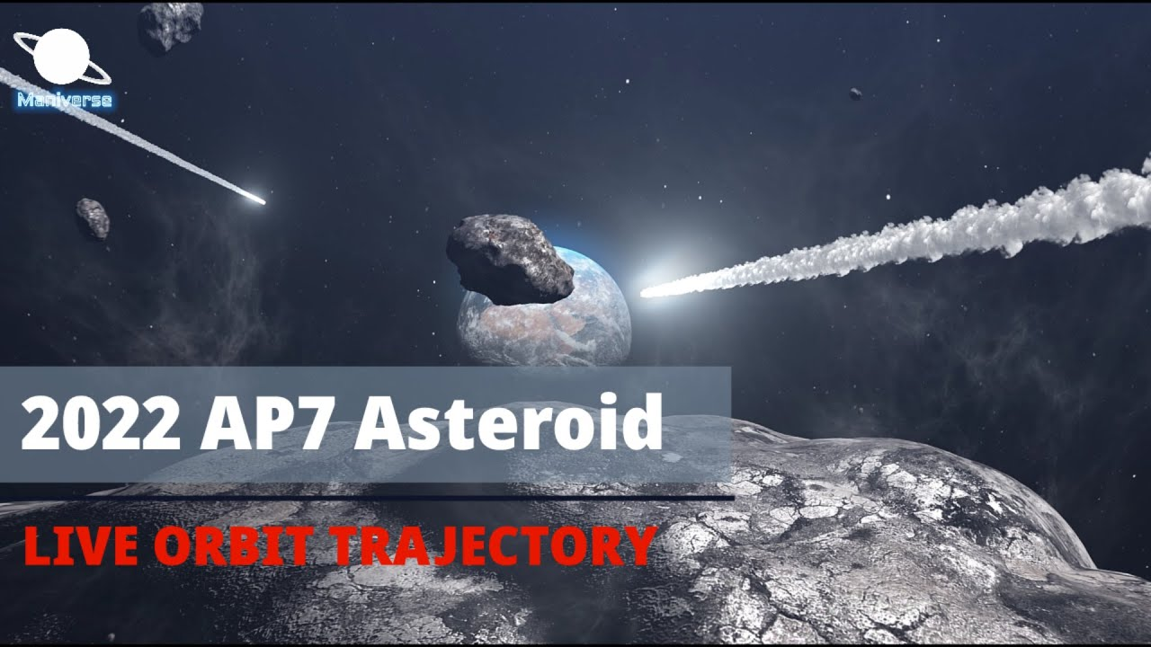
SAVInG THE WORLD
Winston Lewis, Oliver Reera, Xiao Xiao
NASA has found 27,000 asteroids close to Earth [1]
  One of which could wipe out the planet
Most of these asteroids were found with a Dark Energy Camera
  Findings influenced NASA to find and prepare for planetary threats
Notes:
In the real world, computing technology also influences our decisions on a large scale. In 2022, NASA has found 27,000 asteroids that are close to Earth [1]. One of the asteroids uncovered has the potential to obliterate Earth upon impact [1]. NASA used a computing technology called a Dark Energy Camera to find this asteroid, which allows them to view more areas in the sky and view areas more clearly than a telescope would allow them to. In this case, computing technology influenced NASA to look out and prepare for other threats to the planet (like the Double Asteroid Redirection Test).

Slide 10
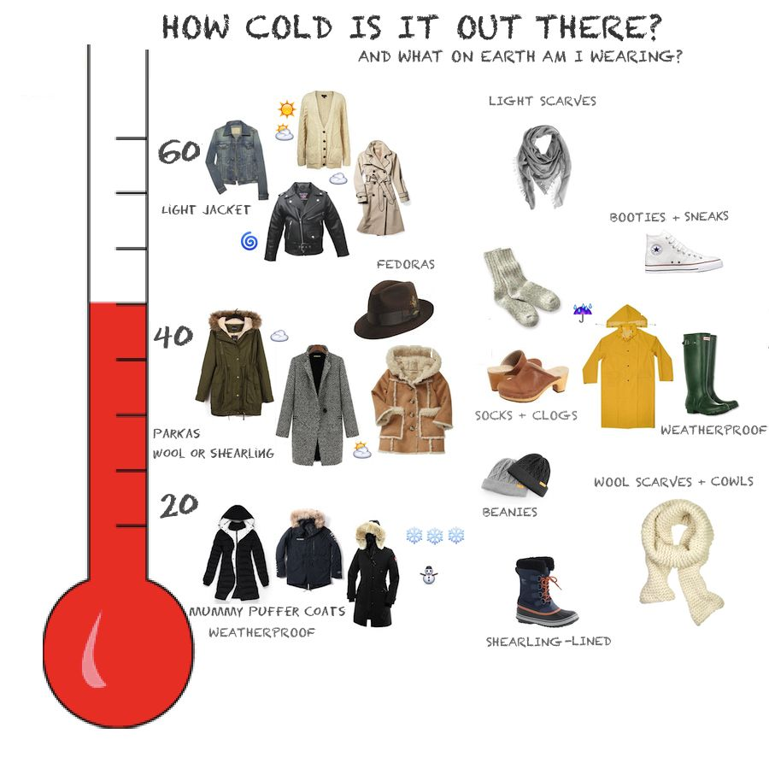
DAILY PLANNING
Winston Lewis, Oliver Reera, Xiao Xiao
Computing tech. influences relatively small everyday too
In 2022, 400+ million people actively used the Weather Channel app [2]
  People actively used the statistics to plan their outfits and activities
Notes:
Computing technology not only influences decisions on a large-scale, but computing technology influences small-scale decisions as well. As of 2022, it was found that over 400 million people actively use the Weather Channel app [2]. This implies that over 400 million people base their outfits, activities, and general plans for the day on information they receive from their computing technology.

Slide 11

Detrimental Influences
Tons of misinformation
"460 sites in 113 countries were studied:
  35% of medical websites and about 75% of financial sites provided poor and unreliable information" [3]
We can use tech. to help us overcome the misinformation
Notes:
State the statistic and explain how the misinformation we find negatively influences us (we go into the world believing and acting upon incorrect information)
For the rebuttal, explain how we can find credible and accurate sources/individuals that will influence us to make better decisions.

Slide 12


Notes:
Continuing to dig deeper into the previous two conclusions, we found different social problems caused by technology: the first is blurring of the public and private spheres.
In the movie, when Dibiasky first came out in the media and expressed the seriousness of things in a more drastic way, people don't like her representation in the media and made very humiliating memes about her. Not only that, Dibiasky's ex-boyfriend immediately write an article about Dibiasky's private life in order to distance himself from the relationship. Such behavior makes Dibiasky seem like a public enemy.

Slide 13
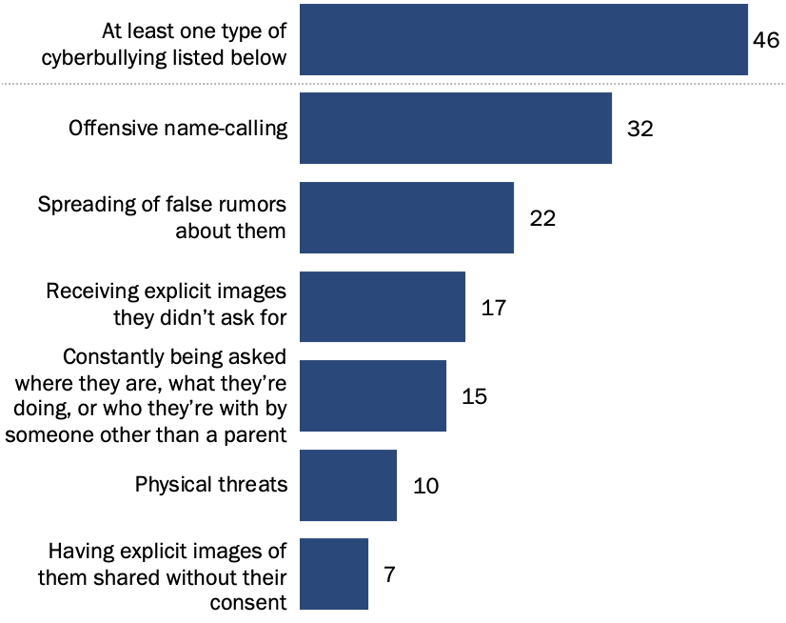
Consequence: cyberbullying
Blurring the sphere may cause cyberbullying or even physical bullying[6]
Notes:
From this scenario, blurring of the public and private spheres may lead to massive cyberbullying.
In the plot of the movie later, Dibiasky was even recognized in real life and abused. In fact, cyberbullying is very common in our daily life. I don't know much about cyberbullying in the English environment, but cyberbullying often occurs in the network environment in the Chinese environment. I found this report chart showing the percentage of US teens who have experienced the listing cyberbullying. This tells me that this chaos is also very common in the English environment

Slide 14
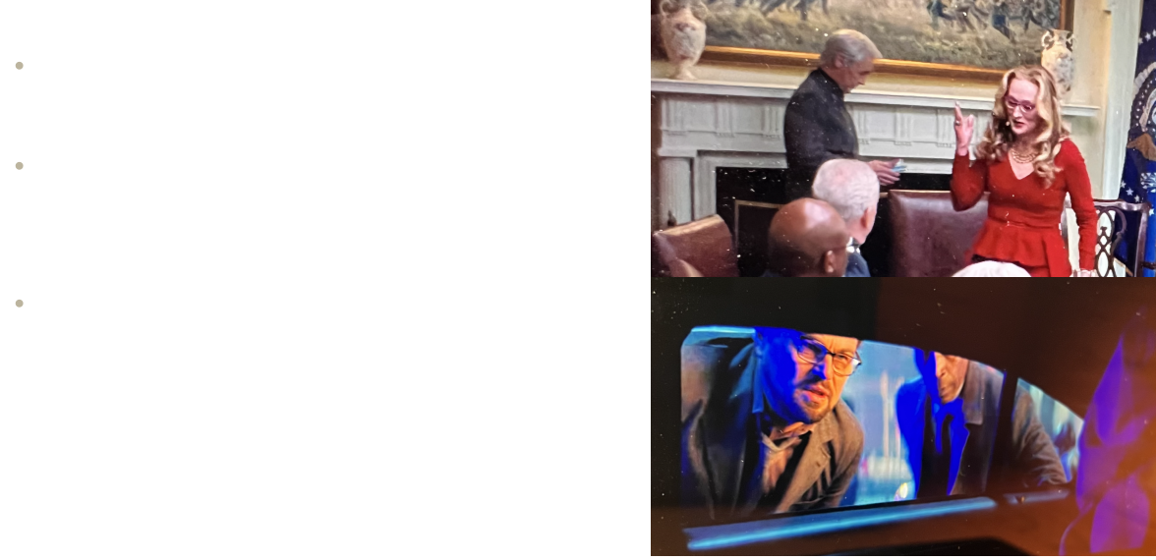
TECH for SURVEIllAnce AND Control
Notes:
Another point that can be excavated from technology is technology as a tool for surveillance and control from the government.
In the plot of the movie, we see that Isherwell can enter and exit the highest-level government discussions, and even lead and influence meeting decisions. This is ridiculous and hilarious. The movie also shows the timeliness of technology in helping officials find people. In the movie, whenever Dr. Randall or Dibiasky said anything against the government, they were immediately found and taken away. The movie also illustrates that technology is also used as a tool for official decision making

Slide 15
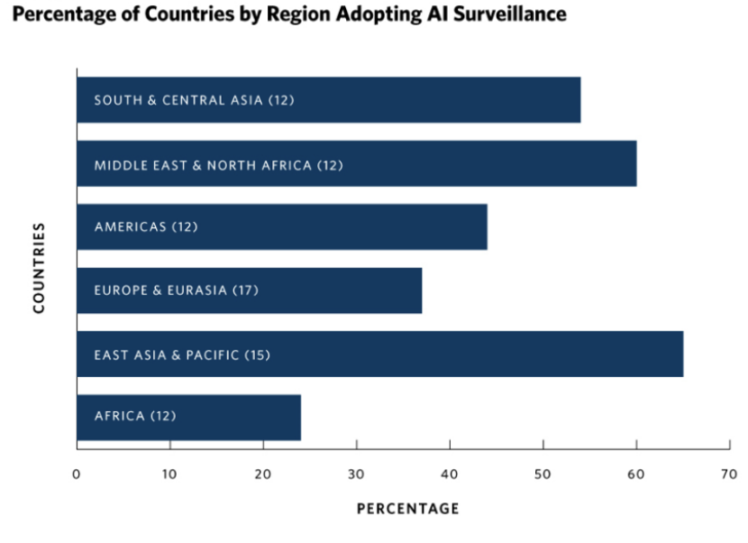
Implication: AI surveillance
One good aspect of technology as a tool is it helps maintain public security. But is it all?[7]
Notes:
A very popular discussion point is about facial recognition. I know china has sky eye system to increase criminal apprehension rate, but from this report I found, it explains how many percentage of countries in different regions use AI surveillance. I also read that At least seventy-five out of 176 countries globally are actively using AI technologies for surveillance purposes. This includes smart city/safe city platforms (fifty-six countries), facial recognition systems (sixty-four countries), and smart policing (fifty-two countries)
Although this technology is very beneficial for catching the actual criminals, it can be easily used for different purposes such as to track the location of people, or even their daily activities, where they visit, whom they meet, and how often. can be used for various purposes by governments

Slide 16
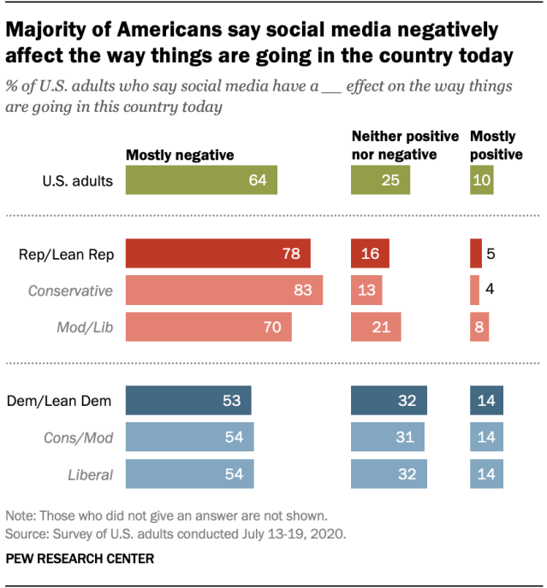
Effects of social media
A major theme of the story is showing social media as one big distraction
"Media training" iterated several times
Americans believe social media has a negative effect [6]
Notes:
A prevalent theme throughout the movie is on social media and how it is really just one big distraction.
Before the scientists' first news interview, someone who works at the news outlet says that Dr. Mindy should get some media training. After the interview, media training is suggested again, this time for Dibiasky. This suggests that the media is less likely to accept a scientist's conclusions based on scientific evidence alone. The scientist would need to be friendly and keep the subject light, as is said in the news interview.
In the movie, social media is shown to be a large presence in people's lives and it has a massive influence over what people believe and how they react to things. A survey from Pew Research Center shows some data on what Americans think about social media and its effect on the way things are going in the country today. The figure on the right shows that 64% of U.S. adults believe that social media has had a mostly negative effect on the country.

Slide 17
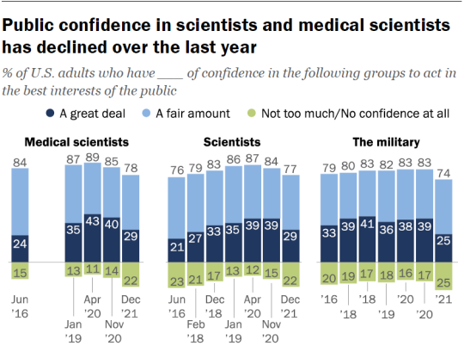
Media and the Global pandemic
Movie reflects how society reacted to the pandemic [4]
Science has become a political debate
People no longer trust science as much as they used to [5]
Notes:
Another parallel to real life that we see in the movie is the media's reaction to the global pandemic.
After having finished writing the script, the director, Adam McKay says that he saw how people were reacting to the very present global pandemic. Some people didn't even believe that Covid was real. The same thing happens in the movie when a scene shows posts on social media of people saying that they're not even sure that the comet is real.
One of the themes from the movie is how science is becoming more and more of a political debate. People are less likely to believe the word of scientists even when they have evidence to back up their claims.
We can see this reflected in real life from a survey by Pew Research Center shows that the public confidence in medical scientists and scientists in general has gone down since before the pandemic.
From the figure on the right, we can see that in 2021, the year the movie was released, 29% of Americans have a great deal of confidence in medical scientists, which is down from 35% before the pandemic. Very similar statistics are shown for scientists in general. Not only this, but the percentage of people who have no confidence at all in medical scientists was at an all-time high at 22%.
A probable cause or catalyst for these trends is social media, and political propaganda in the media. In a setting where everyone can say whatever they want, people start to believe what they want to believe, rather than what has supporting evidence.

Slide 18
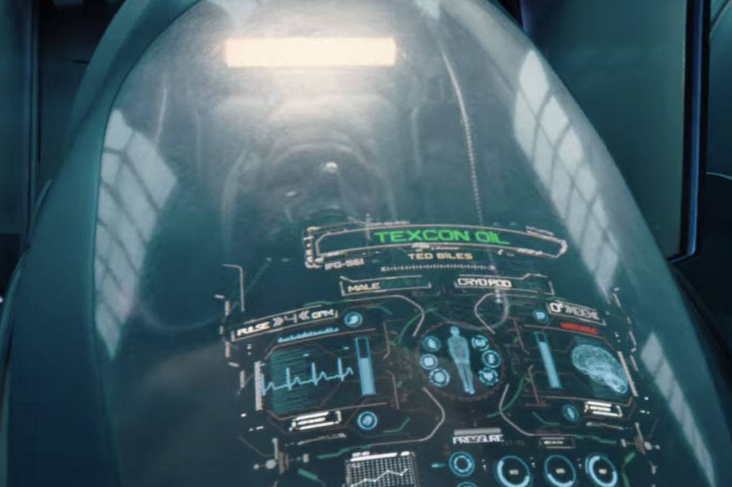
Digital Divide
The wealthy have access to technology that no one else does
Ship to evacuate earth only takes the wealthiest
The wealthy have exploited enough resources to be unaffected by the problems their industries create
Notes:
Another theme that is explored in the movie is the digital divide. The digital divide refers to the gap in access to technology. It shows an extreme version of this where the uber-wealthy have access to computing technologies that regular people do not.
At the end of the movie, we learn that there is a worst-case scenario ship that is designed to find a habitable planet where humans can continue living. The ship only has enough capacity for 2000 people and in the post-credit scene, it shows these people who were allowed on the ship are all wealthy and influential figures. In their pods, they are identified by their company and industry.
This goes to show that the wealthy are able to be unaffected by the problems that their industries have created. We know the movie is an allegory for climate change, and this shows that the movie is making a statement about the wealthy. They only became wealthy in the first place by exploiting resources. A big example of this is fossil fuels, where the leaders of the industry make billions of dollars and damaging ecosystems and the world in the process. And now they are able to stay unaffected by the problems they have created because of their access to costly technology.

Slide 19

CONCLUSIONS revisited
Winston Lewis, Oliver Reera, Xiao Xiao
Computing tech. often influences our decisions in beneficial ways
Social media and technology often shape the public’s opinions
The wealthy are unaffected by the problems they create, through technology
Notes:
In conclusion, the themes that the movie, Don't Look Up, contains suggest that computing technologies influence our decisions in beneficial ways, social media and technology shape public opinion, and that technology allows the wealthy to be unaffected by problems that they cause. Thank you

Slide 20
References
Winston Lewis, Oliver Reera, Xiao Xiao
[1] Ashley Strickland, “‘Planet killer’ asteroid spotted in the sun’s glare”, (CNN, October 31 2022), https://www.cnn.com/2022/10/31/world/potentially-hazardous-near-earth-asteroid-scn/index.html (April 29 2023)
[2] Benjamin Broomfield, “Blue skies and brand utility: How IBM's The Weather Channel became the US' 8th most trusted brand”, (Click Z, October 24 2022), https://www.clickz.com/blue-skies-ahead-how-ibms-the-weather-channel-built-brand-utility-among-millions-of-users/267587/ (April 30 2023)
[3] Darioshi, R, Lahav, E., "The impact of technology on the human decision-making process", (Hum Behav & Emerg Tech., July 2021), https://doi.org/10.1002/hbe2.257 (May 2 2023)
[4] Sims, David. “Don't Look Up Is a Primal Scream of a Film.” The Atlantic, Atlantic Media Company, 14 Jan. 2022, https://www.theatlantic.com/culture/archive/2021/12/dont-look-up-adam-mckay-netflix-movie/621104/ (May 1 2023)
[5] Kennedy, Brian, et al. “Americans' Trust in Scientists, Other Groups Declines.” Pew Research Center Science & Society, Pew Research Center, 15 Feb. 2022, https://www.pewresearch.org/science/2022/02/15/americans-trust-in-scientists-other-groups-declines/.
[6] Auxier, Brooke. “64% Of Americans Say Social Media Have a Mostly Negative Effect on the Way Things Are Going in the U.S. Today.” Pew Research Center, Pew Research Center, 15 Oct. 2020, https://www.pewresearch.org/short-reads/2020/10/15/64-of-americans-say-social-media-have-a-mostly-negative-effect-on-the-way-things-are-going-in-the-u-s-today/.
[7] Anderson, Monica, and Jingjing Jiang. "Teens and Cyberbullying 2022." Pew Research Center: Internet, Science & Tech, Pew Research Center, 15 Dec. 2022, https://www.pewresearch.org/internet/2022/12/15/teens-and-cyberbullying-2022/.
[8] Feldstein, Steven. "The Global Expansion of AI Surveillance." Carnegie Endowment for International Peace, 17 Sep. 2019, https://carnegieendowment.org/2019/09/17/global-expansion-of-ai-surveillance-pub-79847.
Notes:
Possible sources:
https://www.pewresearch.org/short-reads/2020/10/15/64-of-americans-say-social-media-have-a-mostly-negative-effect-on-the-way-things-are-going-in-the-u-s-today/
https://www.youtube.com/watch?v=wBbU-Th5lb8

