Slide 1
Divergent (2014)
Timory Goggin, Jai Patel, Jacob Reiss, Cole Welcher
Notes:
Jacob

Slide 2
Overview
Divergent (2014)
When humans have too much control over technology, there is an opportunity for abuse of power.
When humans rely too much on technology, technology can have too much of influence over society.
Overall: There is a need for a power balance between humans and technology to maintain society.
Notes:
Jacob
To start off with, we came to 3 notable conclusions regarding social technology and computing in Divergent. Our first conclusion was that technology in the wrong hands can lead to an abuse of power. We can see this both in the movie and in the real world, which will be covered later. Our second conclusion was that there is danger in relying too much on technology, as it can negatively influence our society and how we act within it. From these two points we conclude that there is a need for balance between humans and the technology we use.
Technology in the wrong hands can lead to abuse of power.
There is danger in relying too much on technology, as it can negatively influence our society.
From these two points we conclude that there is a need for balance between humans and the technology we use.

Slide 3
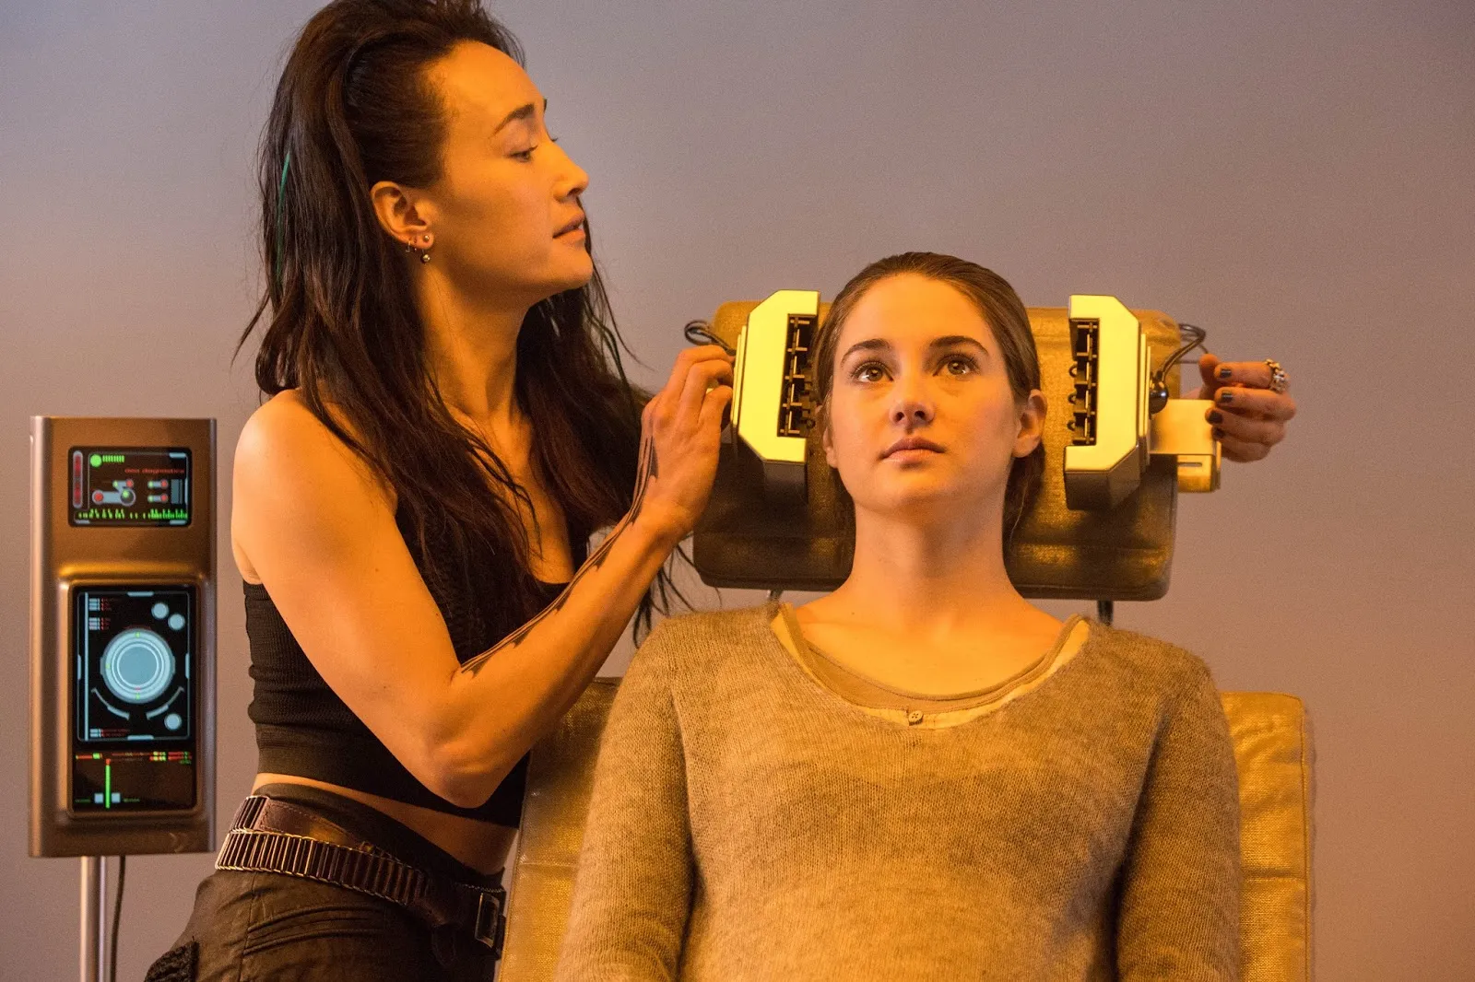

CONTROL OVER TECHNOLOGY
Divergent (2014)
Technology in the right hands
  Serums used to designate characters to a faction
  Not harmful to society
Technology in the wrong hands
  Control serum developed by Erudite
  Injected into Dauntless and used to mass genocide Abnegation
  Harmful to society
No technology regulation
Figure 1: The aptitude test is a
proper use of control [4].
Figure 2: The serum injected into Dauntless is an improper use of control [4].
Notes:
Jai
- In the film, there was little to no control over technology whatsoever.
- Technology was used in a proper manner when in the right hands. Serums were used during aptitude tests to designate characters to a faction.
- Doing this was not harmful to members of society.
- Technology was used in an improper manner when in the wrong hands. Serums developed by Erudite were injected into Dauntless soldiers, causing them to mass genocide members of Abnegation.
- This example of technology in the wrong hands brought danger to all members of society.
- Overall, there was no technology regulation among the five factions. Erudite, the scientists, developed serums as a part of their every day lives. Who can obtain these serums and for what reason
was not taken into consideration by members of society. Having a proper control over technology is imperative.
As you can see figure 1 is an example of the aptitude test and serums being used properly, whereas figure 2 shows Four, the man on the right as a soldier after he was injected by the serum.
Next slide

Slide 4
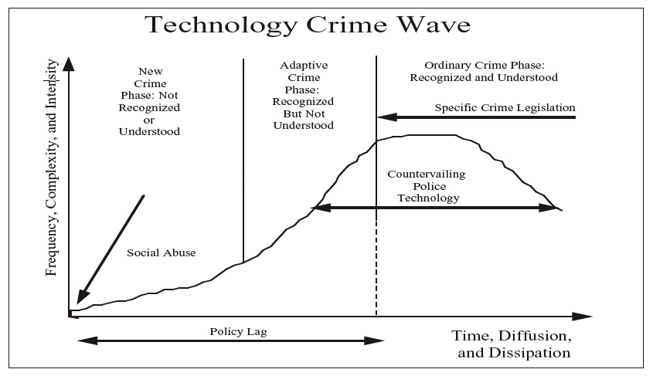
Relevance to society
Divergent (2014)
What if AI/Technology gets in the wrong hands?
  Growing debate
  Can be used for good
  Can also be used for bad [3]
Technological Abuse
How do we regulate control?
  Government
  Researchers
  56% support for more government regulation [12]
Figure 3: Technology Abuse Cycle and Lack of Regulation
Notes:
Jai
- This idea of regulating technology and monitoring the control of it is extremely relevant to society today.
- A growing debate that has come about as we become more technologically advanced is what if AI and or technology gets in the wrong hands.
- AI and technology are capable of helping us all in ways we are all aware of. What if its used improperly. It can put everyone in society at a great danger.
- This relates back to the idea of technological abuse and how prominent technological crime has become today.
- As you can see in the image, technology crime follows a cycle or a wave that is portrayed in the movie as well.
- It begins with a new crime phase or a new technology used improperly, where nobody is aware of the creation and whether it is for bad or good intention. In the film, this is the control serum developed by Erudite and Jeanine. In addition, the reasoning for developing the new technology is a means of social abuse, where one wants to negatively get back at someone or take something. This is Jeanine wanting to take control of the government by overthrowing abnegation.
- Next, is the adaptive crime phase. This is where the new technology is really implemented in the world, and it becomes evident that it is used for bad intention. In the film, this is where Jeanine and Erudite inject the serum into Dauntless, creating their force of an army to kill members of Abnegation.
- Throughout all this, there is a policy lag, where there is little to no control over the newly developing technology and no policies about its regulation. The crime legislation and appropriate control is implemented when the technology reaches the peak of its intensity, after damage has already been done. This is evident in the film, when Triss and Four are able to make Jeanine stop the mass genocide, after Triss already lost her parents and a majority of Abnegation was killed.
Now what this figure shows is that there needs to be a better regulation of control. Overall, when new technology is implemented, means of control are necessary as soon as possible. Waiting will result in the cycle.
The question of how to regulate this control then comes up. Should the government be in charge of all new technologies created to keep it in a safe place and to monitor its usage?
Or should researchers that develop the new technology be in charge. They have the most knowledge of its ultimate capabilities, so it would make sense for them to regulate who can access the new technology.
In a survey conducted amongst Americans, 56% of them support the idea of government regulation over new technology and big tech companies, as they believe they have too much power and control.
In the film, Erudite developed the serum, but they were a part of the plot with Jeanine to take down Abnegation. As a result, keeping new advancements in the hands of researchers can raise concern.
The other alternative would have been giving the control serum over to Abnegation, those in charge of the government, to keep it safe and monitor its usage. This would have resulted in peace among the factions for the time being.

Slide 5
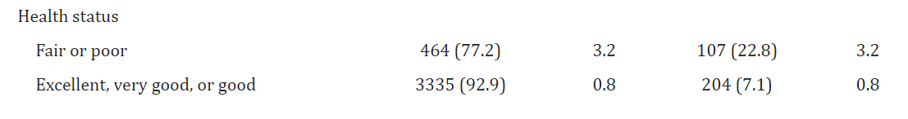
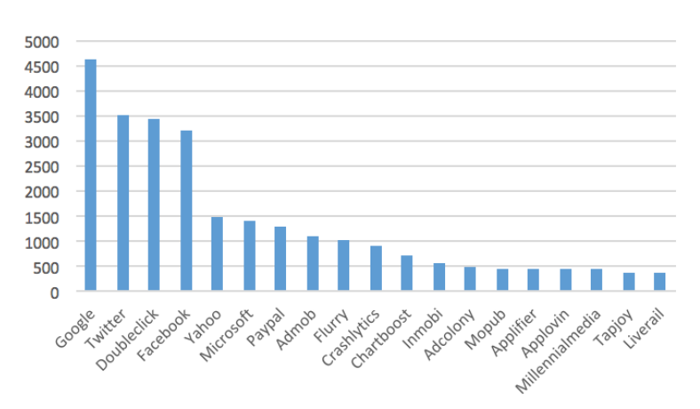
Real world Examples
Insurance Discrimination
  Patients with pre-existing medical conditions are 22.8% more likely to face insurance discrimination
Third-Party Tracking
  Our information is bought and sold without our consent or knowledge
Figure 4: Reports of Insurance-Based Discrimination by Insurance
Type and Selected Characteristics: 2013 Minnesota Health Access Survey[10]
Figure 5: Top 20 trackers that are present in over 100 mobile applications (subsidiaries)[11]
Notes:
Jacob
We can see this abuse of technological power in the real world as well. One case of this is insurance discrimination. A study found that people in fair/poor health are 22.8% likely to be denied coverage by their insurance, compared to the 7.1% denial rate in healthy clients. This is a prime example of data being collected by a particular group (insurance companies) abusing the access they have to our information to benefit the company at the expense of the client.
We can also see this abuse through third-party tracking. Now we did cover this in class already but for those who don’t remember, third party tracking is when websites you haven't directly visited track your information through sites you have directly visited. This information collected about us is then sold to other parties without our consent. The graph in figure 5 shows the frequency of trackers from various applications like google and twitter appearing in third party sites. 5000 sites were checked for trackers, and the results are far from surprising. [Read some of the data]. Once again, the computational data collected by these trackers are in control by parties that do not care about you as anything more than merchandise.
Insurance Discrimination
Study shows that 22.8% of people in fair/poor health are denied coverage when compared to the 7.1% rate of denial in healthy customers.
The use of data on us can be used to discriminate against us in various ways, such as insurance policies
Third-Party Tracking
Covered in class already but for those who don’t remember, third party tracking is when websites you haven't directly visited track your information from a site you did directly visit
Information about us is sold without our consent to the highest bidder.
Graph shows frequency of trackers from these applications in third-party sites in 5k websites

Slide 6

Computers categorizing Humans
Divergent (2014)
Trust in Computers
  Machine Learning
  Collection of Data
  Manual Inputs
Grouping Humans
  Stable and Fixed Identities
  Divergence
  Choosing at 16
Figure 6: The choosing ceremony allows people to go against the aptitude test's recommendation, but even that decision is scrutinized by the government [4].
Notes:
Timory
Next, looking into our second conclusion that reliance on technology that does not accurately complete its purpose can create misconceptions.
The society in the movie relies heavily on a computerized system to determine what faction each individual should choose to be apart of.
The system is an application of machine learning that it able to use collected data and previous decisions to make a choice to recommend.
Despite what appears to be a plethora of collected data and past decisions, the computer can not always define an individual, especially when that individual does not fit into a pre described category.
When this occurs, manual inputs are used as a check to the machine learning system.
Specifically within the adaptation of the machine learning aptitude test, a theme of identity becomes prevalent.
The system and factions themselves present a theme of sorting humans into stable and fixed identities that realistically do not exist.
Divergence represents the lack of ability to confine a group of humans to a single identity.
Choosing at 16 also reflects the common practice of making decisions about the future in reality. (Explain Figure)
When people chose a faction that does not align with their aptitude test results is can be seen by the government and is sometimes considered wrong.

Slide 7
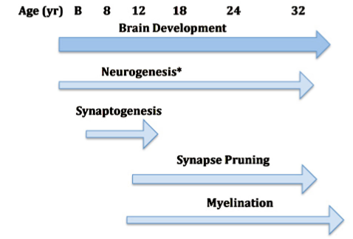
Relevance to society
Divergent (2014)
Machine Learning is Developing
  Analyzing and Grouping People [5]
  Inherent Discrepancies
  Automated Justice
Decide a Group
  27-30 years of Brain Development [6]
  College and Major
  30% change at least once [7]
Figure 7: Depicts that human brains are not fully developed when people start making major decisions about their future [7].
Notes:
Timory
Machine Learning is not advanced enough to accurately analyze and group people in the ways that are displayed in the Divergent Movie.
- A study conducted in 2012 found that although Machine learning technology was able to analyze and find common characteristics that identified success when working in Software engineering groups there were aspects that the program was unable to pick up on [5].
- The inherent discrepancies between machine learning's analysis and the facts of the world make it important to not solely rely on it when making critical decisions.
- The issues with automated justice, such as bias, that Cambria spoke about in her individual presentation exemplify why understanding the limits of machine learning is important.
- The characters ability to make the final decision despite the machine learning shows some level of control.
- There is a limitation created by choosing a singular group at 16 that reflects decisions that 18 year old must make in present day, except characters in the movie are stuck with their choice.
- This causes some issues because brain development, especially parts of the brain associated with decisions, does not finish developing until about 27-30 years old.
- As humans learn and grow, once again enforcing the idea that humans are not stagnant creatures that can be categorized, they should be able to readjust their life goals.
- We see this in switching of majors in education where approximately, 30% of college students change their major at least once and jobs later in life.

Slide 8
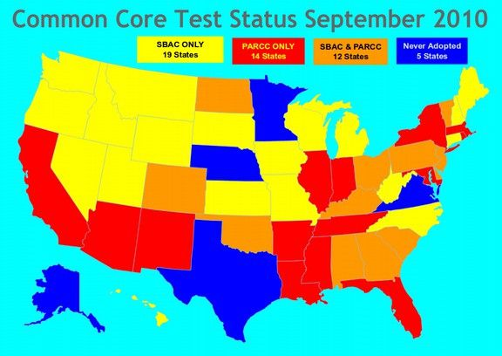
RELEVANCE TO SOCIETY PT.2
Divergent (2014)
Standardized Tests
  ACT
  SAT
  State Testing (Common Core)
  70% NEA say not accurate
Representation
  Focused on STEM
  Often disregards other categories
Figure 8: Depicts states that have adopted standardized testing [8]
Notes:
Cole
A lot of common/standardized testing, each state tends to have its own standardized testing besides 5 states depicted in the figure
In a recent survey 70% of more than 1500 National Education Association, members said that the standardized testing was not an accurate assessment of the students they teach [9]
Often teachers will teach the test instead of the subject students will need to know (just like tris is told to act like a dauntless by four), often leads to gap in necessary knowledge and gets in the way of teachers teaching curriculum
Personal: Teacher taught state testing till test than completely switched to teach towards AP
Aptitude test is like this doesn't help the people that are not in one of the categories (STEM), often suppresses artistic talents and can cause drop outs
Often leads to harmful effects on students and stunts future growths, often leads to poor self-confidence in low- scoring students, taking away student creativity, lowers student motivation, and test anxiety
.

Slide 9
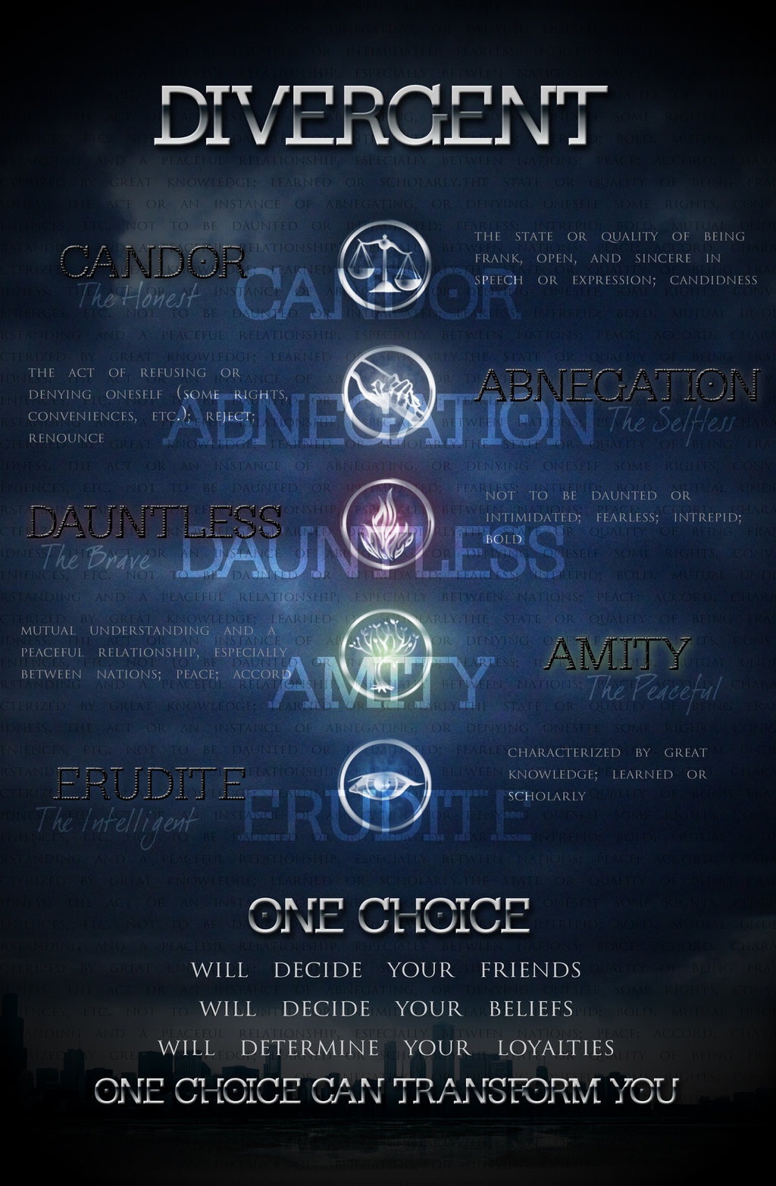
Overall Conclusion
Divergent (2014)
Humans can have too much control over technology
  Resulting abuse of power
  Consequences
Technology can have too much of an influence
  Misconception
  False understanding of reality
Power balance between humans and technology to maintain a society
Notes:
Cole
Divergent depicted a scenario where an individual gain to much power from controlling technology in a way that was unintended in its original purpose (Jeanine).
-Thought she
- It also depicted a society who was reliant on a form of technology that was not entirely suited for the purpose it served, leading to a general misconception .
- The movie presents the idea that in order to maintain a society there is a need for a power balance between humans and technology.

Slide 10
References
Divergent (2014)
[1] Divergent factions by ECHOSONG001 on DeviantArt. by echosong001 on DeviantArt. (n.d.). Retrieved October 1, 2022, from https://www.deviantart.com/echosong001/art/Divergent-FACTIONS-350728813
[2] Divergent actors... Duhn Duhn Duhn...and in the bottom right is uria- oh wait...: Divergent jokes, divergent trilogy, divergent. Pinterest. (2014, July 28). Retrieved October 1, 2022, from https://www.pinterest.com/pin/408490628674916552/%E2%80%8B
[3] Wu, X. (2004). Data Mining: An AI Perspective . Institute of Electrical and Electronic Engineers - Intelligence Informatics Bulletin , 4(2), 23–26.
[4] Wick, D., Fisher, L., Shahbazian, P., Daugherty, E., & Taylor, V. (2014). Divergent. United States; Lionsgate.
[5] Petkovic, D., Okada, K., Sosnick, M., Iyer, A., Zhu, S., Todtenhoefer, R., & Huang, S. (2012). Work in progress: A machine learning approach for assessment and prediction of Teamwork Effectiveness in software engineering education. 2012 Frontiers in Education Conference Proceedings. https://doi.org/10.1109/fie.2012.6462205
[6] Kolb, B., Mychasiuk, R., & Gibb, R. (2013). Brain Development, experience, and behavior. Pediatric Blood & Cancer, 61(10), 1720–1723. https://doi.org/10.1002/pbc.24908
[7] Beginning College Students Who Change Their Majors Within 3 Years of Enrollment. (2017). National Center for Education Statistics - US Department of Education
[8] https://coalitiontoprotectourpublicschools.org/latest-news/states-leave-common-core-sbac-and-parcc-tests-like-rats-deserting-a-sinking-ship
[9] Tim Walker, Survey: 70 Percent Educators Say State Assessments Not Developmentally Appropriate (NEA, 02/18/2016) https://www.nea.org/advocating-for-change/new-from-nea/survey-70-percent-educators-say-state-assessments-not (10/5/2022)
[10] Han, Xinxin., Call, Kathleen., Pintor, Jessie., Alarcon-Espinoza, Giovann., & Simon, Alisha. Reports of Insurance-Based Discrimination in Health Care and Its Association With Access to Care. https://www.ncbi.nlm.nih.gov/pmc/articles/PMC4455519/. Table 1. (10/03/22)
[11] Binns, Reuben., Zhao, Jun., Kleek, Max., & Shadbolt, Nigel. Measuring third party tracker power across web and mobile. https://arxiv.org/pdf/1802.02507.pdf. Figure 2. Accessed (10/04/22)
[12] Vogels, E. (2021, July 20). 56% of Americans support more regulation of major technology companies. Pew Research Center. https://www.pewresearch.org/fact-tank/2021/07/20/56-of-americans-support-more-regulation-of-major-technology-companies/
‌

