Slide 1
Deep Web (2015)
Justin Luce, Qixing Xue, and Emily Baker
5 October 2021

Slide 2

Film summary
2015 Documentary
Produced by privacy advocate Alexander Winter
Politics and Legality of Silk Road
Administrator Dread Pirate Roberts (DPR)
  Arrest, Personality and Family of DPR
Interviews with journalists and Silk Road purveyor’s
Notes:
Deep Web is a documentary released in 2015 by filmmaker and privacy advocate Alexander Winter. Deep Web’s primary topic is the Silk Road, an online marketplace where drugs and other illicit products were for sale. The film narrator describes the politics and legality of the deep web and interviews with journalists and purveyors from the Silk Road detail how the Silk Road operated and what the reason for the website’s existence was. The viewer learns that the Silk Road is more than just an offensive effort against the War on Drugs-it is a message to the powers that be that individuals can stand up for their human rights and they refuse to admit any wrongdoing. The film also goes into depth on the personality and legal troubles of the alleged founder of the Silk Road, who operated under the nom de guerre “Dread Pirate Roberts” (DPR).

Slide 3
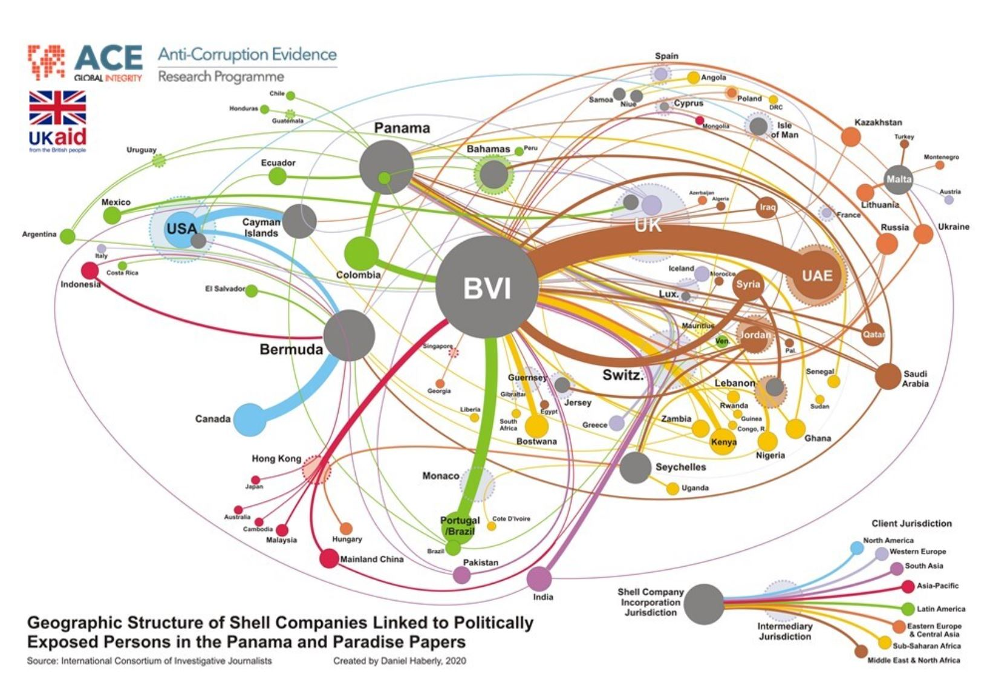
Conclusion #1 Encryption Enables Activism [1]
Journalists and whistleblowers
Bypass censorship
Expose corruption [4]
Transparency and accountability
Fig 1: Relationships exposed by the Panama Papers [3]
Notes:
The first societal conclusion our group found from the movie is that encryption, and the security and privacy enabled by encryption, enable activism.
In this film, the narrator describes how reporters, journalists, and whistleblowers use the deep web to expose crime and corruption if it is too dangerous to do so in their home country through “normal” reporting. Journalists take life-threatening risks when reporting on corruption. For example, in 2017, the journalist who led the investigation into the Panama Papers was killed by a car bomb planted in her vehicle. She exposed compromising connections of her home country’s prime minister, and was using her blog to bring awareness to how money flowed him, his friends, and offshore accounts. This incident is one of the reasons why the organizations Reporters Without Borders supports using Tor, an encrypted browser, in its “Survival Kit” for bloggers and activists in countries where they are at risk of state censorship or repressive regimes.
The image on the right exposes relationships between shell companies, countries, and political figures. Without journalists, this information would not be available to the general public. However, they need encryption and security tools to safely expose corruption.

Slide 4

Conclusion #1 Encryption Enables Activism [2]
Counterargument: Vigilante “justice” is not justice
Illegal
Not objective
Unintended consequences [5]
Fig 2: Anonymous posted Taiwan’s flag onto
China’s tourism promotion website [6]
Notes:
A counter to this argument is that using encryption services to bring attention to corruption is a form of vigilante justice. Vigilante justice is when individuals or groups who do not have formal or recognized legal authority enforce laws. Recently, the hactivist group Anonymous used a little vigilante justice. Figure 2 shows a screenshot from the Chinese government’s tourism promotion website.They inserted the Taiwanese flag onto this government website.
Vigilante justice is not legal, and potentially not objective. It is not possible for someone to be the judge, jury, and executioner, and also claim moral or ethical superiority.
Vigilante justice could have unintended consequences.
A few years ago, neighbors of an individual who downloaded inappropriate images of children decided to take matters into their own hand. They intended to start a house fire, but ended up killing the guy’s wife. The neighbors were arrested for first degree murder and arson. So, vigilante justice does not always work out.
But in countries that do not have a formal or actual method for citizens to report or dispute corruption officially rely on services like encryption to bring attention to their plight.

Slide 5
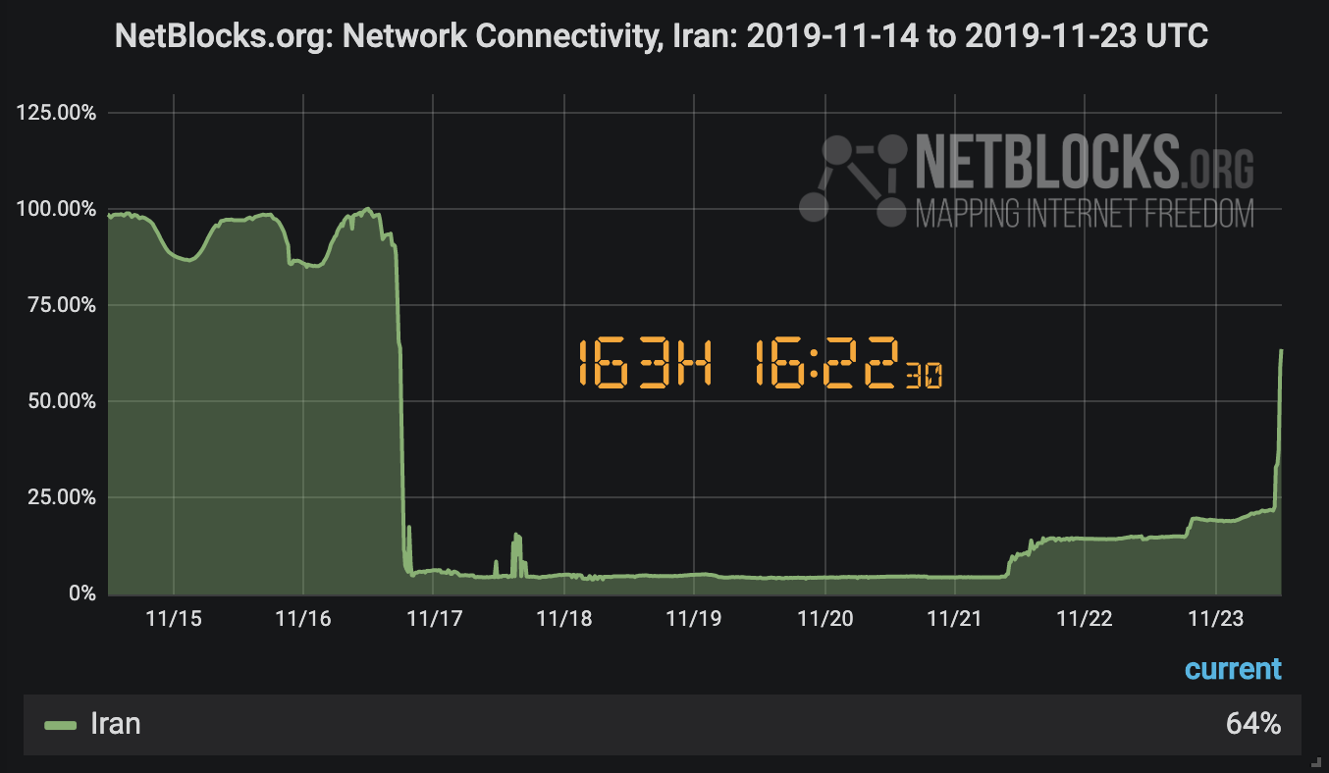
Conclusion #1 Encryption Enables Activism [3]
Response: A formal process to address corruption is not available in all countries
Citizens cannot interfere with the government’s businesses in some countries
Belarus, August 2020 [7]
Iran, November 2019 [8]
Fig 3: Iran’s Internet connectivity of the blackout week [9]
Notes:
Although vigilante justice is not ideal, a formal process to address or bring attention to corruption is not available in all countries. Some countries even prevent their citizens from expressing critical opinions of their government, which further emphasizes the need for encryption and security tools that facilitate activism.
In August 2020, the Belarussian government initiated a communications blackout following a protested national election. VPNs were not even useable. The winner of the national election, now dictator-president Lukashenko, was accused of election fraud. By cutting off Belarussian’s from the internet, the Belarussian government was able to prevent protesters from organizing and communicating with each other.
In November 2019, Iran experienced massive protests after the price of fuel was raised substantially. The government completely blacked out internet access for a week. Individuals had to get creative and rely on other tools, such as a filecasting satellite technology, to share information with each other. The image on this slide comes from NetBlocks, a watchdog organization that monitors cyber security. The graph shows network connectivity in Iran the week of the blackout hovering around 0%.
Encryption tools allow individuals to hold their governments accountable and spread awareness about injustice. Without these tools, information would be kept from the public. The documentary Deep Web demonstrates that encryption enables users to spread their ideas and values, even when ideas and values are contrary to government opinion.

Slide 6
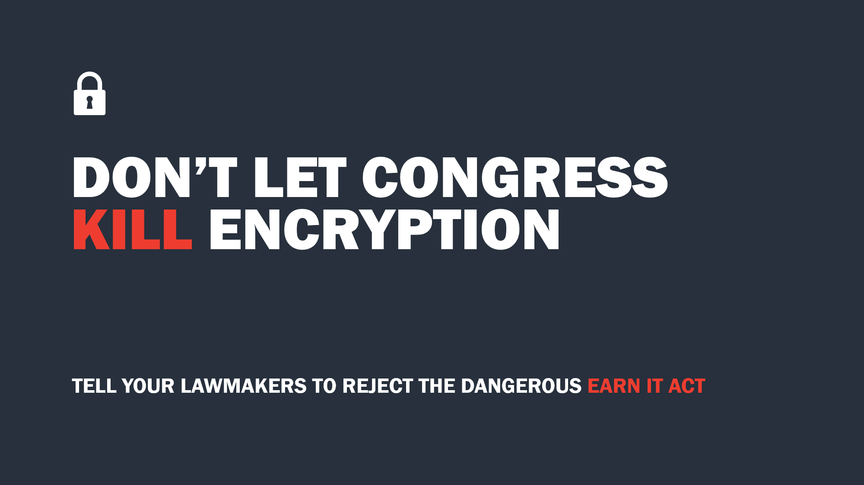
Conclusion #2
Government Regulation Has Collateral Damage [1]
Infrastructure Bill [10]
  Goal of modernizing U.S. infrastructure
  Harms cryptocurrency/the crypto ecosystem
EARN IT Act [11]
  Goal of preventing child exploitation
  Jeopardizes end-to-end encryption
Fig 4: Petition to reject the EARN IT Act
Notes:
The last conclusion our group came to is that government regulation has collateral damage. In the film, lawmakers were extremely concerned that crime went unchecked on the Deep Web and brought attention to it. But, that attention has unintended consequences. Recently, the Senate passed their version of the Infrastructure Bill. One part of this bill requires that those who provide a service to pay with cryptocurrency to register as a broker. The broker would have to collect identifying information about their customers in order to report transactions to the IRS.
This type of regulation is antithetical to the point of cryptocurrency, and if this bill passed in the House, users of cryptocurrency would be dissuaded from uses it.
Another example is the EARN IT Act, which aims to prevent child exploitation online. However, even after multiple amendments, the EARN IT Act still jeopardizes end-to-end encryption.

Slide 7

Conclusion #2
Government Regulation Has Collateral Damage [2]
Counterargument: Only so much can be done to mitigate collateral damage, regardless of the legislation
Tradeoff between preventing criminal activity/protecting people and minimizing collateral damage. [11]
Fig 5: Campaign to rally support for the EARN IT Act
Notes:
Supporters of internet legislation would say that any attempt to regulate any part of the internet will be met with scrutiny, which is true.
Another counter argument is that almost everything comes at a cost.
Even though the EARN IT Act may weaken/jeopardize or weaken, it’s worth it if child exploitation can be prevented and/or caught.
There’s always a tradeoff between regulation, usually targeted at preventing criminal activity, protecting people, protecting companies, etc., and collateral damage.

Slide 8
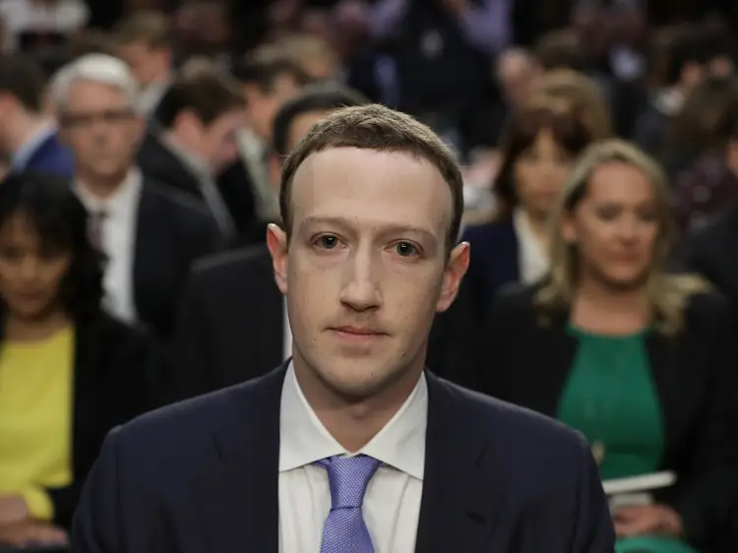
Conclusion #2
Government Regulation Has Collateral Damage [3]
Response: Legislators are technologically illiterate
“How do you sustain a business model in which users don't pay for your service?” [13]
“Does Google, through this [iPhone], know I have moved … over to the left?” [12]
Fig 6: Zuckerberg testimony [13]
Notes:
Unfortunately, collateral damage isn’t being effectively minimized as current legislators are technologically illiterate.
If legislators don’t know what they’re regulating, how they can mitigate collateral damage?
Some easily digestible examples of this are the Mark Zuckerberg and Sundar Pichai testimonies.
In the Zuckerberg testimony, Senator Orrin Hatch, the chair of The Senate High Tech Republican Task Force, asked how facebook sustains a business model in which they don’t charge for their service; a question most high schoolers could answer.
Zuckerberg promptly responded. “We run ads.”
Similarly, in the Pichai testimony, Representative Ted Poe asked if Google knew, through his iPhone, that he was moving.
Pichai, responded that he’d need more information, such as the examples Mr. Poe had opted into.
Mr. Poe, without providing more information, then went on to say that Pichai made $100 million per year, he should be able to answer the question.
We can’t trust legislators who don’t know the technology they’re regulating to mitigate collateral damage.

Slide 9
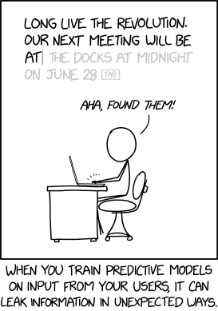
Film maker’s intents
Cautionary tale of privacy
Investigation process still doubtful
  Were rights from the Fourth Amendment violated?
Technological protections cannot mitigate information leakage through socializing
Can we trust the government to justly handle similar cases in the future?
https://xkcd.com/2169/
Notes:
Deep Web is a cautionary tale to both privacy advocates and the casual internet user that Big Brother is watching. Not even the deep web, or the dark web, is protected from government interference.
When the Silk Road was first launched in 2011, the viewer learns that law enforcement quickly joined and posed as drug vendors. Through a series of messages, law enforcement learned of DPR’s criminal behavior and obtained enough evidence for an indictment on Dread Pirate Roberts, but there was no real name attached to the pseudonym.
Though under Tor’s strong privacy protection
Identity connection established through DPR itself via messaging
The government believed Ross Ulbricht moonlighted as DPR, but the way in which the Silk Road’s back-end servers were located to connect these two individuals was not provided to the Ulbricht family.
There is also a short text saying that some officers involved in the investigation work has transferred significant amount of bitcoin to personal account.
Understandings:
1. We generally trust law enforcement of freezing money/bitcoin/etc. for justice
2. Some officers gain personal benefit from it
Thank you for watching!
===
[DRAFT] Was justice served if the LEO’s benefited financially from this case? Can there be trust if it is that the government dishonestly prosecuted a case?

Slide 10
REFERENCES
[1] Winter, Alexander, director. Deep Web . Performance by Keanu Reeves, and Andy Greenberg, Epix, 2015.
[2] Maddox, Alexia et al. “Constructive Activism in the Dark Web: Cryptomarkets and Illicit Drugs in the Digital ‘Demimonde.’” Information, communication & society 19.1 (2016): 111–126. Web.
[3] Haberly, Daniel. “Mapping Politically Exposed Person (PEP)-Linked Shell Companies in the Panama and Paradise Papers.” Global Integrity Anti- Corruption Evidence, 23 June 2020, https://ace.globalintegrity.org/shellcompanies/
[4] Garside, Juliette. “Malta Car Bomb Kills Panama Papers Journalist.” The Guardian, Guardian News and Media, 16 Oct. 2017, https://www.theguardian.com/world/2017/oct/16/malta-car-bomb-kills-panama-papers-journalist.
[5] Police: Vigilante Justice Led to Unintended Death.” NBCNews.com, NBCUniversal News Group, 15 Sept. 2007, https://www.nbcnews.com/id/wbna20780983.
[6] Everington, Keoni. “Anonymous Posts Taiwan Flag, National Anthem on China Government Site: Taiwan News: 2021-09-30 14:11:00.” Taiwan News, Taiwan News, 30 Sept. 2021, https://www.taiwannews.com.tw/en/news/4301718.
[7] . Newman, Lily Hay. “Belarus Has Shut down the Internet amid a Controversial Election.” Wired, Conde Nast, 10 Aug. 2020, https://www.wired.com/story/belarus-internet-outage-election/.
[8] Amnesty International. “Iran: Internet Deliberately Shut down during November 2019 Killings – New Investigation.” Amnesty International, 17 Aug. 2021, https://www.amnesty.org/en/latest/press-release/2020/11/iran-internet-deliberately-shut-down-during-november-2019-killings-new-investigation/.
[9] Netblocks. “Internet Being Restored in Iran after Week-Long Shutdown.” NetBlocks, 26 Mar. 2020, https://netblocks.org/reports/internet-restored-in-iran-after-protest-shutdown-dAmqddA9.
[10] Makena Kelly, Controversial crypto rules remain in infrastructure bill after House vote (The Verge, Aug 25 2021), https://www.theverge.com/2021/8/25/22641375/cryptocurrency-infrastructure-irs-tax-developers-miners-bitcoin (Oct 4, 2021)
[11] Hannah Quay-de la Vallee & Mana Azarmi, The New EARN IT Act Still Threatens Encryption and Child Exploitation Prosecutions (CDT, Aug 25 2020), https://cdt.org/insights/the-new-earn-it-act-still-threatens-encryption-and-child-exploitation-prosecutions/ (Oct 4, 2021)
[12] LIVE: Google CEO Sundar Pichai testifies on Data Collection (C-SPAN, Dec 11, 2018), https://www.youtube.com/watch?v=WfbTbPEEJxI (Oct 4, 2021)
[13] Facebook CEO Mark Zuckerberg testimony on data privacy before Senate committee (ABC News, Apr 10, 2018), https://www.youtube.com/watch?v=GQN4On0K7-w (Oct 4, 2021)
Notes:
[1] Winter, Alexander, director. Deep Web . Performance by Keanu Reeves, and Andy Greenberg, Epix, 2015.
[2] Maddox, Alexia et al. “Constructive Activism in the Dark Web: Cryptomarkets and Illicit Drugs in the Digital ‘Demimonde.’” Information, communication & society 19.1 (2016): 111–126. Web.
[3] Haberly, Daniel. “Mapping Politically Exposed Person (PEP)-Linked Shell Companies in the Panama and Paradise Papers.” Global Integrity Anti- Corruption Evidence, 23 June 2020, https://ace.globalintegrity.org/shellcompanies/
[4] Garside, Juliette. “Malta Car Bomb Kills Panama Papers Journalist.” The Guardian, Guardian News and Media, 16 Oct. 2017, https://www.theguardian.com/world/2017/oct/16/malta-car-bomb-kills-panama-papers-journalist.
[5] Police: Vigilante Justice Led to Unintended Death.” NBCNews.com, NBCUniversal News Group, 15 Sept. 2007, https://www.nbcnews.com/id/wbna20780983.
[6] Everington, Keoni. “Anonymous Posts Taiwan Flag, National Anthem on China Government Site: Taiwan News: 2021-09-30 14:11:00.” Taiwan News, Taiwan News, 30 Sept. 2021, https://www.taiwannews.com.tw/en/news/4301718.
[7] . Newman, Lily Hay. “Belarus Has Shut down the Internet amid a Controversial Election.” Wired, Conde Nast, 10 Aug. 2020, https://www.wired.com/story/belarus-internet-outage-election/.
[8] Amnesty International. “Iran: Internet Deliberately Shut down during November 2019 Killings – New Investigation.” Amnesty International, 17 Aug. 2021, https://www.amnesty.org/en/latest/press-release/2020/11/iran-internet-deliberately-shut-down-during-november-2019-killings-new-investigation/.
9. Netblocks. “Internet Being Restored in Iran after Week-Long Shutdown.” NetBlocks, 26 Mar. 2020, https://netblocks.org/reports/internet-restored-in-iran-after-protest-shutdown-dAmqddA9.
[8] Cadwalader, Wickersham & Taft LLP. “Infrastructure Bill Includes Broker Crypto Reporting.” JD Supra, JD Supra, https://www.jdsupra.com/legalnews/infrastructure-bill-includes-broker-5577030/.
[9] “Sen. Hutchison: Internet Regulation Will Hurt the Economy and Innovation.” Targeted News Service 2011: n. pag. Print

