Slide 1
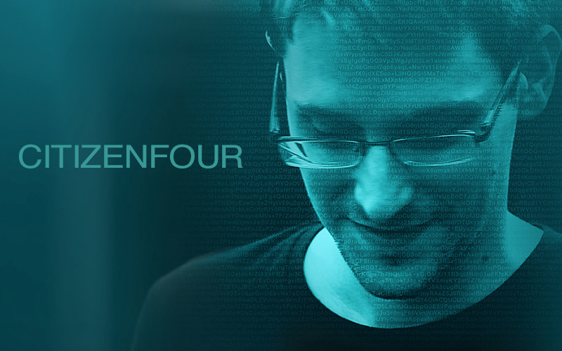
CITIZENFOUR
Michael Giancola, Steven Huynh,
Andrew Rottier, William Van Rensselaer
Michael Giancola, Steven Huynh,
Andrew Rottier, William Van Rensselaer
[17]
Notes:
Speaker: Mike, then Steve, Andrew, Will
Hi everyone, for our project we analyzed the movie Citizenfour. I’m Mike Giancola, <Steve, Andrew, and Will introduce themselves in order>

Slide 2
Agenda
Plot Timeline
Technologies
Conclusions
Supporting Argument
Notes:
Speaker: Mike
First we will briefly discuss the plot and the technologies discussed in the movie. Then we will state our conclusions and provide arguments for them.

Slide 3
Plot Timeline
Correspondence between Snowden and Poitras begins
Snowden meets Greenwald & MacAskill in Hong Kong
The Guardian releases first article discussing collection of Verizon customer data
Snowden’s passport is revoked while in Sheremetyevo Airport
[4]
Notes:
Speaker: Mike
I assume most of you have likely heard of Edward Snowden and his story. I’d like to briefly mention the main points of the movie that most people may not know.
The movie begins in January 2013 with Snowden’s anonymous correspondence with Laura Poitras, a movie director and producer. This movie was actually created while the events unfolded, and Poitras was there to capture all of it.
Later Snowden reached out to Glenn Greenwald, a reporter with The Guardian, and met with him and Ewen MacAskill. They interviewed Snowden for 8 days, after which Greenwald published his first article in The Guardian. On June 6, 2013 he released the article titled “NSA collecting phone records of millions of Verizon customers daily”.
The movie ends with Snowden living in Moscow, Russia, after his US passport was revoked while he was on his way to Ecuador.

Slide 4
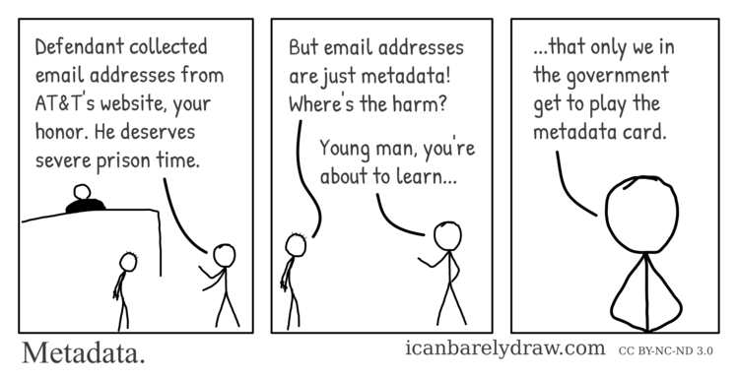
Jacob Appelbaum
Linkability
Pools of metadata
At Occupying Wall Street
Government hypocrisy with metadata
[15]
Notes:
Speaker: Andrew
The movie includes several clips that don’t directly involve Snowden, but that support the themes of the movie. Many clips discuss the importance of protecting one’s privacy, which applies to everyone, but is especially important for journalists. One of those clips shows Jacob Appelbaum giving a talk to members of Occupy Wall Street. He discusses the concept of ‘linkability’.
The basic concept is that, while one particular piece of metadata seems very trivial, it is possible to ‘link’ together many pieces of metadata to learn more about someone. For example, linking a subway card with credit card data and cell phone data could uncover where you go and who you talk to.
-----
Jacob Appelbaum describes the concept of ‘Linkability’ at an Occupying Wall Street conference.
Link personal data, credit card data, metrocard data. Then connect it to social media accounts, which can track gps. Connected to phones to see who you talk to.
This mass linkage of data is called metadata, which the government can aggregate on a person over their life. They can use this to track the steps of a person’s life.
All they need is a person’s email, username, some bit of info that uniquely identifies you and they can start to connect the dots.

Slide 5
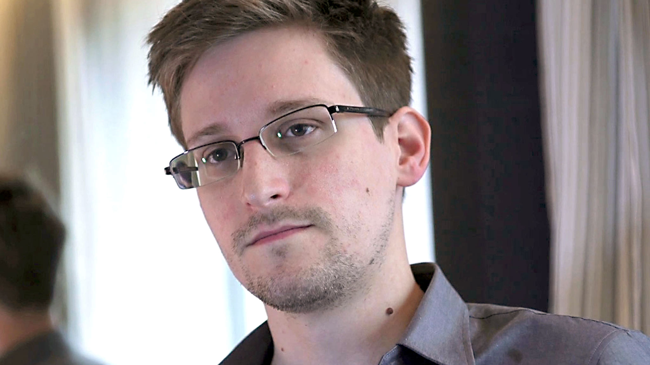
Technologies
GPG
Drone Surveillance
XKeyscore
TEMPORA
Snowden leaks secret government programs to journalists and filmmakers
Notes:
Speaker: Andrew
Next we would like to discuss some technologies which were discussed in the movie. The technologies are very closely related to the theme of the movie; either something that enhances your privacy, or that takes it away.

Slide 6
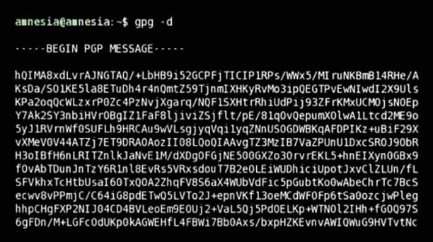
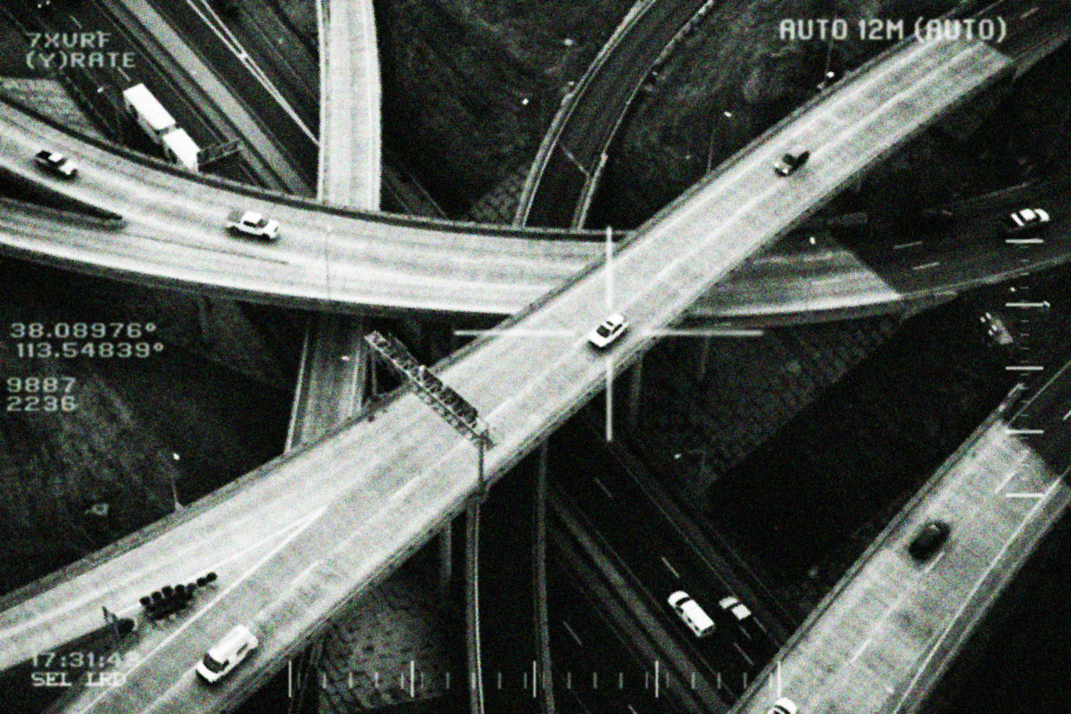
GNU Privacy Guard (GPG)
Drone Surveillance
Command line encryption tool for secure communications
Government has pages of drone feeds surveillancing suspected national threats
[1] [2]
Notes:
Speaker: Andrew
GPG is a commandline tool used for signing and encrypting data and communications across the internet. If this tool is used in mass, can help reduce the effects of bulk surveillance. Snowden used GPG to help him securely communicate with journalists Glenn Greenwald and Ewen MacAskill, and director Laura Poitras. This secure method of communication helped Snowden expose many secrets of the NSA while staying hidden from the government’s surveillance [1]. Poitras used GPG in her movie to portray the sense of insecurity Snowden felt when using online communications.
Drone Surveillance - government still has the ability to monitor ‘anyone they deem a threat’ to national security. Snowden describes the access NSA employees had to these drone feeds. Once you open the system, you’d be displayed pages upon pages of drone feeds from all different countries 24/7.
Just to give you a sense of the power of these drones, i’ll describe one of them. Bae Systems is a government contracted organization that helped create a drone named (ARGUS-IS). This drone can:
take 1.8 gigapixel images and archive them at 2.5/3.3 ~3 frames per second.
It can surveillance an area up to 15-square-miles,
track moving vehicles, and
generate 3-D models from archived images .

Slide 7
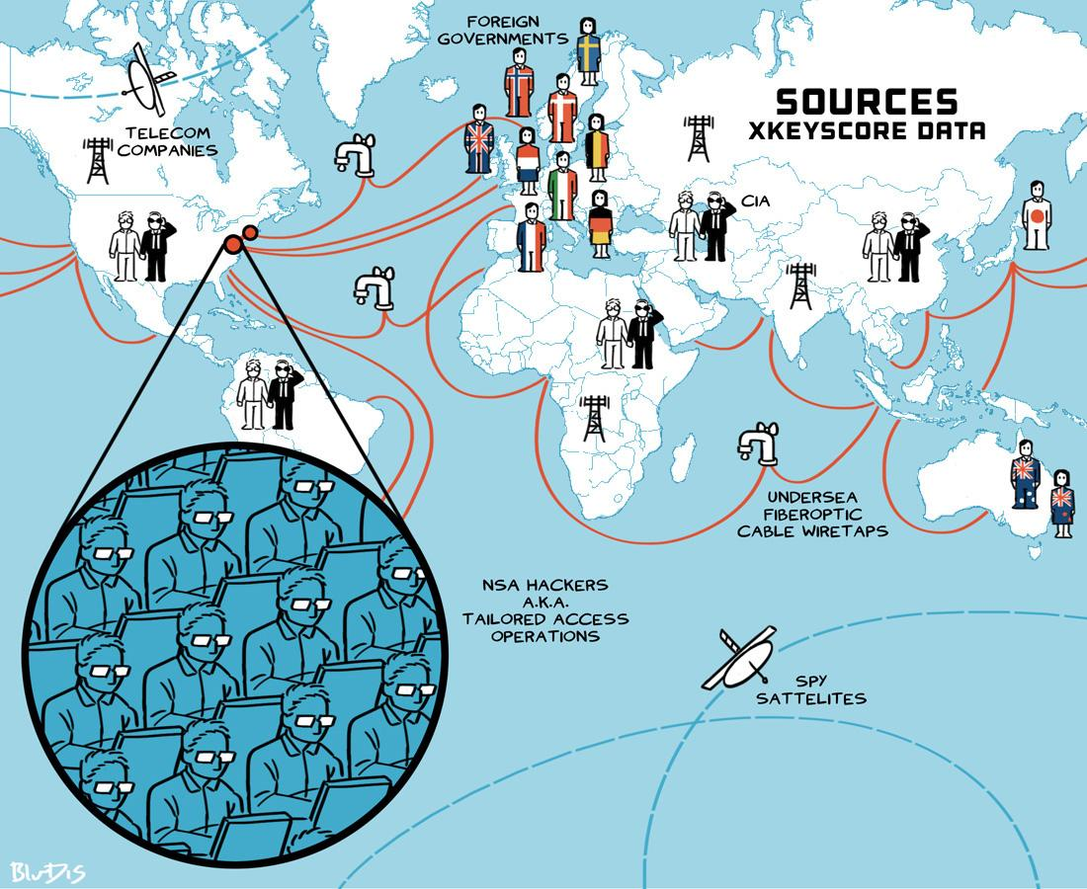
XKeyscore
Querying software that the government uses to search for a person’s internet footprints.
TEMPORA
Government performs bulk surveillance by tapping fibre optic cables.
Government collects data from all over the world
[3]
Notes:
Speaker: Andrew
XKeyscore - person querying software. This program allows the NSA to query across billions of collected records ranging from VoIP data, account credentials, personal information, web searches, and private communications [4].
The collected data for this software is an aggregation of information gained from:
existing government records.
government abused exploits,
data collected through government mandated backdoors in internet and telephone service providers and large computer companies like Facebook, Google, and Apple,
Additionally, the government assists other governments with installing updated surveillance programs in exchange for access to the information.
As described previously by Appelbaum, all of this data can be linked to create detailed set of facts about someone.
Another program that was exposed was TEMPORA. Britain’s Government Communication Headquarters (GCHQ), This system leveraged extracted internet communications through secret fibre-optic interception points. The data is stored in data centers so that it can later be searched [4]. The interception points are located all around the world between communication points under the knowledge of the owners of these points [5]. Some of which are installed underwater between countries (as you can see in the image here to the right). That is how they are able to capture mass communications.
If people were to use tools like GPG, these taps would be rendered useless. They could intercept the data but it would be encrypted.

Slide 8
Conclusions
Whistleblowing is justifiable if all other channels of communication have failed to resolve the problem
Journalists should use encryption to protect themselves and their work
New legislation should be put in place to protect government employees from whistleblower retaliation
Notes:
Speaker: Will
Our first conclusion was that whistleblowing can be justified if there was no other way to resolve the problem. We will argue that this was the case for Snowden’s whistleblowing.
Second, it is important for journalists to use encryption to protect themselves and their work.
Finally, new laws should be created to protect whistleblowers.

Slide 9

Justification: SWE Code of Ethics
1.02: Moderate interests with public
1.05: Address matters of grave public concern
1.06: Avoid deception of public
2.02: Illegal or unethical software usage
2.05: Keep private confidential information
2.07: Identify and report social concerns
2.09: No interest adverse to employer
Association for Computing Machinery and IEEE defined the SWE guidelines
[9] [11]
Notes:
Speaker: Will
So let's breakdown Snowden’s choice to go public against the Soft Eng Code of Ethics and Professional practice pertaining to whistleblowing.
SWE Code of Ethics relevant sections:
1.02 - Conflict
Secret mass surveillance of the public is not moderate. It’s pretty extreme. The government did not make the public aware of these operations.
(1) 1.05 - Mass public surveillance
The systems the NSA was using to record nearly every online action the public took.
When the government has this kind of power, it prevents the public from organizing against or responding to government policies or a corrupt government.
(2, 3) 1.06 - Was going through journalists the best method for this? Removed his bias, but journalists have biases too.
If released by the government, a different story would have likely been painted and much info would be redacted. This is deceptive.
Snowden released the documents in full, so little deception.
Snowden had documentation ready to give to the journalists he had contacted from The Guardian with the intention of raising awareness of this privacy breach, aspiring to bring security to the internet and communications and make users more aware of their online behaviors.
(5?) 2.02 - Unclear if the NSA surveillance programs were illegal due to the broadness of legislation, but certainly unethical.
(1) 2.05 - If NSA programs were illegal and not in the public’s interest, then Snowden was right to make them known.
(4) 2.07 - Snowden claims he tried to do this from the inside and was told to stop and that he was “playing with fire”.
Snowden exhausted his outlets within his organization by “raising his concerns with colleagues, supervisors, and lawyers. He was told he was “playing with fire”. [4]
2.09 - Whistleblowing is an adverse interest, but he felt that what the NSA was doing was of higher ethical concern.
We believe Snowden had rational and ethical reasons to whistleblow on the government based on this code. Though there are some conflicts between points, so we will analyze further using our workable ethical theories.
Does Snowden’s disclosure decrease the U.S. government’s ability to prevent domestic terrorism, thereby allowing more domestic terrorism to occur and harm Americans? Statements from Snowden and his lawyers after the NSA document disclosure claim no.
http://www.nesta.org.uk/edward-snowden-futurefest-full-interview
Is surveillance actually harming the public?
Supposedly, Snowden has driven a wedge between the unspoken partnership between the government and technology companies
https://www.theguardian.com/us-news/2016/may/22/snowden-whistleblower-protections-john-crane

Slide 10
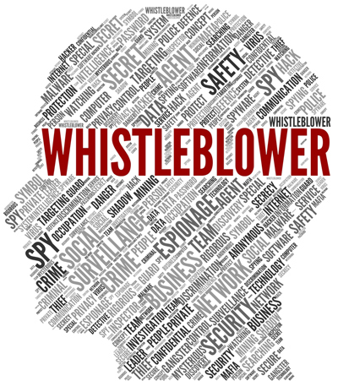
Justification: Ethical Analysis
Kantianism
Rule Utilitarianism
Social Contract Theory
Virtue Ethics
Ethics and morality of whistleblowing
[12]
Notes:
Speaker: Will
Kantianism
Categorical Imperative (First Formulation): Act only from moral rules that you can at the same time will to be universal moral laws.
If whistleblowing were a universal moral rule, the government would have no secrets. Is this good?
Categorical Imperative (Second Formulation): Act so that you always treat both yourself and other people as ends in themselves, and never only as a means to an end.
Snowden attempted to go through proper channels and was silenced, so he didn’t use his employer as a means to an end. The government was using citizens as means to an end so Snowden made them aware of it.
Act Utilitarianism
Difficult to quantify happiness of all parties.
Rule Utilitarianism: Adopt those moral rules that, if followed by everyone, lead to the greatest increase in total happiness.
“Many people are careful about what they type into search engines because they know it’s being recorded, and that limits the boundaries of their intellectual exploration. I’m more willing to risk imprisonment or any other negative outcome, personally, than I am willing to risk the curtailment of my intellectual freedom, and that of those around me.” - Snowden in Citizenfour (26:50)
“it all comes down to state power against the people’s ability to meaningfully oppose that power. And I'm sitting there everyday, getting payed to design methods to amplify that state power. And I'm realizing that if, you know, the policy switches, that there are the only things that restrains these states, were changed, there, you couldn't meaningfully oppose these.”
Social Contract Theory: Morality consists of the set of rules, governing how people are to treat one another, that rational people will agree to accept, for their mutual benefit on the condition that others follow those rules as well.
People should make other people aware when their right to privacy is being violated.
Virtue Ethics: A right action is that of a virtual person
Who were Snowden’s role models? William Binney?
When testifying before German parliament, William Binney states that he sees the programs that Edward Snowden exposed as “the most major threat to our democracies all around the world”
William Binney blew the while on STELLARWIND on account of its use to “actively [spy] on everyone in [the United States]”
Plaintiffs for the Jewel v. NSA case argue that the NSA has caused injury by collecting their AT&T “communications and records”
Snowden had a girlfriend and parents that he cared for. A virtuous person would want to protect their family from privacy intrusions.

Slide 11
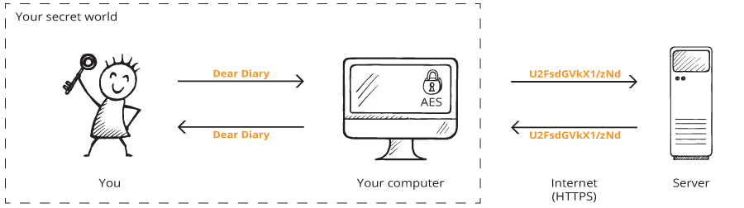
Journalists should utilize encryption
Allows potential whistleblowers to disclose sensitive info to journalists
  Snowden to Greenwald
Protects journalists in the wake of Snowden’s actions
How journalists should use the internet
[5][6][7][8][14]
Notes:
Speaker: Steven
Our second conclusion from the film is that journalists should utilize encryption.
The use of encryption would allow potential whistleblowers to confidently disclose sensitive info to journalists
and would project journalists from the government in the wake of Snowden’s actions
Snowden had a target painted on him by a global surveillance machine, so it's understandable that he would use encryption to ensure that he wouldn’t be caught before his collection of NSA documents could be disclosure to the public
But unfortunately, journalists at the time did not see a need to use encryption
Steve Coll, journalist and dean of the Columbia University Graduate School of Journalism, attributes the sparse use of encryption to improper training by newspapers (as a result of declining revenue) [2]
The film mentions that “In December 2012, an anonymous source contacts Glenn Greenwald. They are not able to establish a secure communication method, so their correspondence stalls.”
Of course, this was Snowden trying to get Greenwald to use GPG, but Greenwald refused to adopt the technology
From a piece by journalist Peter Maass, Greenwald said, “It’s really annoying and complicated, the encryption software. He kept harassing me, but at some point he just got frustrated, so he went to Laura.” [1]
It cannot be said that if Snowden was unaware of Poitras, then the NSA document disclosure would never had been reported, but it can be said that Greenwald’s refusal to use GPG did delay the disclosure.
As for the second point...
In an interview with Jeremy Scahill, investigative journalist, William Binney states that journalists working with the Snowden documents are on a (presumably) government “cast iron cover list”.
The government (again, presumably) will capture data from those journalists’ electronic devices to track their actions and find new whistleblowers
Nowadays, more journalists have adopted encryption to protect their sources and not miss “the next Snowden”
31 media organizations have adopted, a more simple method for whistleblowers to disclose information than through encrypted emaSecureDropil correspondence. [5]
The Freedom of the Press Foundation has developed additional privacy-enhancing tools for journalists such as an iPhone case that enables a “hardware” airplane mode [6]
http://www.nytimes.com/2013/08/18/magazine/laura-poitras-snowden.html
http://www.newyorker.com/news/daily-comment/snowden-changed-journalism
https://us.boell.org/2016/02/02/journalism-after-snowden-how-internet-has-changed-media
https://medium.com/global-editors-network/e-snowden-against-surveillance-journalists-engagement-more-efficient-than-encryption-dbfbacdf9463
https://securedrop.org/directory
https://www.wired.com/2017/02/reporters-need-edward-snowden/

Slide 12
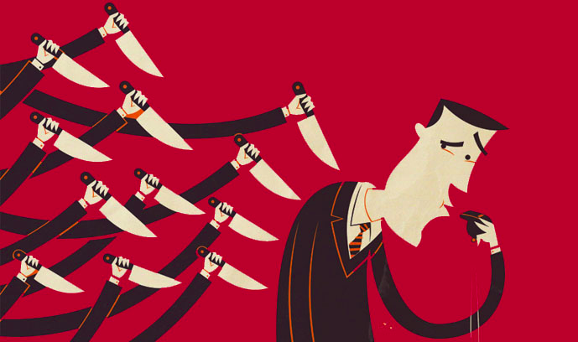
New legislation for government whistleblowing
Intelligence Community Whistleblower Protection Act of 1998
  Limited rights
  No protection against retaliation
Whistleblower Protection Enhancement Act of 2012
  Lacks real protection for Snowden
Thomas Drake in the NSA
  Followed whistleblowing rules, still prosecuted
No protection for whistleblowing on a corrupt government
[9] [10] [13]
Notes:
Speaker: Steven
New legislation should be put in place to protect government employees to safely resolve concerns.
Because current legislation is insufficient to protect these government employees.
Intelligence Community Whistleblower Protection Act of 1998: example of weak whistleblower protection legislation. This act allows a national security employee to whistleblower/release classified information to Congress. However,
It does not protect whistleblowers from retaliation.
Nor permits the release this information to anyone else.
Whistleblower Protection Enhancement Act of 2012: In 2014, Snowden testified to the European Parliament that although it would protect direct US employees against whistleblower retaliation, it would not protect contractors
Dan Meyer, former director for whistleblowing and transparency to the Inspector General of the Defense Department, claims that while contractors are included in the act, they are not protected from retaliation
Movie depicts an example where government employees who become whistleblowers actually reported their ethical concerns within the government, following procedure, but still faced retaliation.
In the movie, former NSA employee, William Binney, spoke at a conference and described a past scenario in which he and his colleagues learned that their work was going to be used to actively spy on everyone in the United States.
The program that they worked on eventually became STELLARWIND, which according to Binney “automated metadata analysis”
His colleague, Thomas Drake, followed government procedure to report abuse all the way to Congress, ended up facing prosecution. He was charged on 10 counts of felonies under the Espionage Act in April 2010.
Could not effectively defend himself, as evidence for his defense was destroyed by the government
These 10 charges were eventually dropped; he eventually pleaded to a misdemeanor and served no jail time.
http://www.pbs.org/wgbh/pages/frontline/government-elections-politics/united-states-of-secrets/the-frontline-interview-thomas-drake/
https://www.whistleblower.org/bio-thomas-drake <- this one is better
https://www.washingtonpost.com/news/fact-checker/wp/2014/03/12/edward-snowdens-claim-that-as-a-contractor-he-had-no-proper-channels-for-protection-as-a-whistleblower/?utm_term=.e89912802396

Slide 13
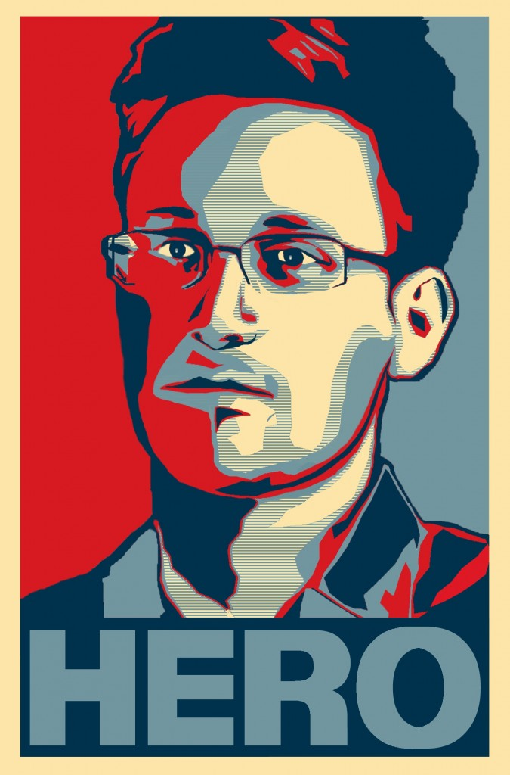
Conclusions
Whistleblowing is justified if other channels of communication fail
Journalists should use encryption
New legislation should be put in place
[16]
Notes:
Speaker: Mike
To recap, we argued that whistleblowing can be justified if there was an effort to first resolve the issue through proper channels.
Second, it is important for journalists to use encryption to protect themselves and their work.
Finally, new laws should be created to protect whistleblowers.

Slide 14
References
[1] Center for the Study of the Drone, “Weekly Roundup 2/10” (Bard College, 2014) http://dronecenter.bard.edu/weekly-roundup-210/ (Accessed 04/25/2017)
[2] Tannhausser, “Una mirada linuxera a Citizenfour” (La Mirada Del Replicante, 2015) http://lamiradadelreplicante.com/2015/02/23/una-mirada-linuxera-a-citizenfour/ (Accessed 04/25/2017)
[3] Moragn Marquis-Boire, Glenn Greenwald, Micah Lee, “XKEYSCORE: NSA’s Google for the World’s Private Communications” https://theintercept.com/2015/07/01/nsas-google-worlds-private-communications/ (Accessed 04/25/2017)
[4] Glenn Greenwald, “NSA collecting phone records of millions of Verizon customers daily” (The Guardian, 2013) https://www.theguardian.com/world/2013/jun/06/nsa-phone-records-verizon-court-order (Accessed 04/25/2017)
[5] Steve Coll, “How Edward Snowden Changed Journalism” (The New Yorker, 2014) http://www.newyorker.com/news/daily-comment/snowden-changed-journalism (Accessed 04/25/2017)
[6] Peter Maass, “How Laura Poitras Helped Snowden Spill His Secrets” http://www.nytimes.com/2013/08/18/magazine/laura-poitras-snowden.html (Accessed 04/25/2017)
[7] Freedom of the Press Foundation, “The Official SecureDrop Directory” (Freedom of the Press Foundation) https://securedrop.org/directory (Accessed 04/25/2017)
[8] Andy Greenberg, “Edward Snowden’s New Job: Protecting Reporters From Spies” (WIRED, 2017) https://www.wired.com/2017/02/reporters-need-edward-snowden/ (Accessed 04/25/2017)
Notes:
Speaker: Mike
This concludes our presentation. Are there any questions?
** TODO: Re-order/re-number citations to go in order of reference

Slide 15
References (cont.)
[9] Glenn Kessler, “Edward Snowden’s claim that he had ‘no proper channels’ for protection as a whistleblower” (The Washington Post, 2014) https://www.washingtonpost.com/news/fact-checker/wp/2014/03/12/edward-snowdens-claim-that-as-a-contractor-he-had-no-proper-channels-for-protection-as-a-whistleblower/?utm_term=.e89912802396 (Accessed 04/24/2017)
[10] “Bio: Thomas Drake” (Government Accountability Project, 2017) https://www.whistleblower.org/bio-thomas-drake (Accessed 4/26/17)
[11] https://upload.wikimedia.org/wikipedia/en/thumb/8/8e/Association_for_Computing_Machinery_%28ACM%29_logo.svg/1024px-Association_for_Computing_Machinery_%28ACM%29_logo.svg.png (Accessed 4/27/17)
[12] http://stewarts.revolutiondata-cms.com/uploads/public/images/News%20articles/News/shutterstock_144257470v2.jpg (Accessed 4/27/17)
[13] http://blog.transparency.org/wp-content/uploads/2016/06/whistleblower.jpg (Accessed 4/27/17)
[14]Comic demonstrating HTTPS: https://www.monkkee.com/en/wp-content/uploads/sites/3/encryption_process.png (Accessed 4/27/17)
[15] http://www.icanbarelydraw.com/comic/2456 (Accessed 4/27/17)
[16] http://www.snowdenshirt.com/2013/07/14/hello-world/ (Accessed 4/28/17)
[17] https://www.participantmedia.com/tags/citizenfour (Accessed 4/28/17)

