Slide 1
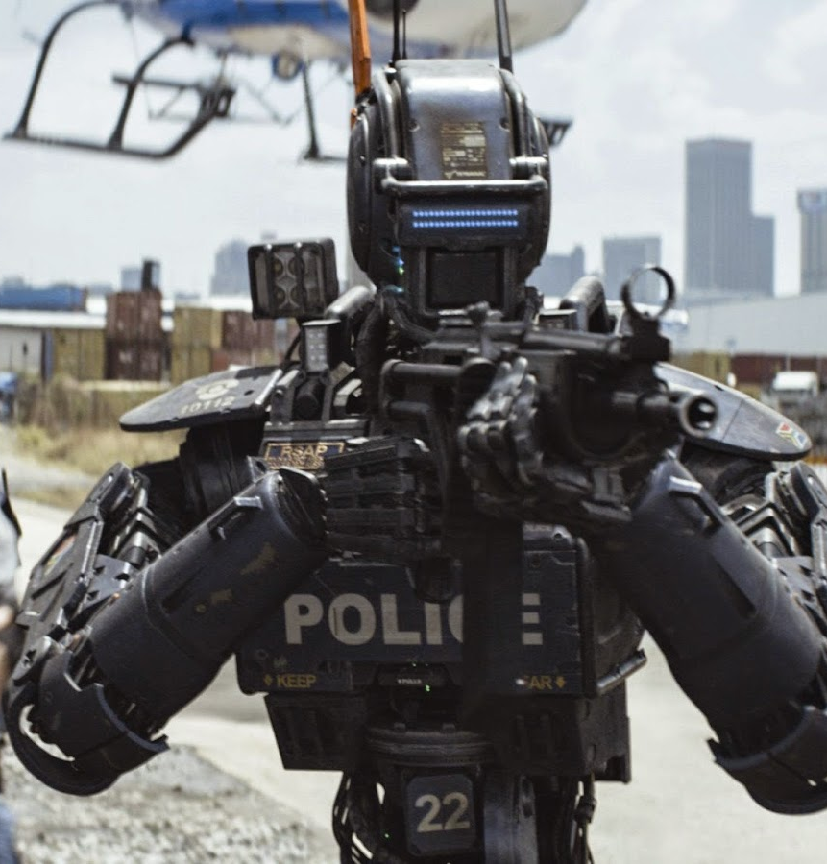
CHAPPiE
[10]
Amanda Adkins, Brett Ammeson, Adilet Issayev,
Patrick Polley, Alec Thompson

Slide 2
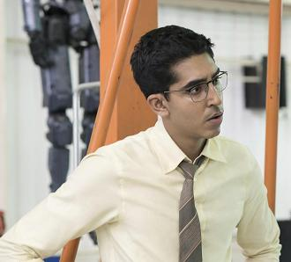
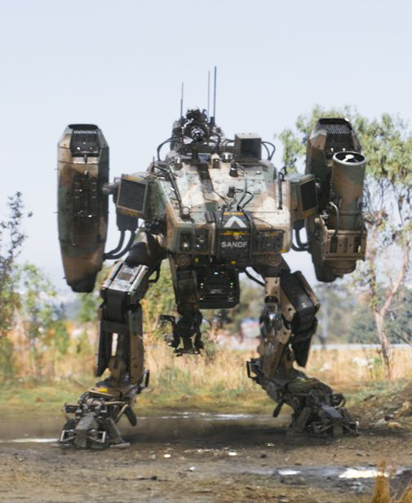
Plot Summary
Takes place in Johannesburg
Tech company Tetravaal produces AI Scouts
Internal competition, Vincent Moore’s MOOSE
Deon creates self-aware, fully conscious AI
Deon kidnapped by gang, upload AI software onto Scout bot, creating Chappie
[13]
[11]
Notes:
Mandi
The movie Chappie takes place in Johannesburg, South Africa. The plot of the movie is based on the work of a company called Tetravaal. This company makes scout robots, which are a highly successful robotic police force in the city. They are controlled by a fairly advanced AI, and their development was led by Deon Wilson, who you can see in the top image. Another employee at Tetravaal, Vincent Moore, is working on the Moose, which you can see in the bottom image. The moose is controlled by a human using a neural helmet and is highly militarized, much more than necessary for most civilian situations. Both technologies rely on a shared single guard key to program them. The movie begins with a deal between a gang boss and a small gang. The small gang owes the gang boss a lot of money and is told they have 7 days to pay him. The movie switches to Deon Wilson, who, outside his job at Tetravaal, is working to create a self-aware AI capable of learning like a human. After a long night of programming, preliminary tests suggest that the current iteration of his AI may be successful. He asks the CEO of Tetravaal if he can try it on one of the Scout robots, but she denies his request, so he steals a robot that is marked to be scrapped because it’s battery is damaged and irreplaceable, making it only work for 5 more days. Meanwhile, the small gang is trying to figure out how to get money to pay back the other gangster, Hippo, and decides that if they can disable the Scout robots, they’ll be able to get enough money. They find out that Deon is the creator of the Scouts and kidnap him and steal his van, with the stolen robot parts in it. Deon tells them that he can’t disable the Scout robots, but that he can give them the robot with the untested learning AI. He programs the robot with his new software and it ‘wakes up’, and one of the gangsters names it Chappie.

Slide 3
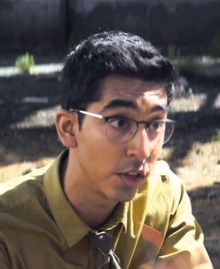
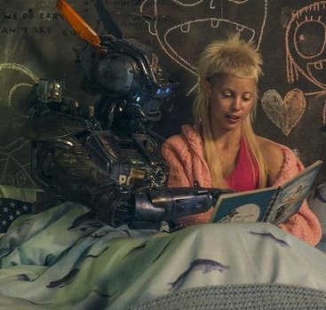
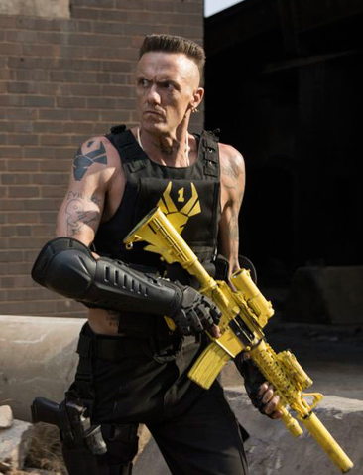
Plot Summary
[14]
[15]
[16]
Deon
Yolandi
Ninja
Notes:
Mandi
After software is uploaded to the robot, there are 3 main characters that really influence Chappie’s development. Deon, the creator of the AI for Chappie, tries to encourage Chappie to be creative and makes Chappie promise not to commit crimes. He is very interested in the technological possibilities for the AI installed in Chappie. Ninja, shown on the right, however, simply wants Chappie to help the gang get money to pay off the other gangster, Hippo. He gets very angry when Deon tries to teach Chappie creative things, such as painting, and tries to teach Chappie to shoot guns and commit crimes. Chappie initially does not like these things and tries to keep his promise to Deon. Yolandi, shown in the middle, is another member of the gang and acts as a mother figure for Chappie. She tries to teach him and comfort him, like Deon wanted, but unlike Deon, her guidance seems more related to caring about Chappie than Deon’s motivation of scientific advancement.

Slide 4
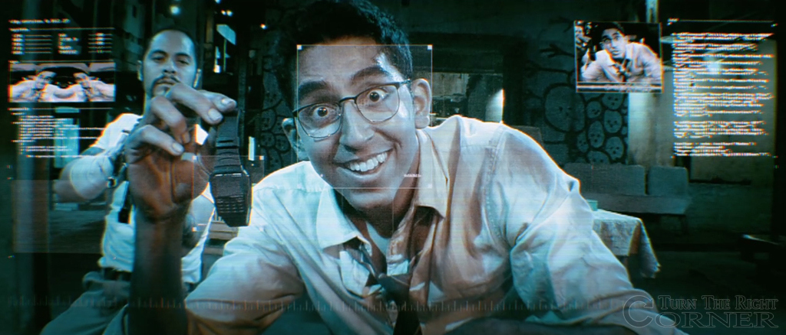
Chappie’s Development
Starts at infant knowledge with naive worldview
Initially wants to be good and follow Deon’s guidance
Intellect grows increasingly rapidly
Faces ethically unclear situations; handles like humans
Fear of death
[19]
Notes:
Mandi
Initially in the movie, Chappie starts out with infant-level intelligence and a very naive worldview and gentle personality. He wants to be good and follows Deon’s guidance not to commit crimes. His intellect grows increasingly rapidly over the course of the movie. He is introduced to a number of ethically unclear situations and handles them like a human might, considering the positives and negatives of potential actions, with a strong focus on self-preservation, particularly toward the end of the movie. He also learns that his battery is damaged and that he is set to die within 5 days. On learning this, he shows a strong fear of ‘death’.

Slide 5
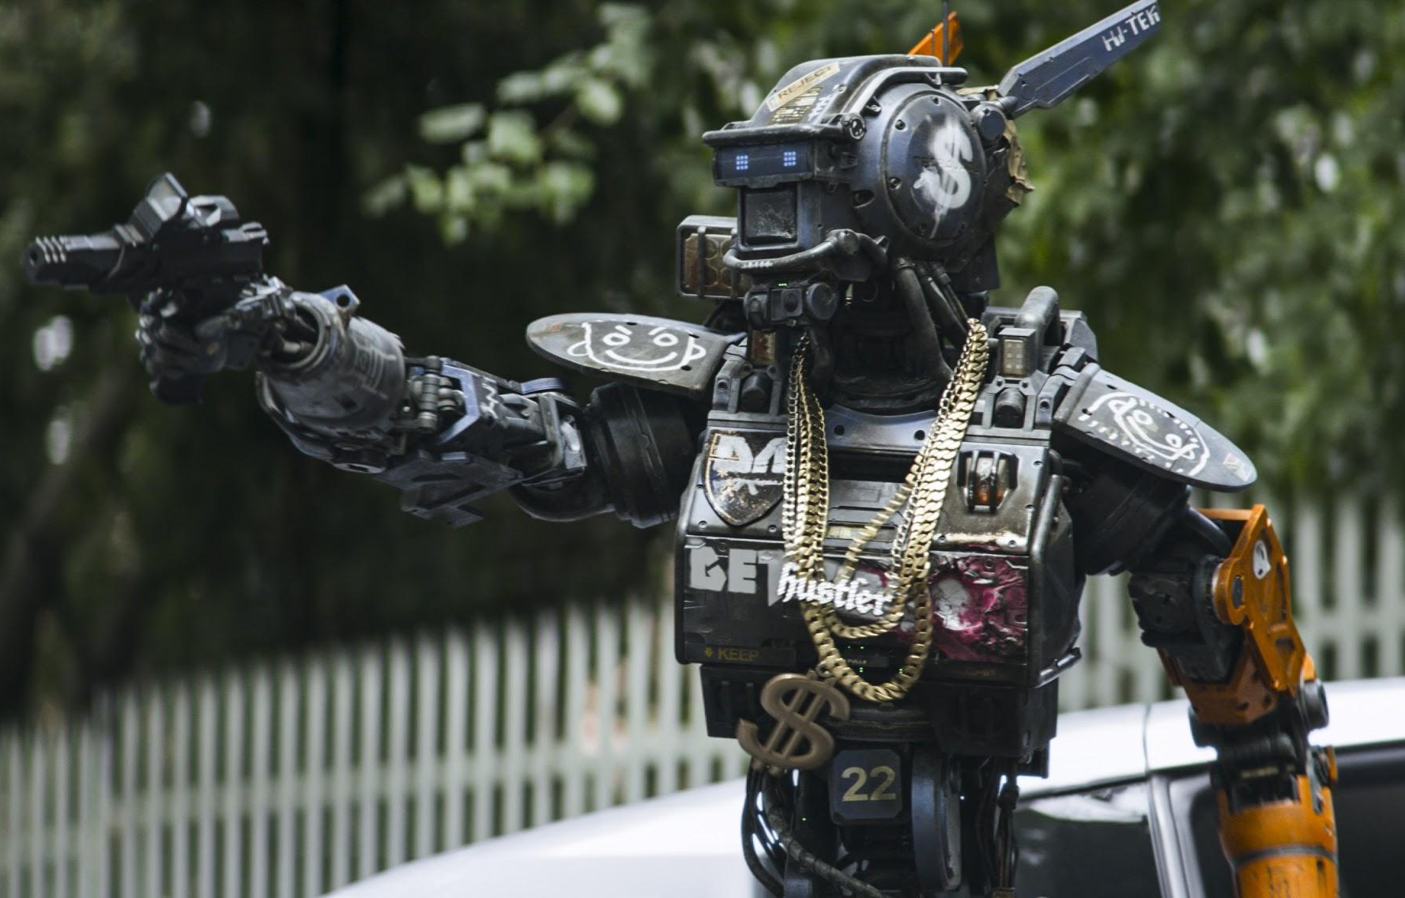
Plot Summary
Chappie commits crimes to earn money to pay for new chassis
Vincent steals Guard Key, disables Scouts with firmware update
Deon quickly restores Chappie, Vincent allowed to use MOOSE
Moose raids complex where gang resides
Uploads consciousness of humans into other Scouts
[12]
Notes:
Mandi
After Ninja tells Chappie that is battery is damaged and has 5 days to live, Chappie becomes very resentful of Deon for installing him in a damaged body. He no longer strictly adheres to his promise not to commit crimes, and Ninja convinces him that if he helps with the heist, they’ll have enough money to buy him a new body.
Chappie commits crimes such as vehicle theft with the gang. At one point, Vincent Moore locates Chappie and steals the guard key from him. Vincent then uses the guard key to reprogram all of the scout robots with bad software, causing widespread failure and subsequent riots all over the city. This causes the robots to be distrusted by the people of Johannesburg. Chappie also helps the gang with an armed robbery, which is featured on the news, causing further distrust in the Scouts program. Moore leverages this to get authorization to use the Moose. He takes it to the complex where the gang resides and a large fight ensues. After a lot of fighting, Deon is critically injured and Yolandi is killed. Chappie destroys the moose and takes Deon to the Tetravaal headquarters. Chappie is uploaded to a new body, and then uses the neural helmet at Tetravaal to transfer Deon’s consciousness to a Scout robot. He later transfer’s Yolandi’s consciousness, which was captured earlier by a stolen neural helmet, onto a Scout body.

Slide 6
Conclusions
Supervision and safeguards may reduce convenience, but are necessary for security and privacy.
If something has sentience and self-awareness, it should be treated as human.
Notes:
Brett
Our first conclusion is that supervision and safeguards will likely reduce convenience, but are necessary to ensure security and privacy goals are upheld.

Slide 7
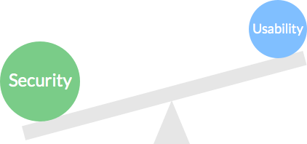
Convenience vs. Security
Parts and Guard Key taken without being noticed
  Access not highly prohibited
Deon & Vincent are technical leads
  Should have divisions of power/access
Scout robots convenient, but failure scenario is dangerous
  Companies need to prepare for failure scenarios [1]
  Broad update-all usually not smart [8]
Notes:
Brett
One of our main arguments is that Deon and Vincent were allowed nearly unrestricted access to the guard key and robot construction and repair areas.
This allowed them to take whatever they wanted, whenever they wanted, which included company cars. Everything is secured by card key, so if someone happened to have assaulted Deon (like the gangsters when Chappie was initially created), they merely needed his card key to access nearly any part of the Tetravaal facility.
For instance, with only one guard key, if that was taken (like Deon did), no one else can correct firmware pushed. This makes it trivial to abuse this functionality, and given it too is only secured by card key, it would be easy to steal.
While Deon and Vincent are technical leads with legitimate need for large areas of access, information and privileges should be departmentalized. Vincent should not be able to issue firmware updates to the scouts, or access the Guard Key without some administrative approval of a firmware upgrade for his project.
The scout robots themselves also represent a tradeoff between security and convenience. They allow reduce potential danger for human police forces and don’t require training, but the risks of failure, as demonstrated by the disabling of all of the scout robots, is catastrophic. There are always risks of failure with technology, and Tetravaal was clearly unprepared for that. For the criticality of the functions provided by Tetravaal, it would seem like they ought to have an around-the-clock team monitoring active AI.

Slide 8
Convenience vs. Privacy
Scout robots can collect a lot of data
Minimal details given on data handling procedures or regulation of data collection
Potential for covert data collection on citizens of Johannesburg
Tetravaal also tracks data about robots
Notes:
Adilet
The convenience of Scout robots also brings a number of potential privacy concerns. The scout robots have a wide variety of sensors that can be used to collect data on individuals. In the movie, there are minimal details given on data handling procedures or regulation of the data collection by either internal company policies or through government regulations. This leaves the potential for data collection on citizens without their knowledge or without good cause. Tetravaal also collects data about their robots. For the traditional scout robots, which are not sentient, this is not a significant issue; however, when you consider that Chappie is sentient and self-aware, the ethicality of tracking him in the same way is less clear.
These privacy issues could be mitigated if policies laid out by the government to get due process for data collection were laid out. Human police forces often require warrants to search. A similar system could be used for robotic surveillance. Tetravaal could also impose it’s own internal regulations and publish their data collection policies.

Slide 9
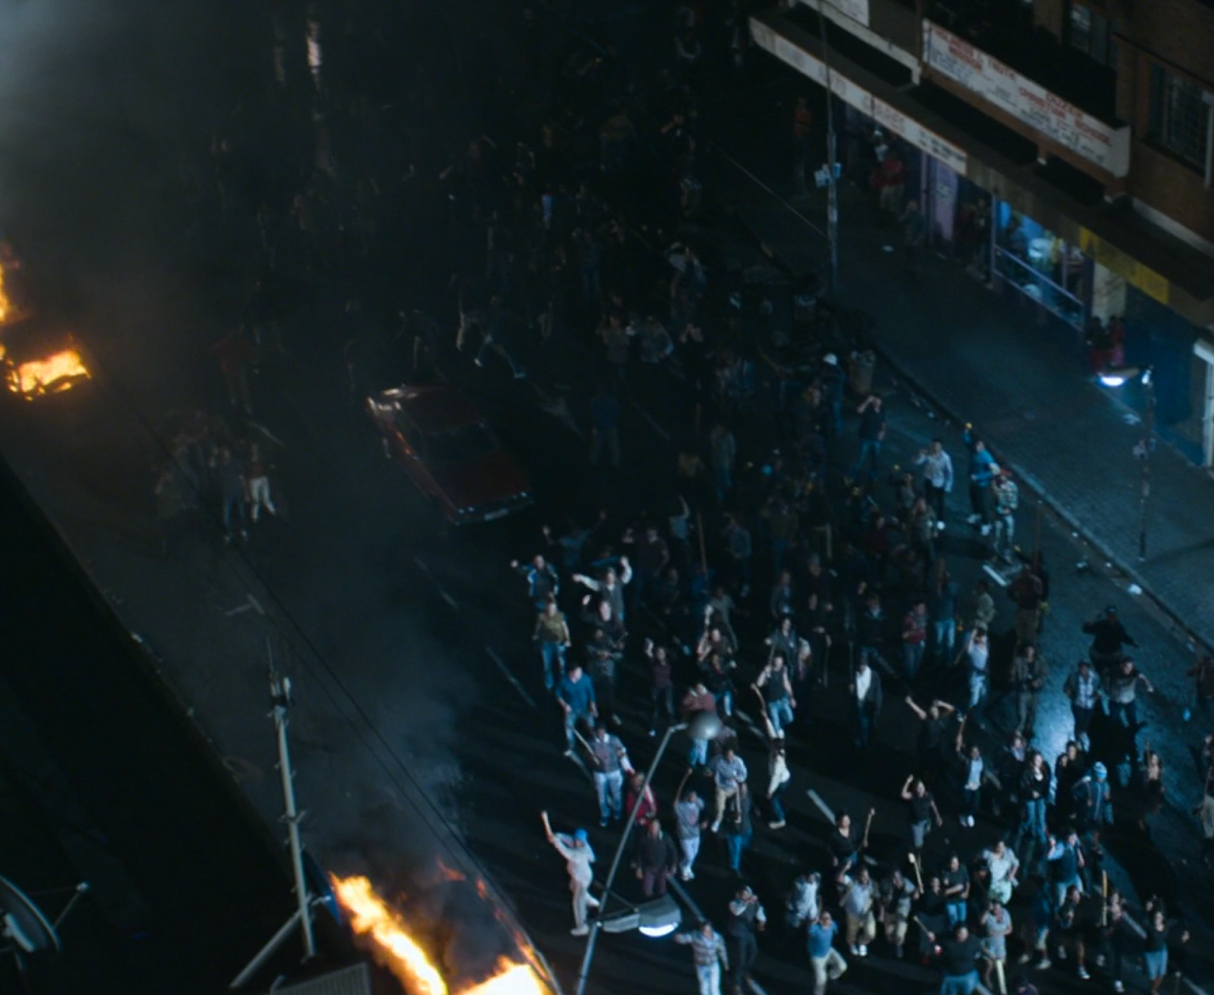
Necessity of Supervision
Deon able to take destroyed scout with no consequences
Vincent Moore reprogrammed all of the scouts simultaneously with a few simple instructions.
MOOSE launched seemingly without any oversight
No government supervision or intervention of any kind portrayed
Notes:
Brett
First off, Deon was able to remove a piece of police hardware after explicitly being told “no” without any repercussions or apparently, anyone noticing.
Following that, Moore pushed updates to reprogram all of the Scout robots simultaneously with little difficulty. The scouts all failed, and the city fell to chaos due to the lack of police presence.
Then, when Chappie was off doing his heist and the MOOSE was launched, Moore had apparent total control over it and its operations, without anyone telling him where to stop and that missiles probably are not appropriate in an urban environment.
Since Tetravaal is a public company, everyone knew the police robots operated out of that facility, and thus could have broken in. The scouts, database, and all other assets were left unguarded through the night, shown by both Deon’s and Vincent’s exploits.
At best, this is criminal negligence on the part of Tetravaal.
With the kind of power concentrated there, the lack of supervision and government involvement seems highly questionable, especially since Deon had ANY difficulty at all in revealing Moore’s deception about disabling all of the Scouts. That shows there is absolutely zero accountability at Tetravaal, which with the significance of the programs being developed, is quite absurd and unreasonable. As a final note, some period of time after the decommissioning of the Scout program, Chappie/Deon are still able to upload Yolandi’s consciousness into a new Scout body assembled at the Tetravaal facility. It seems odd that the facility would still be operational (and connected to the Internet) following the program’s and its creator’s apparent demise.

Slide 10
Conclusions
Supervision and safeguards may reduce convenience, but are necessary for security and privacy.
If something has sentience and self-awareness, it should be treated as human.
Notes:
Adilet

Slide 11
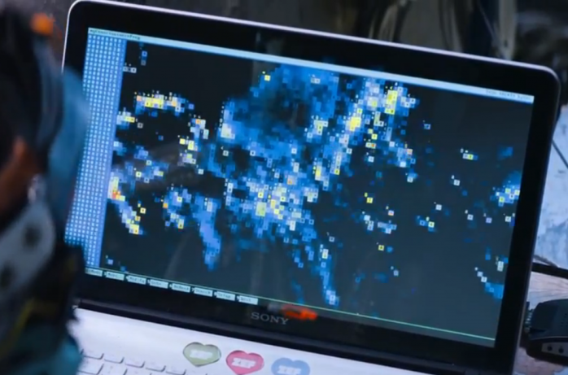
What are sapience and sentience?
Sapience
  Wisdom, self-awareness
  Ability to reason and make judgements
  Marker of personhood [4]
Sentience
  Capability to feel [5]
[9]
Notes:
Alec
Sapience and sentience are two important concepts when speaking about what makes something a person. They’re often used interchangeably, but mean different things. Sapience essentially means that they being possessing it has the ability to act with appropriate judgement. It comes from the same latin root as sapiens in homo sapiens - sapientia, meaning wisdom. In science fiction it’s also gained the connotation of the possession of self-awareness and the concept of ‘self’.
Sentience is the capacity to feel, and to experience emotion. Humans possess both sapience and sentience, and so does Chappie.

Slide 12
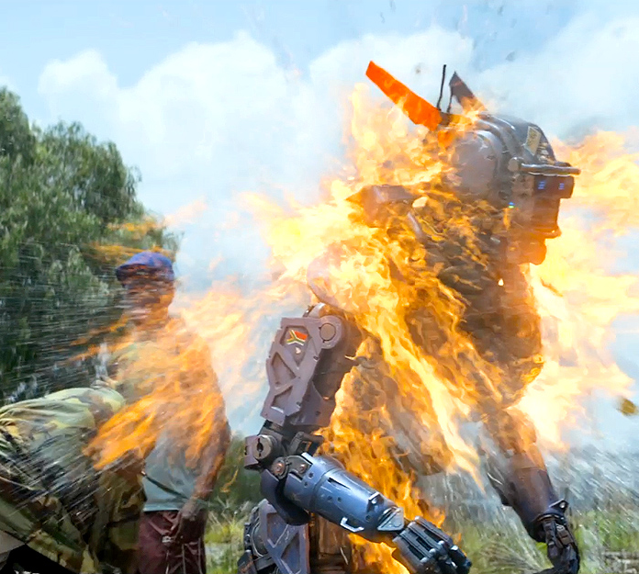
Sentient and Self-Aware Robots Should Be Treated Like Humans
Self-awareness could be used as measure of sapience
Sentient AI can perform tasks humans can
  Can learn, think and feel
  Can create new things
Humans with robotic bodies are not functionally different than sentient AI
[17]
“Because sentient beings can feel, they can be hurt, they have an interest in experiencing well-being, and therefore we owe them moral consideration.”
  Ethicist Carissa Veliz [6]
Notes:
Alec
Chappie demonstrates signs of self-awareness. He says at one point “I am Chappie.”, and when he learns of the limits on his battery, he finds he is afraid to die. He is capable of thinking critically and he develops a way to scan and copy a being’s consciousness - both his own and
In the movie, two humans, Deon and another human are uploaded into robotic bodies. The image on the right is a visualisation of the digitized copy of their consciousness.
Chappie is both sentient and sapient - he thinks and feels, and has a concept of self - he expressed fear of death, and was hurt when members of the gang left him to fend for himself in an area that hated police robots, and to experience the cruelty of humanity. This quote by ethicist Carissa Veliz is particularly striking, which she wrote in an article on the difficulty of recognizing AI sentience.

Slide 13
Conclusions
Supervision and safeguards may reduce convenience, but are necessary for security and privacy.
  Especially important with armed/surveillance technology
If something has sentience and self-awareness, it should be treated as human.
Notes:
Alec
From the movie, we concluded that while supervision and safeguards may reduce convenience, they are necessary for security and privacy. This is especially important with technology capable of being used for surveillance, such as the Scouts, and armed technology like both the Scout and Moose programs.
We also came to the conclusion that if something exhibits sentience and self-awareness, it should be treated as a person. It doesn’t matter whether they’re a human, or an artificial intelligence.
Any questions?

Slide 14
References
[1] A. Slagell, “Thinking Critically about Computer Security Trade-offs - CSI,”Thinking Critically about Computer Security Trade-offs - CSI, Aug-2010. [Online]. Available at: http://www.csicop.org/si/show/thinking_critically_about_computer_security_trade-offs. [Accessed: 21-Apr-2016].
[2]The Urban Child Institute, “TUCL Data Book VII,” Urban Child Institute, 2012. [Online]. Available at: http://www.urbanchildinstitute.org/sites/all/files/databooks/tuci_data_book_vii_2012.05_family.pdf. [Accessed: 21-Apr-2016].
[3] “http://www.urban.org/research/publication/negative-effects-instability-child-development-research-synthesis/view/full_report,” The Urban Institute, rep., Sep. 2013.
[4] G. Mobus, “Sapience,” Question Everything. [Online]. Available at: http://faculty.washington.edu/gmobus/theoryofsapience/sapienceexplained/1.sapienceintroduction/sapienceintroduction.html. [Accessed: 28-Apr-2016].
[5] http://www.merriam-webster.com/dictionary/sentience

Slide 15
References
[6] L. Westaway, “What you need to know about artificial intelligence, and the imminent robot future,” CNET, 22-Dec-2015. [Online]. Available at: http://www.cnet.com/news/what-you-need-to-know-about-artificial-intelligence-and-the-imminent-robot-future/. [Accessed: 21-Apr-2016].
[7] M. Ridley, "Nature Via Nurture: Genes, Experience, and What Makes Us Human," vol. 164, ed. Washington: Society for Science & the Public, 2003, p. 47.
[8] Neumann, Peter G., “The AT&T Crash”, The Risks Digest, Jan 1990. [Online] Available at: http://www.phworld.org/history/attcrash.htm

Slide 16
References (Images)
[9]http://davidtm.com.ar/blog/wp-content/uploads/2015/07/chappie-consciencia-1024x461.png
[10]http://1.bp.blogspot.com/-4BSzVr9rJjM/VTUpFkdPAVI/AAAAAAAACMI/vyo1a7Mezyk/s1600/Chappie%2Bopening.jpg
[11]http://www.standbyformindcontrol.com/wp-content/uploads/2015/07/MOF_0114-0490_1009.jpg
[12]http://www.liveforfilms.com/wp-content/uploads/2015/02/chappie-movie-image-2.jpg
[13]http://fm.cnbc.com/applications/cnbc.com/resources/img/editorial/2015/03/05/102481057-devin-patel-chappie.530x298.jpg?v=1425578166
[14]https://encrypted-tbn2.gstatic.com/images?q=tbn:ANd9GcRe7Clb0Gd07iK9L6hzryGxoyjGeign3OK9SGRr5UerVWlCBP-Uyw

Slide 17
References (Images)
[15]http://images.essentialbaby.com.au/2015/03/10/6338557/Article%20Lead%20-%20wide67186132140aktimage.related.articleLeadwide.729x410.14015g.png1426058070707.jpg-620x349.jpg
[16]http://dl9fvu4r30qs1.cloudfront.net/2e/57/e91fffa44828985b04f2e74f6b44/chappie-szenen-12-scene-picture-ninja.jpg
[17]http://www.ew.com/sites/default/files/i/%5Bcurrent-date%3Acustom%3AY%5D/%5Bcurrent-date%3Acustom%3Am%5D/%5Bcurrent-date%3Acustom%3Ad%5D/chappie-box-office_0.jpg
[18]https://i.ytimg.com/vi/CzRJHygC2DE/maxresdefault.jpg
[19]http://www.jasonbfischer.com/wp-content/uploads/2015/07/chappie-dev-patel-deon.jpg

Slide 18
Environment Shapes Growth
Nature - Chappie’s nature is to be good
Nurture - Chappie is influenced by forces; allows him to learn but also leads him to commit crimes [2][3]
Influence of “nurture” overrides influence of “nature” [7]
Notes:
Adilet
[FILL IN MORE WITH PLOT DETAILS]
Chappie initially very innocent
Chappie committed crimes because ‘brought up’ in uncontrolled environment
Ties into Nature vs. Nurture argument of biologists
http://www.ew.com/sites/default/files/i/%5Bcurrent-date%3Acustom%3AY%5D/%5Bcurrent-date%3Acustom%3Am%5D/%5Bcurrent-date%3Acustom%3Ad%5D/chappie-box-office_0.jpg
https://i.ytimg.com/vi/CzRJHygC2DE/maxresdefault.jpg

