Slide 1
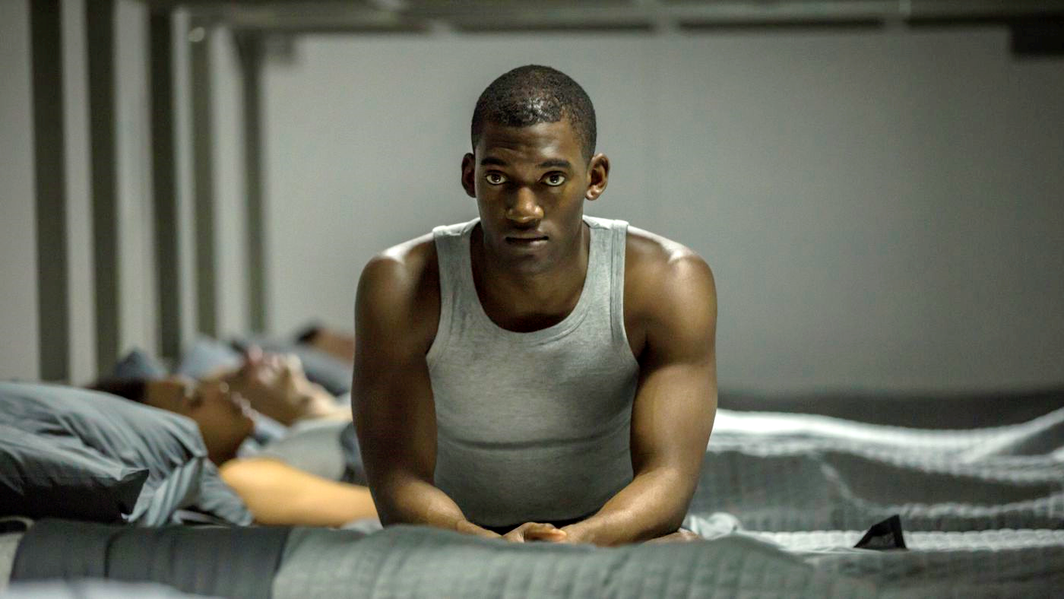
Men Against Fire
Brian DeFlaminio, Cather Zhang, Emily Lin, Talia Andrews

Slide 2


Plot summary
Emily Lin
Main character is a soldier nicknamed “Stripe”
Everyone in the military has an advanced MASS implant
“Roaches” plague society
Stripe encounters a malfunction with his implant
Stripe learns an ugly truth about his role in a much bigger evil
After a torturous encounter with one of the men in charge, Stripe is returned to his old life…
What Stripe sees (top)
What reality is (bottom)

Slide 3
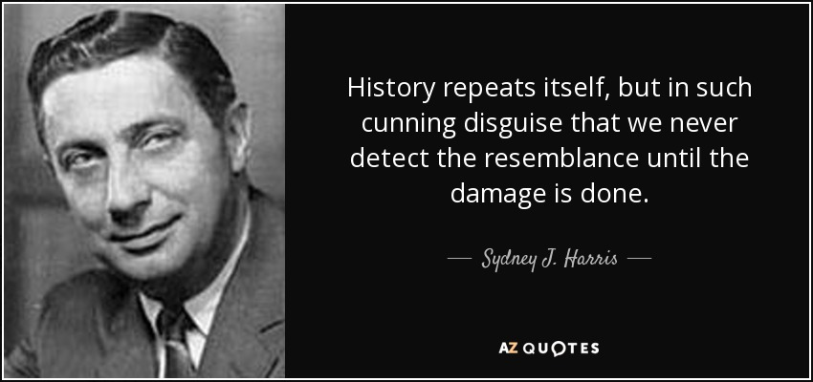
Group Conclusion
Talia Andrews
Warning from the author:
As a species the most important thing we can do is to learn from the past, and not to use computing technologies to repeat history.
- Eugenics makes a resurgence with the DNA Screening in the movie
- Media propaganda used to make a genocide acceptable (Nazism)
- Big brother surveillance with the MASS implant
Notes:
If you’re unfamiliar with Black Mirror, the shows episodes are cautionary tales of dystopian futures.
The conclusion we came to about the film was that the author was warning the audience about the risks associated with computing technologies corrupting our sense of logic and allowing us to repeat mistakes we’ve made in the past including but not limited to;
Eugenics through “clean” and “unclean” DNA, reminiscent of Nazi ideology
Media being used to fool the public into accepting mistreatment and even genocide of their fellow man. (Nazi propaganda)
Big brother surveillance through the implant is similar to the lack of privacy in the digital age.

Slide 4
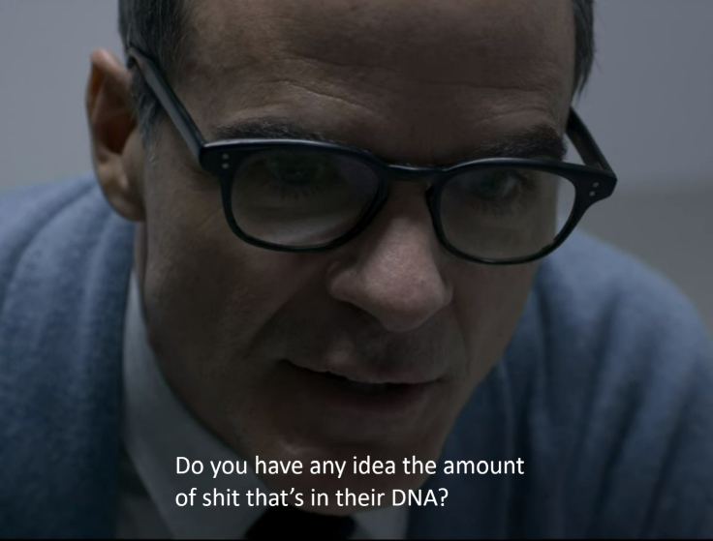

Eugenics
Talia Andrews
History of Eugenics
  Definition [1]
  Positive and negative eugenics [2]
DNA Screening (Fiction)
  "Higher rates of cancer. Muscular dystrophy, MS. SLS. Substandard IQ. Criminal tendencies. Sexual deviances."
Current DNA Screening Technologies
  Types of current genetic testing [3]
  Can detect more than 1,200 disorders and disease [4]
Notes:
Eugenics is "the science which deals with all influences that improve the inborn qualities of a race; also with those that develop them to the utmost advantage," [6]. Eugenics is split into two categories: positive and negative eugenics. Positive eugenics "[encourages] reproduction in people with 'desirable traits'" and negative eugenics "[discourages] reproduction...of people with 'undesirable traits,'" [7]. In the episode, the government practices a form of eugenics, more specifically negative eugenics, by using advanced DNA screening technology. It is mentioned that part of the reason why 'roaches' are persecuted in the show is because their DNA has been found to have "higher rates of cancer, muscular dystrophy, MS, SLS, substandard IQ, criminal tendencies [and] sexual deviances." The MASS implants allow real-time identification of ‘roaches’, through DNA screening or marking. Based on these results, the 'roaches' are killed off, with the goal of removing their genes from the gene pool.
Current DNA screening includes single gene testing, panel testing, large-scale genetic or genomic testing (including exome sequencing and genome sequencing) [8]. These screenings can detect more than 1200 disorders and diseases, from sickle cell disease to cancers such as breast and colon cancer [12][8]. In the future, this technology could be further developed to be more akin to the technology mentioned in the show, and the genetic data gathered from such screenings could be weaponized as it is in the show.

Slide 5
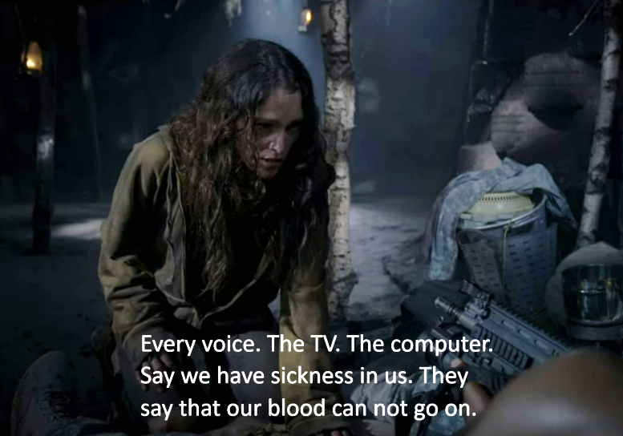


Propaganda
Brian DeFlaminio
Propaganda against human with DNA “defects”
Nazis persecuting Jews for “spreading disease” direct parallels to the propaganda in the movie.
  6 million Jews killed [5]
A female “roach” explain how media was used for propaganda
“Jews are lice they cause Typhus”
Promotional poster for the movie
Notes:
Propaganda is a vital aspect of how the acting government has convinced its citizens to allow a genocide, this tactic of dehumanizing an enemy is not new, but the means in which the government ensures it have changed. During WW2 Germany used propaganda extremely effectively to disguise their true intentions and deceive not just the German public but the international public to justify the war and violence against innocent civilians. A specific example of propaganda is the picture in the bottom left, an antisemitic poster published in German-occupied Poland in March of 1941. The Poster, written in Polish, but clearly from the Nazi party, was an attempt by the Nazis to instill fear of Jews in the Polish. The existence of such posters indicates that in our past there have been multinational efforts to push an ideology in foreign countries that the movie parallels exactly with it’s multinational fear of “roaches”. The people in the foreign country that Stripe is deployed to have almost all bought into the ideology that is being pushed onto them, though we see no propaganda we see the effects of it very clearly via the villagers throwing out all of their food simply because a “roach” touched it.
A piece of promotional art for the movie that is next to the real propaganda is a play on a Stanley Kubrik film titled “Full Metal Jacket” in which the main character has two similarly conflicting symbols on it. In the film FMJ the main character wears a peace symbol but also has “Born to Kill” written on his helmet, similar to how the writing on this helmet reflects the general attitude people in the movie have about MASS “It’s a friend” , “Lets you do it” foreshadows the truth.
(Next Slide)

Slide 6
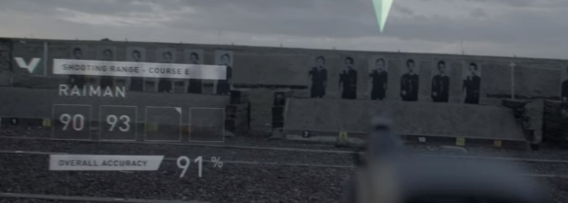
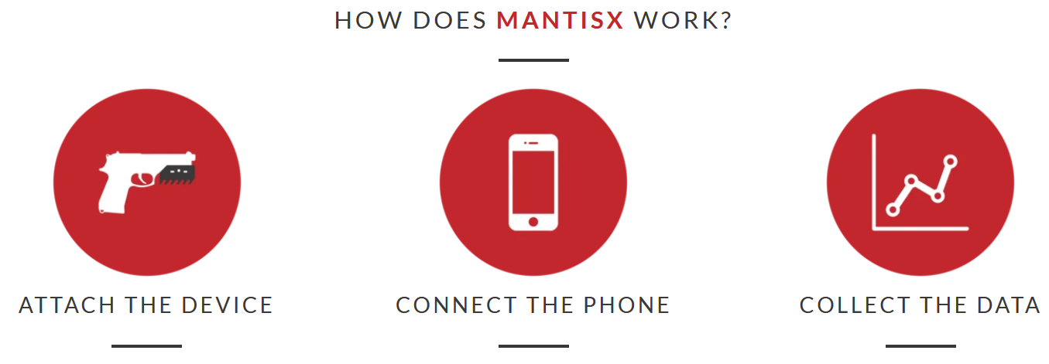
MASS Implant
Cather Zhang
Target Acquisition tool built within the Mass System
Fiction
MASS Implant – A device used by the government to assist a soldier in performing their duties
  Intelligence
  Conditioning
  Communication
Complete control over sight, sound, smell, and possibly touch.
Records these senses to a server for later memory playback
“94% of shooters improve after using MantisX for just 20 minutes” [6]
Notes:
The Mass Implant is the major technology introduced in this movie and was called as the ultimate military weapon. It is very likely a brain implant because it can control soldiers’ memories and senses.
The biggest feature is displaying information directly at a soldier’s eyeline without a need for a screen.
The Mass Implant improves efficiency in the military in many ways, including intelligence, conditioning, and communications.
Soldiers can communicate to each other directly without the need of separate radio devices
Soldiers can also use other tools that are connected to the Mass system to conduct surveillance, which will be talked about in the next slide.
The picture on the right is the target Acquisition tool that soldiers use in their shooting training, which provide aids with targeting and display a real-time shooting accuracy percentage displayed at soldiers’ eyeline. In real life, a company called Mantis produces products that have similar performance except for Mass implant’s unique display feature. It is a very small device that you can attach to rails of almost all firearms. It can be paired to phones and collect data and evaluate shooting performance.
MASS was developed to improve soldiers’ effectiveness in killing. In the movie, the psychologist said in WWII, in firefights, only 15-20% of the men will pull a trigger. With the Mass implant, the military has complete control over what a soldier can see, can smell, can hear, and possibly touch. Soldiers see “roaches” as monster deviants, hear them talking as monster screeches and do not smell blood. By controlling senses and dehumanizing the enemies, the military essentially removes emotions from the soldiers, and allows soldiers to shoot other human beings without suffering from severe psychological trauma. The military can keep a record of every soldier’s experience with and without filters for later memory playback. In the movie, the psychologist showed Stripe his real experience of killing humans without the MASS filter and threatened him to agree to get his MASS system reset, otherwise he would play those memories in Stripe’s head over and over.

Slide 7
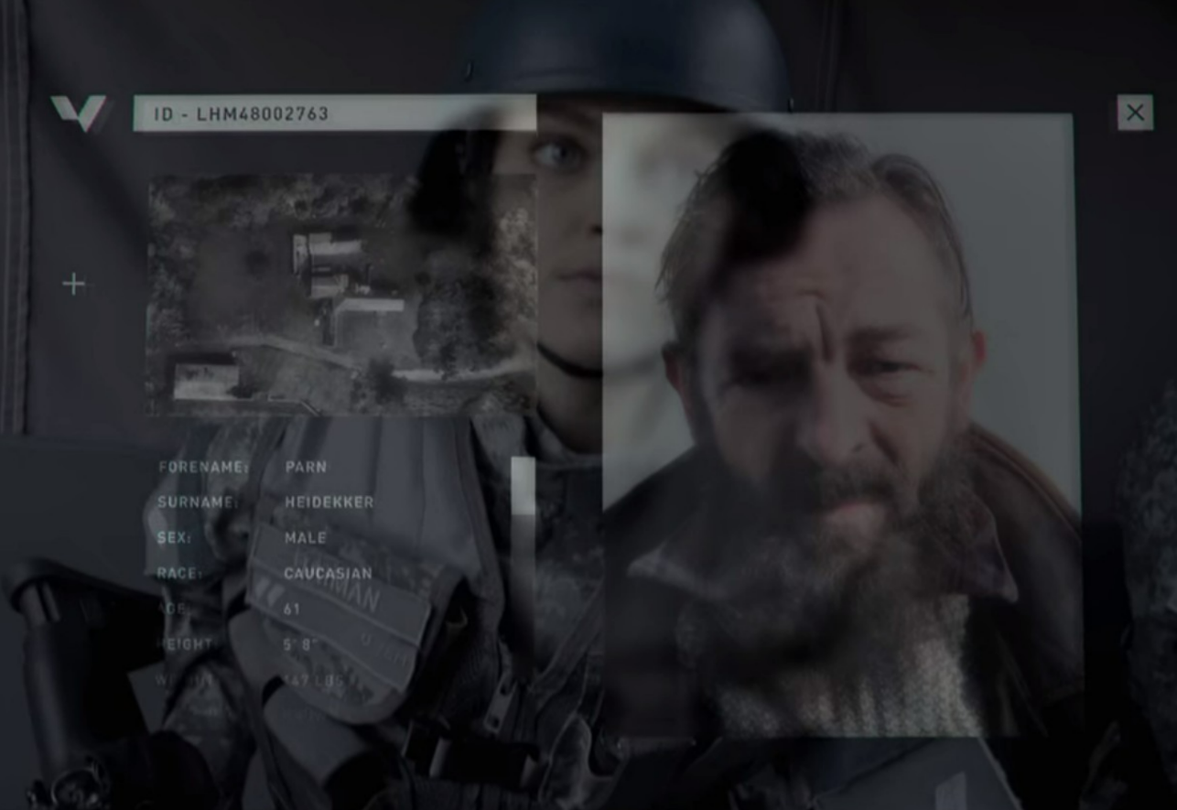
Cather Zhang
Big Brother Surveillance
Boomer – get a layout of any structure
  seismic prospecting (reality) [7]
Drone – observing surroundings
Information about individual
24-7 Monitoring on soldiers
  Found out intimate desires to reward soldiers for killing
  No “turn-off” button
  Police body cameras (on-duty)
Personal info of a man who hides “roaches” in his house
Notes:
Big Brother surveillance on everyone, including both civilians and soldiers.
Boomer is a mapping device that can be fired from a launcher and attached to a building wall. In the movie
generates sonic pulses to analyze and generate a 3D map of the structure.
3D layout is directly displayed at soldiers’ eyeline, eliminating the need for maps or tablets.
In real life, there is a similar technology called seismic prospecting, which has been used in oil exploration, where a vibration source truck sends seismic signals downward to analyze and locate new oil resource sites.
The military can also use surveillance drones with a camera that uses a remote controller, which is almost the same as modern drones we have in real life except for it is connected to the Mass and does not have the eyeline display feature.
- In the show, the military was able to pull out individual’s information and history in detail very quickly, which was due to the earlier on - DNA screening and registration process.
Civilians have no informational privacy because the military knows who they are, they can get a layout of their houses, they are being watched.
The soldiers are also being watched with a 24-7 brain monitoring, soldiers have no secrets and privacy because their activities and their memory are all being watched and stored.
Military is able to find out their intimate desire as reward for killing roaches, and then award soldiers with those dreams when they sleep.
As said earlier, Stripe did not have a choice but to agree with Mass reset because he had no control over his senses. There is no turn-off buttons. Soldiers are more like tools instead of human with proper human rights.
In the current world, there are police body cameras to monitor them. But that is only when the police are on-duty, which is very different from in the movie where soldiers are monitored 24-7.
https://www-proquest-com.ezpv7-web-p-u01.wpi.edu/docview/2311857999?pq-origsite=primo&accountid=29120

Slide 8
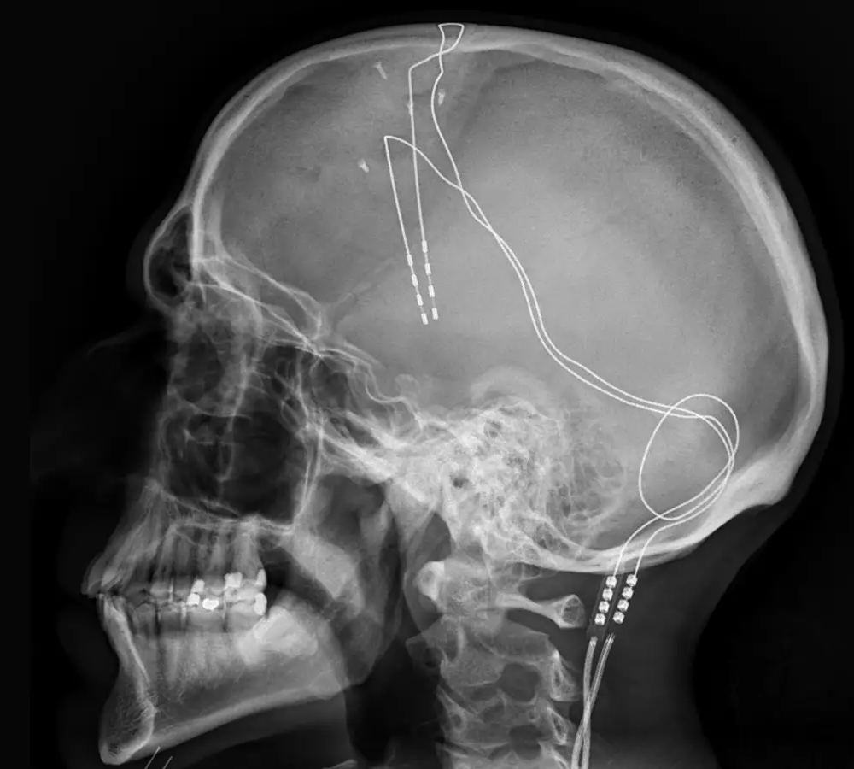
Brain Implants
Brian DeFlaminio
Reality
Brain Machine Interfaces - Will allow for a brain to communicate with machines in small capacities [8].
Neuralink implant (a form of BMI)– Going to be used to help people with nerve damage reactivate the nerves for use again [9][10].
Deep Brain Stimulation – An already approved method of treating Parkinson's disease via electric signals sent through the brain [11]. Has potential in memory erase [12].
Deep Brain Stimulation Implant
Notes:
Real brain implants have been used and are being used to treat medical conditions or assist the differently abled in their day-to-day tasks.
Brain Machine Interfaces are devices that translate neuronal information into commands capable of controlling external software or hardware.
A real world BMI is the Neuralink implant which has been demonstrated to be able to read specific synapses firing and is planned on having the ability to not just read synaptic info, but write synaptic info via sending electrochemical signals to the nervous system to act on the physical body. Planned uses are to assist those with nerve damage to move their limbs again and to allow brain activity to be read and used as movement on a computer, enabling the physically disabled to use a computer with no issue. In April of this year the company showed a monkey with the implant having the ability to move a cursor on a screen by decoding its synapses firing when it thinks about moving and encoding that to movement on a screen. The monkey was able to very effectively play PONG against a computer opponent. This technology, if it were given decades to develop, could conceivably be used to control physical movement, it is also speculated by its creators to be able to be used to bridge the information transfer gap between devices and people, making you symbiotic with an internal intelligence much like having another layer to your conscious mind. This could come about in the form of someone being able to send communications or pictures to your brain like we see the MASS implant achieve.
Deep Brain Stimulation is a form of therapy used to assist people with Parkinson’s via small electric signals stimulating the neurotransmitters whose lack of production causes Parkinson’s.
In the future it is possible for a brain implant to affect different neurotransmitters and affect movement via signals sent to the nervous system.
Studies suggest that it may be possible to not just force emotions via neurotransmitters but to suppress emotions like fear or perform selective memory erasures that can be used to treat mental health issues like PTSD, depression, anxiety, panic, phobia, etc. As of now DBS mainly increases metabolism in the brain. Erasing one’s memory would require inhibiting metabolically overactive nuclei associated with memory to effectively “erase” it.

Slide 9
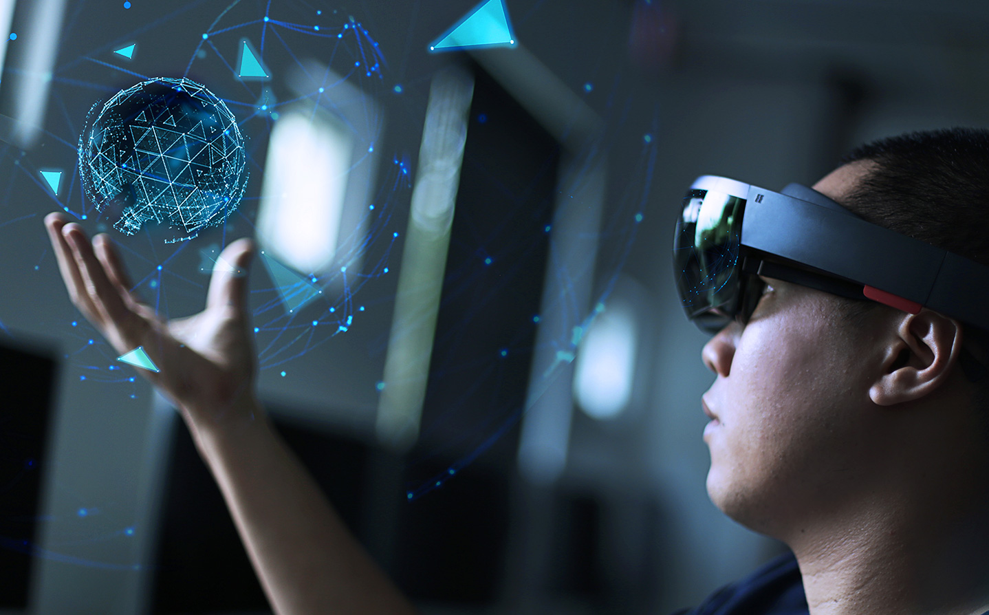
Virtual and Augmented Reality
Emily Lin
Virtual reality – uses sense of vision and sound to transport user into a digital simulation
  Potential to affect sense of touch, but more equipment is required [13]
Augmented reality – displays graphical objects within the physical world [14]
Both "realities" still require some type of headgear
Combination of both can potentially replicate what is shown in the movie
AR/VR headset design
Notes:
Virtual reality uses the sense of vision and sound to transport the user into a digital simulation. The simulation could be realistic enough to make the user believe that they are really in the digital world they're in. While including the sense of touch is possible nowadays, it requires more equipment. VR has not gotten to the point to affect dreams, but It is able to allow people to experience simulations that are dream-like.
Augmented reality differs from virtual reality, in that instead of "transporting" the user to a different world, it displays graphical objects within the physical world. The user is able to see both digitally created objects and the physical objects in front of them. If you've ever played Pokemon Go, you may remember the "AR mode," where you could see the Pokemon appear in front of you through your phone.
Both virtual and augmented reality still require some type of headgear or device, unlike the implant they use in the movie. However, once our technology can achieve virtual and augmented reality without external equipment, the combination of both realities can potentially replicate what is shown in the movie.

Slide 10
Conclusion
Cather Zhang
VS
Fiction
DNA screening
Mass implant
Boomer
Target Acquisition
Memory erase
Virtual display at eye
Reality
Genetic/DNA testing for diseases
Brain implants
Seismic Prospecting
Mantis product
DBS - potential in memory erasure
VR/AR
Notes:
We have summarized the main computing technologies used in the movie and how utilization of such technologies give the military, the government overpower to control civilians and soldiers. We also compared those technologies with current technologies in real life
The DNA screening in the movie compared to current genetics and DNA testing for disease screening
The Mass implant compared to current brain implants like neuralink and Deep brain stimulation
The boomer compared to seismic prospecting for oil exploration
The target squisition compared to Mantis’s product
The memory erase compared to DBS’s potential in memory erasure
The virtual display at eyeline compared to current technologies of VR and AR
All of which provides some hints that similar technologies may be developed in the future.
And back to our conclusion, the author was warning the audience about the risks associated with computing technologies corrupting our sense of logic and allowing us to repeat mistakes we’ve made in the past

Slide 11
Reference
[1] Francis Galton, “Eugenics: Its Definition, Scope, and Aims,” The American Journal of Sociology, vol. 10, no. 1, July 1904. https://www.journals.uchicago.edu/doi/10.1086/211280 (Accessed 10/3/2021)
[2] Alan Templeton, “Chapter 14-Human Population Genetics/Genomics and Society,” Academic Press, 2019. (Accessed 10/2/2021)
[3] “Genetic Testing,” Centers for Disease Control and Prevention. https://www.cdc.gov/genomics/gtesting/genetic_testing.htm (Accessed 10/3/2021)
[4] Karen Norrgard, "Diagnosing Down Syndrome, Cystic Fibrosis, Tay-Sachs Disease and Other Genetic Disorders," Nature Education, vol.1, no.1, 2008. https://www.nature.com/scitable/topicpage/diagnosing-down-syndrome-cystic-fibrosis-tay-sachs-646/ (Accessed 10/4/2021)
[5] “Documenting Numbers of Victims of the Holocaust and Nazi Persecution.” Holocaust Encyclopedia. December 8, 2020. https://encyclopedia.ushmm.org/content/en/article/documenting-numbers-of-victims-of-the-holocaust-and-nazi-persecution (Accessed 10/5/2021)
[6] “Improves shooting accuracy.” Mantis. https://mantisx.com/ (Accessed 10/5/2021)
[7] Qiu-Jing, Z., & Ming-Yue Zhai. “First break of the seismic signals in oil exploration based on information theory.” Neural Computing & Applications, vol.31, no.12, pp.8229-8237, 2019. http://dx.doi.org.ezpv7-web-p-u01.wpi.edu/10.1007/s00521-018-3955-6

Slide 12
Reference (cont.)
[8] Patil, P. & Turner, D.”The Development of Brain-Machine Interface Neuroprosthetic Devices.” Neurotherapeutics, vol.5, pp.137-146, 2008. https://link.springer.com/content/pdf/10.1016%2Fj.nurt.2007.11.002.pdf (Accessed 9/30/21)
[9] Pisarchik1, Alexander N, et al. “From Novel Technology to Novel Applications: Comment on ‘An Integrated Brain-Machine Interface Platform with Thousands of Channels’ by Elon Musk and Neuralink.” Journal of Medical Internet Research, JMIR Publications Inc., Toronto, Canada, https://www.jmir.org/2019/10/e16356 (Accessed 9/30/21)
[10] “Applications of Neuralink.” Neuralink, https://neuralink.com/applications/.
[11] “Deep Brain Stimulation (DBS) for the Treatment of Parkinson's Disease and Other Movement Disorders.” National Institute of Neurological Disorders and Stroke, U.S. Department of Health and Human Services, https://www.ninds.nih.gov/About-NINDS/Impact/NINDS-Contributions-Approved-Therapies/DBS#reference26 (Accessed 9/30/21)
[12] Glannon, Walter. “Brain Implants to Erase Memories.” Frontiers in Neuroscience, 2017. https://doi.org/10.3389/fnins.2017.00584
[13] Suvajdzic, M., Bihorac, A., Rashidi, P., Ong, T., & Applebaum, J. “Virtual Reality and Human Consciousness: The Use of Immersive Environments in Delirium Therapy.” Technoetic arts : a journal of speculative research, vol.16, no.1, pp.75-83, 2018. https://doi.org/10.1386/tear.16.1.75_1
[14] Aydındoğan, G., Kavaklı, K., Şahin, A., Artal, P., & Ürey, H. “Applications of augmented reality in ophthalmology.” Biomedical optics express, vol.12, no.1, pp.511-538, 2021. https://doi.org/10.1364/BOE.405026

Slide 13
Image Reference
Slide 3: https://www.azquotes.com/quote/952206
Slide 5: (Left) https://www.palestineposterproject.org/poster/%C5%BCydzi-wszy-typhus-plamisty
(Right) https://www.amazon.com/Black-Mirror-Against-Original-Soundtrack/dp/B06XS7RHLY
Slide 8: https://commons.wikimedia.org/wiki/File:Xray_of_deep_brain_stimulation_in_OCD,_L. png
Slide 9: https://www.stambol.com/2018/05/28/the-future-of-ar-vr-headset-design-is-hybrid/

