Slide 1


Slide 2
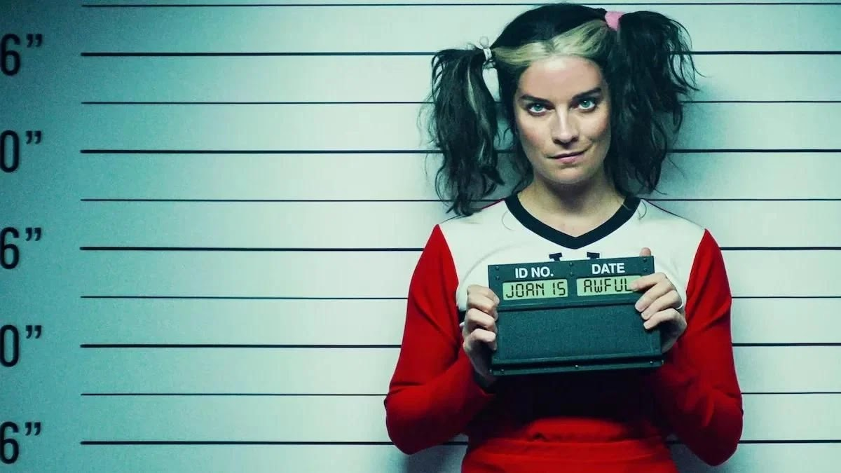

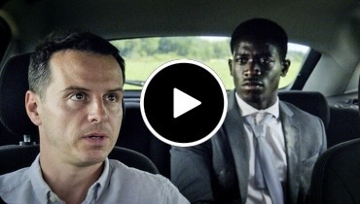

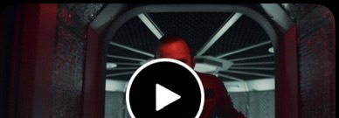
16+
CC
BLACK MIRROR
2020
|
English
Unleash your imagination and dive into this unhinged anthology series. In Black Mirror – just as in life – you never know what you’re going to get.
Action, Drama
Season 5
Striking Vipers
Smithereens
1h 2m
1h 10m
When old college friends Danny and Karl reconnect in a VR version of their favorite video game, the late-night sessions yield an unexpected discovery.
A London rideshare driver ignites an international crisis when he kidnaps a worker from a social media company.
Rachel, Jack and Ashley Too
Beyond The Sea
2
1h 7m
1h 20m
A lonely teen becomes obsessed with a robot doll
In an alternative 1969, two astronauts on a perilous
Notes:
Good Afternoon.
Introduce ourselves.
Today, we’ll be drawing three conclusions about computing ethics from the Netflix hit show: Black Mirror. Black Mirror is well-known for its near-future dystopian settings and sci-fi technology. Often times, these episodes comment on real-world events and problems. We’ll be analyzing the events from season six, episode one– Joan Is Awful.
PHOTO CITATIONS:
All photos are taken from the “Episodes Guide” from Black Mirror’s page on IMDb, Black Mirror (TV Series 2011– ) - IMDb

Slide 3

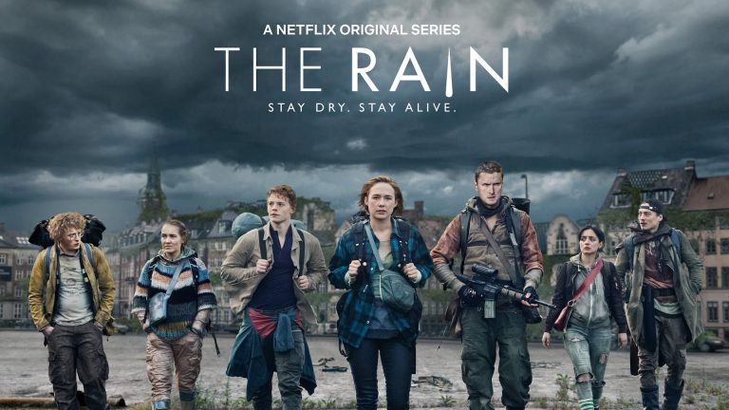

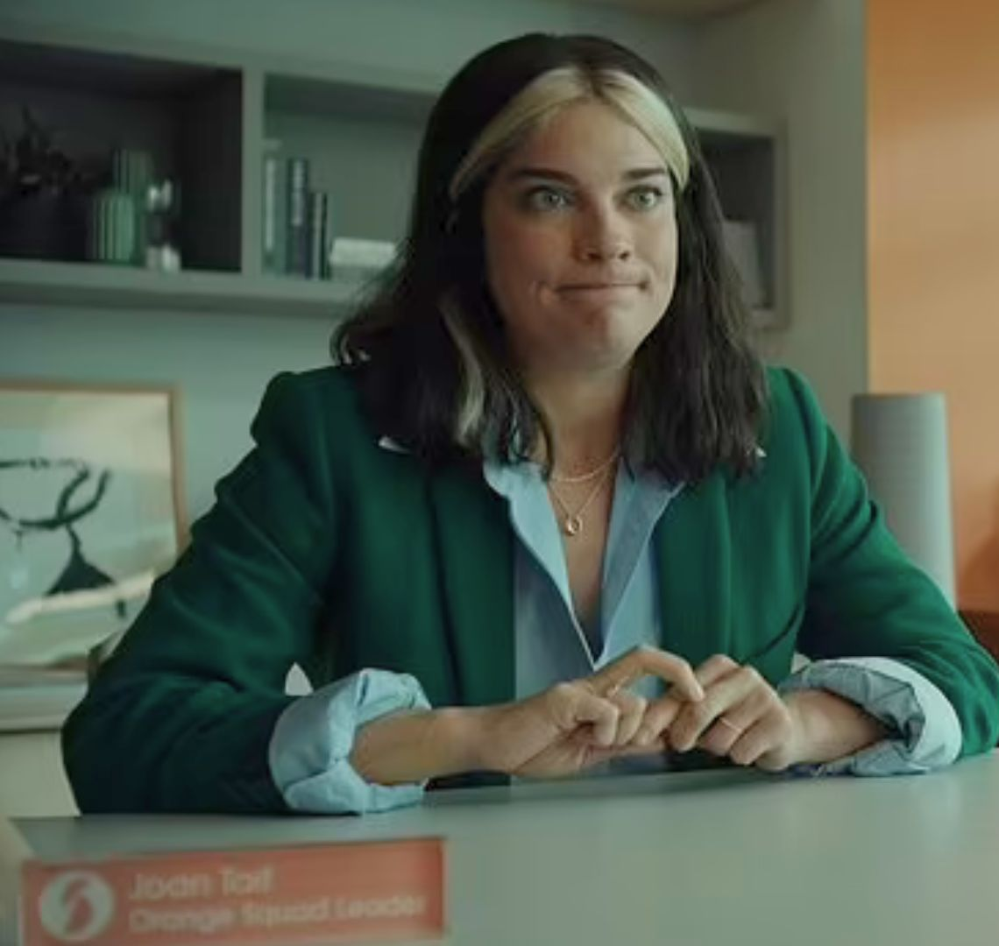
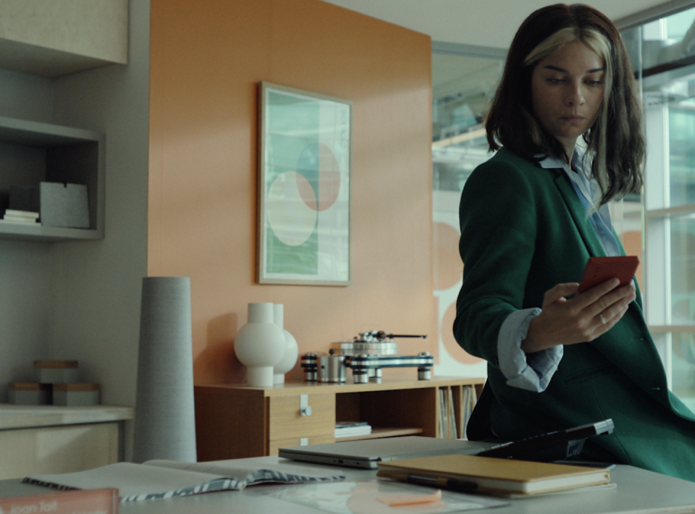
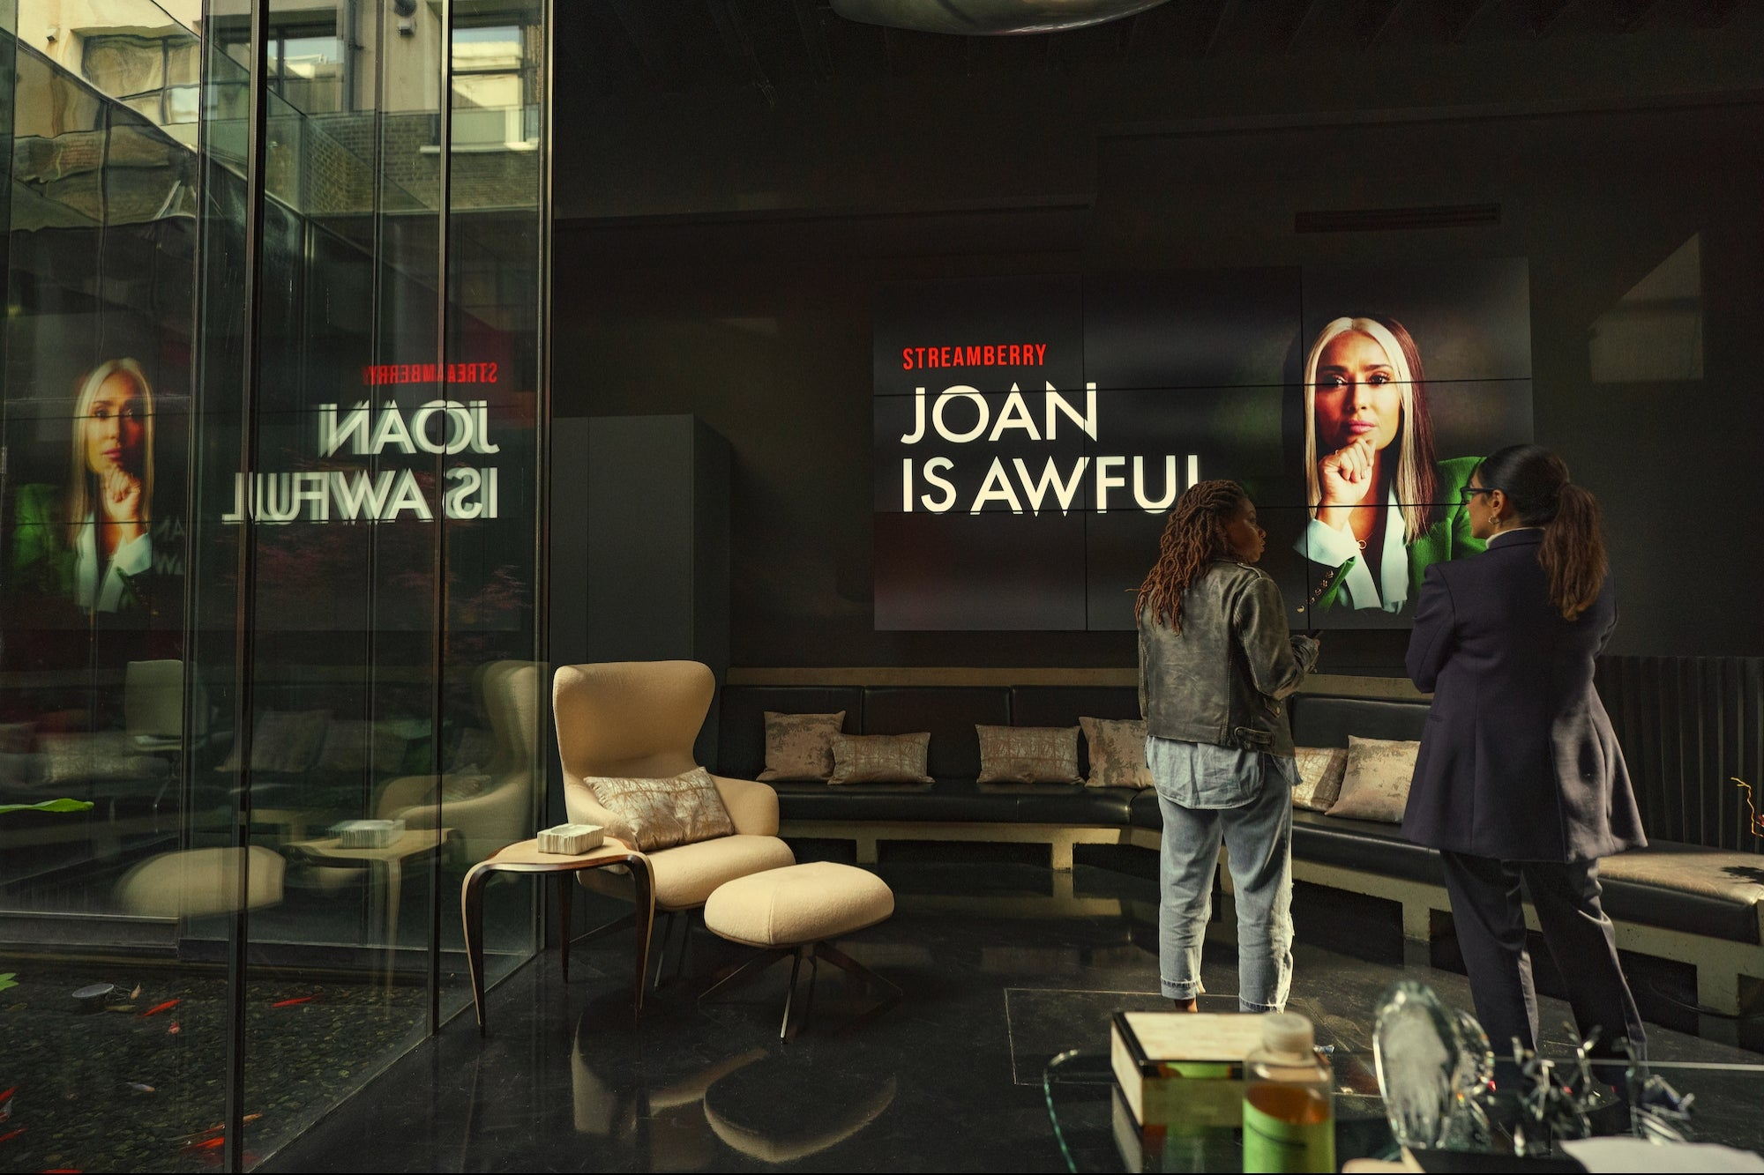
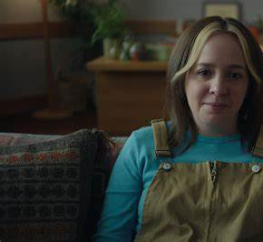
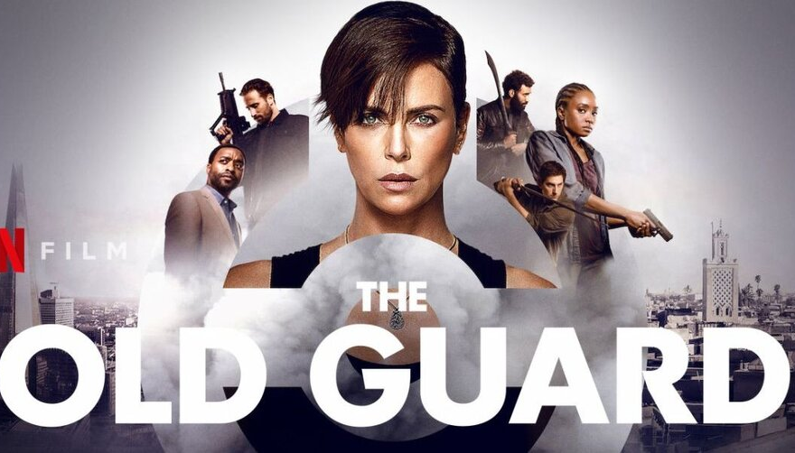
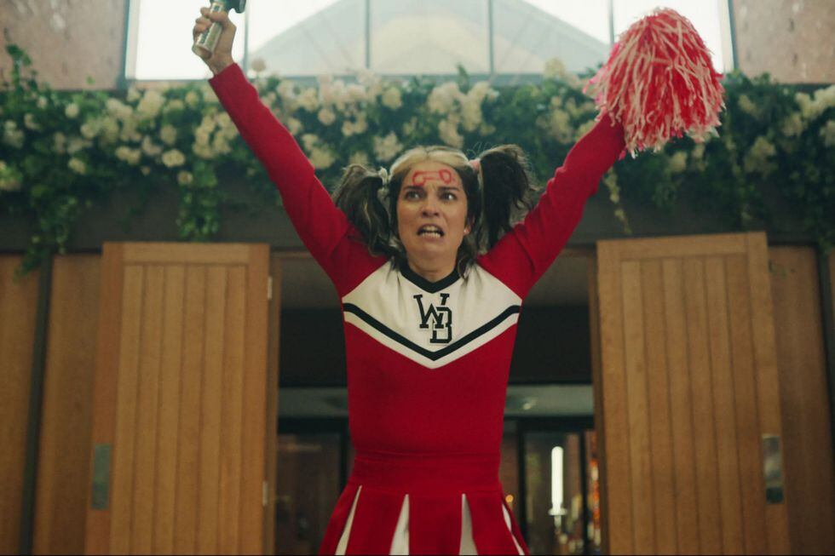
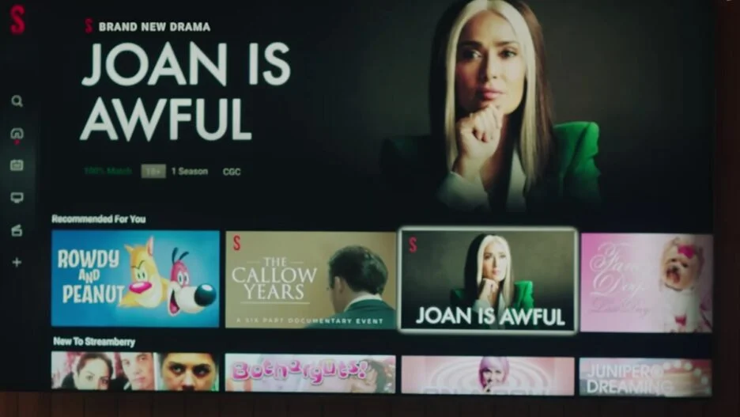
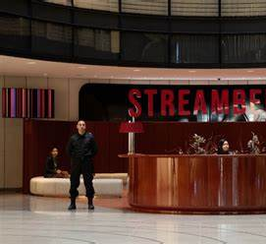
PLOT SUMMARY
Average person vs. preposterous circumstances.
Sci-fi quantum computer enables the broadcast of average people's lives.
Faces the reactions and consequences of her life on display.
Puts an end to it once and for all.
3
Notes:
Joan is Awful tells the story of your average working-class woman who discovers her privacy has been violated when she sees her life played out on a TV show on the streaming platform Streamberry. Her life takes a turn for the worse as the show gains popularity amongst her friends, family, and co-workers, and private moments are put on blast without her consent. In an attempt to regain her privacy, the main character Joan, hires a legal team to take action against Streamberry. This is where she realizes that she had agreed to allow the company to use her private information and life events when she signed the terms and conditions when registering for the service. This highlights the importance of introducing and teaching the concepts of information privacy. In this television show, her character is played by an AI-generated, CGI deepfake of Salma Hayek. In the real world, we see the rise in the popularity of AI-generated content in Holywood as well. As Joan’s world starts to seemingly fall apart and she is deemed as “awful” she begins to realize that those around her have formed a whole new opinion on her based on what they have seen on her show. The episode takes us through how Joan finally overcomes and ends this show and destroys the Quamputer.
PHOTO CITATIONS, going from left to right, top to bottom:
Joan Is Awful Ending Black Mirror, FictionHorizon.com, Joan-Is-Awful-Ending-Black-Mirror.jpg (1200×675) (fictionhorizon.com)
Joan Is Awful Tweet, X, FzPQsv3XsAAlK85.jpg (700×342) (twimg.com)
Joan Black Mirror, Numerama.com, joan-black-mirror.jpg (1920×1080) (numerama.com)
Joan Is Awful, s.yimg.com, 069ccba6b20545ef528951e5e2170e31 (960×710) (yimg.com)
Joan Is Awful Netflix Terms And Conditions, entrepreneur.com, 1687463473-joan-is-awful-netflix-terms-and-conditions.jpg (2000×1333) (entrepreneur.com)
Joan Is Awful, nflximg.net, AAAAQVr8NdvfxWEprhEbPLpKAFYetAgjhASz5QuoQkyta-KyWYlAWfSHDSLFLfRWEbQ7F05HFk7DPA4g9GLaN7MNMj9upW8crzh9xRkJiPH8PIBHBYh1XY_GGuqoIfmM6BMx4uASV7qs5oxY7xTZpOAV7C9iuGw.jpg (1200×675) (nflximg.net)
Black Mirror Season 6 Annie Murphy Scaled, mobilesyrup.comblack-mirror-season-6-annie-murphy-scaled.jpg (2560×1439) (mobilesyrup.com)
Joan Is Awful, ibxk.com.br, joan-is-awful-15144847292249.jpg (1200×601) (ibxk.com.br)
Black Mirror Season 6 Episode Joan Is Awful, moviewebimages.com, black-mirror-season-6-episode-joan-is-awful.jpg (1200×630) (moviewebimages.com)

Slide 4
The Quantum Computer
Powerful
  24/7 surveillance
  Creates simulations
  Uses artificial intelligence to generate tailored content
“It's basically magic.” [20]
4
Notes:
The quantum computer in Black Mirror: Joan is Awful is extremely powerful.
It has the ability to conduct round the clock surveillance on all subscribers to Streamberry.
It creates levels of simulations in which the characters (licensed likenesses of real actors) believe that the simulation is real
It uses artificial intelligence to generate content that is tailored to their viewers, however this content is negative because when Streamberry ran tests they found that there was more engagement when the content was negative rather than positive.
The Ceo of Streamberry admits that they don’t understand how the computer works and states that it is basically magic.
PHOTO CITATION
Joan Is Awful Tweet, X, FzPQsv3XsAAlK85.jpg (700×342) (twimg.com)

Slide 5
CONCLUSIONS
Formal education on information privacy needs to be implemented in all public schools
AI-generated content is changing the creative landscape in Hollywood
Societal biases sourced from the media significantly shape our view of others
JOAN IS AWFUL
5
Notes:
Inspired by the events of the show, we came up with three societal conclusions. First, societal biases sourced from the media significantly shape our view of others. Second, AI-generated content is changing the creative landscape in Hollywood. Third, formal education on information privacy needs to be implemented in all public schools. We’ll now be going through each conclusion in-depth.

Slide 6
CONCLUSION #1
Formal education on information privacy needs
to be implemented in all public schools.
JOAN IS AWFUL
6
Notes:
Formal education on information privacy needs to be implemented in all public schools. This change will support a culture of data privacy consciousness. If Joan grew up in a world where information privacy was a priority, she may have taken a second look at those terms and conditions. Streamberry Services might’ve thought twice about deceiving subscribers if they thought they couldn’t get away with it.

Slide 7
Kids K-12 Are Vulnerable to Data Breaches
2019 report: only 45% of US high schools teach computer science [1]
2012 survey: 92% of American teens used their real name on social media accounts, 91% consistently posts photos of themselves, 82% share their birth date [2]
  Similar majority also post school name, home city or town, relationship status [2]
Personal information (birthdays and places of residence) is a “common but unacceptable” use for passwords [3]
JOAN IS AWFUL
7
Notes:
Kids K-12 are vulnerable to data breaches. A 2019 report published by the Code.org Advocacy Organization, the Computer Science Teacher Association, and the Expanding Computing Education Pathways Alliance reported that only 45% of high schools in the United States teach computer science. This is an unacceptable statistic as the it increases the knowledge gap on a topic that will become increasingly important as time goes on. Furthermore, a 2012 survey by the Pew Research Center found that 92% of American teens constantly post photos of themselves and 82% share their birthdate. A similar majority also share their school name, hometown, and relationship status. Pieces of personal information like the ones mentioned are common but unacceptable uses for passwords, according to the National Institute of Standards and Technology. For these reasons, school-aged kids are especially susceptible to data breaches and need to be taught more robust data security.

Slide 8
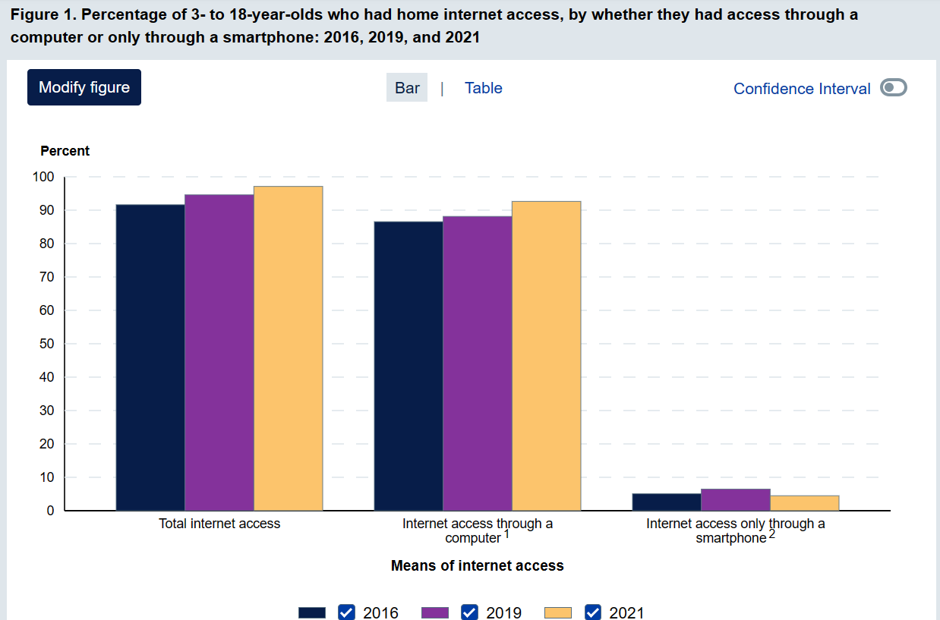
Change Will Reap Generational Benefits
Access to internet continues to expand beyond previous generations’ [4]
Need to foster culture of internet safety on pace with accessibility
JOAN IS AWFUL
Internet Accessibility Growth [4]
8
Notes:
Another reason this education reform needs to take place is that it has the power to reap generational benefits. Access to the Internet is increasing every year. The graphic to the left is sourced from the National Center for Education Statistics. It shows a steady yearly increase from 2016 to 2021. Of the demographic researched, 48% said that the reason they do not have Internet access at home was simply because they do not use it and were “not interested” [4]. We need to foster a culture of internet safety and culture that is on pace with how fast internet accessibility is expanding.

Slide 9
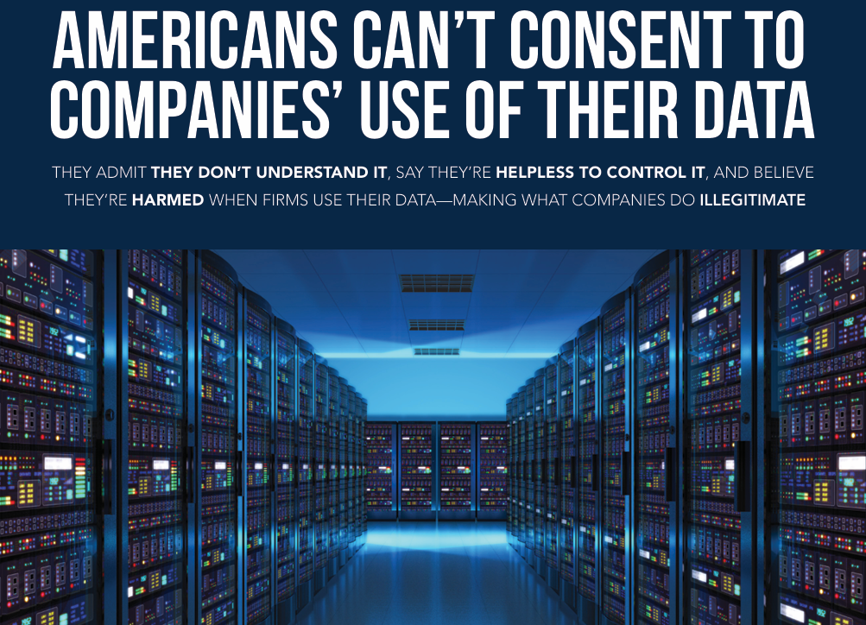
Government Needs a Tougher Stance on Data Privacy
US promotes an “opt out” system when it comes to data collection [5]
  Puts too much responsibility on the individual
  Need to supplement with formal education beside basic math, science, and English
2023 UPenn Report [5]
JOAN IS AWFUL
9
Notes:
Finally, the government needs to take a tougher stance on data privacy to protect its citizens. The United States promotes an “opt out” system when it comes to data collection. This puts too much responsibility on the individual user. This is a stance that prioritizes big tech over the well-being of its citizens. For reference, the European Union is almost strictly “opt in” [5]. If the US continues this path of prioritization, the least they could do is supplement with formal education beside basic math, science, and English.

Slide 10
CONCLUSION #2
AI-generated content is changing the
creative landscape in Hollywood.
JOAN IS AWFUL
10
Notes:
Second, AI-generated content is changing the creative landscape in Hollywood.

Slide 11
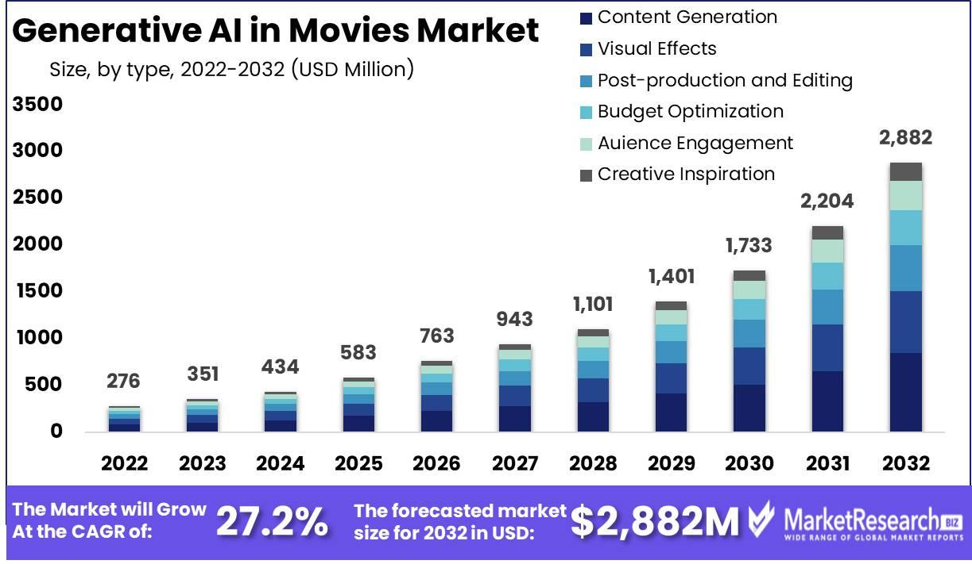
Enhancing Creative Possibilities with AI
Fast editing, by 2023 about 20% of film will be edited using AI [8]
Screenwriting changing scripts for different shows [6]
77% used generative AI: virtual photos, rotoscoping, animation [10]
JOAN IS AWFUL
[9]
11
Notes:
Automation of Repetitive Tasks: AI can automate editing at very fast speeds, ultimately removing the need for humans and freeing up creative professionals to focus on more innovative aspects of filmmaking [8]
AI in Screenwriting: As seen in Joan is Awful the quantum computer takes over creating the show. AI is making video production as easy as typing or speaking, film makers are now able to use AI programs like Storia to create detailed storyboards pre-production[6]
Personalized Content Creation: AI analyzes viewer preferences and viewing habits to assist writers and producers in creating content that better resonates with specific audiences
According to study, nearly 77 percent of respondents use AI image generators enabling for faster landscape photos to screens to post production[10]
Generative AI optimizes costs for example now producers can save money by having virtual characters and virtual environments (decreasing production costs while improving efficiency)[11]

Slide 12
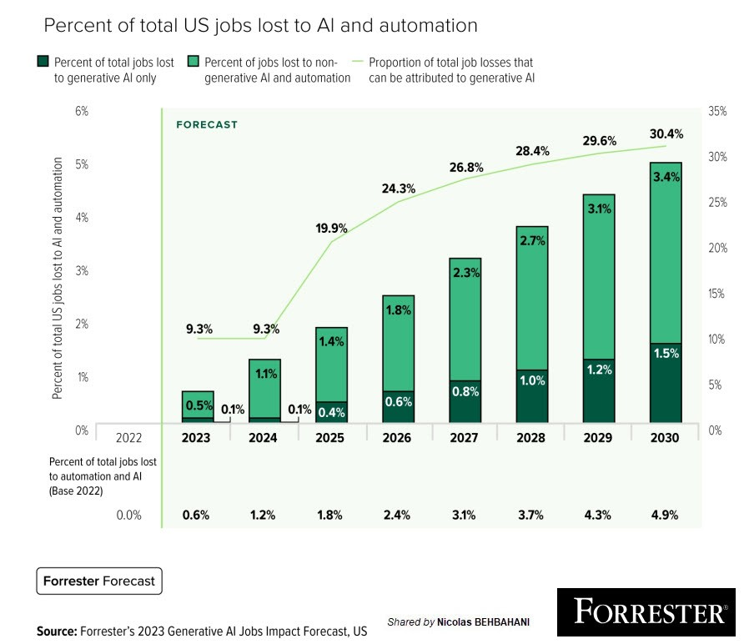
Ethical and Economic Implications of AI in Hollywood
Investors poured $50 billion into generative AI [6]
Study predicts over 118,500 entertainment jobs lost by 2026 [10]
90% of AI startups are minor improvements [6]
AI can amplify but not produce its own film [7]
JOAN IS AWFUL
[12]
12
Notes:
Job Displacement: AI potentially can replace jobs in effects, animation, and even acting
It is an ethical consideration when thinking about the loss of artistic control and creativity, while AI can speed up editing can it speed up creativity?[7]
Study found that by 2026, 20 percent of all entertainment industry jobs, or roughly 118,500 positions, will be cut[10]
This chart forecasts the percentage of total U.S jobs lost to AI and automation from 2022 to 2030, distinguishing between losses attributed to generative AI and other forms of AI and automation. It indicates a growing trend in job losses due to these technologies, with an overall rise from 0.5% in 2023 to an estimated 4.9% by 2030, while the proportion of job losses specifically due to generative AI is expected to increase from 0.1% to 1.5% over the same period [12]
Authenticity vs. AI: There is a big loss of authentic human touch in creative processes versus the precision and efficiency brought by AI. For example in Joan is Awful, the owner of Streamberry shows that everyone's life is going to be used to make an episode of the Awful series.
There is a challenge right now when finding a balance between AI and the human film producers
Economic Impact: AI can lead to cost savings in production but also might require significant investment in new technology and training. Investors are putting money down into generative AI and AI startups [6]
Hollywood is putting money into AI to change the landscape [6]
These AI startups are currently small but they will soon grow to be expansive. [6]

Slide 13
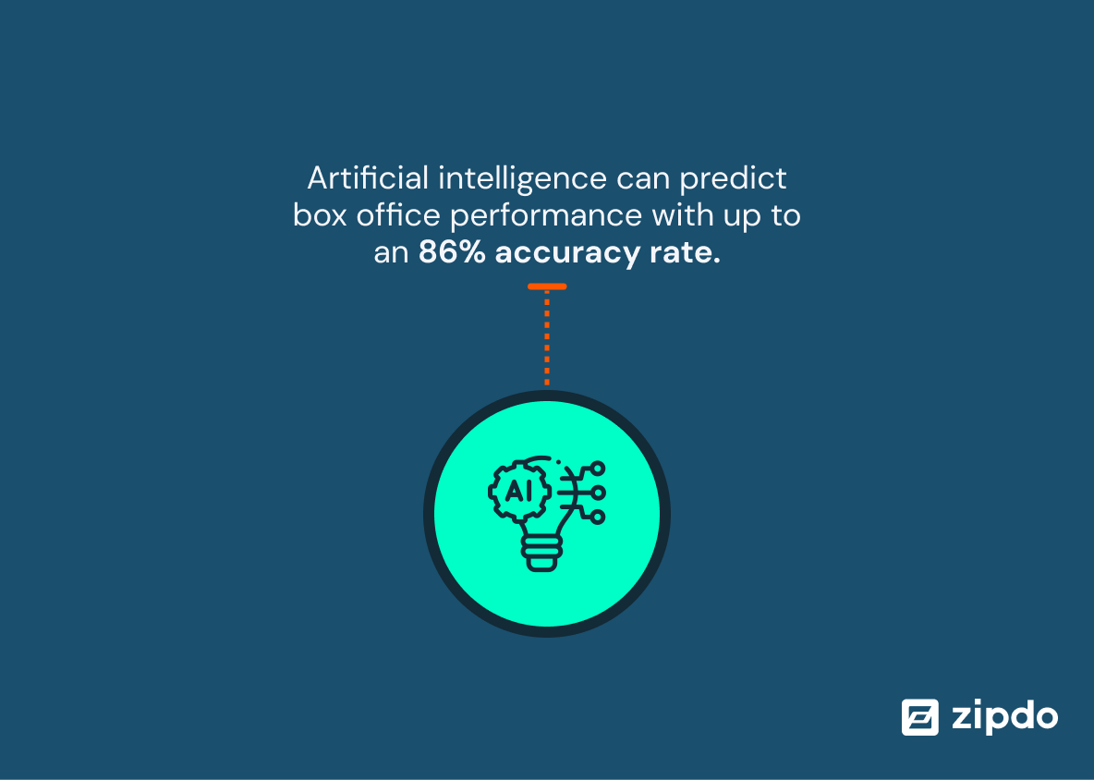
Future Trends and Innovations
Warner Bros achieves 70% accuracy in forecasting film performance[8]
Enhances VR/AR movies, and creates interactive narrative experiences [11]
AI tools enhance visual effects, realistic CGI and immersive scenes[7]
[8]
JOAN IS AWFUL
13
Notes:
Predictive Success Models: Box Office Predictions, AI algorithms can analyze vast amounts of data from past film performances to predict box office success with greater accuracy. Helping studios produce the best movies and films [8]
Warner Bros study specifically did their AI testing which revealed a 70 percent accuracy in testing their films performance
This image presents as a statement about the capabilities of artificial intelligence, indicating that AI can predict the performance of movies at the box office with a high degree of accuracy, up to 86% [8]
Audience preferences: Predictive AI can sift through social media and online reviews to best gauge audience sentiments and preferences. Allowing producers to tailor to viewers tastes. [8]
Interactive and Adaptive Media: Generative AI is transforming how we experience films through Virtual Reality (VR) and Augmented Reality (AR). It enables the creation of adaptive and interactive media, where viewers can step into virtual worlds crafted by AI algorithms. These environments are not only immersive but also allow real-time interaction with characters and settings, providing a personalized narrative experience that adjusts and evolves based on viewer responses. It is a modern innovation. [11]
Automated Cinematic Techniques: AI tools are revolutionizing the entertainment industry by enhancing the quality of visual effects. These advanced technologies enable filmmakers to create highly realistic CGI that integers seamlessly with live-action footage, expanding the boundaries of creativity. This transformation allows for the depiction of intricate scenes–from futuristic cityscapes to epic space battles-making cinematic experience more immersive and visually striking for audiences[7]

Slide 14
CONCLUSION #3
Societal biases sourced from the media
significantly shape our view of others.
JOAN IS AWFUL
14
Notes:
Societal biases sourced from the media significantly shape our view of others.

Slide 15
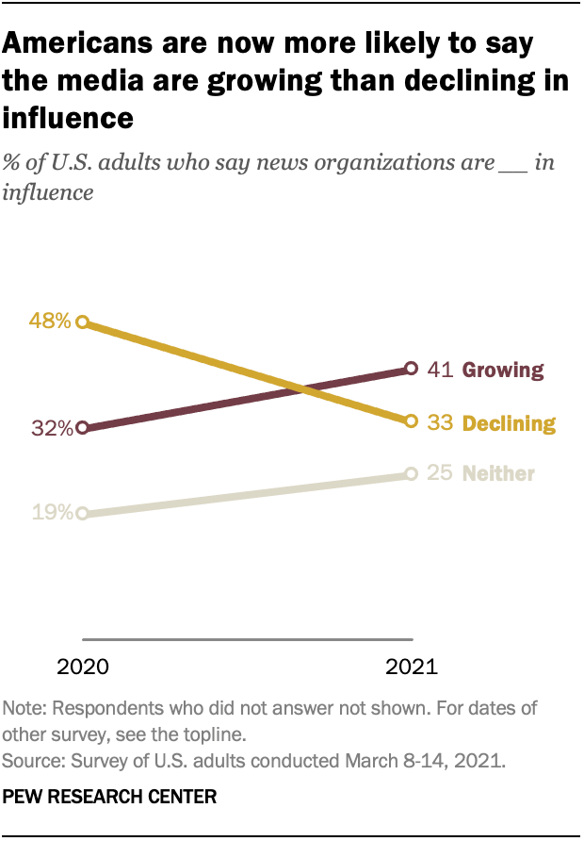
Social Media and Its Impact is Growing
Americans view on media has shifted
Number of social media accounts have grown 8%[14]
70% of teens use social media multiple times a day[15]
JOAN IS AWFUL
15
Notes:
Social media has become an integral part of our lives. As social media grows so will the impact it has.
Social media is experiencing significant growth worldwide. According to the (Pew Research Center) 41% of Americans think that social media is growing. In Jan 2023 to Jan 2024 the number of accounts grew 8% from 4.72b to 5.04b [13][14]. Media is perceived and in actuality is growing but what about its impact. According to a study by bright futures, 70% of teenagers check social media multiple times a day, while 24% have reported that social media has negatively affected them[15]. Social media is becoming much more relevant in people’s lives, and is it continues to grow it will affect us negatively and positively.The influence of societal biases sourced from the media not only shapes our views of others but also perpetuates stereotypes, reinforces inequalities, and impacts our perceptions of various social groups.
Image Reference : [13]

Slide 16
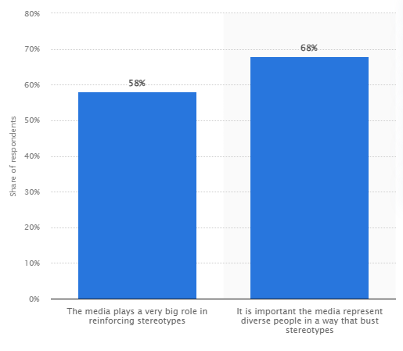
Media Perpetuates Stereotypes
58% of Americans believe media reinforces harmful stereotypes[17]
Media normalizes and reinforces stereotypes
Virtual prejudice perpetuates to real life
JOAN IS AWFUL
16
Notes:
One way media affects us negatively is by perpetuating stereotypes. On the internet anybody is allowed to post anything this often results in potentially harmful content. A study conducted in July 2020 found that 58% of americans believe that media reinforces harmful stereotypes, with an even larger portion of 68% of respondents stating that the media is undermining these stereotypes. An example of this is a current trend going on on TikTok called #Girlmath. The trend targets woman and helps them rationalize spending and making purchases with irresponsible logic. An example is that if you pay in cash you’re not spending real money’ or that ‘if it costs less that $5’ it is free. This trend may have started out however it not only promotes bad behavior it perpetuates the stereotype. Girlmath reinforces the idea that women are immature and less competent with finances[16]. A majority of the time the initial message of these trends may not be apparent, appearing as only a joke, however the underlying implication can undermine the groups that are targeted by these trends.
Image Reference: [17]

Slide 17
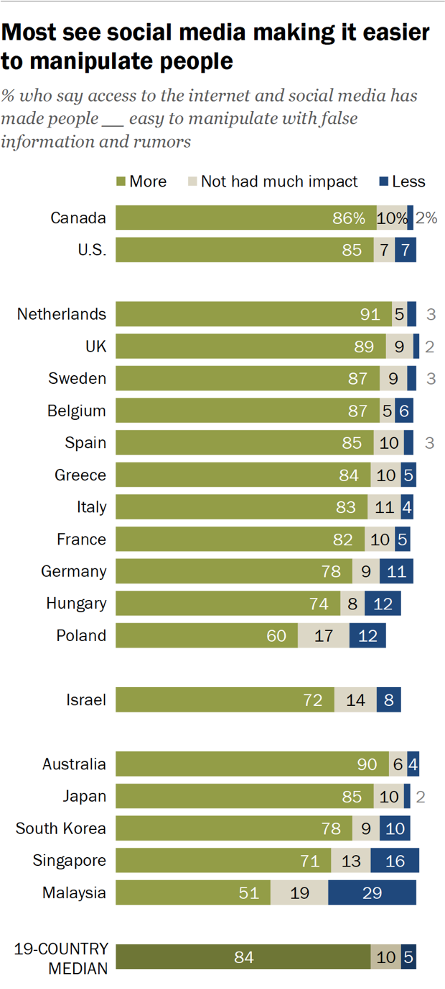
Social Media Affects Decision Making
It is easier now to manipulate false information and rumors
Americans believe that media influence has grown by 58% [18]
Social media is influential in decision making
JOAN IS AWFUL
17
Notes:
Social media can perpetuates stereotypes but it can also affect the way we think and make decisions. In recent studies it was found that 40% of people look towards social media for travel advice. In other sectors this number is lower however still relevant. With 25% of people looking for advice in the financial sector, 22% in retail and 21% in healthcare [18].
Because so many people look to social media for advice it is much easier to spread misinformation and manipulate people. A study by pew pew research found that 84% of people agree that media made it easier to manipulate with false information and rumors. As social media continues to grow it is important to consider its impact and implications[19].
Image Reference: [18]

Slide 18
CONCLUSIONS
Formal education on information privacy needs to be implemented in all public schools
AI-generated content is changing the creative landscape in Hollywood
Societal biases sourced from the media significantly shape our view of others
JOAN IS AWFUL
18
Notes:
April

Slide 19
19

Slide 20
References
2019 State of Computer Science Education, (2019), Retrieved from https://advocacy.code.org/
Brenner, Joanna, Part 2: Information Sharing, Friending, and Privacy Settings on Social Media, (Pew Research Center, 21 May 2013), www.pewresearch.org/internet/2013/05/21/part-2-information-sharing-friending-and-privacy-settings-on-social-media/, Accessed 22 Apr. 2024
Digital Identity Guidelines, (National Institute of Standards and Technology)
Children’s Internet Access at Home, (National Center for Education Statistics 2023), https://nces.ed.gov/programs/coe/indicator/cch, Accessed 22 Apr. 2024
Turow, Joseph, et al. Americans Can’t Consent To Companies Use Of Their Data, (Annenberg School for Communication at UPenn, February 2023), https://papers.ssrn.com/sol3/papers.cfm?abstract_id=4391134
20

Slide 21
References
6. Daniel Zahler, Hollywood GPT: Five Ways AI is Reshaping Media and Entertainment, (Medium, 3/4/2024), https://medium.com/@danielzahler/hollywood-gpt-five-ways-ai-is-reshaping-media-and-entertainment-d76c4650e43d
7. Stewart Townsend, AI Film Production: Revolutionize Your Cinematic Process, (Linkedin, 3/1/2024), https://www.linkedin.com/pulse/ai-film-production-revolutionize-your-cinematic-process-townsend-etuxc/, (4/22/2024)
8. Zipdo, Essential AI in Movie Statistics in 2024, (Zipdo), https://zipdo.co/statistics/ai-in-movies, (4/22/2024)
9. Denis Green, Generative AI in Movies Market Present Development Strategy, And Growth Opportunities 2023 To 2032, (LinkedIn, 8/7/2023), https://www.linkedin.com/pulse/generative-ai-movies-market-present-development-strategy-denis-green/
10. Winston Cho, The HollyWood Jobs Most at Risk From AI, (HollyWoodReporter, 1/30/2024), https://www.hollywoodreporter.com/business/business-news/ai-hollywood-workers-job-cuts-1235811009/, (4/23/2024)
11. MarketResearch, Generative AI in Movies Market By Type (Content Generation, Visual Effects, PostProduction & Editing, Budget Optimization, Audience Engagement, and Creative Inspiration, (MarketResearch, 8/2023), https://marketresearch.biz/report/generative-ai-in-movies-market/, (4/23/2024)
12. Nicolas Bebahani, Job losses due to Generative AI will be lower than many expect, and influence will far outweigh job cannibalization, (LinkedIn, 9/12/2023), https://www.linkedin.com/pulse/job-losses-due-generative-ai-lower-than-many-expect-far-behbahani/, (4/27/2024)
21

Slide 22
References
13. Jeffery Gottfried, Naomi Forman-Katz, More Americans Now See The Media’s Influence Growing Compared With a Year Ago, (May 17th, 2021), https://www.pewresearch.org/short-reads/2021/05/17/more-americans-now-see-the-medias-influence-growing-compared-with-a-year-ago/, (April 24th, 2024)
14. Dave Chaffey, Global Social Media Statistics Research Summary 2024, (Feb 1st, 2024) https://www.smartinsights.com/social-media-marketing/social-media-strategy/new-global-social-media-research/#:~:text=A%20summary%20of%20global%20social,rest%20of%20the%20year%E2%80%A6, (April 25th, 2024)
15. Bright Futures, 70+ Social Media and Mental Health Statistics(2023), (Oct 2nd, 2023), https://www.brightfuturesny.com/post/social-media-and-mental-health-statistics#:~:text=24%25%20of%20teenagers%20say%20social,themselves%20in%20a%20certain%20way, (April 25th, 2024
16. Pam Rutledge, Jokes that Infantilize Women and Glorify Irresponsible Spending Aren’t Funny, (Sep 18th, 2023), https://www.fielding.edu/girlmath-how-social-media-trends-perpetuate-stereotypes/, (April 25th, 2024)
17. Julia Stroll, Impact of TV Content on Perpetuating Sterotypes in the US as of March 2020, (Mar 9th, 2021), https://www.statista.com/statistics/1136068/media-reinforces-stereotypes-in-us/, (April 24th, 2024)
18. Marcia W. DiStaso, Tina McCorkindale, The Science of Influence: HOW SOCIAL MEDIA AFFECTS DECISION MAKING IN THE HEALTHCARE, TRAVEL, RETAIL AND FINANCIAL INDUSTRIES, (Dec 11th, 2017), https://instituteforpr.org/science-influence-social-media-affects-decision-making-healthcare-travel-retail-financial-industries/, (April 25th, 2024)
19. Richard Wike, Larua Silver, Janell Fetterolf, Christine Huang, Sarah Austin, Laura Clancy, Sneha Gubbala, Views of Social Media and Its Impacts on Society, https://www.pewresearch.org/global/2022/12/06/views-of-social-media-and-its-impacts-on-society-in-advanced-economies-2022/, (April 24th, 2024)
20. Black Mirror: Joan is Awful (00:51:00)
22

