Slide 1
CYCLING away FROM SOCIETY
Black Mirror: Fifteen Million Merits Team
Nora Cleary, Matthew Copeland, Javier DeLeon
Adam Kalayjian, Alex Zhang
Notes:
Conclusion: Excessive dependence on technology leads to dehumanization and the loss of an authentic society.

Slide 2
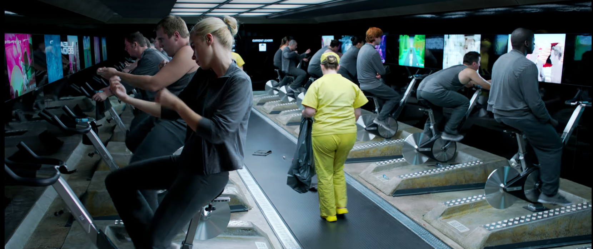

Synopsis
Black Mirror Team
The lives of two main characters change drastically in this alternate, future reality
  Bing, rides his exercise bike for merits
  Abi, talent of singing, who Bing wants to help "make something real"
Revolves around the hope for a change in the system
[32]
[36]
Notes:
Here is the synopsis for our movie. Bing, one of the main characters of the movie, rides his exercise bike to earn merits. He inherits a large sum of merits after the unfortunate death of his brother, and has accumulated a hefty sum and wants to spend it on Abi, our other main character, who he overhears singing In the bathroom, and wants to use his credits to help her use her voice to "make something real in this place". Bing is aware that everything where they are in is completely run by some kind of higher power, and he wants to break free of this norm. He believes, with the help of Abi, that they can overcome this hierarchy based system they are all trapped in and find some true meaning in their lives.

Slide 3
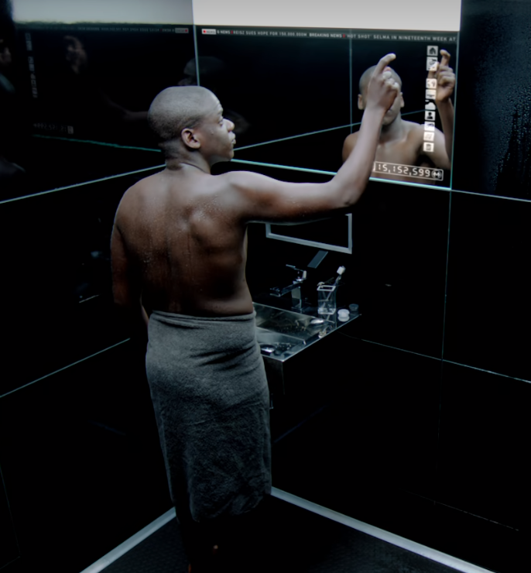
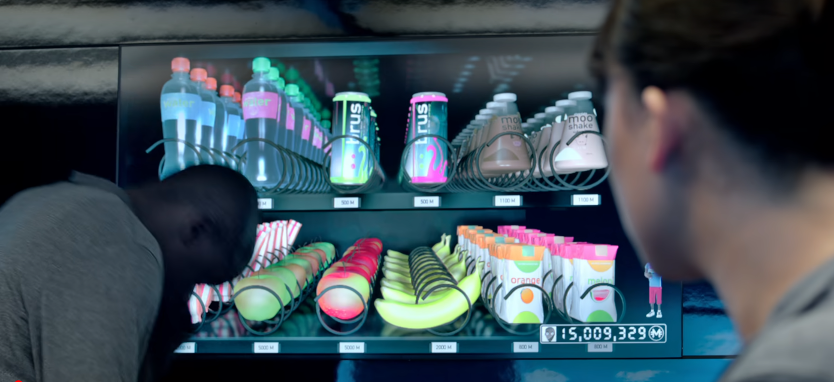
Relevant Technology
Black Mirror Team
Avatars, avatar audience
Surveillance and bio-metric identification
Gesture controlled video game
All-encompassing media + public currency (social credit score)
Social media, online social comms technology (Present)
[33]
[34]
Notes:
Here we have a list of relevant technologies we are going to be addressing in our presentation today. For the interest in time I wont read the whole list but you can always come back to this slide in your own time, or ask questions about anything written at the end of the presentation.

Slide 4
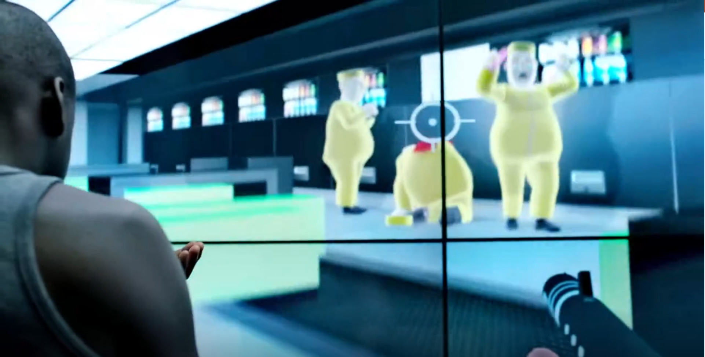
Technological Hierarchy
Black Mirror Team
Success and failure publicized
Middle class rat race
Lower class villainized
Stardom seems achievable
Rulers control media
Bing shoots lower class in a video game [35]
Notes:
(Repeat to clarify) In the film, there is a very clear class hierarchy. The protagonist Bing sits in the middle class, where he rides the bike to earn credits. Below him sits the lower class of "lazy and fat" people who clean up. And above him is upper class that own channels and broadcast entertainment to the middle class.
This system of hierarchy depends on the dehumanization of people, and this made possible through their technology and propaganda.
The key to controlling a population is controlling what people focus on. Hierarchy, in particular for the middle class, is that critical feature to focus on.
There's 2 parts to this
1. Ensure that the middle class are scared of dropping into the lower class
2. Make the middle class believe they can reach the upper class
With these 2 systems in place the middle class – 50% of the people [31] – have their attention on the rat race and the righteousness of the system isn't as important.
Please note that I don't have a statistic confirming this idea, but there is a lot of literature that shares this concern like 1984 and this movie.
In this movie, the lower class are villainized to the point where they are presented in video games as enemies. (Refer to image)
They are also viciously mocked in a show where they are forced to eat pies for others' amusement.
This use of media to further degrade the lower class checks the first box of scaring the middle class.
The path to success is made through another opportunity, a golden for 15 millions merits to perform in front of the world and potentially get a channel.
The big success stories are constantly advertised as a means to become rich. The channel where people can watch others perform gives hope to the idea that anyone can reach stardom and make it big. Frankly, not to different from our world.
As a result the technology ticks the second box through the constant display of these success stories.
So with these 2 elements, the movie also notes how almost nobody cares about the issues of their society.
And this is all accomplished because the channel owners control what everyone sees. (Elaborate in next slide)

Slide 5
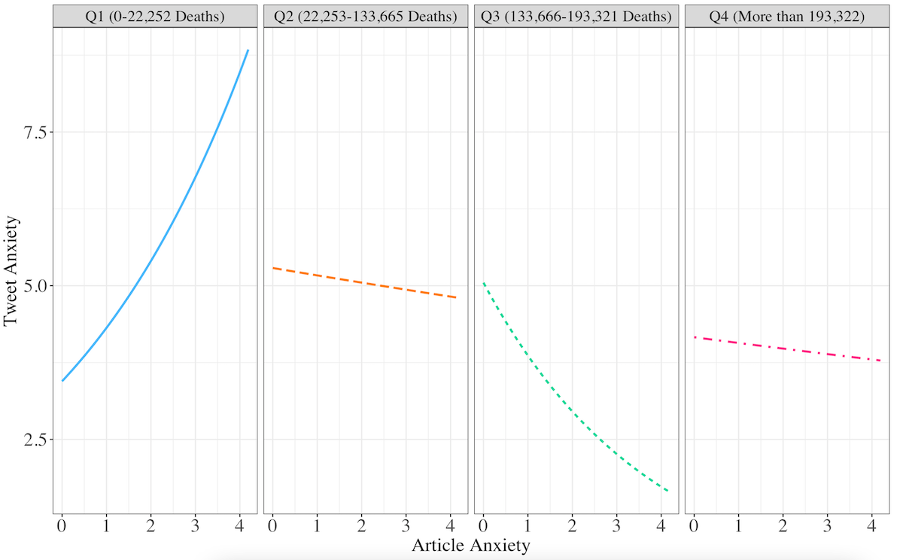
Technological Hierarchy
Black Mirror Team
Tech monopolies
  Google search engine views: 87% [15]
Control Media
Desensitization
Facial recognition doubters:
  China: 9% [30]
  Germany: 32% [30]
  UK: 23% [30]
  US: 26% [30]
Social credit disassociation [11]
Article ‘Anxiety’ vs Tweet ‘Anxiety’ compared to # of COVID Deaths [35]
Notes:
Argument Topology:
Tech monopoly -> control media -> able to desensitize users to ideas -> Chinese support social credit systems while Germany doesn’t because they have been desensitized
So how does relate to our world?
We also have a ruling class based on technology, specifically the big tech monopolies.
For computers we have Microsoft and Apple.
For online goods we have Amazon and... Ebay? Not even.
Worst of all, Google (or Alphabet as it is now known) has it's finger in everything. Especially 87% of all search engine page views [15].
That means that Google has the potential to control our human knowledge. 87% of questions are answered by Google.
What can they really do with that? Look at the graph on the right.
There is 4 graphs for different time periods of COVID deaths. At the beginning is when COVID just started with almost deaths. And near the end is 9 months later with 200k deaths.
These graphs show that at the beginning, the anxiety (based on key terms and linguistic analysis) of tweets responding to articles correlated positively to the anxiety of the articles.
However, as time goes on, the correlation even became negative – meaning the more anxious an article, the less anxious the responses.
This shows that it's possible to desensitize people from deaths just by repeating it enough.
The movie shows this desensitization with Bing, when his message about the problems of the societal problems becomes a fun channel to tune into, rather than a serious issue.
To put this into perspective of a real and scary statistic. Consider facial recognition, social credit score and contact tracing – all of which allow the government to track people.
In the US, 26% of people have serious doubts about facial recognition, while in China that number is only 9%.
Furthermore, 81% of people China support contact tracing while in the US, the best of the 3, facial recognition only has 44%.
China heavily controls the media, and that's the influence they can get.
To finally reconnect this to dehumanization, social credit score which has 79% support in China [30], is a technology that promotes choosing friends based on status. Specifically, your social credit score can be lowered if you have low social credit score friend [11].
The highest class is entirely based on those who control the tech monopolies. (Connect to chapter 10)
Highest support for social credit score, facial recognition, or contact tracing apps:
- China: 81% (CTA) [30]
- Germany: 40% (CTA) [30]
- UK: 47% (Facial recognition) [30]
- US: 44% (Facial recognition) [30]

Slide 6
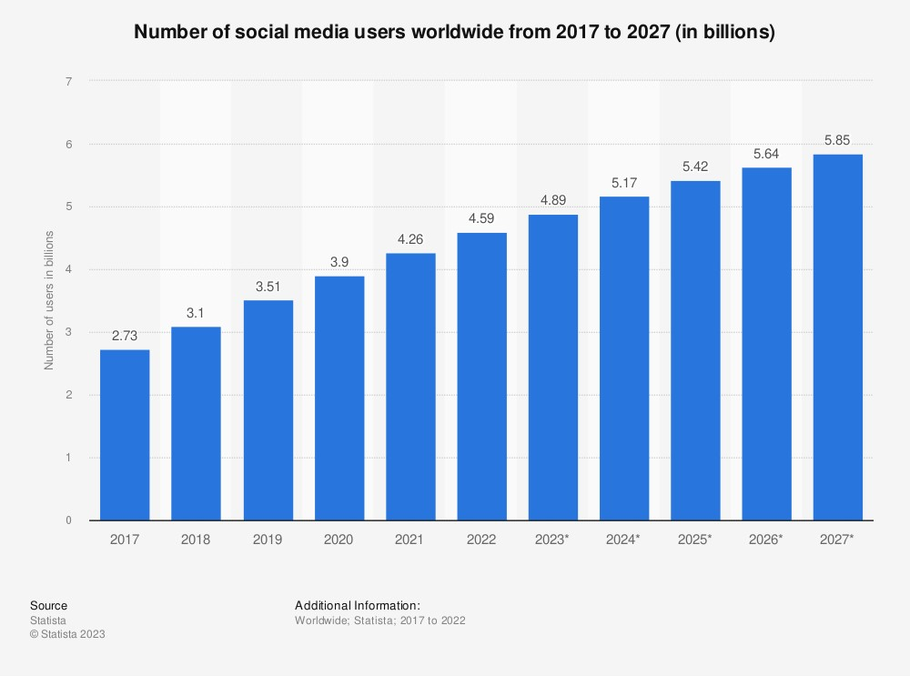
Reactionary culture creation
Black Mirror Team
Reactionary Culture in the movie
Reactionary Culture creation on Social Media [1][4]
[3]
Notes:
Within the movie of Fifteen Million Merits we see a restrictive social hierarchy where there are three total layers, Janitors, Cyclists, and Media Personnel. The movie focuses on the cyclists however we do see how all three layers interact with each-other.
In the movie we see #324 watching a game show where heavy weight people are being messed with and its played off as a joke however we see later on that #324 gets upset at a janitor when they appear in the reflection of his screen. He also treats them as lesser by throwing his garbage onto the ground for the janitor to pickup. On top of the game show example there is also a video game that we see #324 and #325 play later on, where it is a zombie apocalypse shooter where all of the zombies are wearing the janitors uniforms. If to make things worse too we see #324 excessively shooting one of the zombies and the game rewarding his actions with points [will get timestamps from the movie]. Further reinforcing the idea that the media in the world is supporting the strict social hierarchy by dehumanizing literally and figuratively the janitors.
Now to bring things into our world I will be focusing on the media and information we consume through social media. This is because social media has 4.59 billion users in 2022 and there is projected to keep growing to 5.85 billion by 2027, The average time spent on a social media has also grown from 40 minutes per day in 2015 to 151 minutes per day in 2022 [3].
With so many people using social media the companies running it have to build the platform around filtering out the information shown to the user [1]. However this is compounded by the company's desire to retain as many users as possible. This leads to Facebook showing users politically divisive content in order to get engagement with the posts from the users as Facebook themselves knows as shown through the Facebook Files leak [1]. The divisive content users interacts has a point value that effects the content they see next. Feeding the cycle and showing the same ideas to the user over and over. With research published in Trends in Cognitive sciences finding that people dehumanize groups of people when action is the rallying point instead of a rhetoric [4].
But how do these echo chambers effect users outside of social media? Well the January 6th where a group of rioters broke into the US capital building shouting "Stop the Steal" despite Facebook removing the original group of the same name weeks before. The group Women for America First was the leader in recreating the Stop the Steal Facebook group having the new one gain 365,000 members within the first 24 hours [5]. Showing just how effective Facebook is at circulating engaging posts. With the groups involved getting permits for events in DC on January 5th and 6th [5]. To end this off there is one last statistic I want to show, between 2021 and 2022 we saw a drastic increase in the number of hate groups in the US this brought the total to the highest it has ever been, as shown by this graph [2].
Definitions (all taken from Merriam-wester);
Reactionary culture:
An ultraconservative culture
Conservatism:
A political philosophy based on tradition and social stability, stressing established institutions, and preferring gradual development to abrupt change.

Slide 7
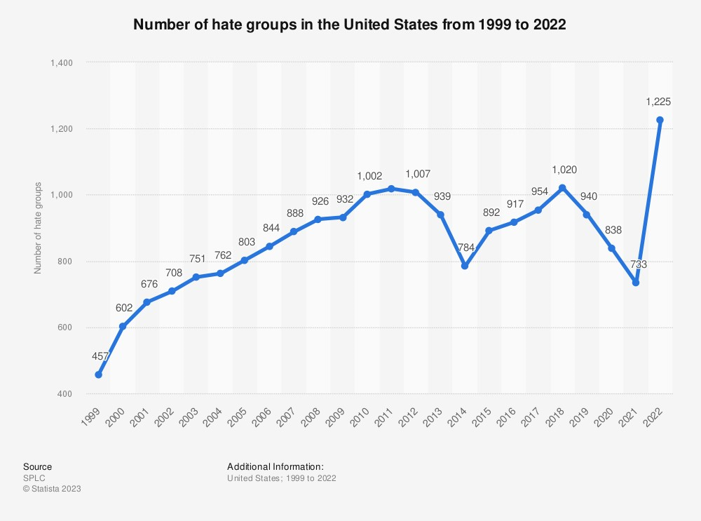
Reactionary culture creation
Black Mirror Team
Reactionary Culture creation on Social Media [1][4]
Real world effects [5]
[2]
Notes:
Within the movie of Fifteen Million Merits we see a restrictive social hierarchy where there are three total layers, Janitors, Cyclists, and Media Personnel. The movie focuses on the cyclists however we do see how all three layers interact with each-other.
In the movie we see #324 watching a game show where heavy weight people are being messed with and its played off as a joke however we see later on that #324 gets upset at a janitor when they appear in the reflection of his screen. He also treats them as lesser by throwing his garbage onto the ground for the janitor to pickup. On top of the game show example there is also a video game that we see #324 and #325 play later on, where it is a zombie apocalypse shooter where all of the zombies are wearing the janitors uniforms. If to make things worse too we see #324 excessively shooting one of the zombies and the game rewarding his actions with points [will get timestamps from the movie]. Further reinforcing the idea that the media in the world is supporting the strict social hierarchy by dehumanizing literally and figuratively the janitors.
Now to bring things into our world I will be focusing on the media and information we consume through social media. This is because social media has 4.59 billion users in 2022 and there is projected to keep growing to 5.85 billion by 2027, The average time spent on a social media has also grown from 40 minutes per day in 2015 to 151 minutes per day in 2022 [3].
With so many people using social media the companies running it have to build the platform around filtering out the information shown to the user [1]. However this is compounded by the company's desire to retain as many users as possible. This leads to Facebook showing users politically divisive content in order to get engagement with the posts from the users as Facebook themselves knows as shown through the Facebook Files leak [1]. The divisive content users interacts has a point value that effects the content they see next. Feeding the cycle and showing the same ideas to the user over and over. With research published in Trends in Cognitive sciences finding that people dehumanize groups of people when action is the rallying point instead of a rhetoric [4].
But how do these echo chambers effect users outside of social media? Well the January 6th where a group of rioters broke into the US capital building shouting "Stop the Steal" despite Facebook removing the original group of the same name weeks before. The group Women for America First was the leader in recreating the Stop the Steal Facebook group having the new one gain 365,000 members within the first 24 hours [5]. Showing just how effective Facebook is at circulating engaging posts. With the groups involved getting permits for events in DC on January 5th and 6th [5]. To end this off there is one last statistic I want to show, between 2021 and 2022 we saw a drastic increase in the number of hate groups in the US this brought the total to the highest it has ever been, as shown by this graph [2].
Definitions (all taken from Merriam-wester);
Reactionary culture:
An ultraconservative culture
Conservatism:
A political philosophy based on tradition and social stability, stressing established institutions, and preferring gradual development to abrupt change.

Slide 8
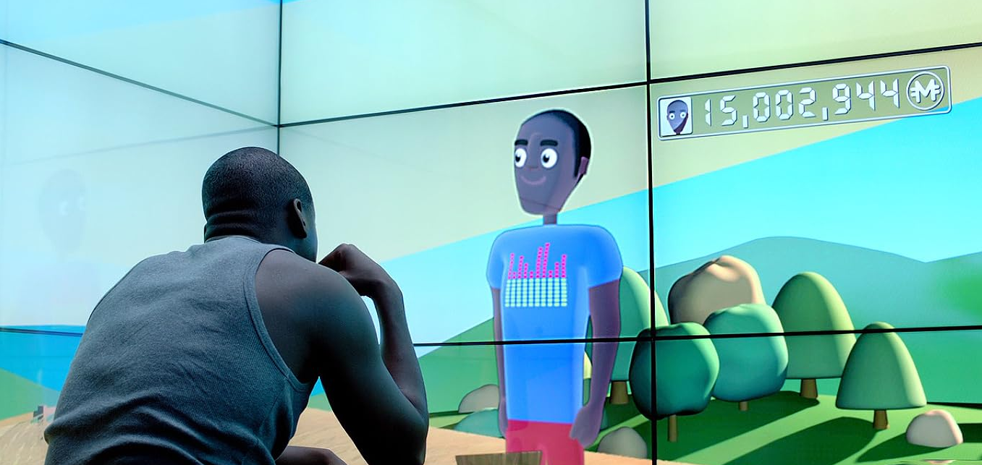
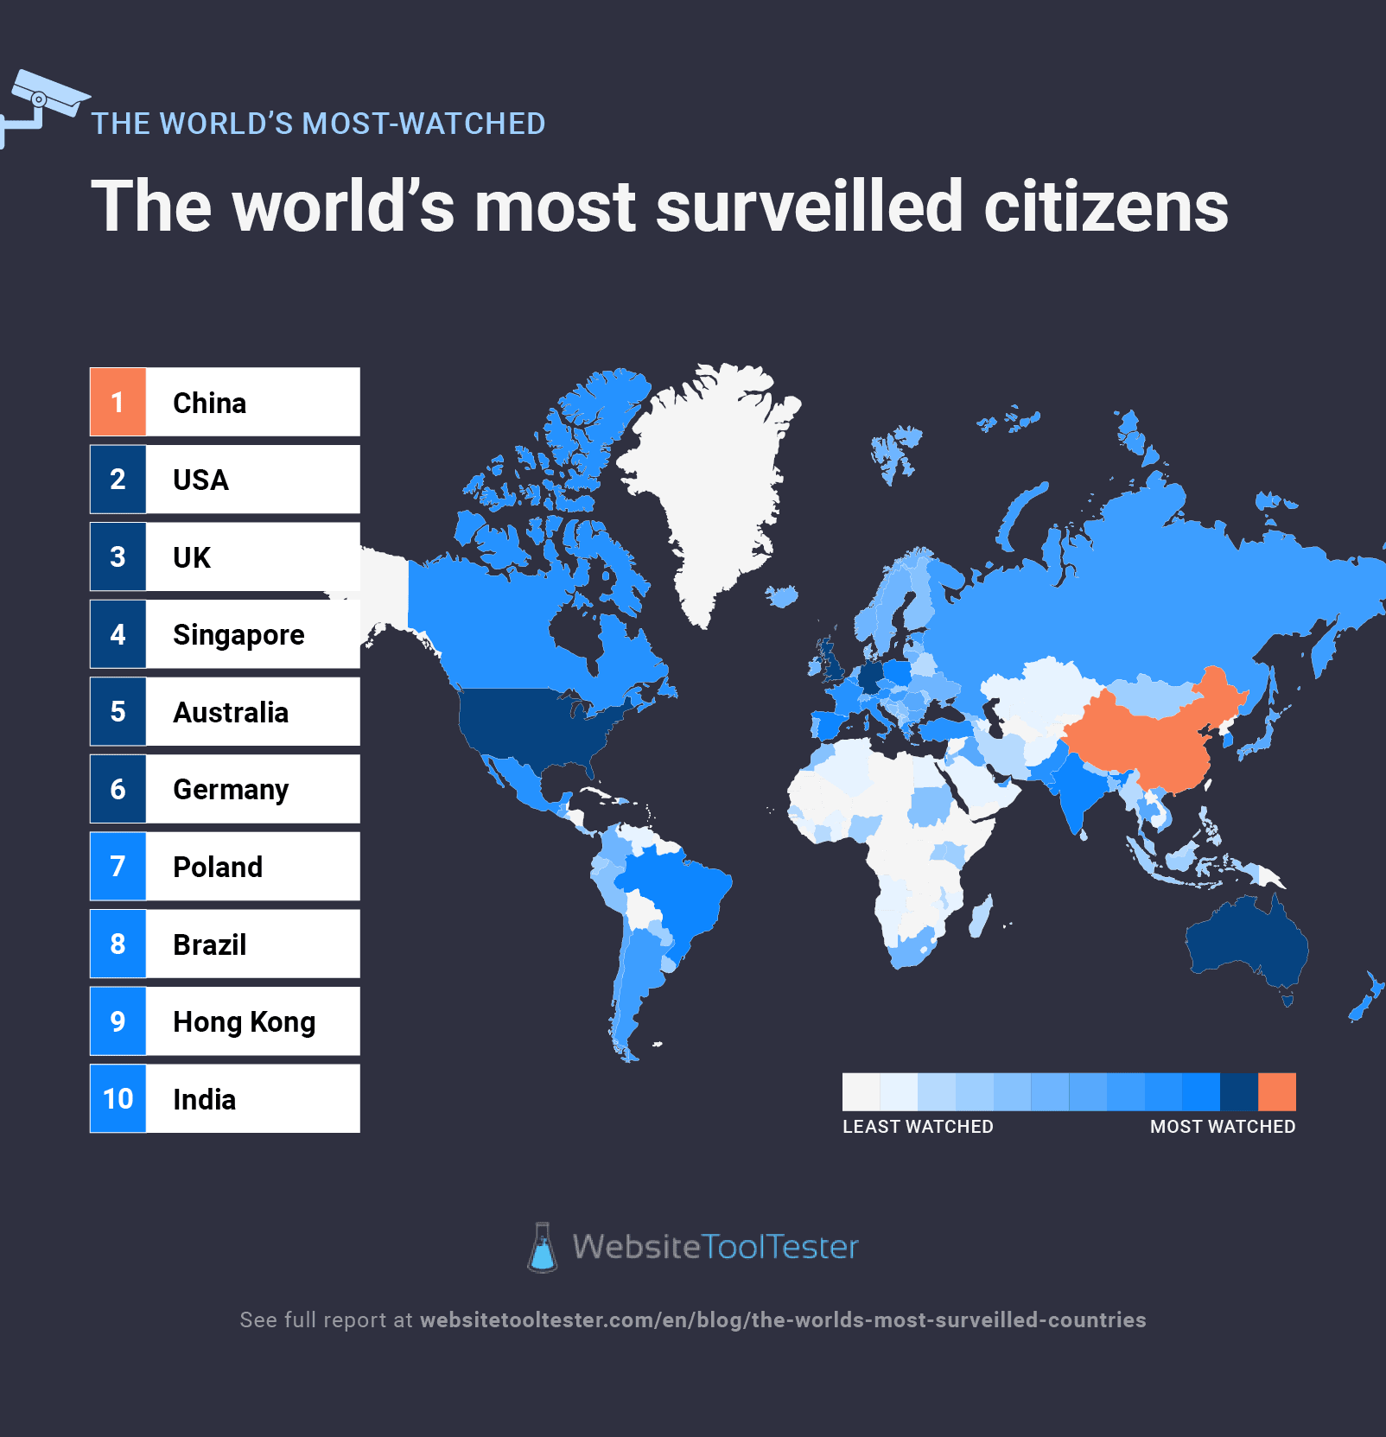
Loss of Privacy
Black Mirror Team
Constant surveillance from cameras and screens
Little to no control over personal data by being subjected to advertising and surveillance
Digital avatars and identity by having online personas act as individuals
Bings' avatar as shown in the movie, with his total merits alongside it [7].
Worlds most surveilled citizens [9]
Notes:
Our next section is on loss of privacy, where I will go over some of the ways the characters are subjected to this idea. First we have:
Constant surveillance
In the movie, no matter where the characters go they will always find themselves surrounded by some kind of screen. These screens automatically capture each individuals preferences, habits, and activities. As soon as Bing wakes up in the morning and faces his wall, he is automatically signed into his profile and shown his avatar, along with his accumulated merit total. As he leaves to go brush his teeth, the screens in the bathroom are also aware of his presence, and automatically turn into a mirror. This scene can segway into the next point which is
Advertising
When Bing is in the bathroom, we're shown the first occasion of being subjected to these fine tailored advertisements. Bing is either forced to watch the advertisement, or must spend some of his hard earned merits to skip the ad. If Bing decides to do neither, and cover his eyes, the screens begin to play an increasingly louder and higher pitched noise until he finally looks at the screen. Once he heads down to the exercise room full of bikes, he sits down, has the screen sign him in automatically, and his avatar gets to take part in several different activities to distract the user while they pedal to earn their merits.
Avatars
Every individual in the movie has their own avatar that is fully customizable with different cosmetics that can purchased with merits earned by pedaling. These avatars represent each individual, and appear in place of them. This depicts each person as just a part of some bigger system rather than each person having their own individual identity.
Relating this to the real world
It's no questions that most public places we go to have some sort of CCTV surveillance, usually for the sake of protection of some sort. Nowadays it is pretty difficult to find places where we aren't being constantly monitored, just like its seen in the movie. This picture here shows the worlds most surveilled citizens, unsurprisingly China being number one on this list. For each citizen in China, there is more than one camera for that citizen in major cities making it practically impossible to go unnoticed [9]. Not only are we being monitored physically, but our phones even monitor our activities when we least expect it. These come in the form of advertisements based on what you have been searching or actively browsing, or even just talking about with someone. For example, you could be talking to your friend about how college is taking up all your money paying student loans and all of a sudden you see an ad on your phone to become a Door Dasher. This isn't just a coincidence, your phone is actually actively listening to your conversations. Voice data is used by your phone and plan provider and can take many different forms, such as customized adverts and voice assistant programs like Siri and Google Assistant. For marketing objectives, they also pay attention to you. Your voice data is used in the same manner that Google and other search engines do to keep track of your search and browsing history and ensure that the internet advertisements you view are pertinent to your individual interests [10].

Slide 9
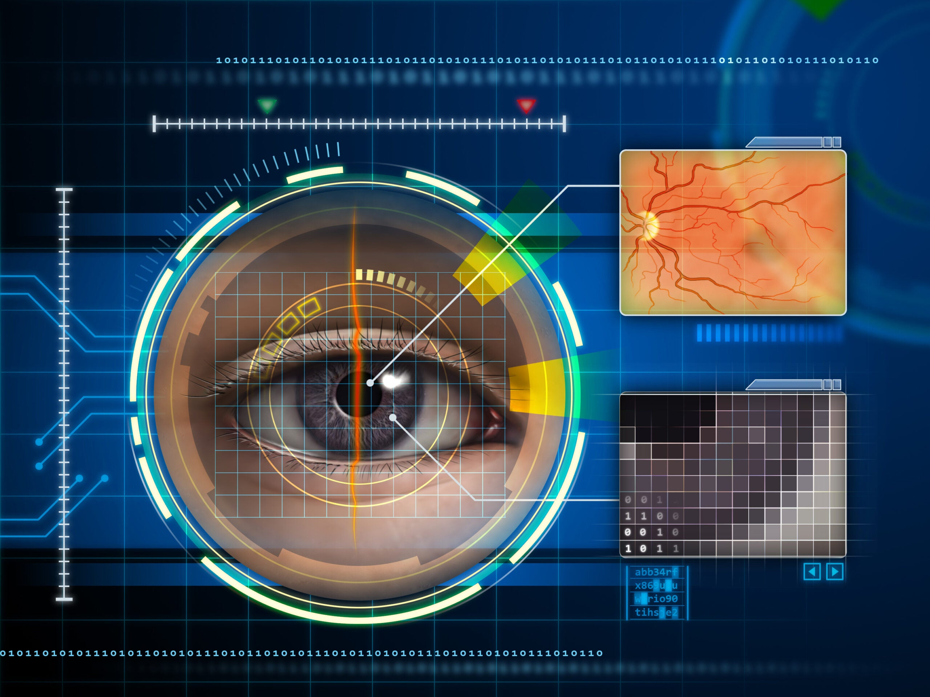
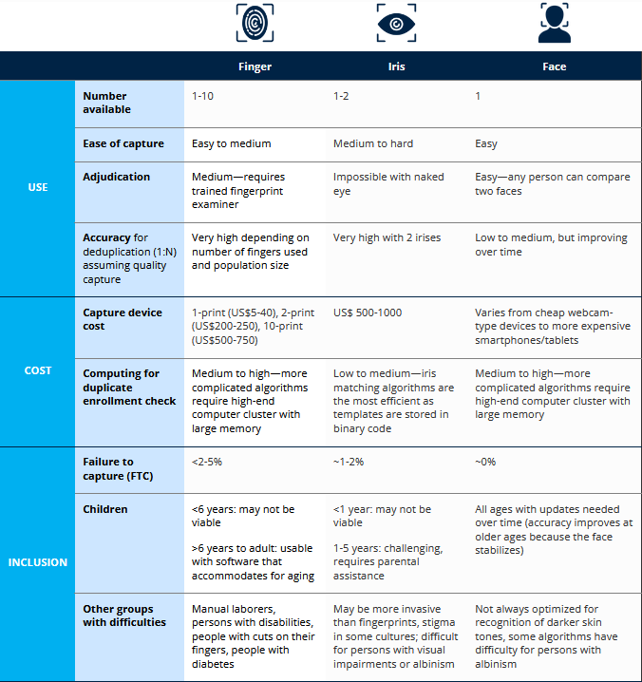
loss of privacy
Black Mirror Team
Public social credit score
  Merits openly visible for all to see
Bio-metric identification
  Identified everywhere you go; when person uses soap, that person is charged.
  Relates closely to question of facial recognition and constant monitoring like in China [16].
An example of how bio-metric identification works [6].
Comparison of biometric technologies commonly used in ID systems [14].
Notes:
Continuing with loss of privacy, we have:
Public social credit score
Like previously stated, goods and services are purchased with a currency called merits. Whenever you are in public spaces, your total merit count is visible for all to see, with the user having no control over displaying this information. This results in others actively judging other people based on their total merit count, and subsequently making games out of guessing who is going to "go blob", or drop the exercise bike in favor of becoming pretty much a janitor, who actively get made fun of by individuals in the bike room. Next we have
Bio-metric identification
What this means is anyway to identify an individual based on their body measurements or human characteristics such as eye color, height, or weight. In the movie, all any of the characters need to do is to look at the screen they wish to interact with, and the screen will automatically scan them and determine who the individual is. This again ties to loss of privacy due to the fact that every individual is under constant surveillance and are capable of being identified within seconds of looking at a screen.
Relating this to the real world
Most of you probably already use your biometric information to unlock your phones, whether its your face, or fingerprint. Your devices store your biometric information to easily refer back to if when unlocking your device using its on-board storage. We are also told that our biometric information is secured in encrypted templates in attempt to combat hackers gaining and using our biometric information. The same legal, procedural, and technical safeguards must be used to protect biometric data processing, regardless of whether it is processed as a raw image or a template and whether it is encrypted or not [14]. In China, it is said that the Cyberspace Administration would only use facial recognition in events where it is a necessity and reassure that it will be under strict protective measures and that it will be done under individual consent. Other non biometric identification solutions will be provided in the case the individual does not give consent. Even with these measures, biometric identification has become widespread around China. Facial recognition specifically has been reported to even be used to activate toilet roll dispensers in public toilets [16]. Imagine having to give your face data just to use the restroom. This connects to our conclusion of dehumanization by subjecting individuals to this standard regardless of how embarrassing and ridiculous it may be.

Slide 10
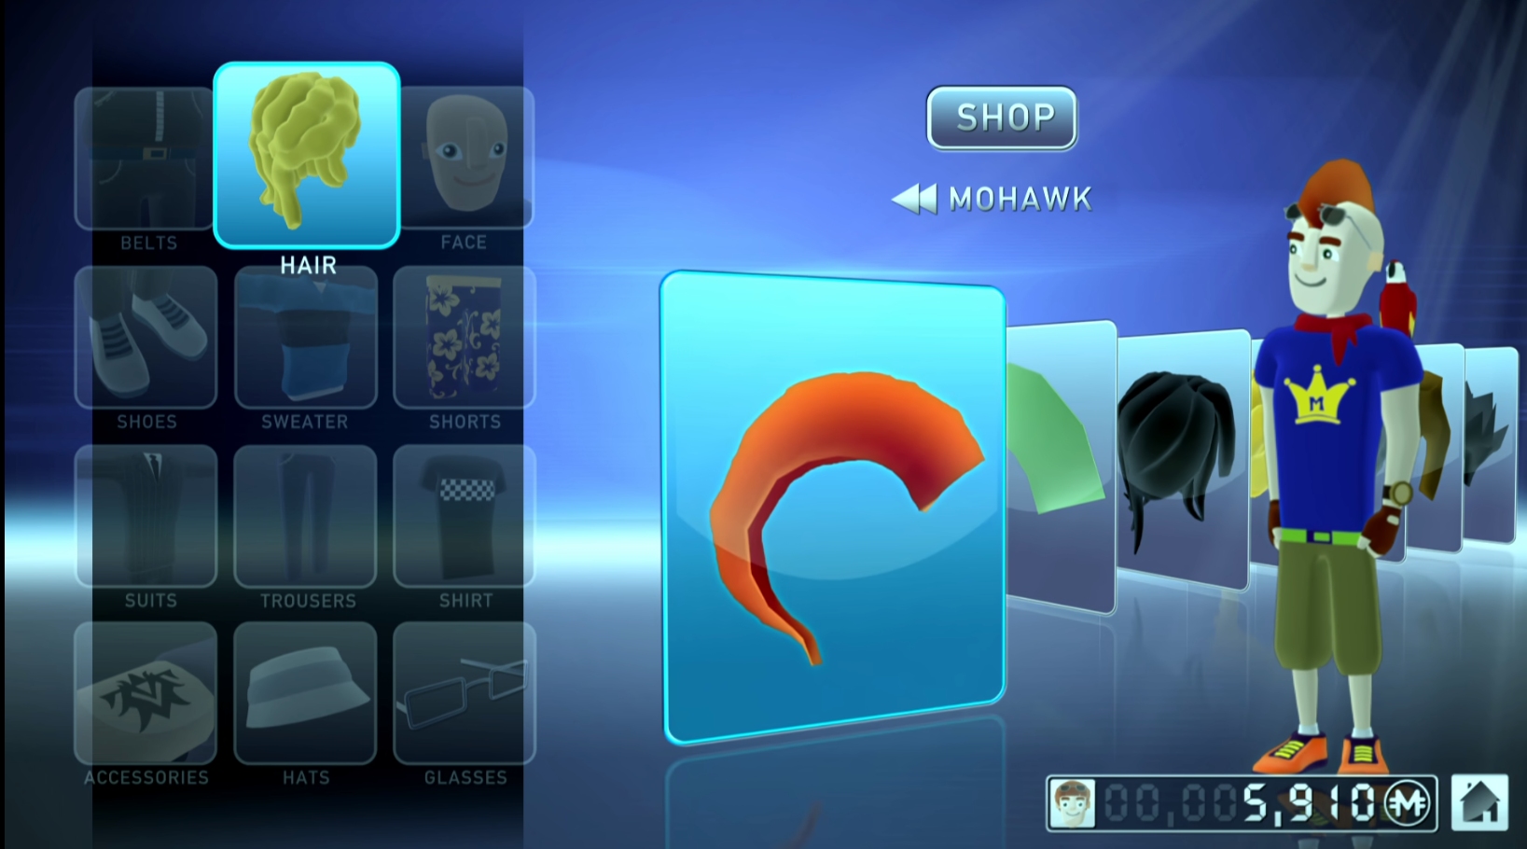

individual expression
Black Mirror Team
No ‘real world’ self expression
  Uniforms
  Personal items
Digital social interactions
  Avatar representation
  Digital audience
Pay to customize online persona [17]
Virtual audience [18]
Notes:
Nora Cleary
Characters are not allowed to express any form of creativity or individual in the real world. They all wear the same grey sweatsuits and are prohibited from possessing personal items. Abi explains her daily routine of making an origami penguin, displaying it on her bike, and a yellow uniformed employee discarding of it.
Consequently, the only means of self expression is through the digital world, sharing their personality, thoughts, and feelings through customizable avatars. As the characters are in secluded rooms, their avatars mimic their movements in real time, allowing them to interact their peers, however, this interaction limited to the capabilities of the avatars. The avatars cannot talk, have limited emotions, and require payment for personalization.
17. Euros Lyn, “Black Mirror: Fifteen Million Merits”, (Netflix, 11 December 2011), 12:14
18. Euros Lyn, “Black Mirror: Fifteen Million Merits”, (Netflix, 11 December 2011), 50:56

Slide 11
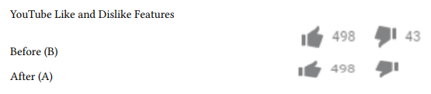
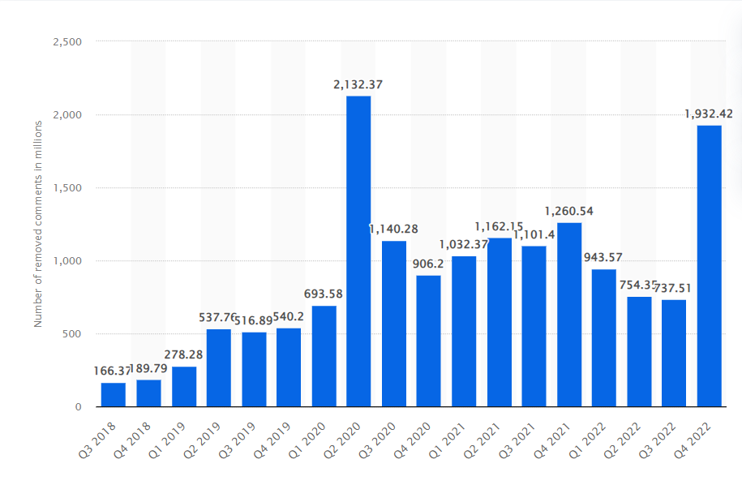
individual expression
Black Mirror Team
YouTube hides the number of dislikes November 2021
  Dislikes decrease 60.7% [19]
  Likes decrease 53.8% [19]
Creators can restrict, remove and disable comments [20]
  1.6 Billion comments removed by creators in January – April 2023 [21]
[19]
YouTube video comments removed worldwide 2018 to 2022 [22]
Notes:
Nora Cleary
Using the internet to vocalize your opinions or portray your personality limits agency in expression, as YouTube and video creators can restrict any words or phrases in their comments, remove comments, block commentors, or disable the comment feature entirely.
In 2021, YouTube hid the number of dislikes on videos, as depicted in the image on the right. This lead to an overall decrease in engagement. A study analyzed the engagement on 500 videos, observing that the average number of likes and dislikes decreased after the removal of the dislike count, the dislikes decreasing by 60.7% and likes decreasing by 53.8%. After hiding the dislike feature, users were less likely to express their opinions as their expression was not being seen by others.
Additional restrictions occur in the comments of videos. The graph on the left shows the number of comments removed from YouTube videos. From Jan – April of 2023, 1.6 billion comments were removed by creators.
An increased reliance on technology is dehumanizing and induvial expression is restricted as media platforms ultimately control public discussions.
19. Soon-Gyo Jung, “The Effect of Hiding Dislikes on the Use of YouTube’s Like and Dislike Features”, (WebSci ’22, June 26–29, 2022), https://dl.acm.org/doi/pdf/10.1145/3501247.3531546 (October 1, 2023).
20. YouTube Help, “Comment Settings”, (Google Help, 2023), https://support.google.com/youtube/answer/9483359?hl=en#zippy=%2Cblocked-words (October 1, 2023).
21. Google Transparency Report, “YouTube Community Guidelines Enforcement”, (Google, 2022), https://transparencyreport.google.com/youtube-policy/removals?hl=en&videos_by_country=period:2023Q2;region:;p:2&lu=total_comments_removed&total_comments_removed=period:2023Q2 (October 1, 2023).
22. Google, "Number of YouTube video comments removed worldwide from 3rd quarter 2018 to 4th quarter 2022 (in millions)." (Statista, April 14, 2023), https://www.statista.com/statistics/1132989/number-removed-youtube-video-comments-worldwide/ (October 2, 2023).

Slide 12
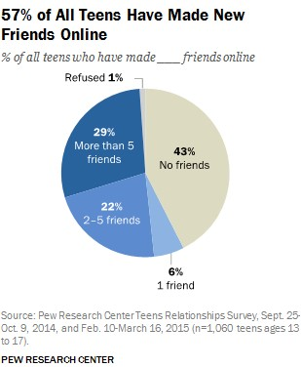
Internet bringing people together
Black Mirror Team
Meeting Friends
Freedom in Online Communicaiton
Notes:
While there are many different ways that the technology can dehumanize us it can also be used to bring people together that otherwise wouldn't be possible. To put things in reference in our world, the internet is used to meet people online with 57% of teens on the internet meeting at least 1 friend online, with over half of that 57% meeting more than 5 friends online [13]. This is supported by a paper published in 2019 that talks about how the internet grants users freedom for interpersonal interactive and community-formation. The same paper also discusses how when users interact online it done when the user is able to express themselves the way they want to, allowing them to find others with the same ideas creating a form of virtual togetherness [12]. Showing how when people make friends online they meet people that they are likely to resonate with more as they can express themselves in the way they want to rather than dehumanizing them.

Slide 13
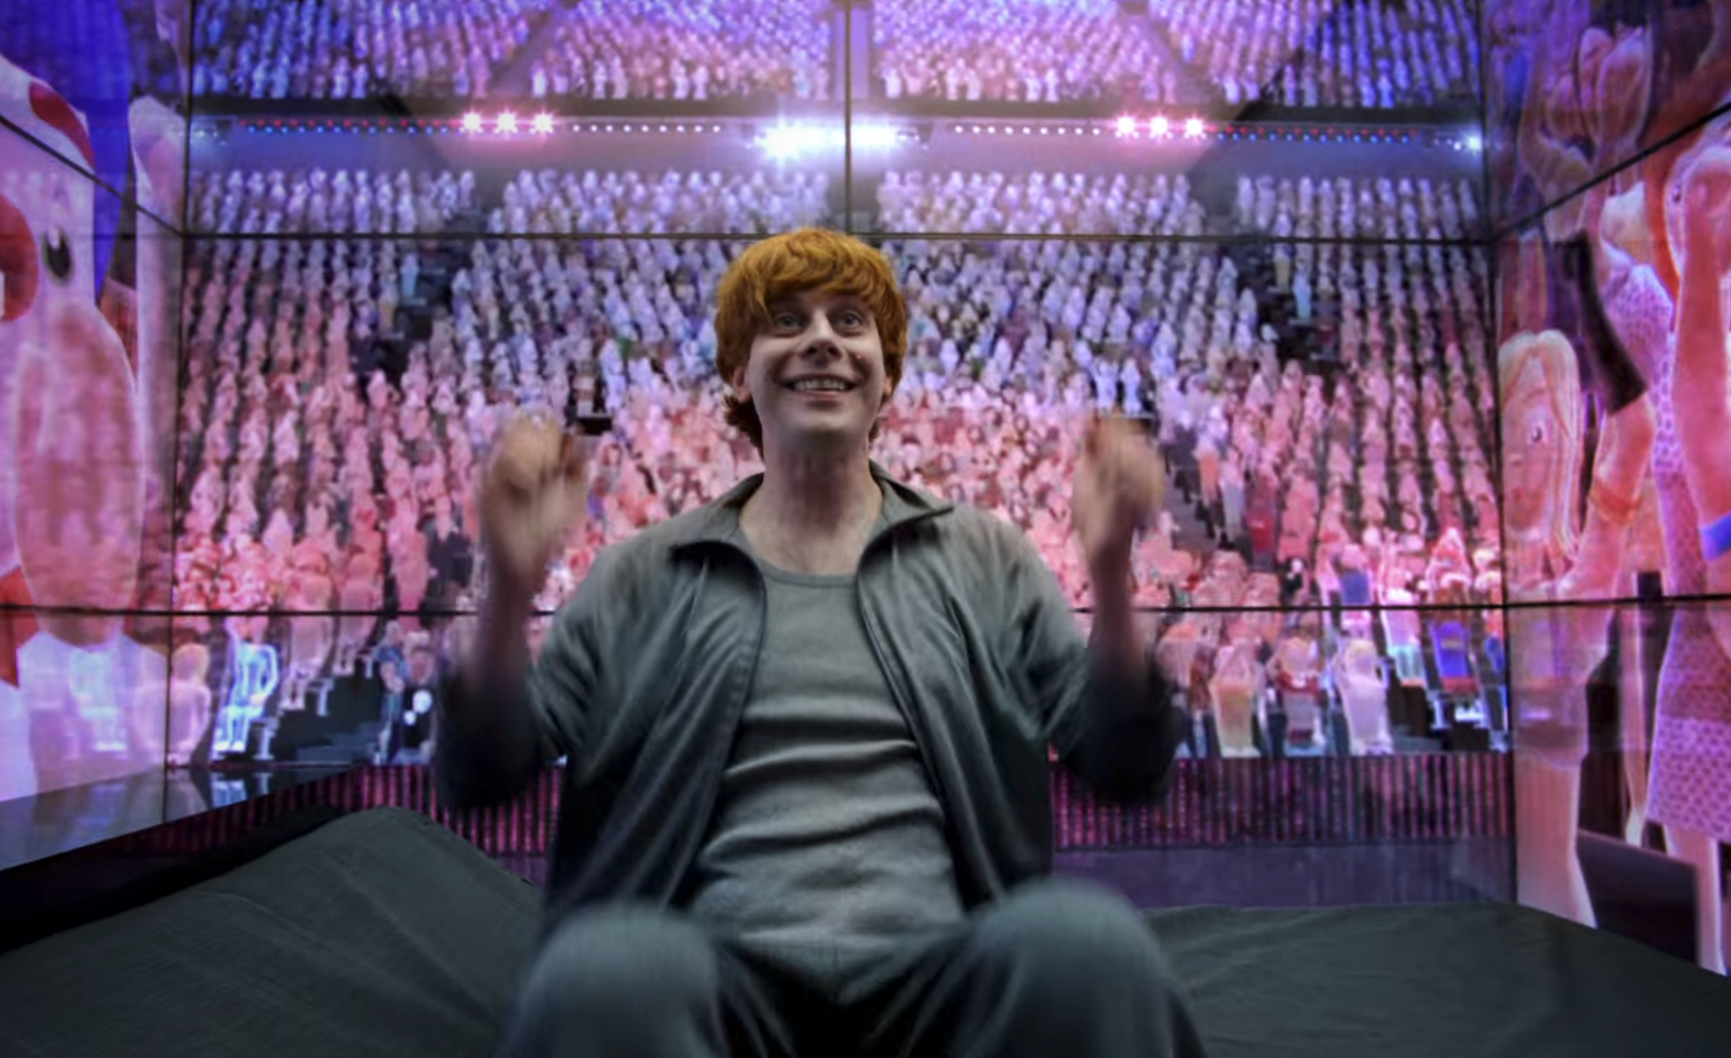
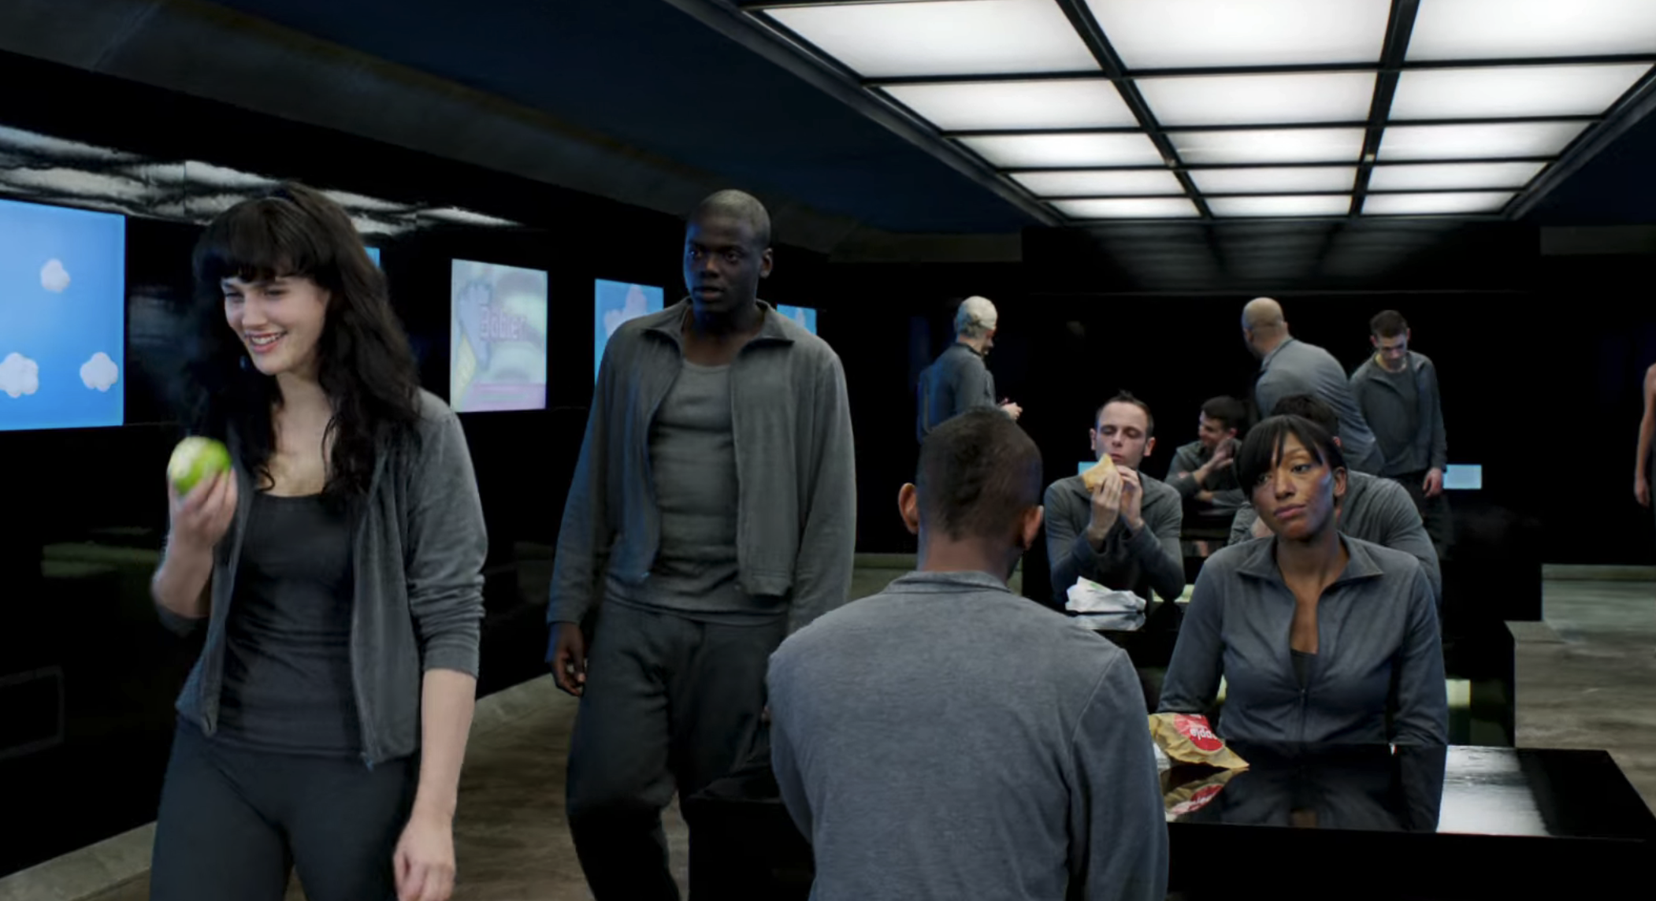
Technology affects individuals’ sociability
Black Mirror Team
When watching the ”Hot Shot” channel, users’ avatars mirror their real-life actions
Individuals do not socialize in real-life situations, incentivized to interact through “channels”
Lack of social skills between individuals
Virtual interaction and social spaces [23] [28]
Notes:
It is evident that certain technologies can effect individual’s sociability, affecting the ability for the members of the society to connect effectively. In the context of the movie, individuals watch the “Hot Shot” talent show, and interact using virtual avatars, as described earlier. In this society, individuals are incentivized to interact and somewhat socialize using the “channels” and gift features of the system software. As we see throughout the episode, these individuals have trouble connecting and expressing their thoughts, as most primarily engage with the software content rather than in person conversation. One could say that these individuals have a low amount of sociability, or the ability to engage and interact effectively in social situations. This is illustrated by their reliance on technology for basic interactions and the absence of genuine, face-to-face conversations.

Slide 14
Technology affects individuals’ sociability
Black Mirror Team
- Online connectivity, especially during obsessive dependence have lower emotional intelligence, r=0.52 [24] [25]
- “Social media use facilitates formation of ideologically homogeneous groups” [25] [26]
- Aspects of an open society, including dialogue, understanding, and sociability degraded.
Notes:
A study found that individuals who have an intense craving for online connectivity and show signs of obsessive dependence on their mobile phones often display reduced emotional intelligence. This is especially evident in their capacity for emotion regulation.
Key points:
Correlation Coefficients between CERI (internet related issues) and CERM (mobile phone related issues): 0.52. This strong positive correlation indicates a decrease in emotional intelligence as the issues increase.
There's a significant body of research supporting the idea that usage of the internet, and especially social media platforms, tends to foster the creation of ideologically consistent groups. These groups often act as barriers, preventing members from accessing or considering opposing viewpoints.
The online environment provides mechanisms that enable individuals to act harmfully with greater anonymity and efficiency. This dynamic can magnify the negative implications for societal interactions and sociability.
A recurrent finding across multiple studies is a direct association between cyberbullying (aggressive behavior exhibited online) and a discernible reduction in empathy levels. This suggests that online aggressive behaviors might be impacting core human traits essential for positive societal interactions. [27]
It is evident that certain attributes of an open society, including free expression, mutual emotional understanding, and happiness can be negatively affected by the strong usage of technology, especially social media.

Slide 15
Summary
Black Mirror Team
Excessive dependence on technology leads to dehumanization and the loss of an authentic society.
Technological hierarchy
Reactionary culture
Loss of Privacy
Individual Expression
Sociability
Notes:
Re state conclusion
Technology promotes a class hierarchy where tech monopolies can control and dehumanize people.
A dependence on technology allows companies to control the collective thought through the media consumed.
Loss of privacy includes factors of constant surveillance and reduced individuality leading to dehumanization of individuals
Relying entirely on the internet for social interactions restricts self expression and individuality.

Slide 16
References
Black Mirror Team
[1] Remo Gramigna (2022) Inside Facebook’s semiosphere. How social media influence digital hate and fuel cyber-polarization, Social Semiotics, 32:5, 606-633, https://doi.org/10.1080/10350330.2022.2157171
[2] SPLC. (February 1, 2023). Number of hate groups in the United States from 1999 to 2022 [Graph]. In Statista. Retrieved September 30, 2023, from https://www.statista.com/statistics/739551/number-of-hate-groups-in-the-us/
[3] Statista. (June 15, 2022). Number of social media users worldwide from 2017 to 2027 (in billions) [Graph]. In Statista. Retrieved September 30, 2023, from https://www.statista.com/statistics/278414/number-of-worldwide-social-network-users/
[4] Nour S. Kteily, Alexander P. Landry, Dehumanization: trends, insights, and challenges, Trends in Cognitive Sciences, Volume 26, Issue 3, 2022, Pages 222-240, ISSN 1364-6613, https://doi.org/10.1016/j.tics.2021.12.003.
[5] H.R. Rep. No. 117-663 (December 22, 2022). https://www.govinfo.gov/content/pkg/GPO-J6-REPORT/pdf/GPO-J6-REPORT.pdf
[6] Moren, D. (2014, December 31, accessed 2023, October 1). 7 surprising biometric identification methods. Popular Science. https://www.popsci.com/seven-surprising-biometric-identification-methods/
[7] IMDb.com. (2011, December 11, accessed 2023, October 1). “Black mirror” Fifteen Million merits. IMDb. https://www.imdb.com/title/tt2089049/?ref_=tt_mv_close
[8] Kostka, G. (2023, accessed 2023, October 1). Digital doubters in different political and cultural contexts: Comparing citizen attitudes across three major digital technologies. Data & Policy, 5, https://doi.org/10.1017/dap.2023.25
[9] Brandl, R. (2022, July 25). Who has the most CCTV in the world? the world’s most watched people. Tooltester. https://www.tooltester.com/en/blog/the-worlds-most-surveilled-countries/
[10] Does your phone listen to you? yes, and here’s what you can do about it. All About Cookies. (2023, August 24). https://allaboutcookies.org/stop-your-phone-from-listening
[11] Susan Ahlborn, (2015, August 18, accessed 2023, October 2) Friends Don’t Let Friends Have Bad Credit, https://omnia.sas.upenn.edu/story/friends-don%E2%80%99t-let-friends-have-bad-credit

Slide 17
References
Black Mirror Team
[12] Osler, L. Feeling togetherness online: a phenomenological sketch of online communal experiences. Phenom Cogn Sci 19, 569–588 (2020). https://doi-org.ezpv7-web-p-u01.wpi.edu/10.1007/s11097-019-09627-4
[13] "Teen, Technology, and Friendships." Pew Research Center, Washington, D.C. August 6, 2015. https://www.pewresearch.org/internet/2015/08/06/teens-technology-and-friendships/
[14] Biometric data. Biometric data | Identification for Development. (accessed 2023, October 4). https://id4d.worldbank.org/guide/biometric-data
[15] Wenning, S. Use and Effect of Google Ads Effect of Google Ads for Marketing Success (2021, accessed 2023, October 4), https://dx.doi.org/10.35940/ijmh.B1402.116321
[16] Ye, J. (2023, August 8, accessed 2023, October 5). China drafts rules for using facial recognition technology. Reuters. https://www.reuters.com/technology/china-drafts-rules-using-facial-recognition-technology-2023-08-08/
[17] Euros Lyn, “Black Mirror: Fifteen Million Merits”, (Netflix, 11 December 2011), 12:14
[18] Euros Lyn, “Black Mirror: Fifteen Million Merits”, (Netflix, 11 December 2011), 50:56
[19] Soon-Gyo Jung, “The Effect of Hiding Dislikes on the Use of YouTube’s Like and Dislike Features”, (WebSci ’22, June 26–29, 2022), https://dl.acm.org/doi/pdf/10.1145/3501247.3531546 (October 1, 2023).
[20] YouTube Help, “Comment Settings”, (Google Help, 2023), https://support.google.com/youtube/answer/9483359?hl=en#zippy=%2Cblocked-words (October 1, 2023).
[21] Google Transparency Report, “YouTube Community Guidelines Enforcement”, (Google, 2022), https://transparencyreport.google.com/youtube-policy/removals?hl=en&videos_by_country=period:2023Q2;region:;p:2&lu=total_comments_removed&total_comments_removed=period:2023Q2 (October 1, 2023).
[22] Google, "Number of YouTube video comments removed worldwide from 3rd quarter 2018 to 4th quarter 2022 (in millions)." (Statista, April 14, 2023), https://www.statista.com/statistics/1132989/number-removed-youtube-video-comments-worldwide/ (October 2, 2023).

Slide 18
References
Black Mirror Team
[23] Euros Lyn, “Black Mirror: Fifteen Million Merits”, (Netflix, 11 December 2011), 24:03
[24] Beranuy, M. “Problematic Internet and Mobile Phone Use and Clinical Symptoms in College Students: The Role of Emotional Intelligence.” Computers in Human Behavior, vol. 25, 2009, pp. 1182–87, https://doi.org/10.1016/j.chb.2009.03.001.
[25] Waytz, A., & Gray, K. (2018). Does Online Technology Make Us More or Less Sociable? A Preliminary Review and Call for Research. Perspectives on Psychological Science, 13(4), 473-491. https://doi.org/10.1177/1745691617746509
[26] Colleoni, Elanor, et al. “Echo Chamber or Public Sphere? Predicting Political Orientation and Measuring Political Homophily in Twitter Using Big Data.” Journal of Communication., vol. 64, no. 2, 2014, pp. 317–32, https://doi.org/10.1111/jcom.12084.
[27] Brewer, G., and J. Kerslake. “Cyberbullying, Self-Esteem, Empathy and Loneliness.” Computers in Human Behavior, vol. 48, 2015, pp. 255–60, https://doi.org/10.1016/j.chb.2015.01.073.
[28] Euros Lyn, “Black Mirror: Fifteen Million Merits”, (Netflix, 11 December 2011), 41:24
[29] Stevens HR, Oh YJ, Taylor LD, (2018, July 16, accessed 2023, October 3) Desensitization to Fear-Inducing COVID-19 Health News on Twitter: Observational Study, https://infodemiology.jmir.org/2021/1/e26876
[30] Kostka, G. (2023). Digital doubters in different political and cultural contexts: Comparing citizen attitudes across three major digital technologies. Data & Policy, 5https://doi.org/10.1017/dap.2023.25
[31] Rakesh Kochhar and Stella Sechopoulos, (2022, April 20, accessed 2023, October 3), How the American middle class has changed in the past five decades, https://www.pewresearch.org/short-reads/2022/04/20/how-the-american-middle-class-has-changed-in-the-past-five-decades/
[32] Euros Lyn, “Black Mirror: Fifteen Million Merits”, (Netflix, 11 December 2011), 4:09
[33] Euros Lyn, “Black Mirror: Fifteen Million Merits”, (Netflix, 11 December 2011), 1:55
[34] Euros Lyn, “Black Mirror: Fifteen Million Merits”, (Netflix, 11 December 2011), 5:17
[35] Euros Lyn, “Black Mirror: Fifteen Million Merits”, (Netflix, 11 December 2011), 7:40
[36] Butcher Billy, “Reflections From a Black Mirror”, (21 December 2016), https://onpiratesatellite.com/home/reflections-from-a-black-mirror-s1-e2-fifteen-million-merits-netflix#:~:text=That%20art%20is%20from%20Butcher,the%20best%20shows%20on%20television.

