Slide 1
ARRIVAL
CS 3043
1
Presented by:
Michael Alicea, Sasha Daraskevich, Michael Sensat, & Edward Smith
Notes:
[00:20]
Template Courtesy of https://slidesgo.com/theme/futuristic-background#search-Futuristic&position-10&results-174

Slide 2

PLOT OF ARRIVAL:
THE ABRIDGED VERSION
2
THE ALIENS
ARRIVE SUDDENLY
INTERNAT’L RESEARCH BEGINS
GEN. SHANG’S ULTIMATUM
THE HEPTAPODS VANISH
1st CONTACT WITH THE HEPTAPODS
INTERNAT’L
BREAKDOWN OCCURS
DR. BANK’S BREAKTHROUGH
Notes:
[1:33]
To be brief:
The film centers around linguist Dr. Louis Banks
Who, upon the arrival of a mysterious alien race with 12 ships scattered across the world
Is taken to an army base in Montana
Upon her arrival, Banks meets Dr. Ian Donnelly, a physicist
While on base
Banks communicates with the creatures, the Heptapods
Mysterious squid-like creatures which communicate via ink-like projections
Slowly, the collaboration among countries fails
China and Russia go on the offensive with a nuclear ultimatum
Having deciphered the Heptapods’ “give weapon”
The rest of the 12 go dark
Dr. Banks has a breakthrough
Understands the Heptapod language
Becomes unstuck in time
Viewing it the same way the Heptapods do
The language is “the weapon/gift”
The Heptapods then leave, and humanity is brought together with the language
[30] Image of Heptapods

Slide 3
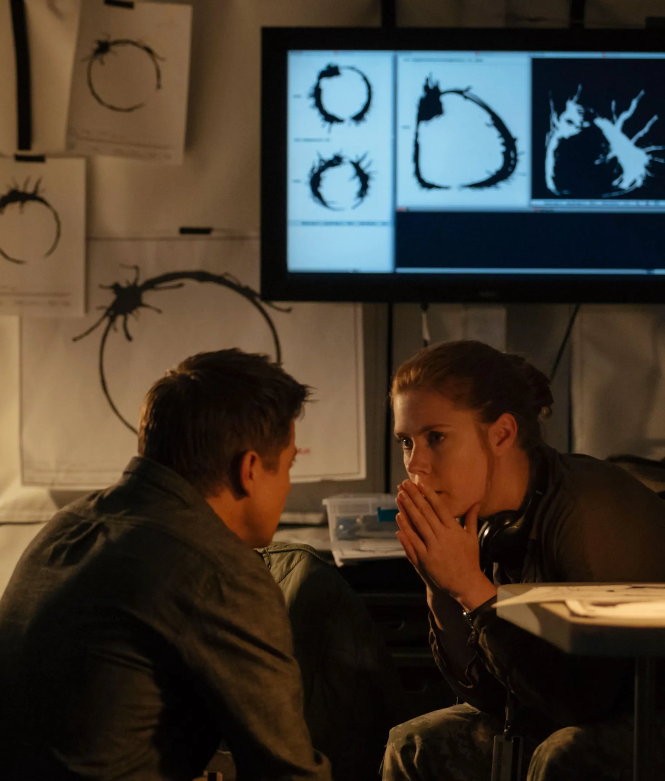
FILM INTENTIONS:
DIRECTOR’S NOTES
3
Film Inspirations
  Story of Your Life (1998)
  2001: A Space Odyssey (1968)
  Contact (1997)
Directorial intent
  Denis Villeneuve
  Crossing genre boundaries [1]
  Language “unites and divides us” [2]
  Elements of computation [1]
    Language
    Software
[3] Dr. Donnelly (left) & Dr. Banks (rights)
Notes:
[1:03]
The inspirations for the film Arrival come from multiple places
The plot and concept of the movie was inspired by the short story, Story of Your Life (1998) by Ted Chiang.
The more artistic inspiration of the film can be attributed to 2001: A Space Odyssey (1968) and Contact (1997)
Directorial intent
The director of Arrival is Denis Villeneuve (De-knee Vill-i-nouv), who is French-Canadian
Wanted to create a film within the science-fiction genre, yet which also incorporated elements of humanity
Jeremy Renner, one of the actors from the film, stated in an interview that language is the element that “unites and divides us” the most
Arrival isn’t a film about computation, yet more a film that encapsulates it and shows its deep rooted connections to society
For example, there is a strong focus on language as a form of computation that allows individuals to communicate and transfer information
For the film, the production team created an entire dictionary of the heptapod language, as well as created software that would decode and rebuild the language. The software was used in many scenes in the film as well, rather than using CGI.
[1] FilmIsNow, Arrival | On-set visit with Denis Villeneuve 'Director', (Youtube, Nov. 13, 2016), https://www.youtube.com/watch?v=qzKLJ4GeFto, Sep. 24, 2022
[2] Zeitchik, Steven, Exclusive ‘Arrival’ interview: We talk to Denis Villeneuve, the director being compared to Christopher Nolan, (California Times, Sep. 14, 2016), https://www.latimes.com/entertainment/movies/la-et-mn-arrival-denis-villeneuve-amy-adams-premiere-release-20160914-snap-story.html, Sep. 28, 2022
[3] Morgan, Laura, Inside the Design of the New Amy Adams Film Arrival, (Condé Nast, Nov. 10, 2016), https://www.architecturaldigest.com/story/inside-the-design-of-the-new-amy-adams-film-arrival, Oct. 3, 2022

Slide 4
CONCLUSION 1:
TECHNOLOGY HAS THE CAPACITY TO CONNECT ACROSS CULTURAL BOUNDARIES
4
International Relations via Communication Technology [26]
  National security, defence, and intelligence
  E-Diplomacy and projection of power
Increased connectivity and development among nations; Globalization [5]
  New trade routes and spreading influence
  Near Instantaneous contact around the world[4]
    ≥70% of global population possesses a cellular phone [4]
Notes:
[1:16]
With our analysis of the film “Arrival” we came to two main conclusions. The first of which is that technology has the capacity to connect across cultural boundaries.
INTERNATIONAL RELATIONS VIA COMMS TECH
The new generation of emerging tech is transforming the policies that many nations will address in its national security. Because of this new space it has forced many countries to cooperate to create a uniform policy with addressing new scenarios. The result of this is alliances such as NATO and the EU which have sparked a change in classic diplomacy among nations [26].
Increased Connectivity among nations; Globalization
This new globalization allows countries to gain easier access to foreign knowledge further boosting technological development. Today, news and information travels around the world in an instant. People can read about foreign countries just as easily as they read about their local news. [4] About 70 percent of people in the world use cell phones. Because of this for example, someone from deep in Russia can call their friend in New York and connect with each other despite the massive distance between them.
4. Tehranian, Majid, “Global Communication and International Relations: Changing Paradigms and Policies” (International Journal of Peace Studies, 1997), http://www.jstor.org/stable/45037972, (2 Oct. 2022).
5. Choi, Jaeyoung; et al.; “Understanding the Language, the Culture, and the Experience: Translation in Cross-Cultural Research.”(International Journal of Qualitative Methods, 2012), https://doi.org/10.1177/160940691201100508, (2 Oct. 2022).
https://www.hoover.org/research/emerging-technologies-and-their-impact-international-relations-and-global-security
26. Danilin, Ivan V.; “Emerging Technologies and Their Impact on International Relations and Global Security” (Hoover Institution, 2018), https://www.hoover.org/research/emerging-technologies-and-their-impact-international-relations-and-global-security, (6 Oct. 2022).

Slide 5
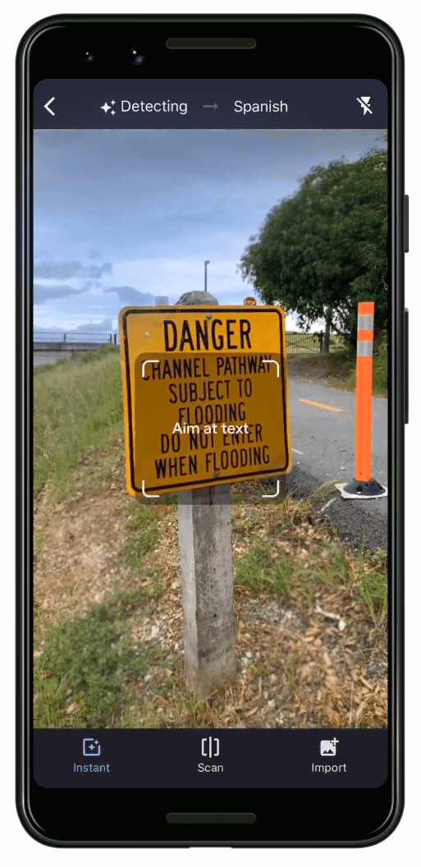
COMMUNICATIONS:
ARRIVAL VS. REALITY
5
Heptapod Input Visualizer vs. Speech-to-Text Translation [6]
3D Software vs. Laser Scanner 3D Visualization [7]
Negative Space Learning Algorithm vs. Photogrammetry and laser volume technology [8]
Heptapod Instant Translator vs. Real-Time Translator [9]
[9] Real-Time Translation
Notes:
[2:00]
6. Ren, Yi; Liu, Jinglin; Tan, Xu; Zhang, Chen; et. al; “SimulSpeech: End-to-End Simultaneous Speech-to-Text Translation” (ACL, 2020), https://aclanthology.org/2020.acl-main.350.pdf (1 Oct. 2022).
Communication is very important in the film arrival, although it may seem very futuristic, we are surprisingly very close to having all of the technologies
In the film Arrival, technology using a touch screen input, words are given, and the Heptapod visualization is outputted.
With our current technology advancements, it would completely be in our capabilities to be able to make the same device use speech-to-heptapod, given the same information obtained by Dr. Banks in the movie.
In Arrival, the humans used 3D visualization software to visualize a Heptapod message.
Using laser scanners worn on a backpack, walking through a building allows you to model the inside of a 3d area. [7]
7. Turner, Eric; Cheng, Peter; Zakhor, Avideh; “Fast, Automated, Scalable Generation of Textured 3D Models of Indoor Environments” (IEEE, 2015), https://ieeexplore.ieee.org/abstract/document/6985553 (2 Oct. 2022).
The film Arrival includes a technology that calculates the negative space of a 3d model.
We have technology using photogrammetry to calculate the volume and negative volume of an area using photos and lasers and have done so with 96% accuracy. [8]
8. Yakar, M.; Yilmaz, H. M.; Mutluoglu, O.; “Close Range Photogrammetry and Robotic Total Station in Volume Calculation” (ISSN, 2010), https://citeseerx.ist.psu.edu/viewdoc/download?doi=10.1.1.800.1538&rep=rep1&type=pdf (2 Oct. 2022).
Arrival contains the usage of a technology that takes a picture of Heptapod language and translates it directly to english.
By scanning an image with google translate, you can translate the image’s text to a different language. The Heptapod language would most likely be harder to translate, it may possible with our current technology. [d]
9. Gu, Xinxing, “Google Translate’s Instant Camera Translation gets an Upgrade” (Google, 2019), https://blog.google/products/translate/google-translates-instant-camera-translation-gets-upgrade/ (2 Oct. 2022).

Slide 6
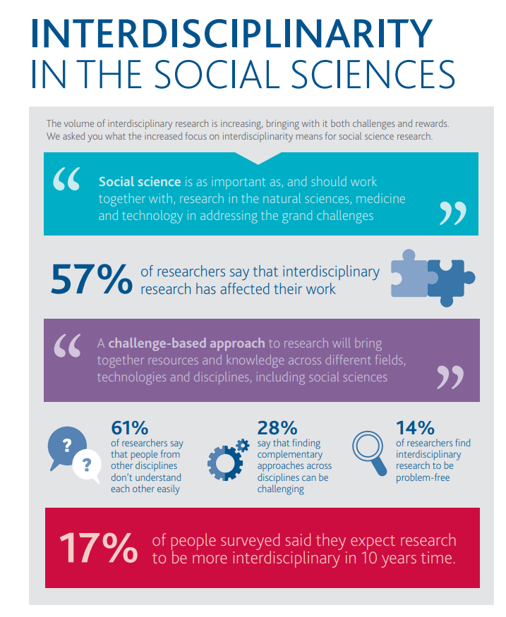
CONCLUSION 2:
CROSS-DISCIPLINARY STUDY IS TANTAMOUNT TO INTELLECTUAL GROWTH
6
Constructivism
Modern Learning Debate [27]
  Benefits of modern education
  Differences in spoken languages [14]
  Differences in programming languages
  Learning a subject can change how you think [10]
“To a man with a hammer, everything looks like a nail" -Abraham Maslow
[28] Interdisciplinarity
Notes:
[2:28]
Macmillan, Palgrave. “INTERDISCIPLINARITY IN THE SOCIAL SCIENCES.” SSM, https://media.springernature.com/full/springer-cms-preview/rest/v1/content/16216776/data/v2.
Cross disciplinary study or studying a variety subjects as opposed to a focus, is tantamount to intellectual growth.
Constructivism is the idea that learners construct knowledge opposed to taking in information.
A learner who focuses on multiple subjects and disciplines will have more experience in those subjects therefore have constructed more knowledge in those fields.
Someone that only knows the scientific method may not be as great at tackling problems that aren’t STEM related
The debate for modern learning is whether or not modern education should focus on well-rounded development of students.
Examples of modern education could include “curricular activities like arts, sports, physical education, library activities, community services, etc.”
Benefits of modern education
“Modern education widens the intellect of a student by introducing new methods and objective psychology, which enables them to face different situations with confidence.”
“It helps in developing analytical skills among students so that they can understand complex issues easily. This ultimately results in making good decision-makers who can contribute positively towards social growth.”
More relative to the movie, your language can affect how you think, and learning different languages can grow your intellect.
Guugu Yimithirr doesn't have words like left and right or front and back. They use words for north, south, east, and west. they wouldn’t say that a person is standing in front of a house; instead, they'd say he is standing east of the house. They also would think the boy is standing east of the house, while a speaker of English would think of them in front.
Programming languages are very similar to language
Different programming languages have different strengths and weaknesses, and also do the same task in different ways.
Learning a number of programming languages is beneficial to a developer as they can choose the one best a completing the task.
Learning a variety subjects can cause you to think in different ways.
According to a study, students that learned a programming language increased their use of logical thinking and problem solving skills.
This could be true for varying topics which suggests that learning many subjects can allow you to have more well-rounded thinking.
14. Birner, Betty; “Does the Language I Speak Influence the Way I Think?” (Linguistic Society of America, 1999), https://files.eric.ed.gov/fulltext/ED426605.pdf (2 Oct. 2022).
27. Chaudhary, Firzooq. “Modern Education: Purpose, Benefits, Need & Challenges.” (LearnOBots, 8 Nov. 2021), https://learnobots.com/modern-education-purpose-benefits-need-challenges/ (6 Oct. 2022).
10. Mains, Margaret Gradwell, “The Effects of Learning a Programming Language on Logical Thinking Skills” (UMI, 1997), https://www.proquest.com/docview/304403122?pq-origsite=gscholar&fromopenview=true, (3 Oct. 2022).
Waldmann, Jasmin. “Redefining Education for a New Society.” Mindbrews, 2 Sept. 2020, https://www.mindbrews.in/redefining-education-for-a-new-society/.

Slide 7
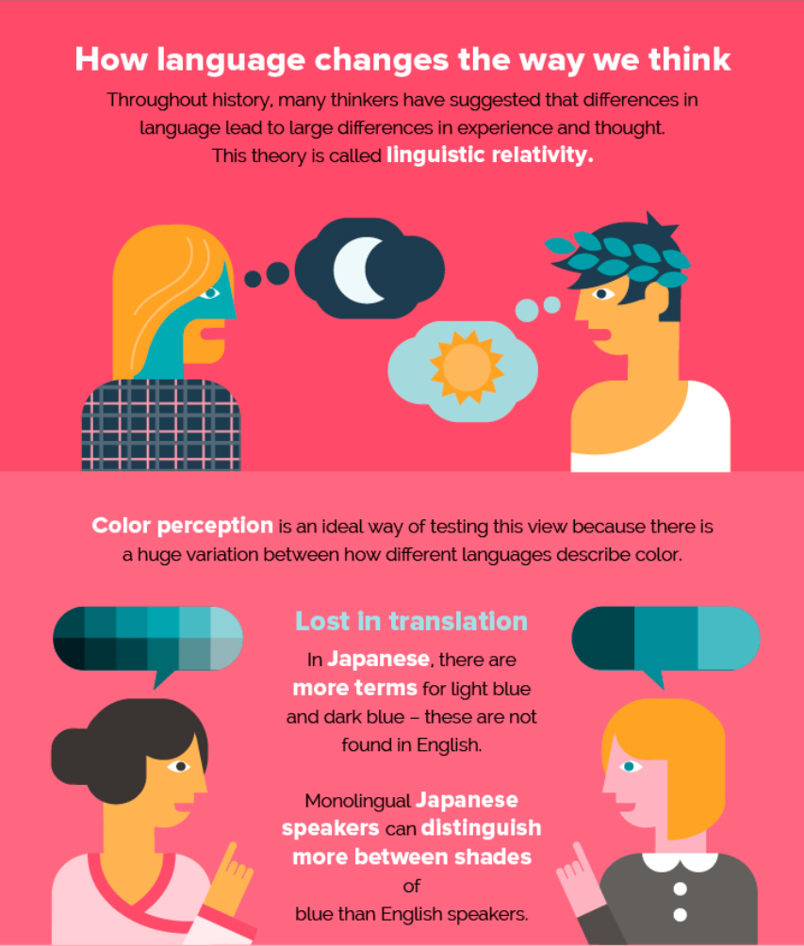
LEARNING:
ANOTHER LANGUAGE CHANGES HOW YOU THINK
7
FOR EXAMPLE:
  English vs. Russian color identification [11]
  English vs. German goal-oriented and ambiguous events [12]
  German vs. Spanish masculine and feminine word descriptions [13]
  English vs. Chinese time metaphors [15]
[29] Difference in language changes understanding
Notes:
[2:17]
Richardson, Chad. “Overcoming Language Differences and Communicating with Translation.” Keylingo, 16 Sept. 2019, https://keylingo.com/overcoming-language-differences-and-communicating-with-translation/.
Although learning another language won’t make you smarter, learning another language can allow you to think from a new perspective and have a better understanding of how other cultures perceive the world. A great example of this is when comparing English and Russian. When asking English speakers were asked what colors two different shades of blue were, they would always say blue, whereas the Russians had specific words to differentiate the colors, as they experience the colors more often. [11]
11. Winawer, Jonathan; Witthoft, Nathan; Frank, Michael C.; et al.; “Russian Blues Reveal Effects of Language on Color Discrimination” (PNAS, 2007), https://www.pnas.org/doi/abs/10.1073/pnas.0701644104 (2 Oct. 2022).
Not only does your language affect how you perceive the world, but it may also affect how you express events. Another study shows that depending on your language, you may express the same event in a different way. When asking German speakers to identify whether events were goal oriented, or ambiguous, “German speakers matched ambiguous scenes with goal-oriented scenes about 40% of the time on average, compared with 25% among English speakers.” [12]
12. Weiler, Nicholas, “Speaking a Second Language May Change How You See the World” (Science.org, 2015), https://www.science.org/content/article/speaking-second-language-may-change-how-you-see-world#:~:text=Speakers%20of%20the%20two%20languages,thinking%20can%20be%20more%20flexible (2 Oct. 2022).
Depending on if your language has masculine and feminine words, you may also describe objects as such. According to a study, “when asked to describe a "key" — a word that is masculine in German and feminine in Spanish — the German speakers were more likely to use words like "hard," "heavy," "jagged," "metal," "serrated," and "useful," whereas Spanish speakers were more likely to say "golden," "intricate," "little," "lovely," "shiny," and "tiny."” All this suggests that language may affect the way you interpret, express, and identify different experiences in the world. [13]
13. Boroditsky, Lera, “How Does Our Language Shape the Way We Think?” (EDGE, 2009), https://my.uopeople.edu/pluginfile.php/57436/mod_book/chapter/38890/BUS2207U4Text1.pdf (2 Oct. 2022).
Another example of how language may change the way we think is the english metaphor for time compared with the chinese metaphor for time. “English speakers tend to talk about time using horizontal spatial metaphors (e.g., "The best is ahead of us," "The worst is behind us"), whereas Mandarin speakers have a vertical metaphor for time (e.g., the next month is the "down month" and the last month is the "up month").” [15]
15. Boroditsky, Lera, “Does Language Shape Thought?: Mandarin and English Speakers’ Conceptions of Time” (Cognitive Psychology, 2001), https://www.sciencedirect.com/science/article/pii/S0010028501907480 (3 Oct. 2022).
https://keylingo.com/overcoming-language-differences-and-communicating-with-translation/

Slide 8
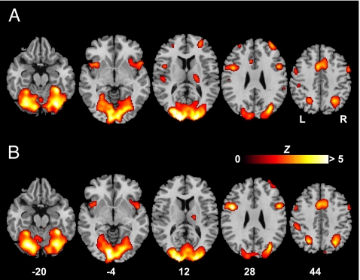
LEARNING:
ANOTHER LANGUAGE CHANGES HOW YOU THINK
8
Sapir-Whorf Hypothesis, 1940s [16]
  Language influences perception
  Forced to differentiate between languages
  MRI brain imaging [17]
  Whorf’s original research
Full-immersion model, 1960s [18]
  Half-and-half language use
  2-3 years before fluency/full effects
  Language and cognition correlated
[19] Brain activity with color differentiation
Notes:
[2:17]
In the 1940s, an American anthropologist and linguist, collaborated on the Sapir-Whorf Hypothesis [16]
Their hypothesis states that language influences perception and in turn how people view the world
A main focus on this theory is how different languages force you to differentiate between items due to factors including sex, time and number
This theory has been proven true over the past century
MRI brain imaging has proven to show language can rewire circuits in the brain [17]
As shown as image to the right, A shows easy to name colors v. B harder names [19]
Highlights how forced to differentiate between items forces you to shift your thinking
For example, in Whorf's original research, he had both Navaho speaking and English speaking children recite cards with a colored shape. English speaking children recalled the color, while Navaho children recalled the shape [16]
Similarly, Spanish and English bilingual displayed more intense emotions in Spanish than English regardless of first language in a psychological interview [17]
Full-immersion was developed as a new form of schooling in Canada in the 1960s.
In these programs, teachers typically split different languages in half during the day.
Commonly, body language, visuals, facial expression tactics all used to teach different words.
Typically, full-immersion required 2-3 years to demonstrate fluency before truly seeing effects [18]
Strong correlation between language and cognition [18]
The connection tests ability to understand relationship from speech to physical word and from one language to another
Students in full-immersion learning score the same or even better on standardized verbal and math tests in English
16. Hussein, Basel, “The Sapir-Whorf Hypothesis Today” (University of Jordan, 2012), https://www.academypublication.com/issues/past/tpls/vol02/03/30.pdf (30 Sept. 2022).
17. Perlovsky, Leonid, “Language and Emotions: Emotional Sapir–Whorf hypothesis” (Neural Networks, 2009), https://doi.org/10.1016/j.neunet.2009.06.034, (3 Oct. 2022).
18. Fortune, Tara and Diane Tedick, “What Parents Want To Know about Foreign Language Immersion Programs” (ERIC, 2003), https://eric.ed.gov/?id=ED482493, (30 Sept. 2022).
19. Tan, Lin et al, “Language Affects Patterns of Brain Activation Associated with Perceptual Decision” (Proc Nat’l Acad. Sci. USA, 2008), https://www.pnas.org/doi/10.1073/pnas.0800055105, (30 Sept. 2022).

Slide 9
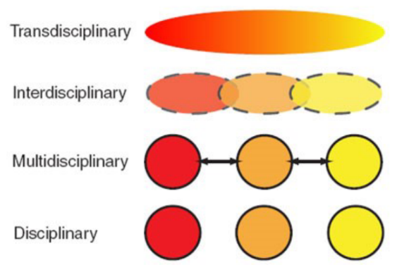
LEARNING:
SCIENCES CAN CHANGE HOW YOU VIEW PROBLEMS
9
Differences across the Sciences [21]
  Different tools of evaluation & scope
  Gaps in analysis
Issues:
  “Scientific Territorialism” [20]
  Ignorance [22]
  Failure of scope & POV [20, 22]
  Generalizations fail due to these failures [22]
Goal:
  Cultivate wide knowledge array
  Movement to Inter/Transdisciplinary Model
[20] Hierarchy of Disciplinary Integration
To a man with a hammer, everything looks like a nail" -Abraham Maslow
Notes:
[1:55]
___________________________________________________________________________________________________
NEW NOTES
Sciences can change how you view problems
There exists Differences Across Sciences [21]
Differences in design approach
Differences in scope
Different means and methods of evaluation
Gaps in Qualitative and Quantitative Analysis
This creates some issues:
“Scientific Territorialism” [20]
Insular habits, desire to do their field and failure to share
I’m certain we’ve all been guilty of this even here at WPI once or twice
Little communication
E.G. Even in the film, Dr. Banks dismisses her fellow linguist Dr. Danvers
Is dismissed by Donnelly initially & Agent Halpern
Both preoccupied with their fields of expertise (physics and intelligence)
Leads to a lack of understanding between the various groups involved
Ignorance [22]
Failure to recognise, failure to record as significant
Differences in thought about what qualifies as significant or worth the inquiry
Failure of Scope, limited POV
Fails with generalizations and larger research due to limited scope & POV [20, 22]
Goal
Cultivate a wider array of knowledge and skill
Have a cross-disciplinary understanding of a project’s component cross-section
Move from Discrete to Multi to Inter to Trans
Something like IQP seeks to model an inter or transdisciplinary collab
___________________________________________________________________________________________________
20. Darian-Smith, Smith; McCarty, Philip C.; “Beyond Interdisciplinarity: Developing a Global Transdisciplinary Framework” (Global and International Studies Curriculum, 2016), https://www.researchgate.net/publication/311486261_Beyond_Interdisciplinarity_Developing_a_Global_Transdisciplinary_Framework (5 Oct. 2022).
21. Uhur, Jana, “Functions of Units, Scales, and Quantitative Data: Fundamental Differences in Numerical Traceability between Sciences” (Dordrecht, 2022), https://www.proquest.com/docview/2695726872/724419EE5957410APQ/6?accountid=29120 (5 Oct. 2022).
22. Itabashi-Campbell, Rachel; Gluesing, Julia; Sheri, Perelli; “Mindfulness and Product Failure Management: An Engineering Epistemology” (Bradford, 2012), https://www.proquest.com/docview/1022670295/1AFD94826B1A45AFPQ/4?accountid=29120 (1 Oct. 2022).

Slide 10
LEARNING:
ARRIVAL VS. REALITY
10
Dr. Banks brain rewiring vs. Sapir-Whorf Hypothesis
  Verbal structures change how one will perceive the world [24]
Dr. Banks Fluencies vs. Timeline of Learning
  Takes around 720 hours to reach basic fluency[25]
Similar techniques used in reality
  full-immersion programs
    half v. half language
    using gestures to explain words
Notes:
[1:26]
In relation to learning, there are some key similarities and differences with how Dr. Banks learns the Heptapod language vs. how one may typically learn a new language.
FIRST POINT: Dr. Banks brain rewiring vs. Sapir- Whorf Hypothesis
The sapir-Whorf Hypothesis states that the more grammatical and verbal structure of a person’s language influences how that person perceives the world. In the film Dr. Banks is a linguist so it is generally understood that she is fluent in most of the human languages spoken today. After she begins to understand the heptapod’s language she perceives the world in a completely new way as time is not linear, just as Sapir-Whorf’s hypothesis states. [23]
SECOND POINT: Dr. Banks fluncies vs. typical timeline of learning a language
As FSI research indicates it can take around roughly 720 hours to reach a basic fluency with more complex human languages. Within the timeline of the movie, Dr. Banks is trying to decipher the heptapods pictographic language at a breakneck pace. She begins to understand the language after a week of contact with the aliens which is unrealistic especially since this is a language with no human influence.
[23] Cibelli, Emily; Xu, Yang; Austerweil, Joseph L.; et al.; “The Sapir-Whorf Hypothesis and Probabilistic Inference: Evidence from the Domain of Color” (PLoS, 2016), https://www.ncbi.nlm.nih.gov/pmc/articles/PMC4951127/, (3 Oct. 2022).
[24] Frothingham, Mia Belle, “Sapir-Whorf Hypothesis” (SimplyPsychology, 2022), https://www.simplypsychology.org/sapir-whorf-hypothesis.html#:~:text=The%20Sapir-Whorf%20hypothesis%20states,various%20things%20in%20other%20languages, (3 Oct. 2022).
[25]
Kaufmann, Steve, “How Long Should it Take to Learn a Language?” (The Linguist, 2022), https://blog.thelinguist.com/how-long-should-it-take-to-learn-a-language/#:~:text=FSI%20research%20indicates%20that%20it,for%20difficult%20languages%2072%20days, (3 Oct. 2022).

Slide 11
CLOSING POINTS:
LINGERING THOUGHTS
11
Technology has created a whole new avenue of connecting the world
Immersion allows useful and unique learning
Different languages contain different views of the world
It’s important to explore topics outside of your realm of traditional expertise
Notes:
[1:26]
Michael A’s Conclusion:
Technology has created a whole new avenue of connecting the world in an entirely new light. Thanks to the internet and modern technological advances, people from across the world can share their experiences and have an impact on those thousands of miles away from them.
Sasha’s Conclusion:
The idea of immersion creates a more consistent form of learning that blends new concepts with an individual's everyday life. While it can be a lengthy and often challenging process, it can help develop important skills like problem solving and complex thinking that pushes an individual to think beyond their perception of reality
Michael S’s Conclusion:
Language learning often seems to be used only for communication but learning different languages can help you think in different ways. It is important to be able to think in multiple lights. A good computer scientist will use a computing language that is best fit to their task.
Edward’s Conclusion:
The movement into a inter or even transdisciplinary model of scientific collaboration is already happening. The concept that learning different disciplines outside the typical scope of our degrees doesn’t seem so foreign. Here at WPI and other institutions like it, we have the opportunity to dabble in other sciences and expand that metaphorical tool set. After all, who wants to hammer nails all day? We don’t want a hammer, we want a whole toolbox!

Slide 12
REFERENCES:
12
[1] FilmIsNow, Arrival | On-set visit with Denis Villeneuve 'Director', (Youtube, Nov. 13, 2016), https://www.youtube.com/watch?v=qzKLJ4GeFto, Sep. 24, 2022
[2] Zeitchik, Steven, Exclusive ‘Arrival’ interview: We talk to Denis Villeneuve, the director being compared to Christopher Nolan, (California Times, Sep. 14, 2016), https://www.latimes.com/entertainment/movies/la-et-mn-arrival-denis-villeneuve-amy-adams-premiere-release-20160914-snap-story.html, Sep. 28, 2022
[3] Morgan, Laura, Inside the Design of the New Amy Adams Film Arrival, (Condé Nast, Nov. 10, 2016), https://www.architecturaldigest.com/story/inside-the-design-of-the-new-amy-adams-film-arrival, Oct. 3, 2022
[4] Tehranian, Majid, “Global Communication and International Relations: Changing Paradigms and Policies” (International Journal of Peace Studies, 1997), http://www.jstor.org/stable/45037972, (2 Oct. 2022).
[5] Choi, Jaeyoung; et al.; “Understanding the Language, the Culture, and the Experience: Translation in Cross-Cultural Research.”(International Journal of Qualitative Methods, 2012), https://doi.org/10.1177/160940691201100508, (2 Oct. 2022).
[6] Ren, Yi; Liu, Jinglin; Tan, Xu; Zhang, Chen; et. al; “SimulSpeech: End-to-End Simultaneous Speech-to-Text Translation” (ACL, 2020), https://aclanthology.org/2020.acl-main.350.pdf (1 Oct. 2022).
[7] Turner, Eric; Cheng, Peter; Zakhor, Avideh; “Fast, Automated, Scalable Generation of Textured 3D Models of Indoor Environments” (IEEE, 2015), https://ieeexplore.ieee.org/abstract/document/6985553 (2 Oct. 2022).
[8] Yakar, M.; Yilmaz, H. M.; Mutluoglu, O.; “Close Range Photogrammetry and Robotic Total Station in Volume Calculation” (ISSN, 2010), https://citeseerx.ist.psu.edu/viewdoc/download?doi=10.1.1.800.1538&rep=rep1&type=pdf (2 Oct. 2022).
[9] Gu, Xinxing, “Google Translate’s Instant Camera Translation gets an Upgrade” (Google, 2019), https://blog.google/products/translate/google-translates-instant-camera-translation-gets-upgrade/ (2 Oct. 2022).
[10] Mains, Margaret Gradwell, “The Effects of Learning a Programming Language on Logical Thinking Skills” (UMI, 1997), https://www.proquest.com/docview/304403122?pq-origsite=gscholar&fromopenview=true (3 Oct. 2022).
[11] Winawer, Jonathan; Witthoft, Nathan; Frank, Michael C.; et al.; “Russian Blues Reveal Effects of Language on Color Discrimination” (PNAS, 2007), https://www.pnas.org/doi/abs/10.1073/pnas.0701644104 (2 Oct. 2022).
[12] Weiler, Nicholas, “Speaking a Second Language May Change How You See the World” (Science.org, 2015), https://www.science.org/content/article/speaking-second-language-may-change-how-you-see-world#:~:text=Speakers%20of%20the%20two%20languages,thinking%20can%20be%20more%20flexible (2 Oct. 2022).
[13]Boroditsky, Lera, “How Does Our Language Shape the Way We Think?” (EDGE, 2009), https://my.uopeople.edu/pluginfile.php/57436/mod_book/chapter/38890/BUS2207U4Text1.pdf (2 Oct. 2022).
[14] Birner, Betty; “Does the Language I Speak Influence the Way I Think?” (Linguistic Society of America, 1999), https://files.eric.ed.gov/fulltext/ED426605.pdf (2 Oct. 2022).

Slide 13
REFERENCES:
12
[15]Boroditsky, Lera, “Does Language Shape Thought?: Mandarin and English Speakers’ Conceptions of Time” (Cognitive Psychology, 2001), https://www.sciencedirect.com/science/article/pii/S0010028501907480 (3 Oct. 2022).
[16] Hussein, Basel, “The Sapir-Whorf Hypothesis Today” (University of Jordan, 2012), https://www.academypublication.com/issues/past/tpls/vol02/03/30.pdf (30 Sept. 2022).
[17] Perlovsky, Leonid, “Language and Emotions: Emotional Sapir–Whorf hypothesis” (Neural Networks, 2009), https://doi.org/10.1016/j.neunet.2009.06.034, (3 Oct. 2022).
[18] Fortune, Tara and Diane Tedick, “What Parents Want To Know about Foreign Language Immersion Programs” (ERIC, 2003), https://eric.ed.gov/?id=ED482493, (30 Sept. 2022).
[19] Tan, Lin et al, “Language Affects Patterns of Brain Activation Associated with Perceptual Decision” (Proc Nat’l Acad. Sci. USA, 2008), https://www.pnas.org/doi/10.1073/pnas.0800055105, (30 Sept. 2022).
[20] Darian-Smith, Smith; McCarty, Philip C.; “Beyond Interdisciplinarity: Developing a Global Transdisciplinary Framework” (Global and International Studies Curriculum, 2016), https://www.researchgate.net/publication/311486261_Beyond_Interdisciplinarity_Developing_a_Global_Transdisciplinary_Framework (5 Oct. 2022).
[21] Uhur, Jana, “Functions of Units, Scales, and Quantitative Data: Fundamental Differences in Numerical Traceability between Sciences” (Dordrecht, 2022), https://www.proquest.com/docview/2695726872/724419EE5957410APQ/6?accountid=29120 (5 Oct. 2022).
[22] Itabashi-Campbell, Rachel; Gluesing, Julia; Sheri, Perelli; “Mindfulness and Product Failure Management: An Engineering Epistemology” (Bradford, 2012), https://www.proquest.com/docview/1022670295/1AFD94826B1A45AFPQ/4?accountid=29120 (1 Oct. 2022).
[23] Cibelli, Emily; Xu, Yang; Austerweil, Joseph L.; et al.; “The Sapir-Whorf Hypothesis and Probabilistic Inference: Evidence from the Domain of Color” (PLoS, 2016), https://www.ncbi.nlm.nih.gov/pmc/articles/PMC4951127/ (3 Oct. 2022).
[24] Frothingham, Mia Belle, “Sapir-Whorf Hypothesis” (SimplyPsychology, 2022), https://www.simplypsychology.org/sapir-whorf-hypothesis.html#:~:text=The%20Sapir-Whorf%20hypothesis%20states,various%20things%20in%20other%20languages (3 Oct. 2022).
[25] Kaufmann, Steve, “How Long Should it Take to Learn a Language?” (The Linguist, 2022), https://blog.thelinguist.com/how-long-should-it-take-to-learn-a-language/#:~:text=FSI%20research%20indicates%20that%20it,for%20difficult%20languages%2072%20days, (3 Oct. 2022).
[26] Danilin, Ivan V.; “Emerging Technologies and Their Impact on International Relations and Global Security” (Hoover Institution, 2018), https://www.hoover.org/research/emerging-technologies-and-their-impact-international-relations-and-global-security, (6 Oct. 2022).
[27]. Chaudhary, Firzooq. “Modern Education: Purpose, Benefits, Need & Challenges.” (LearnOBots, 8 Nov. 2021), https://learnobots.com/modern-education-purpose-benefits-need-challenges/ (6 Oct. 2022).
[28] Macmillan, Palgrave. “INTERDISCIPLINARITY IN THE SOCIAL SCIENCES.” SSM, https://media.springernature.com/full/springer-cms-preview/rest/v1/content/16216776/data/v2. (7 Oct. 2022)
[29] Richardson, Chad. “Overcoming Language Differences and Communicating with Translation.” Keylingo, 16 Sept. 2019, https://keylingo.com/overcoming-language-differences-and-communicating-with-translation/. (7 Oct. 2022)
[30] Gasser, Mathis, “Learning from Time” (BNL, 2017), https://brand-new-life.org/b-n-l/learning-from-time/, (7 Oct. 2022).

