Slide 1
Anon
Aaron Brady, Bryce Lukens, Cody Rueda, and Michael Gatti
Notes:
Hello everyone my name is Michael and today I will be presenting the 2018 Sci-fi Thriller Anon along with Aaron, Bryce, and Cody

Slide 2
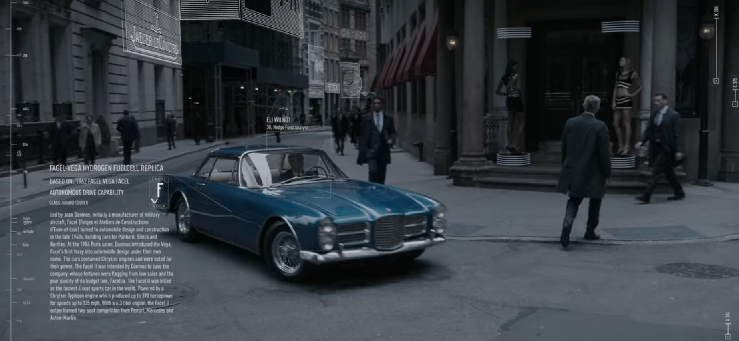
Relevant technologies
The Mind’s Eye
  Augmented Reality Heads Up Display
    Current Occupation
    Criminal History
    Family Tree
    Bio Data
    Relationship Status
Ether
Seamless Augmented/Virtual Reality
Smaller Technologies:
  Real Time Translation
  Driver Assist
  Door Unlocks By Looking At It
Notes:
Michael Gatti
I first wanted to touch on what technologies are engrossed in this story and how they shape the world around Anon.
The most prominent technology is Mind’s Eye. It is a optical implant that the government forces everyone to have. It comes with Augmented Reality Heads Up Display that can be minimized but not disabled. While being used you are able to see information such as a person's current occupation, their criminal history, family tree, bio data (including height down to the nearest millimeter and their weight), and relationship status. This is all done with a simple glance at their face. It also allows you to see information about inanimate objects that you look at such as nutritional data from foods, the make and model of a car driving by (as shown in the image), and even can be used to pay and tip a street vendor without exchanging a word.
There is also the Ether that is a government database that has the entire history of every person from what they have seen through their mind’s eye. They can access the person’s view in real time at anytime with the prime example of this being when it was hacked into to project what a killer sees onto its target in real time.
The final main technology used is seamless augmented/ virtual reality. There is a complete blurring of reality with hyper realistic projections onto what the people can see through the mind’s eye. Throughout the film this concept was used frequently from making a musophobic (fear of rats) person see a room filled with them, change the position of objects in front of them, to even replacing the entire world around them with other videos so life like that you could have thought you were dying.
Some other minor yet notable technologies is real time translation where the mind’s eye was able to project what the person was saying to your HUD, Driver assist where it says and projects the route ahead of you while driving, and being able to unlock a combination lock on the door just by looking at it.
Information:
Image: Niccol, A. (2018, May 11). Anon [Sci-fi Noir Thriller]. Netflix. https://www.netflix.com/watch/80195964?trackId=255824129&tctx=0%2C0%2CNAPA%40%40%7C0281440f-7025-4f0a-8692-ccb1533a9472-263798107_titles%2F1%2F%2Fanon%2F0%2F0%2CNAPA%40%40%7C0281440f-7025-4f0a-8692-ccb1533a9472-263798107_titles%2F1%2F%2Fanon%2F0%2F0%2Cunknown%2C%2C0281440f-7025-4f0a-8692-ccb1533a9472-263798107%7C1%2CtitlesResults%2C80195964

Slide 3
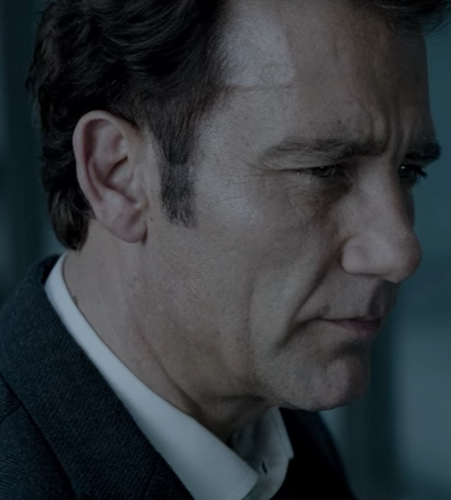
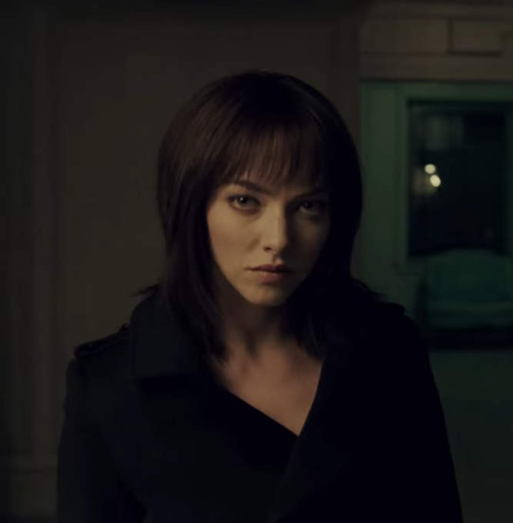
Plot Summary:
Set in the near future in a unnamed metropolis
Sal Frieland
  Main character
  Detective for the Metropolitan police force
“The Girl” / “Anon”
  Hacker
  Invisible to the police
Cyrus
  Information Technology Employee for the police force
  Obsessed with Anon
Notes:
All of those somewhat futuristic technologies envelop a mundane unnamed metropolis. Despite the advanced technology in the film, the architecture is quite similar to what you would see in any standard city in the US.
Anon follows Sal Frieland. A cold stoic detective for the metropolitan police force. He is tasked to find and stop a mysterious hacker/murderer that has found a way to hack into the ether and completely remove themselves from all records including people’s own recollection. They later find the perceived suspect working with a collective of hackers that help people remove what they want to forget. He goes on a series of sting operations to get in contact with this mysterious hacker known as The Girl and hopefully shut her operation down.
Anon values her own privacy so once she finds out that Sal is a detective she exacts revenge. To punish him for getting too close she shows him his worst fears and even deletes memories of his passed son.
Sal is stripped from his duty for accidentally shooting a civilian during Anon’s tourture of him and placed under house arrest. During this time the hunter became the hunted and he is attacked by the true murderer, Cyrus. He has found a way to project what he is seeing onto others and visa versa. In order to combat this Sal blindly shooting Cyrus killing him and freeing Anon from her torturous stalker.
The movie ends with our main characters starting off into the city skyline with Anon sharing that she has “nothing that she would want Sal to see” then leaves him there clouded in a shade of errors.
Images: Niccol, A. (2018, May 11). Anon [Sci-fi Noir Thriller]. Netflix. https://www.netflix.com/watch/80195964?trackId=255824129&tctx=0%2C0%2CNAPA%40%40%7C0281440f-7025-4f0a-8692-ccb1533a9472-263798107_titles%2F1%2F%2Fanon%2F0%2F0%2CNAPA%40%40%7C0281440f-7025-4f0a-8692-ccb1533a9472-263798107_titles%2F1%2F%2Fanon%2F0%2F0%2Cunknown%2C%2C0281440f-7025-4f0a-8692-ccb1533a9472-263798107%7C1%2CtitlesResults%2C80195964

Slide 4
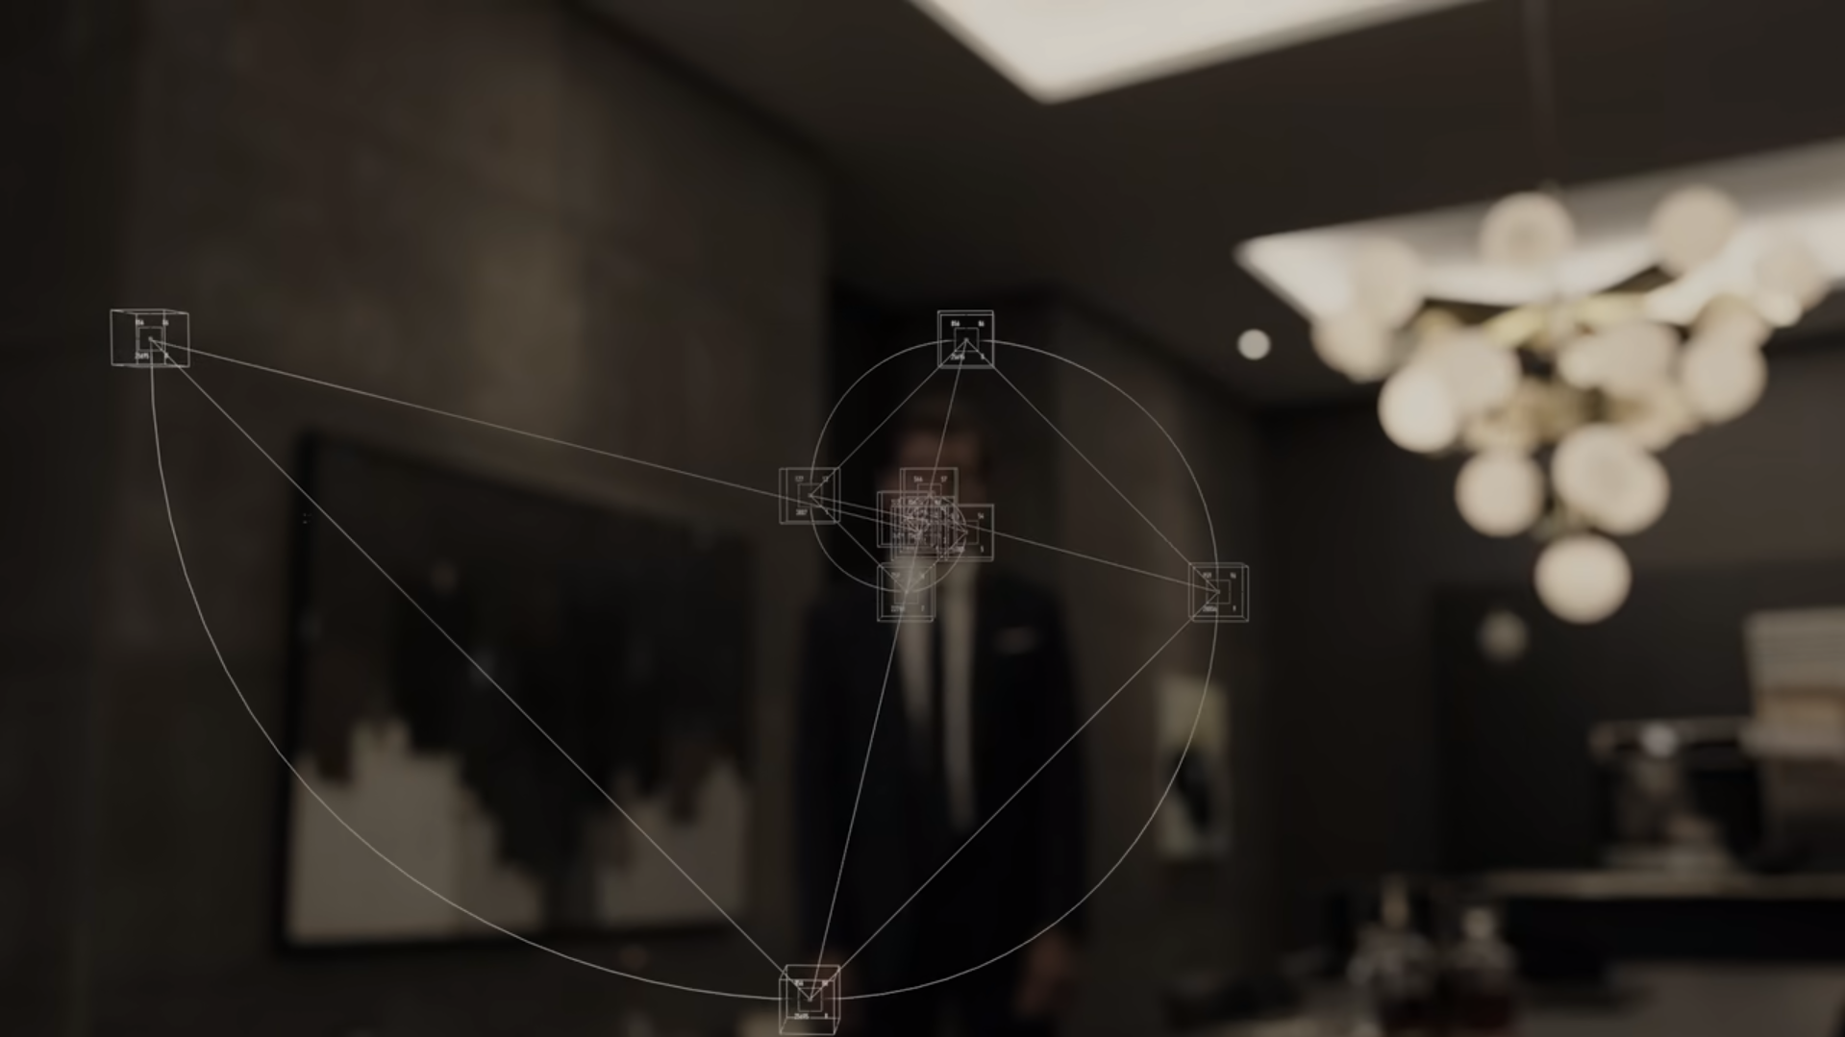
The technology in Anon is not secure
The girl and Cyrus
  Gain unauthorized access to the Ether
    Used to delete/edit/replace records of memory
    Critical issue
  The kind of attack used is not specified
    Most similar real life attack is SQL injection
  Background characters
    Never seen attempting
    Claim to be able to access Ether
Notes:
The girl and Cyrus are the two main characters we see access the Ether through unauthorized methods
Cyrus uses an attack to be able to access the girl’s eyesight in an attempt to determine her location
Uses the same attack later to edit what the end user sees,
The girl uses the attack to gain read/write access to Sal’s and other clients memory records as seen in the visual
As well as alter what Sal sees
The closest real life attack would be SQL injection
Based on the idea that the Ether is a database of memories and SQL injection would be used to get read access to a person’s
memories and then further attacks to edit/upload/delete data
Although we only see 2 characters execute the attack, there are background characters who attempt to make contact with Sal that claim to be able to hack the Ether
This could mean the number of people with knowledge of the vulnerability/ attack method is larger than just Cyrus and the girl

Slide 5
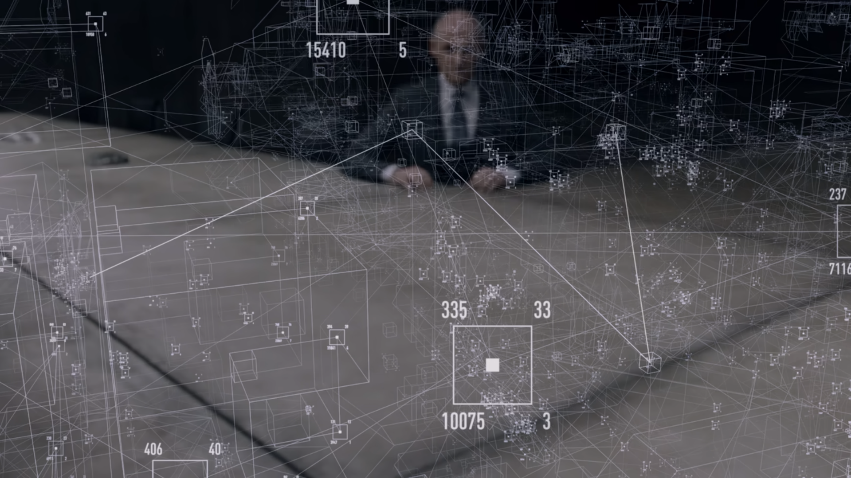
Lack of Fixing Vulnerabilities/ using countermeasures
Lack of attempts to fix vulnerabilities
  No focus on preventing future attacks
    No appearance of engineers to diagnose
    Factual events are crucial to just trials
    Security isn’t a priority
  See the editing attack used by Gov
    When Sal goes undercover
    Cyrus using similar attack
Notes:
In the movie the government agency that regulates and uses the Ether never visually makes attempts to prevent these attacks from occurring
There is no scene where a software engineer is seen diagnosing or patching out the vulnerability
The only reason they investigate it is because of the murders related to the problem
This suggests that the security of the Ether isn’t the main concern of the Government Agency
Even though it is critical for just trials where all information in the Ether must be unedited and true
We see the Government Agency use the editing attack on Sal’s memories for their own use
This demonstrates that the Government understands to some extent the editing attack, but not how to prevent it

Slide 6
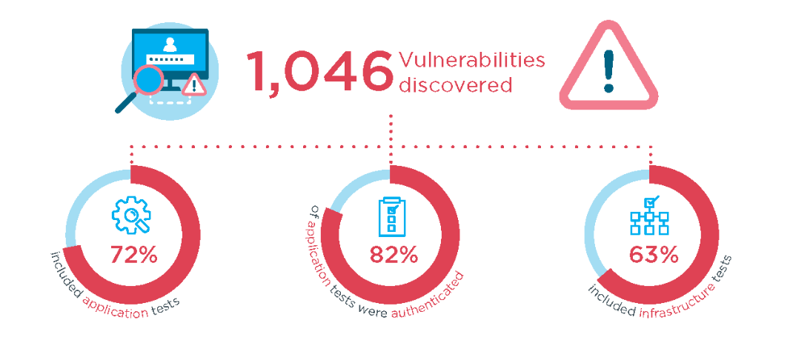
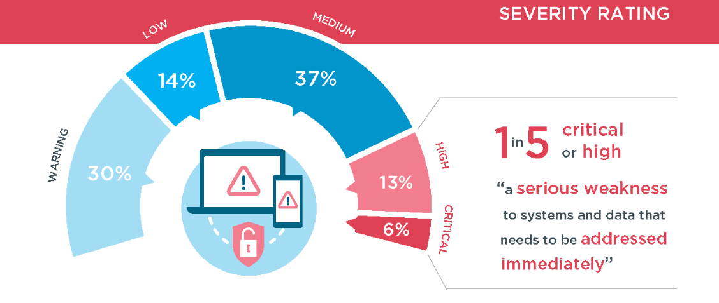
How secure is private information in reality
Most companies are secure
  Penetration Testing [9]
    White Box Testing
      Inside hacker
    Black Box Testing
      Outside hacker
    Vulnerability Scans
      Software based
Notes:
Penetration testing is a common business practice where companies use inside and or outside testers to attempt to hack their own system to find vulnerabilities
White box Testing results in the tester being able to provide key information on internal vulnerabilities
Black Box Testing is more lifelike, tester is given no information other than possibly an IP address.
These tests don’t teach much about the internal structure, usually tests firewall and outward defences
Vulnerability Scans
Software based scan of a system that requires human analysis afterwards to ensure that the listed recommendations are applicable
Useful for deployment of a software and for making sure patches are installed across the estate
All of these are parts of penetration testing which can be and are employed by businesses that have confidential data like ssns, addresses, etc.
But we don’t see them employed in the movie Anon to assess the vulnerabilities of the Government’s system
The infographic on the right is from Bulletproof which is a business who conducts external penetration testing
In 2018 they found 1,046 vulnerabilities across their clients
Of the weaknesses 18% were of high significance or greater
If the government agency in Anon had their system tested by a company like this, they would likely have mostly critical or high vulnerabilities related to the attacks by the girl and Cyrus which is demonstrative of how unsecure the technology is.

Slide 7
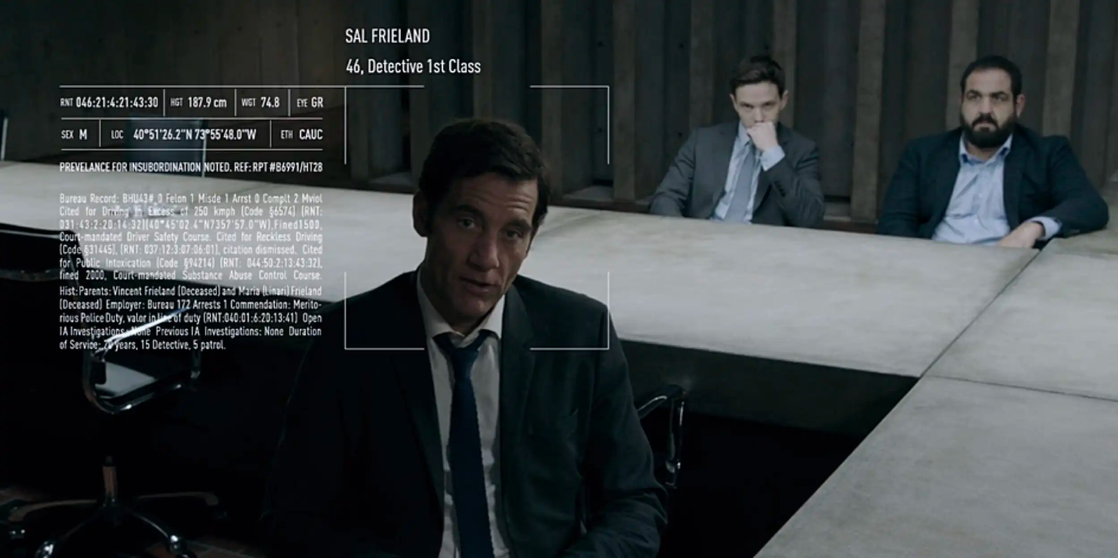
The concept of privacy did not exist in Anon and is fading in real life
Everything seen is recorded
Any part of a person's life can reviewed by someone with access to the Ether
Others can share videos of you doing daily activities
Can’t understand that there are some things that people do not want to share
Notes:
Everything viewed by the mind’s eye is recorded and stored government database with restricted access. Anyone with access either government officials or hackers can look at the memories of anyone the want. Even without government access people can share their own memories to others, so if someone was seen doing something it is being recorded and can be sent to others. The antagonist in the movie basically wants to be anonymous and keep her privacy. As Michael said when the detective confronts her and asks why she hides she says how shes not hiding there are just things she does not want to share. No one else could even comprehend that way of thinking.
Seen in the picture is what others see when looking at people. It is small, but the information provided includes his name, age, occupation, height, weight, eye color, gender, location, ethnicity among other things. Being able to see this much information on someone without even meeting them proves there was no privacy.

Slide 8
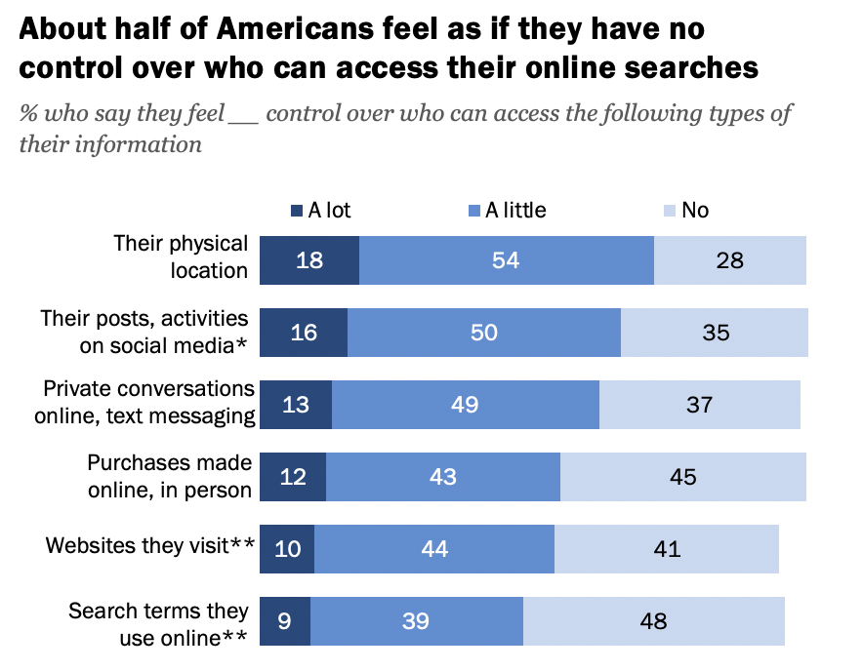
Privacy is being lost in the virtual world leading to a loss of privacy in the real world
79% of websites track user data [12]
60% of Americans think it's impossible to go through their day to day life without having data collected [13]
Over 80% of Americans believe they have no control over the data collected by companies and the government [13]
[13]
Notes:
With more and more personal information being collected everyday our privacy is decreasing. About 80% of websites track user data including location, emails, phone numbers and more. 60% of Americans believe they are not able to go day to day without having personal information collected. 80% of Americans don’t think they can even control what information about them is collected about them. It is starting to look like the world In Anon where all information is already collected and freely shared between everyone.
The graphic shows specifically what information americans feel like the have control over who can see their information. They feel safest about their physical location but least safe about search terms they use online. This is contradictory however because often searches involve your location such as restaurants in worcester or target near me.
Losing privacy in the virtual world can lead to privacy issues in the real world. Information such as addresses, house price, relatives, current place of work or school, and contact information can be found online as we demonstrated through our privacy essay assignment.
Overall losses in privacy online causes a loss of privacy in real life
[1] Eliza Crawford, Why and how do website track you (cookie pro 2020) https://www.cookiepro.com/blog/website-tracking/#:~:text=Website%20tracking%20is%20incredibly%20common,track%20users%20outside%20of%20advertising. Oct 1 2022
[2] Americans and Privacy: concerned confused and feeling lack of control over their personal information (PEW Research Center 2019) https://www.pewresearch.org/internet/2019/11/15/americans-and-privacy-concerned-confused-and-feeling-lack-of-control-over-their-personal-information/ Oct 1 2022

Slide 9
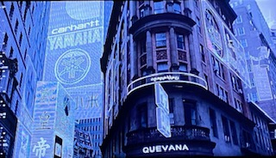
The technology blurred reality and virtual elements
Live manipulation
Memory became nonexistent
Notes:
Our next conclusion is that the technology was too powerful in that it blurred reality and virtual elements. In the movie we often saw a lack of differentiation between what was real and what was not.

Slide 10
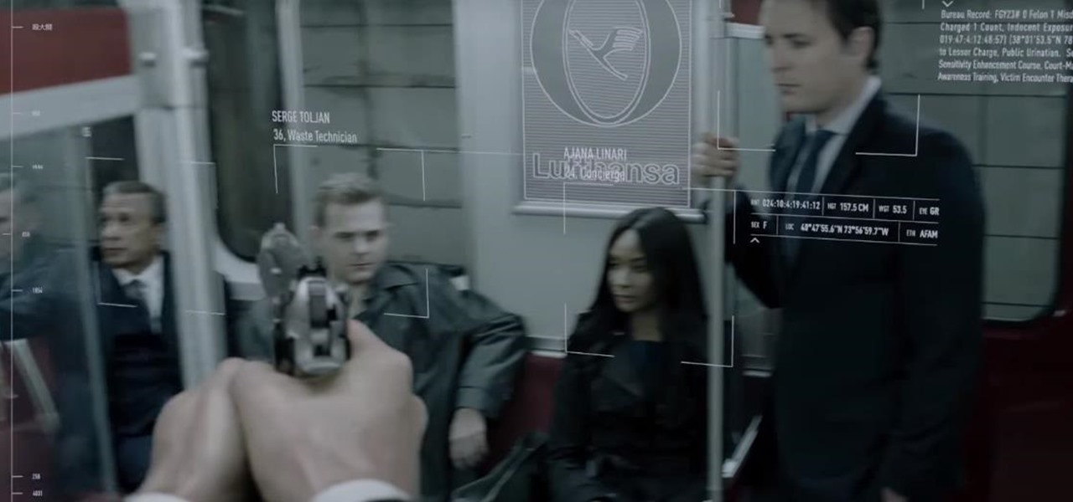
Hackers were able to create false realities
False danger
  Chase in subway
  Rats and fire
False safety
Fake recommendations
Notes:
Anon was able to manipulate Sal’s sight to escape and torture him. While she was being chased down a subway, Anon made fake images appear making Sal stumble, and she also made a fake subway train appear at the station that Sal then searched as pictured. Seconds later a real train pulled in and almost killed Sal. Another instance was while Sal was on house arrest. She took advantage of his fears and shortly after this, it appeared his apartment building caught on fire and was tricked into shooting and killing his neighbor despite, Sal never seeing him in his point of view. In both these instances Sal was unable to differentiate between real life and the hack.
There was also a fake sense of safety that the hackers created for Sal. While driving they made the traffic patterns different than what it was in real life. This resulted in Sal getting into a car accident.
The last fake reality the hackers created were fake recommendations. The main hacker, Cyrus, was able to manipulate the government to convince them to hire him for the investigation. The hackers were able to make anything they wanted a reality through the use of the reality.

Slide 11
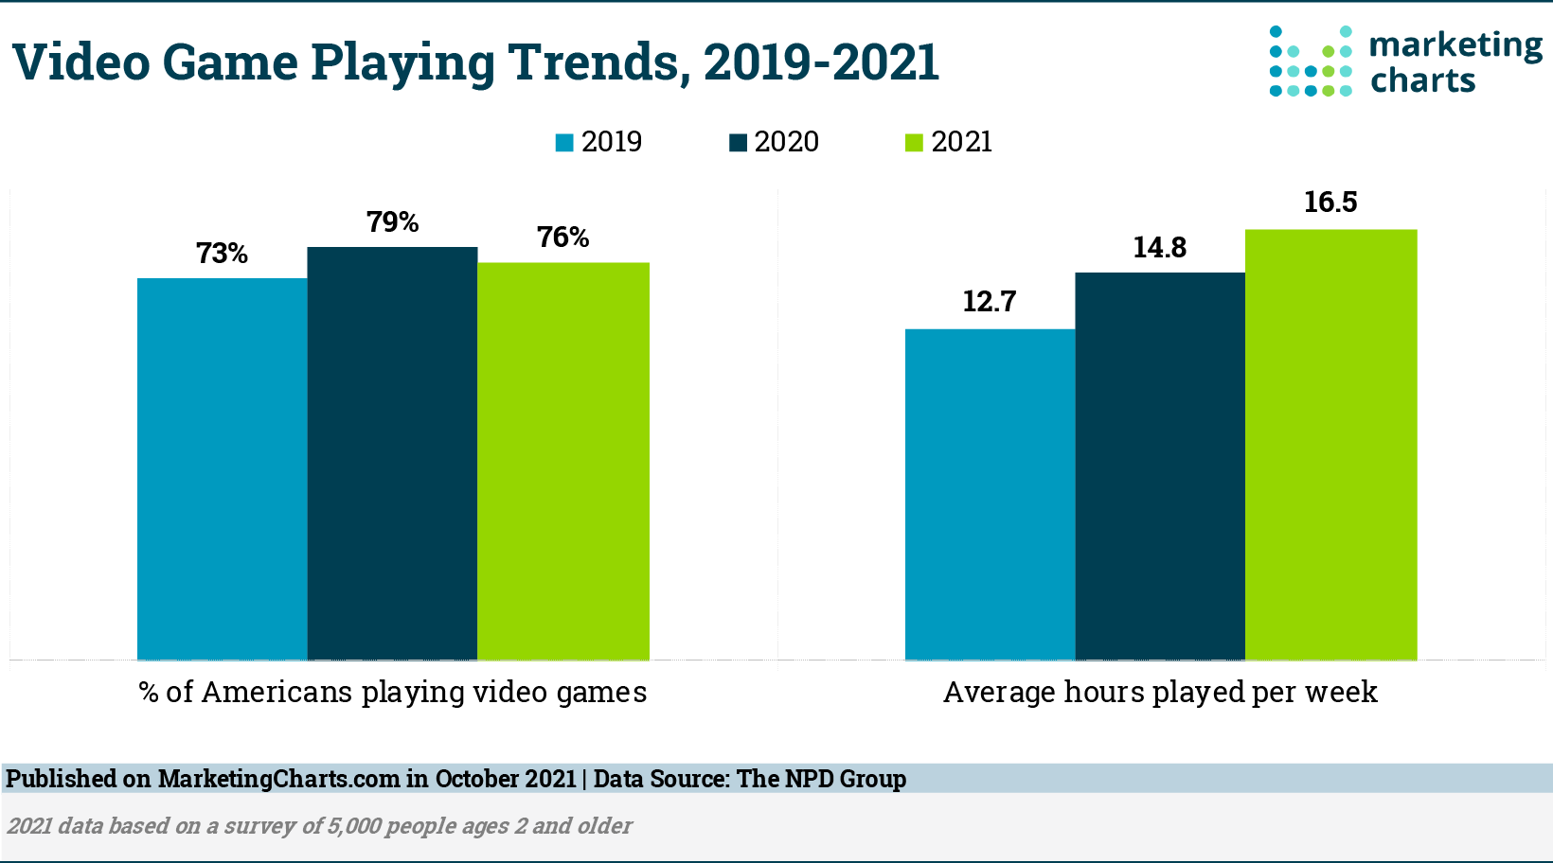
Fake realities exist in real life
Pokemon Go
  At least 26 deaths and 64 injuries [1]
Cat fishing
  Dating app usage has increased by 18.4% [2]
  Americans lost $201 million in 2019 and $143 million in 2020 to scams [2]
Video game addiction
  Statistical significance between video game addiction and anxiety, depression, aggression [3]
Video game use since 2019 [8]
Notes:
Instances in our world that we can see technology blurring reality between what is real and what is fake is Pokemon Go, Cat Fishing, and the addition to video games
Pokemon Go was one of the first augmented reality games that was easily available to everyone. Augmented reality is a technology that superimposes a computer-generated image on a user's view of the real world. So pokemon go combined the real world with catching pokemon. 26 deaths and 64 injuries can be attributed to using the app and having the app lead people where they are not supposed to be whether that be on someone’s private property, crossing a road, or near dangerous landmarks. We can see that with an augmented reality, people lose touch of real life and put themselves in danger.
The next example is cat fishing. People are able to create a false image on the internet. They are able to make these profiles have characteristics that they lack or wish they had. This can be most seen on dating apps or in general online relationships. Dating app usage has increased by 18.4% since 2020. Cat fishing can be detrimental in two ways. Psychologically it can take a toll on the person who got tricked. A documentary on Netflix called “Untold:The Girlfriend who Didn’t exist” where Manti Te'o was a college football player and his football career was ruined shows the consequences. What is becoming more popular is internet scams. The cat fishers can make up fake situations and ask the person they are in a tight financial situation and trick them into sending them funds. Americans lost $201 million in 2019 and $143 million in 2020 to scams [2].
The final example is video game addiction. Video games create a virtual reality that most times is not in touch with the real life. People become addicted to such video games as we have seen in South Korea. People are experiencing negative effects such as increased in anxiety, depression, and aggression [3]. The graphs also show that while the percent of users is staying even, we see an increase in average hours spent during a week on video games.
In all these instances we can see that technology is able to distance people from reality in such a way that it can lead to harm in real life.

Slide 12
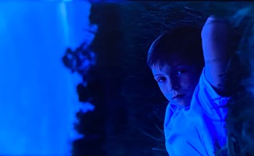
Memory becomes non-existent
“We have to believe our eyes, or the system doesn’t work”
If there are no files to back you up no one will believe you
No physical memorabilia of his child, his memory is deleted
Notes:
In the movie, society no longer has memory, but rather they rely on technology for their memory. Sal’s boss tells him “We have to believe our eyes, or the system doesn’t work,” when Sal is arguing that their security had been breached. There is no trust between people if there are no files to backup their claims. Sal’s files were hacked and edited so all of his claims were not believed. In a non investigation situation, Sal lost all his files of his son who had passed away. He did not have any physical memorabilia so his son was essentially deleted from the world.

Slide 13

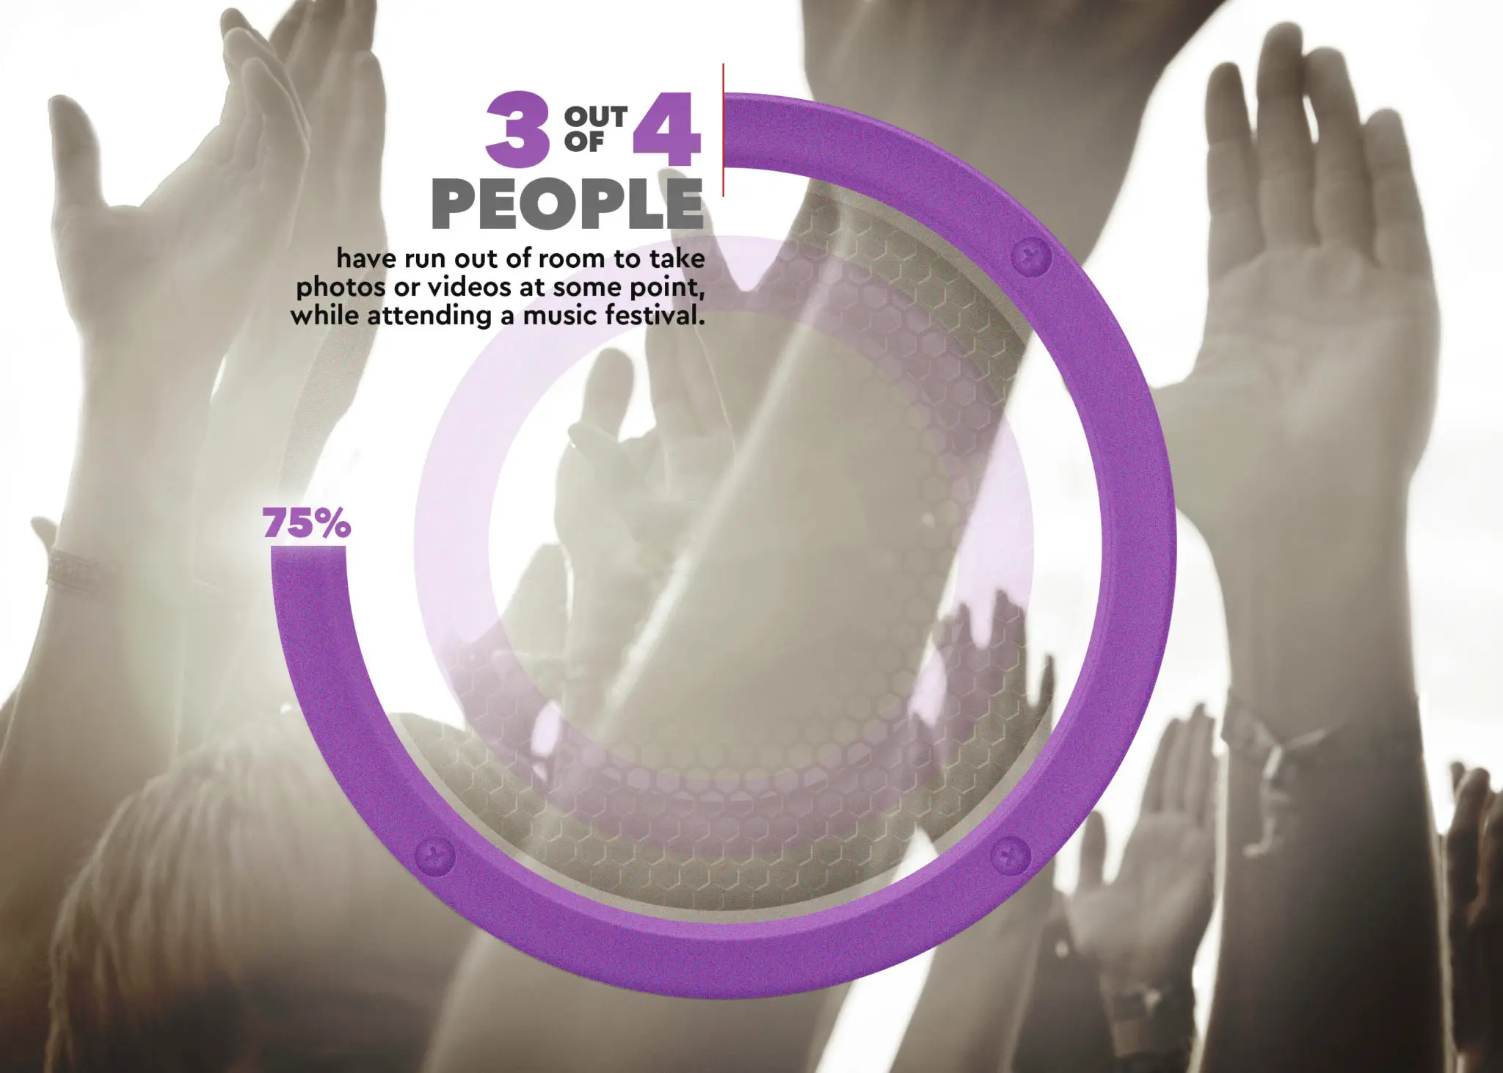
Dependency on technology for memory in real life
Memory and decision making is closely related [6]
Video evidence is involved in about 80% of crime cases as of 2016 [4]
On facebook 71.2% of the content are pictures, 16.6% are videos [5]
Results from a survey of music festival attendees [7]
Notes:
In today's society we can see a heavy reliance on videos and technology for looking at past events.
There is a strong relationship between memory and decision making. When we are faced with decision we automatically value the outcomes based on past events. Being able to manipulate our memory would then in turn give people the power to alter our decision making.
An example of society using videos to make decisions can be seen in court. Video evidence is used in about 80% of crime cases. The jury and judge use videos to base their decisions on. As technology improves there is a possibility that video editing could be done in such a way that it cannot be proved as fake. This idea is why we cannot only rely on videos.
On a social media perspective, 71.2 % of the content on Facebook are pictures and 16.6% are videos. While there is no danger, this shows that people are not living in the moment, rather they use their time to video their experiences. Virtually everyone (96 percent of the respondents) will take photos or video of the event, 66% felt they were deleting core memories when they delete pictures and 75% run out of storage while at events which shows the mass amount of pictures and videos that are being taken. [7]. Society has to consider becoming lost in videoing and not taking time to enjoy their experiences through their eyes.

Slide 14

Director’s Intent
The Loss of Privacy / “A War For Information”
  Andrew Niccol avoids social media
  “ It’s all for convenience, and maybe people are thinking twice about that. Perhaps that is an element to this. It’s a cautionary tale.”
The Overuse of Technology
  GPS is making us lose our ability to navigate
Notes:
Andrew Niccol, well known for his other works such as The Truman Show, Gattaca, and Good Kill is no stranger to incorporating innovative technologies the movies he makes. But along with the heavy use of technology you can also see the underlying unease behind it. He completely avoids social media entirely. In an interview with Ryan Lambie of Den of Geek, he said that the primary reason for it is privacy [10]. This is reflected in Anon with the government’s and later the hacker’s access to the Ether. This closely mirrored the 2018 FaceBook (now Meta) data breach that leaked 50 million accounts worth of data. In another interview with Tasha Robinson of the verge Niccol mentioned that. “Facebook is now giving people pause because they’ve given themselves up for nothing. It’s all for convenience, and maybe people are thinking twice about that. Perhaps that is an element to this. It’s a cautionary tale.”[11] He further mentioned that due to people’s overuse of technology we have become permanently changed by it, citing that “Because we rely on GPS we’re losing our innate ability to navigate our world”[10]. The bottom line is throughout the film anon you can see how engrossed every individual is in their mind’s eye and how it is reshaping the world around it.

Slide 15
References
http://pokemongodeathtracker.com/. Accessed 4 Oct. 2022.
Knafo, Danielle. “Digital Desire and the Cyber Imposter: A Psychoanalytic Reflection on Catfishing.” Taylor & Francis Online, https://doi-org.ezpv7-web-p-u01.wpi.edu/10.1080/10481885.2021.1976187. Accessed 4 Oct. 2022.
Sockdale, Laura, and Coyne, Sarah. “Video game addiction in emerging adulthood: Cross-sectional evidence of pathology in video game addicts as compared to matched healthy controls.” Science Direct, https://doi.org/10.1016/j.jad.2017.08.045. Accessed 4 Oct. 2022.
“Video Evidence: A Primer For Prosecutors.” Bureau of Justice Assistance, https://bja.ojp.gov/sites/g/files/xyckuh186/files/media/document/final-video-evidence-primer-for-prosecutors.pdf. Accessed 4 Oct. 2022.
Ahmed, Arooj. “Images, Videos Or Links? Study Shows Most common Social Media Post Types on Facebook and Instagram.” Digital Information World, https://www.digitalinformationworld.com/2021/05/images-videos-or-links-study-shows-most.html. Accessed 4 Oct. 2022.
Reddish, David, and Mizumori, Sheri. “Memory and Decision Making.” National Library of Medicine, https://www.ncbi.nlm.nih.gov/pmc/articles/PMC4428655/. Accessed 9 Oct. 2022.
“SURVEY: CONCERT ATTENDEES BASICALLY TAKE TOO MANY PHOTOS.” https://www.thephoblographer.com/2016/06/08/survey-concert-goers-photos/. Accessed 9 Oct. 2022.
“Time Spent Playing Video Games Continues to Rise.” Marketing Charts, https://www.marketingcharts.com/demographics-and-audiences-118663. Accessed 9 Oct. 2022.
MOONEY, TOM. “PENETRATION TESTING.” Information Security A Practical Guide: Bridging the Gap between IT and Management, IT Governance Publishing, 2015, pp. 90–102. JSTOR, http://www.jstor.org/stable/j.ctt155j4c1.14. Accessed 4 Oct. 2022.
jbindeck2015. (2018, May 7). Andrew Niccol interview: Anon, privacy, My Little Pony. Den of Geek. https://www.denofgeek.com/movies/andrew-niccol-interview-anon-privacy-my-little-pony/ Accessed 6 Oct. 2022.
Robinson, T. (2018, May 3). Gattaca director Andrew Niccol discusses his new Netflix film Anon. The Verge. https://www.theverge.com/2018/5/3/17312756/gattaca-director-andrew-niccol-interview-netflix-film-anon-clive-owen-amanda-seyfried Accessed 6 Oct. 2022
Eliza Crawford, Why and how do website track you (cookie pro 2020) https://www.cookiepro.com/blog/website-tracking/#:~:text=Website%20tracking%20is%20incredibly%20common,track%20users%20outside%20of%20advertising. Oct 1 2022
Americans and Privacy: concerned confused and feeling lack of control over their personal information (PEW Research Center 2019) https://www.pewresearch.org/internet/2019/11/15/americans-and-privacy-concerned-confused-and-feeling-lack-of-control-over-their-personal-information/ Oct 1 2022
Niccol, A. (2018, May 11). Anon [Sci-fi Noir Thriller]. Netflix. https://www.netflix.com/watch/80195964?trackId=255824129&tctx=0%2C0%2CNAPA%40%40%7C0281440f-7025-4f0a-8692-ccb1533a9472-263798107_titles%2F1%2F%2Fanon%2F0%2F0%2CNAPA%40%40%7C0281440f-7025-4f0a-8692-ccb1533a9472-263798107_titles%2F1%2F%2Fanon%2F0%2F0%2Cunknown%2C%2C0281440f-7025-4f0a-8692-ccb1533a9472-263798107%7C1%2CtitlesResults%2C80195964

