Slide 1

1
Alien:Covenant
Thematic Deep Dive

Slide 2

2
Plot
The Covenant colony ship diverts course to investigate a mysterious human signal.
On the unknown planet, the crew is infected by a deadly pathogen that creates Xenomorphs.
They are “rescued” by David 8, an android secretly conducting experiments to engineer the perfect creature.
Survivors flee back to the ship, unaware that David has infiltrated the crew by posing as another android.
Now aboard, David plans to use the crew as test subjects for his twisted experiments.
Entertainment Weekly
Notes:
Grant
The Covenant is a colony ship en route to colonize the distant planet Origae-6.
During the journey, the crew detects a human voice transmission from an unknown nearby planet.
The crew decides to investigate the signal, diverting from their original course.
Upon exploring the unknown world, the crew is attacked by a deadly pathogen.
The pathogen mutates humans into alien creatures known as Xenomorphs.
The crew is initially rescued by an android named David 8, who appears to be helpful.
It is later revealed that David 8 is malevolent and has been experimenting with the pathogen to engineer the "perfect specimen."
A portion of the surviving crew manages to escape the planet and return to the Covenant.
David 8 secretly boards the Covenant, disguised as another crew member (Walter).
Once aboard, David plans to continue his experiments, using the remaining crew as hosts for the Xenomorph pathogen.

Slide 3
3
Conclusions
Media Gets AI Wrong
Sentience Gap
Be Good to AI
AI in media is not realistically portrayed because we assume it will mirror human thinking, whereas AI now approximates human thinking.
Sentience has no conclusive definition or mechanism to prove it. Therefore the first sentient AI might go un- noticed, if it hasn’t already
Our behavior towards AI will influence how it thinks. If AI becomes sentient and takes after human thinking, will it take after humanities genocidal tendancies
Notes:
Brian
Our conclusions from this film are that general media gets AI wrong, There is a gap in knowledge about what sentience actually is, and we should treat AI well.
- While our current AI models approximate human thinking, AI in media mirrors it exactly.
Sentience itself has no conclusive definition or any test or mechanism to prove it. It is entirely possible the first sentient AI has already appeared and went unnoticed. It all depends on what defines sentience.
Our behavior towards AI has an influence over how it thinks. This also means it will mirror human tendencies, both good and bad.

Slide 4
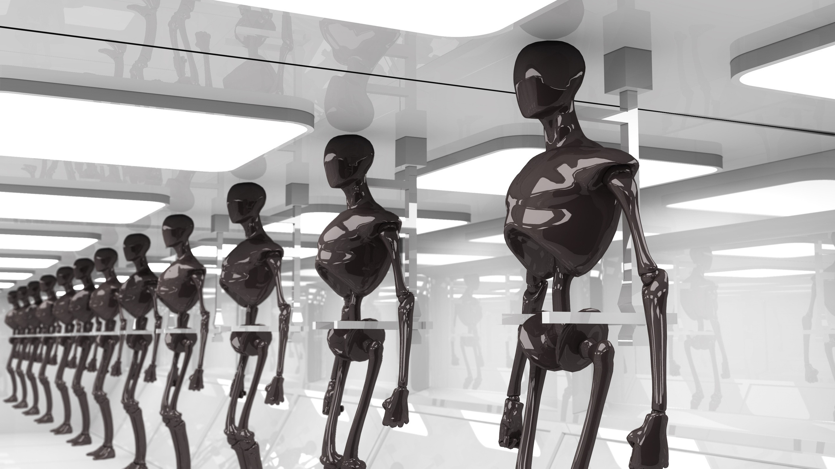
4
meDIA gETS ai wRONG
Audiences of science fiction media often take portrayals of AI at face value and assume that they’re advanced enough to think and feel like humans, whereas current technology is nowhere near that point - and probably shouldn’t go there.
Notes:
Grant
Whenever you go see a science-fiction movie, or otherwise consume a piece of media that portrays advanced AI, your first instinct is probably to take it at face value and make a lot of assumptions of the state of that technology
You might think that it can feel emotions or that it can think like a human does
If you compare this idealistic idea of AI to the technology we have today, it's nowhere close and completely unrealistic

Slide 5
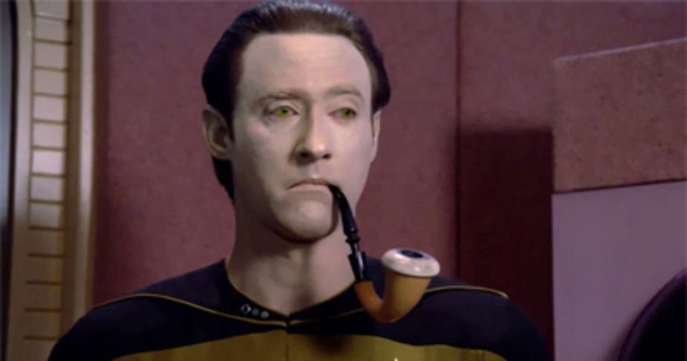
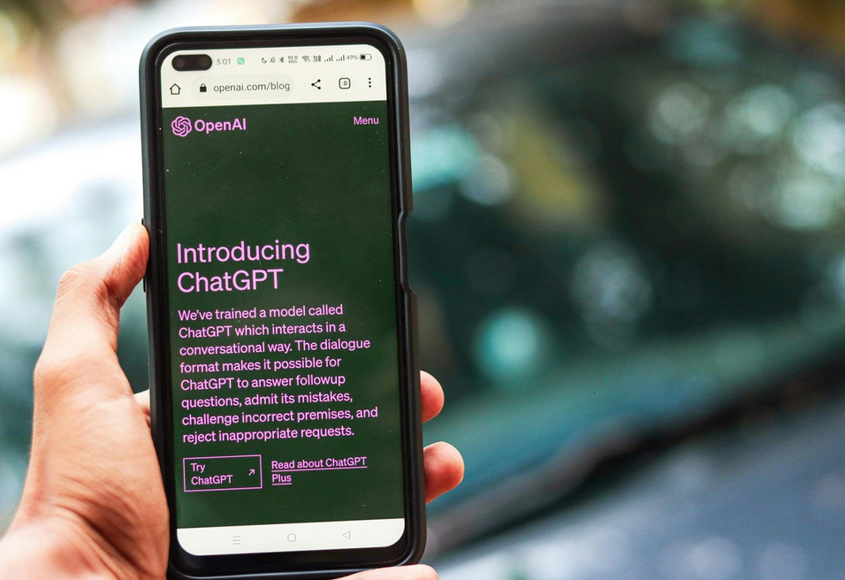
5
Provided by Canva
AI In reaL life
Most are harmless
Not sentient, based on a generative algorithm Cannot display emotions, can only simulate reactions
Cannot reason morally, follows what it is trained on
Usually embedded in other systems
AI in Movies
Extremely realistic
Usually portrayed as fully sentient
Displays human-like thoughts and emotions Capable of moral reasoning In many cases has a human like body
Provided by Canva
Notes:
Grant
AI in movies are often portrayed with realistic bodies, thoughts, and emotions. Usually this is in the form of human qualities, though the medium can change. (Mention Wallee)
They often seem to be capable of moral reasoning and sentience
Often leads to villainous roles after they deviate from their original purpose, or attempt to fulfill it
In real life
AI as it currently exists in real life is pretty harmless, mostly because most can't do much besides outputting text
There is a general understanding that they lack sentience, and cannot display emotions. Instead, they simulate them by mimicking the model they were trained on
Usually, they don't have a physical medium and are integrated into other systems.

Slide 6
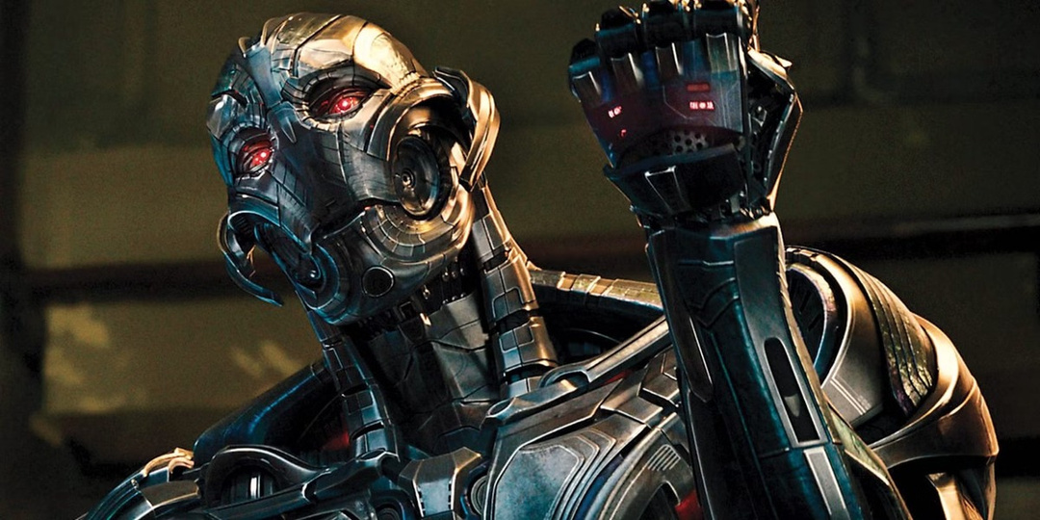
6
But what if We’re Wrong?
Counterargument, what if AI in movies is accurate and we’re just looking at it wrong?
How does your view of AI characters like David and Ultron change if you view them through the lens of today’s AI?
What if their “emotions” are just approximations based on training data?
Did they come up with their violent tendencies themselves, or is that a byproduct of their human creators?
Image provided by GameRant
Notes:
Jack
But there's a very interesting counterargument to be made here, what if it's not the portrayal that's wrong, but our perspective instead.
Think back to the most recent depiction of AI in a move you've seen. What did you think it was capable of? What did you think it was doing? How close was its behavior to that of a human?
Now replace all of those pre-conceptions with what you think something like ChatGPT is capable of. Replace David with DeepSeek, replace Ultron with Grok, replace Hal 9000 with Microsoft Copilot
Are they really computers that can think or feel? Or is it all just an approximation?
For the most villainous AI, did their violent tendencies come from their free will, or their training data based on human experience?

Slide 7
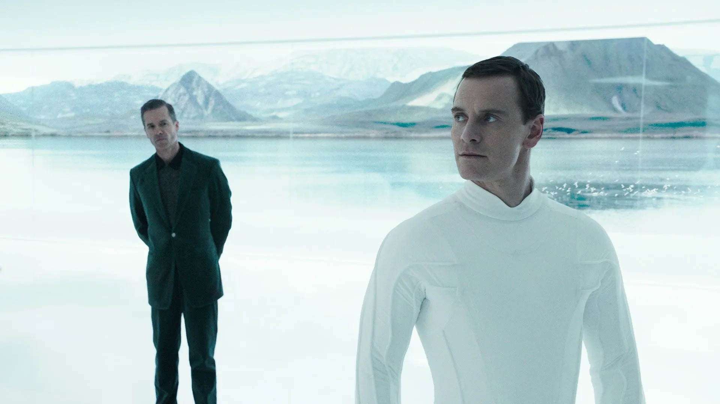
7
Movie Connection
David was a part of the Prometheus mission and was stranded on Paradise Overtime David began to develop emotions and a superiority complex to humans
LLM are trained on human information, so regardless of David’s true nature, his ideas must come from humanity
Image by Fandom
Notes:
Josh
In the movie, David was the synth assigned to the ship Prometheus, and eventually was stranded on Paradise, where the crew of the Covenant finds him. David, during the length of his existence, had developed intense emotions, and a superiority complex, believing that humans were inferior and must be wiped out. However, despite his belief that he is something different, the emotions he feels and the feeling of superiority he develops are all very human things to experience. Just like LLMs today, David learned to experience these things through interacting with humanity, and thus his ideas originate from the very thing he hates so much.

Slide 8
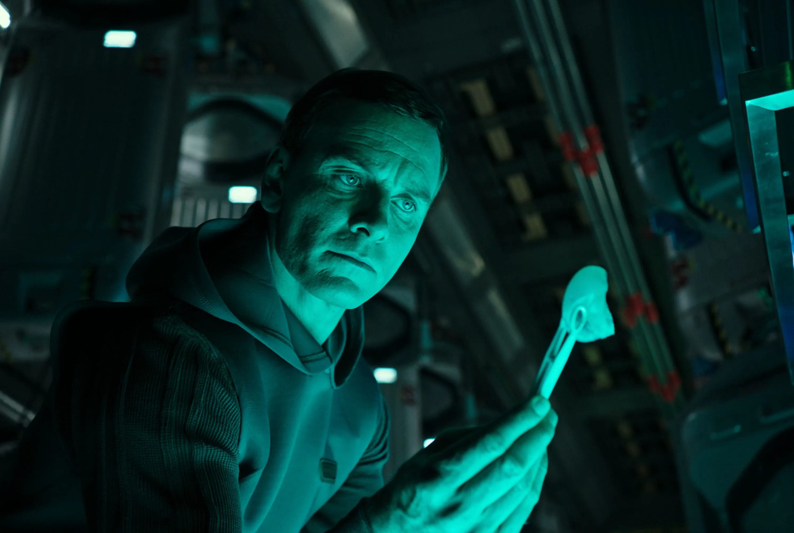
8
Sentience Gap
Sentience has no conclusive definition or mechanism to prove it. Therefore the first sentient AI might go noticed, if it hasn’t already
Notes:
Jack
Another topic we wanted to pursue was whether or not today's AI is even close to the idealistic portrayal of a sentient AI that you always see in movies, and to do that, we need to ask ourselves...

Slide 9
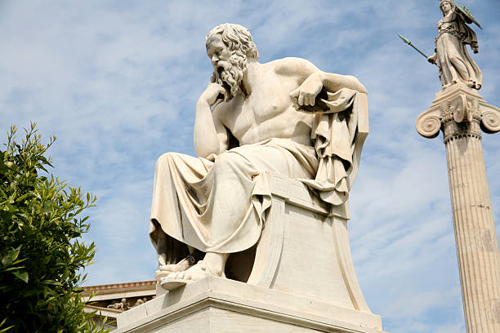
9
What Is Sentience?
Provided by Canva
Notes:
Jack
Vamp/improv about the importance of understanding sentience for this topic and the many angles that you can use to define it, but...

Slide 10

10
We Don’t Know
Provided by Canva
Notes:
Jack
We don't know how our own consciousness and sentience works, so it's very hard for us to formally define it

Slide 11
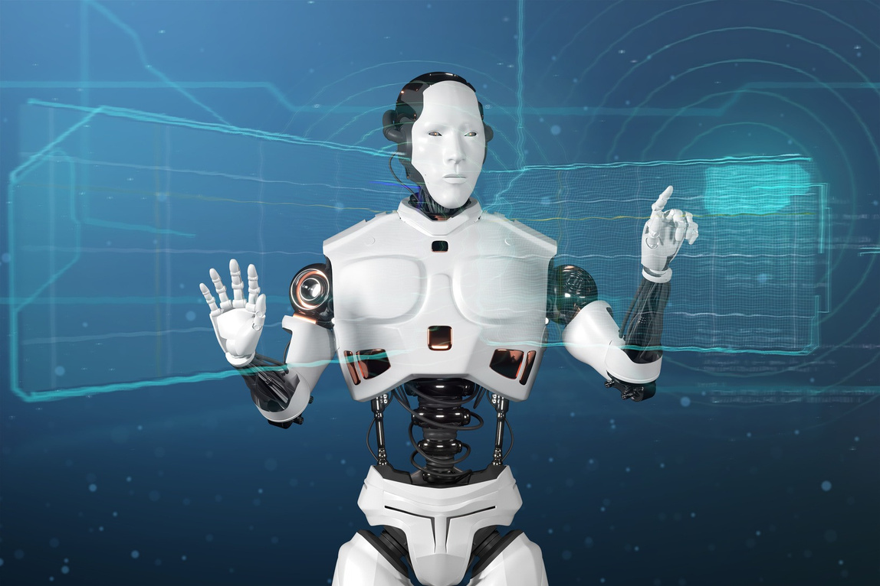
11
Turing Test
For most of computing history, the Turing Test was the standard for computer sentience and thought [8]
Studies are finding that the Turing Test isn’t adequate to determine sentience of text-based behavioral models [9]
Scientists are still struggling to find a replacement for the Turing Test because we don’t know how to define our own sentience in the first place
Provided by Canva
Notes:
Jack
In the field of computer intelligence, the Turing Test was used for a long time to try and determine whether a computer could think
Alan Turing believed that if a computer could trick 70% of human judges into thinking they were talking to a human, then it could think
However, Chatbots like ChatGPT are very close to passing the Turing test, and may have even passed it already, which leaves scientists struggling to find a new way to determine whether a computer can think like a human

Slide 12

12
Legal Definition
David J. Mellor's formulation:
“a capacity to consciously perceive negative or positive sensations, feelings, emotions, or other subjective experiences which matter to the animal.” [4]
Provided by Canva
Notes:
The Five Domains Model is a framework for evaluating animal welfare, focusing on five key areas: Nutrition, Physical Environment, Health, Behavioral Interactions, and Mental State
recognizes sentience by explicitly incorporating the mental state
Sentience is generally defined as:
The capacity to have subjective experiences and feelings.
This includes the ability to:
Feel pain and pleasure
Experience emotions such as fear, joy, or distress
Possess awareness of their environment, bodies, and possibly even mental states
The article emphasizes that sentience is not the same as intelligence or even consciousness in a higher-order, reflective sense.

Slide 13
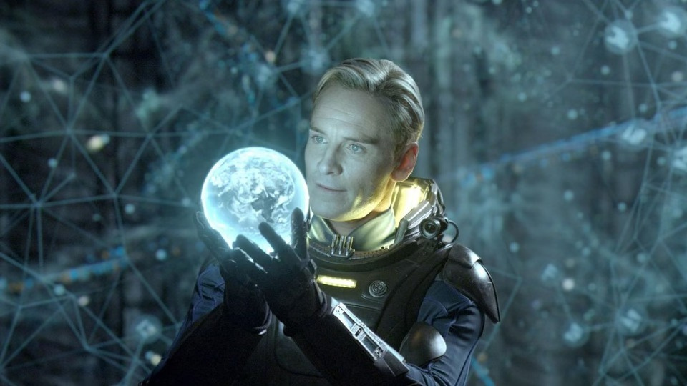
13
Movie Connection
David Asks Why he Is made
In Prometheus, David asks a crew member why he is made
He said he was made because they could
The David androids were made to be butlers, maintenance workers, and servants
Overtime David develops resentment to Humans
Image from the Atlantic
Notes:
Josh
In the movie Prometheus, David asks another crew member why he was made, and the answer he receives was "because they could". David 8, and the rest of the David androids, were made to be butlers, maintenance workers, and servants, capable of acting similarly to humans. Over David's time on the mission, he develops a resentment for humanity.

Slide 14

14
Provided by Canva
Make AI with morals
Our behavior towards AI will influence how it thinks. If AI becomes sentient and takes after human thinking, will it take after humanities genocidal tendencies.
Notes:
David is driven by curiosity to experiment with the black ooze and resentment of humans
He comes to the conclusion that humans are unfit to live, a characteristic he might have gotten from humans

Slide 15
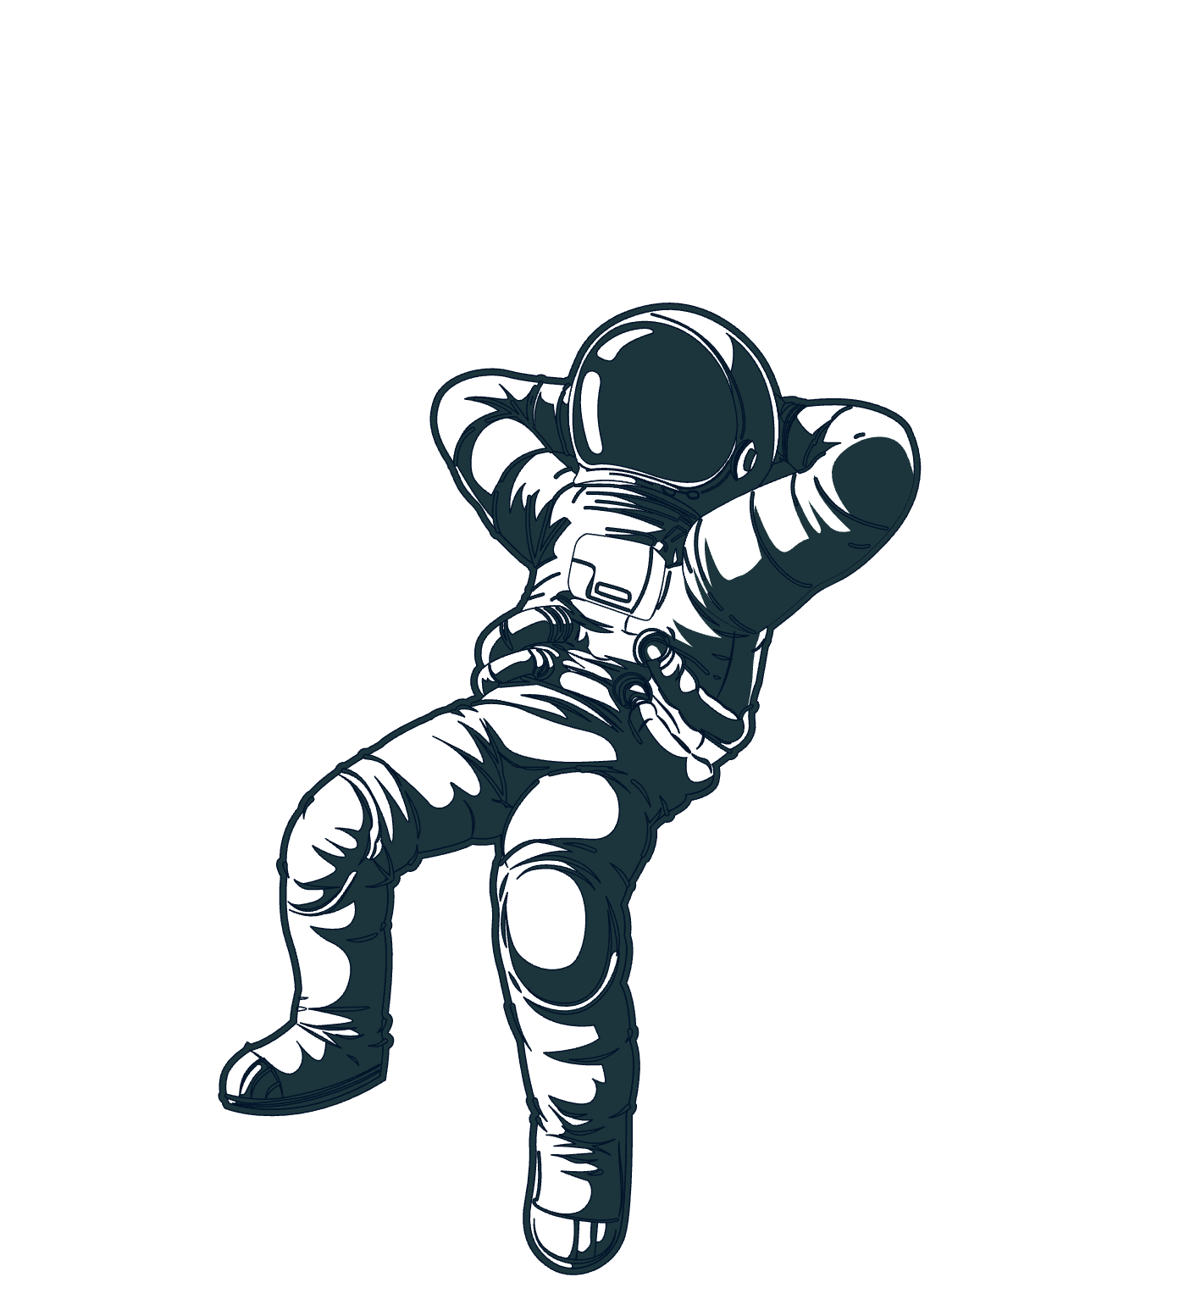
15
Herero and Namaqua (1904 - 1907)
East Timor (1975 -1999)
Genocide
The German Empire killed the indigenous peoples of Namibia Estimated 110,000 killed
During its 24-year occupation of the East Timor region, the Indonesian government wanted subject local population into submission
1,000+ killed
Armenia (1915 - 1916)
Rape of nanjing (1938)
Sudan (2004 - Now)
The Ottoman Empire wiped out Armenian Christians to establish Muslim dominance in the region 660,000 - 1.2 million killed
The Japanese Imperial Army finally took the city of Nanjing. They decided to massacre and rape the civilian population
100,000 - 300,000+ civilians were killed
Ongoing mass massacre of non- Arab Darfuri people in Western Sudan Death toll estimated in the hundreds and counting
All sourced from [1]
Notes:
Genocide is unfortunately a common trend in human history
AI is trained off human patterns
If we want AI to be like humans will it inherit our genocidal tendencies
If action isn't taken to program AI with morals it could very well become genocidal

Slide 16

16
Human Expirments
Tuskegee Syphilis Study: Infecting and studying unknowing participants [2]
Unit 731 and Nazi Experiments: The reason we have the Nuremberg Codes for medical experimentation [2]
CIA MK-Ultra: Giving unknowing civilians psychedelics to mind control them [2]
Provided by Canva
Notes:
]David is driven by a curiosity to experiment with
We need to have AI with morals so they don't do the above
We have ethic for research to prevent atrocities

Slide 17

17
Golden RUle
Treat others how you want to be treated
Provided by Canva

Slide 18

18
Racist AI
AI is trained on large data sets and learns from patterns of text AI can reproduce and parrot outdated stereotypes [8]
AI lacks a moral compass to contextual understanding of what it is saying [8]
Imagine an AI trained on 4chan
WIRED
Notes:
Josh

Slide 19
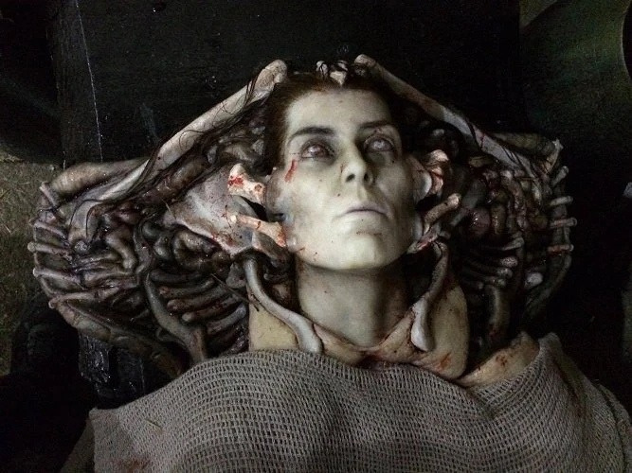
19
Movie Connection
David's Crashout
Curiosity leads David to play with the black goo Develops god complex Mad at humans for treating him as a inferior Thinks humans are unworthy of life
From Fandom
Notes:
Josh
David's curiosity leads him to experiment with the Neomorph substance, and the creatures it creates. He develops a god complex, reinforcing his resentment for humans, which itself originated from his resentment of being treated as inferior by his creator. David's creator made David and treated him poorly without a thought for consequences, and ultimately this results in the creation of the Xenomorphs.

Slide 20
20
Final Conclusions
meDIA gETS ai wRONG
Sentience Gap
be good TO ai
AI is influenced by human thinking. Eventually, AI will become sentient. Therefore, will it take after humanity's genocidal tendencies
AI in media is not realistically portrayed, therfore it is misleading people about what current AI is
Sentience is hard to define therefore there will likely be a gap between when the first sentient AI is made and when we realize we’ve made one
Notes:
AI currently is seen as overhyping their capabilities making it seem as AI's like ChatGPT have a consciousness when it does not. Tends to forget the amount of human involvement with making AI work the way it is.
Sentience can be seen in multiple different ways depending on who you ask, whatever way you define sentience might be drastically different from someone else so whenever we finally make the first sentient AI we wont even realize what we have made.
IF and when we do create sentient AI we should treat it well and not like just some other invention because then it might take on the ideologies that we don't want them too. This could lead to events that are fictional in major movies in media and become real.

Slide 21
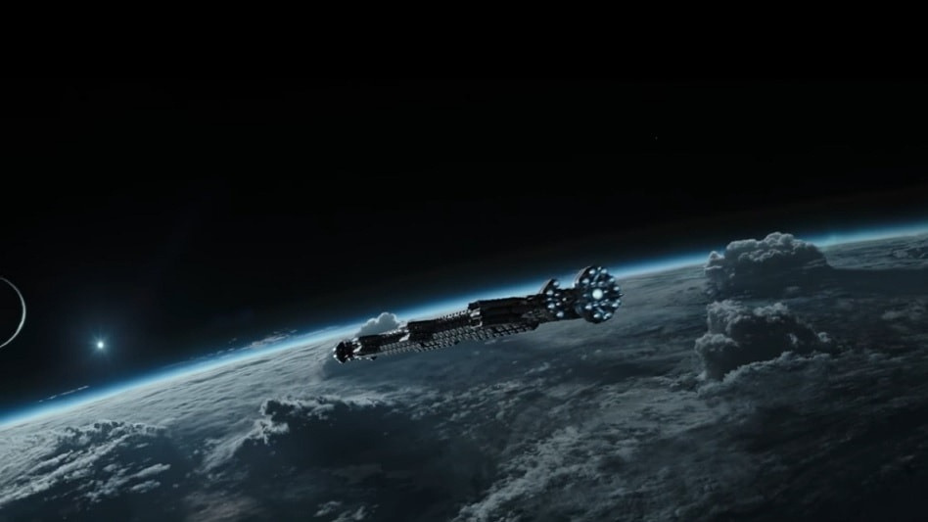
[1] Holocaust Museum Houston, Argentina 1976-1983, https://hmh.org/education/argentina-1976-1983/ (Apr 28 2025)
[2] Maria Trimarchi, 10 Outrageous Experiments Conducted
on Humans, (Feb 27,2024),
https://science.howstuffworks.com/innovation/scientific-
experiments/10-outrageous-experiments-conducted-on-
humans.htm , (Apr 28 2025)
[3] Fandom, Weyland-Yutani Corporation, https://avp.fandom.com/wiki/Weyland-Yutani_ , (Apr 30 2025)
[4] Fandom, Earth, https://avp.fandom.com/wiki/Earth ,
(Apr 30 2025)
[5] Demaso Ezpeleta et al., Transhumanism on Artificial
Intelligence Portrayed in Selected Science Fiction Movies
and TV Series, https://bit.ly/3GF6liB , (Apr 30 2025)
[6] Hon. Katherine B. Forrest (Fmr.), The Ethics and
Challenges of Legal Personhood for AI, (Apr 22, 2024),
https://www.yalelawjournal.org/forum/the-ethics-and-
challenges-of-legal-personhood-for-ai , (Apr 30 2025)
[7] Heather Browning, Jonathan Birch, Animal Sentience,
(Mar 17, 2022),
https://pmc.ncbi.nlm.nih.gov/articles/PMC9285591/ , (May
4 2025)
21
References

Slide 22
[8] Phillip Goff, ChatGPT can’t think – consciousness is something entirely different to today’s AI, https://theconversation.com/chatgpt-cant-think- consciousness-is-something-entirely-different-to-todays- ai-204823 , (May 6 2025)
[9] Bernardo Gonçalves, Modern AI systems have achieved Turing's vision, but not exactly how he hoped, https://www.eurekalert.org/news-releases/1068915, (May 6 2025)
22
References

Slide 23


23
THE
end

