Slide 1
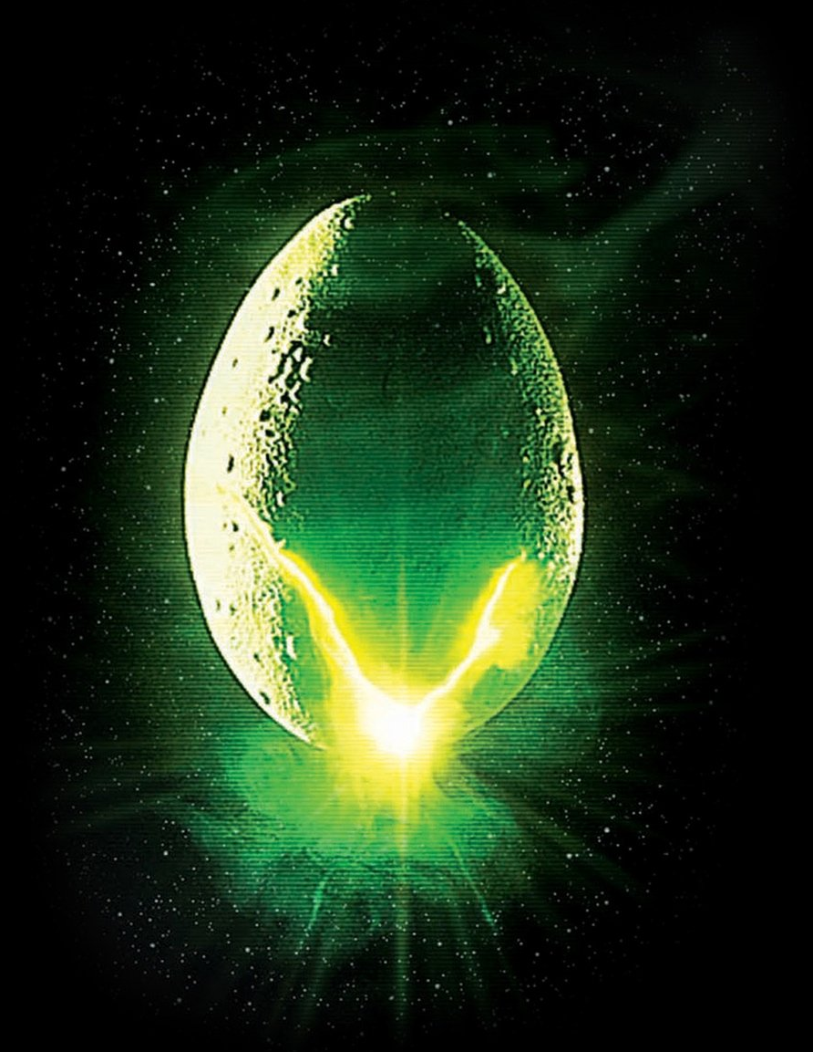
A L I E N
In Space, No One Can Hear You Scream
Connor Flanigan, Chris Hanna, Chris Knapp, Lucas Lebrao, Kerrin Spinney

Slide 2
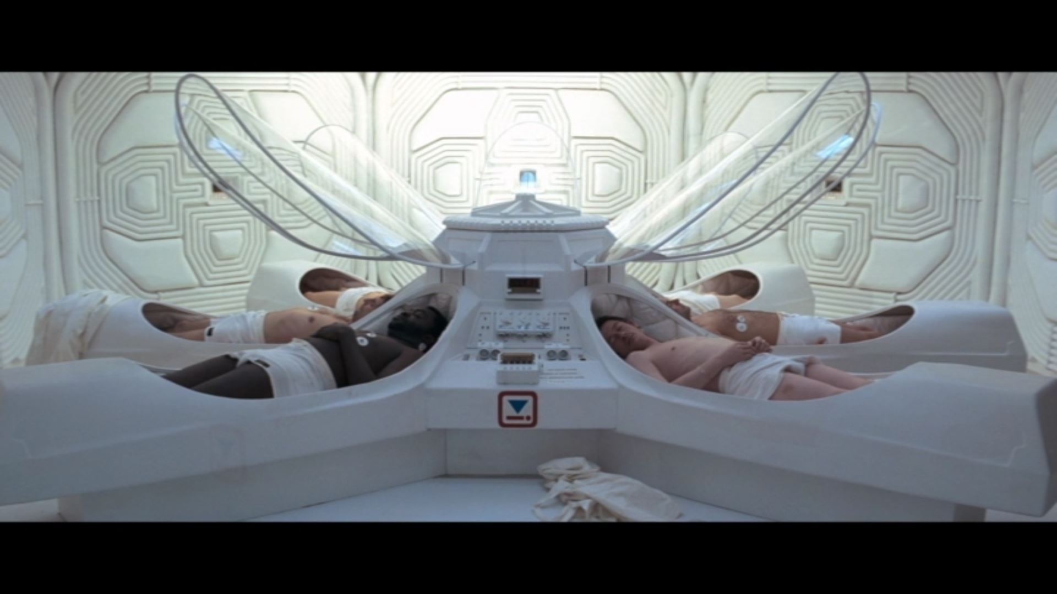
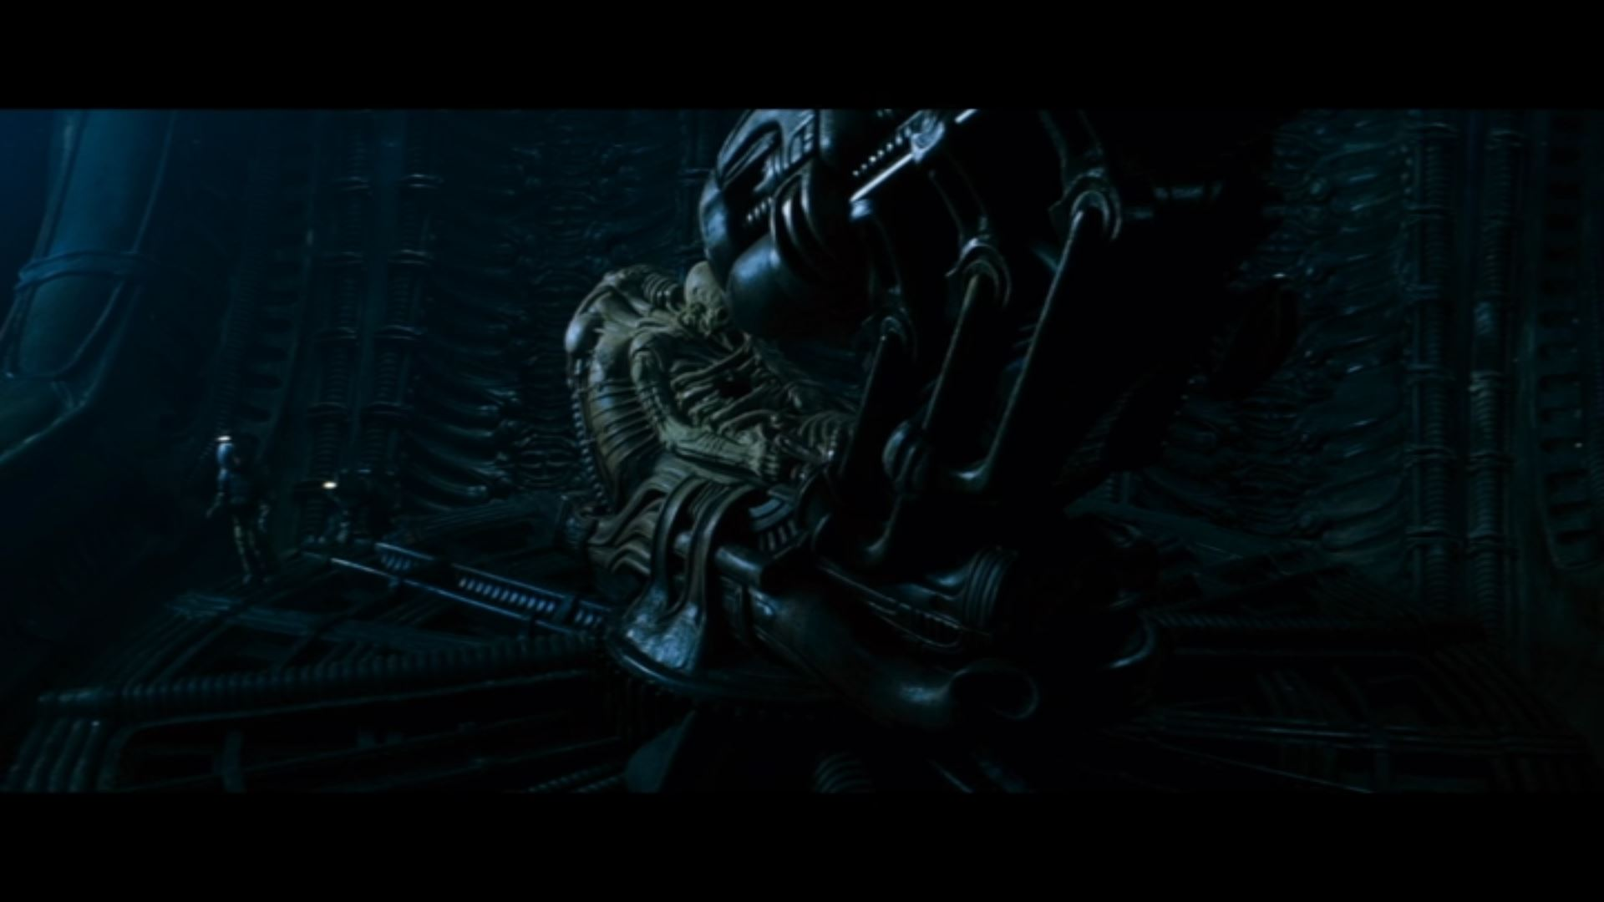

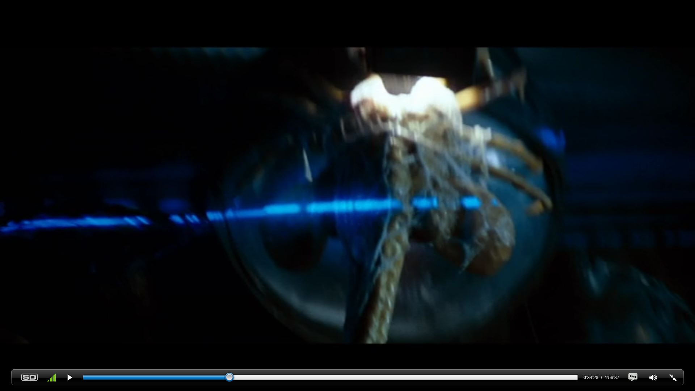
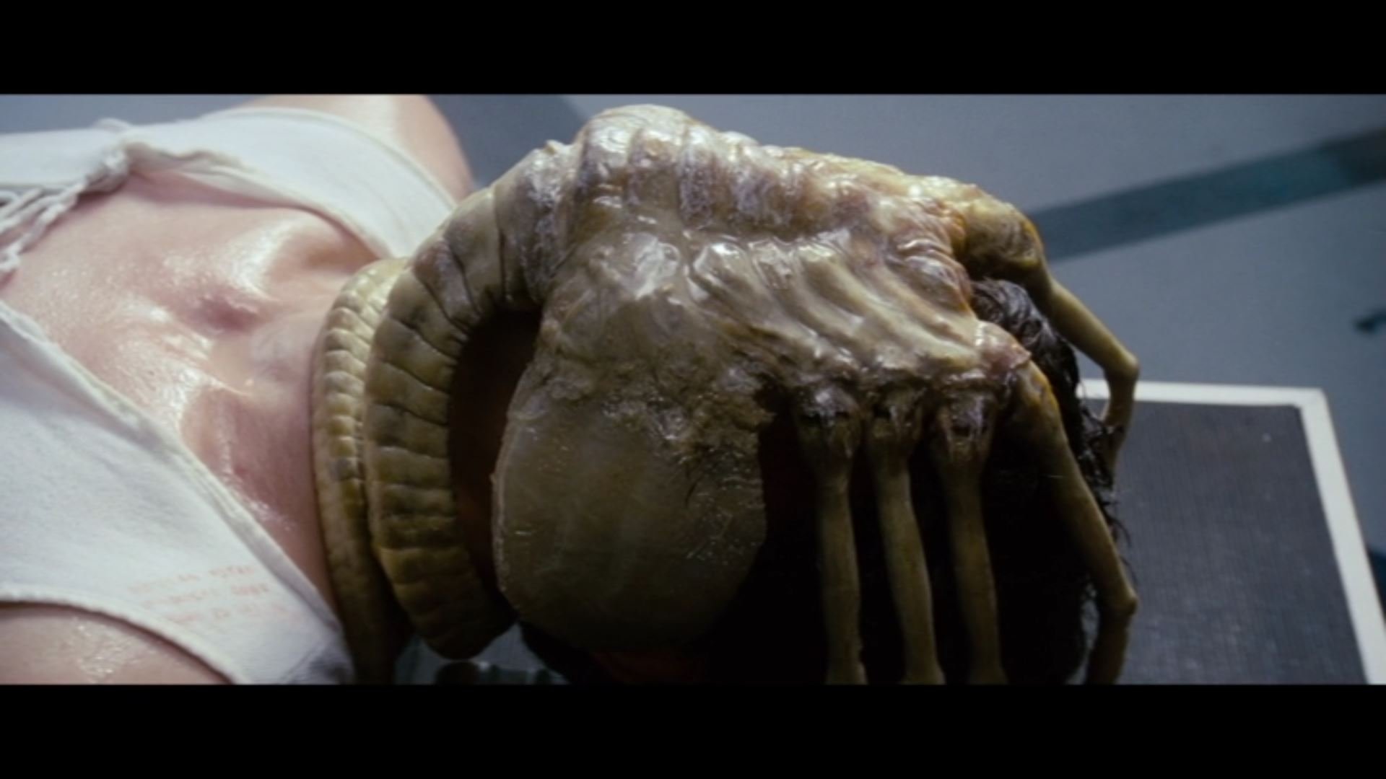
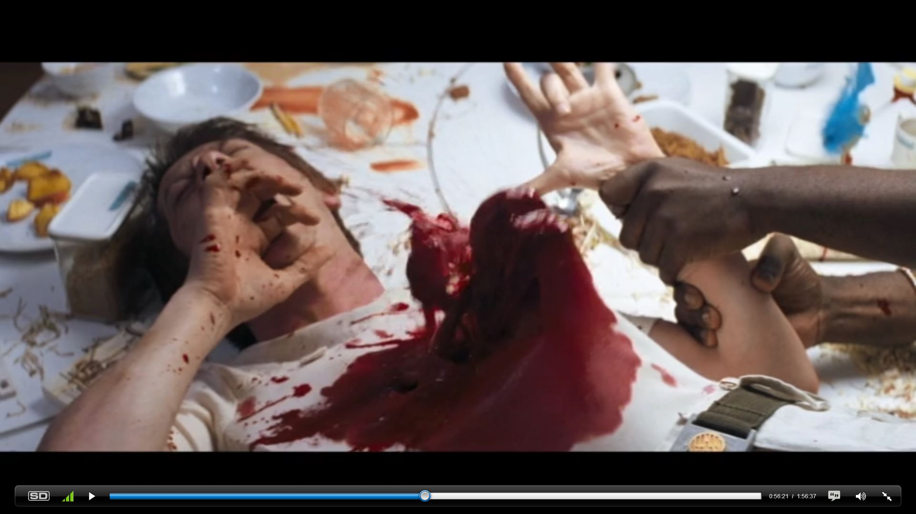
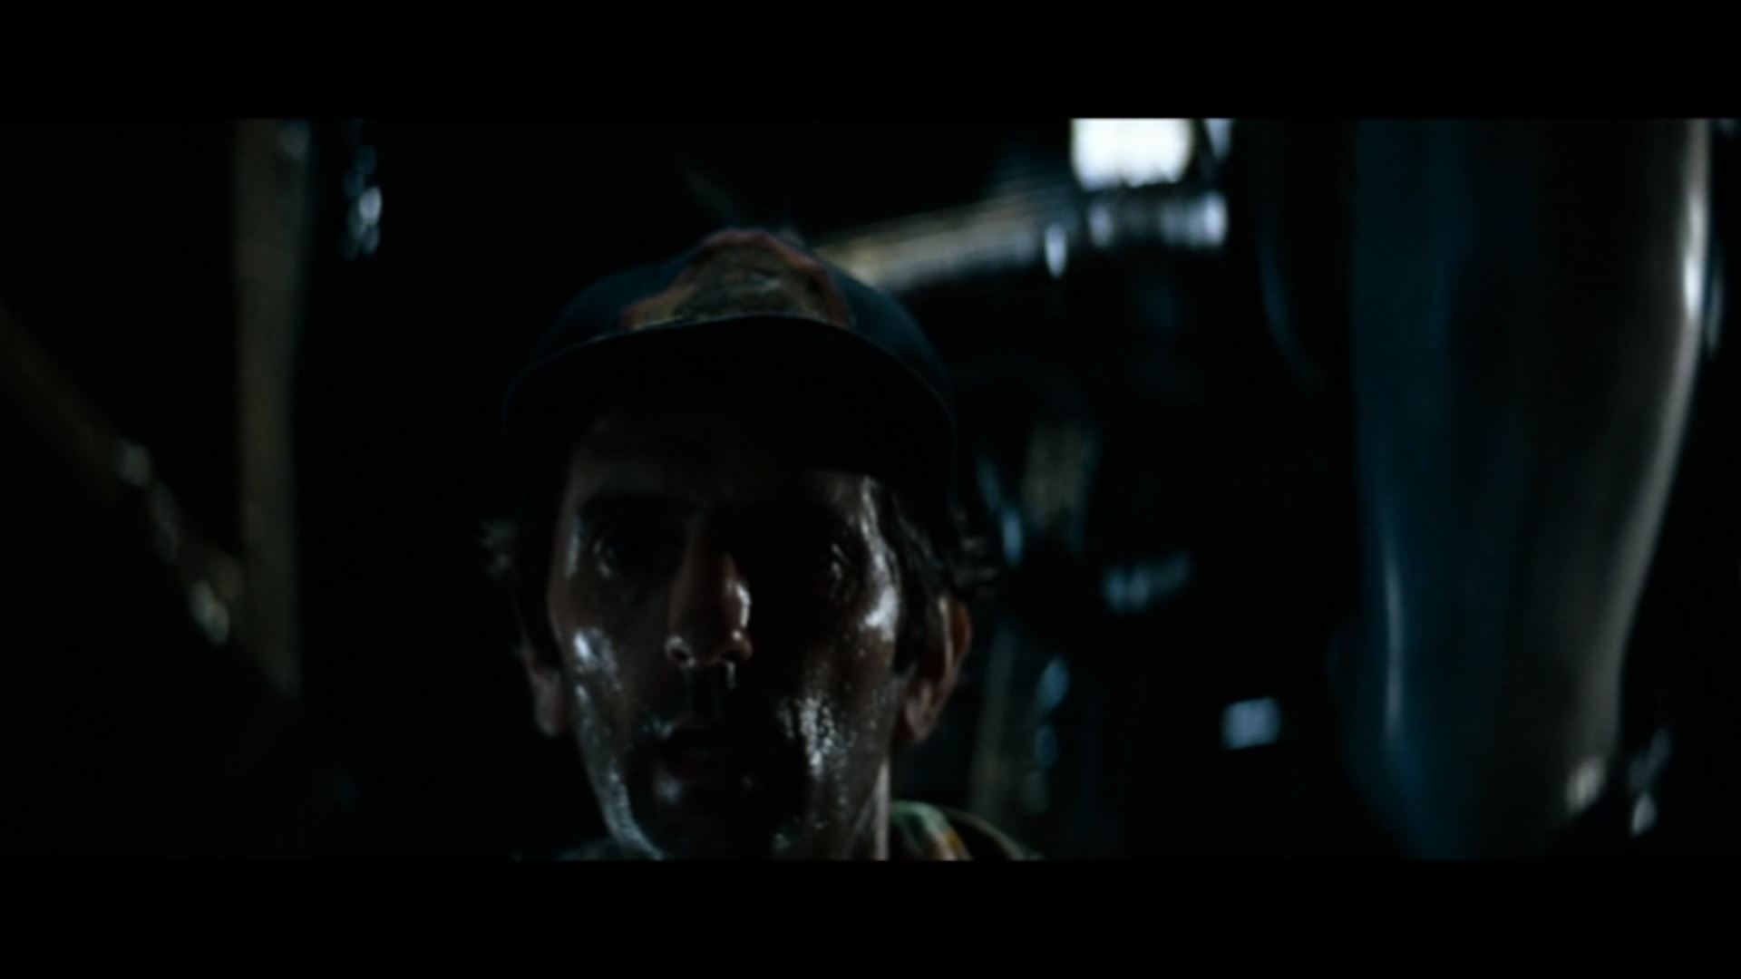
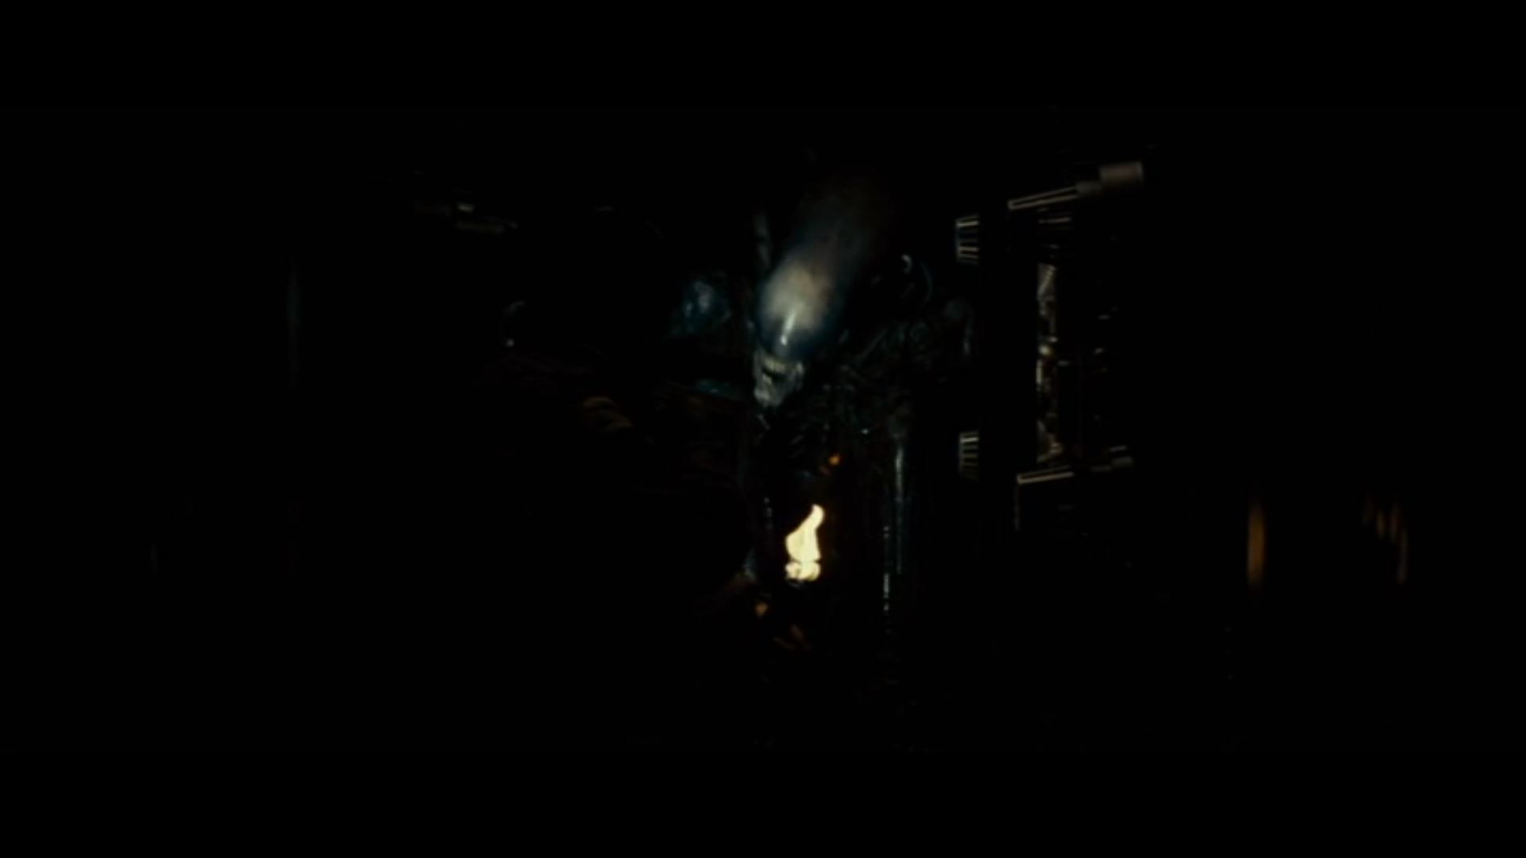
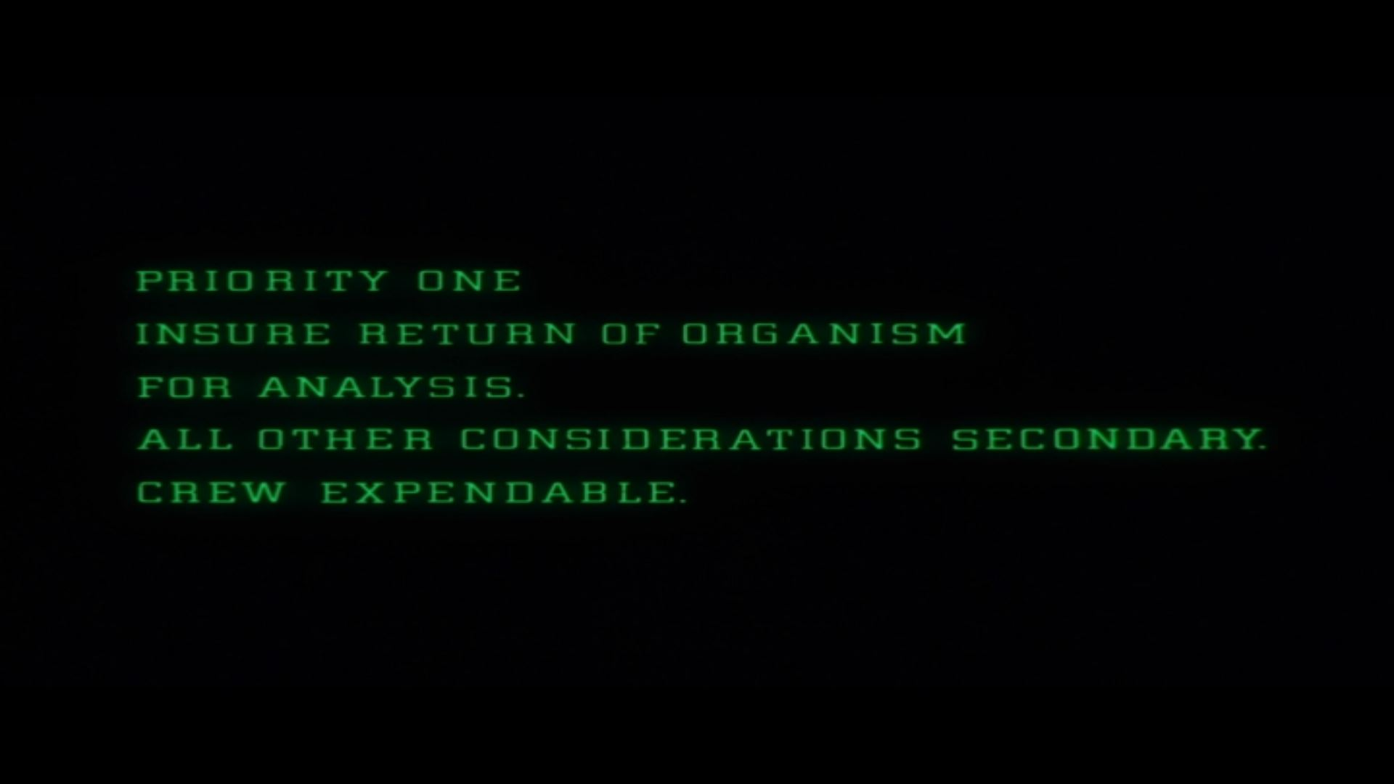
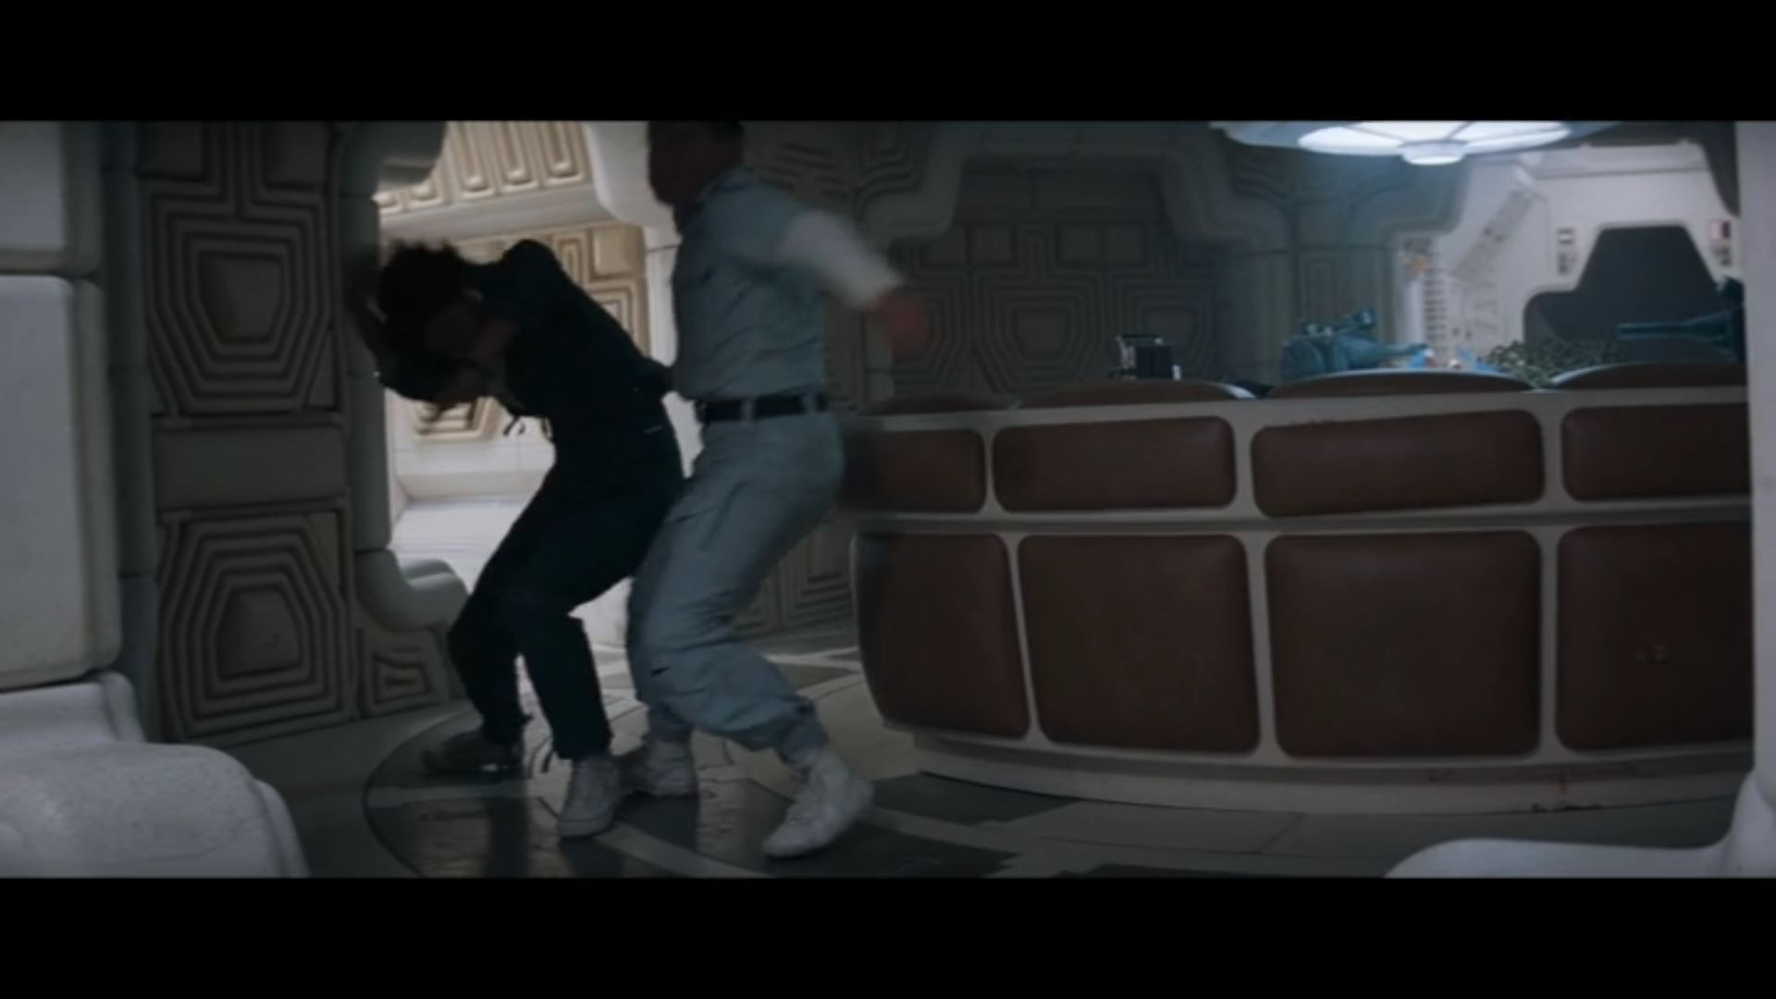
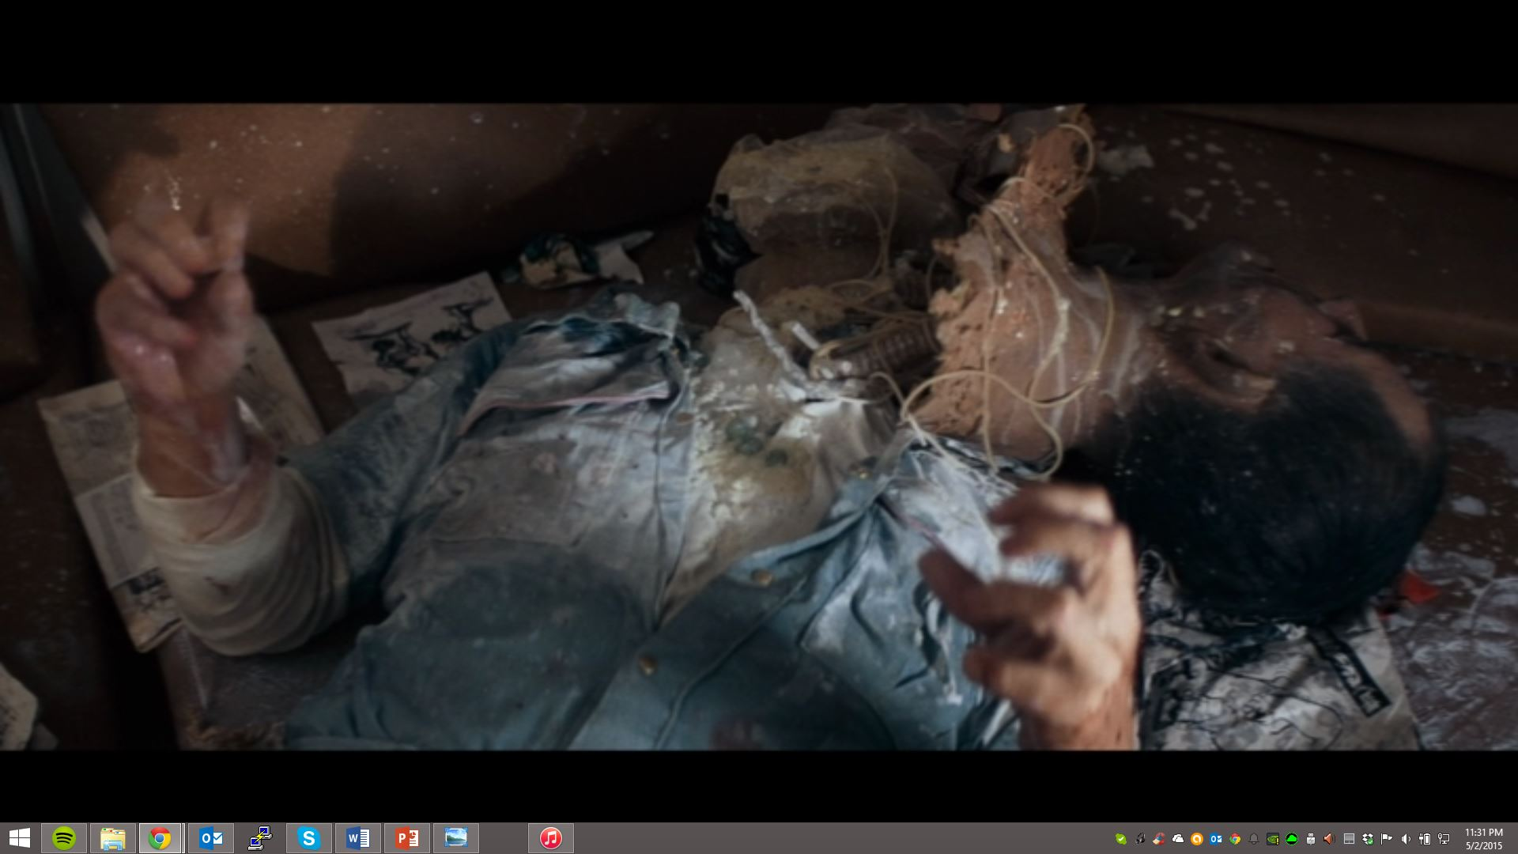
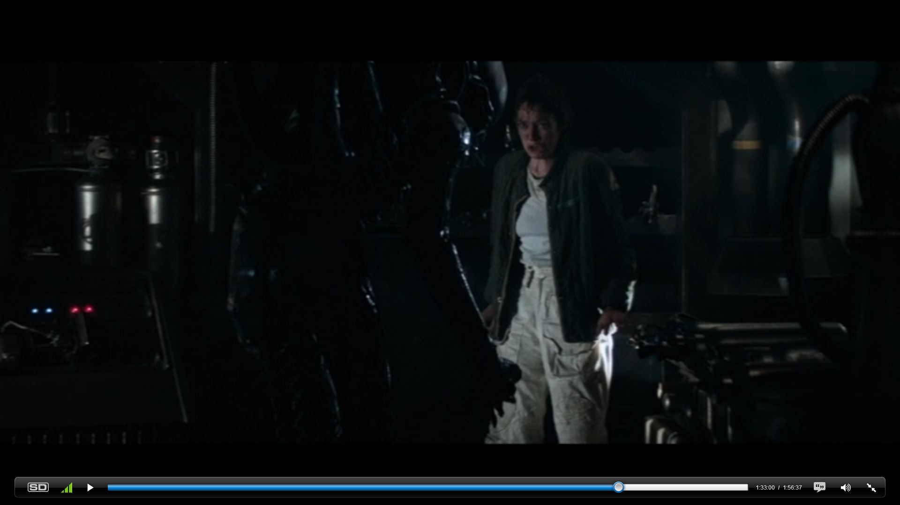
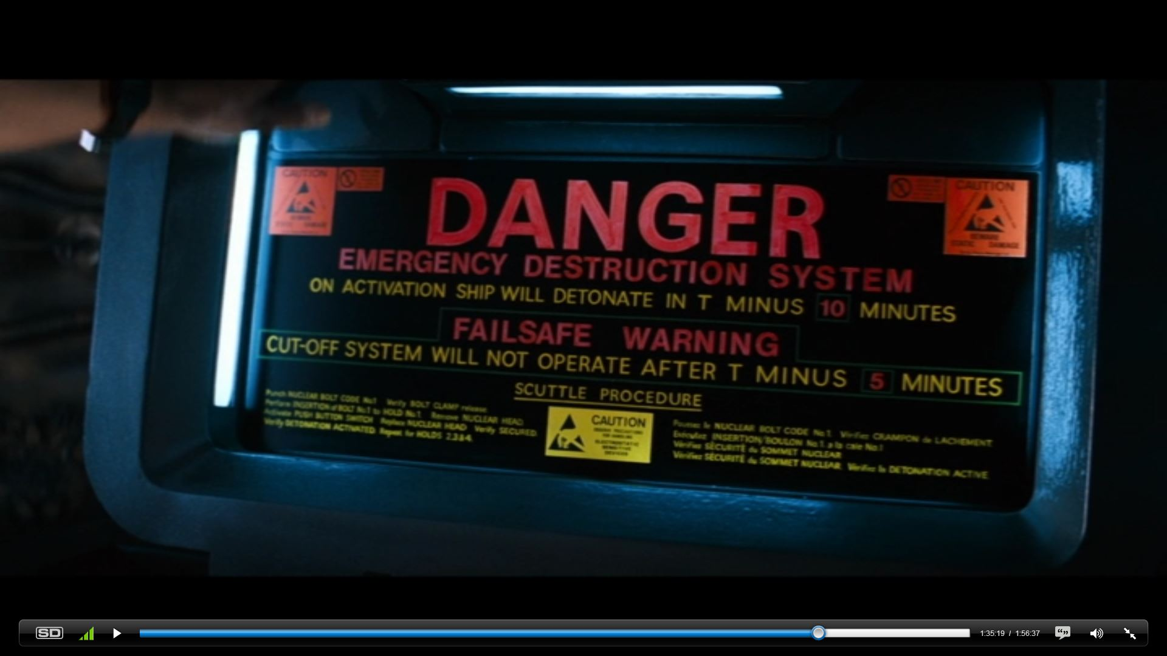
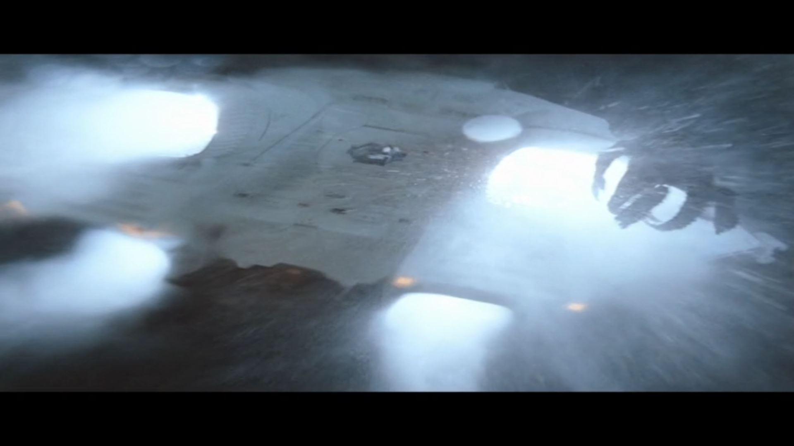
Plot Summary
Notes:
[]Alien follows the lethal adventures of seven space truckers half-way through a two year voyage hauling 20 million tons of ore to Earth.
They detect a signal of unknown origin, which they’re contractually obligated to respond to
They land near the origin of the signal and find an ancient, []alien ship, so they form an away-team to investigate
Meanwhile, Ripley discovers that it’s broadcasting a warning, not a distress beacon
Kane []finds a bunch of large egg sacks and gets a []hug when he gets close to one
Ripley won’t let him back on the ship, insisting that they must maintain quarantine
Ash, however, decides that Kane needs medical help and lets them in anyway
Unfortunately, no matter what they do, []The alien won’t stop hugging
Kane gets left alone while Dallas decides what to do
And when they check back on their patient, Kane awakens, and the alien is dead
They decide to eat dinner before routing back to Earth
But it turns out []The alien was having dinner too, and it escapes
The crew decides to corner it in the vents, burn it, and space it
Turns out it’s better at vents than they are, and it []kills Brett and []Dallas
Ripley, now acting captain, decides to stick to the plan, asks MOTHER for help
[]Turns out MOTHER and Ash were in on it the whole time
[]When Ripley confronts Ash, he loses his head and tries to kill her
[]Parker and Lambert manage to fight him off, and Ash loses his head
Ripley decides to try to fit everyone in the shuttle, now that there are only three of them
[]Lambert and Parker die while gathering supplies, so []Ripley activates the self destruct and grabs Jones the Cat
She abandons the cat when the xenomorph ambushes her and tries to shut off the self destruct to buy time
MOTHER won’t let her disarm the self destruct, so Ripley tries to get back to the shuttle and grab Jones on the way
Ripley gets herself and Jones to a minimum safe distance before detonation, but the xenomorph made it onto the ship, and there’s a bit of a scuffle
[]The alien loses
Ripley and Jones are safe for now, and enter stasis en route to Earth

Slide 3

The Universe of Alien
Truckers in Space_{[7]}
Mega Corporations
Notes:
To be clear, Alien is not Star Wars or Armageddon, or any other kind of space opera. It is not a fantasy story, it is a horror story. The creators of the film gave Alien a wealth of culture in the film, that make it feel lifelike and real to viewers. The characters in the film are nothing more than Truckers in Space, as the filmmakers put it. They work for a mega corporation, transporting some cargo through light years of space. They behave like you might imagine a stereotypical trucker to behave. They mouth off, they dodge responsibilities, and they're rough around the edges. All that being said, they are good at what they do, and they are hardened. Their parent company, Weyland Yutani is a huge company. That is the other important note to make about the world of Alien. In the first film, we only get to see the crew, and everyone works for Weyland Yutani. The company is so massive though, that hardly anyone actually calls it Weyland Yutani. They just refer to it as The Corporation. Its your standard archetype master company, dominating as much as it can. Its purpose is money, and money alone. Those two points together, a money centric mega company, and space truckers, make for a fun and gripping atmosphere to set a horror film.

Slide 4
Conclusion
Alien is a fantastic allegory for the social climate of the 70’s
Alien’s predictions of technology controlling humans and corporations gaining power are becoming accurate
Notes:
Alien is very representative of the culture in the 1970s in which it was made
The movie makes predictions on technological advancements which are turning out to be true in our world today
To start, we’ll provide context by examining the social climate of the 1970s
Alien is a great allegory, especially with the fear surrounding the cold war.
The predictions of companies and tech would evolve is turning out to be accurate, and that is a little unsettling.
To convince you of these two points, were going to look at the decade of the 70’s in regards to a couple of different topics. Then, we’ll look at how those topics show up directly in Alien, and how they were reflections of the time.

Slide 5
Living the 1970’s
Economic Problems
  Deindustrialization of America
  Limits to Growth_{[8]}
Paranoia
  Rise of Consumer Activism
  Watergate
Notes:
During the 70s, Americans became very dissilusioned with institutions which supposedly should have had their best interests at heart
They experienced serious economic problems
10%-15% inflation rate
70% of jobs created at the time were low paying service jobs
The real income fell 2% / year from 1973 –’81
There was a realization that resources were limited – and so was growth. This caused a lot of stress about the future
In addition to economic problems, the consumer rights movement began to demand changes to corporate practices
Since the turn of the century, corporations had been increasing in size and power, and were almost entirely unrestricted
actively fought against unionization and other efforts to introduce regulation
Ralph Nader’s book “unsafe at any speed, the designed in dangers of the american automobiles” brough attention to these issues when it attributed high amounts of car accidents and deaths to poor safety measures in production factories
Social paranoia was also at a high, as Americans lost trust in their government
Congress revealed that the CIA had opened citizens’ mail and listened in to private phone conversations
Watergate scandal destroyed trust in the highest level of government
The red scare (bridges to cold war)
UNFINISHED DRAFT!!!
[Economic Problems] The 1970s was marked by great economical changes, marked by inflation, recession and high unemployment rates [need reference]. Part of this issues arised due to an oil embargo imposed by the Organization of Arab Petroleum Exporting Countries in 1973 [need reference], which in turn led the US citizens see Oil and gasoline prices rising. Alien plays right in these fears by showing the Nostromo returning from a very distant trip to collect 20,000,000 tons of minerals to possibly replace Oil.
LIMITS TO GROWTH!
http://www.colorado.edu/AmStudies/lewis/2010/anxiety.htm#Trends
https://books.google.com/books?id=wG08BAAAQBAJ&pg=PA77&lpg=PA77&dq=1970s+corporate+distrust&source=bl&ots=Zt9COkWtc-&sig=rTymwkjLwZdSofC5qSSO19GGBWE&hl=en&sa=X&ei=z6w-VY__H4busAWe7oDwBA&ved=0CEsQ6AEwBw#v=onepage&q=1970s%20corporate%20distrust&f=false

Slide 6
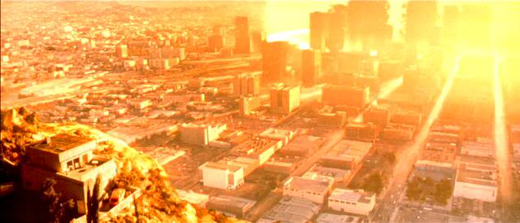
Living the 1970’s
The Cold War
  Threat of annihilation
  Vietnam war
http://bogscifi.forumotions.net/t409-terminator-2-judgment-day-1991
Notes:
-> Cold War
Constant Threat of Anihilation
M.A.D. [Fear of superweapons and two world giants at each others throats and paranoid about it]
Red Scare [U.S. incentivation of fear and search of USSR spies / CIA opening mail, running propaganda]
Cuban Missile Crisis
(DEFCON 3) [ROUND HOUSE – Increase in force readiness above than required for normal measures / Air Force ready to mobilize in 15 min]
(DEFCON 2) [FAST PACE – Next step to nuclear war / Armed Forces ready to deploy and engage in less than 6 hours]
Vietnam War
American citizens lost trust on the government
College Students did not support the war
Massive counter culture movement

Slide 7
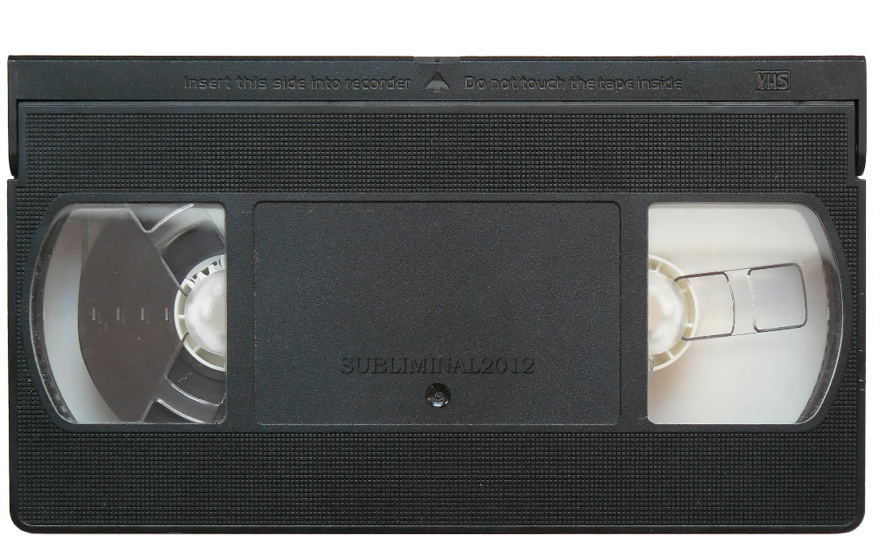
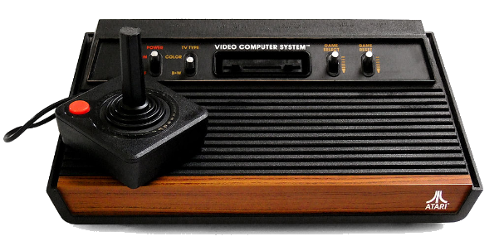
Living the 1970’s
Technological Advances
  Computer based entertainment
  Home computing
http://en.wikipedia.org/wiki/VHS
http://pt.wikipedia.org/wiki/Atari_2600
Notes:
The ‘70s saw a great deal of technological advancement. The decade started with the birth of eMail. The Wang 1200 word processor was developed. The first microprocessor came out. The C programming language was developed. Bulletin Board Systems arrived. This was the decade that technology was embraced by the public. Thanks to microprocessors, people could finally afford to buy personal computers. Admittedly, only hobbyists invested in them at first, but thats where it began. Apple was founded in ‘75 and the Apple II was selling a few years later.
Arcade games were a huge hit as well. The coin-op machine halls were incredibly popular. Atari released a home system in ‘77 called the Atari 2600. It had games like Pitfall, Breakout, Adventure, games that you’ve probably heard legends about, but probably never played. People could play these games in their own homes instead of having to go to arcades. Just a year earlier, the VHS came out, allowing people to watch videos on their own time. Technology was coming into the house. Technology had arrived it seemed. It wasn’t something that was just out there in laboratories and used by the Defense industry. It was there for people to enjoy for the first time.
While people were enjoying all the benefits of home entertainment, there were definitely concerns about how far technology might go. That is mostly evident from the movies coming from that time, and the early 80’s. Terminator came out in ‘84, and if that isn’t the most obvious warning sign of tech-gone-wrong, then I don’t know what is.

Slide 8
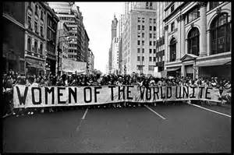
Living the 1970’s
Feminist Movement_{[1]}
  Second Wave
  Body Autonomy and Body Horror
http://womencivilright.weebly.com/significant-figures-of-the-feminist-movement-in-usa.html
Notes:
-> Feminist Movement
Second Wave
First Wave
Feminist Movement goals
Remove social bias over women
Body ownership
Job equality
Divorce
Equal Right Amendment (1923-82) An amendment designed to guarantee equal rights for women, passed Congress but failed ratification by 3 states
Equal Employment Opportunity Commission (1965) Mixed success, no discrimination on employment
Title IX of Higher Education Act (1972) Prohibits discrimination of on the basis of sex in educational institutions
Body Autonomy
Discussion of the liberty to be in charge of one’s own body
Sexuality / Abortion / Rape
Our Bodies, Ourselves
Heavily popular solely through word of mouth
Highly informative on the many truths of the body, sex, life of women

Slide 9
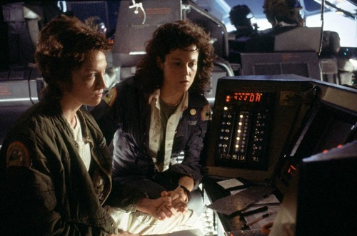
Manifestations in Alien
Feminist Movement
  Ripley
  Body Horror
Notes:
-> Feminist Movement
Ripley
Female main-protagonist
Stood out when attempted to stop Dallas’s scouting group from returning to the probe ship (post-alien infection)
Begins to take a bigger role as people were killed off (round character)
Terribly Human -> BELIEVABLE
Strong, intelligent
Belongs to the crew (wears same uniform)
Suffers from deaths, has insecurities and values a cat under alien death threat
Body Horror
Plays with the idea of birth
Clean, bright, human “birth”: White, controlled environment where crew awakes
Dirty, dark, alien “birth”: Black, mysterious environment where alien “awakens”
Plays with the idea of losing control over their own body
Kane becomes the “mother” to the alien against his own will
Gruesome nature
Smaller aliens were made of organic parts (animal insides)
Actors had no idea of the Dinner Scene

Slide 10
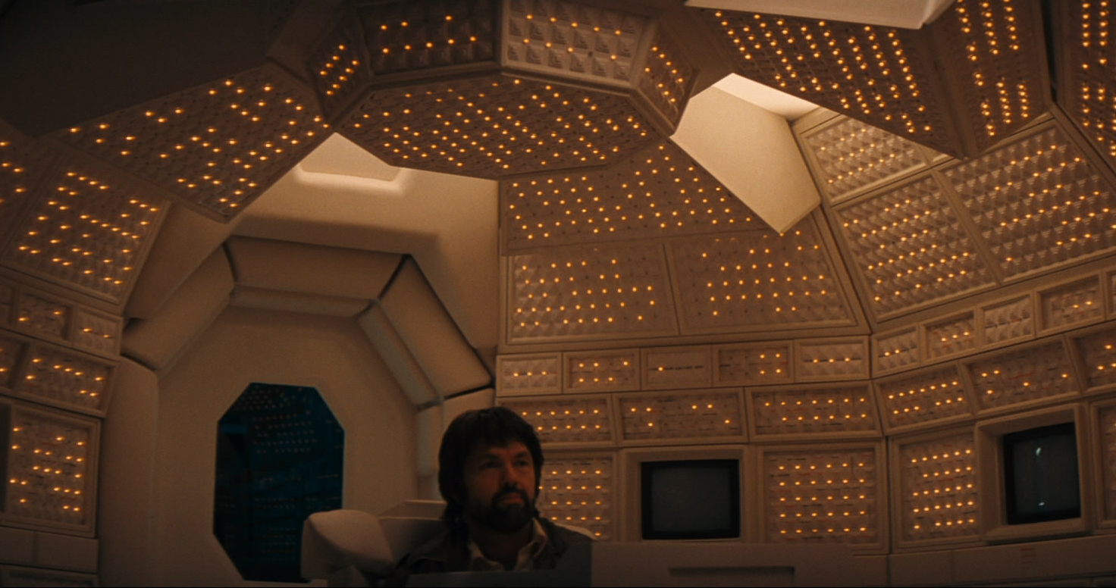
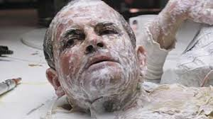
Manifestations in Alien
Technological Advances
  Artificial Intelligence (Mother, Ash)
Notes:
Ash and Mother are both perfect examples of the fear and distrust towards AI and robots, specifically in Ash
Ash passes the Turing Test, fooling the entire crew, shocked that he is an android
Raises questions on what happens when AI can replicate human life to such a degree, where do we draw the line between an AI and a human?
Also demonstrates the fear of AI and robots having control or power over people as both Ash and Mother actively sabotage the crew in order to sacrifice them and bring the alien back to Earth. This is done without the crew’s knowledge, and the information is deliberately withheld from them
Shown through Ash feigning ignorance
Mother refusing to answer the questions asked to her
- To what extent should we entrust ourselves to such AI and robotic systems?
Technology is seen by the crew as a source of safety, yet the whole film demonstrates technology failing the Nostromo’s crew, most notably the Artificial Intelligence that acted against the humans. Both Ash and Mother are different types of AI, where Ash seems to have an Artificial General Intelligence and Mother is slightly less versatile as an Artificial Narrow Intelligence.
Mother’s intended usage, or at least as far as the Nostromo’s crew was concerned, is to navigate Nostromo itself and maintain life support. Secondary functions include awakening the crew in special scenarios and of searching, retrieving, and analyzing data. As a highly important part of the crew’s survival, there is a certain level of implied trust given to the AI; the name “Mother” suggests that it would “care” for its crewmembers. However, its real goal was to follow the Special Order 937 issued by W-Y.
Ash assumed goal was one in common with its fellow crewmates, to deliver a large quantity of minerals to its contractor and gain his shares. But, unknown by everyone Ash actually was an Android that could emulate “humanity”, even if he seemed odd to everyone. His real objective was to bring back the Alien that was to be found within the forgotten spaceship, hence he broke the quarantine Ripley tried to upkeep and signed the fate of the Nostromo’s crew. Lastly, Ash was the Scientific Officer of Nostromo, also responsible of medical obligations, as seen when he was caring for Kane. Which leads to a question of ethics, where depending how advanced Ash’s AI could he be considered human and would be responsible for holding back whatever information was found from the Alien carcass.
Which leads to an important question, very relevant to the 1970s, of how far technology has gotten. The 1970s was marked by the Cold War and the potential usage of nuclear weapons, with countries scrambling to find different technologies to beat the adversary. In Alien, we have a corporation trying to capture a creature which Ash describes as “Perfect Organism” at any cost and use it as some weapon. This coupled with technologies failing to defeat the unknown creature, Alien presents a world where technologies betrays everyone.

Slide 11
Manifestations in Alien
Economic Problems & Corporate Distrust
  Characters are money conscious
  Suspicious and paranoid of W-Y
  Corporations turn out to be evil
The Cold War
  W-Y wants super weapons (Alien)
  Constant fear
Notes:
The Economic problems, poor work conditions, and distrust in corporations that colored the socail climate of the 70s can be seen in alien
the characters of the film are all blue collar workers
and are very money conscious, as well as paranoid that their employers might not pay them what they’re due
Additionally, the attitudes of corporate paranoia come to a head in the film when it is revealed that WT really does not have the crew’s best interests at heart
the company intends to sacrifice their lives to obtain a biological superweapon – the alien
The idea of a superweapon, as well as the feeling of paranoia and isolation within the supposedly safe confines of their ship, are indicative of the attitudes of americans during the cold war

Slide 12
Alien’s Legacy
“Alien isn’t the least bit inventive”_{[9]}
$78 Million Box Offices
Multiple Awards
Cult Fanbase
Notes:
This is all important, because Alien was such a huge success. Its still relevant today
here, note that Alien is wildly popular.
But mention that it didn’t get artistic success right off the start. Some critics didn’t like it when it came out. However, after a few years went by and the hype was still there, critics seemed to change their minds

Slide 13
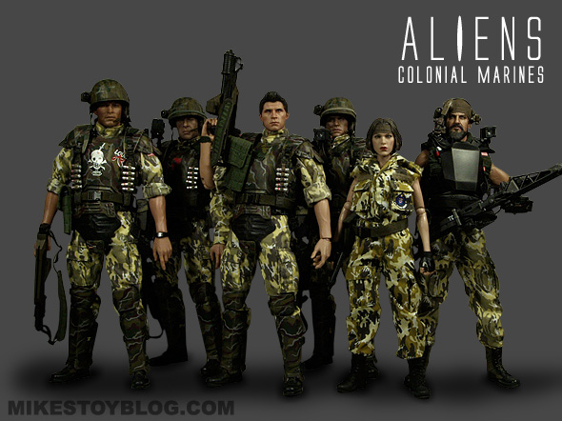
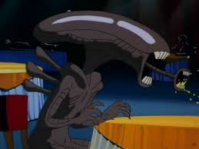
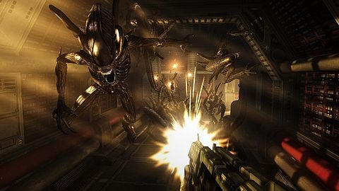
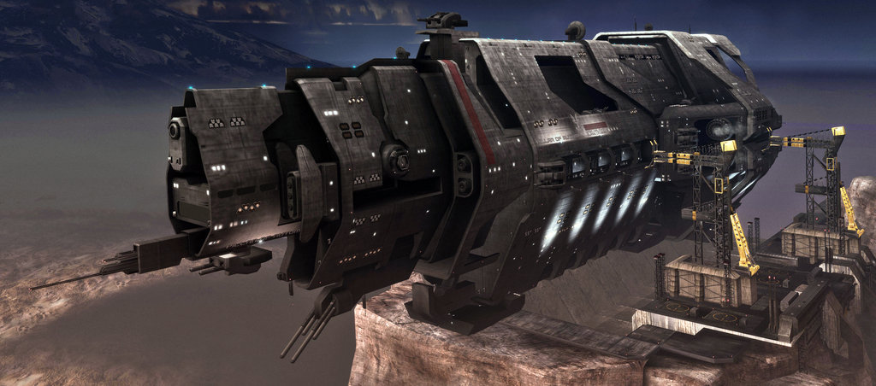
Alien’s Legacy
http://www.minecraftforum.net/forums/mapping-and-modding/maps/1535731-halo-unsc-pillar-of-autumn
http://en.wikipedia.org/wiki/Aliens_vs._Predator_(2010_video_game)
http://www.google.com/url?sa=i&rct=j&q=&esrc=s&frm=1&source=images&cd=&ved=&url=http%3A%2F%2Fwww.avpgalaxy.net%2Fforum%2Findex.php%3Ftopic%3D10900.0&ei=g3pGVbrxD8yMNqrFgWg&bvm=bv.92291466,d.eXY&psig=AFQjCNENg8jOhLTYQu49-77ghxxPEiUOBw&ust=1430768643720660
https://mikestoyblog.com/2014/04/toy-workshop-aliens-colonial-marines/

Slide 14
Alien’s Technology, Today
Narrow A.I.
Computer Controlled Infrastructure
Internet Information
Robotics
Notes:
There are many advancements today in the robotics and AI development field that are in line with the representations of them in Alien
Attempts are being made today to replicate a human brain in its entirety with an AI
AIs being worked on to learn how to learn, teaching themselves independently how to do tasks
One such attempt was successful recently, teaching itself how to play 47 different video games with no prior game knowledge or rules programmed into it.
Hotel opened in Japan staffed almost entirely by robots, except for only 10 human staff
Baxter developed to perform a wide range of manual tasks
Atlas, developed by DARPA to save lives, performs tasks ranging from driving a car, scaling a building, or destroying walls
Mother
Automation
Controls
Travel
Stock Trading
Internet
SIRI, Google Now, Cortana
Net Neutrality
Robotics
Humanoid bots

Slide 15



Mega Corporations
“Corporations are People”
Pop Culture
  Cyberpunk
  Blade Runner
  The Island
  Inception
Notes:
#WAKEUPSHEEPLE
How many people have used a service from Google, Microsoft, or Amazon in the past week?
Inb4 everyone raises hands
It is becoming more and more difficult to go through a single day without using a service provided by a mega corporation
Bleeding into all facets of life that they can reach into
Becoming extraordinarily huge and powerful with a tremendous amount of control
Personal data
Economic superpowers
Also represented in pop culture
Cyberpunk specifically shows distrust fro large corporations, often showing a form of oppression by such an entity

Slide 16
Conclusions
Alien is a fantastic allegory for the social climate of the late 70’s
Alien’s predictions of technology controlling humans and corporations gaining power are becoming accurate
Notes:
State our conclusions

Slide 17
References
[1] Elinor Burkett, "Women's movement - Political and Social Movement",
http://www.britannica.com/EBchecked/topic/647122/womens-movement/216000/Successes-and-failures
[2] Lawnix, "Roe v. Wade - Case Brief Summary", http://www.lawnix.com/cases/roe-wade.html
[3] Olaru, Bogdan. Autonomy, Responsibility, and Health Care : Critical Reflections.
Villejuif Cedex, FRA: Zeta Books, 2009. ProQuest ebrary. Web. 25 April 2015. p45-50.
[4] Lehmann-Haupt, Christopher. "Thinking About the Thinkable." New York Times (1923-Current
File) 13 Mar. 1973: 37. ProQuest Historical Newspapers: The New York Times. Web. 25 Apr. 2015.
[5] Kuhn, Annette, and Guy Westwell. "body horror." A Dictionary of Film Studies. :
Oxford University Press, 2012. Oxford Reference. 2012. Date Accessed 25 Apr. 2015
[6] Rick Wolff, "Capitalism Hits The Fan",
http://www.rdwolff.net/sites/default/files/attachment/4/03Wolff.pdf
[7] The Beast Within: The Making of 'Alien' Dir. Charles De Lauzirika. 20th Century Fox, 2003. DVD.
[8] Meadows, Donella H., et al. "The limits to growth." New York 102 (1972).
[9] alien by Gordon Carroll; David Giler; Walter Hill; Ridley Scott; Dan O'Bannon
Review by: Henry Ladson Cinéaste Vol. 9, No. 4 (Fall 1979) ,
pp. 45-46Published by: Cineaste Publishers, IncStable URL: http://www.jstor.org/stable/42683331
Notes:
To be filled in, there are a bunch.

Slide 18
Questions ?

