Slide 1

21 (2008)
Alex Bolduc, Conor McDonough, Luke Savoie, Andrew Whitney,
and Renee Sawka
[11]
Notes:
Luke
Hi everyone, in this presentation we will be talking about the movie 21. The film follows the story of the MIT blackjack team, who, across a decade, developed a very structured, well rehearsed, and collaborative card counting strategy. Using their knowledge and initiative, they are shown regularly making rounds in Vegas casinos and bringing home substantial winnings, using their powers of mathematical computation and covert signaling to increase their probability of winning hands. Another focus of the film centers around the head of security who monitors the casino floor for unwanted behavior and how his attention is drawn to the MIT team, all while his job is threatened by the emergence of a biometric facial recognition software.

Slide 2
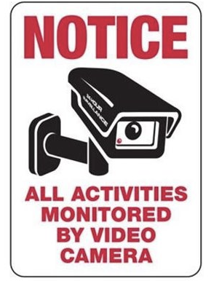
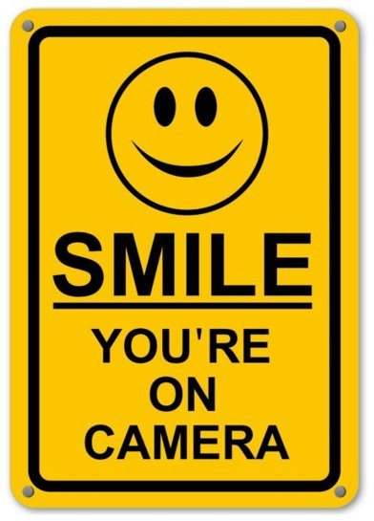
Surveillance promotes conformity
[12, 13]
Notes:
Luke
With a large focus of the movie centering around the monitoring techniques used to identify suspicious behavior on the casino floor, one of the societal conclusions that we drew from this technology is that surveillance promotes conformity. On this slide are some examples of security notices that establishments will post to make their clientele sensitive to the fact that their actions are being watched, which serves to make individuals hyper aware of their behavior. We will discuss this in depth over the next few slides, but as a general premise, the acknowledged presence of security cameras provides a conscious reason for individuals to refrain from attempting to cheat the system, resulting in increased conformity to a set of socially acceptable behaviors.

Slide 3
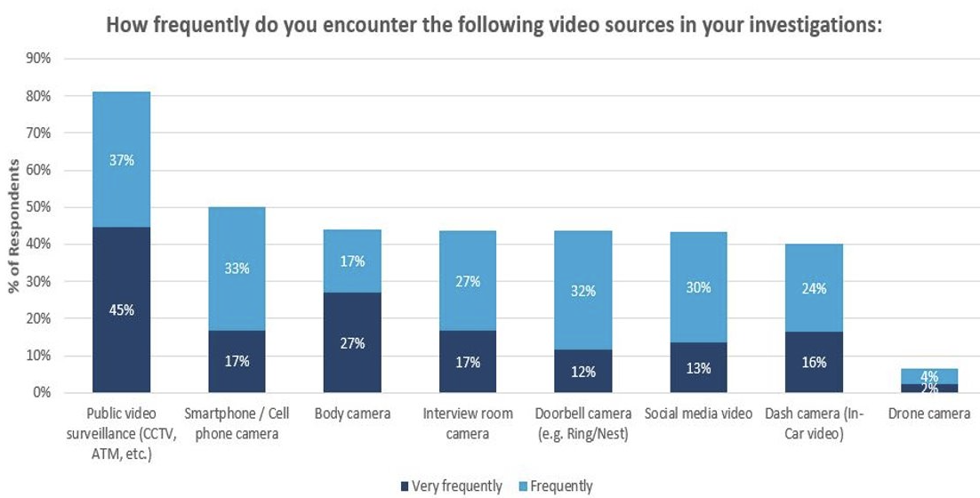
Video evidence is indisputable
Involved in 80% of criminal hearings
  Corroborate witness' testimonies
  Offer further unbiased context
  Typically, always admissible as evidence
Rarely dismissed
  Despite risk of alteration, video is
  inherently more trustworthy
  Evidence vetted before admitted
Figure 1: Law enforcement agents regularly have access to security footage they use to support their investigations [14]
[1]
Notes:
Andrew
One notable feature of surveillance footage is just how powerful it is and not just in the context of sheer computing ability, but also as a means of evidence. While the average human with 20/20 vision can see in detail up to around 20 feet away, standard cameras can capture up to 70 feet and more powerful ones can see up to 700 feet in high resolution. Additionally, they have the ability to record and store every last detail for incredible durations of time, while humans have more difficulty recalling specifics and tend to remember events subjectively.
These combined abilities of being able to replay unbiased footage and analyze it in greater detail than the naked human eye makes surveillance the ultimate tool for evidence. As supported by the graphic, video evidence is presented in around 80% of all criminal court cases, so if one were to commit a crime they greatly risk the odds that their actions were captured on film whether it be official CCTV footage or just a passerby on their phone.
Additionally, video evidence captures a concrete and accurate representation of the events that occur and is therefore commonly seen as bulletproof in the court of law. Because video evidence must go through a seemingly thorough vetting process to ensure its authenticity and relevancy, once it is admitted and accepted into evidence there is a very low chance that it is overlooked. The knowledge that this form of evidence is rarely dismissed by a jury or judge encourages ideal behavior of those being surveilled, as they are cognizant of how if they are observed doing an illegal activity there is little chance for vindication.

Slide 4
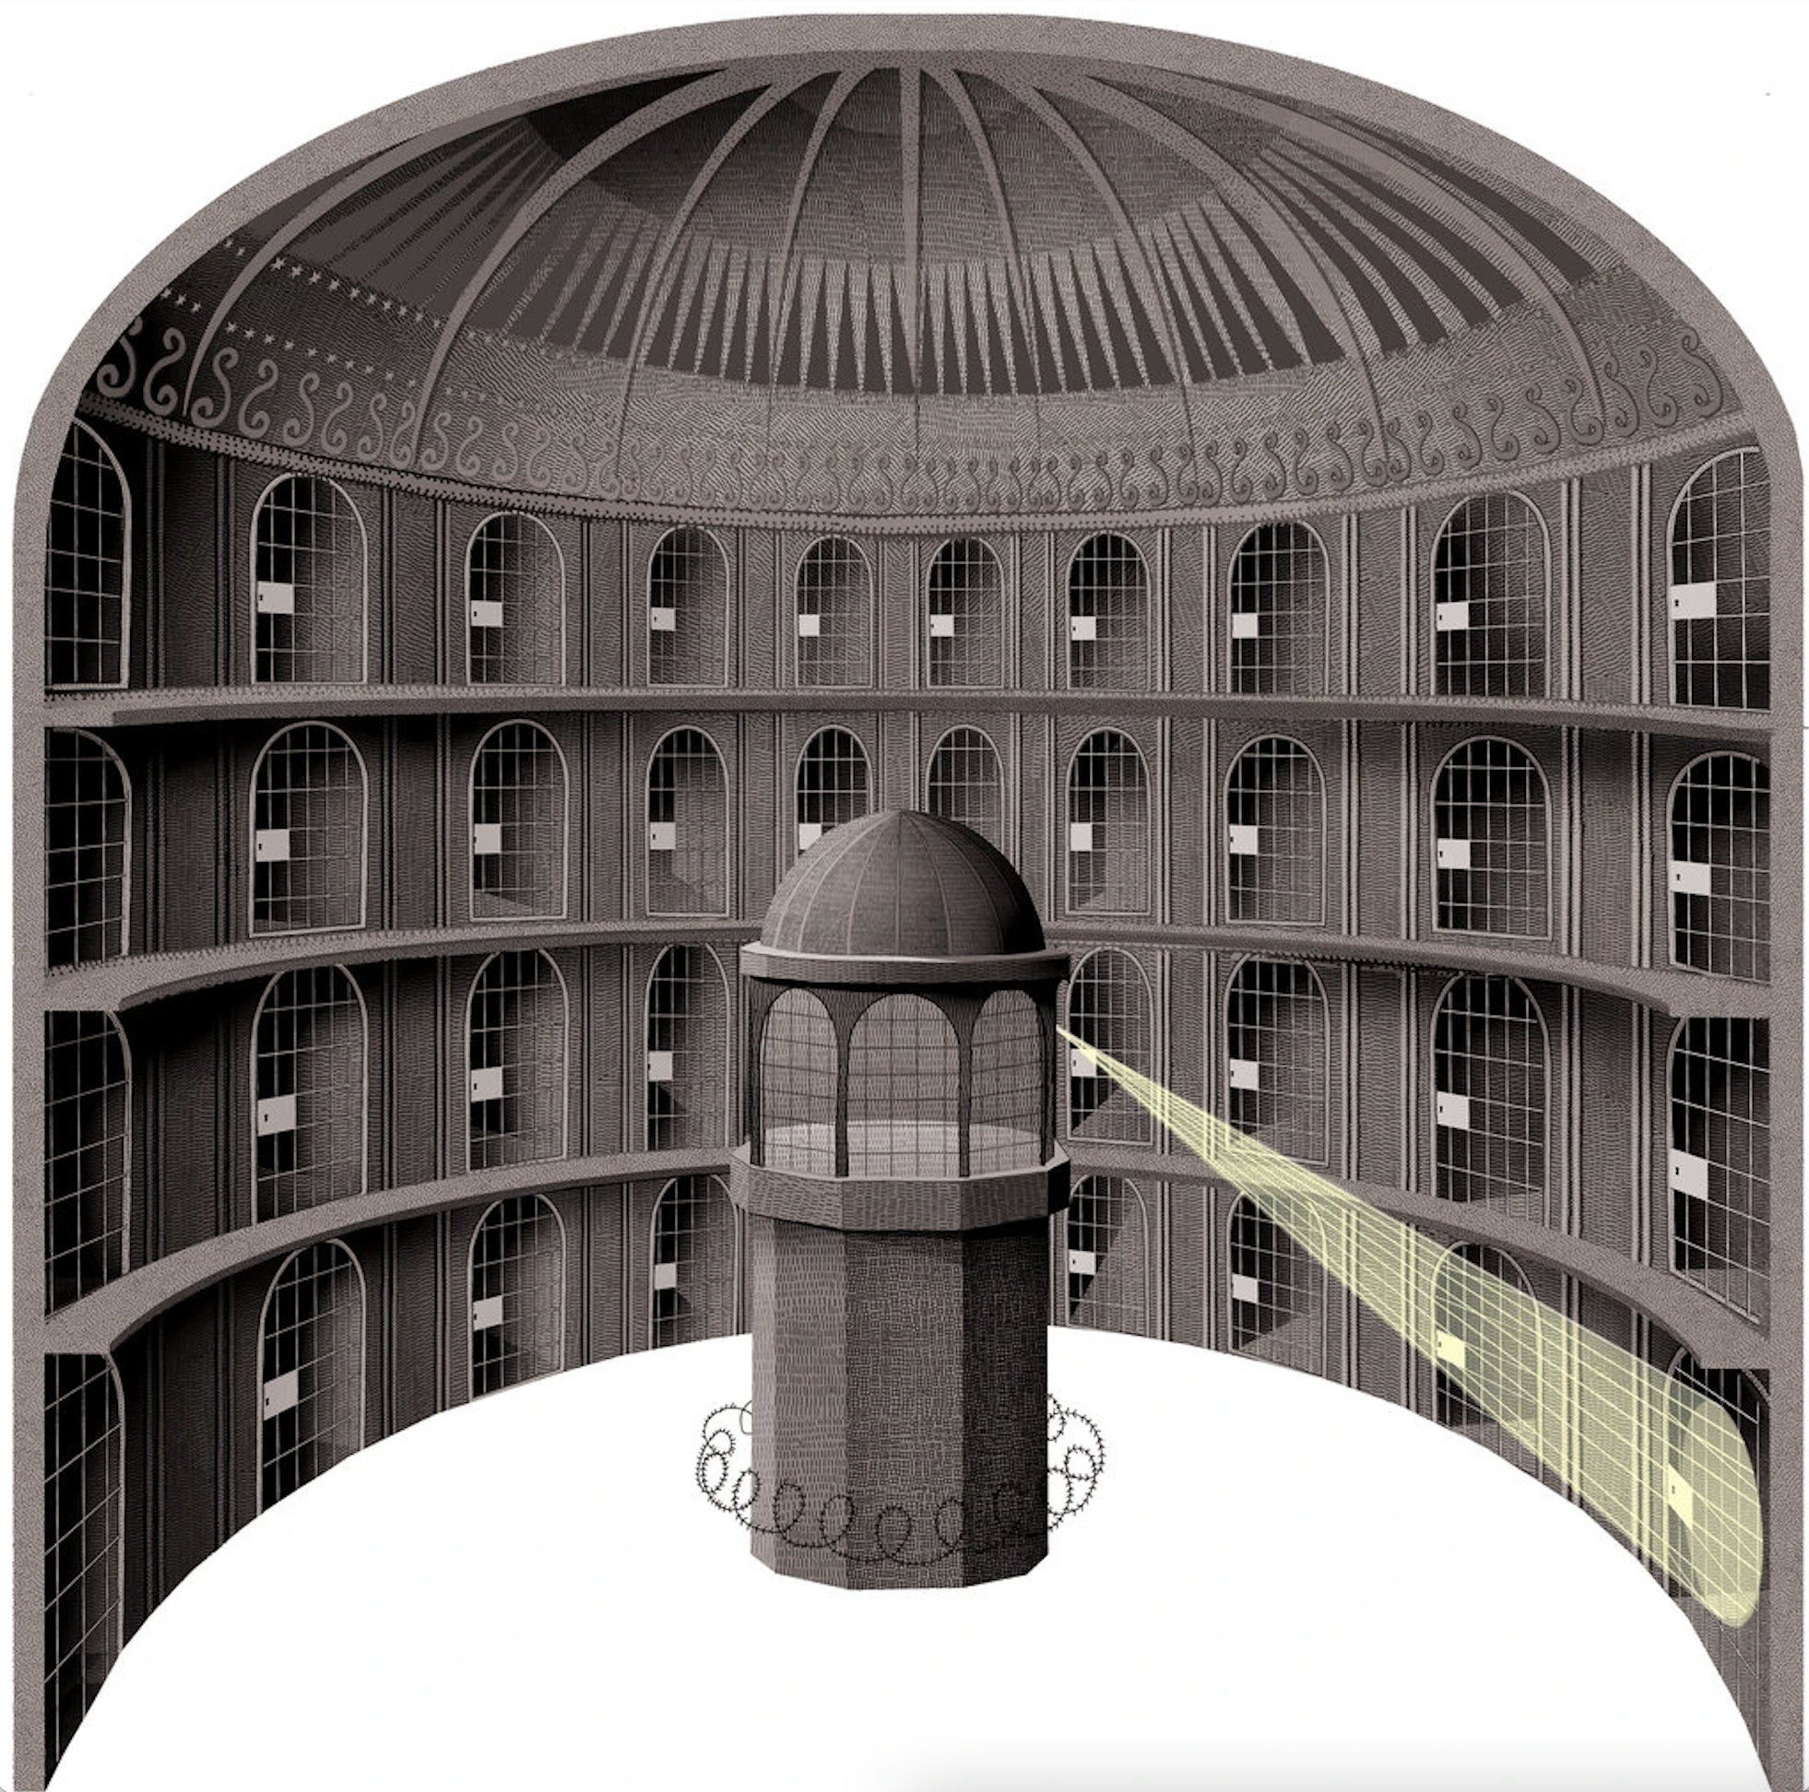
The feeling of constant observation
Panopticon encourages hypervigilance
  Plays on feeling of self-importance
  Immensely conscious of stakes at hand
  Intuitively inclined to behave
Promotes ordered society
  Puppeteers individuals
  Leads to self-policing
  Surveillance capitalism in casinos
Figure 2: Inmates never know where the spotlight is and thus naturally assume it is on them [15]
[2,3]
Notes:
Renee
As loosely suggested in the previous slide, people are innately more inclined to behave acceptably if they know their actions are being watched. This theoretical construct that the existence of surveillance promotes is known as panopticon and was introduced in the nineteenth-century by philosopher Jeremy Bentham, who is also credited as the founder of modern utilitarianism.
Bentham argued that a perfect prison would look like the image here, having a central control tower where guards are able to see into each and every of the surrounding jail cells, however, the inmates contained in them would not be able to see back into the tower. The architecture of most modern casino surveillance cameras follows this principle, as they are encased in a semi-transparent globe that obscures anyone looking at the camera from determining which direction it is actually focusing on.
Both of these induce a state of conscious visibility and serve to drive people to make the assumption that they are always being watched, which directly corresponds to individuals policing their own behavior. By implementing a system of control that resembles that of big brother authority, the presence of surveillance cameras effectively shapes behavior to fall in line with those that are morally acceptable.
A simpler analogy is to picture an employee in a typical workspace, when their boss is out of the room they might be working diligently yet unconsciously check their personal text messages, however, when their boss is in the room they avoid checking their phone and become hyperaware of their actions, even if nothing they are doing is disobedient in nature. In this situation panopticon would be as though the employee's boss is always in the room and although the boss's attention is not always concentrated on this one given employee, they can't help but feel like they are under intense scrutiny.
As a whole, panopticon assures the automatic functioning of power and manifests Bentham's belief that power should be visible but unverifiable. Such a structure helps maintain order in various establishments, which is why it is very widely implemented in places like casinos where there is a lot of commotion. In addition to being used to discipline noncompliant behavior, casinos also carry out the idea of surveillance capitalism, where by using a panoptic method of monitoring, significant amounts of data can be gathered on each client, which can then be used for targeted marketing campaigns towards different classes of consumers.

Slide 5
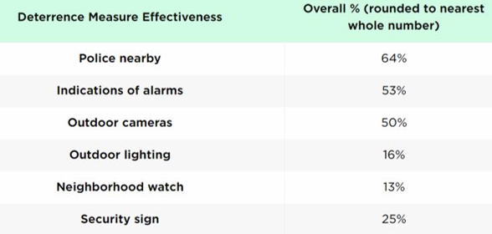
Surveillance greatly decreases crime rates
Halo effect
  Greater security in areas outside of direct camera view
  No evidence of displacement to different area
Criminals do not want to be seen or recorded
  Very few willing to risk consequences if caught
  Psychological barrier
  Cameras do not make crime any harder to commit
Figure 3: The presence of outdoor cameras effectively prevents up to half of all crimes from being committed [5]
[4, 5]
Notes:
Conor
Building off of this panopticon effect, it is a very reasonable argument to make that surveillance naturally lowers the number and scale of crimes. In a study on the effects of surveillance cameras from Urban Institute, 500 cameras were placed in areas around Baltimore, Washington D.C., and Chicago, all three of which have notably high crime rates. The study found that there was a decrease of 30 crimes per month.
While cameras were understandably found to be more effective when paired with another security measure, a 50% baseline reduction in crime is very significant and highlights how many potential perpetrators are deterred by the planning that would be required to bypass this obstacle.
Another study, carried out by the University of North Carolina's Department of Criminal Justice and Criminology, surveyed 422 burglars in the greater North Carolina, Ohio, and Kentucky area. Their findings reported that 60% were deterred from theft after happening upon an alarm, which are tripped by sensors that take advantage of similar motion detection technology that surveillance cameras use to automatically rotate to track movement patterns and focus on specific targets.
As we see in the movie, however, the blackjack team takes numerous precautions such as disguising their appearances and assuming alternate identities in order to circumvent detection by the casino surveillance. However, these characters are highly trained in masking their actions and thus are the exception not the rule. Most individuals would be dissuaded by the mere presence of video cameras, lacking the confidence and skills to stay under the radar.
In summary, by providing indisputable evidence and creating a panopticon effect, it can be said that surveillance conforms human behavior as shown through decreased crime rates in monitored areas. While individuals should naturally be inclined to follow society's moral code, surveillance simply provides a conscious reason for people to do so and self-govern to make sure that their behaviors meet the acceptable standards.

Slide 6
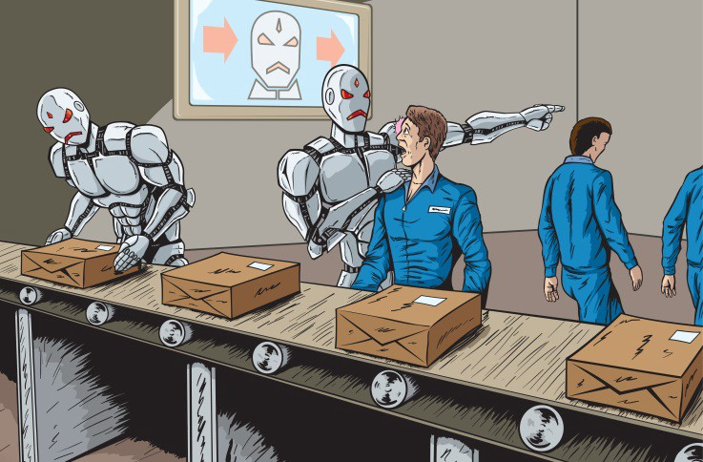
Not everyone is replaceable
[16]
Notes:
Luke
(pause)
Like seen in the movie 21, casino security agents are in danger of being phased out by upcoming biometric facial recognition software that will revolutionize how casinos target marketing campaigns and also identify card counters on the floor. This technology will automatically scan every face that steps foot onto the grounds, comparing it to a database of undesirable clients, in addition to tracking every movement, purchase, and decision. While automated security in this form questions the need for physical personnel, one scene that is particularly significant shows a security agent linking behavior between certain individuals, a collaborative card counting effort that would likely not be picked up even by such advanced technology. This leads us to the second conclusion we will discuss with you today. Not every task can be automated and thus, not everyone can be replaced by a machine.

Slide 7
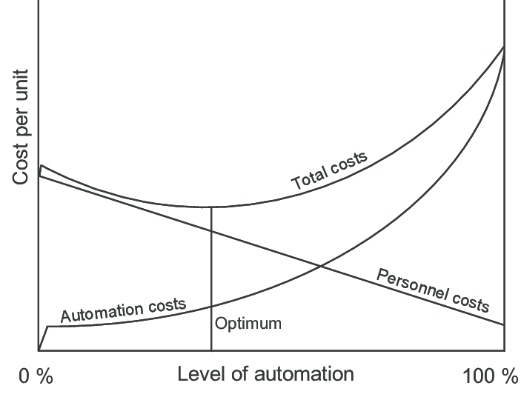
automation is computationally expensive
Automating everything would have low return on investment
  Ideal tasks are high in volume and cost and low in variation
  Takes time, money, and resources to automate
  Late breakeven point
Continuous need to train and re-train
  Avoid bias in data
  Coded Bias movie discusses racial inequity
  with facial recognition
Figure 4: 100% automation sees very low personnel costs, but it takes a long time and significant capital to reach this point [17]
[6, 7]
Notes:
Alex
As industries strive to create lower operating costs and maximize efficiency and developments in automation technology advance, the drive to replace humans with machinery is accelerating at a rapid pace. However, while many are quick to jump onto the "lets automate everything" bandwagon, not a lot of individuals consider the initial capital it takes to get to a point where automation makes everything incredibly efficient and significantly under normal operating costs. Even though automation has transformed into a massive buzzword in recent years, when analyzing how it is implemented in the workforce, it really has only significantly impacted employment in the industrial sector.
Jobs like automotive manufacturing are naturally the ideal candidate for automation to be applied to, as the tasks that are involved are innately repetitive and numerous and therefore easily replicable by a machine. There are indeed many jobs whose primary tasks fall under these same categories, yet the overwhelming majority do not and in that regard it would be counterintuitive to waste valuable resources automating tasks that would take a long time to pay off. One study that we found looked into various technologies' theoretical breakeven points and overall automated machinery averaged to have a 15 year amortization period, which is the gradual time that it takes to write off the initial cost of automation.
Not only does automation require a large capital investment, it also requires a lot of upkeep to make sure that the training data is representative of what the algorithm should use. One concern that nicely ties in to the biometric software presented in 21 is the known prevalence of historical bias in machine learning algorithms that are used for facial recognition technology. The movie coded bias discusses in depth how minorities like females and people of color are often misidentified or not even recognized by the system.
Knowing that facial recognition technology is not at an acceptable standard that promotes equality, it can be argued that it is not quite ready to fully integrate automation. While the technology will surely advance and adapt to more inclusive training data, until certain automated machines can evolve past the point of causing undue harm to individuals in society, they should not be implemented in some fields.
As a whole there are many contributing characteristics that factor into whether or not automation should be applied to tasks in a given industry. While automation is most definitely a positive advancement in a variety of industries, there is an equal number where it is not, demonstrating how not all humans jobs can or will be replaced by machines.

Slide 8
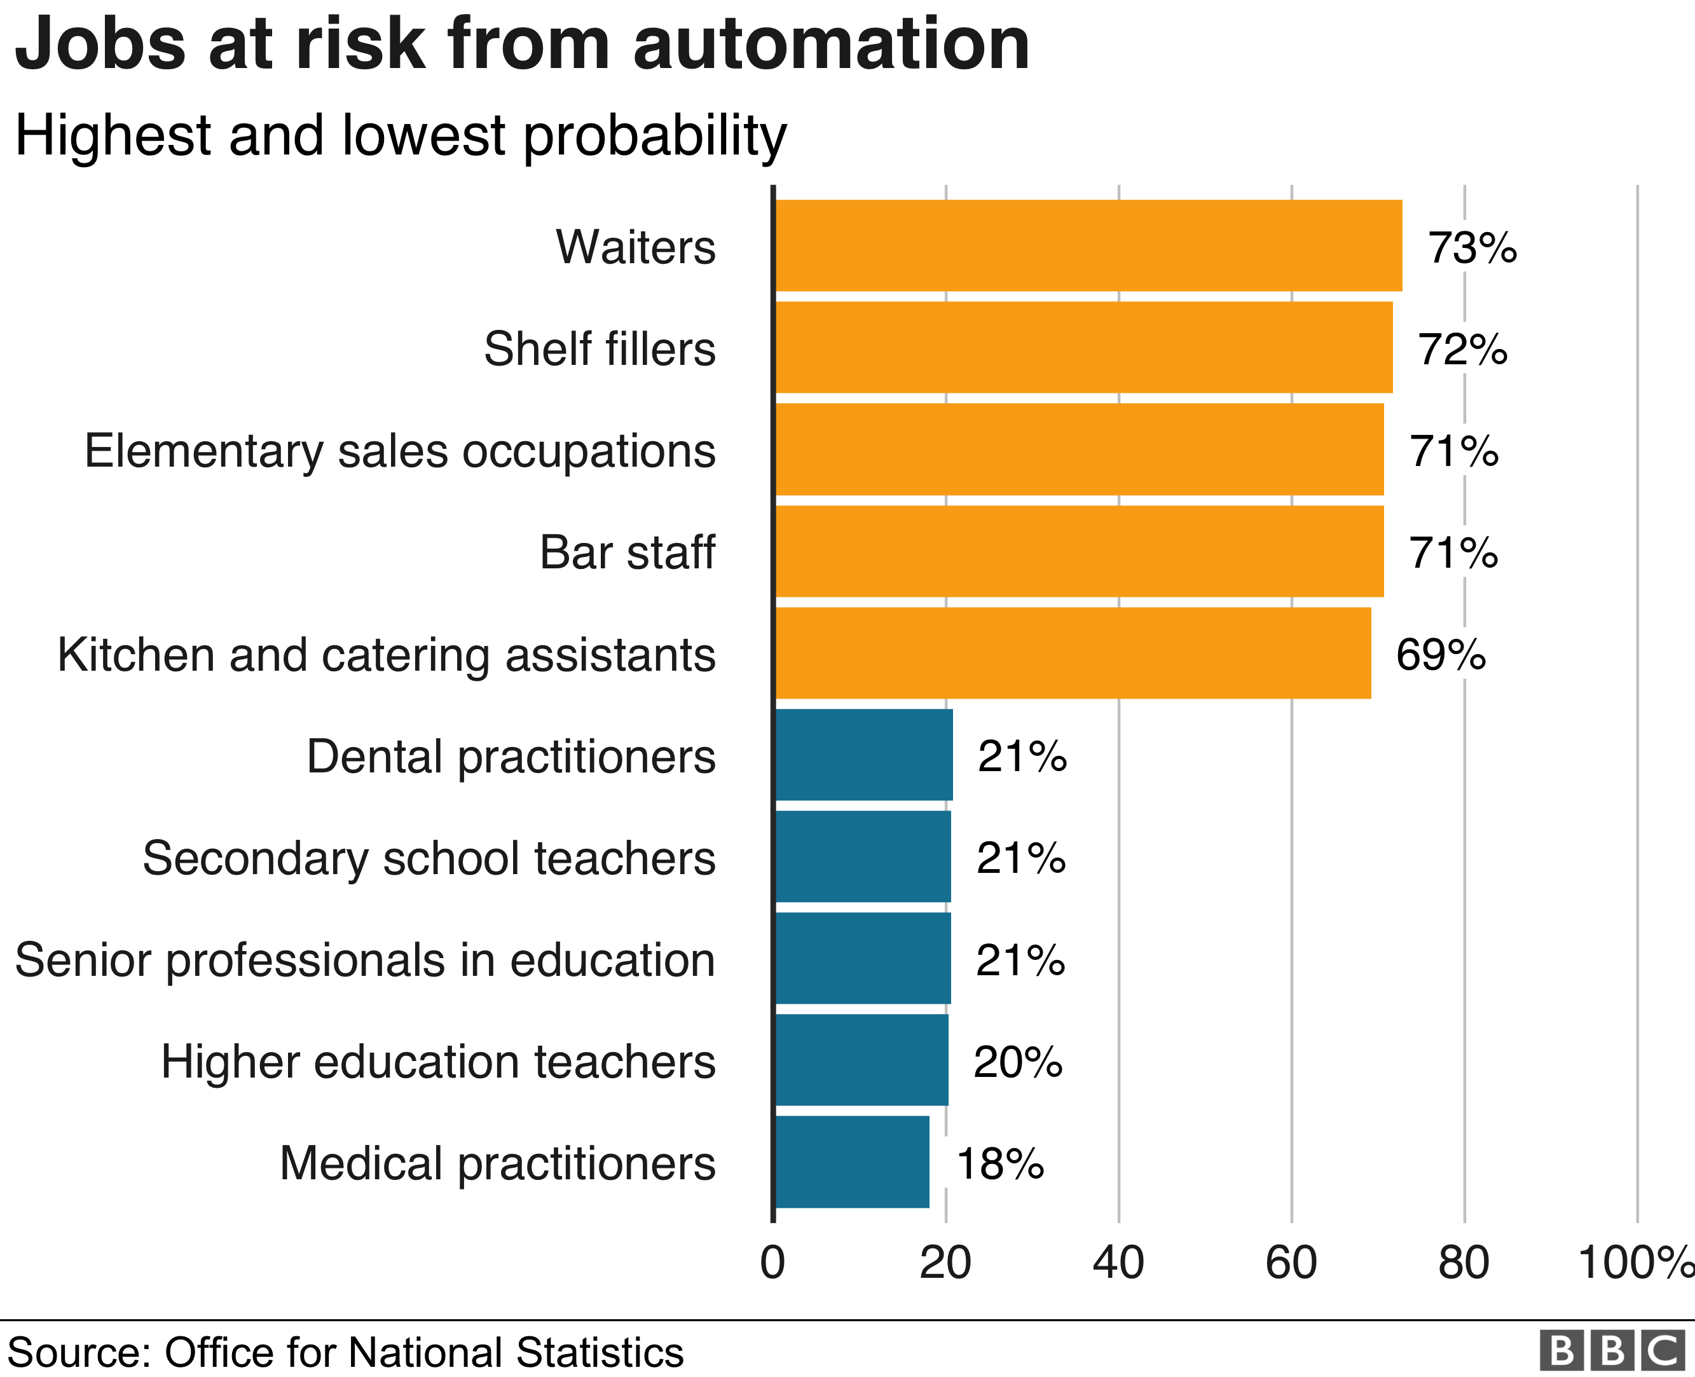
AI can never entirely replace a real human
Intangible 'human element'
  Interpersonal skills
  Decision making and human intuition
  Creativity and leadership
Some jobs can never be automated away
  Doctors particularly surgeons
  Therapists/psychologists
  Professors and teachers
  Athletes
Figure 5: Automation requires predictable conditions and cannot be applied to jobs that have high variability[18]
[8]
Notes:
Andrew
Not only does automation present a challenge in the cost of adopting and implementing the technology, but there are many instances where having an actual human present is critical to an operation. Like we see with Cole Williams in the film, certain abilities are unable to be replicated by a machine, leading us to conclude that overall, automation will merely serve to augment employees. While the concept of full automation is a nice ideal, in reality it is more of an unreachable delusion, since there will always need to be humans involved in some regard.
Skills like critical thinking and adaptability that are required for a multitude of jobs are impossible for robots and software to emulate in any capacity. We mentioned on the previous slide how machine learning algorithms must learn and continuously relearn from enormous training data sets, however, humans are vastly preferable in these scenarios because we are able to learn quickly with little information.
Humans also naturally excel at applying their knowledge and thus have the versatility to handle unforeseen situations. With the current realized abilities of automation, robots are generally unable to respond to unpredictable conditions, rendering them unsuitable for a variety of jobs.
Furthermore, along the lines of creativity and human intuition, automated machines likewise possess no capacity to emit or detect emotion. Artificial intelligence may in some forms be able to detect traces of certain emotions by our body language, but even the most advanced of automated systems will never be able to comprehend human emotions and respond to them in the same way a human can. This translates to jobs like management and human resource officers among some of the others listed on the slide being well protected from automation. The human ability to empathize with other individuals is sometimes overlooked in the automation industry, yet a lot of professions would alienate clients and other employees were they to lose out on the human feel and friendliness that we all appreciate.

Slide 9


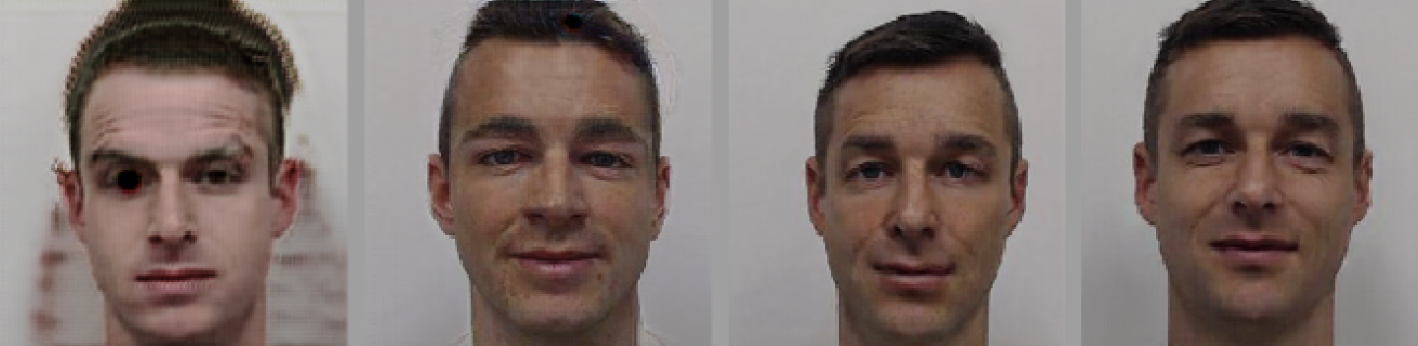
Full Automation has dangerous impliCATIONS
Shift human experience
  Loss of sense of purpose
  Too much freedom
  Society becomes more unproductive
Increased danger of terrorism
  Technology is hackable
  Simple changes to input data interpreted vastly differently by AI
  Attacks not detectable by traditional methods
Real person A Real person b
AI modified images
Figure 6: A faked image that looked like person A to the naked eye was identified as person B by facial recognition technology[10]
[9, 10]
Notes:
Renee
So far we have discussed how creating a fully autonomous world is less than feasible, but in discussing how not everyone can be replaced, it is also important to consider the implications of what a fully autonomous world would look like. One of the well touted benefits of artificial intelligence is assuming roles that perform menial tasks which as a whole provides us with more freedom. Similar to how our class discussion mentioned that the majority of us would not like an extra day off from work, the consequences of automating every imaginable task is that everyone will have to find activities or learn new skills to channel their time towards as a result of their unemployment. Without work, individuals may feel like their lives have lost their overarching sense of purpose.
Not only does automation pose the potential for a dramatic transformation of the human experience, but it also poses new dangers to society. AI systems, like all other technologies, are susceptible to being hacked and a greater reliance on automation brings a greater threat that bad actors will poison training data for adversarial machine learning. In situations like self driving cars or even surgeries if automation reaches some level of adequacy in the medical field, the incredible vulnerability of algorithms could have severe impacts on human lives. With respect to the film 21, facial recognition technology can also be hacked, causing systems to misidentify one individual as another as highlighted by figure 6 where an MIT experiment proved to do just that. This could have significant consequences for criminals, who by altering online photos that are the input data machines are trained on, they can cloak their faces and fool AI systems. This would allow them not only to pursue criminal behavior in casinos but also bypass the no fly list and other law enforcement protections.
In summary of the past few slides and our societal conclusion as a whole, human characteristics are exactly that – human. The same degree that we can interpret emotions, collaborate with others, exhibit manual dexterity, and demonstrate higher order thinking can not be reproduced by automation proving not everyone is replaceable.

Slide 10
References
[1] “Video Evidence: A Primer for Prosecutors.” Bureau of Justice Assistance , U.S. Department of Justice, bja.ojp.gov/sites/g/files/xyckuh186/files/media/document/final-video-evidence-primer-for-prosecutors.pdf. Accessed 6 May 2021.
[2] Felluga, Dino. "Modules on Foucault: On Panoptic and Carceral Society." Introductory Guide to Critical Theory. 31 January 2011. Purdue U. <http://www.purdue.edu/guidetotheory/newhistoricism/modules/foucaultcarceral.html>. Accessed 6 May 2021.
[3]Semple, Janet. “Bentham's Prison.” Oxford Scholarship Online, Oxford University Press, Oct. 2011, oxford.universitypressscholarship.com/view/10.1093/acprof:oso/9780198273875.001.0
001/acprof-9780198273875. Accessed 6 May 2021.
[4] La Vigne, Nancy. 2011, Evaluating the Use of Public Surveillance Cameras for Crime Control and Prevention, https://www.urban.org/sites/default/files/publication/27556/412403-evaluating-the-use-of-public-surveillance-cameras-for-crime-control-and-prevention_1.pdf. Accessed 6 May 2021.
[5] Kuhns, Joseph. “Understanding Decisions to Burglarize from the Offender's Perspective.” UNCC Alarm Industry Research and Education Foundation, doi:10.13140/2.1.2664.4168. https://www.researchgate.net/publication/268444817_Understanding_Decisions_to_Burglarize_from_the_Offender's_Perspective. Accessed 6 May 2021.
Notes:
Luke
That is the end of our presentation so we will now move to answering any questions you guys would like to ask.

Slide 11
References
[6] A. Lawson, "The Economics of Automation --- Some Important Considerations," in IRE Transactions on Production Techniques, vol. 1, no. 1, pp. 34-37, September 1956, doi: 10.1109/TPGPT.1956.1135334. https://ieeexplore.ieee.org/abstract/document/1135334?casa_token=EHXEbjGDtSMAAAAA:QZZ-3gs0DR_N_DjXd1iERvpyzjPmiZUHdDSQZVXHWbYqMB8lcrqlbZ6ty95WK6vdGBp476d0. Accessed 6 May 2021.
[7] Manyika, James. “What Do We Do About the Biases in AI?” Harvard Business Review, 25 Oct. 2019, hbr.org/2019/10/what-do-we-do-about-the-biases-in-ai?registration=success. Accessed 6 May 2021.
[8] "How Robots Change the World.” Oxford Economics. https://resources.oxfordeconomics.com/
how-robots-change-the-world. Accessed 6 May 2021.
[9] Kobie, Nicole. “To Cripple AI, Hackers Are Turning Data against Itself.” WIRED UK, 9 Nov. 2010, www.wired.co.uk/article/artificial-intelligence-hacking-machine-learning-adversarial. Accessed 6 May 2021.
[10] Hao, Karen. “The Hack That Could Make Face Recognition Think Someone Else Is You.” MIT Technology Review, MIT Technology Review, 10 Dec. 2020, www.technologyreview.com/2020/08/05/1006008/ai-face-recognition-hack-misidentifies-person/. Accessed 6 May 2021.

Slide 12
Image credits
[11] Young, Simon. “What Is the Ace's Value in Blackjack.” Twinspires Edge, 14 July 2020, edge.twinspires.com/casino-news/what-is-the-aces-value-in-blackjack/. Accessed 6 May 2021.
[12] “5pk Smile You're on Camera Sign Alarm Warning Stickers Home Car Busines Security for Sale Online.” EBay, www.ebay.com/p/1558306233. Accessed 6 May 2021.
[13] “Home.” Seton, www.seton.com/all-activities-monitored-by-camera-surveillance-signs-l11969.html?utm_campaign=PC-01-Safety%26FacilitySigns_SecuritySigns_Seton_PLA_NB_C_Google_US&utm_source=google&utm_medium=cpc&utm_term=&matchtype=&device=c&adgroupid=Security%2BCamera%2FSurveillance%2BSigns&keycode=WS0287&gclid=CjwKCAjwhMmEBhBwEiwAXwFoEeja6Glh1epC0DJxcaGvr6Vikq9SxCQ2uRG8cw7g5sPy6JnPWVptYhoCw9AQAvD_BwE&gclsrc=aw.ds#L119694BBVPLYVAD. Accessed 6 May 2021.
[14] “Survey Results.” Forensic Video Solutions, 5 Nov. 2019, www.forensicvideosolutions.com/
survey/. Accessed 6 May 2021.
[15] Shone, Tom. “Surveillance State.” New York Times, 18 July 2013, www.nytimes.com/2013/
07/21/books/review/the-panopticon-by-jenni-fagan.html. Accessed 6 May 2021.

Slide 13
Image credits
[16] Ruse, Brandon. “5 Automation Challenges Facing Today's Workforce: Salary Loss, Job Automation, Lack Of Data Literacy, & More.” Colaberry Inc., 10 Jan. 2020, www.colaberry.com/5-automation-challenges-facing-todays-workforce-salary-loss-job-automation-lack-of-data-literacy-more/. Accessed 6 May 2021.
[17] Wessel, O., and O. Wessel. “A COMPARATIVE STUDY OF AUTOMATION STRATEGIES AT VOLKSWAGEN IN GERMANY AND SOUTH AFRICA.” The South African Journal of Industrial Engineering, vol. 19, no. 1, 2012, doi:10.7166/19-1-112. https://www.researchgate.net/publication/272689373_A_comparative_study_of_automation_strategies_at_Volkswagen_in_Germany_and_South_Africa. Accessed 6 May 2021.
[18] Bloom, Jonty. “Automation Could Replace 1.5 Million Jobs, Says ONS.” BBC, 25 Mar. 2019, www.bbc.com/news/business-47691078. Accessed 6 May 2021.

