Slide 1

Children of
Men
Alexander Kirkman
Notes:
Xander

Slide 2


Summary
Humanity faces extinction after global infertility leaves the world without children
A former activist, Theo, is recruited to help a miraculously pregnant refugee
The refugee, Kee, is the first woman to become pregnant in 18 years
Kee’s child is seen as hope by rebels, the government, and profiteers alike
As the two journey toward safety, they are pursued by enemies and caught in a collapsing world
Notes:
Xander

Slide 3



Conclusions
Claim 1: AI in Fertility Tech Must Be Regulated
Notes:
Xander

Slide 4

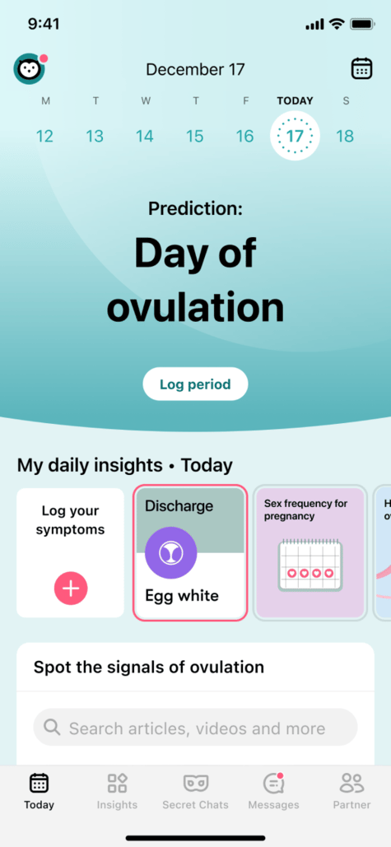

Conclusion 1: AI in Fertility Apps Must Be Regulated
AI in Fertility Prediction Apps
AI fertility apps ( Flo, Ovia) collect intimate reproductive data
FTC found Flo shared data with Facebook and Google without clear consent. [1]
Despite claims of confidentiality, these apps have monetized intimate data for advertising. ​[2][3]
Notes:
Xander
- Flo and Ovia use machine learning to predict fertility windows based on user-input health data.
- In 2021, the FTC found that Flo Health shared sensitive reproductive data with Facebook and Google analytics without proper user consent.
- Due to the limited regulations, apps monetize user health data for advertising and analytics.
- Users often unaware of how much data is being collected and used.
- Children of Men shows a society where fertility is surveilled and politicized.
- Parallel: Private health becomes public control and bodily autonomy is lost.

Slide 5



Conclusion 1: AI in Fertility Apps Must Be Regulated
Corporate Use of Reproductive Data
Fertility platforms (Carrot, Progyny) collect and analyze reproductive data [3]
Companies ( Apple, Facebook) offer egg freezing as a benefit.[5]
Data used to create HR dashboards: predicts pregnancy risk, retention, etc. [4]
Notes:
Xander
-Reports suggest that fertility benefit providers (e.g., Progyny) may collect data on reproductive intent and share it with employers.
-Companies like Facebook and Apple offer to cover the cost of egg freezing for female employees, often framed as empowerment.
-This encourages women to delay motherhood for corporate productivity, subtly influencing reproductive choices for workplace gain.
-Employers may pressure decisions that benefit productivity within a company.
-Computing tech enables predictive analytics : automated HR bias.
-Children of Men parallel: Pregnant woman becomes a political asset.
-Individual choices are reduced to coorprate strategy.

Slide 6


Conclusion 1: AI in Fertility Apps Must Be Regulated
Exploiting Fertility Data
Post-Roe, users fear period trackers may be used in legal cases. [6]
Apps like Premom and Glow lack HIPAA protections. [7]
In authoritarian states, surveillance already target reproductive behavior
Notes:
Xander
-In the U.S., the overturn of Roe V Wade raised fears that fertility and menstrual tracking data could be used to prosecute abortions.
-Apps like Glow and Premom have been criticized for failing to meet HIPAA standards, putting users at risk.
-fertility data can be used to deny insurance, increase premiums, or criminalize choice.
-In authoritarian regimes, digital surveillance of reproductive behavior is already a tool for state control (e.g., Xinjiang, China).
-Children of Men shows pregnancy used to serve national agendas.
-Personal dignity is erased when fertility is treated as a tool of control.

Slide 7
Sources
[1] FTC. “Flo Health, Inc.” (Federal Trade Commission, June 22, 2021) https://www.ftc.gov/legal-library/browse/cases-proceedings/192-3133-flo-health-inc (May 5, 2025)
[2] Consumer Reports. “Period Tracker Apps and Privacy” (Consumer Reports, July 12, 2022) https://www.consumerreports.org/health/health-privacy/period-tracker-apps-privacy-a2278134145/ (May 5, 2025)
[3] Electronic Frontier Foundation. “Reproductive Privacy Requires Data Privacy” (EFF, May 2022) https://www.eff.org/deeplinks/2022/05/reproductive-privacy-requires-data-privacy (May 5, 2025)
[4] Sarah Kessler. “The Egg-Freezing Industry and Workplace Fertility Benefits” (New York Times, June 29, 2024) https://www.nytimes.com/2024/06/29/business/egg-freezing-fertility-benefits.html (May 5, 2025)
[5] Ruth Reader. “Fertility Benefits Are Getting More Expensive, but 69% of Employers Still Invest in Them” (Fast Company, February 13, 2024) https://www.fastcompany.com/91279447/fertility-benefits-are-getting-more-expensive-but-69-of-employers-are-still-investing-in-them (May 5, 2025)
[6] Lauren Goode. “Stardust Is a Period Tracker with Encryption for the Post-Roe Era” (Gizmodo, July 13, 2022) https://gizmodo.com/stardust-roe-v-wade-encrypted-period-tracking-app-abort-1849113572 (May 5, 2025)
[7] Privacy International. “Privacy and Sexual and Reproductive Health in a Post-Roe World” (Privacy International, July 27, 2022) https://privacyinternational.org/long-read/4937/privacy-and-sexual-and-reproductive-health-post-roe-world (May 5, 2025)

Slide 8
Image Sources
Slide 1:
- https://electricliterature.com/i-will-never-watch-children-of-men-the-same-way-again/
Slide2:
-https://popculturephilosopher.com/top-ten-movies-children-of-men/
Slide 3:
-https://www.imdb.com/title/tt0206634/mediaviewer/rm736312064/
-https://www.imdb.com/title/tt0206634/mediaviewer/rm3845587456/

Slide 9
Image Sources
Slide 4:
-https://apps.apple.com/us/app/flo-period-pregnancy-tracker/id1038369065
-https://apps.apple.com/us/app/ovia-cycle-pregnancy-tracker/id570244389
-https://www.babycenter.com.au/thread/5563837/graphic-image-implantation-bleeding-false-positive-make-it-make-sense-please
Slide 5:
-https://www.brickergraydon.com/insights/publications/navigating-artificial-intelligence-in-the-workplace
-https://www.flaticon.com/free-icon/apple-logo_747
-https://www.vecteezy.com/vector-art/18910719-facebook-logo-vector-facebook-icon-free-vector
Slide 6:
-https://thebaccrag.com/staff_name/clara-burke/
-https://www.indiatv.in/web-stories/world/these-are-the-10-most-expensive-fighter-jets-in-the-world-the-price-will-surprise-you-2023-11-07-999992

