Slide 1
Class 3 Ethics
Keith A. Pray
socialimps.keithpray.net
Notes:
How is the first paper going?
What are your topics?
Conclusions?

Slide 2
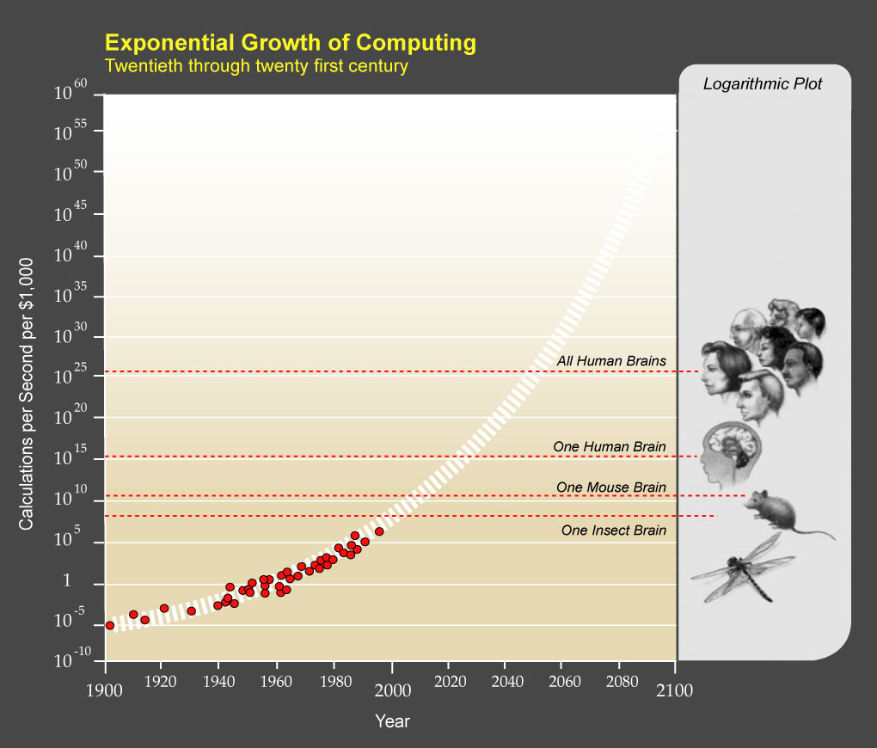
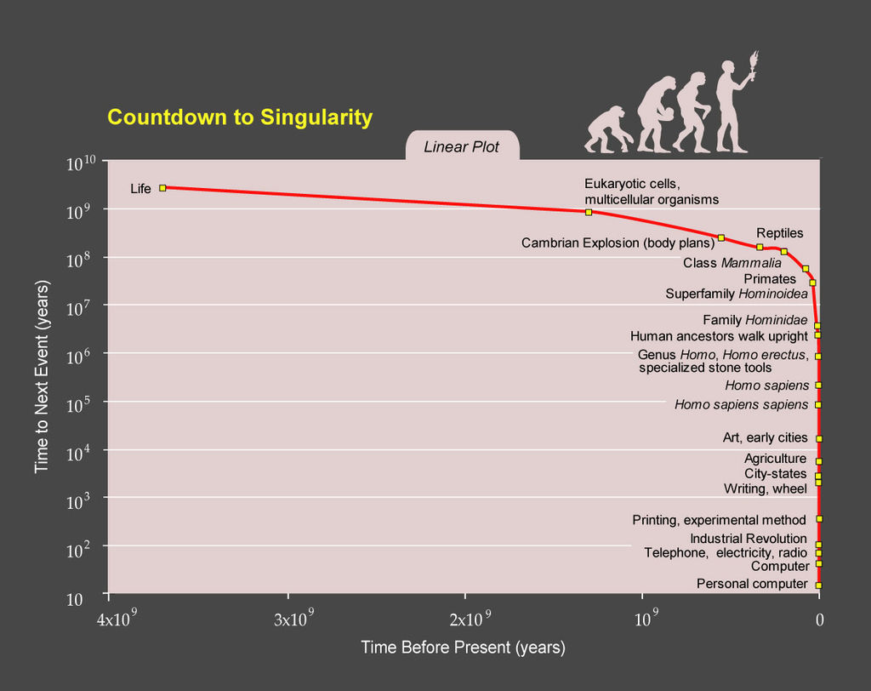
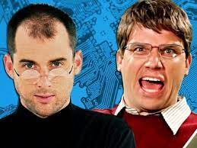
Ray Kurzweil
Notes:
TODO: https://epicrapbattlesofhistory.fandom.com/wiki/Steve_Jobs_vs_Bill_Gates/Rap_Meanings
This puts it a different way:
Show Epic Rap Battles of History: Steve Jobs vs. Bill Gates (2013) (If class ok with crude lyrics) (2:47)
https://www.youtube.com/watch?v=njos57IJf-0
[1] "PPTExponentialGrowthof Computing" by Coutesy of Ray Kurzweil and Kurzweil Technologies, Inc. - en:PPTExponentialGrowthof_Computing.jpg. Licensed under CC BY 1.0 via Wikimedia Commons - http://commons.wikimedia.org/wiki/File:PPTExponentialGrowthof_Computing.jpg#/media/File:PPTExponentialGrowthof_Computing.jpg
[2] "PPTCountdowntoSingularityLinear" by Coutesy of Ray Kurzweil and Kurzweil Technologies, Inc. - en:PPTCountdowntoSingularityLinear.jpg. Licensed under CC BY 1.0 via Wikimedia Commons - http://commons.wikimedia.org/wiki/File:PPTCountdowntoSingularityLinear.jpg#/media/File:PPTCountdowntoSingularityLinear.jpg

Slide 3
Logistics Reminder
Sign up for individual presentations
Great ideas so far!
11 slots still open, 3 disappear March 31st
Worth 10 points
Send me you top 3 movie choices so we can form groups
Email all the course staff, you’ll get a quicker response
Notes:
Hide if N/A
Common Reminders:
Email Etiquette – thoughts?
Extra credit for identifying extra credit opportunities requires you complete the extra credit assignment
Email all the course staff, you’ll get a quicker response
Read Assignment Slides
Sign up for individual presentations
Send course staff email

Slide 4
Overview
Group Project
Review
Ethics
Assignment

Slide 5
Movie Group Project Overview
Explore computing technology portrayed, analyze course topics
Project Web Site
Analyze subject from the prospective of each topic covered in class
Critical Thinking, Ethics, and Professional Ethics are analysis tools, not topics
Presentation
Give arguments for most salient conclusions drawn
We will review group project details at end of class time permitting

Slide 6
Overview
Group Project
Review
Ethics
Assignment

Slide 7
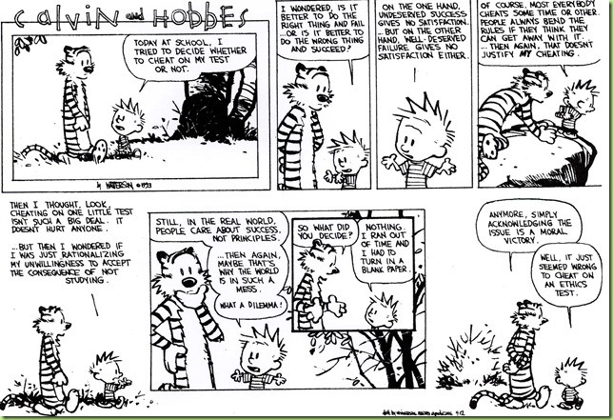

Slide 8
My Reading Notes
pp. 49 Nice quote to start with, previous one was good too:
“No man is an island, entire of itself; every man is a piece of the continent, a part of the main. If a clod be washed away by the sea, Europe is the less, as well as if a promontory were, as well as if a manor of thy friend’s or of thine own were. Any man’s death diminishes me, because I am involved in mankind; and therefor never send to know for whom the bell tolls; it tolls for thee. – John Donne, Meditation XVII , 1624
pp. 54 Self driving car would change example scenario a lot
pp. 56 Does mention of Hitler invalidate the argument? - Mike Godwin
pp. 57 “Instincts were learned…”?
pp. 59 many/any fallacy not mentioned in Appendix B
pp. 65 There’s no expectation the doctor’s practice would suffer?
pp. 69 Is it easier for CS types to use 2nd Categorical Imperative formulation? Am I generalizing or biased for asking?
pp. 79 Insurance companies do it, should they?
pp. 84 Convenience stores rent DVDs?
pp. 92 Case 3 against: minors vs adults, help and education vs. punishment
Notes:
Need to check against new 8th edition:
pp. 94-95 Do most states (#?) have anti-texting while driving laws now?
pp. 99 Good to see using multiple theories to see how many produce same outcome
pp. 106 “… everyone… become… programmer” – Why is this an ethical issue?
End of Chapter questions I liked: 9, 10, 14, 15

Slide 9
Overview
Group Project
Review
Ethics
Assignment

Slide 10
Clarifying Points
Ethical Actions
Based on belief that people are
Rational
Free to choose
Can be
Mandatory
Prohibited
Acceptable
Rights
Negative
Liberties
Often Absolute
Positive
Claim-rights
Often Limited
Usually requires someone else to provide

Slide 11
Ethics Vocabulary
Deontological Theories
A.K.A. nonconsequentialist
Theory/study of moral obligation
Consequentialist Theories
Social Contract Theory
A.K.A. Contractarianism
Virtue Ethics
A.K.A. Character Based Theory
Information Ethics
Greek deon = duty
Emphasizes duty and absolute rules to be followed whether they lead to good or bad consequences.
Kant often primary example.
Rules should apply to everyone.
Good rules intrinsically follow logic. Follow reason not emotion to make decisions.
Treat people as an ends, not solely as a means. Respect for persons.
Notes:
Which formulation of the categorical imperative do you prefer?
Kant’s Axe (1:33)
Published on Nov 18, 2014 – BBC Radio 4
Accessed 2016-09-02
www.youtube.com/watch?v=x_uUEaeqFog

Slide 12
Ethics Vocabulary
Deontological Theories
A.K.A. nonconsequentialist
Theory/study of moral obligation
Consequentialist Theories
Social Contract Theory
A.K.A. Contractarianism
Virtue Ethics
A.K.A. Character Based Theory
Information Ethics
Main example is Utilitarianism.
Increase aggregate utility, value, or happiness. How to measure?
The Happiness Unit: util
“just perceivable increment of subjective wellbeing (or happiness) over a just perceivable interval of time” –Ng (1996) [1]
Watch out for theories going to far; violating rights of a few for the “good” of the many.
Notes:
[1] Ng, Y.-K. (1996). Happiness surveys: some comparability issues and an exploratory survey based on just perceivable increments. Social Indicators Research, 38: 1-29.

Slide 13
Ethics Vocabulary
Deontological Theories
A.K.A. nonconsequentialist
Theory/study of moral obligation
Consequentialist Theories
Social Contract Theory
A.K.A. Contractarianism
Virtue Ethics
A.K.A. Character Based Theory
Information Ethics
Uses rights as basis
Explains people’s selfishness in absence of common agreement
Analysis of moral issues regarding people and government.
Characterization of actions can change outcome of analysis, does not solve conflicting rights.
Are laws based on ethics?
Are all laws ethical?
Notes:
From Wikipedia (TODO: get primary source):
“Consent of the governed" is a political theory stating that a government's legitimacy and moral right to use state power is, or ought to be, derived from the people or society over which that power is exercised.
This theory of "consent" is historically contrasted to the divine right of kings and has often been invoked against the legitimacy of colonialism.
Following John Locke's notion of a nation of "free and equal" citizens, the Founders of the United States believed that consent of the governed was the only legitimate basis upon which one "free and equal" citizen could exercise legal authority over another -- otherwise neither equal could overcome the other.

Slide 14
Ethics Vocabulary
Deontological Theories
A.K.A. nonconsequentialist
Theory/study of moral obligation
Consequentialist Theories
Social Contract Theory
A.K.A. Contractarianism
Virtue Ethics
A.K.A. Character Based Theory
Information Ethics
Stresses character development and moral education, not formalized rules.
What kind of person should I be?
Does this feel right or wrong?
Depends on homogeneous community standards for morality.
Plato and Aristotle, more recently by Alasdair MacIntyre.
Notes:
Aristotle on 'Flourishing’ (2:00)
https://www.youtube.com/watch?v=j_7deR0idvs
BBC Radio 4
Published 2015-03-30

Slide 15
Ethics Vocabulary
Deontological Theories
A.K.A. nonconsequentialist
Theory/study of moral obligation
Consequentialist Theories
Social Contract Theory
A.K.A. Contractarianism
Virtue Ethics
A.K.A. Character Based Theory
Information Ethics
Macroethics – Luciano Floridi [1]
All entities informational → moral value → right to persist
Information = Good
Entropy = Evil
Moral agents: interactive, autonomous, adaptable transition systems that can cause good or evil
Accountability != Responsibility
Notes:
Moral accountability is different from responsibility. Responsibility is current focus of much ethics and certainly law but moving to accountability and managing ethical decisions from this perspective may enable a more inclusive framework.
[1] Luciano Floridi, “Information Ethics,” in The Cambridge Handbook of Information and Computer Ethics, ed. Luciano Floridi (Cambridge, UK: Cambridge University Press, 2010)
“The philosophy of information and information ethics – Lecture” (15:35) https://www.youtube.com/watch?v=s2QLL8WawoQ Luciano Floridi Published 2016-12-19
“TEDxMaastricht - Luciano Floridi - "The fourth technological revolution” (8:50) https://www.youtube.com/watch?v=c-kJsyU8tgI Published 2011-04-06

Slide 16
Group Quiz Scenario 4 in Section 2.1.2
Split into teams of 4
Pick one:
Kantian
Act Utilitarian
Rule Utilitarian
Social Contract Theory
Virtue Ethics
Does your team recommend release next week?
Provide justification (argument)
Ethical Analysis Guide
https://socialimps.keithpray.net/documents

Slide 17
Overview
Group Project
Review
Ethics
Assignment

Slide 18
Assignment
Complete all assigned reading
Work on your individual presentations
Start Group Project work
Review assignment slides
Notes:
Common Reminders:
Send email with your top 3 movie choices after I send out the list to choose from

Slide 19
Class 3 The End
Keith A. Pray
socialimps.keithpray.net

Slide 20
what works well Online With Zoom
Sign in with First and Last Name
Stay muted unless you are going to speak
To speak use the raise your hand feature
To answer yes/no questions use the “yes” ”no” buttons
Turn your camera on
Wait until the end of student presentations to ask questions
Write them down so you don’t forget

