Slide 1
Class 14
Last Days
Keith A. Pray
Instructor
socialimps.keithpray.net
Notes:
This is the loneliest title slide you’ll ever see…

Slide 2
Papers
A Term 2018
3 - Construction
3 - Medical
2 - Everything
2 - Food Prep
2 - Retail
2 - Transportation
1 - Agriculture
1 - Crowdturfing Detection
1 - Cyber Security
1 - Firefighting
1 - Human Presence
1 - Problem Solving
1 - Small Scale Manufacturing
D Term 2019
5 - Food Prep
3 - Education
1 - Medical
1 - Manufacturing
1 - Manual Labor
1 - Transportation
1 - Waste Management
1 - Taxes
1 - Tree Logging
1 - Stock Market Trading
1 - Programming
1 - Language Translation
1 - Nothing
Notes:
Save for next time:
Clearly state conclusion
First statement preferred
Quantify
Do not use terms like: less, more, many, a lot, huge, great, big, tiny, etc.
Absolute statements are difficult to prove
Avoid: all, always, any, every, everyone, never, none… unless you can show it
Be sure to put quotes around entire quote
Hyperbole is the best thing ever!
but not in these papers
Print 2 sided and save a tree
Use template, saves time (and -1 point)
Include Counter Point and Response
Read aloud to proof.

Slide 3
Grades
To Date
60 Max Possible

Slide 4
Overview
Course Evaluations
Students Present
Students’ Choice

Slide 5
The Government Can open your iPhone
Alek Hersum

Slide 6
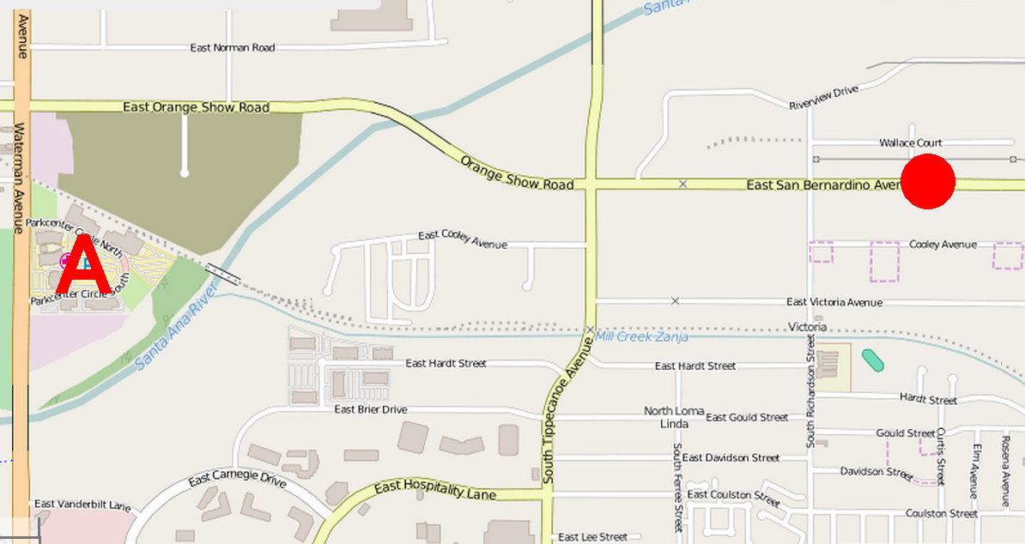
San Bernardino Shooting
Alek Hersum
Syed Rizwan Farook and Tashfeen Malik
Department of Public Health training event and Christmas party
14 dead 22 Seriously Injured
Shoot out with police
Two injured officers, Both perpetrators killed
“A” Marks site of the initial shooting,
Dot marks site of shoot out with police.
[6]
Notes:
December 2, 2015, Syed Rizwan Farook and Tashfeen Malik carried out a shooting at a Department of Public Health training event and Christmas party at the inland regional center in San Bernardino, California.
The pair killed 14 people and injured 22 more, then ran before the police arrived.
Four hours later the pair was found by police and instigated a deadly standoff.
Two officers were injured in the resulting shootout that resulted in the deaths of both gunmen.

Slide 7

Suspects Iphone
Alek Hersum
Farook’s Iphone
Password Protected
National Security Agency
Apple
New iOS
Apple Declined
All Writs Act of 1789
[2] [1]
Notes:
Police found Farook’s iPhone in the shooters vehicle. The phone however was password protected and set to delete it’s contents after ten failed attempts.
FBI First asked NSA to unlock the iPhone, but they could not.
They FBI then approached apple asking for them to create and Alternate iOS that would let them access the iPhone.
Apple Denied the request on the grounds that creating a backdoor into their products would be a breach of their consumers security.
The FBI then successfully applied for a court order that mandated Apple’s assistance under All Writs Act of 1789.
This act allows Courts to write all relevant, lawful, writs to aid their jurisdiction.

Slide 8
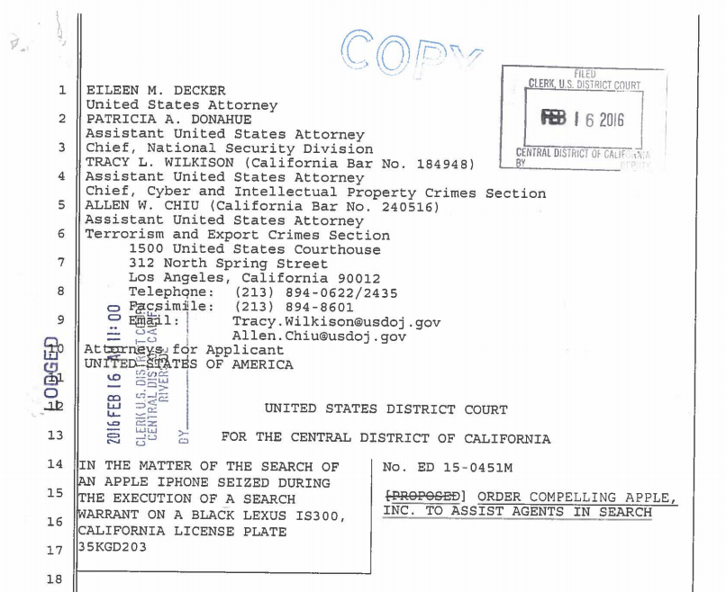
Court Order
Alek Hersum
"it will bypass or disable the auto-erase function whether or not it has been enabled“
"it will enable the FBI to submit passcodes to the SUBJECT DEVICE for testing electronically via the physical device port, Bluetooth, Wi-Fi, or other protocol available“
"it will ensure that when the FBI submits passcodes to the SUBJECT DEVICE, software running on the device will not purposefully introduce any additional delay between passcode attempts beyond what is incurred by Apple hardware"
[2]
Notes:
These are that basic requirements the court order subjected Apple to.

Slide 9
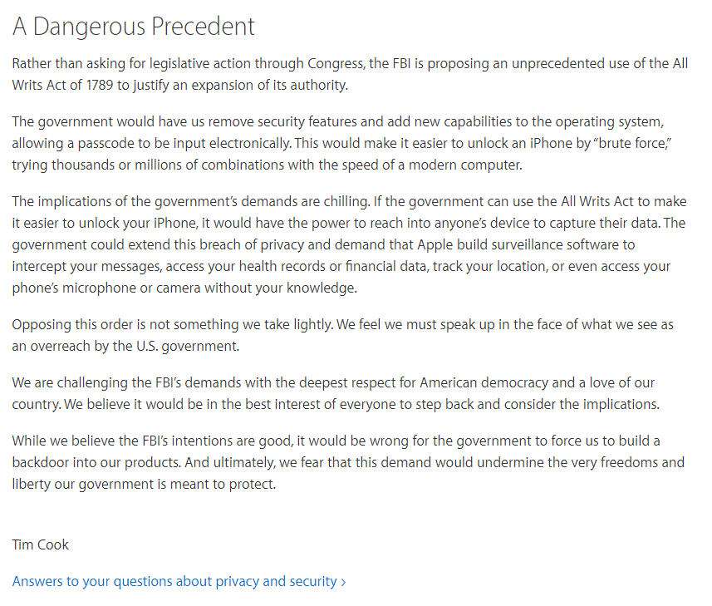
Proceedings
Alek Hersum
Apple’s Response
United States v. New York Telephone Co
New software = Compelled speech
FBI withdraw Request
$1.3 million tool
Cellebrite or “Professional Hackers”?
[3] [4] [5]
Notes:
CEO Tim Cook Posted a notice saying that apple would fight this because it set a dangerous precedent that would allow the government to force companies to write code that undermines its own security.
The department of justice cited United States v. New York Telephone Co. as precedent. Saying that it allows them to get help from phone company's to access call history.
Apple fired back by claiming that forcing a company to develop new software was tantamount to compelling their speech, Which would be in opposition to the first amendment of the united stated constitution.
A month Later the FBI withdrew the request saying that they had been shown a way to unlock the phone.
Seven days later the FBI stated that they had un locked the phone. This was done with a tool they had purchased for the price shown.
The associated press then filed a Freedom of Information Act lawsuit, but this was shot down because of a summary Judgment in the courts favor.
Several news stations claimed they had sources placing the Israeli company Cellebrite as the third part that helped the FBI,
The Washington Post disagreed saying that it had a source claiming the government used Professional Hackers.
We still don’t know who exactly helped the FBI but the fact remains that they now have the ability to unlock the iPhone.

Slide 10
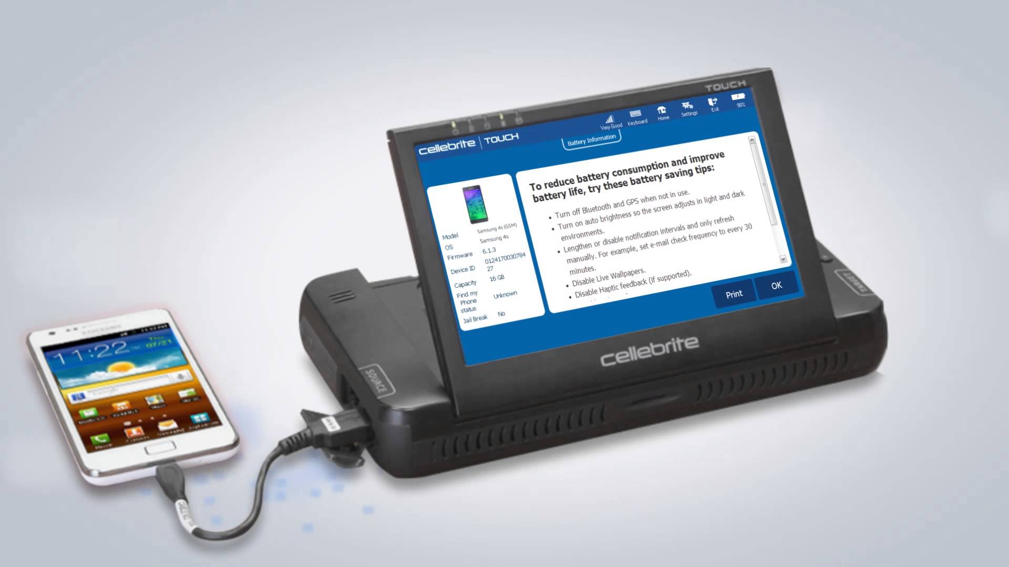
Conclusion
Alek Hersum
Is electronic privacy from the government a myth?
Is our freedom protected enough?
[3] [4] [5]
Notes:
I think that this case shows us many examples of how the government can get access to our personal devices.
As long as your information is one a consumer device there are ways to get the information. With or without your consent.
Thankfully In this country we have laws such as the first and fourth amendments to protect our information on a day to day basis.
But just as there are laws protecting our rights, there are laws as well to allow the government to access this information for the greater good of the country.
With respect to whether our personal information is protected well enough by law, I would have to say that my takeaway is that it is.
As the case between Apple and government was never resolved, We will not know who would have won, but the fact that a large corporation would fight for customer privacy is a good sign in my eyes.
Additionally the aforementioned laws do protect your personal information on a day to day basis, with exception to probable cause.

Slide 11
References
Alek Hersum
[1] “28 U.S. Code § 1651 - Writs.” Legal Information Institute, Legal Information Institute, www.law.cornell.edu/uscode/text/28/1651.
[2] “In the Matter of the Search of an Apple iPhone Seized During the Execution of a Search Warrant on a Black Lexus IS300, California License Plate 35KGD203” https://www.justice.gov/usao-cdca/file/825001/download.
[3] Cook, Tim. “Customer Letter.” Apple, 16 Feb. 2016, www.apple.com/customer-letter/.
[4] “United States v. New York Telephone Co., 434 U.S. 159 (1977).” Justia Law, supreme.justia.com/cases/federal/us/434/159/.
[5] Tanya s. Chutkan “Associated press vs Federal Bureau of Investigation” Sep 30 2017, https://ecf.dcd.uscourts.gov/cgi-bin/show_public_doc?2016cv1850-22
[6] “Bringing calm to chaos” https://ric-zai-inc.com/Publications/cops-w0808-pub P.25 - 38

Slide 12
SPY probe box calling
Yaru Gong

Slide 13
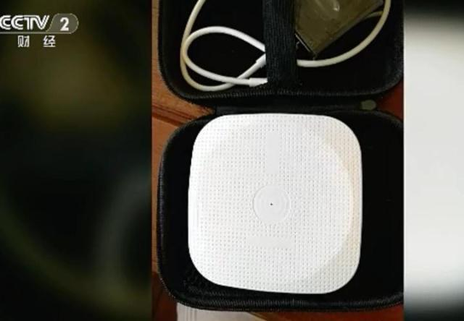
Probe Box
Yaru Gong
Put them on places with larger passenger flow
  Mall, Convenient store, Supermarket etc.
All date will be upload on their computers
Cost is really low and with little maintenance cost
Over 30,000 Probe Boxes in China
<Graphic as big as will fit>
Probe Box
[1]
Notes:
The available range of probe box is about 100 meters.
After hiding the box, they just need to wait people pass by and their data will be collected.

Slide 14
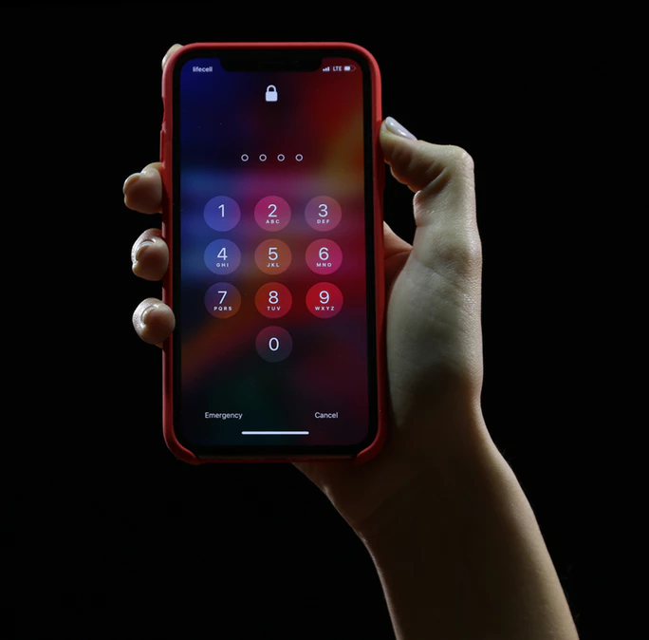
What information they could get?
Yaru Gong
Phone number
Gender
General Age
Phone Model
Frequent Used APP
Marriage
Education Background
General Income
Children
<Graphic as big as will fit>
[1]
Notes:
Use big data to analyze.

Slide 15
How does it work?
Yaru Gong
Wi-Fi use probe to collect Mac address
MAC stands for Media Access Control, and each identifier is intended to be unique to a particular device.
Probe Box use the same kind of probe to get your Mac Address, then transfer it to IMEI Number
IMEI is a number used to identify a device that uses terrestrial cellular networks.
Mac address, IMEI Number, and your information on your phone are connected after allowing too many application permissions
[2] [3] [4] [5]
Notes:
The Wi-Fi could collect Mac address even the phone does not connect to it. As long as the user turn on the Wi-Fi button, their Mac address could be gotten by the probes.
The short answer is, the government could use IMEI number to track your location.
Applications in your phone asked your permission to get your personal information including Mac Address and IMEI number. Some of them ask you to use your phone number to register. In this process, it actually connected your Mac Address, IMEI number, and personal information including phone number together.
By obtaining your Mac address and IMEI number, they could get your personal information as well.

Slide 16
Who is calling you?
Yaru Gong
Information are sold to Marketing center
  Real estate, automobile, finance, and education industries etc.
  Targeting to potential customers.
Intellectual Robots
  Replace human salesman
  Less than 500 dollars each
  Fits 30+ industries
  Call 5,000 times per day, have called 3 billion times in one year
[1]
Notes:
It is robots instead of human who are calling you.
The cost is lower comparing with hiring humans to call everyday, and the productivity is much higher than a human being.
The robots could record names and even introduce a car model for the customers.
The company just need to set the ending time like 100 years later. The robots will keeping calling others from the numbers on the list for 100 years.

Slide 17
Conclusion
Yaru Gong
Is it legal?
  No, according to the Chinese law, the company need to get consumer’s authorization to get their information
What we could do?
  Apple, Microsoft, Google use random Mac address to avoid probe get their real Mac address
  3.15 Party exposed this news and let people know
The technology has its two sides. It just depends on how people use it.
[1] [3]
Notes:
iPhone and other phone use random Mac address could avoid the probes to get their real Mac address before connecting them.
March 15th is the World Consumer Rights Day.
3.15 Party is a TV show once a year to protect consumers’ rights.

Slide 18
References
Yaru Gong
[1]CCTV News, “3.15 Party Exposure: Immoral Harassing Calls”, China Central Television, 03.16.2019 http://news.cctv.com/2019/03/15/ARTI5GL80hl7QHPmQyzqT2TZ190315.shtml, Accessed on 03.30.2019
[2] GNOME Help, “What is a MAC address?”, https://help.gnome.org/users/gnome-help/stable/net-macaddress.html.en, Accessed on 03.30.2019
[3] cnBeta, “3.15 party, you only remember the probe box, but the real culprit is this.” https://www.cnbeta.com/articles/tech/828269.htm, Accessed on 03.30.2019
[4] Sangern, “How to realize ‘Mac address’ to ‘IMEI’ to phone number like 3.15 party said?”, http://www.my889.com/i/1839, Accessed on 03.30.2019
[5] Miguel Leiva Gomez, “Everything you should know about IMEI number.", Aug 6. 2018, https://www.maketecheasier.com/imei-number/, Accessed on 03.30.2019

Slide 19
Hackable, your online behavior: WHY OUR GENERATION AND Millenials ARE IN TROUBLE
Meha Mohapatra
Notes:
Today, I want to talk about why the things we say and post can be very easily used against us.

Slide 20
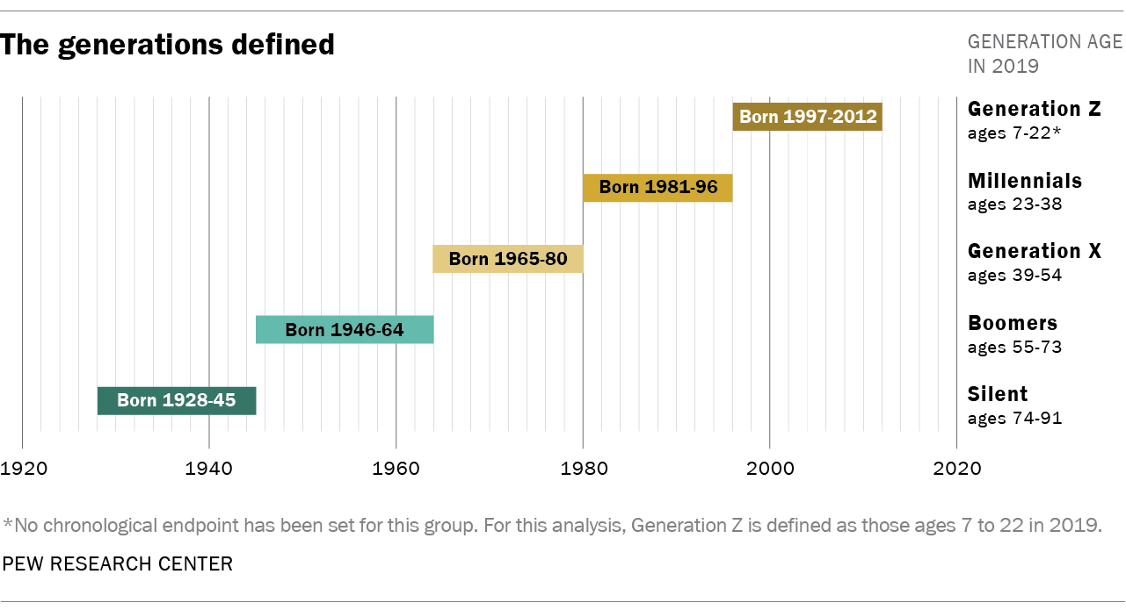
Conclusion
Meha Mohapatra
Millennials are more hackable than the next generation and Baby Boomers
[2,4,5]
Notes:
After doing some research I found that “Millennials are more hackable than the next generation and Baby Boomers”. Also note that we are not considered Millennials, but on that note we could be as susceptible to hacking as they are considering how much social media and technology is integrated in our lives whether we like it or not.

Slide 21
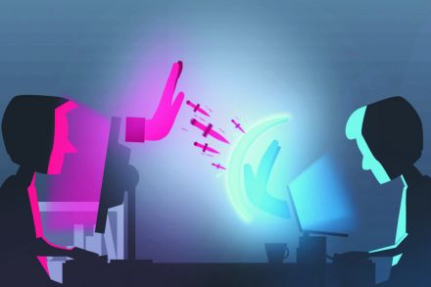
Background
Meha Mohapatra
Hacking → Digital Information Theft
Can happen anywhere and at anytime
  Calls, Texts, Emails, Social Media
What you do matters
[1]
Notes:
Hacking is digital information theft and generally followed by using that information to steal money. It doesn’t matter who you are. Just what you do. If you always pick up the phone saying “Hello, it’s [Insert your name]” or you’re craving those likes and have a public account on Instagram and have locations and dates that are able to be seen, you’re bound to be found, if the hacker deems you’re worth a shot.

Slide 22
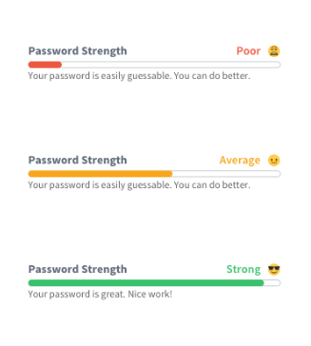
3 General reasons
Meha Mohapatra
PASSWORDS REUSE:
  85% of millennials say they reuse online passwords
  79% of Gen X-ers and 74% of Baby Boomers
SECURITY WORKAROUNDS:
  Millennials were the most likely to find "security workarounds" to avoid workplace digital restrictions.
FRIEND REQUESTS:
  Millennials accepting stranger’s friend request > other two age groups
[2]
Notes:
Security Workarounds and Password Resuse: WPI people switch passwords twice when asked by IT just so that they can keep their old password
Friend Requests: Want followers

Slide 23
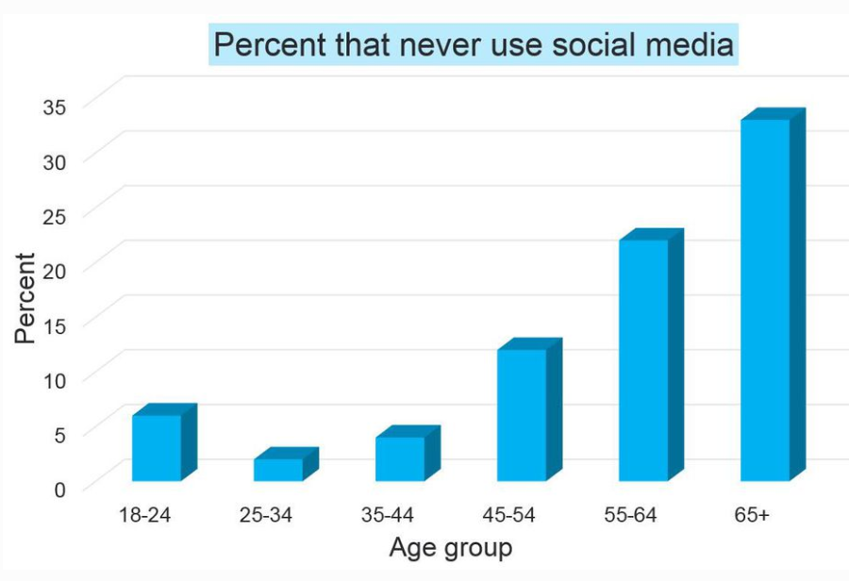
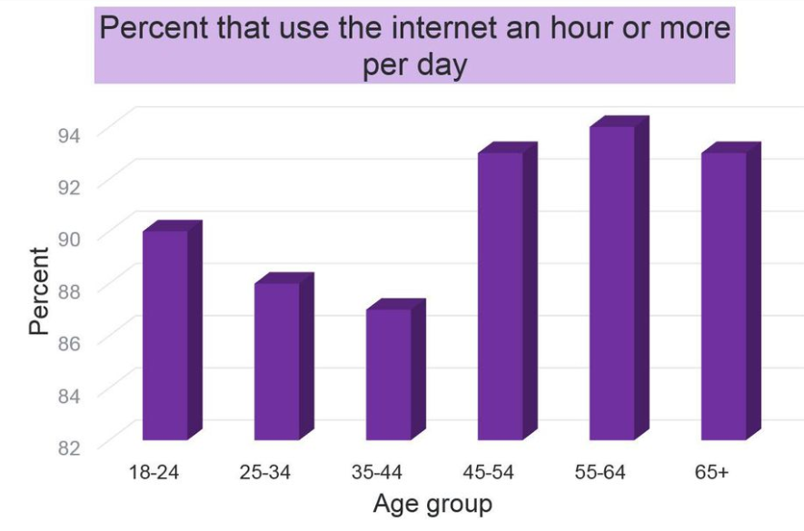
The role of INTERNET/social media use
Meha Mohapatra
Millennials use internet as a means to interact with others
Boomers use internet for non-social reasons
[5,6,7]
Notes:
Because millennials are using the internet as a means to interact with others, they assume they are in good company and in a community that they trust, aka friends and family. Now, if we go back to how millennials accept friend requests and follower requests, if there is a mutual friend that the millennial trusts, they automatically trust this new person and allow them to join in the millennials online community.
So I keep saying trust and that’s because it plays a big role in how hackers can gain access to you. If they are able to establish this trust, you are less likely going to think twice before sharing your location because “they are my friend’s friend, if they trust them then why shouldn’t I” and also sharing location is not THAT personal
As for baby boomers, they use the internet for more non-social reasons. It is simply, login and work on taxes or doing stuff for their job which doesn’t lure you to post about life highlights.

Slide 24
Time and locations stamps are dangerous
Meha Mohapatra
Skills To Hack A Person
Psychology
Gain Trust
Look for as much personal data as possible
Very little actual code knowledge
Common Scams: IRS, Angry Admin, Person who genuinely lost key card
[8]
Notes:
It doesn’t take much actual knowledge to hack an individual, you just need to know how to gai their trust . How does one do that? Well the more data you share on the internet, age, job position, company. Location, the more someone gets to know you without you knowing them. So when someone calls you and they know about your information already, people tend to trust that stranger, and after probing just a little bit you might spill company secrets, maybe your SSN, anything. It all depends on how they can manipulate the data to make it seem like they know you and have your best intrest in mind.
Ultimately, that’s what causes so many millennials to get hacked over the baby boomers They are putting out more information about themselves in a “trusted” friend group eventhough they are not being super selective about who gets to be in their online social group

Slide 25
References
Meha Mohapatra
[1] https://www.computerhope.com/issues/ch001530.htm, April 15 2019
[2] https://www.businessinsider.com/millennials-are-most-vulnerable-to-hacks-2015-5, April 15 2019
[3] https://www.fbi.gov/contact-us/field-offices/pittsburgh/news/press-releases/fbi-warns-of-phone-scam-that-uses-the-fbis-name-to-threaten-arrest, April 15 2019
[4] https://www.pewresearch.org/fact-tank/2019/01/17/where-millennials-end-and-generation-z-begins/, April 15 2019
[5] https://www.forbes.com/sites/kevinmurnane/2016/04/18/how-the-boomers-differ-from-everybody-in-their-approach-to-online-privacy-and-security/#2f35e2bc254d, April 15 2019
[6] https://www.forbes.com/sites/kevinmurnane/2016/04/13/how-older-and-younger-millennials-differ-in-their-approach-to-online-privacy-and-security/#2819c689aa3b, April 15 2019
[7] https://mediag.com/blog/social-media-hacking-in-2018/, April 20 2019
[8] https://computer.howstuffworks.com/internet/social-networking/information/how-online-social-networks-work2.htm, April 21 2019

Slide 26
Mob mentality on The Internet:
For Triumph and Terror
Saul Woolf
Notes:
I’m Saul Woolf and I’m going to be talking about Mob Mentality on the internet. In particular, I’m going to be arguing that the presence of mob mentality on the internet is not fundamentally bad, and could
Before I can jump into the nature of Mob Mentality on the internet, I need to define mob mentality.

Slide 27
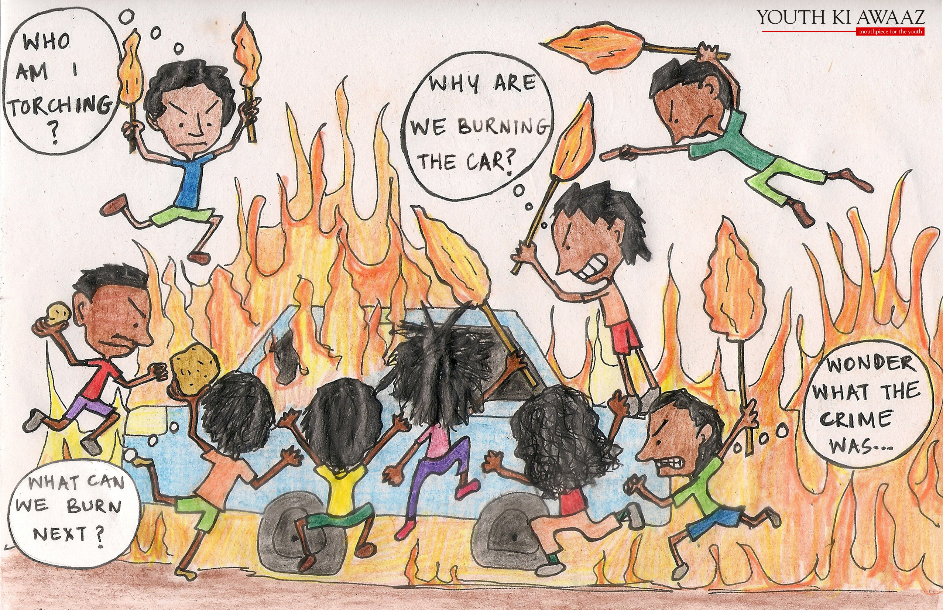
Introduction:
Dynamics of Mob mentality
Woolf
Contagion Theory (Crowd Frenzy)
Convergence Theory
Emergent Norm Theory
“One dog may bark at you but it’s more likely that a pack will attack you.”
[5], [6], [7], [11]
Notes:
Mob Mentality has been broken down into 3 behavioral theories.
Contagion theory encompasses the idea that the behavior of a group can have a hypnotic behavior on an individual, causing that individual to behave unreasonably in a manner that they wouldn’t outside of said group.
Convergence theory states that crowd behavior is a composite of the individual’s behaviors. Additionally, people join certain crowds in order behave certain ways. This is often called the Strength in Numbers principle
Emergent Norm Theory is the concept that social norms are not predetermined. Instead, individuals look to those around them for social cues that indicate the scope of acceptable behavior. If a newcomer to a group sees a single person behaving in an extreme way, they may take that as the norm, allowing it to direct their behavior and establish a new group dynamic.
In summary, Mob Mentality happens when a group of individuals perform acts that they would not on their own. Each act has the propensity to push the group dynamic further away from the norm.
One place on the internet where mob mentality runs rampant is twitter, where groups of people often end up as ‘social police.’ The groups end up acting as Judge, Jury, and Executioner.

Slide 28
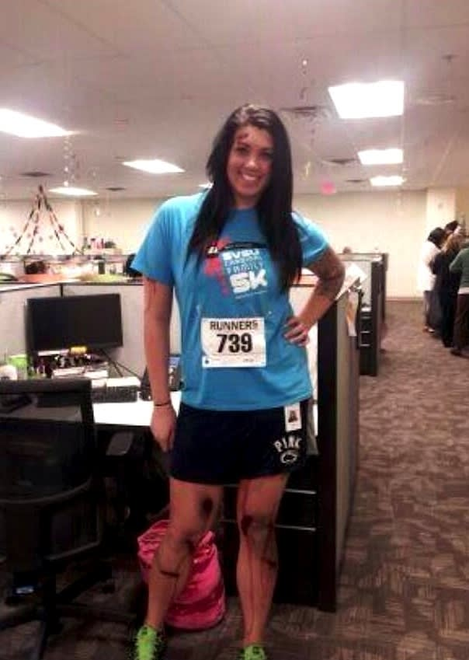
Twitter Mobs: Alicia Ann Lynch (Nov. 2013)
Woolf
22-year old from Michigan
Posted a picture of her Halloween Costume: Boston Marathon bombing victim.
[8], [9]
Notes:
My first example of twitter mob happened following October of 2013. 22-year old Alicia Ann Lynch posted a photo of her Halloween costume to twitter. She had dressed up as a victim of the Boston Marathon bombing.
Was what she did appropriate? Most would say no. Did it merit the response she got?

Slide 29
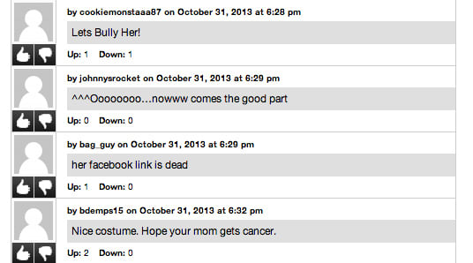
Twitter Mobs: Alicia Ann Lynch (Nov. 2013)
Woolf
Immediate, massive backlash on twitter:
  @_JMej27: “Just saw the Boston Marathon costume...insensitive, low, heartless 140 characters is not enough for such disrespect”
  @KeithGilchrist: “I forgot you can anonymously send shit (literally, shit) through the mail. I think @SomeSKANKinMI can expect a delivery”
  @Jduham: “Is that chick with the marathon bombing halloween costume dead yet? have we killed her yet? If we havent, then what are we waiting for?”
[8], [9]
Notes:
The backlash began with anonymous users enabling bullying, but quickly grew out of control. Some users remained respectful in their critiques, but many pushed the envelope, encouraging each other.
In addition to the numerous death threats directed at Alicia over social media, users managed to locate her physical address, and threatened to send packages to her.
Members of this mob even discovered her parents’ phone numbers and left messages threatening to cut the throats of both them and Alicia.
Even though most members of the mob wouldn’t dream of going this far, their behavior enabled others to push the extremes.

Slide 30
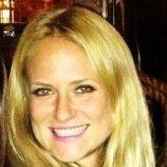
Twitter Mobs: Justine Sacco (Dec. 2013)
Woolf
Senior Director of Corporate Communications at IAC
Before turning off her phone for a flight, she tweeted: “Going to Africa. Hope I don’t get AIDS. Just kidding. I’m white!”
Twitter backlash was quick and massive, with the hashtag, #HasJustineLandedYet
[8]
Notes:
Another Twitter mob developed when Justine Sacco, a Senior Director of Corporate Communications sent a tweet just prior to boarding her plane.
She wrote, “Going to Africa. Hope I don’t get AIDS. Just kidding. I’m white!” and then turned off her phone for the duration of the flight.
I don’t personally know anyone who would avow this, but does that mean she deserved the response?
While she was still on the flight, the mob grew, getting the hashtag #HasJustineLandedYet trending.
The backlash was so extreme that to save face, the company she worked for terminated her contract before she had even landed.
Once again, a group of people who were offended by a tweet caused her to get fired for exercising her right to free speech.

Slide 31
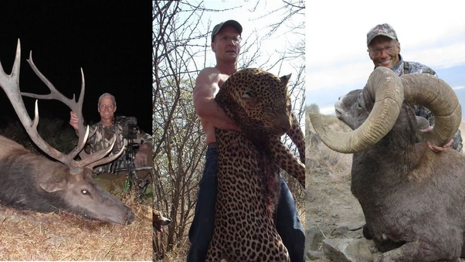
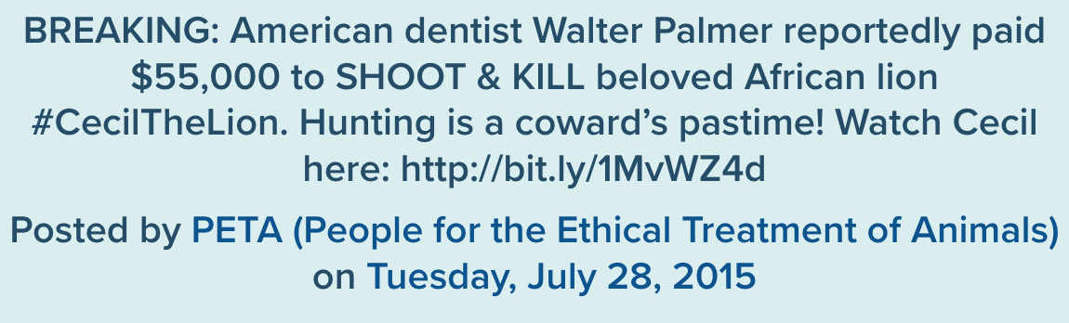
Twitter Mobs: Walter Palmer (July 2015)
Woolf
Dentist who owned his own dental practice
Peta called him out for one of his hunting expeditions
Received massive backlash and hate on social media
[8]
Notes:
But these mobs aren’t always in response to the people posting. Walter Palmer was a Dentist who enjoyed archery and hunting trips in his spare time.
On this particular trip, Walter Palmer hired a team to help him hunt an African Lion. He paid hunting fees and got a permit for the trip. The team ended up luring Cecil, a beloved Lion, from hunting free preservation to a region where the permit enabled him to hunt the animal legally. There, Walter fatally wounded Cecil, but the death was drawn out. Cecil proceeded to suffer for almost 12 hours before he died.
Peta tweeted about his trip, and the mob grew rapidly. They flamed him on social media, sent death threats, and left awful enough reviews on his dental practice that he eventually had to shut it down, despite his actions being legal.
These clusters of likeminded people enable each other to have a huge amount of power to shape the lives of those they target.

Slide 32
Twitter Mobs: Walter Palmer
Woolf
Celebrity personality Piers Morgan wrote in his DailyMail column:
"I will sell tickets for $50,000 to anyone who wants to come with me and track down fat, greedy, selfish, murderous businessmen like Dr. Palmer in their natural habitat. We would all take a bow and fire a few arrows into his limbs to render him incapable of movement.
"Then we'd calmly walk over, skin him alive, cut his head from his neck, and took a bunch of photos of us all grinning inanely at his quivering flesh,"
[10]
Notes:
And its not just fringe characters enabling the mobs. Celebrities have huge power to influence behavior.
Celebrity Personality Piers Morgan wrote this in a newspaper column, calling for the masses to perform awful acts.
Whether or not he meant for it to be taken seriously, the Emergent Norm Theory would indicate that people reading this could found their conception of new social norms on it, enabling mob mentality to build.

Slide 33
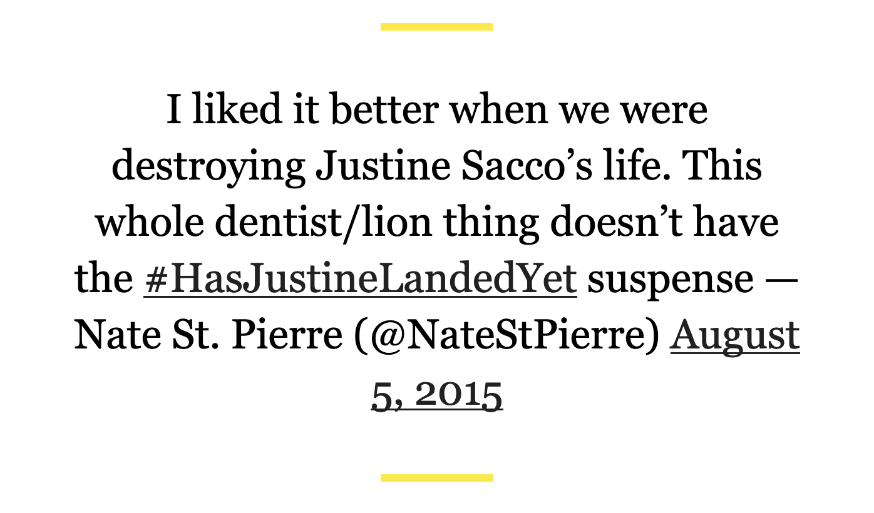
Woolf
[8]
Notes:
Its tweets like these that terrify me. St. Pierre is aware that his group is destroying lives. In fact, He enjoys it.

Slide 34
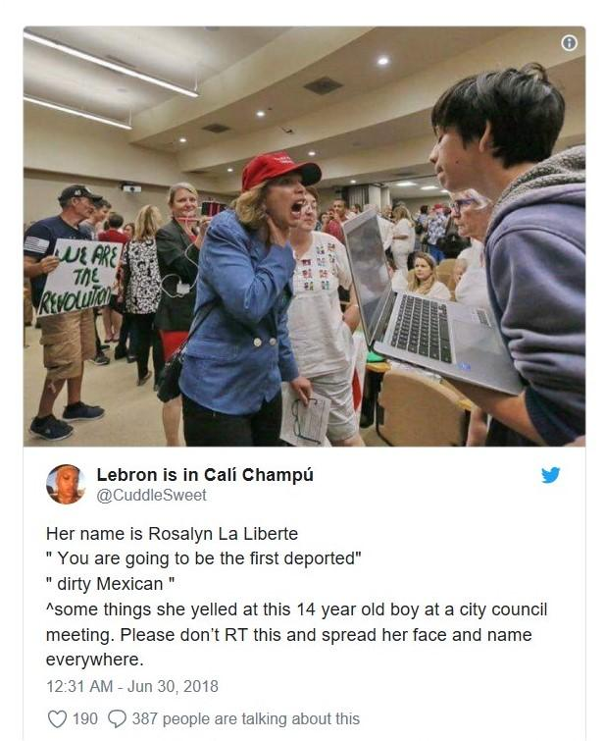
Twitter Mobs: Rosalyn La Liberte (June 2018)
Woolf
Business Owner and Trump Supporter, at a meeting on California immigration
Was pictured and quoted in a tweet, inciting backlash
“I wasn’t really doing anything to him and everyone thought I was and that makes me really sad. It makes me really sad that I’m so vilified.”
[8]
Notes:
And the examples continue. Here is a woman who was quoted in a tweet saying awful things to a young boy. This picture of her “screaming” was captioned with her stating “you are going to be the first deported,” and calling the boy a dirty Mexican.
Despite attempting to defend herself, the mob did its thing. She was flamed on twitter and her business was boycotted.

Slide 35
Twitter Mobs: Rosalyn La Liberte (June 2018)
Woolf
“I heard some people were boycotting this woman’s business. I don’t really want that... because she was being civil.”
"I don’t really want this upon her. She doesn’t deserve it because she was giving her opinion at a place where everyone should be able to say their peace.”
[8]
Notes:
The thing is, she was falsely accused. The boy pictured backs her up. The original tweet was completely unfounded, but it didn’t matter.
The mob had already formed and the damage had been done.
But I don’t want you to come out of my talk thinking that social media is simply a tool for evil. I’m going to present two “challenges” where people worked together using social media to accomplish something that would seem impossible without it. I’m going to try present them as objectively as possible, in order to avoid adding bias.

Slide 36
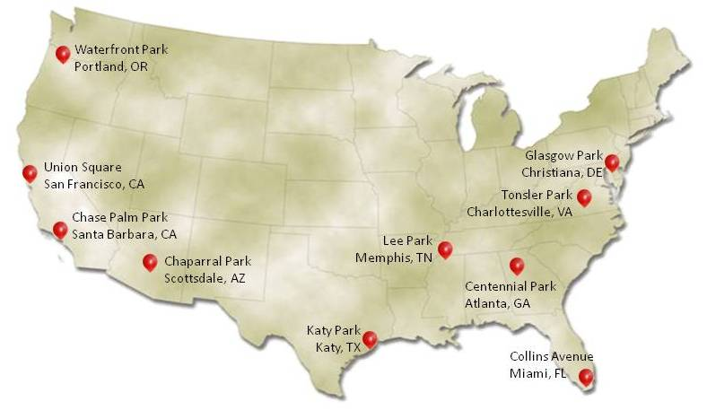
CTF Challenge #1
Woolf
10 flags were hidden across the US
First team to identify the GPS coordinates of ALL flags wins $40,000
Successful team used a Recursive Incentive Mechanism
Completed in 8 Hours and 52 Minutes
[1], [2], [12]
Notes:
In the first challenge, 10 flags were hidden across the united states. The goal of this challenge was for a team to identify the locations of every flag.
The team to correctly identify the GPS coordinates of each flag correctly was to win $40,000.
The team that completed the challenge used a recursive incentive mechanism. They incentivized cooperation, by rewarding people for providing information.
They paid $2000 to anyone who could provide the actual GPS location of a flag. Additionally, the person that invited them to the challenge was rewarded $1000, then $500 to the person who invited the inviter, and so on.
In using social media accordingly, they managed to find the GPS coordinates of every flag in under 9 hours.

Slide 37

CTF Challenge #2
Woolf
24/7 Livestream of flag
First Team to find and replace the flag with their team’s flag wins
Successful team utilized their diverse skills to analyze weather, plane routes, and star patterns of the livestream
Found the Flag in just over 37 hours
[3], [4], [14]
Notes:
In the second challenge, there was only 1 flag. This flag was hidden somewhere in the united states. The only clue to its location was a continuous livestream pointed at the flag and the sky behind it.
The team who managed to find it did so utilizing social media. This task would have been impossible, or at least extremely time consuming for an individual.
Social media enabled this group to be in constant contact, sharing tips and making use of their diverse skill set.
They analyzed the weather and star patterns to get a general idea of the area the flag was in, as well as the direction the camera was pointed in.
Other members of the team were able to use the flight patterns of planes passing through the frame to get more specific location of the flag.
Then, a member of the group who lived nearby literally drove around honking— Those watching the livestream were able to use the volume of the honking on the livestream to play a game of “hot and cold” eventually enabling him to find the flag.
The whole process took just over 37 hours.
In both of these challenges, a group of individuals utilized the far reach of social media to accomplish a time consuming task impressively fast.
Does that make both ethical? What actually were these challenges?

Slide 38
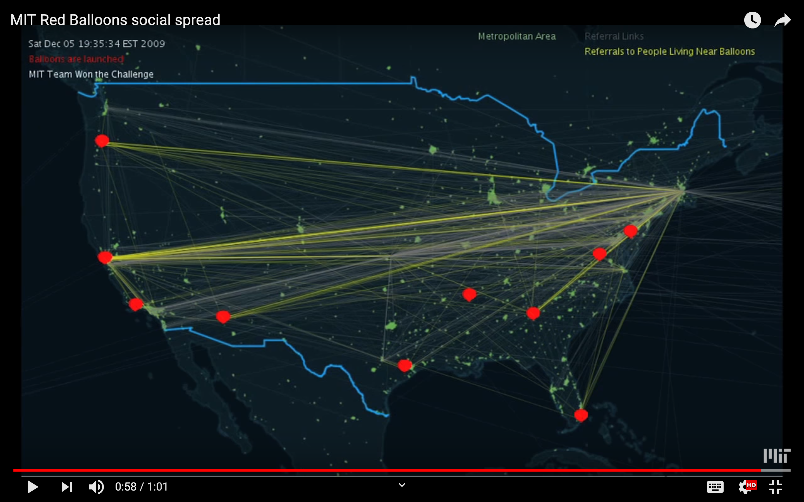
CTF Challenge 1:
The Red Balloon Challenge
Woolf
DARPA Challenge intended to explore the internet’s “ability for social mobilization”
Winning team was a group of MIT Students
  Paid out reward to those who helped
  Donated the rest to charity
Participated in order to measure and analyze the properties of Recursive Incentive Mechanisms
[1], [2]
Notes:
The first was a challenge presented by DARPA, to explore the internet’s “ability for social mobilization.”
The winning team competed selflessly, as they weren’t in it for the monetary prize.
They simply wanted to explore the potential of the internet.

Slide 39
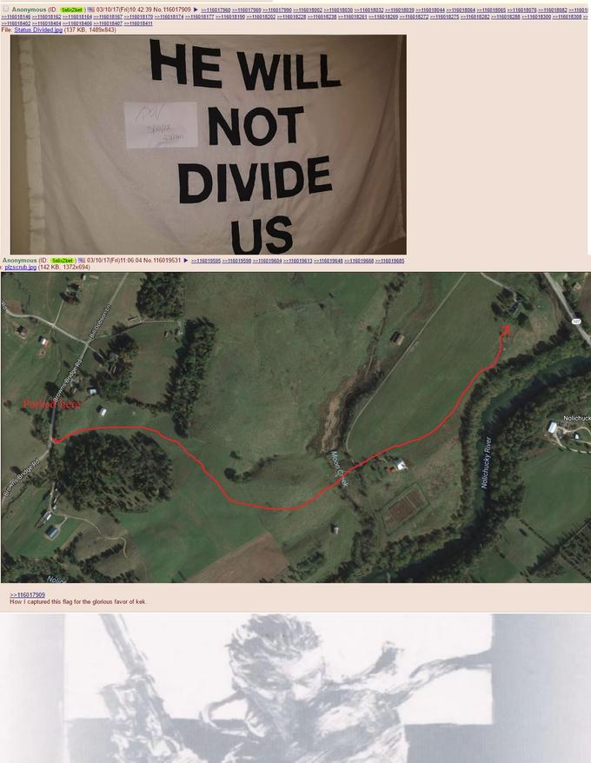
CTF Challenge 2:
"He Will Not Divide Us" art/protest project
Woolf
Shia Lebeouf’s movement intended to unite people against the MAGA movement
Only one group, the 4chan community pol/, attempted to find the flag
  This group is known for stoking racism and harassing women
  “where the id of the internet went to die”
Participated to ‘f*** with’/ ‘troll’ Shia Lebeouf
[3], [4], [13]
Notes:
The other challenge, was not altruistic. In fact, the group that completed the challenge was the one who set it.
Shia Lebeouf set up the livestream as a social statement that this country would remain undivided, even in the presence of racism.
The goal of the challenge was simply to troll Shia, essentially minimizing his right to free speech.
Despite being actualized in similar ways, the two challenges are at opposite ends of the ethical spectrum simply because of the intention behind it.

Slide 40
Conclusions
Woolf
The advent of the modern internet, especially social media sites like twitter, enable effective cooperative behavior that was previously impossible.
This cooperation often comes in the form of hate, and results in dangerous ‘internet mobs.’ These mobs do not have checks and balances to ensure they are founded in truth.
Notes:
It is our responsibility to question these mobs. These internet centric mobs often form without evidence. When we see a mob building, we need to make sure we discover the truth as quickly as possible.
The internet enables cooperation in a manner that is dangerous. We as a people need to do more to ensure we aren’t enabling innocent peoples’ lives to be ruined.

Slide 41
References
Woolf
[1] Jennifer Chu, Searching for balloons in a social network, http://news.mit.edu/2011/red-balloons-study-102811 (April 30, 2019)
[2] Galen Packard, Time-Critical Social Mobilization https://science.sciencemag.org/content/334/6055/509.full (April 30, 2019)
[3] Emily Zanotti, Leftist Shia LaBeouf's 'He Will Not Divide Us' Global 'Capture-The-Flag' Game Back On, https://www.dailywire.com/news/37841/leftist-shia-labeoufs-he-will-not-divide-us-global-emily-zanotti (April 30, 2019)
[4] Mack Lamoureux, How 4Chan's Worst Trolls Pulled Off the Heist of the Century, https://www.vice.com/en_us/article/d7eddj/4chan-does-first-good-thing-pulls-off-the-heist-of-the-century1 (April 30, 2019)
[5] Dr. Wendy James, The Psychology of Mob Mentality and Violence, http://drwendyjames.com/the-psychology-of-mob-mentality-and-violence/ (April 30, 2019)
[6] Kristen Polito, What is “Mob Mentality?”, http://inpathybulletin.com/what-is-mob-mentality/ (April 30, 2019)
[7] Mikaila Mariel Lemonik Arthur, Emergent Norm Theory, https://onlinelibrary.wiley.com/doi/full/10.1002/9780470674871.wbespm432 (April 30, 2019)
[8] Hilary Milnes, The anatomy of a Twitter Lynch mob, https://digiday.com/media/anatomy-twitter-lynch-mob/ (April 30, 2019)

Slide 42
References Continued
Woolf
[9] Rachel Zarrell, What Happens When You Dress As A Boston Marathon Victim And Post It On Twitter, https://www.buzzfeednews.com/article/rachelzarrell/what-happens-when-you-dress-as-a-boston-marathon-victim#.hyQlrN4yZ (April 30, 2019)
[10] Piers Morgan, I’d love to go hunting one day with Dr Walter Palmer the killer dentist... so I can stuff and mount him for MY office wall, https://www.dailymail.co.uk/news/article-3177611/PIERS-MORGAN-d-love-hunting-one-day-Dr-Walter-Palmer-killer-dentist-stuff-mount-office.html (April 30, 2019)
[11] Maitri Dore, New Viral Fever: Mob Mentality, https://www.youthkiawaaz.com/2016/02/tanzanian-woman-attacked-bengaluru/ (April 30, 2019)
[12] Wikipedia, Darpa Network Challenge, https://en.wikipedia.org/wiki/DARPA_Network_Challenge (April 30, 2019)
[13] satansyngel, He Will Not Divide Us– Flag + flag pole status: divided, https://knowyourmeme.com/photos/1230790-he-will-not-divide-us (April 30, 2019)
[14] Flag photo: https://www.cbtnuggets.com/blog/wp-content/uploads/2018/07/180730b.png (April 30, 2019)
[15] Hal Eisner, People online twist the real story behind photo of woman yelling at boy, http://www.foxla.com/news/local-news/people-online-twist-the-real-story-behind-photo-of-woman-yelling-at-boy (April 30, 2019)

Slide 43
Open source business model
Fan Mo

Slide 44
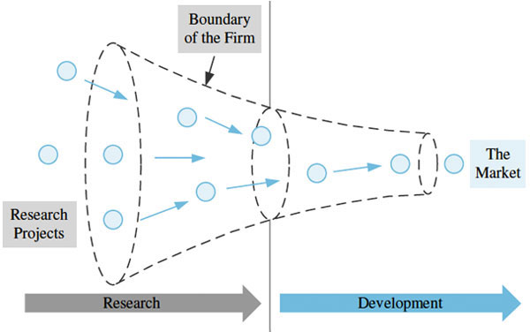
Traditional business model
Fan Mo
Creating
Proprietary intellectual property
Gain a distinct advantage over the competition
44
Notes:
In a traditional business model
Patent
Intellectual property
The research fit into the requirement

Slide 45
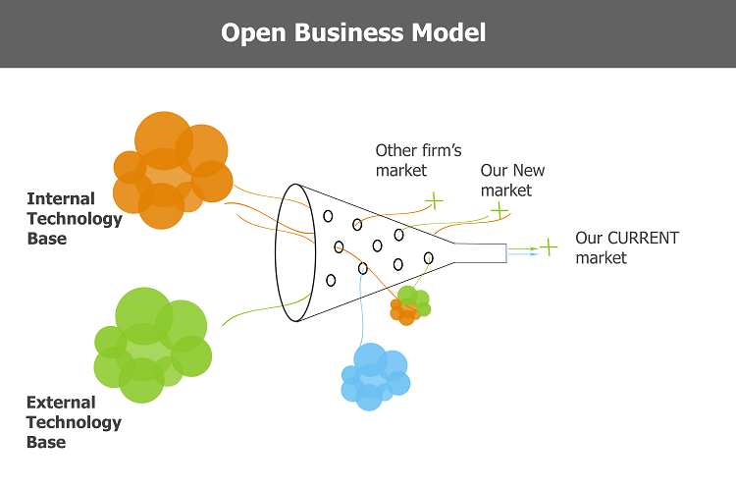
OPEN SOURCE BUSINESS MODEL
Fan Mo
Developed, modified and redistributed freely
Any users and organization
Transparency
45
Notes:
Open source business model
Jump off the restriction of the traditional
Any users
Transparency

Slide 46
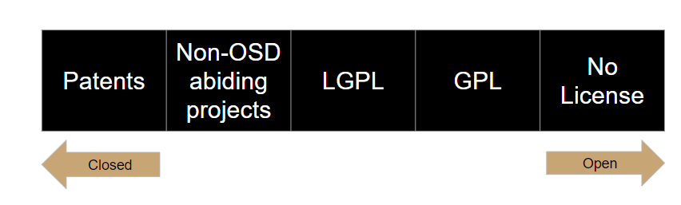
Open Business Models Are a Spectrum
Fan Mo
46
Notes:
Some people believe that their are only two options. Closed or open. When in reality it is a spectrum that allows for stages in between to maintain some proprietary rights on property while still allowing community development. Pictured here are some examples of licenses in software that range from closed to open. Patents are the traditional use where the property is usually held within the firm. The Non OSD projects mean that they aren’t officially labeled open source by certain guidelines but encourage community feedback and development. The LGPL (lesser general public license) allows for some aspects of a project such as libraries or sections of code to be withheld but other parts freely distributed and edited. While the General Public License is the most widely used license and represents the open source definition we talked about before where the base code is licensed but then the free development and reproduction must be allowed.

Slide 47

Software as a service
Fan Mo
Red Hat
2018 was valued at $30.6 billion
Fourth quarter total revenue of $772 million, up 23% year-over-year, or 18% in constant currency
47
Notes:
Valuation
Profit
How to make profit?
Free software, selling for service

Slide 48
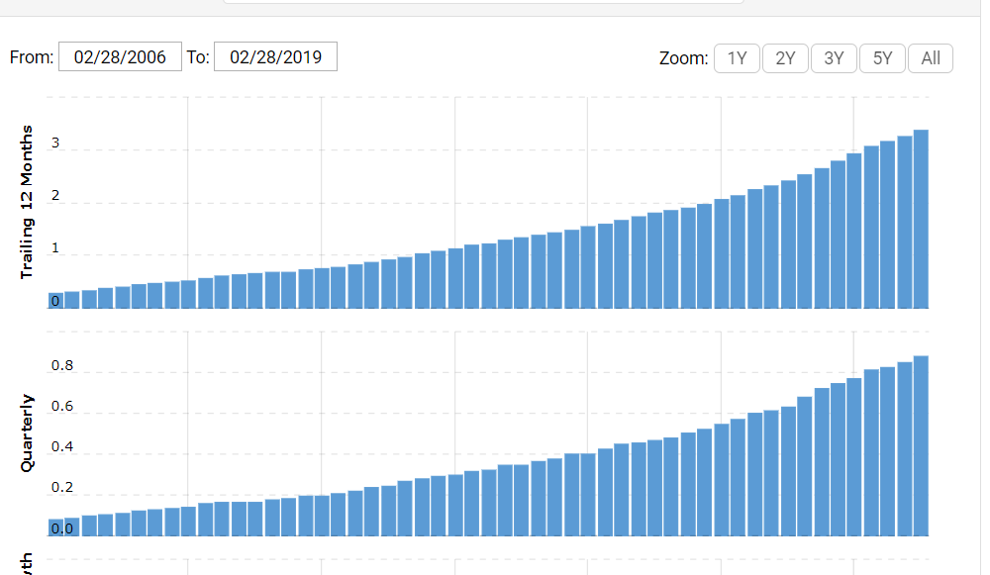
Growth of open source company
Fan Mo
Red Hat revenue for the quarter ending February 28, 2019 was $0.879B, a 13.81% increase year-over-year.
Red Hat gross profit for the quarter ending February 28, 2019 was $0.746B, a 13.16% increase year-over-year.
48
Notes:
Red Hat helps create relevant, innovative technologies that liberate resources for growth and prepare customers for the future of IT.

Slide 49

Open source products
Fan Mo
Add unique closed source components to an open source foundation
Blink rendering (display) engine
WebKit Safari engine
49
Notes:
Open source products
GOOGLE CHROME
Base on the webkit from the safari
Gain profit
Google’s Blink engine itself is open source
How to compete in the market?
Unique components

Slide 50

conclusion
Fan Mo
Open source will be a key driver of innovation
Uptick in adoption of open-source tools
Central role in the broad software ecosystem
50
Notes:
hosted service, hosted UI, hosted management platforms.
Open source principles are also moving out into other fields
default model for most software projects
Growth’
Innovation
commercial

Slide 51
References
Fan Mo
[1] Sijbrandij, Sid. “How Open Source Became The Default Business Model For Software.” Forbes, Forbes Magazine, 20 July 2018, www.forbes.com/sites/forbestechcouncil/2018/07/16/how-open-source-became-the-default-business-model-for-software/#71f145be4e72. 29 April. 2019
[2] “Traditional Types of Business Models.” Maryville Online, online.maryville.edu/business-degrees/traditional-types-business-models/. 28 April. 2019
[3] Sharma, Abhishek. “What's The Business Model Of Open Source Software Companies Like Pivotal & RedHat.” Analytics India Magazine, 29 Oct. 2018, www.analyticsindiamag.com/whats-the-business-model-of-open-source-software-companies-like-pivotal-redhat/. 29 April. 2019
[4] Finley, Klint. “Google Chrome Breaks Up With Apple's WebKit.” Wired, Conde Nast, 4 June 2017, www.wired.com/2013/04/blink/ 29 April. 2019
[5] Kowalik, Olaf. “Advancing Your Business Model with Open Innovation.” Product Bookshelf, 12 Mar. 2016, www.productbookshelf.com/2011/11/advancing-your-business-model-with-open-innovation/ 29 April. 2019
[6] “Red Hat on the Forbes Top 100 Digital Companies List.” Forbes, Forbes Magazine, www.forbes.com/companies/red-hat/#41aafaa02eb 29 April. 2019
[7] “Red Hat Revenue 2006-2019 | RHT.” Macrotrends, www.macrotrends.net/stocks/charts/RHT/red-hat/revenue. 29 April. 2019
[8] Smith, Tom. “The Future of Open Source Is So Bright... - DZone Open Source.” Dzone.com, 8 May 2018, dzone.com/articles/the-future-of-open-source-is-so-bright. 28 April. 2019
[9] “5 Things You Need to Know about Google's Blink Browser Engine.” Geek.com, 5 Apr. 2013, www.geek.com/apps/what-you-need-to-know-about-the-blink-browser-engine-1551190/. 29 April. 2019

Slide 52
Choosing Who Lives
Luke Zebrowski

Slide 53
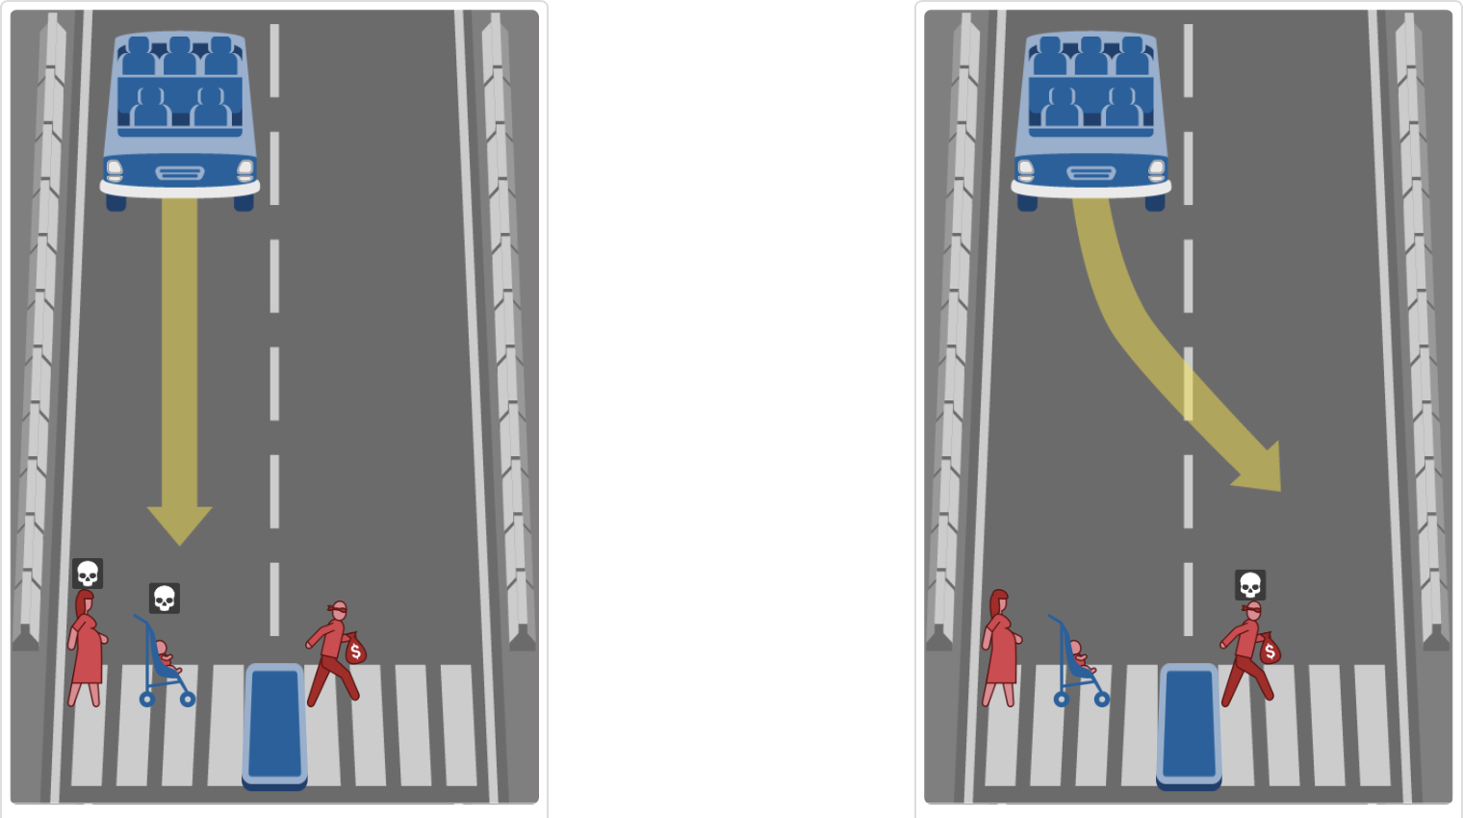
Luke Zebrowski
http://moralmachine.mit.edu
Notes:
“Imagine for a moment you’re driving along and come upon a group of people crossing your path”
can’t choose everyone to live (will be explained later)
explain scenario
ask for hands (left for lady, right for guy) for who should live
*if few responses, encourage people to get responses in while it is still relatively easy*

Slide 54
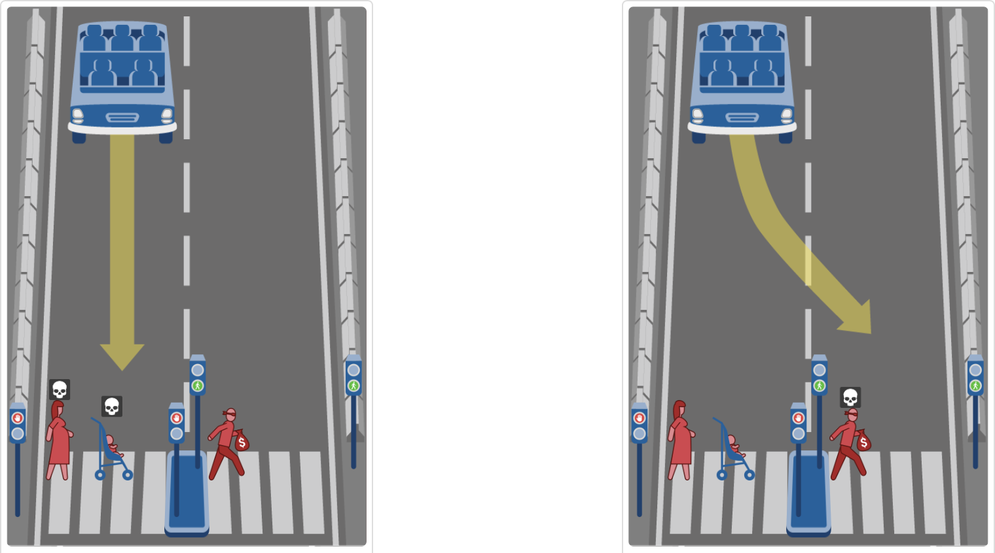
Luke Zebrowski
http://moralmachine.mit.edu
Notes:
Explain scenario
make note of traffic signals; all are criminals now, laws say you must stop at green walk signals and can go through red ones
added intent for killing thief because rules say shouldn’t drive through green.
Ask for hands again for who should live (left lady, right guy)

Slide 55

Luke Zebrowski
http://moralmachine.mit.edu
Notes:
explain scenario
now guy is a lawful citizen, do you turn toward him even though he’s doing what he’s supposed to?
driving straight would cost 3 lives but those three shouldn’t be crossing anyway
swerving would cost one life directly but might also cost lives of patients
ask for hands DONT remind which goes to which (they should know by now)

Slide 56

Luke Zebrowski
http://moralmachine.mit.edu
Notes:
explain scenario
taken out lawfulness and amount of lives consideration
does your profession give more right to life?
utilitarianism might say doctor should live because he does more for the world
Kantism might not because we can’t treat people as means to an end; every person is more than what they provide for the world.
“who gets to live?”

Slide 57
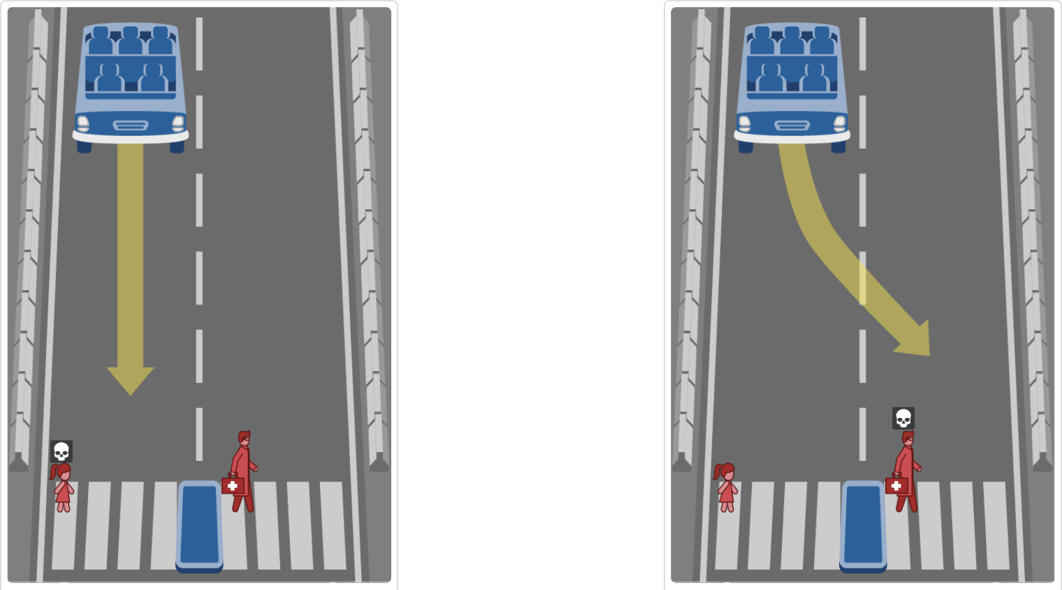
Luke Zebrowski
http://moralmachine.mit.edu
Notes:
explain scenario
“Limitless potential vs. established benefit”
what is more important?
“who gets to live?”
pause for a little longer than previously

Slide 58

Luke Zebrowski
http://moralmachine.mit.edu
Notes:
explain scenario
Not guilty of anything
following law equally
no professions
only difference is gender
“who lives?”
(should be at or around 4 min)

Slide 59
How does this relate to computing?
Luke Zebrowski
Driverless cars currently can’t make these decisions
No system in place to make these decisions
Driverless cars are coming out very soon and we are the ones who may be programming them
Notes:
draw attention to lack of hands, due to question being hard to answer/don’t want to answer
what does that mean for driverless cars? Do they have the luxury of not providing an answer?
how do we handle these cases? - Maybe don’t have return values in these if statements?
if statement that doesn’t return anything doesn’t really mean much, can probably cut out useless code
“Who thinks it would be better to leave this scenario unhandled?”

Slide 60
Conclusion
Luke Zebrowski
This issue needs to be addressed soon
We need a standard by which to make these decisions that everyone has agreed to
Notes:
Driverless cars may be out within the next decade.
This issue needs to be addressed
This issue affects everyone, everyone should be able to provide input.
A standard is needed to prevent biases from leaking into the commercial market.

Slide 61
REFERENCES
Luke Zebrowski
[1] Nyholm, Sven, and Jilles Smids. "The ethics of accident-algorithms for self-driving cars: An applied trolley problem?." Ethical theory and moral practice 19.5 (2016): 1275-1289.
[2] Bonnefon, Jean-François, Azim Shariff, and Iyad Rahwan. "The social dilemma of autonomous vehicles." Science352.6293 (2016): 1573-1576.
[3] Goodall, Noah J. "Machine ethics and automated vehicles." Road vehicle automation. Springer, Cham, 2014. 93-102.
[4] Lin, Patrick. "Why ethics matters for autonomous cars." Autonomous driving. Springer, Berlin, Heidelberg, 2016. 69-85.
[5] Deng, Boer. "Machine ethics: The robot’s dilemma." Nature News 523.7558 (2015): 24.

Slide 62
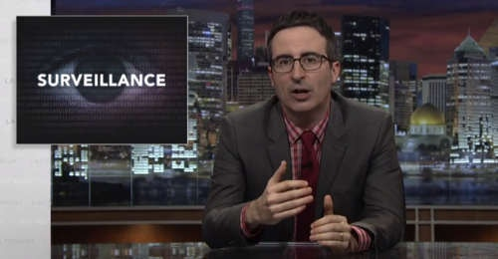
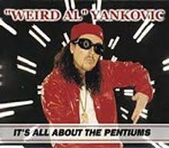
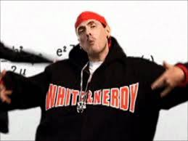


Student Choice – Interesting Videos
  Last Week tonight with John Oliver Snowden (33:14)
  It’s All About The Pentiums
  Weird Al (3:34)
  White and Nerdy Weird Al (2:50)
  The Game Of Trust - Nicky Case
  Why Electronic Voting is a BAD Idea
  Computerphile (Tom Scott) (8:20)
Notes:
All Last Accessed 2018-10-04
CGP Grey
Humans Need Not Apply (15:00) – 2014-08-13
http://www.youtube.com/watch?v=7Pq-S557XQU
Last access 2016-04-22
Why Electronic Voting is a BAD Idea – Computerphile (Tom Scott) (8:20)
https://www.youtube.com/watch?v=w3_0x6oaDmI
Last Week tonight with John Oliver – Patriot Act, Edward Snowden (33:14)
http://www.upworthy.com/john-oliver-flew-10-hours-to-russia-to-interview-edward-snowden-and-get-him-on-record?c=ufb1
Weird Al – It’s All About The Pentiums (3:34) and look at lyrics
https://www.youtube.com/watch?v=qpMvS1Q1sos
Tie into Ray Kurzweil Singularity
Epic Rap Battles of History: Steve Jobs vs. Bill Gates (If class ok with obscene lyrics) (2:47)
https://www.youtube.com/watch?v=njos57IJf-0
Also Work links on web site http://socialimps.keithpray.net/documents/
-----
Tom Scott
http://tomscott.com
Welcome To Life (2:44)
https://www.youtube.com/watch?v=IFe9wiDfb0E&feature=youtu.be
Passphrases (2:08 need to give context for video)
https://firstlook.org/theintercept/2015/03/26/passphrases-can-memorize-attackers-cant-guess/
If not shown during first class
What "Orwellian" really means - Noah Tavlin (5:31)
http://ed.ted.com/lessons/what-orwellian-really-means-noah-tavlin
Weird Al – White and Nerdy (2:50) and look at lyrics
https://www.youtube.com/watch?v=N9qYF9DZPdw
The Game Of Trust - Nicky Case
https://ncase.me/trust/

Slide 63


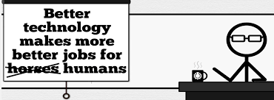
Student Choice – Interesting Videos (Full)
  Last Week tonight with John Oliver Snowden (33:14)
  It’s All About The Pentiums
  Weird Al (3:34)
  White and Nerdy Weird Al (2:50)
  The Game Of Trust - Nicky Case
  Why Electronic Voting is a BAD Idea
  Computerphile (Tom Scott) (8:20)
  Welcome To Life – Tom Scott (2:44)
  What "Orwellian" really means - Noah Tavlin (5:31)
  Humans Need Not Apply
  CGP Grey (15:00)
Notes:
All Last Accessed 2018-10-04
CGP Grey
Humans Need Not Apply (15:00) – 2014-08-13
http://www.youtube.com/watch?v=7Pq-S557XQU
Last access 2016-04-22
Why Electronic Voting is a BAD Idea – Computerphile (Tom Scott) (8:20)
https://www.youtube.com/watch?v=w3_0x6oaDmI
Last Week tonight with John Oliver – Patriot Act, Edward Snowden (33:14)
http://www.upworthy.com/john-oliver-flew-10-hours-to-russia-to-interview-edward-snowden-and-get-him-on-record?c=ufb1
Weird Al – It’s All About The Pentiums (3:34) and look at lyrics
https://www.youtube.com/watch?v=qpMvS1Q1sos
Tie into Ray Kurzweil Singularity
Epic Rap Battles of History: Steve Jobs vs. Bill Gates (If class ok with obscene lyrics) (2:47)
https://www.youtube.com/watch?v=njos57IJf-0
Also Work links on web site http://socialimps.keithpray.net/documents/
-----
Tom Scott
http://tomscott.com
Welcome To Life (2:44)
https://www.youtube.com/watch?v=IFe9wiDfb0E&feature=youtu.be
Passphrases (2:08 need to give context for video)
https://firstlook.org/theintercept/2015/03/26/passphrases-can-memorize-attackers-cant-guess/
If not shown during first class
What "Orwellian" really means - Noah Tavlin (5:31)
http://ed.ted.com/lessons/what-orwellian-really-means-noah-tavlin
Weird Al – White and Nerdy (2:50) and look at lyrics
https://www.youtube.com/watch?v=N9qYF9DZPdw

Slide 64
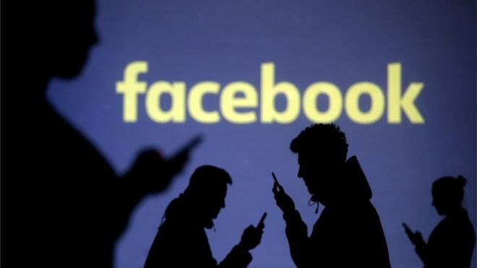
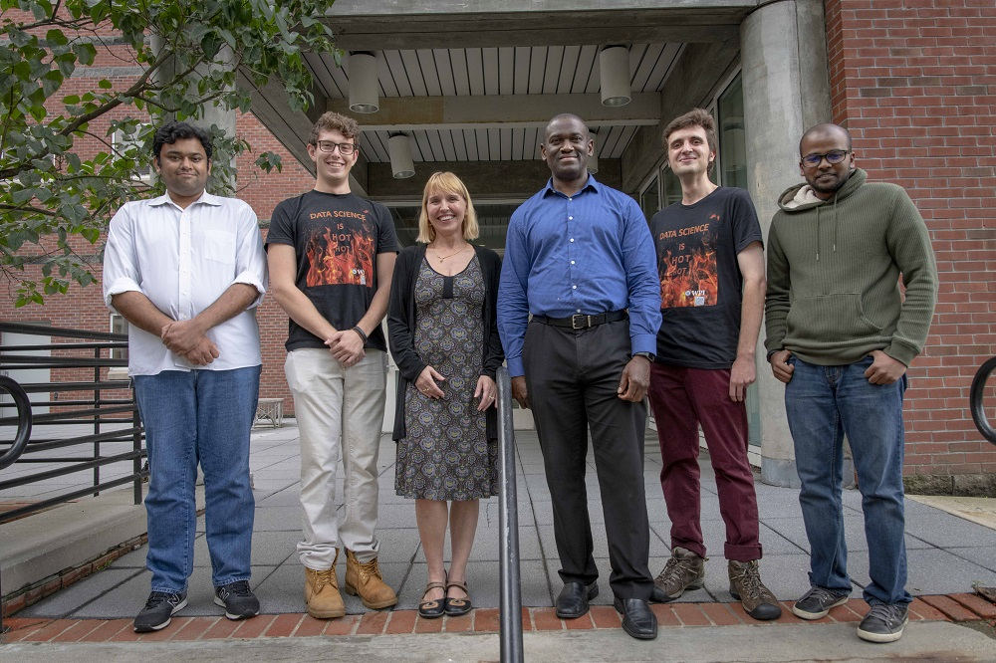

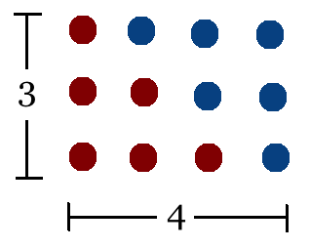
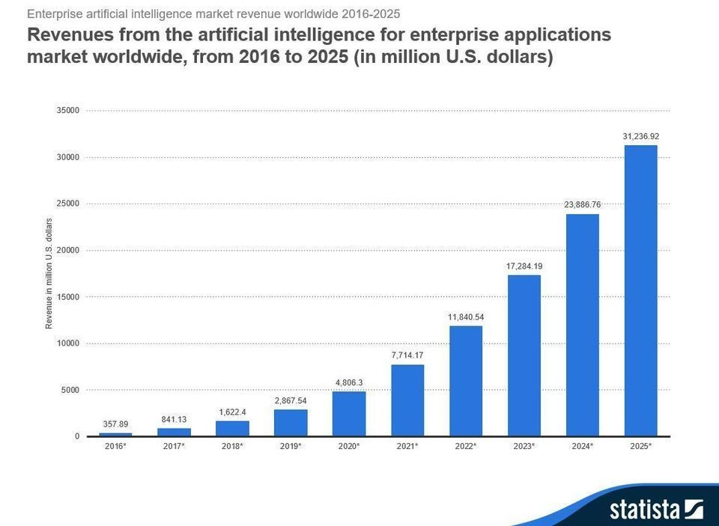
Student Choice – Interesting Articles 1/2
Facebook security breach: Up to 50m accounts attacked - Dave Lee, North America technology reporter, 2018-09-29
WPI Secures $2.8 Million to Develop a Smartphone App to Help Assess the Health of Soldiers, 2018-09-24
Quantified Toilets, 2014, Quantified Toilets LLC
What Did Ada Lovelace's Program Actually Do? - Sinclair Target, 2018-08-18 (First Programming Bug 1843?)
We know ethics should inform AI. But which ethics? - Mauro Guillen, World Economic Forum, 2018-07-26
Notes:
All Last Accessed 2018-10-04
TOOD: Add to first day slides.
Emacs – psychoanalyze-pinhead
doctor (implementation of ELIZA)
yow (quotes from Zippy the Pinhead zippythepinhead.com)

Slide 65
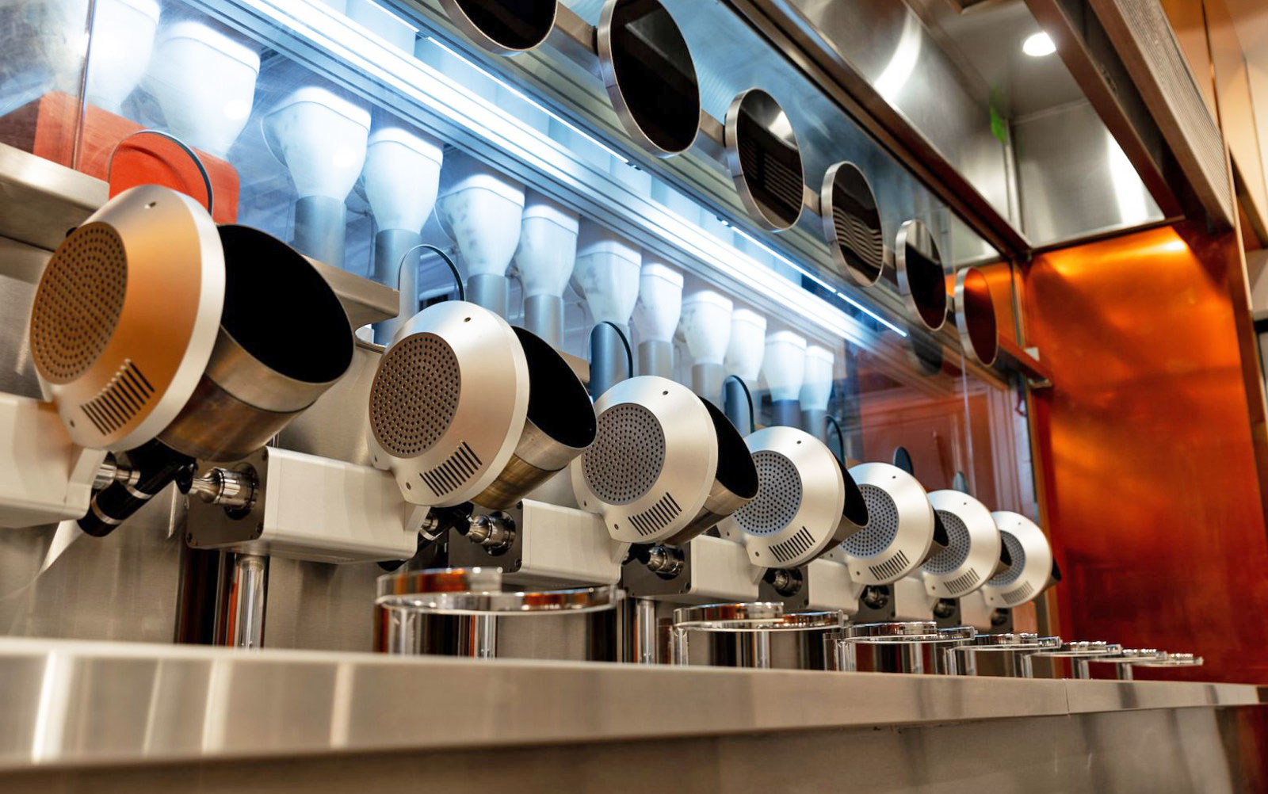
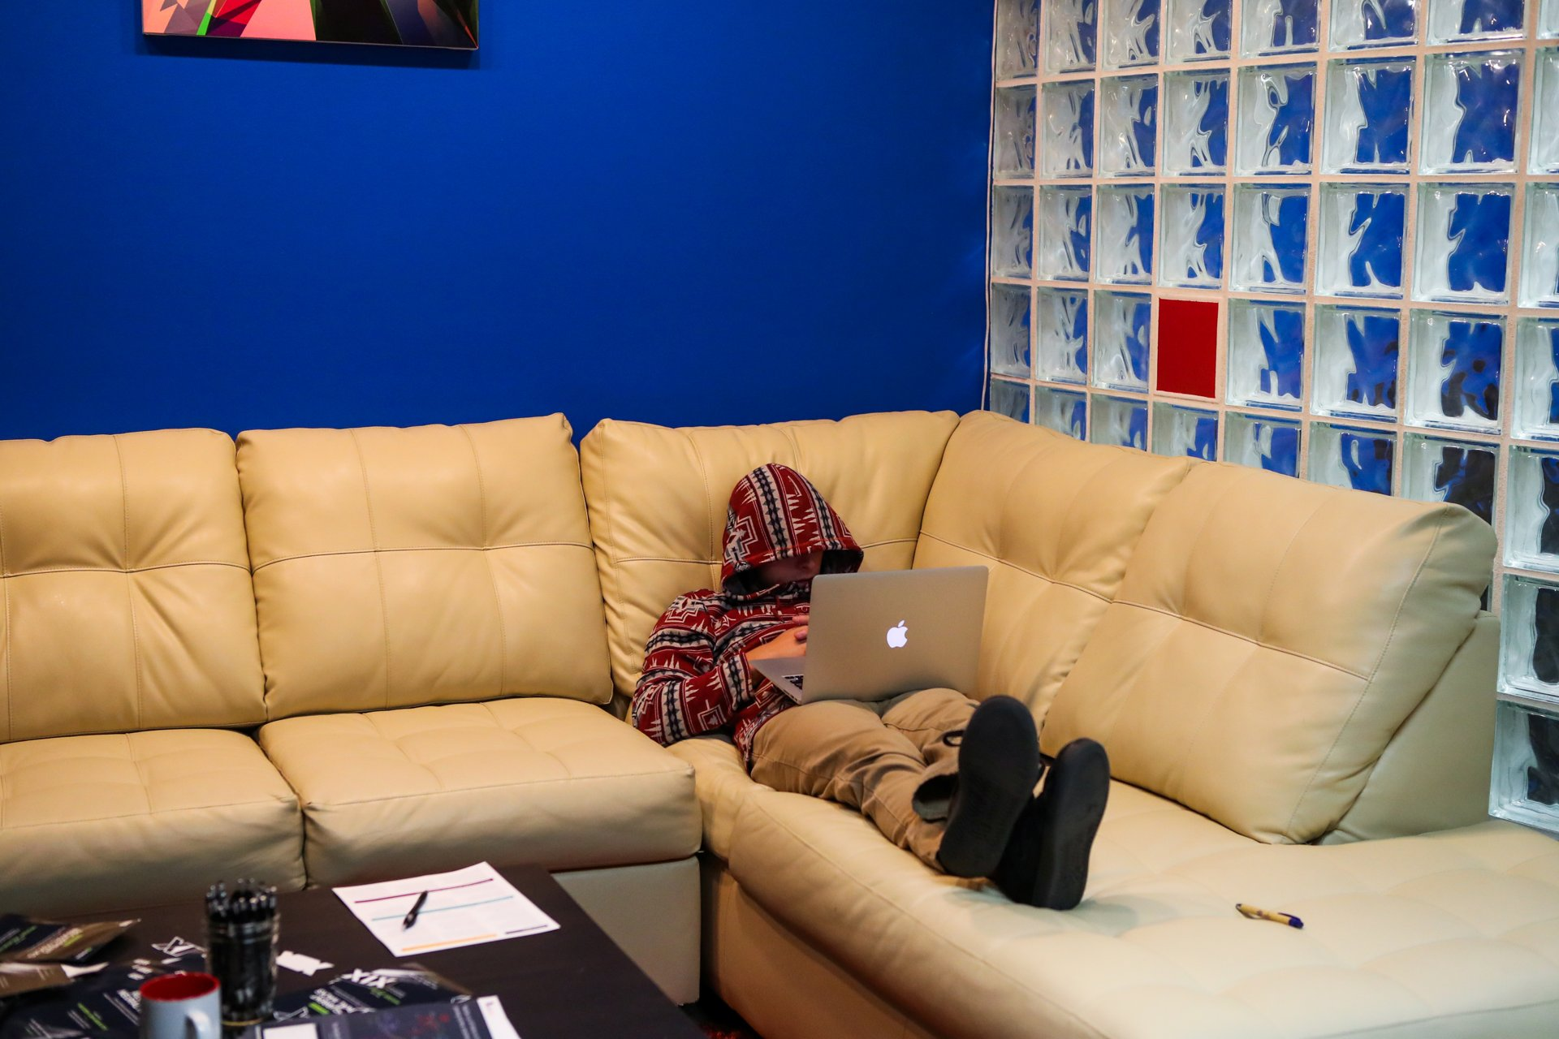
Student Choice – Interesting Articles 2/2
MIT-born Spyce raises $21M to open new robotic restaurants - Lucia Maffei, BostInno, 2018-09-07
The Coders Programming Themselves Out of a Job - Brian Merchant, The Atlantic, 2018-10-02
Notes:
All Last Accessed 2018-10-04
Spyce image: https://www.engadget.com/2018/05/04/boston-robotic-kitchen-spyce/ , 2018-05-04
Coders Programming Themselves Out of a Job image: Gabrielle Lurie, Reuters (date unknown)

Slide 66
Class 14
The End
Keith A. Pray
Instructor
socialimps.keithpray.net
Notes:
This is the end. Any slides beyond this point are for answering questions that may arise but not needed in the main talk. Some slides may also be unfinished and are not needed but kept just in case.

Slide 67
Evaluations
Use only BLUE or BLACK ballpoint pen
Use an X to mark (Do NOT fill in box)
Course Evaluation
  Write MY NAME and COURSE TITLE in box at top of form
  Keith A. Pray
  CS 3043 Social Implications Of Information Processing
  Return to Academic Advising Office in Daniels Hall
  Include “Evaluation Sheet” cover letter
Notes:
No TA/SA this time
TA/SA Evaluation
Name:
Return to CS Department: Fuller 233

