Slide 1
Class 2 Critical Thinking
Keith A. Pray
Instructor
socialimps.keithpray.net
Notes:
Here’s the title slide. Excited already, aren’t you?
Have wiki open to show time line. https://wiki.wpi.edu/cs3043

Slide 2
Overview
Assignment
Guest Speaker
Review
Critical Thinking
Notes:
Review reference notation

Slide 3
Assignment
Create an information processing technology timeline
You can choose any scope (time periods, domains, etc.) and format you like
Example timeline - Class Site → Wiki → Timeline
Write a 1 page paper that draws a conclusion using your timeline to illustrate your point.
Class Timeline Wiki
Add items from your timeline to Class Site → Wiki → Timeline
Please (insertion) sort according to date.
Add your references
If you encounter any trouble please contact me and our TA/SA to assist
Notes:
Be sure to read paper guidelines!
Sign up to present in class
Send TA (and me) email
Specify your topic. By that I mean be specific.
I’ll be happy to discuss your ideas.

Slide 4
My Reading Notes
pp. 5 Three Mile Island source published 2001, 1979 + 25 = 2004. How about now?
pp. 6 No slide rule?
pp. 20 Metric for most popular? Are there are more popular PCs today?
pp. 27 How did computerized prediction of election results get worse from 1952 pp 13?
pp. 28 “…transfer programs and data only.” Isn’t everything data? “200 million email messages” 90% of which are spam (pp. 112)
pp. 30 Lots of buzz on campus for the 1995 switch of backbone providers.
pp. 31 1973 saw the introduction of *handheld* mobile phone, larger versions available dating back to 1946^{[1]} and earlier.
pp. 32 What surfaced was inked?
pp. 34 Email demonstrated in 1968, pp. 28 claims 1972 but maybe just for ARPANET.
pp. 34 the “mother of all demos” is worth watching if you haven’t. Watch it and write a 1 page paper for extra credit (2 points).
pp. 35 Does Windows still have a near monopoly? HyperCard was my first.
pp. 38 Compare free Windows upgrade with pp. 20 open letter to hobbyists.
pp. 42 Q 22, Source for 90%?
End of Chapter questions I liked: 1, 7, 21
Notes:
[1] http://www.corp.att.com/attlabs/reputation/timeline/46mobile.html accessed 2014-09-01.
[2] http://www.wolframalpha.com accessed 2014-09-01
[3] http://www.radicati.com/wp/wp-content/uploads/2013/04/Email-Statistics-Report-2013-2017-Executive-Summary.pdf accessed 2014-09-01
Didn’t notice in new edition but keeping around just in case:
~pp. 38 “just about everyone” implies a large majority, 7.22 billion people ^{[2]} , ~4 billion email accounts^{[3]} , with many people having multiple accounts.

Slide 5
Group Quiz!
List 4 ways of committing plagiarism.
Name earliest wireless network mentioned in Chapter 1.
List 2 practical reasons it was more rapidly adopted on the continent of Europe than the British Isles.
Principal innovation of IBM System/360?
Who invented the computer mouse?
Notes:
Possible Answers:
copying another’s words without putting the words in quotation marks and citing the source
paraphrasing another’s words without citing the source
incorporating someone else’s figures or drawings without citing the source
referencing facts that are not common knowledge without citing the source
using another person’s ideas without giving that person credit
Semaphore Telegraph
Poor visibility due to weather, distance between islands
Circuit/Switched:
Douglas Engelbart – Mother of all demos. Announce extra credit for watching the demo and writing a paper.
-----
Difference between plagiarism and misuse of sources?
Deliberate attempt to conceal source versus failure to use quotes and citations correctly.
Principal innovation of IBM System/360?
Compatible software
What different meanings of “codex” can you list?
Earliest books, audio/video encoding schemes,…
When was the term “hypertext” introduced? The concept?
1965 (Ted Nelson) – 1945 (Vannevar Bush)

Slide 6
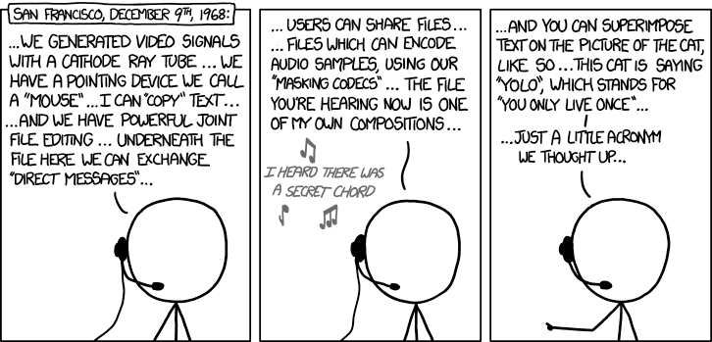
Douglas Engelbart (1925-2013) http://xkcd.com/1234/
Notes:
Highlighted are parts I am unable to find evidence of Engelbart inventing
Video Windowed Display
Mouse Cursor Text Operations including Drag and Drop
Collaborative File Authoring
Email
Video and Audio Teleconferencing with Picture-In-Picture
Personal Computer
Inter Networking
Desktop and Application Sharing
Hierarchical File System and Files
Pattern Search
Interactive Line Drawing
Hyperlinks in and across documents
Graphics tagging and Hyperlinking

Slide 7
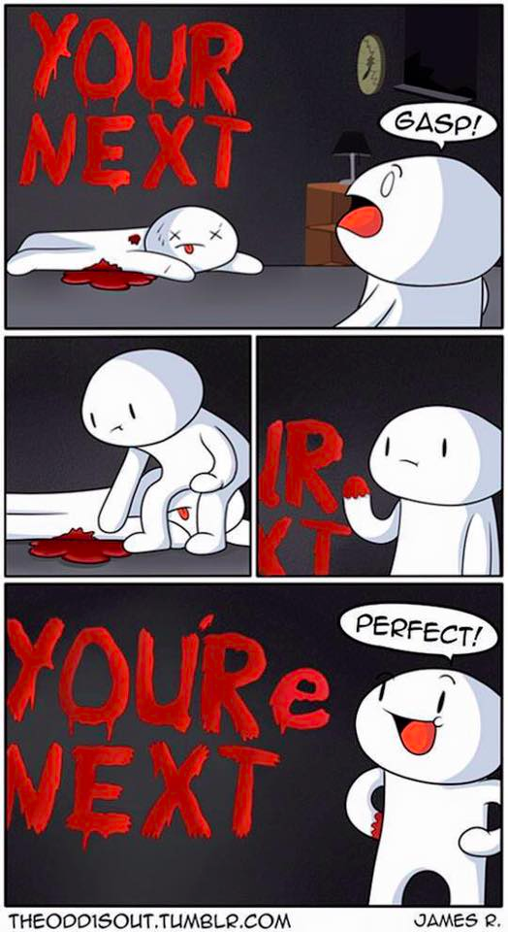
Overview
Assignment
Guest Speaker
Review
Critical Thinking
Notes:
Review Paper Guidelines
“Weird” Al Yankovic – Word Crimes (3:45)
https://www.youtube.com/watch?v=8Gv0H-vPoDc
If not shown last class:
What "Orwellian" really means - Noah Tavlin (5:31)
http://ed.ted.com/lessons/what-orwellian-really-means-noah-tavlin

Slide 9
Logical Arguments
Premise 1
Premise 2 (optional)
.
.
.
Premise x (optional)
Conclusion
Every A is a B
C is an A
Conclusion: C is a B
Every dog is a canine
Rupert is a dog
Conclusion: Rupert is a canine
Notes:
A basic argument contains 2 or more claims, one of which is the conclusion.
The others are the premises.
The premises should logically lead to the conclusion being true if each in turn is true.
For 1 page papers it is more clear to start with your conclusion.

Slide 10
Weak Or Strong Arguments
Valid | Invalid
Valid: conclusion logically true
Inductive: conclusion likely true
Fallacious: error in logic
Sound: facts true
All bats are animals
Some wooden objects are bats
Some wooden objects are animals
Inductive | Fallacious
Sound | Unsound
Strong
Weak
Notes:
Valid: Assuming the premises are true, does it logically follow that the conclusion must be true. One way of doing this is to find a counter example where the premises are true but the conclusion is not.
Inductive: If an argument is invalid it could still be inductive, that is it could increase the likelihood that the conclusion is true. Otherwise it might include a fallacy. A fallacy is an error in logic.
Sound: If an argument is valid or inductive the premises should be verified as facts. If they are true the argument is sound, and the argument strong. Otherwise the argument is weak.

Slide 11
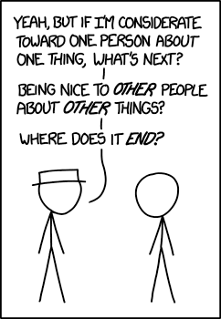
Common Fallacies 1/7
Slippery Slope
“A bad guy might use computers to steal. Therefore we should outlaw computers.”
http://xkcd.com/1332/
Notes:
Another interesting source:
http://www.informationisbeautiful.net/visualizations/rhetological-fallacies/

Slide 12
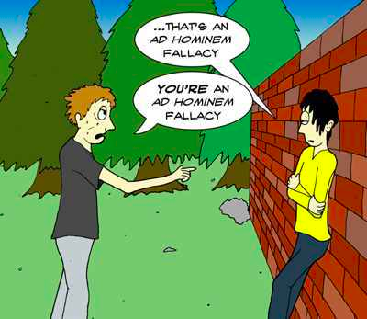
Common Fallacies 2/7
Attack Person, Not Argument
Ad Hominem
“He’s a messy eater, obviously his software design will never work.”
http://listverse.com/2012/11/08/15-bad-arguments-we-all-abuse/
Notes:
http://listverse.com/2012/11/08/15-bad-arguments-we-all-abuse/
Accessed 2015-03-19

Slide 13
Common Fallacies 3/7
Begging The Question
Petitio Principii, Circulus in Probando
“OO languages are superior to non-OO languages because they have objects as their basic constructs.”
Appeal To Authority
Ad Vericundiam
“Ernie, an expert on internet protocols, said MySpace is far superior than Facebook, so it must be so.”
Many / Any
“Many programming languages such as C, C++, and Java are statically typed. Scheme is a programming language so it is statically typed too.”
Notes:
Static vs. Dynamic Typed: Dynamically-typed languages perform type checking at runtime. Statically typed languages perform type checking at compile time. Statically-typed languages require you to declare the data types of your variables before you use them, while dynamically-typed languages do not.
Strong vs. Weak Typing: is about how strictly types are distinguished. Strongly typed languages do not allow for implicit casts. [2]
Explicit vs. Implicit Typing: is about declaring a variable’s type. Explicit languages enforce a programmer to clearly ("explicitly") define a variable type during the declaration, while implicit typing languages may infer the type of a variable during compile or interpretation time. [3]
[2] Yedhu Krishnan, Static/Dynamic vs Strong/Weak, http://stackoverflow.com/questions/2351190/static-dynamic-vs-strong-weak (last retrieved August 31, 2016)
[3] Wiz E. Wig, C: Implicit vs. Explicit Typed Variables, https://bitwizards.com/Thought-Leadership/Blog/2014/November-2014/C-Implicit-vs-Explicit-Typed-Variables (last retrieved August 31, 2016)
[4] https://docs.oracle.com/cd/E57471_01/bigData.100/extensions_bdd/src/cext_transform_typing.html

Slide 14
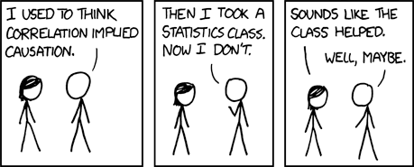
Common Fallacies 4/7
False Cause
Non Sequitur – post hoc ergo propter hoc
“The day after Billy Bob Joe bought a Mac, Apple’s stock went up. Clearly Billy Bob Joe’s purchase was the cause.”
http://xkcd.com/552

Slide 15
Common Fallacies 5/7
Composition / Division
“All the actors in this movie are highly skilled, the movie must be great.”
“WPI was founded in 1865 so all the faculty must be at over 150 years old.”
Appeal To The People
Argumentum ad Populum
“Windows is installed on more desktop computers than any other OS. Windows is the best OS.”

Slide 16
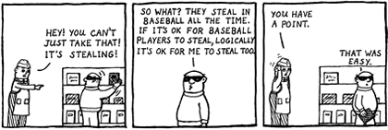
Common Fallacies 6/7
Ambiguity
Often a form of conflation.
Respect – “recognize a right” vs. “hold in high regard”
Notes:
http://www.christianlogic.com/images/uploads/christianlogic_nunaandtoodles_2003_equivocation.png
Accessed 2015-03-19
From Wikipedia: (accessed 2012-08-27)
In logic, conflation is the error of treating two distinct concepts as if they were one. The result of conflating concepts may give rise to fallacies of ambiguity, including the fallacy of four terms in a categorical syllogism. For example, the word "bat" has at least two meanings: a flying animal, and a piece of sporting equipment (such as a baseball bat or a cricket bat). If these two meanings are not distinguished, the result may be the following categorical syllogism, which is clearly intended as a joke (pun):
1. All bats are animals.
2. Some wooden objects are bats.
3. Therefore, some wooden objects are animals.
Conflating words with different meanings can cause real confusion. For example, respect is used both in the sense of “recognize a right" and "have high regard for". We can recognize someone's right to the opinion that humanity is controlled by alien lizards in human form, without holding this idea in high regard. But conflation of these two different concepts leads to the notion that all religious ideas, for example, should be treated with respect, rather than just the right to hold these ideas.

Slide 17
Common Fallacies 7/7
Straw Man
“He says taking Social Imps is a waste of time. He wants you to think computing and society are useless.”
”She says OO is not superior. She wants you to put everything in one big main function.”
There are many more… seems to be no limit to the ways in which humankind can err.

Slide 18
Class 2 The End
Keith A. Pray
Instructor
socialimps.keithpray.net
Notes:
This is the end. Any slides beyond this point are for answering questions that may arise but not needed in the main talk. Some slides may also be unfinished and are not needed but kept just in case.

