Slide 1
Class 4 Freedom Of Speech
Keith A. Pray
Instructor
socialimps.keithpray.net
Notes:
Here’s the title slide. Excited again, aren’t you? You should be.
Paper Notes:
Average: ~5.5 (usually 4)
Quantify
Missing Counter Point and Response
Be sure to put quotes around entire quote
Try reading paper aloud to proof
Save for next time:
State Conclusion clearly

Slide 2
Overview
Review
Assignment
Students Present

Slide 3
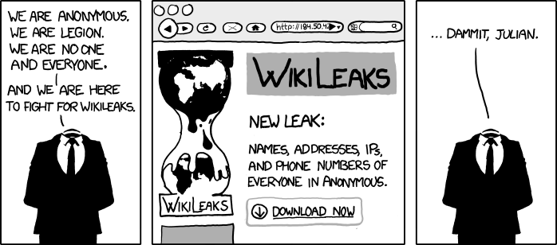
http://www.xkcd.com/834/

Slide 4
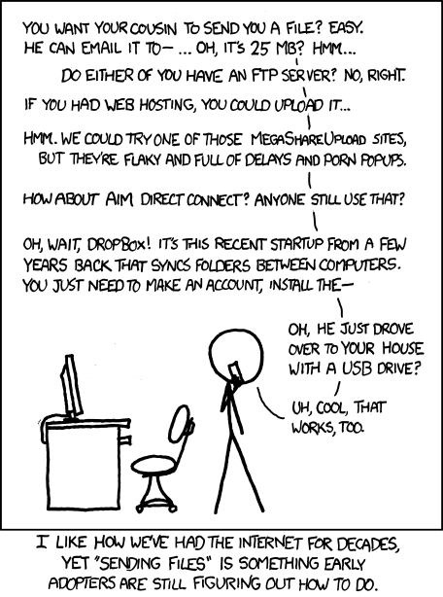
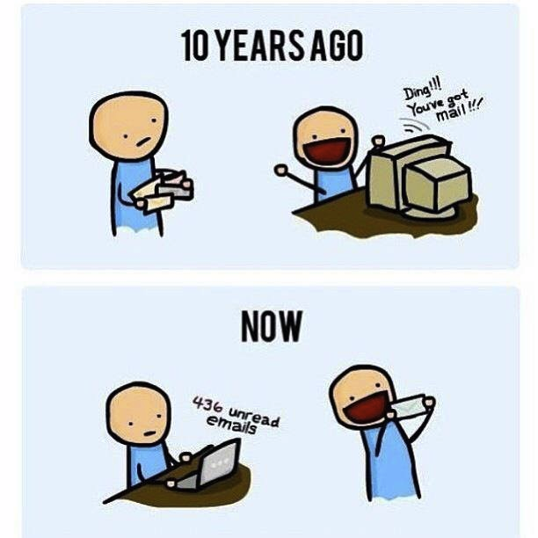
http://poofytoo.com/
20
http://xkcd.com/949/

Slide 5
My Reading Notes
pp. 110 What powers the cell phones and towers? “everyday tasks” not apparent from image.
pp. 114 Ann did not force people to complain.
pp. 117 7% # transactions or $$? Wikipedia critics source [19] from 2005, how has quality turned out? Nice to see darknet added.
pp. 118 [27] PC bangs youth source from 2003, all grown up now.
pp. 130 Is 20% realistic? What will search engines and facial recognition be capable of? Rule Utilitarian ignores the private setting.
pp. 131 Do any filters use image processing?
pp. 133 Stating people searching did not consent to material being blocked makes more sense.
pp. 134 Web access for no cost?
pp. 145 More accurate to say addicted to single app?
pp. 149 20 same as 39
pp. 150 36 same as 42
End of Chapter questions I liked: 2, 25 http://en.wikipedia.org/wiki/Wikipedia:Citing_Wikipedia

Slide 6
Group Quiz
Name two methods some governments use to control access to information.
A large company has a policy prohibiting employees from blogging about company products.
Name two possible reasons for the policy.
Does it violate the First Amendment? Why?
Is it reasonable? Why?
What does “URL” stand for and what is it?
Notes:
Censorship (religious, governmental, private). Adult authentication. Global dissemination. Freedom of Speech not an absolute right.

Slide 7
Overview
Review
Assignment
Students Present
Notes:
But before that:
CPG Grey - This Video Will Make You Angry [Thought Germs] (7:25)
https://www.youtube.com/watch?v=rE3j_RHkqJc
Cedric Gervais - Hashtag (Original Mix) (3:58)
https://www.youtube.com/watch?v=6OmBKd7X7EE
Dave Audé vs Luciana - You Only Talk In #HASHTAG (3:36)
http://www.youtube.com/watch?v=53wIN87lJn0

Slide 8
Assignment
Reading
Individual Presentations
Extra Credit – One page paper
Is WPI’s IT Acceptable Use Policy morally acceptable?
Work on your group project.
See full group project description on course website.
Notes:
Or review group project and individual presentation guidelines right now.
Possible One page paper:
Global intellectual property laws, friends or foes?

Slide 9
Overview
Review
Assignment
Students Present

Slide 10
Avatar Based Interactions: The Ethics of Self-representation
Tom Farro
Is it dishonest to misrepresent yourself with an avatar?
Doesn’t matter unless deception is intentionally being used to take advantage of others
Notes:
Avatar Based Interactions: The Ethics of Self-representation
Computers let us represent ourselves in all sorts of new ways . The question: is it ethical to use these tools to assume a decidedly different online avatar? Is this a form of trickery to other players?
In my opinion, no. It’s an old adage to not judge a book by its cover, and to me it seems even more unethical to require people to restrict their freedom of self-expression to the physical characteristics they were born in to.
Even if it is dishonest, as long as it isn’t used to hurt someone, it’s ethically neutral at worst.
Furthermore, it’s unclear at best whether or not games like these even intend for you to be creating your “real-self” in the first place. However, it becomes tricky when role-players are put in the same pipeline of social interaction as people less dedicated to being “in character”

Slide 11
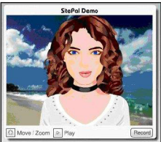
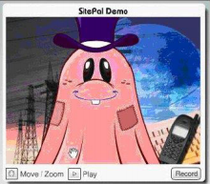
Categories of Avatars
Tom Farro
Real-Self Avatars
Designed to closely resemble user
Fantasy-Self Avatars
Entirely different than user
Images from [1]
Notes:
Most people in this class are probably familiar with the concept of an Avatar, so no need to dawdle on the subject.
Quickly address the two types of avatars

Slide 12
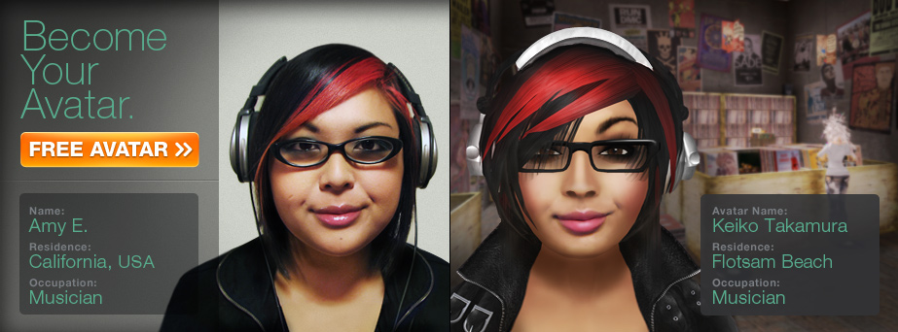
The Avatar as the Essential Self
Tom Farro
Studies find that people tend to make avatars that resemble them¹
Users expect others to follow this mindset
Creates expectation of “visual honesty”
Image from [5]
Notes:
Second Life is a social MMO that is extremely user-driven. It offers a kind of unbelievable amount of customization options, because the content is user-created.
Obviously, the graphic provided is cherry-picked to demonstrate a high level of user-avatar parity and impress potential customers, but Second Life is actually remarkably good in this aspect.
Because people tend to gravitate towards making avatars that resemble them, they come to expect other people to do the same, which can cause problems when not everyone follows that mindset

Slide 13
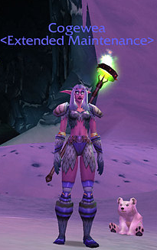
The Avatar as the Essential Self
Tom Farro
Who is the user behind this avatar, “Cogewea the Night Elf”?
How do we know?
Can we know?
Image from [6]
Notes:
Quick example. We just can’t draw any conclusions about the user behind the avatar, but people will still make assumptions.
Confusion arises when a fantasy-self avatar contains human-enough characteristics to also pass as a theoretical real-self avatar

Slide 14
Visual Dishonesty
Tom Farro
In World of Warcraft, men are three times more likely than women to play as an opposite-sex avatar³
The reason is trite: they just prefer to look at a female avatar³
Some users take avatars at face value
Users “take a don't-ask, don't-tell approach when it comes to […] avatars” ⁴
“Female avatars are often the center of attention and showered with gifts such as swords or armor by other characters” as a form of flirtatious behavior ⁴
Notes:
In some cases, players choose to forego a real-self avatar for ethically trivial reasons. For example, in WoW, many men that play as opposite-sex avatars simply because the game is in a third-person perspective, and they prefer to be staring at a woman’s butt over another man’s.
As trite as that may be, there are some people who take these representations at face value and implicitly assume the player is female as well. In an article I read, the phrase “don’t ask, don’t tell” is used to describe player mentality in regards to user identity. Usually, player identity doesn’t matter “so long as you can fight”, so people don’t ask. Additionally, lonely male players often just “hope for the chance of there being a cute girl on the other end”[4]

Slide 15
Dishonest Representation
Tom Farro
Consider the following scenario:
Player 1 plays as a female avatar because he would prefer to stare at a female avatar during hours of gameplay
Player 2 sees this female avatar and assumes the user is also female
Player 2 begins being extra-friendly to Player 1 as a form of flirtation
It is never stated by Player 2 to Player 1 that this behavior is due the assumption of Player 1’s identity
Is this a form of lying on Player 1’s part?
Kantian ethics suggest lying is ALWAYS wrong
Is the ethical onus on Player 1 to provide a “disclaimer” about themselves?
Notes:
An ethically dilemma, ask the class to think about this one, it will come back at the end for discussion
Is it fair to put the onus on Player 1? To me, that feels like a “guilty until proven innocent” kind of situation.
Things get complicated because these games are often RPGs, but not everyone gets into in-character roleplay. Still, they’re in the social pipeline, so someone who is not playing a character might not realize that someone else is.

Slide 16
Compulsory Dishonesty
Tom Farro
Second Life lets users model their own assets
Most editors are not so flexible
For example, many games lack sophisticated “body-type” options
Can an editor force you to be dishonest?
Notes:
An extension of the previous hypothetical to help convey my point. It’s ridiculous to assume that people match their avatar, when people are so complex but most avatars are relatively simplistic.

Slide 17
In-Between Real and Fantasy
Tom Farro
Suppose the disparity between user and avatar is more subtle
Many Second Life users make their avatars their ideal selves, rather than photorealistic copies²
At what point is the line drawn?
Survey find that users care about consistency rather than accuracy²
When does it become “lying” to other players?
Active lying vs passive lying
You cannot be lying by just existing
Notes:
How different is too different? Studies actually find that people in Second Life care more about parity between avatar appearance and mannerisms than avatar identity and user’s identity
Active lying would be: telling people “yes I am my avatar in the physical realm”
Passive lying in this case would be looking a certain way, which I contend can’t really be a type of lie.

Slide 18
References
Tom Farro
[1] Mohammad Nur Azhar Mazlan, Mohamad Azhari Abu Bakar, “Students’ Perception of Self-presentation towards Avatar”, from Procedia: Social and Behavioral Sciences, 2013.
[2] Simon Gottschalk, “The Presentation of Avatars in Second Life: Self and Interaction in Social Virtual Spaces”, from Symbolic Interaction Vol. 10, Fall 2010.
[3] Nick Yee, “The Surprisingly Unsurprising Reason Why Men Choose Female Avatars in World of Warcraft”, from Slate, accessed September 5th, 2016 http://www.slate.com/blogs/future_tense/2014/05/13/world_of_warcraft_gender_switching_why_men_choose_female_avatars.html
[4] Reuters, “Female Impersonation Tarts Up Online Game”, from CNET, accessed September 5th, 2016 http://www.cnet.com/news/female-impersonation-tarts-up-online-games/
[5] “What is an Avatar?” from the Second Life Official Website, accessed September 5th 2016 http://secondlife.com/whatis/avatar//?lang=en_gb
[6] Cogewea, “Public Screenshot”, accessed September 5th, 2016 http://eu.battle.net/wow/en/media/screenshots/transmog/nightelves?view=nightelf-female008&keywords=female

Slide 19
Social Norm Changes with Networked Communications
Alex Huot
The use of online communication is now part of our everyday lives
What effect has this had on social interactions?
Networked communications (email, social media), when used in moderation, help improve social interactions offline
Notes:
Quick overview of conclusion (last point is the conclusion)

Slide 20
Strengthening community Bonds
Alex Huot
Use of Social media
Usually friends with offline friends
Strengthen connections with others
Knowing each other off and online = more often meet each other
Meeting new friends
Chances of being introduced to friends of friends
Strengthen local connections
At home, workplace, neighborhood, ect.
[1],[2],[3],[4]
Notes:
In a study concerned with the use of Social Media, it was determined that most of the student’s online friends were people they knew from offline connections [1]. It was also discovered that “the friends they spent the most time with online and offline were very good friends whom they saw most often in-person” [1]. Connecting with friends online allows an individual to learn more about and spend more time with their friends, when it may not be possible, such as late at night when they cannot meet normally.
Social media is used to strengthen these offline connections [2]. One study showed that adults, “use online communication for offline issues, and to connect with people in their offline lives” [2]. When you meet online, you are given opportunities to express yourself more, such as in a post, allowing friends to learn more about you and provide opportunities for friends to connect with your beliefs and opinions.
People living in communities that are connected both offline and online participate are in contact with each other more often [3]. Online communication, as mentioned before is used to strengthen offline connections. Connecting with people online allows for individuals to learn more about others and learn about new ways that they can connect offline. For example, learning that you both love sports.
There is a chance in online communications where a message one individual writes gets forwarded to a friend of a friend, resulting in the creation of more friendships [4]. Computer networks allow us to connect with the community, such as when setting up meetings [4].

Slide 21
New Form of Support
Alex Huot
Sharing of more personal ideas
No direct feedback
Disclose more personal information online
Speak to more people
Wider group can participate online
Beneficial to communicate with more distant friends
[1],[4],[5]
Notes:
“The absence of direct feedback in most [Computer-mediated communication] encourages more extreme forms of communication” [4]. Without direct feedback, individuals can say what they want without having to be concerned with what particular people have to say. With this freedom, individuals can say or ask things that they might otherwise have been too nervous or embarrassed to say in person. In one study (new friendships), it was found that “Individuals are more likely to disclose not only more personal information but also information that they otherwise might not in person” [3]. For an earlier stage in friendship, it is easier to talk about some things online than in person, since an individual might be nervous about how their friend would respond. Being able to learn about friends online can reveal new connections with that person, strengthening offline friendships.
“Online contexts might present an alternative, and less threatening, forum for younger adolescents” [5]. When meeting online where a large number of friends have the opportunity to respond to posts, resulting in the creator of the post having a wide array of responses to look at. This works for helping out an individual with personal concerns, as well as learning what their friends think about a particular idea. Communicating with distant friends not only helps to stay in touch with more distant friends, but can also provide more variety in views [4]. Overall, communicating in this way online can be used to improve relations (what you know about them) with the friends you meet offline.

Slide 22
Keep in touch with all friends
Alex Huot
Communication
People they don’t see often
Distance communication
Maintain connections
Information gathering
Learn what is happening in their lives
Learn about different cultures (such as different city cultures)
[3],[4]
Notes:
In a study about college students, social media websites were used “as a means of staying in touch with their friends as well as their family members and relatives” that they do not see often [2]. Using online communications such as social media allows for individuals to communicate with distant friends and relatives, which helps with the continuation of current connections. Online communication can be used to connect people with varying schedules, such as those in different time zones [4]. Without social media and online communication, many of these connections could easily fall apart. Thus, social media can be used to keep these weak-ties (relationships with distant people) supported until a meeting can occur in person to strengthen these ties again.
Communicating with distant friends online also allows for the exchange of what is happening in their community and your own community. The use of social media can connect various social communities and provide different set of information for individuals [4]. A person can be informed about changes in the community far away while also maintaining the changes in their current community. For example, you could learn about the difference between the community in New York City and Boston. In this way individuals can better connect with friends in person. Friends will be better informed with what is going on in the various communities so they do not have to catch up with what has been going on, since this could put a strain on their relationship.

Slide 23
Need for moderation
Alex Huot
Social anxiety
Online communications is not an alternative
Need offline meetings
Not as important
Popularity
Online profile = not convincing
Misleading information
[6],[7],[8]
Notes:
While online communications are useful, it is important to remember that it is not necessary to spend a large amount of time using them. In a study about the well-being of youths, it was found that “Internet use by socially anxious youths as an alternative to face-to-face communication results in poorer well-being” [6]. However, socially anxious youths could benefit from their online use if they participated in many offline meetings.
Some people use online communications for popularity. However, one study showed that an individual’s self-esteem related to offline popularity, not online popularity [7]. There is no need to try to make yourself look popular online since most people identify popularity in offline communications. Also, people can identify misleading information [8]. Information, such as having a lot of friends, does not make a person look more popular, since it is so easy to gain a large number of friends. Posting often has a similar effect.
Occasionally, people will exaggerate information about themselves online [7]. It has been shown that youths with low self-esteem and high sociability might present themselves differently than they do when in person [7]. Misleading information can have a negative impact on an individuals’ social connections, especially if you are not closely connected to others. For example, “misleading online information signified untrustworthiness and hypocrisy to a significantly greater extent for acquaintances than friends” [8]. This could ruin chances of friendships with other people.

Slide 24
References
Alex Huot
[1] Reich, Subrahmanyam and Espinoza, Friending, IMing, and hanging out face-to-face: Overlap in adolescents' online and offline social networks (US: American Psychological Association, March 2012), http://psycnet.apa.org/journals/dev/48/2/356
[2] Reich, Subrahmanyam, Waechter and Espinoza, Online and offline social networks: Use of social networking sites by emerging adults (Journal of Applied Developmental Psychology, Volume 29, Issue 6, 2008), Pages 420-433, http://www.sciencedirect.com/science/article/pii/S0193397308000713
[3] Uwe Matzat, Reducing Problems of Sociability in Online Communities: Integrating Online Communication With Offline Interaction (SAGE Publications, 2010), http://abs.sagepub.com/content/53/8/1170
[4] Barry Wellman and Keith Hampton, Living Networked On and Offline (American Sociological Association, 1999), http://www.jstor.org/stable/2655535?pq-origsite=summon&seq=1#page_scan_tab_contents

Slide 25
References Continued
Alex Huot
[5] Artemio Ramirez Jr. and Shuangyue Zhang, When Online Meets Offline: The Effect of Modality Switching on Relational Communication, (Communication Monographs, Vol. 74, Issue 3, 2007), Pages 287-310, http://www.tandfonline.com/doi/full/10.1080/03637750701543493?scroll=top&needAccess=true
[6] Koo Hoon Jung, Woo Sungbum, Yang Eunjoo, and Kwon Jung Hye. Cyberpsychology, Behavior, and Social Networking. September 2015, 18(9): 514-520. Link
[7] Jolene Zywica and James Danowski, The Faces of Facebookers: Investigating Social Enhancement and Social Compensation Hypotheses; Predicting Facebook™ and Offline Popularity from Sociability and Self-Esteem, and Mapping the Meanings of Popularity with Semantic Networks, (Journal of Computer-mediated Communication, Vol. 14, Issue 1, 2008), Pages 1-34, http://onlinelibrary.wiley.com/doi/10.1111/j.1083-6101.2008.01429.x/abstract
[8] David DeAndrea and Joseph Walther, Attributions for Inconsistencies Between Online and Offline SelfPresentations, (Communication Research, Vol. 38, No. 6, 2011), Pages 805-825, http://crx.sagepub.com/content/38/6/805.full.pdf+html

Slide 26
Class 4 The End
Keith A. Pray
Instructor
socialimps.keithpray.net
Notes:
Use remaining time to form groups, approve group topics, etc.
This is the end. Any slides beyond this point are for answering questions that may arise but not needed in the main talk. Some slides may also be unfinished and are not needed but kept just in case.

