Slide 1
Class 9
Errors Failures Risks
Keith A. Pray
Instructor
socialimps.keithpray.net
Notes:
Here’s the title slide. Excited already, aren’t you?
What errors? – Have student record list on board
Who looked for existing test strategies?
Who looked for directions on how to test currency?
Paper Reminders:
Use #’s and facts instead of “great, a lot, numerous, many, most, much…”
Avoid absolutes unless quoting facts “always, never, must, will…”
Make organization clear, avoid CP R, CP R through out whole paper.

Slide 2
Survey Results 1/2
Likes
  Open dialogue (7)
  Class stays on topic
  Up-to-date course site (2)
  Good textbook
  Active discussion (12)
  Papers are helpful and applicable to material
  No quizzes
  Cares about students and the course (2)
  Class time well spent
  Variety of paper types
  Small, but constant assignments
  Interesting videos (2)
  Current day examples (2)
  Interesting topics for discussion
  Comics (2)
  Ensures critical thinking in class
  Guided learning through textbook
Likes
  Encourages reading and discussion (2)
  Assignments create opportunity to learn something new
  Playing devil’s advocate (2)
  Recaps on slides (4)
  Reviewing key terms from reading
  Lots of extra credit
  Gives everyone a chance
  Encourages questions
  Daily quiz discussions are more helpful than regular quizzes
Improve
  More examples or case studies
  Post slides before class
  Enforce choosing presentation assignment on first day of class
  Readings too long
  Provide schedule of each class
  PPT slides shouldn’t need to follow template
  Tell students what to focus on in the readings
  More context when assigning papers
  Finding assignment descriptions can be difficult (3)
  Spend more than one class on some topics
  Post grades online
  Different types of assignments than papers
  Reduce paper work load or spread out more (3)
  Keep it lively
  Better call-on-people distribution
  Grading of papers and presentations contradicts what I’m familiar with
  One page isn’t enough, especially with five sources (3)
  Pre-determined discussion topics to get people thinking at beginning
  Grade less determined by participation
  Post paper assignment somewhere more convenient than class slides
  More debates with opposing points on controversial topics
  Up-to-date examples to illustrate reading (2)
  Please write neater feedback on papers
  Less work
  Make conversation between students and not directed at you. Sit in a circle
  More group debates
  Less sarcasm

Slide 3
Survey Results 2/2
Self-Improve:
  Read more often (1)
  Start work earlier (10)
  Dedicate more time (5)
  Go to the writing center (1)
  Proof read (1)
  Less timid in discussions (6)
  Read more carefully (6)
  Do extra credit (1)
  Read outside of chapter (2)
  Find more sources on papers (1)
  Read chapter before writing paper (1)

Slide 4
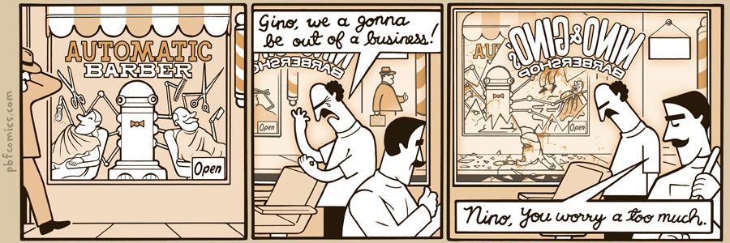
http://pbfcomics.com/197 (2014-09-26)
Notes:
10 – Errors, Failures, Risks

Slide 5
Overview
Review
Assignment
Students Present
Guest Speaker
Notes:
We can also discuss articles listed on Security Discussions under documents of course web site.
ADD QUIZ AS BACKUP IF CLASS DISCUSSION OR GUEST SPEAKER FAIL

Slide 6
My Reading Notes
pp. 362 Any false arrests since 1989?
pp. 368 This is not to keep the system from responding to false alarms.
pp. 371 Always encapsulate units!
pp. 373 Why did they refuse?
pp. 376 Republicans and Florida.

Slide 7
Assignment – 1 Page Paper
From Chapter 9 In-class Exercises # 24.
Should the company produce the game?
Use the SWE Code Of Ethics as the basis for your argument.
The SWE Code of Ethics should not be the sole source for your premises.

Slide 8
Overview
Review
Assignment
Students Present
Guest Speaker
Notes:
We can also discuss articles listed on Security Discussions under documents of course web site.
ADD QUIZ AS BACKUP IF CLASS DISCUSSION OR GUEST SPEAKER FAIL

Slide 9
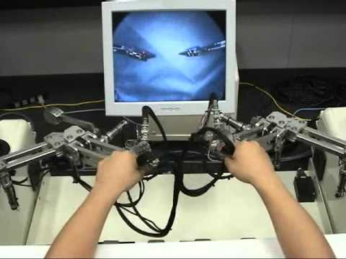
Remote telesurgery
Saraf Rahman
Surgical Robots
  Background
Telesurgery
  First case
  Strengths & Weaknesses
  Conclusion
https://www.youtube.com/watch?v=mICsAkOeep4 [1]
Notes:
Conclusion: The benefits of telesurgery outweigh the risks
State Argument: Telesurgery benefits patients by providing proper medical care in areas where there would be none otherwise
State Counter Argument: it’s more hassle than it’s worth because it’s costly and there are legal troubles
Response to Counter Argument: No, the cost will go down with time and there are always legal troubles
Restate Conclusion: The benefits of telesurgery outweigh the risks

Slide 10
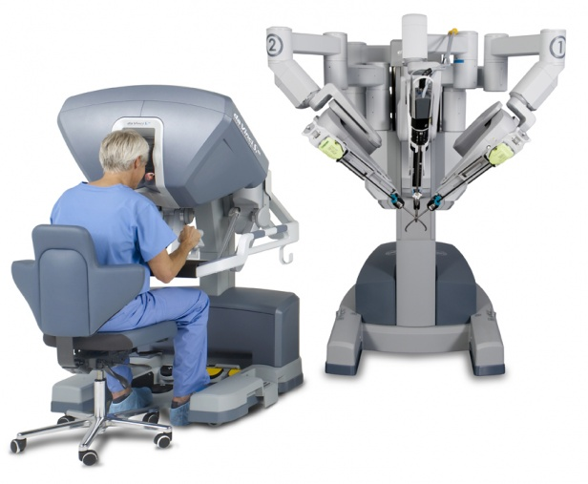
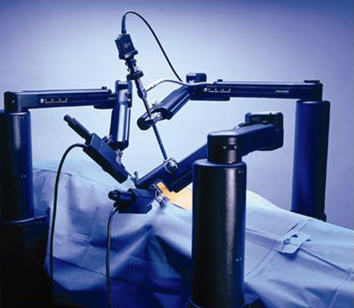
Surgical robots
Saraf Rahman
Da Vinci
  FDA-approved in 2000
  Costs $1 million
  4 robotic arms
Zeus System
  FDA-approved in 2001
  Costs $975,000
  3 robotic arms
http://www.technologyreview.com/view/512011/are-surgical-robots-worth-it/
Notes:
Differences between the systems:
Zeus costs $975,000 where daVinci costs $1mill
Zeus has 3 robotic arms, where daVinci has 4
Besides these differences, the actual procedures performed have little no difference depending on the machine [4]. In 2003, the Zeus system was discontinued because the company that makes the daVinci, Intuitive Surgical, bought out zeus’ company.
57 s.

Slide 11
WHY DOES ROBOTIC SURGERY MATTER?
Saraf Rahman
Open Surgery (OS)
Larger incisions
Laparoscopic Surgery (LS)
Minimally invasive
Shorter recovery time than OS
Robotic Surgery (RS)
easier technically for surgeons than LS
Shorter recovery time than LS
Longer recovery time
Notes:
The reason surgical robots came to exist is because they benefit both patients and surgeons.
(Open Surgery (OS) is the usual way that surgeons operate – they cut directly into the patient:
Results in longer postoperative recovery time
more blood loss than LS or RS.
Laparoscopic surgeries are:
Minimally invasive
Surgeon still cuts into patient but uses smaller tools which allows surgeons to operate with more precision [7]
Smaller tools = small incisions = shorter recovery time and lower blood loss
Also uses a camera to assist) DON’T SAY ANY OF THIS I GUESS
Robotic Surgery:
Also minimally invasive
Uses even smaller tools than LS = smaller incisions = shorter recovery time and lowest blood loss
Surgeon doesn’t operate on patient directly – sits at a console and controls robotic arms
May lead to lower risk of infection [4]
Arms are able to rotate and bend in ways the human wrist can’t [6]
2 min. 17 s.

Slide 12
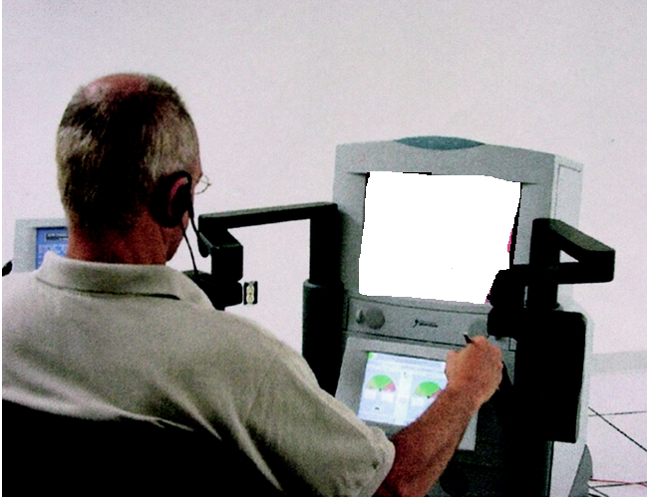
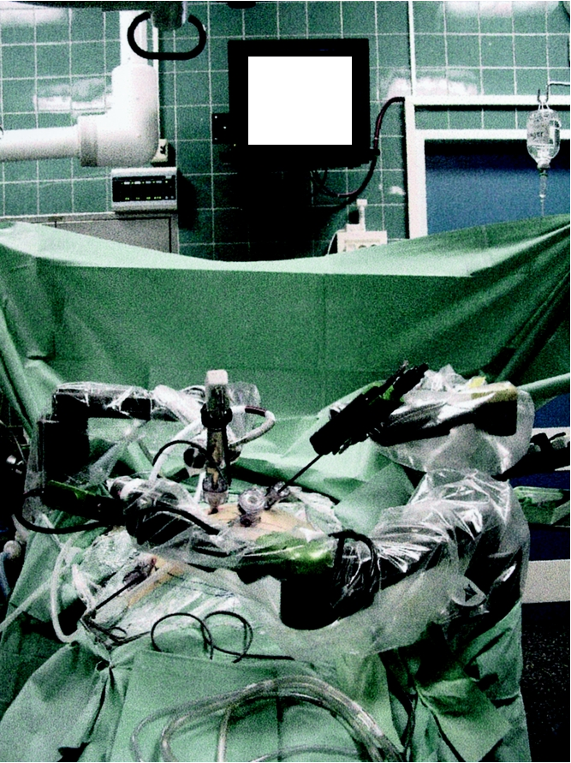
Lindbergh operation
Saraf Rahman
Performed in 54 minutes
Delay was 155 ms
Probability of no network outage is 99.99%
Image Quality Rating: 9.5/10
Safety Rating: 10/10
http://www.ncbi.nlm.nih.gov/pmc/articles/PMC1422462/
Notes:
The first case of remote telesurgery was called the “Lindbergh operation” and was performed in 2001 on a 68-year old woman in Strasbourg, France by surgeons in New York. This surgery used the ZEUS system and had two subsystems: the “surgeon side” shown on the left, and the “patient-side” shown on the right. The surgeons in France set up the robotic arm, while the surgeons in NY prepared the console. The connection between New York and Strasbourg was establish through asynchronous transfer mode (ATM) technology, which has network nodes that provides low transport delay, low packet loss ratio, and the probability of having no network outage is 99.99%. The time lag was an average of 155 ms which is pretty impressive considering that the surgeon and patient were almost 4000 miles apart.
The console takes in the patient’s subsystem (which are two of the robotics arms which translate the surgeon’s movements into robotic movements) and the third arm which controls the camera.
Three other surgeons in NY watched the surgery and evaluated the safety of the procedure and quality of the images seen on the screen. The procedure was completed in 54 minutes including the set-up time. After the procedure was completed, the surgeons rated the quality of the image 9.5/10 and the safety of the operation a 10/10. The patient was discharged from the hospital 48 hours after the procedure and monitored her progress in the later weeks. At the 2-week mark, she had no infection, her wounds were healed, and was back to her daily activities. [3]
2 min 9 s

Slide 13
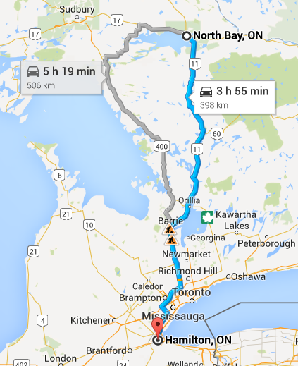
Rural area operations
Saraf Rahman
Performed in 2003 in Canada
  Surgeon was in Hamilton
  Patient was in North Bay
Used IP/VPN to link hospitals
Performed 21 surgeries
Notes:
The use of telesurgery in rural communities occurred in 2003 in Canada. The equipment set up was the same as the Lindberg Operation, the only difference was that this operation used IP/VPN (Internet Protocol – Virtual Private Network) using Quality of Service (which are used for bank and government offices) instead of an ATM line. This kind of network runs secure communication and has a back up line in case the first line gets interrupted. The hospitals chose to utilize this network instead of ATM because it was more cost-effective and telesurgery surgeries have the highest priority.

Slide 14
Saraf Rahman
Strengths
  Not limited by location
  Filters unwanted hand movements
Weaknesses
  Cost of Technology
  Privacy Issues
  Malpractice Lawsuit
  Jurisdiction Issues
Notes:
A few of the benefits of Telesurgery are that surgeries aren’t limited by location. For example, if someone in a third world country needed an emergency surgery performed, they ideally have access to that surgery – they wouldn’t be limited by their geographical location.
While ATM lines are available in 200 countries, it’s not available everywhere. The cost for having access to ATM lines from point A to point B ranges between $100,000 to $200,.000 a year. [3]
While there are weaknesses that are unique to telesurgery, these weaknesses can be overcome. While the technology may not be available due to cost, the cost of this technology will probably decrease over time as it becomes more used, and the privacy of patients can be protected by using some type of encryption.
2 min 34 s

Slide 15
Summary
Saraf Rahman
Why surgical robots are necessary
Remote Telesurgery
  Lindbergh & Rural Area Operations
  Strengths & Weaknesses
  Conclusion:
  The benefits of remote telesurgery outweigh its risks
Notes:
Robotic surgery is necessary because it benefits the patient the most compared to any other type of surgery. While the Lindbergh and Rural Area operations were successful and had high safety ratings, there are disadvantages to telesurgery such as cost of technology and legal issues. While the availability of technology and privacy issues can be resolved by different means, there will always be some kind of legal issue when it comes to any kind of new technology, especially medical technology.
Conclusion: The benefits of telesurgery outweigh the risks
State Argument: Tele surgery benefits patients by providing proper medical care in areas where there would be none otherwise
State Counter Argument: it’s more hassle than it’s worth because it’s costly and there are legal troubles
Response to Counter Argument: No, the cost will go down with time and there are always legal troubles
Restate Conclusion: The benefits of telesurgery outweigh the risks

Slide 16
References
Saraf Rahman
[1] “Tele-surgery robot”. Web. 7 April 2015. https://www.youtube.com/watch?v=mICsAkOeep4
[2] Rojahn, Susan Young. “Are Surgical Robots Worth It?”. Web. 7 April 2015.
[3] Marescaux, Jacques, et al. “Transcontinental Robot-Assisted Remote Telesurgery: Feasibility and Potential Applications”. Web. 7 April 2015.
[4] GT, Sung. IS, Gill. “Robotic laparoscopic surgery: a comparision of the DA Vinci and Zeus systems.”. Web. 7 April 2015. http://www.ncbi.nlm.nih.gov/pubmed/11744453
[5] Finkelstein, Julia et al. “Open Versus Laparoscopic Versus Robot-Assisted Laparoscopic Prostatectomy: The European and US Experience”.
[6] “da Vinci…Changing the Experience of Surgery”. http://www.davincisurgery.com/. Web. 8 April 2015.
[7] “What is Laparoscopic Surgery”. Web. 8 April 2015. http://www.surgery.usc.edu/divisions/tumor/pancreasdiseases/web%20pages/laparoscopic%20surgery/WHAT%20IS%20LAP%20SURGERY.html
[8] “ATM” Web. 8 April 2015. https://www.youtube.com/watch?v=3VAmcN8VmIU
[9] Mehran, Anvari, et al. “Establish of the World’s First Telerobotic Remote Surgical Service”. Web. 14 April 2015.
Notes:
If people ask about how ATM works:
There are a fixed number of nodes or switches in the network
Transmits packets of a fixed length (also called cells and only contain special routing information)
This routing info allows the switches to forward the packets quickly to their destination
Each node starts at point A and ends at point B which allows for fast transmission
Allows a permanent circuit between the machines
This fast transmission allows for live video feed which is crucial for telesurgery [8]

Slide 17
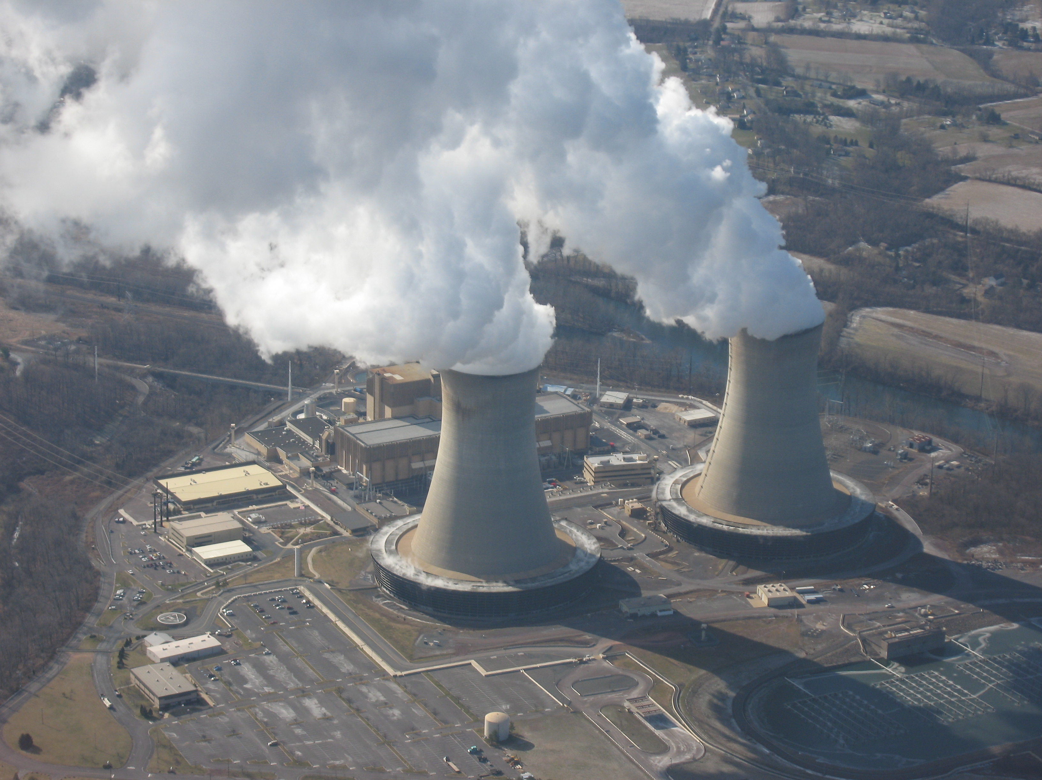
Avoiding Nuclear Power plant Meltdowns
Ethan Prihar
1986 – Chernobyl
1979 – Three Mile Island
2011 – Fukushima
http://upload.wikimedia.org/wikipedia/commons/5/50/LimerickPowerPlant.JPG
Notes:
My Presentation today will be on how nuclear power plants measure for error. I will use these three examples of power plant meltdowns to explain what went wrong and how those issues have been fixed.

Slide 18
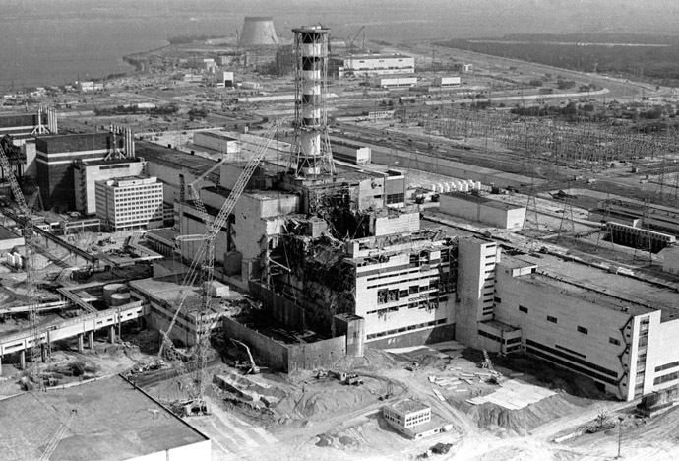
Chernobyl
Ethan Prihar
Performing system test
Large power surge
Ruptured reactor vessel
Neutron moderator exposed
Big fire
Big fallout
http://rt.com/files/news/25/dc/00/00/cher-1.jpg
Notes:
In 1986 Chernobyl nuclear power plant failed due to a power surge. What happened is that during some system test there was a large power surge that caused too much of a power output and the emergency shutdown failed f there were sensors in place that could have detected this surge and reacted to it then the plant could have shut down sooner. The energy of the surge ruptured the reactor Vessel which sent radioactive steam into the atmosphere. Part of the reactor caught fire and the fire grew and spread radioactive smoke into the atmosphere. The worst part of this disaster was how much fallout there was. The fallout is responsible for an estimated 4,000 cancer cases and is one of the worst possible outcomes from a nuclear power plant failure.

Slide 19
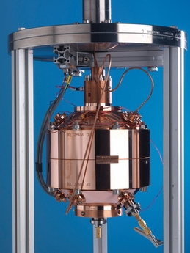
Avoiding Chernobyl
Ethan Prihar
Control rod material change
Protection from power surges
http://www.neimagazine.com/uploads/pictures/web/m/v/d/npl_cranfield_resonator.jpg
Notes:
One of the major failures of Chernobyl was the lack of information processing in the facility. At the time of the incident there was no sensors to indicate the power surge before it effected the facility. Another issue at Chernobyl was that there wasn’t enough protection from power surges. To protect from power surges today, There are advanced cooling systems in place that keep the rod at a temperature too low to rupture the reactor vessel. Now there are sensors to read the temperature and power output of the rods to prevent surges from damaging the facility. There are also a series of shut down protocol to stop the reactor if things get too hot. Unlike Chernobyl, modern day cooling systems have a backup power supply not connected to the rest of the facility, so even in a total shutdown, the cooling system will continue to cool the rod. The image is a picture of a more advanced temperature sensor. This sensor is one of many sensors being used in a modern nuclear power plant.

Slide 20

Three Mile island
Ethan Prihar
Cooling system stopped working
Plant automatically shuts down
Pressure builds in cooling system
Valve is automatically opened
Valve is never shut
Cooling water leaks out
Rod heats up
Nuclear power plant fails
http://upload.wikimedia.org/wikipedia/commons/2/2e/Three_Mile_Island_nuclear_power_plant.jpg
Notes:
At three mile island the power plant failed due to a sensor malfunctioning. Early in the morning the cooling system for one of the reactor rods stopped working. Because the power plant had controls in place to prevent meltdown, part of the system shut down. This caused an expected build up of pressure in the cooling system so there is a valve that is opened in order to release the pressure. All of that should have happened during a failure and so far the controls in place were effective. But, the sensor connected to the valve indicated that the valve had closed when it hadn't. This made the cooling water flow out of the system and not make it to the rod. The rod then heated up and there was a melt down where the reaction chamber had ruptured due to the immense heat. Luckily, unlike Chernobyl, the damage was mostly contained to within the facility.

Slide 21
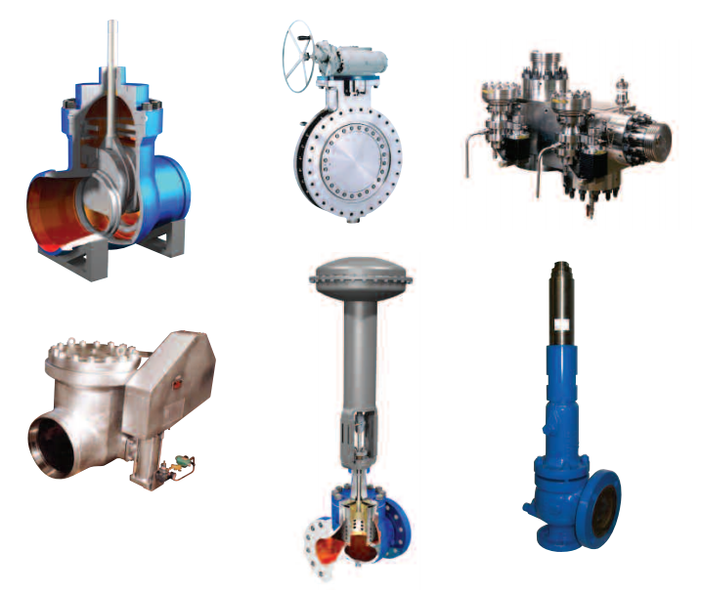
Avoiding Three Mile Island
Ethan Prihar
New more accurate controls
Backup control systems
More sensors
http://www.weirpowerindustrial.com/PDF/Nuclear%20A4%20UK%20English%20-%20web%20ready.pdf
Notes:
In order to reduce the risk of a failure similar to that of three mile island. Nuclear power plants have added redundant sensors and more accurate sensors to the valves. Now if a valve is in the wrong position, there are more reliable sensors to monitor that, and there are multiple of these reliable sensors. One major change is that at the time there was no sensor in the reaction chamber to measure if the reaction rod was completely covered in water, which it wasn't, which is why it heated up and caused a meltdown. Now there are additional sensors to measure how much water is around the fuel rod. If those sensors had existed at the time, there would have been an alert that coolant was leaking out before three mile island had a meltdown. The image is of a variety of safety valves inside the nuclear power plant. They work either mechanically by having a max pressure before opening. Or they have a pressure sensor inside of them to computationally control the valve release.

Slide 22
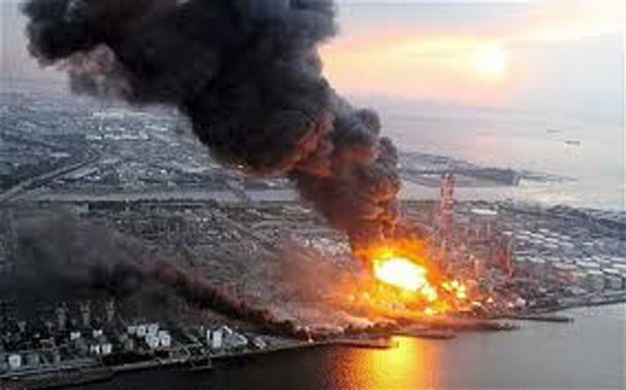
fukushima
Ethan Prihar
Earthquake destroyed pipe systems
Tsunami destroyed power supplies
Every backup broke
Everything failed
http://b-i.forbesimg.com/williampentland/files/2013/08/Fukushima_nuclear.jpeg
Notes:
The problem with the Fukushima nuclear power plant failure was not faulty equipment or improper procedure. The power plant failed because of the incredibly large scale natural disaster that it was confronted with. Even though the power plant had multiple backup cooling systems, due to the earthquake all systems were damaged. The power plant was shut down, because that is what is supposed to happen when systems fail, and the multiple backup generators were supposed to be used but they were damaged and broken by the tsunami. The next day radiation leaks were detected and workers tried to prevent a meltdown, but with all systems broken or severely damaged, the entire facility eventually had a meltdown. Looking to the future, we could prevent disasters like this by developing better weather monitoring software. So far we have seen examples of how electrical components can improve the safety of a nuclear reactor. But in modern times we have to look to software that can predict weather pattenrs and earthquakes before they occur in order to be able to take precautionary measures before its too late.

Slide 23
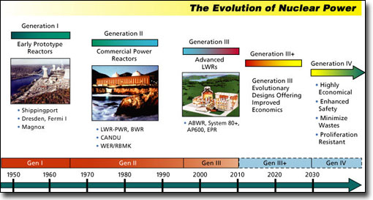
Analysis of Risk
Ethan Prihar
Abundance of Controls
Redundancy in every system
Multiple backups in every system
Sounds good to me
http://www.45nuclearplants.com/images/generations_of_nuclear_power_stations.jpg
Notes:
The risks associated with a nuclear power plant are evident. You are working with very dangerous materials that can create a lot of damage. Although systems weren’t adequately prepared to handle potential failures before, modern nuclear power plant facilities have a tremendous amount of backup systems and controls to ensure the safety of the facility and the people around it, barring any natural disaster. Basically, the nuclear power plant isn’t going to hurt people unless everybody is the area is already hurt by a much bigger threat, like a tsunami, or a meteorite. As you’ve seen from the previous examples, nuclear reactors fail because the rod gets too hot, and melts through the system. Modern nuclear reactors have complex cooling systems that have checks at the rod, at the source of the water, and periodically in the pipes to ensure that water is flowing to the rod. They also have sensors to measure the pressure and flow rate of the water in the system to ensure that it is behaving properly. Modem nuclear reactors have a series of automatic shut downs to prevent the reactor from operating if anything goes wrong. Even when the facility is shut down there are still multiple backup generators to keep the cooling system functioning. This image shows how nuclear power plants have changed over time

Slide 24
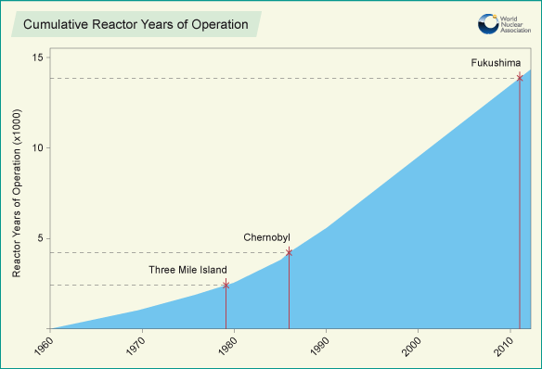
Conclusion
Ethan Prihar
The information processing that takes place at nuclear reactors has improved greatly over the years and its time to use predictive software to continue to improve the safety and reduce the risk associated with nuclear power plants.
http://www.world-nuclear.org/uploadedImages/org/info/cumulative_reactor_years.png
Notes:
Since nuclear power plants were created they have been constantly redesigned to process more information and be able to analyze greater amounts of data in order to create as much safety as possible. I think that with all the improvements that software has made recently, it is time to use software to measure and predict the environment around a nuclear power plant to prevent from things such as earth quakes and tsunamis. If we new a week before an earthquake that there would be an earthquake, than nuclear fuel rods and other hazardous material could be evacuated from the site in order to prevent a meltdown. This image shows the increase in reliability of nuclear power plants over time.

Slide 25
References
Ethan Prihar
"World Nuclear Association." Safety of Nuclear Reactors. N.p., 15 Feb. 2015. Web. 12 Apr. 2015.[2]
"Safety Measures at Nuclear Power Plants." - The Federation of Electric Power Companies of Japan(FEPC). N.p., n.d. Web. 12 Apr. 2015.
"Safety & Security." Nuclear Energy Institute -. Nuclear Energy Institute, n.d. Web. 12 Apr. 2015.
"Safety of Nuclear Power Plants." Nuclear Power Education. N.p., n.d. Web. 12 Apr. 2015.
Basic Safety Principles for Nuclear Power Plants: 75-INSAG-3 Rev. 1: INSAG-12. Vienna: International Atomic Energy Agency, 1999. BASIC SAFETY PRINCIPLES FOR NUCLEAR POWER PLANTS. International Nuclear Safety Advisory Group. Web. 12 Apr. 2015.

Slide 26
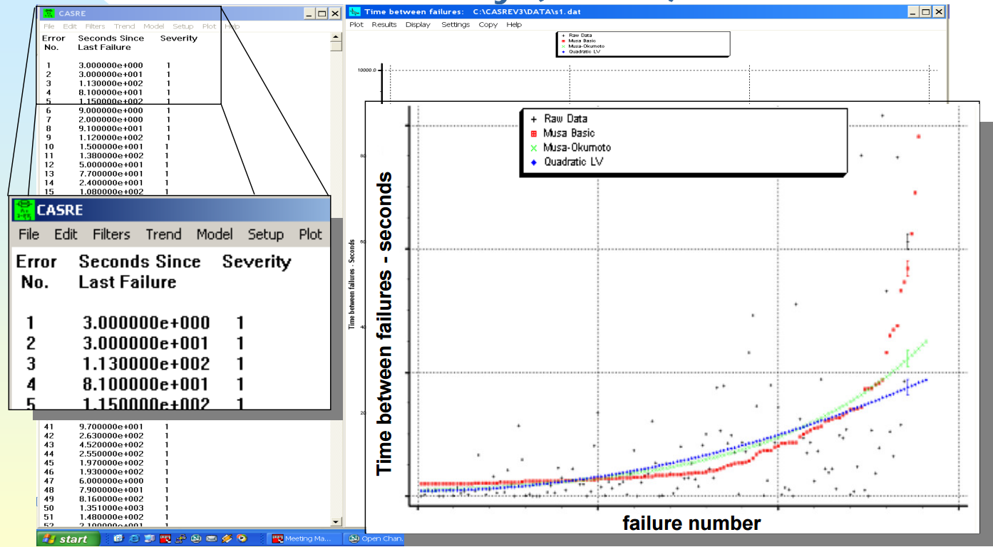
Measuring reliability
Fangming Ning
Notes:
Traditional way of measuring reliability, which is time consuming.

Slide 27
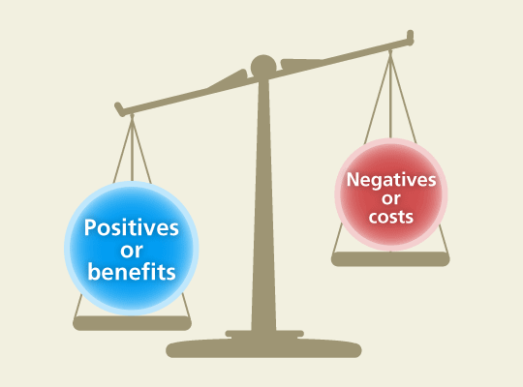
My way of doing it
Fangming Ning
http://cyberthevote.org/wp-content/uploads/2011/09/Cyber-The-Vote-Cost-Benefit-Analysis-1.gif
Notes:
Reliability is determined by costs and benefits of breaking a software. (My theory)

Slide 28
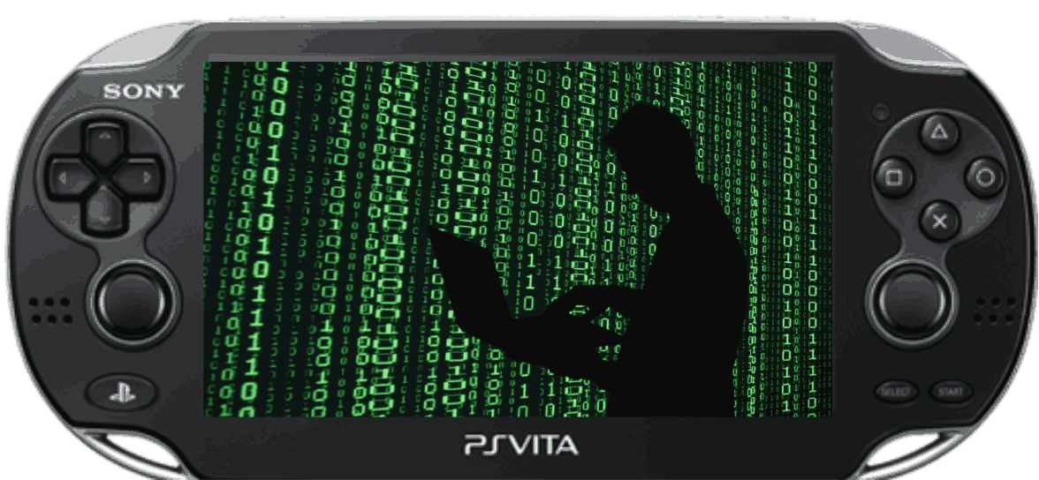
PSVita jailbreak[1]
Fangming Ning
https://encrypted-tbn3.gstatic.com/images?q=tbn:ANd9GcRXhJCxkMsQx3XDoM-7_dzEQOFkQSwhHYCT3TodlrITuYLe9FMa_w
Notes:
Psvita system is considered reliable because breaking it costs more than the profits of you receive from doing so.

Slide 29
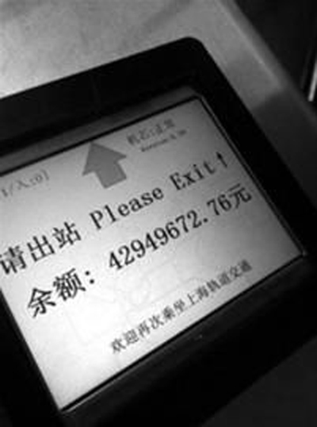
Matro card bug[2]
Fangming Ning
http://image.xinmin.cn/2013/03/16/20130316133201652599.png
Notes:
This toll collection software is not reliable because the cost is zero and profit is a huge amount of money

Slide 30

More about benefits and costs[3]
Fangming Ning
http://berryflow.com/wp-content/uploads/2014/09/iCLoud_Hack.jpg
Notes:
Costs and benefits are more complicated in real life. Besides money, other things like fate and joy are also considered as costs and benefits.
Use iCloud hack to illustrate a condition that benefit is not money.

Slide 31
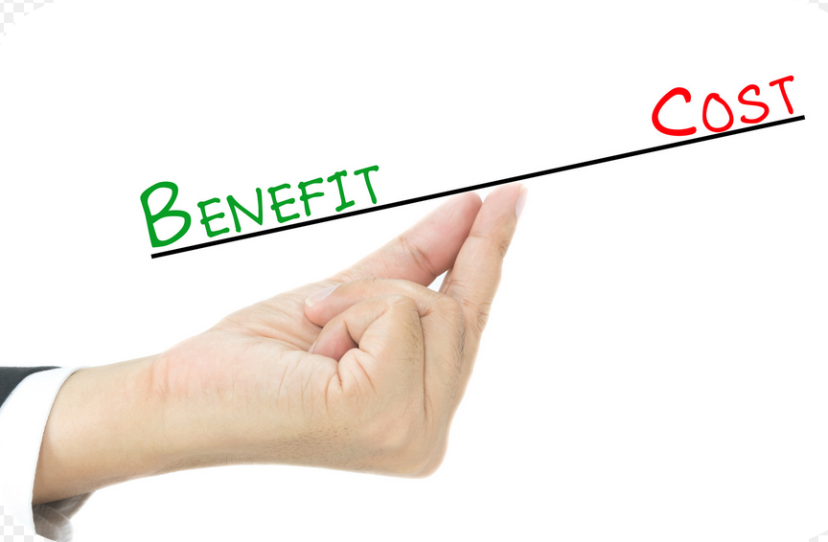
Conclusion
Fangming Ning
http://thumb7.shutterstock.com/display_pic_with_logo/2139560/194552051/stock-photo-benefit-vs-cost-comparison-on-hand-194552051.jpg
Notes:
Conclusion. It’s easier to measure reliability by considering the cost and benefits of breaking the software.

Slide 32
References
Fangming Ning
[1] PSVita Jailbreak: http://yifan.lu/2013/09/10/why-hacking-the-vita-is-hard-or-a-history-of-first-hacks/
[2] Metro Card bug: http://news.365jilin.com/news/20130318/530371.html
[3] ICloud hack: http://en.wikipedia.org/wiki/2014_celebrity_photo_hack

Slide 33

Effect of sequencing errors on gene prediction
Lina Anderson
False-positives and false-negatives are prevalent in genetic testing and can create a negative aftermath
“PGD-Preimplantation Genetic Diagnosis.” 2015. Retrieved April 10, 2015 from IVF1.com: http://www.ivf1.com/pgd/
Notes:
What I’m going to talk about

Slide 34
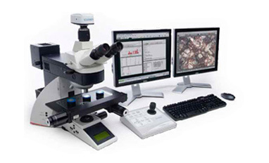
Genetic testing
Lina Anderson
Preimplantation testing
  Uses microscopy
Comparative genomic hybridization (CGH)
  Uses microscopy and software
<Graphic>
“The most complete image analysis solution.” CLEMEX Technologies Inc. 2015. Retrieved on April 14, 2015 from Clemex.com: http://www.clemex.com/fr/Products/Multipurpose-Image-Analysis/Clemex-Vision-PE/Description
Notes:
Preimplantation testing involves in vitro fertilization (fertilization that takes place outside the body) to create an embryo, which is examined for specific genetic mutations
Specifically CGH- type of preimplantation testing that can be beneficial because the analysis is done using a computer rather than the human eye
This technique is made possible by computer software. With preimplantation testing, embryos are observed under a microscope but because CGH uses the microscope in conjunction with computer software, it allows for examining more genes at a time than the standard laboratory techniques, but still CGH is not perfect.

Slide 35
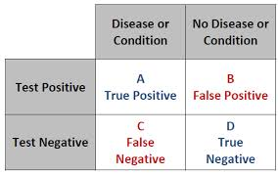
Sensitivity vs. Specificity
Lina Anderson
Sensitivity (False Negatives)
  95% sensitive: 100 diseased people
  95 test positive & 5 test negative
Specificity (False Positives)
  95% specific: 100 disease-free people
  95 test negative & 5 test positive
<Graphic>
“False Positives and the Base Rate Fallacy.” Phoenix Area Skeptics Society. 2013. Retrieved April 11, 2015 from Phoenixskeptics.org: http://phoenixskeptics.org/
Notes:
Two major parts of a genetic test’s quality is its sensitivity and its specificity
95 will test positive but 5 will receive a false-negative result
95 will test negative but 5 will receive a false-positive result

Slide 36
Experimental studies
Lina Anderson
257 cell samples
  42 false positives
  9 false negatives
False positive and false negative rate 3%
Notes:
In an experimental study testing the validity of comparative genomic hybridization, results of CGH compared to results from a standard laboratory technique, 257 samples tested for a genetic condition
Another study found that the false positive and false negative rate was 3% when studying embryos
Not a very high percentage but affects a lot of individuals

Slide 37
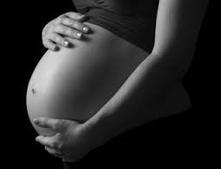
Genetic Test results
Lina Anderson
Used to make important decisions
  Have children?
  End a pregnancy?
Cause relief/distress
Affect various areas of life
  Confidence
  Life outlook
  A couple’s relationship
  Psychological stability
<Graphic>
“UKBA puts pregnant women at risk.” Women’s View on News. 2013. Retrieved April 13, 2015 from Womensviewonnews.org: http://www.womensviewsonnews.org/2013/03/ukba-puts-pregnant-women-at-risk/
Notes:
Whether to have children or end a pregnancy
Can influence confidence, life outlook, a couple’s relationship, & can have psychological effects
More explaining about false-positives and false-negatives
If a person receives a false-positive result and terminates pregnancy, that’s a life that wasn’t created under false pretense.
If a person receives a false-negative result and has a child with an ailment, that opens the door for a lot of issues:
Money wasted, Guilt, financial strain, stress in the relationship

Slide 38

Conclusion
Lina Anderson
Embryonic genetic testing errors is a concern for people planning families
False-positives and false-negatives can be detrimental and psychologically taxing
CGH is a useful technique, but should be continuously improved to decrease error rates
<Graphic>
“How to Write a Journal Article : Step 2 – The Conclusion.” 2014. Retrieved April 11, 2015 from Nequalsone.wordpress.com: https://nequalsone.wordpress.com/2014/04/28/how-to-write-a-journal-article-in-6-steps-step-2-the-conclusion/
Notes:
False-positives and false-negatives can be detrimental and psychologically taxing on parents who want to start or add to their families.
Although CGH technology is useful for finding diseases in embryos the technology should be continuously improved to decrease the error rates

Slide 39
References
Lina Anderson
[1] “PGD-Preimplantation Genetic Diagnosis.” 2015. Retrieved April 10, 2015 from IVF1.com: http://www.ivf1.com/pgd/
[2] "Genetic Testing." Genetics and Genetic Engineering. 2008. Retrieved April 11, 2015 from Encyclopedia.com:http://www.encyclopedia.com/doc/1G2-3049300012.html
[3] Barth, T. F. E., Benner, A., Bentz, M., Döhner, H., Möller, P., & Lichter, P. (2000). Risk of false positive results in comparative genomic hybridization. Genes, Chromosomes and Cancer,28(3), 353-357. doi:10.1002/1098-2264(200007)28:3<353::AID-GCC15>3.0.CO;2-0
[4] “Preimplantation Genetic Diagnosis by Array Comparative Genome Hybridization and Blastocyst Biopsy.” 2015. Retrieved April 14, 2015 from Clinicaltrials.gov: https://clinicaltrials.gov/ct2/show/NCT01332643
[5] "Genetic Testing." Genetics and Genetic Engineering. 2008. Retrieved April 11, 2015 from Encyclopedia.com:http://www.encyclopedia.com/doc/1G2-3049300012.htm

Slide 40

Hacking for Defects
Jonathan Leitschuh
Let the world attack you!
  Competitions
  Bug Bounty
Responsible Disclosure
<http://blog.ericgoldman.org/archives/shutterstock_123604057-1.jpg>
Notes:
http://www.eweek.com/security/what-security-researchers-need-to-know-about-the-law
<speaker notes>
Security researcher: Someone who finds security holes in software
Corporations encourage hacking their software
Competitions
Bug bounty programs
Individuals can report bugs they find using Responsible disclosure
Computer Fraud and Abuse Act Law states something along the lines of: ”It is illegal to intentionally access a computer without authorization or in excess of authorization and thereby obtaining information from any protecting computer”

Slide 41

Competitions
Jonathan Leitschuh
Pwn2Own 2015 Outcomes
  Microsoft Windows: 5 bugs
  Microsoft IE 11: 4 bugs
  Mozilla Firefox: 3 bugs
  Adobe Reader: 3 bugs
  Adobe Flash: 3 bugs
  Apple Safari: 2 bugs
  Google Chrome: 1 bug
  $442,500 paid out to researchers
<http://www.gizmag.com/pwn2own-browser-hack-success/14697/picture/113004/>
Notes:
https://threatpost.com/all-major-browsers-fall-at-pwn2own-day-2/111731
http://www.infosecurity-magazine.com/news/pwn2own-sees-all-major-browsers/
<speaker notes>
Pwn2Own
Korean researcher Jung Hoon Lee, who worked alone under the name lokihardt made $110,000 in under two minutes
He “leveraged a buffer overflow race condition in Chrome, then used an info leak and race condition in two Windows kernel drivers to get SYSTEM access.”

Slide 42
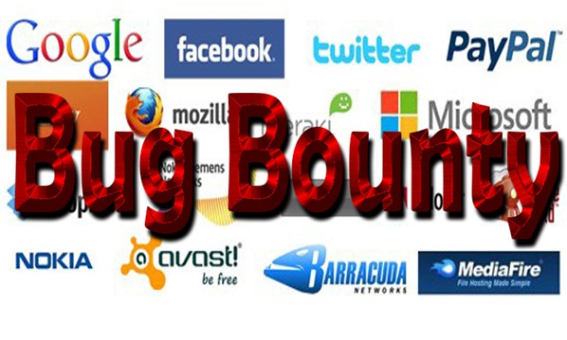
Bug Bounty
Jonathan Leitschuh
Will reward you find and report bugs
  Cash Reward
  Swag
  Hall of Fame
Facebook
  $3 Million rewarded since 2011
  Average reward is $1,788
Bug Bounty Failure
  Khalil Shreateh posts on Mark Zuckerberg’s wall
<http://www.360logica.com/blog/2014/05/bug-bounty-programs-a-big-security-measure.html>
Notes:
https://bugcrowd.com/list-of-bug-bounty-programs
https://www.facebook.com/BugBounty
Khalil:
https://grahamcluley.com/2013/08/mark-zuckerberg-facebook-account-hacked-by-peeved-security-researcher/
Gofundme http://www.gofundme.com/3znhjs
<speaker notes>
Khalil Shreateh
Discovered a bug that allowed any user to post to anyone elses wall without being their friend.
Attempted to report a bug to Facebook twice
Reported bug by posting message on Mark Zuckerberg’s wall
Dear Mark Zuckerberg,
First sorry for breaking your privacy and post to your wall, i has no other choice to make after all the reports i sent to Facebook team.
My name is KHALIL, from Palestine.
couple days ago i discovered a serious Facebook exploit that allow users to post to other Facebook users timeline while they are not in friend list.
i report that exploit twice, first time i got a replay that my link has an error while opening, other replay i got was "sorry this is not a bug". both reports i sent from www.facebook.com/whitehat, and as you see iam not in your friend list and yet i can post to your timeline.
Response:
Facebook did not reward Khalil for his find
Community raised $13,125 reward on gofundme

Slide 43
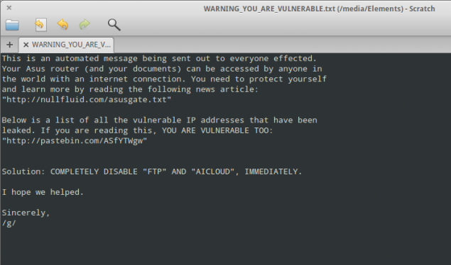
Responsible Disclosure
Jonathan Leitschuh
Normally:
  Find bug/security flaw
  Inform company
  Wait for confirmation of fix (~90 days)
  Publish
Failures:
  Moonpig (Aug 18th 2013 - Jan 5th 2015)
    3,000,000 Customer Details Exposed
  Asus (June 6, 2013 - June 22, 2013)
    Remote access to all storage devices connected
    No fix 8 months after disclosure
<http://arstechnica.com/security/2014/02/dear-asus-router-user-youve-been-pwned-thanks-to-easily-exploited-flaw/>
Notes:
Moonpig:
Well explained by Tom Scott: https://www.youtube.com/watch?v=CgJudU_jlZ8
OP of Vulnerability: http://www.ifc0nfig.com/moonpig-vulnerability/
Asus:
http://www.ted.com/talks/keren_elazari_hackers_the_internet_s_immune_system#t-248668
http://arstechnica.com/security/2014/02/dear-asus-router-user-youve-been-pwned-thanks-to-easily-exploited-flaw/
http://nullfluid.com/asusgate.txt
<speaker notes>
Questionably Legal to release this information
What is Responsible Disclosure
Moonpig: Makers of “Personalized Cards, Flowers and Gifts” bug Descovered by Paul Price
User data was made available to their mobile app via the REST API
Login authentication returned the UserID which was used for authentication for future communication with the server.
UserID was sequential for each users so you could iterate over all of the users in the database pulling all of their information
This includes
Credit card type
Experation Date
Last 4 digits of credit card number
Name on card
No rate limiting meaning you can send as many requests as you want without the server throwing a warning
Disclosure Process:
August 18th 2013 Initial disclosure to the vendor via email. Vendor used the reasoning that it was legacy code and that they would get ‘get right on it’
September 24th 2014 Follow up email because it was still not fixed. ETA of fix according to Moonpig “before christmas”
January 5th 2015 Public release by Paul on his blog
Vulnerability discoverer, Paul: “I've seen some half-arsed security messures in my time but this just takes the biscuit. Whoever architected this system needs to be shot waterboarded.”
Response:
Shut down REST API server
The app stopped working
PR Mode:
“We are aware of claims re customer data and can confirm that all password and payment information is and has always been safe.” Twitter @MoonpigUK
Asus: Discovered by Kyle Lovetts
Given a month to fix problem before disclosure
Allowed anyone on the web FTP access to the storage device attached to the ASUS device
8 months after disclosure a group of hackers (The Brothers Grim) used this security hole to hack 12,937 ASUS routers
They left a message in a text file: “This is an automated message being sent out to everyone effected [sic],” “Your Asus router (and your documents) can be accessed by anyone in the world with an Internet connection. You need to protect yourself and learn more by reading the following news article: http://nullfluid.com/asusgate.txt”
They included a list of the IP’s that are vulnerable (http://pastebin.com/ASfYTWgw)
You can also find a convenient python script to test all of these IP’s to see if they are still vulnerable (http://pastebin.com/zunt8jeu)

Slide 44

Summary
Jonathan Leitschuh
Programmer
  Code like you are being attacked
  Never trust user input
Corporate
  Allow for responsible disclosure
    Fix problems promptly
  Challenge people to break your code
    Reward them for their research
Importance
  Encourages disclosure instead of exploitation
<http://codemink.com/wp-content/uploads/2013/05/Three-Hats.jpg>
Notes:
<speaker notes>
This should only be like 30 seconds at the end

Slide 45
References
Jonathan Leitschuh
[1] <http://www.eweek.com/security/what-security-researchers-need-to-know-about-the-law>
[2] <https://threatpost.com/all-major-browsers-fall-at-pwn2own-day-2/111731>
[3] <http://www.infosecurity-magazine.com/news/pwn2own-sees-all-major-browsers/>
[4] <https://bugcrowd.com/list-of-bug-bounty-programs>
[5] <https://www.facebook.com/BugBounty>
[6] <https://grahamcluley.com/2013/08/mark-zuckerberg-facebook-account-hacked-by-peeved-security-researcher/>
[7] <http://www.gofundme.com/3znhj>
[8] <https://www.youtube.com/watch?v=CgJudU_jlZ8>
[9] <http://www.ifc0nfig.com/moonpig-vulnerability/>
[10] <http://www.ted.com/talks/keren_elazari_hackers_the_internet_s_immune_system#t-248668>
[11] <http://arstechnica.com/security/2014/02/dear-asus-router-user-youve-been-pwned-thanks-to-easily-exploited-flaw/>
[12] <http://nullfluid.com/asusgate.txt>

Slide 46

Simulations and the stock market
Sam La
Outline
  What software is used to simulate the stock market?
  What are the educational value of these simulations?
  Important factors for a successful simulation
  Conclusion
<http://wallstreetgraphics.com/wp-content/uploads/2012/03/FinancialBloggerFreeImage_10.jpg>
Notes:
Remind people that simulations are basically used for predicting outcomes (weather, medical procedures, etc). Used to help people understand different concepts
Introduce concept of software simulating the stock market, different approaches in doing so (some are educational, like courses) while some are more like games.
The “less-gamey” ones have educational value so we will get into what the good things are
Reality vs simulation, what factors are there, will go into this

Slide 47

Stock market Simulation Programs
Sam La
Investopedia
  Financial education
  Stock simulator
  FXtrader
Wall Street Survivor
  Finance courses
Smart Stock
MarketWatch
Investfly
<http://blogs-images.forbes.com/steveolenski/files/2014/12/stock-market-down.png>
Notes:
Investopedia: Offers a comprehensive financial dictionary, tutorials, quizzes, etc. FREE
Wall Street Survivor:
-Similar to Investopedia, however courses are not free ($600 for all courses)
Other software “games” that give users a virtual currency and allow them to trade. These other applications are basically just games for students/kids to play around with. Compared to Investopedia/Wall Street Survivor, they provide little educational value.
Overall, all these are basically just games for people to use. They each have a rewards system (how much money you profit/lose) and badges you achieve. This motivates students to start learning about the stock market from a younger age. Some have its benefits compared to the others because of it being more popular and better at mirroring the real stock market.
GAMIFICATION: clarify that most of these are like games but there are those that aren’t. this will be explained in the following slide.

Slide 48

Stock market Simulation Programs cont.
Sam La
Investopedia [2]
  Free signup
  Finance dictionary
  Tutorial/Videos
  Exam Prep
  Articles
  Strategies
<http://wire.kapitall.com/wp-content/image-import/INVESTOPEDIA-LOGO-UPDATED-300x86.png>
Notes:
Mentioned earlier for stock simulator/fxtrader.
-Stock simulator/Fxtrader are both free. Helps user work on their investing skills in the stock
market or foreign exchange market. They are supplied with $100,000 virtual cash.
-Millions of users
-Over 13000 finance terms (comprehensive)
-Tutorials and videos help someone with no background get caught up and right into finance
-Articles keep users updated on current events. Articles range from how “something” can affect or is affecting a brand/company.
-Tips and strategies are offered to help users get the best out of their trading. Includes when to trade, fundamentals to follow, patterns to watch out for, etc.
Overall this is almost like a crash course in finance. People can learn how to trade stocks without any real risks. Similar to tutoring in a way in schools

Slide 49

Educational value
Sam La
Trade stocks
  No financial risk
Follow current events [1]
Investment skills
Becky Smith [5]
  Won Wall Street Pros vs. Main Street Joes game
  “…understanding of… how stocks [reacting] to [the] news”
<http://www.binarytribune.com/wp-content/uploads/2013/07/Stock-Market-News.jpg>
Notes:
Trade stocks: Before committing to trading with “real” money, users can practice and see how they do. They can virtually win or lose (there is value in this because they learn to see trends and what practices are good)
Current events: Some of these programs inform the users of what is happening currently, how items are doing, new developments, updates, etc. (item not doing so hot in news = probably not worth investing in)
Investment skills: Users learn the vocabulary used,
Becky Smith: Practiced her strategies with other stock market games/simulations. Never studied finance/economics or even went to college. If she can do it, anyone else with the commitment can probably achieve the same.

Slide 50
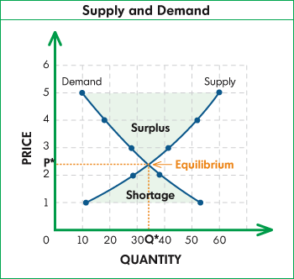
Important factors
Sam La
Product information
Preferences of people
Supply and demand
Expectations [3]
Simulation vs Reality [4]
  Supplied money
  Simulated prices vs Actual prices
  Proposed Strategies
<http://blog.themistrading.com/wp-content/uploads/2010/11/supplydemand.gif>
Notes:
Product information: Knowing the trend a product is very important in determining whether to invest in it or not (etc, knowing if the stocks fell in the past, raised, constantly rising, etc)
Preferences of people: If people don’t want it, why buy it? Same goes in simulation, the value is determined by the consumers
Supply and demand: Basic concept. Offer high price (to buy) = find a seller. Offer low price (to sell) = find a buyer.
“Expectation of future earnings”: This motivates people to buy and sell stocks. In some cases, there might be inflated prices that could be unrealistic, but missed because of the heat of the moment -> leads to everyone else jumping in and could lead to stock market crash. In a simulation however, does this happen?
Simulation vs Reality: if someone makes a bad investment, is the company liable? (thanks andy). The answer is no, if you go on their terms of use, they mention that any information provided, though very general, that they are not responsible or liable for any content. They touch upon the different strategies used too are also not their responsibility for accuracy.

Slide 51
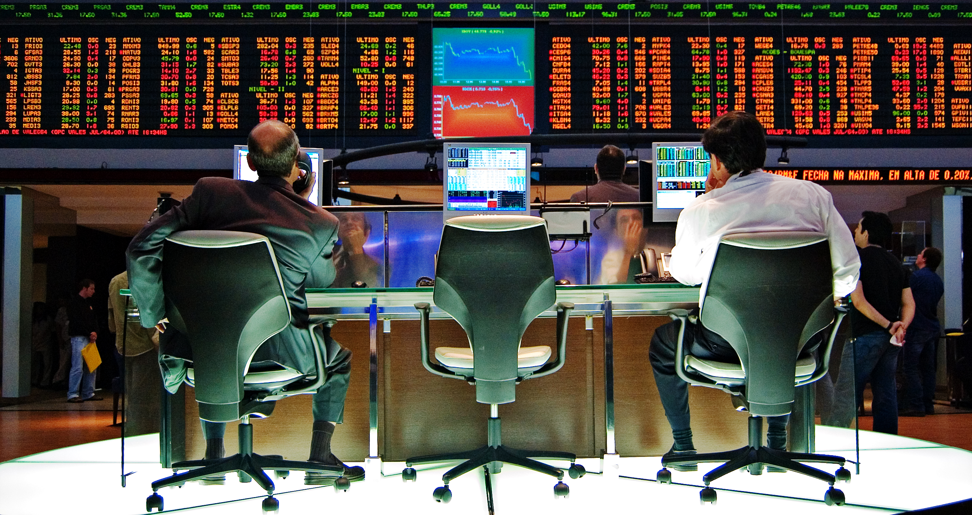
Summary & Conclusion
Sam La
Stock market simulations provide a lot of educational value.
  A lot of resources on the web
  Interest people to get involved in investing
Reliable (?)
  Multiple factors still apply
  Cannot predict how the market will change in simulation compared to reality
<http://upload.wikimedia.org/wikipedia/commons/b/b8/Sao_Paulo_Stock_Exchange.jpg>
Notes:
People can learn a lot, see Becky Smith. Encourages users/students to research further into the topic.
More people getting involved in investing has its economic impact as more people could possibly join in on investing in stocks. More people investing in stocks = more money to be invested in stocks. Good because potentially create jobs and there’s more money flow.
Again, is this reliable? Can we use this simulation to predict how the stock market will actually be like? The answer is probably no, there are multiple factors such as new improvements in the company and how useful something is to people. Supply and demand (most likely demand) plays a big role and simulations can’t predict what people want because it changes.

Slide 52
References
Sam La
[1] "Online Stock Market Games for High Schools." The Journal of Economic Education 33.2 (2002): 192-. Print.
[2] "About Us | Investopedia." Investopedia. N.p., n.d. Web. www.Investopedia.com/corp/about.aspx. 12 Apr. 2015.
[3] Sornette, Didier. Why Stock Markets Crash: Critical Events in Complex Financial Systems. Princeton: Princeton University Press, 2004. Print.
[4] Downing, Douglas. "Stock Market Simulation.“
[5] "How to Win a Stock Market Game." TheStreet. N.p., 11 Feb. 2011. Web. http://www.thestreet.com/story/11005193/1/how-to-win-a-stock-market-game.html. 12 Apr. 2015.
…

Slide 53
Class 9
The End
Keith A. Pray
Instructor
socialimps.keithpray.net
Notes:
This is the end. Any slides beyond this point are for answering questions that may arise but not needed in the main talk. Some slides may also be unfinished and are not needed but kept just in case.

Slide 54
Reliability Of Statistics
Are other factors controlled?
Is enough time covered?
Is all data reported?
Use Intuition
  Are results reasonable?
Notes:
Power line dangers. Electromagnetic fields? PCBs in transformers?

Slide 55
Cost-Benefit Analysis
How much does it cost?
What do I get for this cost?
Notes:
Like a social contract.

Slide 56
Risk-Benefit Analysis
What could go wrong?
How likely is it?
How costly are the consequences?

Slide 57
Limitations to
Risk-Benefit Analysis
Hard to quantify probabilities
Hard to quantify costs
Who bears the costs?
Are the potential benefits worth it?
Notes:
What is the value of a human life?
What is the value of a species?
E.g. future generations, poor people.
Omelas

Slide 58
Some Measures
Mean Time To Failure (MTTF)
Mean Time Between Failures (MTBF)
Mean Time To Repair (MTTR)
Notes:
Is it repairable?
What does it mean to repair? Running again? Data fixed? Caught up?
Restoring the GBC Web site.

Slide 59
Relying Too Much
Limits of modeling reality
Limits of precision
Limits of algorithms
Limits of interpretation
Notes:
Battle of the X-Planes
Trusting the statistics. Are differences significant?
Colin Chapman’s Lotus 7 chassis.

Slide 60
Producing Good Software
Good specifications
Good usability
Good design
Robustness
Good implementation
Testing
Notes:
Specs: Know what you are going to do. Often difficult. What does the customer want? What does the customer need?
Usability: Logical and intuitive, Consistent, Helpful, Complete, Accessible, Disability. Complete—not have to write things down.
Design: Logical, Modular, Consistent, Well-specified, Flexible, Extensible, Adaptable, New features, new platforms.
Robustness: Tolerant of data errors, Tolerant of human errors, Tolerant of network errors, Enough detail / not too much. Stack trace vs. “?” “A script error has occurred. Do you want to debug?”
Implementation: Adequate hardware (E.g. memory, storage, speed), Adequate software (Languages, OS, libraries), Internal and external documentation
Testing: Should be at all phases of the development cycle. Plan ahead for it. Consistent, repeatable, documented. Regression testing.

Slide 61
Plan For The Long Term
Version control
Future development
New platforms
Patches
Security
Training
Customer support

